Slide 1

Agency Report
Geoscience Australia
Committee on Earth Observation Satellites
LSI-VC5
Agenda Item 2
February 2018

Slide 2
Outline
IGARSS paper
US Cal-val workshop / paper by Helder et al
Surface Reflectance Validation Program
ARD abstract / Remote Sensing Journal
2nd ODC conference (12-16 Feb)

Slide 3
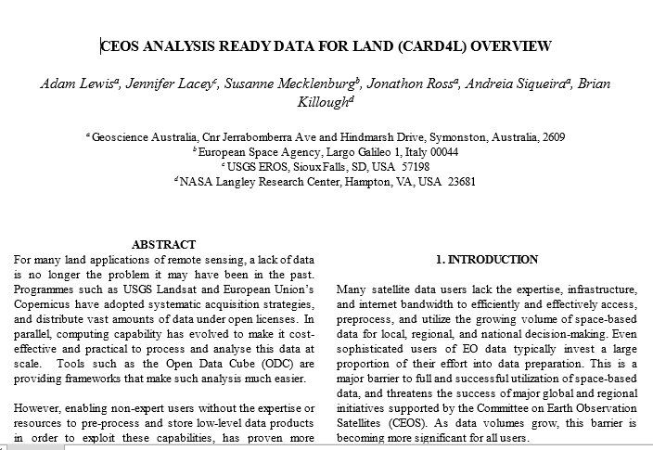
IGARSS Abstract
Extended abstract on CARD4L submitted
Authors: Adam Lewis, Jennifer Lacey, Susanne Mecklenburg, Jonathon Ross, Andreia Siqueira, Brian Killough
Mid-March to May 4 –revisions and final manuscript
July 23-27, Valencia - Spain

Slide 4
Calibration and Validation paper
Sensor interoperability
Authors: Dennis Helder et al
Recommendations
Title: Observation and Recommendations for the Calibration of Landsat 8 OLI and Sentinel 2 MSI for improved data interoperability

Slide 5
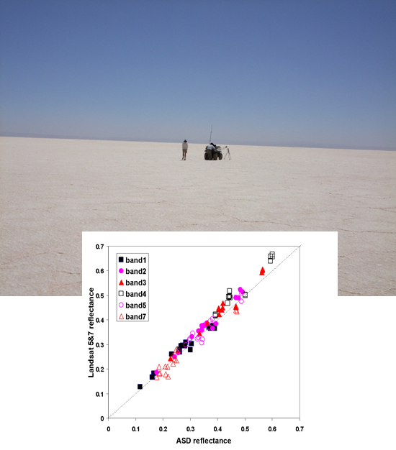
Surface Reflectance Validation Program - AUS
Continental Scale
Validate Surface Reflectance products
Collaboration (GA, CSIRO and AUSCOVER partner-nodes)
Framework for other downstream products
Project agreement signed (16 February 2018)
Data acquisition (March 2018)
Instrument calibration (February 2018)

Slide 6
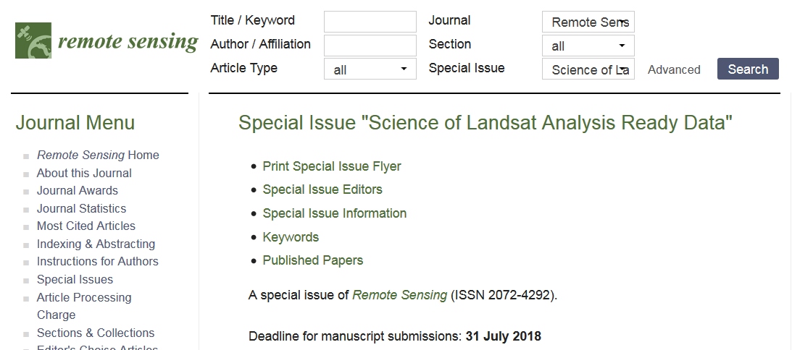
Remote Sensing ARD Abstract
GA has initiated an abstract on ARD
Invitation to additional authors
Abstract/paper structure
  ARD importance
  Describing the CEOS framework
  Applying the specification to an ARD product
  Challenges for validation

Slide 7

ODC Conference
12-16 February 2018, Canberra
ODC community sees themselves as users of ARD
ARD 2018 objective

Slide 9
CEOS Analysis Ready Data for Land (CARD4L) Framework Recap
Committee on Earth Observation Satellites
Geoscience Australia
LSI-VC5
Agenda Item 4a
February 2018

Slide 10
Outline
Maximizing the value of data
  Opportunity
  Rational
Analysis Ready Data
  Terminology
CARD4L
  Background
  Definition
  Framework
Multiple Sensors & CARD4L products example

Slide 11
Maximising the value of data - Opportunity
Unlocking the potential of Earth observation
‘Open Data’ Policies (USGS Landsat and European Union’s Copernicus)
Computing capability and methods

Slide 12
Maximising the value of data - Rational
Large proportion of effort into data preparation
Growing volume of space-based data
Lack the expertise
End users focused on adding value/not data pre-processing
Data from multiple platforms must be integrated
Systems must be future-ready – platforms and sensors will evolve

Slide 13
Analysis Ready Data - Terminology
ARD
  generic measurements of the land
  is not focussed on the instrument or platform
CEOS has identified a generic ARD ‘framework’ (CARD4L)

Slide 14
CARD4L Background
LSI-VC & CEOS Analysis-Ready Data
CARD4L underpins a large amount of the future data architectures work being progressed within CEOS
Endorsement of CARD4L definition and framework - CEOS Plenary / 2016

Slide 15
CARD4L Definition
CEOS Analysis Ready Data for Land (CARD4L) definition:
  CARD4L are satellite data that have been processed to a minimum set of requirements and organized into a form that allows immediate analysis with a minimum of additional user effort, and, interoperability both through time and with other datasets
CARD4L is a framework for establishing ‘minimum requirements’ for products that:
  Are ready for ‘immediate analysis’
  Require minimal additional user effort to prepare
  Interoperable with other CARD4L datasets

Slide 16
CARD4L Framework
Definition of CARD4L
Product families with specification (e.g. surface reflectance, surface temperature, SAR backscatter intensity)
Providers self-assess how well their products meet the specifications
Peer review
CARD4L stamp (threshold: immediately useful for scientific analysis or decision-making; target: will reduce the overall product uncertainties and enhance broad-scale applications)

Slide 17
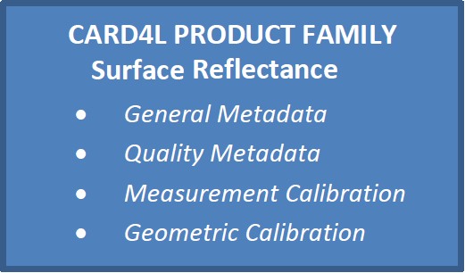
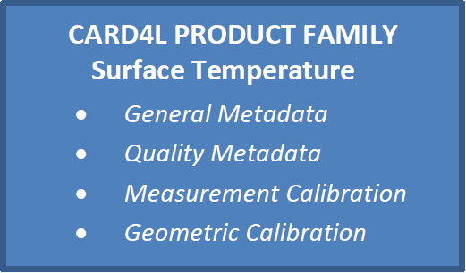
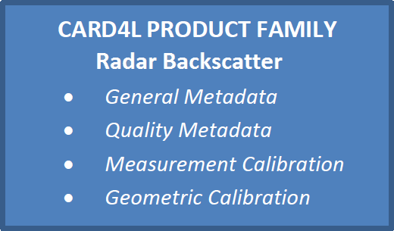
Multiple Sensors & CARD4L products
Sensors
Product Families
ARD products
Landsat OLI
Surface Reflectance - OLI
Landsat ETM+
Surface Reflectance – ETM+
Landsat TM
Surface Reflectance - TM
Landsat TIRS
Surface Reflectance - MSI
Sentinel-2a MSI
Surface Reflectance – Planet.
Sentinel-2b MSI
Surface Temperature - TIRS
ALOS - PALSAR
Backscatter – L band PALSAR
Sentinel-1a,b
Backscatter – C band SAR
… etc.

Slide 19
CARD4L Product Family Specifications
Refinement – Update Process – 2018 schedule
Committee on Earth Observation Satellites
Geoscience Australia
LSI-VC5
Agenda Item 4b
February 2018

Slide 20
Outline
CARD4L Product Family Specifications
  Background
  2017 Teleconferences outcomes
  Refinement process
  2018 revision schedule

Slide 21
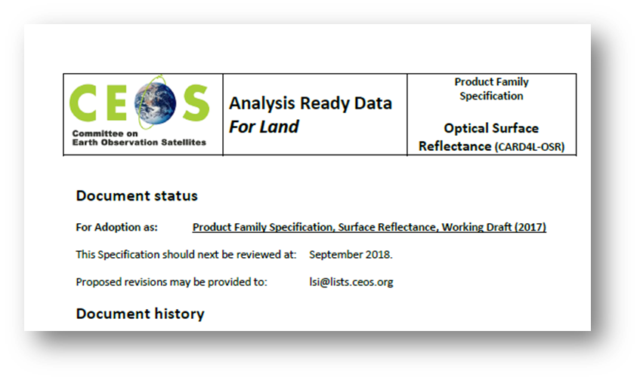
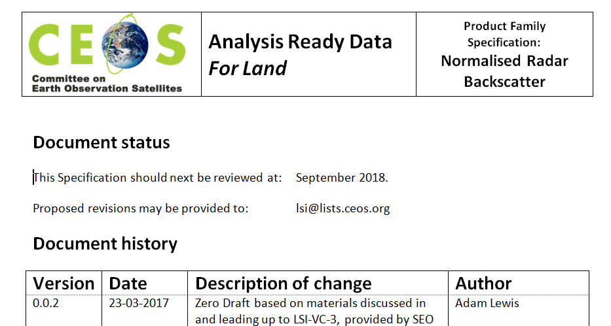
CARD4L Product Family Specifications - Background
Product Family Specifications (PFS) have been first developed (early 2017)
Product Family Specifications are technical documents
Detailed input to the draft CARD4L specifications was received in June-Sep2017 and in Dec 2017 (technical teleconferences)
Other PFS will probably emerge, e.g., Radar phase data, water leaving radiance
Very strong support for CARD4L is indicated by a range of experiences and activities (UK, ESA, USGS, NASA, Canada, GA, CNES, etc.).

Slide 22
Teleconferences Outcomes
Feedback gathered before and during teleconferences
All inputs and actions and updated PFS are kept in google drive
Teleconf participants numbers
Applied to all three PFS
  Definitions chapter included
  Guidance session re-worded
Open discussion points
  Split ST PFS into Land Surface Temperature and Surface Brightness Temperature
  A separate CARD4L product should be discussed for interferometric applications
Rational for changes

Slide 23
CARD4L Product Family Specifications - Refinement
PFS may change over time in a controlled process, e.g.:
  feedback gathered from technical experts
  Proposed changes are collated
  Proposed changes are submitted to CEOS (LSI-VC) for acceptance

Slide 24
Suggested Revision Schedule - 2018
Email calling for input / expert community (April 2018)
Deadline for input submission (Jul 2018)
PFS teleconferences (Aug 2018)
Changes recommendations (Mid Sep 2018)
Updated PFS release (End Sep 2018)

