Slide 1
CEOS Status/Overview
Committee on Earth Observation Satellites
Steven Hosford
LSI-VC-5
Agenda Item #1.4
February 2018

Slide 2
Summary
Introduction to CEOS
CEOS annual cycle
Relationships
Organisational structure
LSI within CEOS
Focus areas in 2018

Slide 3
Introduction to CEOS
Viewing Earth, serving society
The Committee on Earth Observation Satellites (CEOS) ensures international coordination of civil space-based Earth observation programmes
60 members and associate members
151 missions currently operating
177 missions under development

Slide 4
Introduction to CEOS
Three primary objectives:
Optimise benefits of EO through cooperation between CEOS Agencies in mission planning and the development of compatible mission outputs
Provide a focal point for international coordination of space-based Earth observation
Serve as a forum for exchange for technical and policy information to encourage complementarity and compatibility among space-based Earth Observation systems

Slide 5
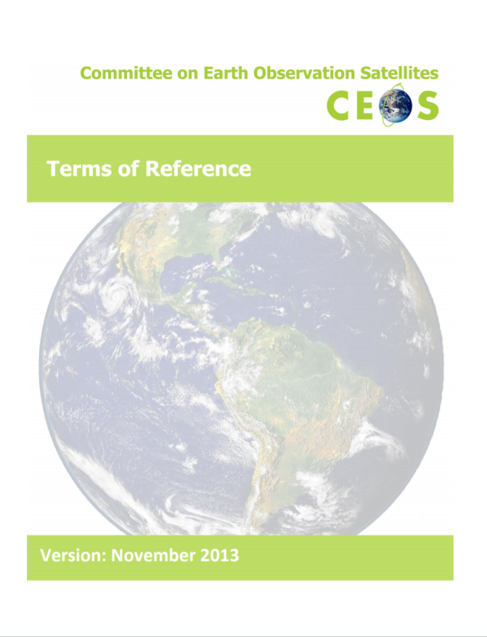
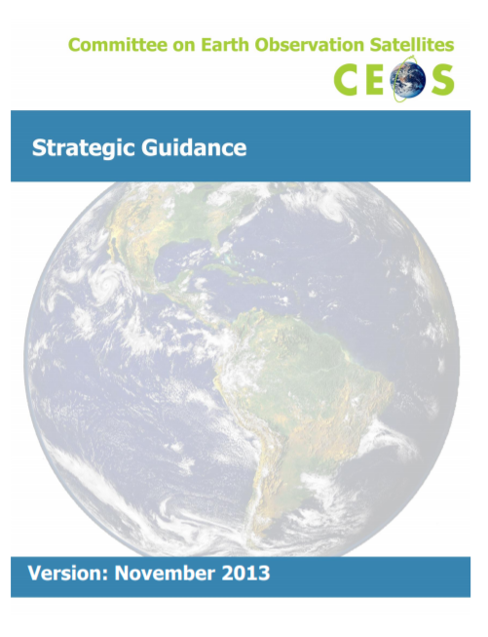
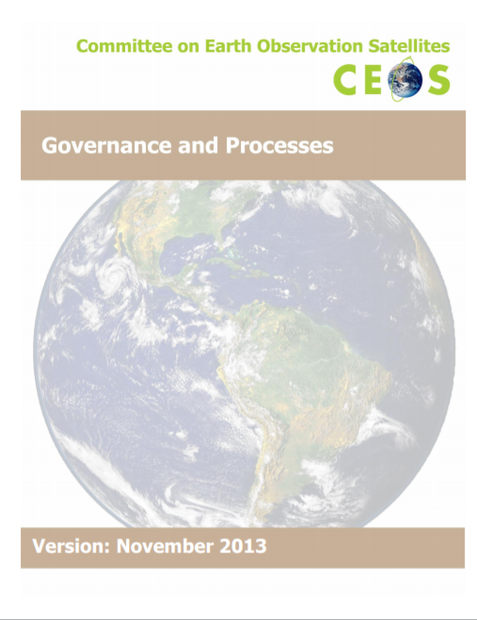
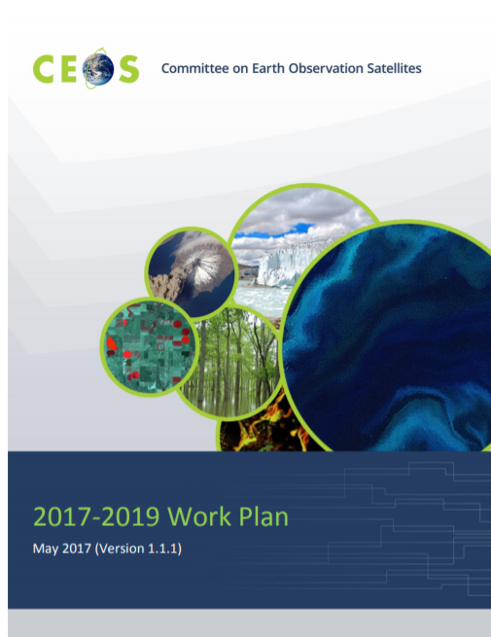
Introduction to CEOS
Governing documents

Slide 6
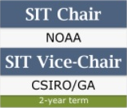
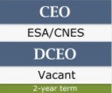
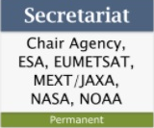
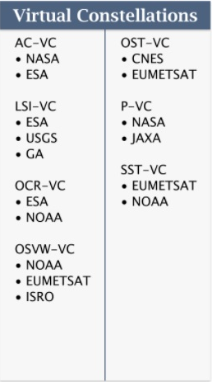
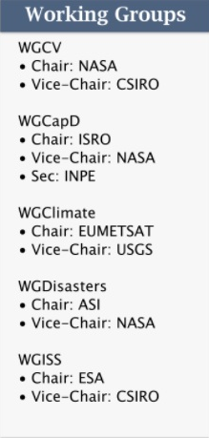
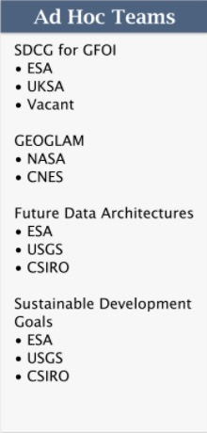
Organisational structure
CEOS Leadership
Support roles
Working Groups
Virtual Constellations
Ad-hoc Teams

Slide 7
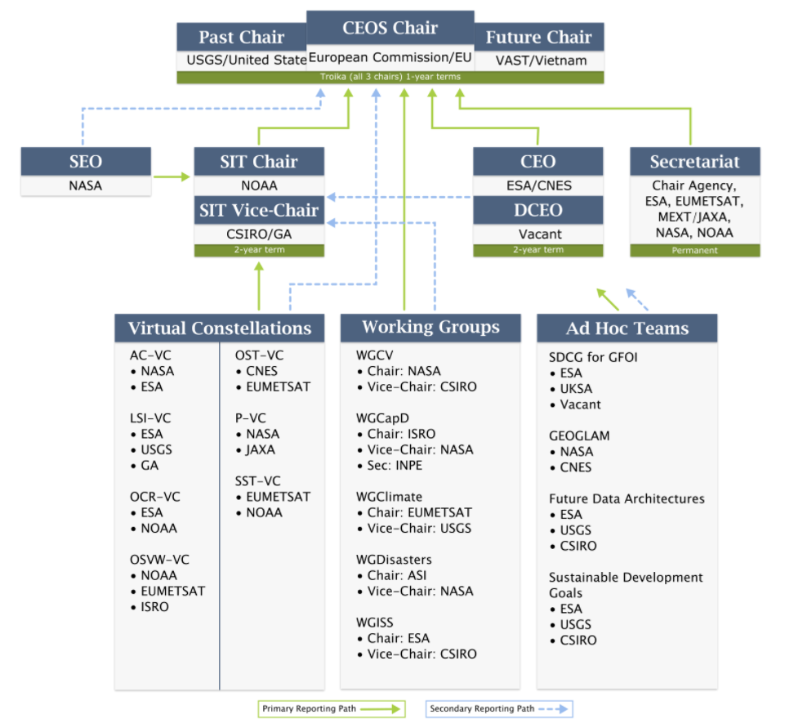
Organisational structure

Slide 8
CEOS annual cycle
July
June
August
May
SIT Technical Workshop
April
SIT meeting
September
WG/ADT meetings
WG/ADT meetings
March
October
Plenary meeting
Update CEOS Work plan
November
February
GEO Plenary
December
January
CEOS/GEO bilateral

Slide 9
Institutional relationships
CEOS is GEO’s “space arm” coordinating the provision of space data to the Global Earth Observation System of Systems
CEOS seeks to benefit from GEO’s “convening power”
Strong institutional relationship on all levels
Annual bilateral meeting arranged with GEO Secretariat to align work
CEOS Climate work feeds into the UN Framework Convention on Climate Change through the Subsidiary Body for Scientific and Technical Advice (SBSTA)
SBSTA is one of two SBs which supports the work of the COP

Slide 10
Institutional relationships
UN International Strategy for
Disaster Reduction – Sendai framework
CEOS contribution through activities from the WG on Disasters, since 2011 in order to promote & enhance the use of EO data in all phases of Disaster Risk Management, with focus on Disaster Risk Reduction.
Use of EO satellite data is recognized as key for DRR in “Sendai Framework for Disaster Risk Reduction 2015-2030”
Several activities with strong involvement of user communities and major non-space stakeholders e.g. World Bank GFDRR.
UN Sustainable Development Goals
EO can support several of the 17 SDG goals (2, 6, 11, 14 and 15) and associated targets and indicators.
On indicators, cooperation with UN agencies
and National Statistical Agencies
Dedicated CEOS Ad Hoc Team on SDG

Slide 11
CEOS Priority areas in 2018
CEOS Chair priorities for 2018
Priority ‘A’: Laying the foundation for an international CO2 and GHG emission monitoring system through
Completion of the AC-VC whitepaper on defining an optimum constellation for GHG emission monitoring with the CEOS Carbon Strategy
Place the space segment in the broader context of a sustained system for GHG emission monitoring
Advance the relationship with CGMS to ensure a ssustained observation capability

Slide 12
CEOS Priority areas in 2018
CEOS Chair priorities for 2018
Priority ‘B’: Continue and progress work within CEOS on Data access and use including
developing a common understanding of Future Data access and analysis Architectures (FDAs), identifying current examples and the needs for interoperability between them
developing User metrics that enable a deeper understanding of trends in data usage and thus guide the development of FDAs
progress definition and production of Analysis Ready Data including identifying and developing ARD specifications for priority data streams

Slide 13
CEOS Virtual Constellations
Demonstrate the value of collaborative partnerships in addressing key observational gaps and bridging multiple GEO Societal Benefit Areas while maintaining the independence of individual contributions
Focus dialogue from “all topics/all agencies” to small, specialized groups
Guidance for design and development of future systems to meet the broad spectrum of EO requirements
Avoid duplication and overlap in EO efforts
Close information gaps for GEO SBAs
Establish and sustain global EO coverage and data availability
Sea Surface
Temperature
Land Surface
Imaging
Atmospheric
Composition
Ocean Surface
Vector Winds
Ocean Surface
Topography
Precipitation
Ocean Colour
Radiometry
Co-Leads:
NOAA,
Eumetsat
Co-Leads:
USGS, ESA, GA
Co-Leads:
NASA, ESA
Co-Leads:
NOAA, ISRO,
EUMETSAT
Co-Leads:
CNES,
EUMETSAT
Co-Leads:
JAXA, NASA
Co-Leads:
ESA,
Eumetsat
A Virtual Constellation is a set of space and ground segment capabilities operating together in a coordinated manner to meet a combined and common set of Earth observation requirements.

Slide 14
LSI within CEOS
7 Virtual Constellations of which
4 VCs focused on observing the oceans
3 VCs on
Precipitation
Atmospheric Composition
Land Surface Imaging
Land Surface Imaging VC is unique within CEOS by its breadth
Observing technics (optical, thermal, radar, …)
Observing resolutions (submetric to km)
Parameters of interest
Implementation approaches (commercial, semi-public, science)
Challenges associated with re-invigorating this VC have their origins in this breadth
Recent focus on medium resolution optical public/science missions has enabled significant prop

Slide 15
LSI within CEOS
Challenges associated with re-invigorating this VC have their origins in this breadth
Recent focus on medium resolution optical public/science missions has enabled significant progress on
Analysis Ready Data
Working toward combined and merged products (Medium Resolution Interoperability – CEOS Chair priority 2017)
Tools for facilitating access to and processing of this category of data (datacube …. )
Scope for LSI to broaden (cautiously)
Radar ARD
Consider other tools and data access approaches

Slide 16
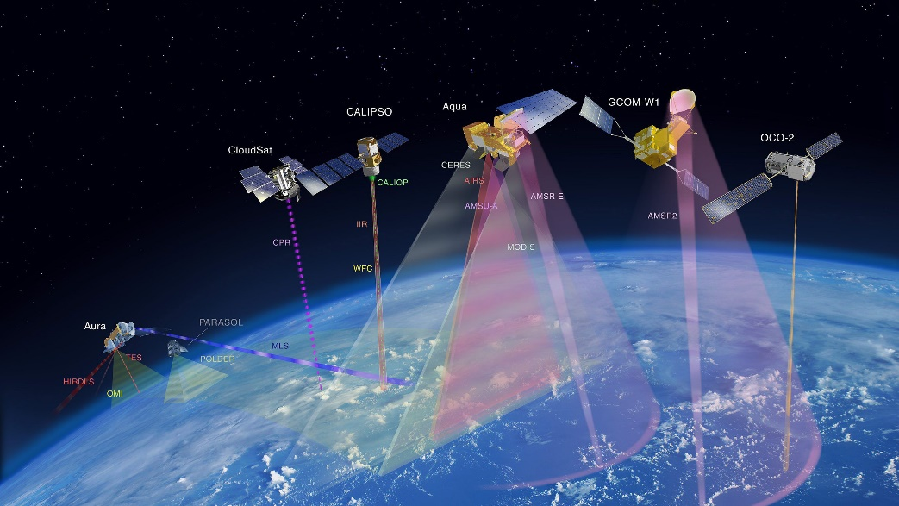
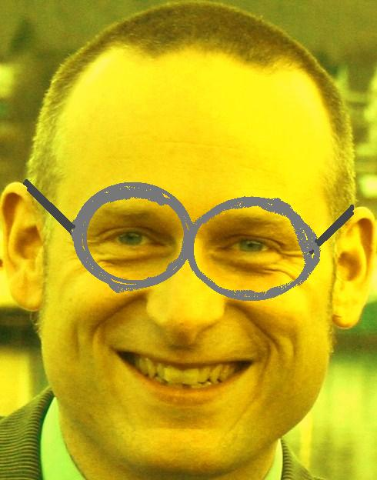
Questions?

