Slide 1
Moderate Resolution Sensor Interoperability
Committee on Earth Observation Satellites
USGS
SIT Tech Workshop 2017 Agenda Item 5
CEOS WP deliverables VC-29 & VC-30
CEOS Strategic Implementation Team Tech Workshop
ESA/ESRIN, Frascati, Italy
13th-14th September 2017

Slide 2
Moderate Resolution Sensor Interoperability (MRI) Initiative
This initiative addresses the CEOS strategic objective to encourage complementarity and comparability among the increasing number of Earth observing systems in the moderate resolution class for both optical and SAR sensors and the data received from them.
2017 Deliverables
A framework paper for moderate (10-100m) resolution interoperability provides a living document for the creation and use of multi-sensor data streams.
The Harmonized Landsat Sentinel-2 (HLS) case study identifies and summarizes lessons learned through the production of the HLS data product.
The Vegetation dynamics monitoring with HLS data explores the relationship between spatial resolution, temporal resolution and vegetation type.
The MRI Survey searches for examples of multi-sensor analysis throughout the user community

Slide 3
MRI Framework and Survey
Framework – living document
Product recommendations to CEOS agencies to maximize interoperability
Provide user community guidance for implementing and using multi-sensor data streams
Work with user community to understand user uncertainty requirements
Move beyond focus on Surface Reflectance products to included higher level products and SAR products
Survey - continue?
Engage user communities
Embed in LSI-VC website

Slide 4
MRI Case Studies and Synergy with FDA and CARD4L
Data Access Case Studies - FDA
The HLS data product will migrate to Amazon Web Services to provide easier access
The CEOS System Engineering Office in coordination with CEOS agencies will continue to evolve tools for building and using data cubes
CARD4L standards and Future Data Architectures will continue to evolve to support user communities
User Case Studies – GFOI & GEOGLAM
Coordinate the selection of user case studies through coordination with GFOI, GEOGLAM and other user communities.

Slide 5
MRI Way Forward - 2018
MRI organizational structure for 2018
Continue as Chair Initiative
Continue as LSI-VC activity
Other?
Do not continue
Changes to MRI going forward?

Slide 6
Time lines
Kickoff telecon on the 2-3 March 2017
Presentation of framework for endorsement at LSI-VC-3 on 20 March 2017
Presentation of work plan with emphasis on metadata at WGISS in April 2017
Presentation of work plan at SIT-32 in April 2017
Presentation of work plan with emphasis on data at WGCV in May 2017
Presentation of 2017 results at LSI-VC-4 in September 2017
Presentation at SIT TW in September 2017
Incorporate feedback with recommendations for CEOS Plenary
Presentation at CEOS Plenary in October 2017
Seek endorsement

Slide 7
The MRI Team
Co-leads
Team members
Gene Fosnight | USGS | USGS chair team co-lead, Landsat, LSI-VC, SDCG
Cindy Ong | CSIRO | WGCV co-lead, imaging spectroscopy
Richard Moreno | CNES | WGISS co-lead, Copernicus
Jeff Masek | NASA | Landsat Sentinel-2 Case study, LSI-VC
Zoltan Szantoi | JRC | Landsat Sentinel-2 Case study, LSI-VC
Adam Lewis | GA | LSI-VC, FDA, CARD4L
Paul Briand | CSA | LSI-VC, GEOGLAM, SAR
Yves Crevier | CSA | SDCG, GEOGLAM, SAR
Brian Killough | NASA | SEO, LSI-VC, SDCG, FDA, CARD4L
Debajyoti Dhar | ISRO | Optical/SAR data fusion
Takeo Tadono | JAXA | LSI-VC, CARD4L, SAR
Koji Akiyama | RESTEC | LSI-VC
Amanda Regan | EC | User needs for satellite constellations
Nigel Fox | UKSA | WGCV IVOS
Kurt Thome | NASA | WGCV
Andy Mitchell | NASA | WGISS
Kerry Sawyer | NOAA | Represent SIT vice chair
Kevin Gallo | NOAA | LSI-VC, LPCS data integration
Eric Wood | USGS | Represent USGS Chair Team

Slide 8
Background Slides

Slide 9
MRI Framework Current and Future Outcomes
Promote changes to operational products or post processing methodologies to create interoperable ARD products
For example, radiometric cross calibration to standard references, and acceptance of compatible geographic reference grid, DEMs and atmospheric models – typically reduces uncertainty
Identify good practices to accommodate differences among products
For example, spatial resampling to the same pixel-size and to remove residual misregistration and spectral band adjustment for different spectral response curves – typically increases uncertainty
Understand uncertainties
Producer uncertainties associated with geometry, radiometry, illumination and view angle, atmosphere, etc.
User uncertainty requirements for monitoring application specific change
Provide user guidance
Lessons learned and good practices

Slide 10
MRI Framework Components
MRI components complement CARD4L and describe issues and solutions with for multi-sensor data sets.
General Metadata provided at the scene or product level describe data characteristics
Reference grid accuracy; geometric accuracy; spectral bands; spectral response curves, radiometric accuracy, revisit time and lifetime; field of view; and mean local time
Per-Pixel Metadata support data filters and corrections
Clouds; cloud shadow; land/water mask; snow and ice masks; DEM; terrain shadow mask; illumination and viewing geometry; data quality
Measurements and corrections applied using metadata and data models
Measurements; measurement normalization; aerosol, water vapor and ozone corrections; SBAF corrections
Geolocation and corrections for image to image registration
Geometric corrections; resampling

Slide 11
Multi-sensor implementations
Cooperation among agencies is needed to support interoperability through the continued evolution of Analysis Ready Data.
Adopt Standards
OGC/ISO metadata standards
Shared reference grids and DEMs
Reflectance and atmospheric models
Common general and per pixel metadata
Understand impact of inherent differences
Pixels sizes
Spectral band differences
Spectral band availability
Revisit time
The MRI initiative supports CARD4L and Future Data Architecture studies and studies at agencies evolving implementation strategies. These strategies may be physical higher level products or models designed to use well defined lower level products as inputs. When standards cannot be adopted, compensation for differences is needed.

Slide 12
MRI Framework: General Metadata
Adopt common OGC or ISO metadata standard
Items | Threshold Verification | Target, Next steps
Coordinate Reference System | Document pixel sizes, origins and map projections in machine readable format. | Document in standardized metadata format. When practical establish common origins and map projections.
Reference grid accuracy | Document absolute accuracy of reference data. Reference grid uncertainty contribution to geometric accuracy should be minimized. | Document relationships among reference databases in operational use. Share reference databases when possible. Adopt common accuracy metric.
Geometric accuracy | Document uncertainty of each individual product and the methodologies used. | Document in standardized metadata format. Total uncertainty when combined with reference grid uncertainty should be on the order of 1/3 pixel. Adopt common accuracy metric.
Spectral bands | Document available bands in machine readable metadata | Document in standardized metadata format. Quantify benefits provided by additional bands.
Spectral response curves | Document spectral response curves in public literature | Document spectral response curves in machine readable, standardized metadata and in CEOS MIM database
Radiometric Accuracy | Document biases and uncertainty in public literature. | Document total error budget and temporal consistency for product families in metadata.
Revisit time & lifetime | Document revisit time and active lifetime in public literature. Interoperability goal to achieve 7-day cloud free revisit time. | Identify critical time periods and regions. Encourage access to historical archives. Extend interoperable time series globally to the beginning of the Landsat MSS period (1972) or earlier.
Field of View | Document Field of View. High level products need to account for different viewing geometries | Quantify radiometric uncertainty associated with off-nadir viewing angles.
Mean Local Time | Document Mean Solar Time. High level products need to account for different solar geometries. | Quantify uncertainty associated with different solar geometries between missions and through the life of the mission

Slide 13
MRI Framework: Per Pixel Metadata
Items | Threshold Verification | Target, Next steps
Clouds | Document cloud definition and methodology, including treatment of cirrus clouds and cloud edges. Document potential confusion with other classes, such as sand, snow and ice. | Verify and validate cloud masks. Include opacity and probability estimates. Investigate new bands needed to optimize estimates. Quantify confusion with other classes. Adopt common methodology and standards for use on multiple sensors.
Cloud Shadow | Document cloud shadow methodologies. Document potential confusion with other dark objects such as water and terrain shadow. | Verify and validate cloud shadow masks. Quantify confusion with other dark objects. Adopt common methodology and standards for use on multiple sensors.
Land/water mask | Document land/water methodology. | Verify and validate methodologies within context of their use in radiometric corrections. Adopt common methodology and standards for use on multiple sensors.
Snow & Ice masks | Document Snow & Ice detection methodology. | Verified and validated snow & Ice detection methodologies. Adopt common methodology and standards for use on multiple sensors.
DEM | The required accuracy of the DEM is dependent upon the corrections implemented, swath width and pixel size. | Share DEMs when possible both among operational agencies and with users. Requirements are highly variable.
Terrain Shadow mask | Terrain shadow masks are needed to estimate radiometric contamination associated with shadows. Known confusion such as with water and cloud shadow needs to be quantified. | Terrain shadows are particularly important for mountainous areas, wide swaths and for SAR sensors. Adopt common methodology and standards for use on multiple sensors.
Illumination and Viewing geometry | Solar angles are needed for reflectance calculations. View angles are needed for BRDF related corrections including terrain illumination corrections | Per pixel versus scene center solar angle corrections. View angle corrections.
Data Quality | No data, saturated, contaminated, terrain occlusion pixels need to be identified. | Establish standardized QA mask for different product levels. Adopt common methodology and standards for use on multiple sensors.

Slide 14
MRI Framework: Data Measurements
Items | Threshold Verification | Target, Next steps
Measurements | Documented absolutely calibrated measurement units with or without corrections below. Validated and verified at-sensor data measurements | Validated and verified Surface reflectance data
Measurement normalisation | Normalise measurements to nadir viewing and temporally constant by spatially varying by latitude solar angle. Use consistent methodology to create multi-sensor data stream | Investigate more complete, but practical BRDF models, which will require prior knowledge of the Earth surface.
Aerosol, water vapor and Ozone corrections | Document atmospheric model corrections. Use consistent methodology to create multi-sensor data stream. | Validate and verify atmospheric models and compare results. If convergence on single model is not possible, document and accommodate differences.
SBAF compensation | Initial estimate is a linear fit between equivalent spectral bands using hyperspectral spectra. | Spectral Band Adjustment Factors (SBAF) need to compensate for different spectral response curves and are surface type dependent.

Slide 15
MRI Framework: Geolocation
Items | Threshold Verification | Target, Next steps
Geometric Correction | Image data are precision corrected to a reference data set. | Minimize misregistration through orthorectification and precision registration to a common reference data set. Document methods & uncertainties/error throughout processing chain
Resampling | The number and type of spatial resampling will impact the radiometric signal | Minimize the number of resampling operations. Quantify impact of upsampling or downsampling on time series analysis for different applications. Document resampling type/method applied.

Slide 16
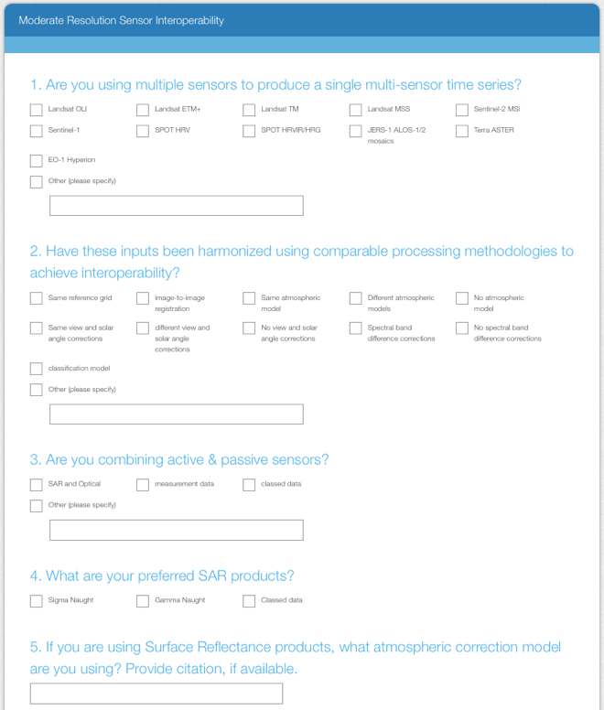
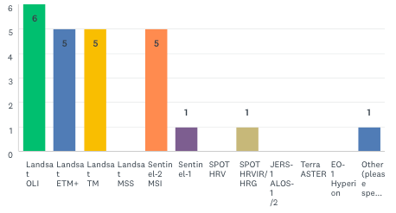
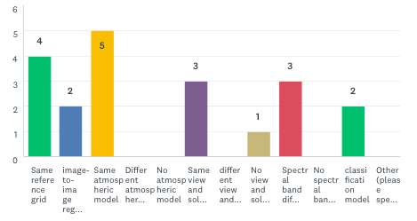
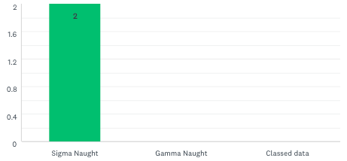
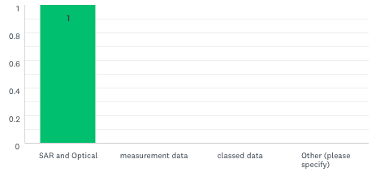
MRI Survey
The MRI Survey provides the user community an opportunity to contribute lessons learned and good practices.
Q1
Q2
Q3
Q4
Q5: 4 responses

Slide 17
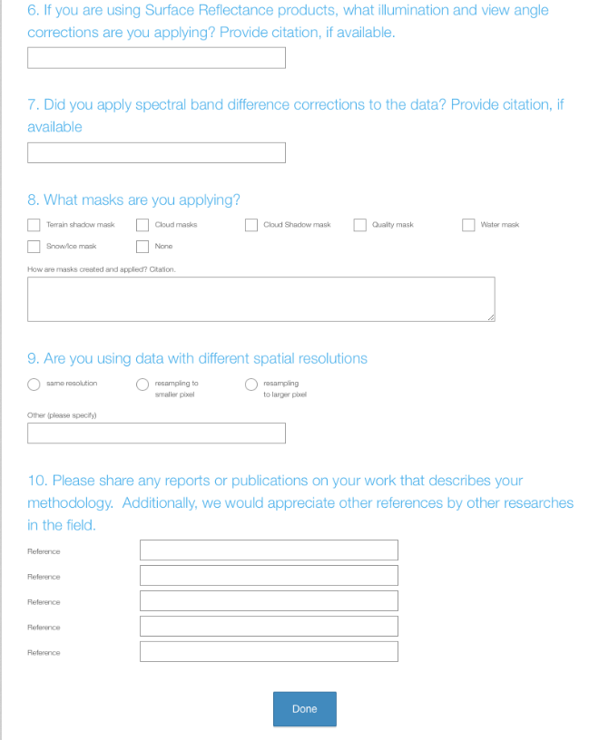
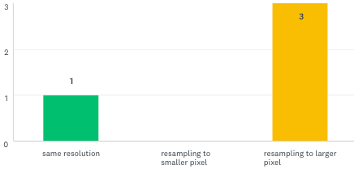
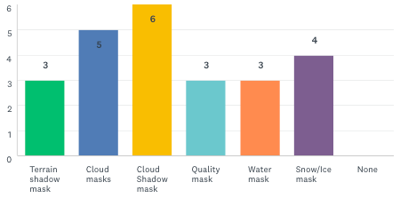
MRI Survey
The MRI Survey was distributed initially to the LSI-VC, MRI, SDCG and GEOGLAM teams.
Q6: 4 responses
Q7: 4 responses
Q8
Q9
Q10: 1 response

