Slide 1

USGS Agency Update:
CARD4L Production Roadmap
Committee on Earth Observation Satellites
LSI-VC-4
Session 6: Item 1
Frascati, Italy
7 September 2017

Slide 2
Landsat ARD Status
& Global Approach
Plan to release Landsat ARD over the U.S by November 2017, which provides an initial step towards Landsat Global ARD
  Primary purpose is for the USGS Land Change Monitoring, Assessments, and Projections (LCMAP)
  Science data sets are identical (Surface Reflectance, Top of Atmosphere (TOA) Reflectance, Brightness Temperature (BT))
  Many of the parameters, such as pixel-level metadata, apply to Global ARD
  Some parameters such as projection and tiling/grid for the U.S. product may not apply to the global product
Targeting Landsat Global ARD production by January 2019
Taking a “default” parameter approach but plan to drive out final specifications through a set of pilots and community feedback

Slide 3
Landsat Global ARD Definition
& Product Generation – Definition
Product Definition Approach
Utilizing the CARD4L product family specification (PFS) framework (as follows), USGS plans to adopt an initial default set of Landsat Global ARD specifications that are then confirmed or refined through a set of pilots:
  Product Type (Family)
  General Metadata
  Per Pixel Metadata
  Radiometric Measurement Corrections
  Geolocational Correction
  Product Format
Maximizing Landsat/Sentinel-2 interoperability is also a goal
Ultimately, specification will be documented and distributed in a typical Landsat Data Format Control Book (DFCB)
Landsat Global ARD products to be part of USGS Collection 2 (Jan 2019 target)

Slide 4
Landsat Global ARD Definition
& Product Generation – Definition
Product Definition Characteristics
Product Type (Family)
  Landsat Global ARD product includes Surface Reflectance, TOA, and Brightness Temperature
    Analyzing including Surface Temperature instead of Brightness Temperature
  Where unable to generate standard product, fallback products include L1TP, L1GT, L1GS
General Metadata
  Collection vs granule level metadata traceability to lowest level metadata and processing chain provenance
  ISO 19115 metadata, including time of acquisition and sensor spectral characteristics, more…
  Ancillary and geometric data sources referenced
  Sensor calibration file (CPF) included
  Geometric accuracy RMSE values provided
  Examples available via existing U.S. ARD sample products and DFCB
Per Pixel Metadata
  Per pixel quality values provided via quality bands and arranged by sensor, angles and timing, non-surface targets, and surface targets
  Per pixel metadata provided at all product levels (Level-1 and Level-2)
  Examples available via existing U.S. ARD sample products and DFCB

Slide 5
Landsat Global ARD Definition
& Product Generation – Definition
Product Definition Characteristics (cont’d)
Radiometric Measurement Corrections
  Utilizing USGS modified Landsat Ecosystem Disturbance Adaptive Processing System (LEDAPS) for Landsat 4-7
    Developed through a NASA MEaSUREs grant by NASA GSFC and UMD (Masek et al., 2006) (Eric Vermote)
  Utilizing Landsat Surface Reflectance Code (LaSRC) for Landsat 8
  Atmospheric correction data sources provided at: https://landsat.usgs.gov/landsat-surface-reflectance-high-level-data-products
  Atmospheric correction software provided at: https://github.com/USGS-EROS/espa-surface-reflectance
  Includes corrections for:
    Nadir view angle
    Solar incident angle
  No BRDF or terrain illumination correction, but users can apply for themselves
    Corrections not currently available in LEDAPS or LaSRC
    Still under consideration for Landsat Global ARD product

Slide 6
Landsat Global ARD Definition
& Product Generation – Definition
Product Definition Characteristics (cont’d)
Geolocational Correction
  *Map Projection = UTM (current Landsat Level-1 product approach)
  *Tiling & Grid = Full WRS-2 tiles with fixed UL lat/lon location
    Virtual tiling schemes could be introduced (issues with overlapping UTM zones)
  Grid Cell Size = 30m
  Orientation = UL pixel orientation (same as Level-2 U.S. ARD today)
  Ground Control = Updated GCPs correlated with S-2 Ground Reference Image (GRI)
  DEM = Current Landsat DEM
    Considering improved DEMs along the Landsat Global ARD development lifecycle
* Primary purpose of pilots is to confirm these parameters (next slide)
Product Format
  Storage Format = Cloud-optimized Geotiff with internal compression but plan to consider Meta Raster Format (MRF) and NetCDF
  Distribution Format = Deliver in the same format as it is stored but plan to consider converting to other formats as the data is accessed

Slide 7
Landsat Global ARD Definition
& Product Generation – Pilots
Pilot Demonstrations to Finalize Science Requirements for Collection 2
3 pilots, each over various areas (including overlapping UTM zones) [areas TBD]
Utilize "worst case" scenarios to gather feedback to drive the final requirement
UTM Projection with WRS-2 Grid (current Landsat product approach)
  Utilize fixed maximum WRS scene boundaries for each scene
  Provide a virtual shape file grid of WRS-2 on top of the data
  Provide a mechanism for simplified delivery and access to the data
UTM Projection with MGRS Grid (similar to Sentinel-2)
  This will require double processing of the data over overlapping UTM zones (~30% larger data set)
EQUI7 Family of Continental Projections
  7 equidistant projections over the major land areas of the Earth (Europe, Mainland Asia, Africa/Middle East, SE Asian Islands/Australia, South America, North America, and Antarctica) with relatively few boundary areas (Europe/Asia and Africa/Asia being the most extensive)

Slide 8
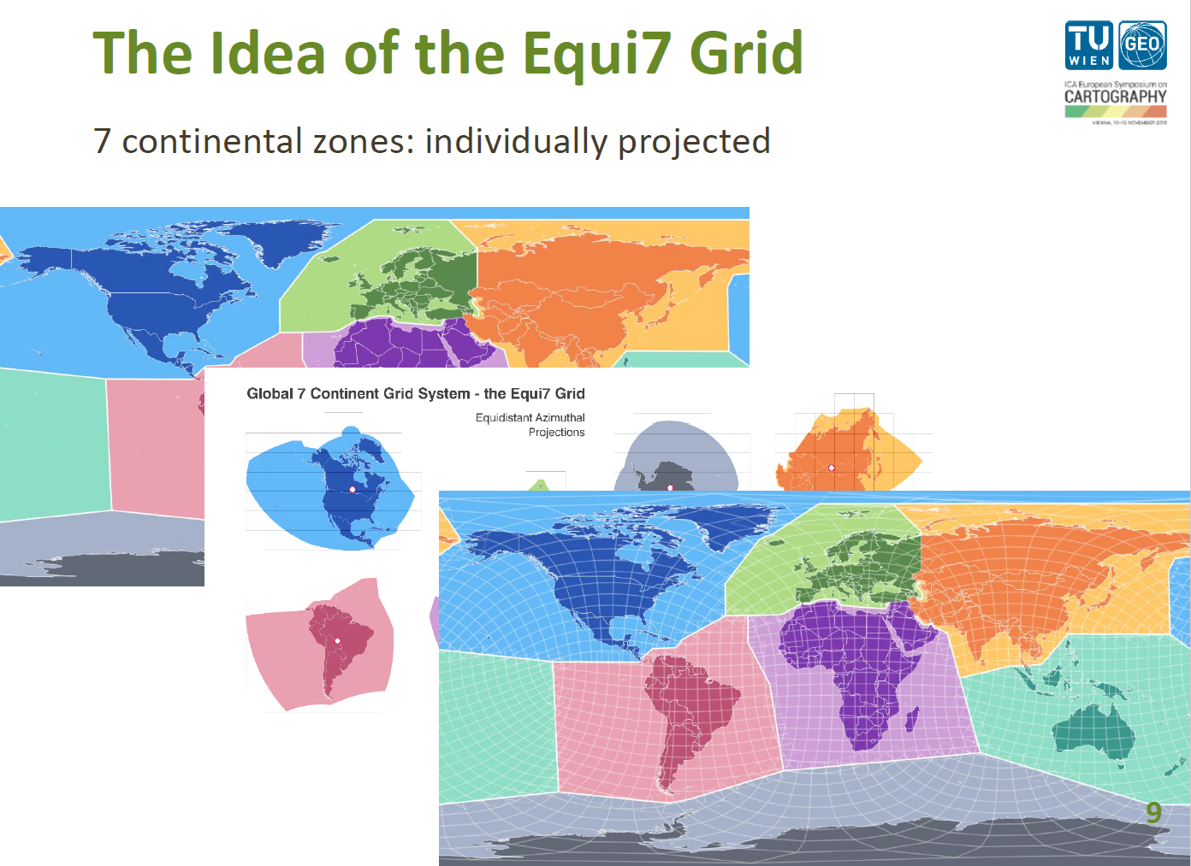
EQUI7 Family of Continental Projections

Slide 9
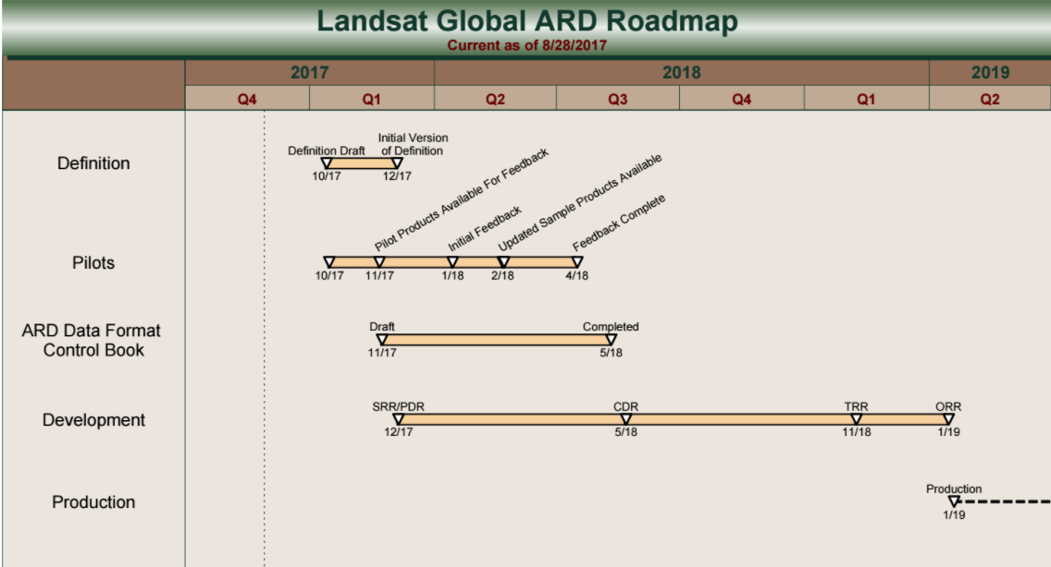
Landsat Global ARD Definition
& Product Generation – Roadmap

Slide 10
References
U.S. ARD Product Samples and DFCB
https://edclpdsftp.cr.usgs.gov/downloads/collections/l2-ard-tiles/
Equi7 Grid
https://github.com/TUW-GEO/Equi7Grid

