Slide 1
ESA: LSI-VC, session PFS and ESA Agency status on ARD implementation
Bianca Hoersch for the Sentinel Missions
CEOS meetings, ESRIN, Sep 2017

Slide 3
ARD specifications: Backscatter (S1 et al.)
Uncertainties are expressed as root mean square error (RMSE) or Circular Error 90% Probability (CEP90): not provide as metadata for S-1, ERS or ASAR.
Calibration parameter file located through a DOI : available but no DOI.
DOIs for each algorithm are identified in the metadata. The versions of the algorithms are identified: The algorithm process is described in the algo document. S1 will not comply to this
Noise removal: Those are generic requirements and thus the name of S-1 has nothing to do there. Please reformulate the requirement.
Geometric accuracy: In order to have a proper DEM based correction as in section 3.4 the geometric accuracy needs to be absolute. then the level of geometric correction should be clarified. All the mission have a range timing correction. Some include the atmosphere (ASAR) and other not (S-1).
IN SUMMARY: good start but some major comments
Detailed comments to the PFS are available. Contact: Nuno Miranda, Pierre Potin

Slide 4
Sentinel-2: we go ARD!
Sen2COR processed S2A atmospherically corrected (L2A) data have been processed over Europe since May 2017
The feasibility study comparing European algorithms concluded that none of the algos is THE mature one and require further consolidation. However SEN2COR and MAJA have been earmarked as most mature.
ESA has proposed a roadmap towards global systematic L2A to EC using SEN2COR to comply with cost and schedule, precise implementation under consolidation, tentative:
Routine systematic L2A Europe within 24h from sensing: Jan 2018 (to start serving JRC organised ‘Global S2 seamless’
Worldwide systematic production, online rolling 18 months: mid 2018,
On-demand service including access to archive: Q4/2018 to Mid 2019
Re-assess the status & algos mid 2019

Slide 5
ARD specifications: SR (S2)
Geometric accuracy: clarify why only RMSE and CEP90? Can we consider also the CEP95 which is used in Sentinel-2 project?
Sensor calibration: use of DOI necessary?
Radiometric accuracy: use ‘uncertainty’; Usually uncertainty is derived from the measurements of reference standards (Rayleigh, PICS, DCC,...). Rephrase?
Algorithms/processing chain: requires clarification: reference to ATBD publication? What if not published?
Data Access: Shouldn't be more the Access Points, identified with a DOI, refering to the versions/references of the products included?
Clouds: An image can be of good quality even if fully covered by clouds.
➔ IN SUMMARY: current SR ARD is a good basis, some changes are required to make sure that the constraints on the products defined by the “threshold” requirements make sense and are practically feasible.
➔ Detailed comments to the PFS are available. Contact: Ferran Gascon, S2 MM

Slide 6
ARD specifications: LST (S3)
- Looks like LST ARD is a cut and paste of the reflectance (some parts not relevant)
- There are some requirements that are dubious (and not relevant for ARD according to ESA first assessment): ex: distance to cloud per pixel in the metadata. Reconsider?
- There are some requirement that maybe valid for the US algo and not for S3 (ex: S3 does no map projection, no retrieval of emissivity in the algo....etc...) - If we want to comply with it we must redesign our processing chain …..we need specifications that encompass all missions falling in this category
We don't do (yet) DOI in S3. It will come, but for now we are not yet there.
IN SUMMARY: current LST ARD makes us feel uncomfortable…. Let’s rediscuss. ARD should be simple and following the ‘bon sens’.
Detailed comments to the PFS are available. Contact: Steffen Dransfeld, Philippe Goryl

Slide 7
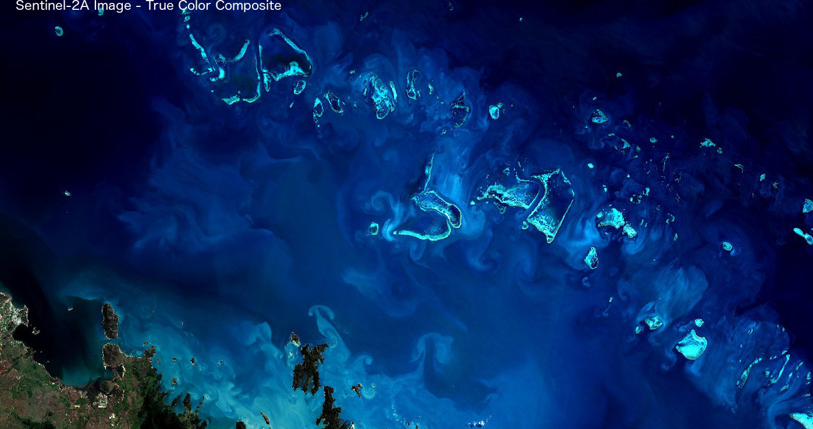
Thank you very much for your attention!
http://sentinels.copernicus.eu

