Slide 1
Session 2: Analysis Ready Data
Committee on Earth Observation Satellites
LSI-VC-4 / SDCG Joint Meeting
Session 2: Item
Frascati, Italy
6 September 2017

Slide 2
CARD4L Overview and Status
Committee on Earth Observation Satellites
LSI-VC-4 / SDCG Joint Meeting
Session 2: Item J4
Frascati, Italy
6 September 2017

Slide 3
CARD4L Achievements and Outlook
Outlook: ✔✔✔✔
Strong and increasing acceptance of the Concept
Data providers are moving toward production of ARD
Future Data Architectures have indicated that ARD is a key ingredient
Interoperability studies point to the need for ARD as a start point for scientific interoperability
Worldcover (March 2017, Frascati) presented several methods to produce analysis ready radar and surface reflectance data
Catapult (UK) have independently initiated a series of workshops on Analysis – Ready Sentinel 2
Some appetite to extend the work to include Ocean and Atmosphere ARD (CARD4O; CARD4A)

Slide 4
CARD4L Achievements and Outlook
Achievements and next steps: ✔✔
Framework developed

Slide 5
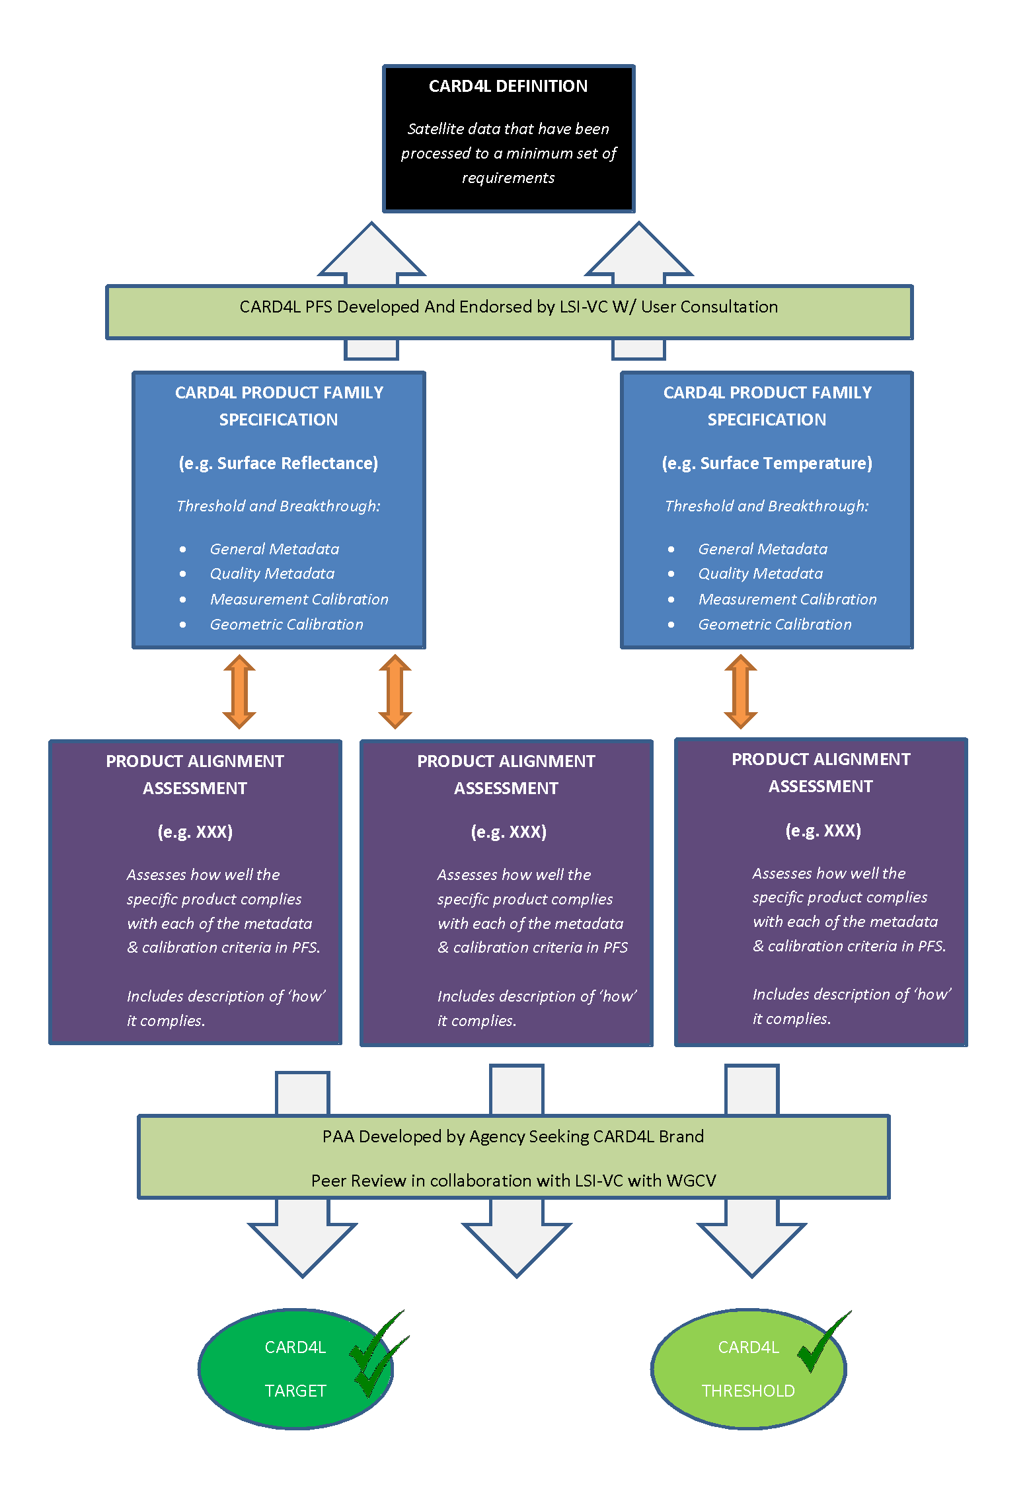
CARD4L Assessment Framework
Background
The CARD4L Framework

Slide 6
CARD4L Achievements and Outlook
Achievements and next steps: ✔✔
Framework developed
Product Family Specifications (PFS) – working Drafts of:
Surface Reflectance
Radar Backscatter
Land Surface Temperature / Surface Brightness Temperature
Next steps:
Use selected datasets to implement the ‘alignment assessment’ components and road-test the PFSs:
ALOS PALSAR global mosaics
Landsat Collection-2
Sentinel-2 surface reflectance test datasets
Two new members to LSI-VC – Daniel Wicks (UKSA), and Andreia Siqueira (GA)
This work is moving too fast for some, too slowly for others – so probably about right – but it will accellerate.

Slide 7
Broader CEOS ARD Strategy
To be worked during LSI-VC
Several questions to consider:
Why? What is the problem to be addressed or the benefit to CEOS of a broader ARD strategy?
The main arguments seem to be that Future Data Architectures need interoperable ARD. It would also grow the community.
How? Would it be done?
The core ideas don’t change. The high level definition can be generalised, and we would need to have CARD4O and CARD4A
New Product Family Specifications would be needed
Who? What are the roles? Who within CEOS would do ‘it’.
Some parts of a general scheme (e.g., the definition, the overall framework) should be centrally managed, other parts (Product Family Specifications) progressed within the domains
SIT would need to play an oversight role; A new sub-team of FDA would need to be formed to maintain the framework; The VC’s and WG’s would take ownership of Product Family Specifications, Alignment Assessments etc.

Slide 8
How can the LSI-VC and thematic activities work together encourage data providers..?
Motivations: Data Providers may need to be:
Convinced of the value / benefit of providing CARD4L
Supported to move to the CARD4L framework
Recognized / Acknowledged for their achievements
LSI-VC / CEOS role
What can, and should, LSI-VC and the thematic activities do?

