Slide 1
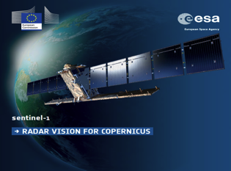
Sentinel-1 Mission Status
Pierre Potin, Sentinel-1 Mission Manager
CEOS LSI-VC-4 / SDCG-12 / GEOGLAM Trial Joint Meetings
5th – 8th September 2017
ESA/ESRIN, Frascati, Italy

Slide 2
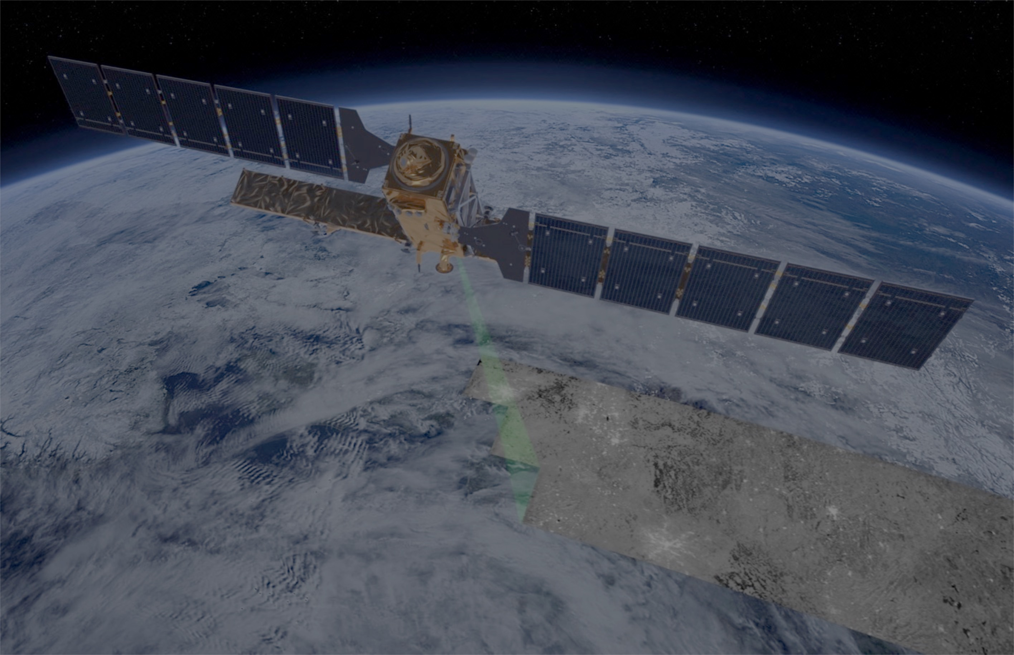
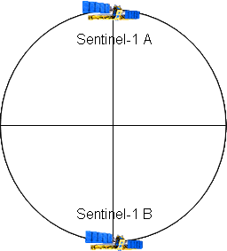
Sentinel-1: Copernicus radar imaging mission for ocean, land, emergency
Part of the Copernicus Programme led by the European Union
Mission based on 2 identical satellites (S1A & S1B) and a highly performing ground segment
Main satellites characteristics:
C-band Radar instrument
Instrument duty cycle of 25 min/orbit in HBR modes and 75 min/orbit in LBR (Wave)
Sun-synchronous orbit at 693 km altitude
Inclination: 98.18˚
7 years lifetime, consumables for 12 years
Mean LST: 18:00h at ascending node
12-day repeat cycle at Equator (6 days with 2 satellites)
Instrument operations based on a predefined observation scenario
Systematic data processing with open & free data access
Gradual increase of the mission operational capacity from the S1A launch up to the mission constellation routine operations

Slide 3
Sentinel-1 Mission Phases
S1 Mission Routine Operations
S1 Mission Operations
Qualification
S1A Routine Operations
S1A Operational qualification
S1A Space Segment Commissioning
S1B Space Segment Commissioning
S1A-Launch
3 April
2014
S1A IOCR
Sep
2014
1st S1A ROR
9 June
2015
S1B Launch
25 April
2016
6 Sep 2017
S1B
IOCR
Sep
2016

Slide 4
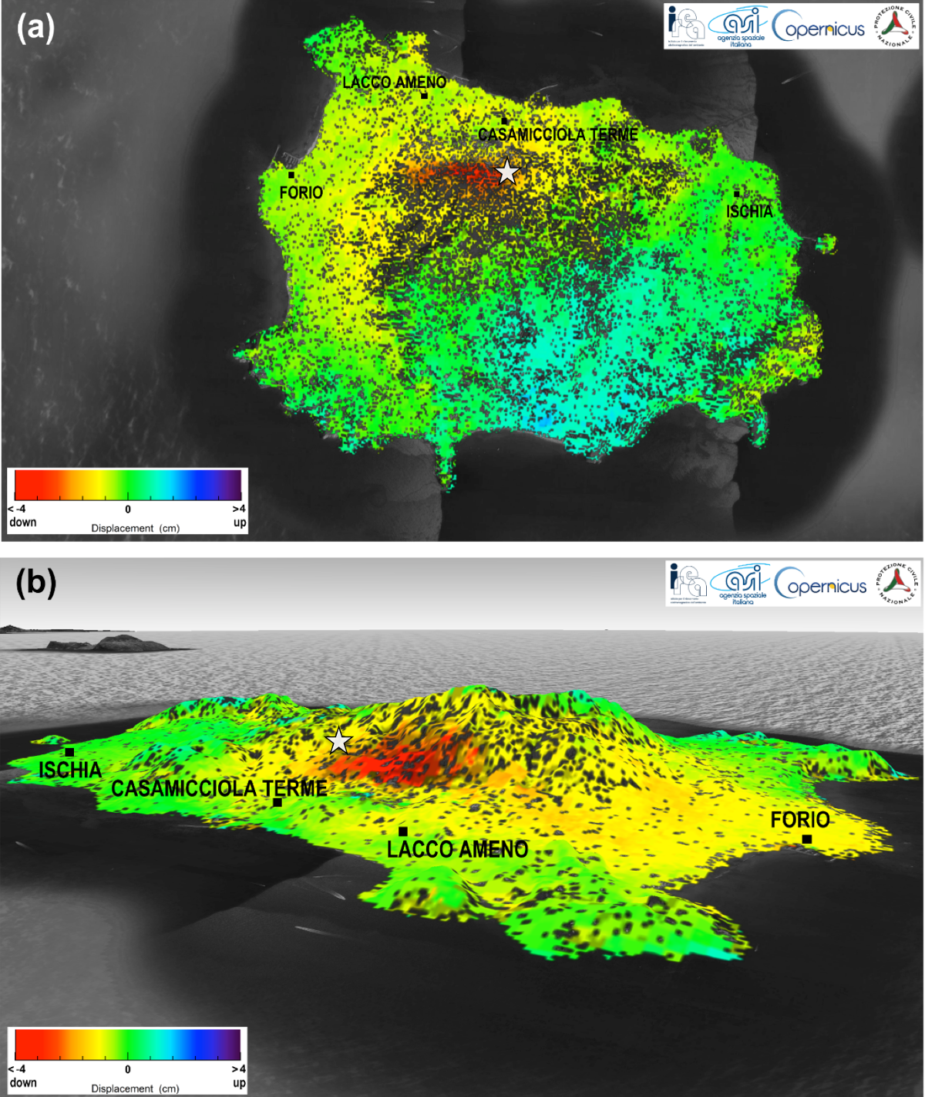
Sentinel-1: mission status
Mission Status
Sentinel-1 nominal routine operations continue
Sentinel-1A and -1B data routinely provided to Copernicus Services and users worldwide
On-going support to various activations from the Copernicus Emergency Management Service and International Charter Space and Major Disasters
Use of EDRS service has been progressively increased as part of routine operations, for both Sentinel-1A and Sentinel-1B
Sentinel-1 constellation generates now 11 TB of products daily (against a formal specification of 3 TB)
Upcoming activities
Start of gradual increase of Quasi Real Time observations in response to Copernicus and Member States needs
Identify and implement mission evolution to support new user needs, increased system capacity enabling further mission exploitation, etc.
Md 4.0 Earthquake in Ischia, Italy, 21/08/2017.
Ground deformation measured by Sentinel-1
© Contains Copernicus Sentinel Data (2017) / CNR-IREA
Notes:
Upd –status and picture (Pierre)

Slide 5
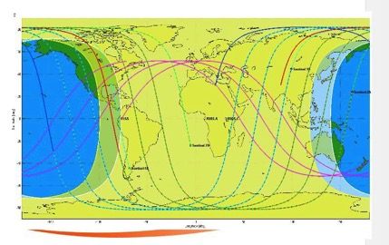
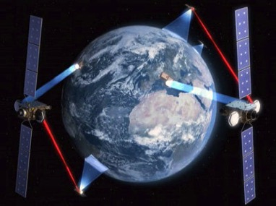
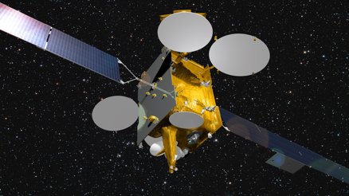
Operational use of European Data Relay System (EDRS)
The European Data Relay System service provides complementary acquisition of Sentinel-1 mission data addressing in particular:
increased coverage
enhanced timeliness, including quasi-real time (QRT) observation capabilities, in particular outside Europe
The main functions provided by the service are:
Sentinels mission data transmission via Optical (Laser) link to the GEO satellites
Mission data relay between the GEO satellites and the Ka-band ground receiving terminals
Mission data reception, decommutation and provision to the service interface point (Copernicus WAN circulation network)
EDRS-Sentinels geometrical visibility map
EUTELSAT 9B hosting EDRS-A

Slide 6
Sentinel-1 Constellation operations Operational services status summary

Slide 7
Sentinel-1 observation scenario Main thematic domains & components
Land cover: agriculture, forestry, hydrology, etc.
Maritime surveillance
European coverage
Sea-ice, icebergs, lake-ice
Emergency
Calibration/validation
Ground deformation: Tectonic, volcanoes, landslides, subsidence… (InSAR applications)
Global land mapping
Security
PR actions (infrequent)
Ice sheets, glaciers, permafrost, snow, etc
Sea state

Slide 8
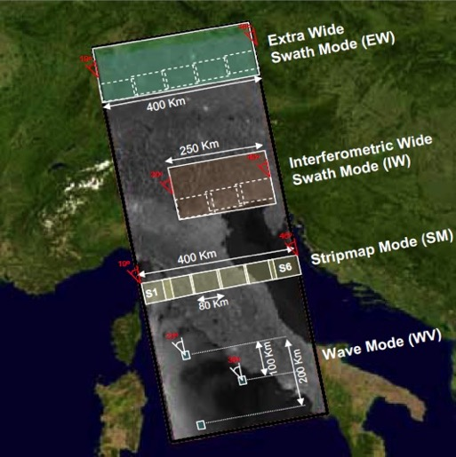
Sentinel-1 observation scenario SAR Operational Modes
GRD Level 1 product resolution | Swath Width | Polarisation
50m (3 ENL) | > 400 km | HH+HV or VV+VH
20m (5 ENL) | > 250 km | HH+HV or VV+VH
9m (4 ENL) | > 80 km | HH+HV or VV+VH
50m (140 ENL) | 20 x 20 km² at 100 km spacing | HH or VV
EW
IW
SM
WV
IW: main mode over land
and coastal areas

Slide 9
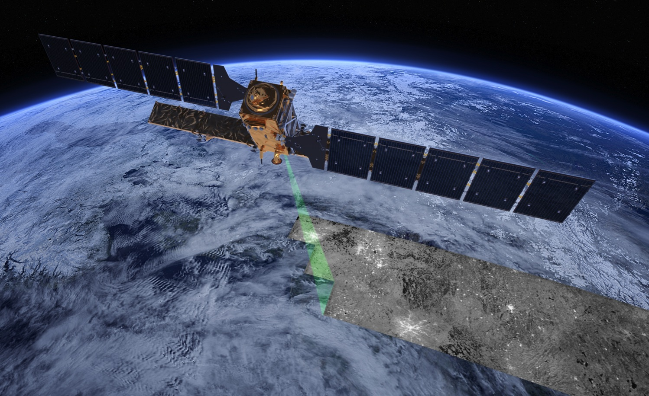
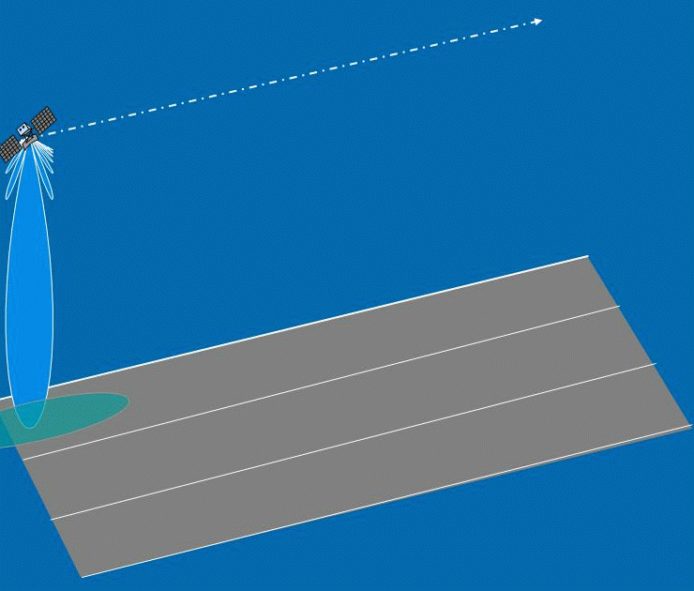
Image Acquisition in Interferometric Wide Swath mode (IW)
Terrain Observation
by Progressive Scans
(TOPS)

Slide 10
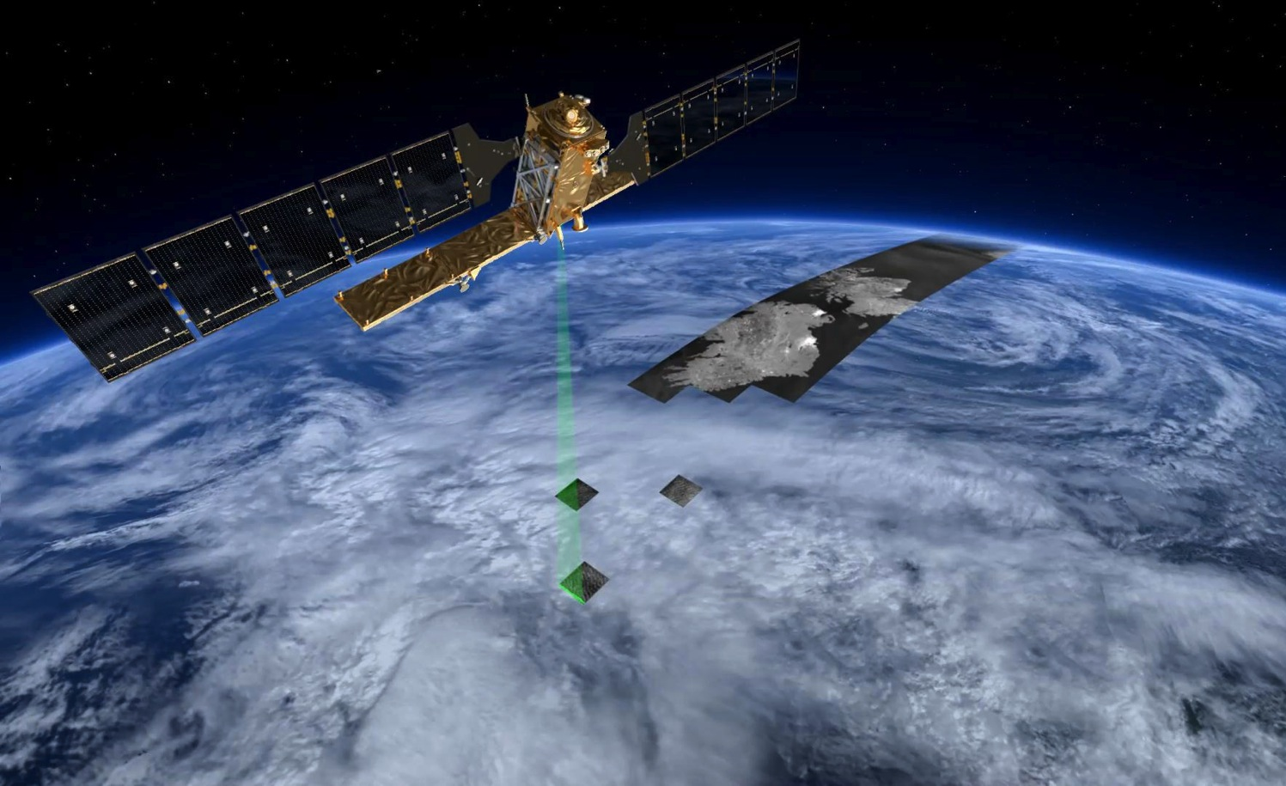
Image Acquisition in Wave Mode (VW) (used over open oceans)

Slide 11
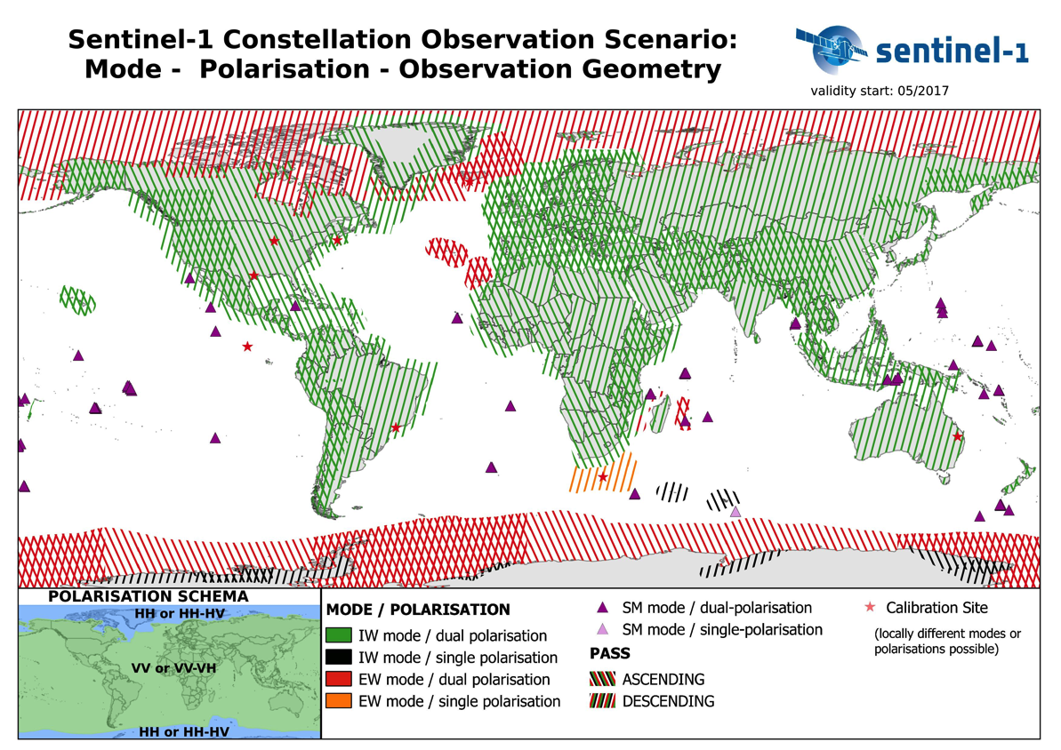

Slide 12
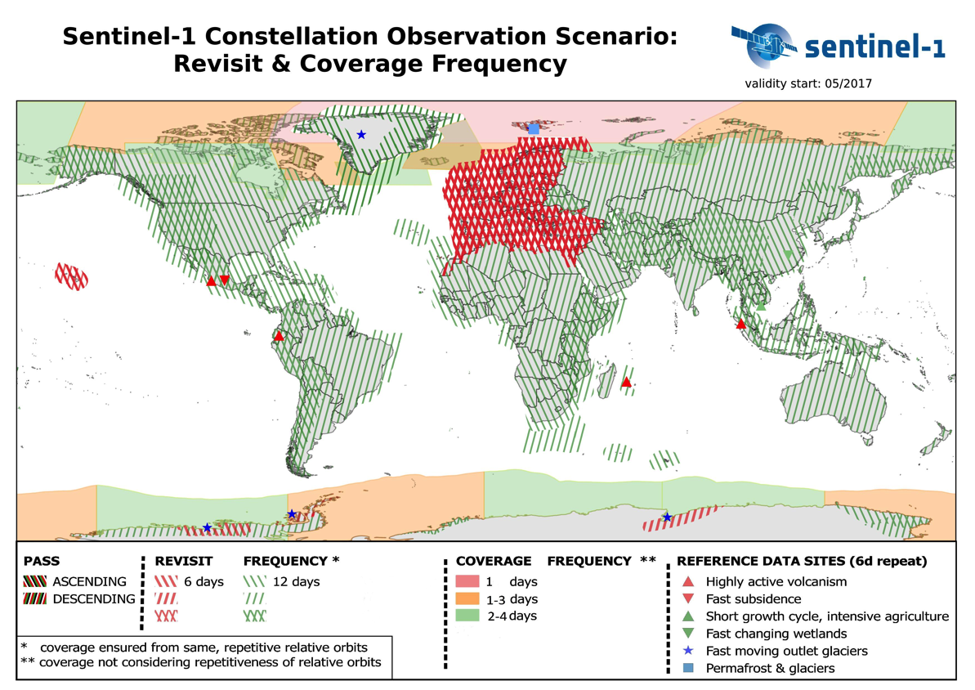

Slide 13
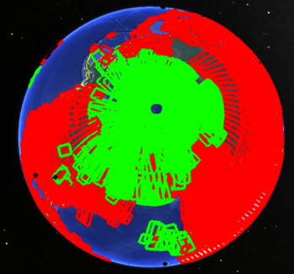
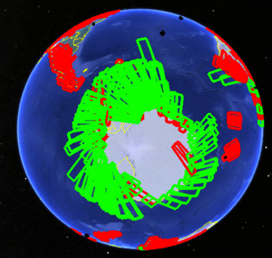
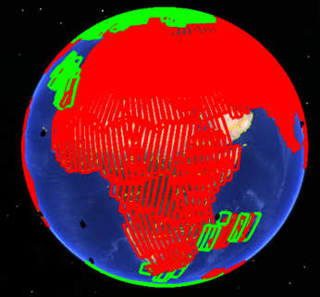
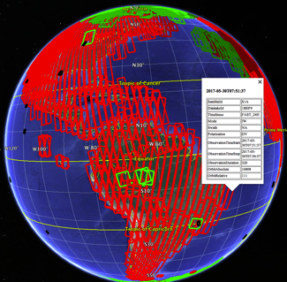
Sentinel-1 observation scenario
KML files providing detailed information on the planned acquisitions, regularly published on Sentinel Online
https://sentinels.copernicus.eu/web/sentinel/missions/sentinel-1/observation-scenario/acquisition-segments

Slide 14
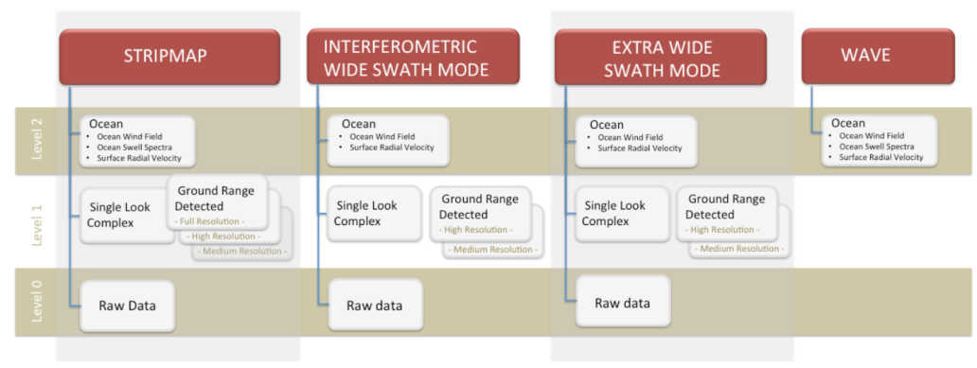
Sentinel-1 systematic production scenario
All Sentinels acquired data are systematically downlinked and processed to generate the core products within 24 hours from sensing:
L0 products
L1 GRD
L1 SLC (initially over selected regional areas, since July 2015 over all land masses)

Slide 15
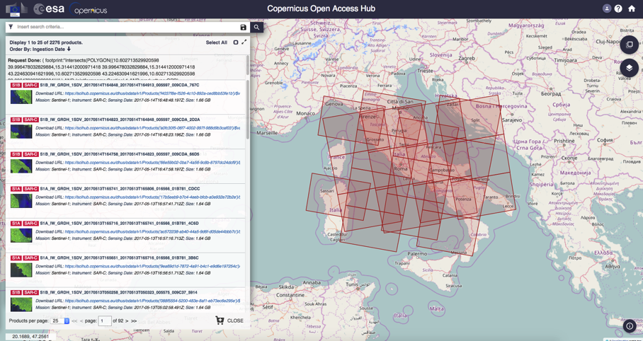
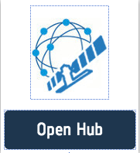
Sentinel Open Hub: Free and Open Access to Sentinel data (previously called “Scientific” Hub)
https://scihub.copernicus.eu/
Access through self-registration
Automated download scripting capability and dedicated API-Hub
Restriction on concurrent downloads
More than 95,000 users registered
1.7 Million Sentinel-1 products are available on-line for download, representing about 2.6 PB of data.
More than 12 PB of data downloaded by users.

Slide 16
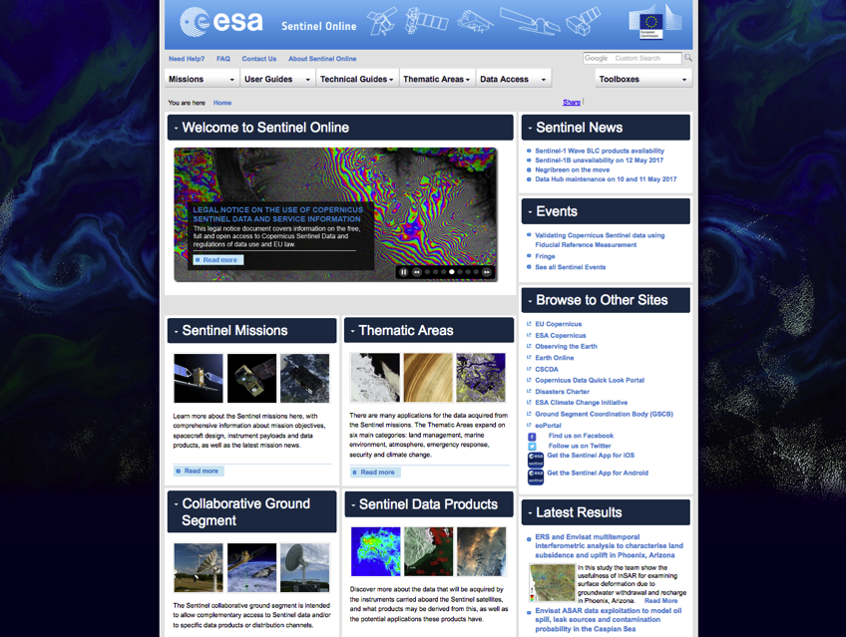
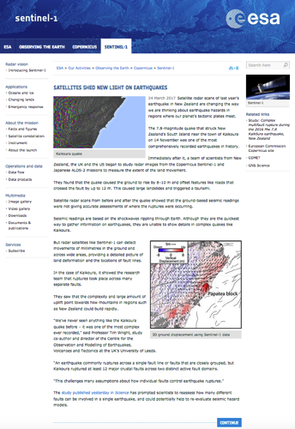
Sentinel Online web portal
http://sentinels.copernicus.eu Sentinel-1 related documentation and technical notes available on this portal, as well as news and regular web stories

Slide 17
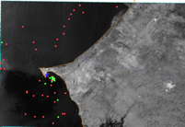
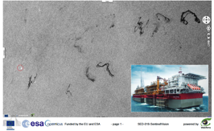
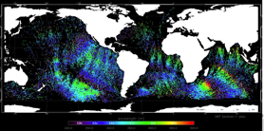
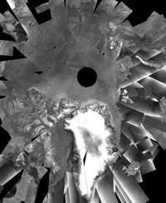
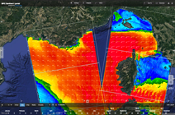
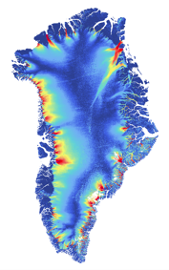
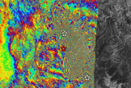
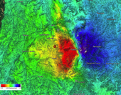
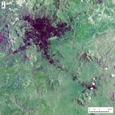
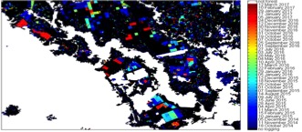
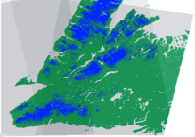
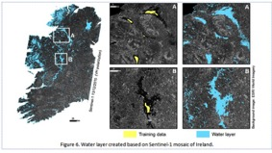
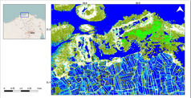
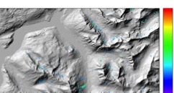
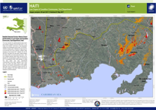
Sentinel-1 applications → ever increasing
Sea ice and iceberg monitoring
Maritime surveillance: oil spill monitoring, ship detection, illegal fisheries, etc.
Sea state: wind, wave
Ice sheets, glaciers, climate change
Ground deformation: subsidence, landslides, earthquakes, volcanoes, infrastructure monitoring
Land use, agriculture, forestry, logging, land classification, urban planning
Emergency management
Soil moisture, wetland
Snow, permafrost, avalanches,…
Notes:
Overview on the main Sentinel-2 applications, examples from each domain are following

Slide 18
Concluding remarks
Sentinel-1 mission routine operations on-going, overall mission in a very good shape
High quality data routinely provided to Copernicus Services, Member States, International partners and to a wide spectrum of user communities worldwide for various thematic applications
The mission provides:
global and routine coverage, with a systematic production scenario,
open and free data access,
the long-term perspective,
➔ to further bring SAR applications into the operational domain, at local, national, regional, continental and global scale

Slide 19
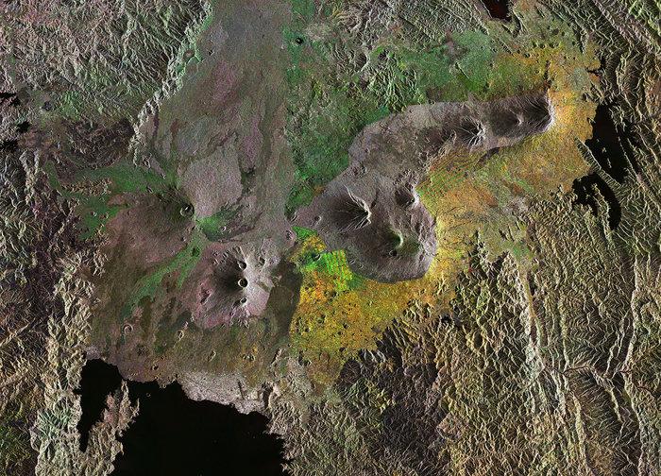
CSC Missions Management On-Line
Thank you !
Copernicus Programme: copernicus.eu
Sentinel Online: sentinels.copernicus.eu
CSC Data Access: spacedata.copernicus.eu
ESA Sentinel app: available for iOS and Android

