Slide 1
Land Imaging Requirements Assessment:
GEOGLAM Case and its Applicability
Alyssa K. Whitcraft et al.
GEOGLAM Secretariat akwhitcraft@GEOGLAM.org
GEOGLAM/SDCG/LSI-VC Meeting
Frascati, Italy – 7 September 2017

Slide 2
Outline
A framework for evaluating imaging requirements
  GEOGLAM example (2012-2014)
Status of the GEOGLAM EO Data Requirements “Refresh”
Thoughts on carbon and the role of LSI-VC
Identifying common requirements across applications

Slide 3
A Framework for Characterizing and Evaluating Requirements
1. Policy Driver
WHY do we need to monitor? → Information needs
  What decisions are supported?
WHAT variables? → Monitoring application’s data needs, to derive Information
WHAT instrument characteristics? → Spatial, Spectral
WHAT purpose? → R&D agenda? Firm operational needs?
WHERE? → Target features
  e.g. major croplands; S/M/L fields; rangelands
WHEN? → Target periods
HOW OFTEN? → inc. Latency
  Every year? Every 5 years? Every decade?
  How many times per year? [more common for ag applications]
PRIORITY?
2. Tabular Best Practices, Community Insight
Spatial Datasets:
Cropland mask
Field Size Distribution
Crop Calendars
Cloud coverage (impact on optical)
Priority Croplands
3. Tabular
+
Spatial Datasets
4. Mission capacity & gap analyses
Notes:
This process might be a bit different for Carbon – seems like the main goal is inventory (on what time step?).
- You are not likely reporting multiple times per year, but you may need to monitor certain highly dynamic events (e.g. fires) as input to a larger inventory.

Slide 4
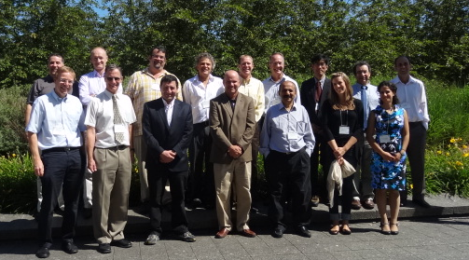
GEOGLAM CEOS Workshop on OBSERVATION REQUIREMENTS
CSA, Montreal July 10-11, 2012
Tabulating the satellite observation requirements (spatial resolution, frequency, and period of coverage) for GEOGLAM

Slide 5
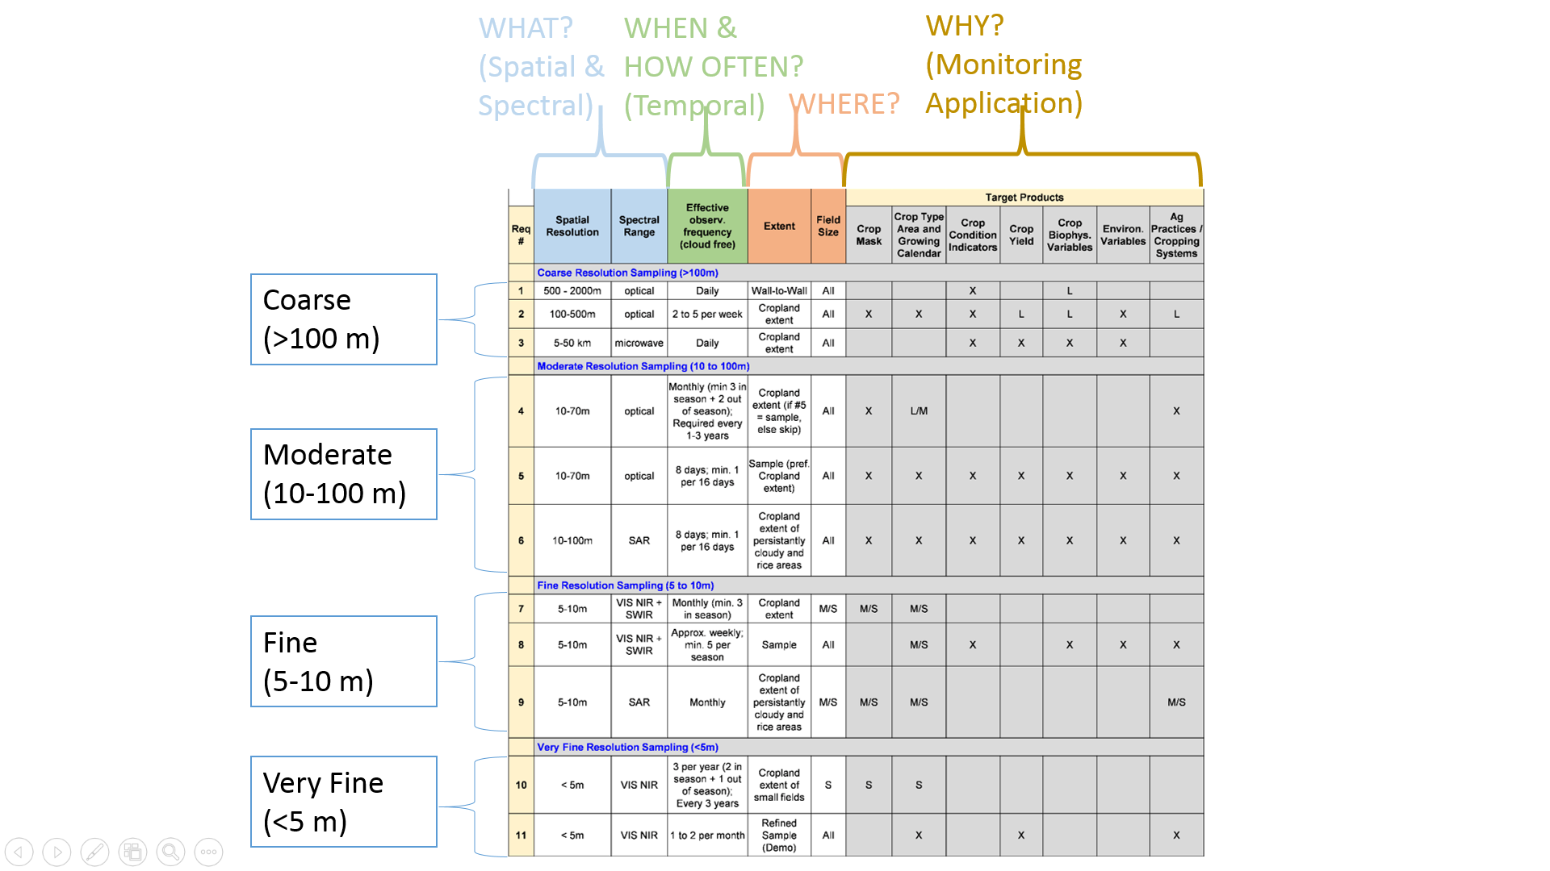

Observation
Requirements
Table
State of the Science as
2012-2014
Currently designing a “refresh”
Note:
Optical = Reflective & Emissive (Thermal)
Notes:
TALKING POINTS
In 2012, GEOGLAM scientists & CEOS representatives met at CSA in Montreal to develop a refined and set of EO requirements which are necessary to generate a variety of target products or applications (crop mask, crop type area, crop condition, crop yield, crop biophysical variables (LAI), environmental variables, and information on cropping system (crop cycles).
The requirements (such as these [ANIMATION] for moderate resolution instruments like Sentinels and Landsats) are broken down by spatial and spectral ranges (the “what?”), each with a corresponding temporal requirement for cloud free data (sometimes different revisit frequencies are needed during the season vs. out of season) as well as information on the geographic extent to which the data are necessary (all croplands? Or just a sample? Are the data necessary for just small and medium fields, or for all fields?).

Slide 6
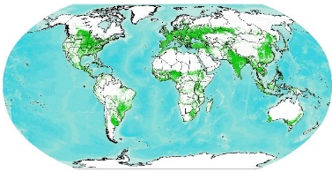
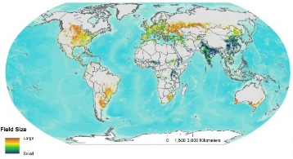
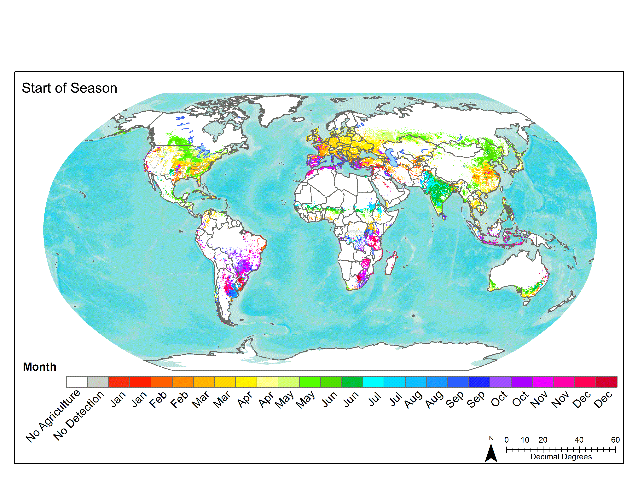
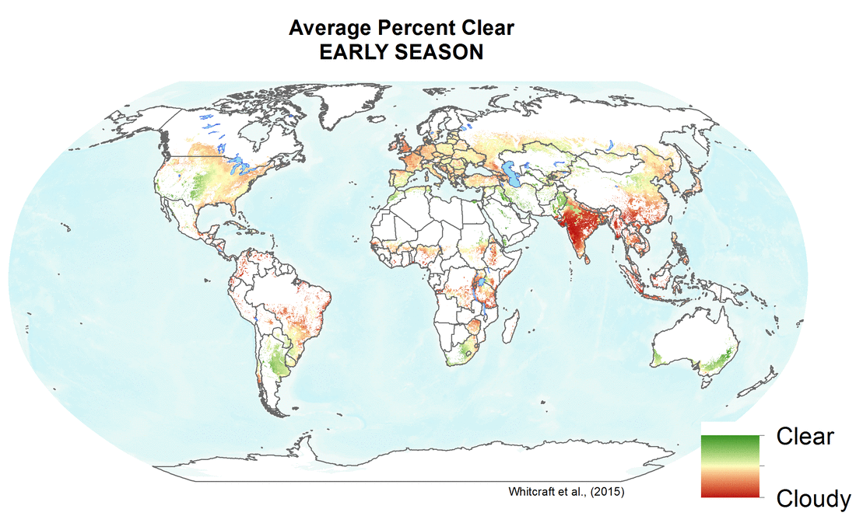
Key Components of Spatially Explicit EO Requirements
GEOGLAM Example
Where to image?
When to image?
How frequently to image?
At what spatial & spectral resolution [instrument type] to image?
‘best-available’ cropland mask + field size distribution (e.g. Fritz et al., 2015)
Agricultural growing season calendars (e.g. Whitcraft et al., 2014)
Cloud cover info (e.g. Whitcraft et al., 2015a)
+
GEOGLAM Requirements Table
(How) can we meet these requirements?
(Whitcraft et al., 2015c)
Notes:
The key components of EO requirements include where to image (as in where the crops of interest are – as indicated by information on crop location and field size distribution), when to image (clarified by when crops are growing), and how frequently/at what spatial resolution to image – determined by the applications of these data (such as crop type and crop condition) and the methods used to derive that information. We combined all of these together for the different requirements in the table, to see where, when, and how frequently we’d really have to image (incorporating cloud cover, as necessary) to meet our EO requirements.

Slide 7
What is the revisit frequency required (RFR) to probabilistically return
a reasonably cloud free clear view within 8 days over croplands of all sizes? (Req #5)
[GSCs] + [crop mask + field size] + [cloud cover impacts + req table]
When?
Where?
Revisit Frequency Required?
Two thresholds of acceptable clarity: ≥ 70% or ≥ 95%
Notes:
At this point, we need to place these requirements in the spatial context – what do we need, when, and where? Again, we’re drawing on the two perspectives of cloud cover

Slide 8
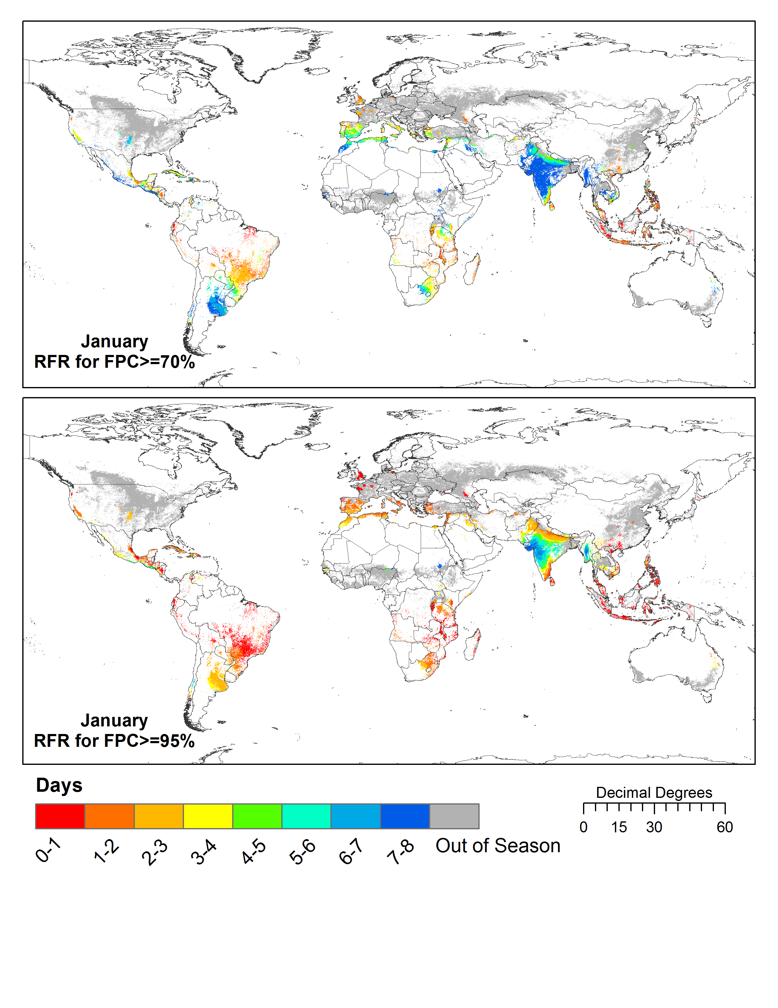
≥ 70% Clear
≥ 95% Clear
Requirement #5
What is the revisit frequency required (RFR) for a view at least 70% or 95% cloud-free within 8 days over in-season global croplands?
Whitcraft et al., (2015a), Rem. Sens.
Notes:
The maps show what revisit frequency would be required to yield a view at least 70% (top) or 95% (bottom) cloud free within 8 days over in season croplands. For 70% clear, 8 days is sometimes sufficient, but generally most areas are in the 3-5 day range. For 95% clear, a much more frequent revisit is required.
- Determining acceptable cloud cover thresholds is a priority research area

Slide 9
(How) can we meet these requirements for
optical, moderate resolution (10-70m)
data within 8 days during the growing
season with current & planned missions?
 | Agency, Satellite, Sensor | Revisit | Spatial Res
L7 | NASA/USGS Landsat 7 ETM+ | 16 Days | 30-60 m
L8 | NASA/USGS Landsat 8 OLI, TIRS | 16 Day | 30-100 m
S2A | ESA Sentinel-2A MSI | 10 Days | 10-20 m
S2B | ESA Sentinel-2B MSI | 10 Days | 10-20 m
R2 | ISRO Resourcesat-2 AWiFS | 5 Days | 56 m
Revisit Capabilities
of the
7 Hypothetical
Constellations
Overpass Analysis:
CEOS SEO
Whitcraft et al., (2015b), Rem. Sens.
Notes:
To evaluate our ability to meet these requirements, Brian Killough’s group at the CEOS SEO (NASA Langley) have utilized their COVE tool to model coincident overpasses of hypothetical constellations of polar-orbiting, optical, moderate resolution (10-100m) systems.
Most of these constellations have a revisit of less than a day to 4.5 days (the two present Landsat are at 8 days almost everywhere) → these are acquisition opportunities, mind you, not necessarily acquisitions… only the 2 Sentinels are claiming to have systematic acquisitions, L7+L8 are close, SLC-off issues not withstanding.
Constellation #7 is what we have now… 8 days in most locations
Constellation #3 is what we could have if AWiFS had systematic acquisition/and we could gain access to the data… 1-3 days
Constellation #5 is what we’ll have in ~2 years when the 2 Sentinel missions are lost (#4 if L7 is still functional at that point) … 1.5-4 days

Slide 10
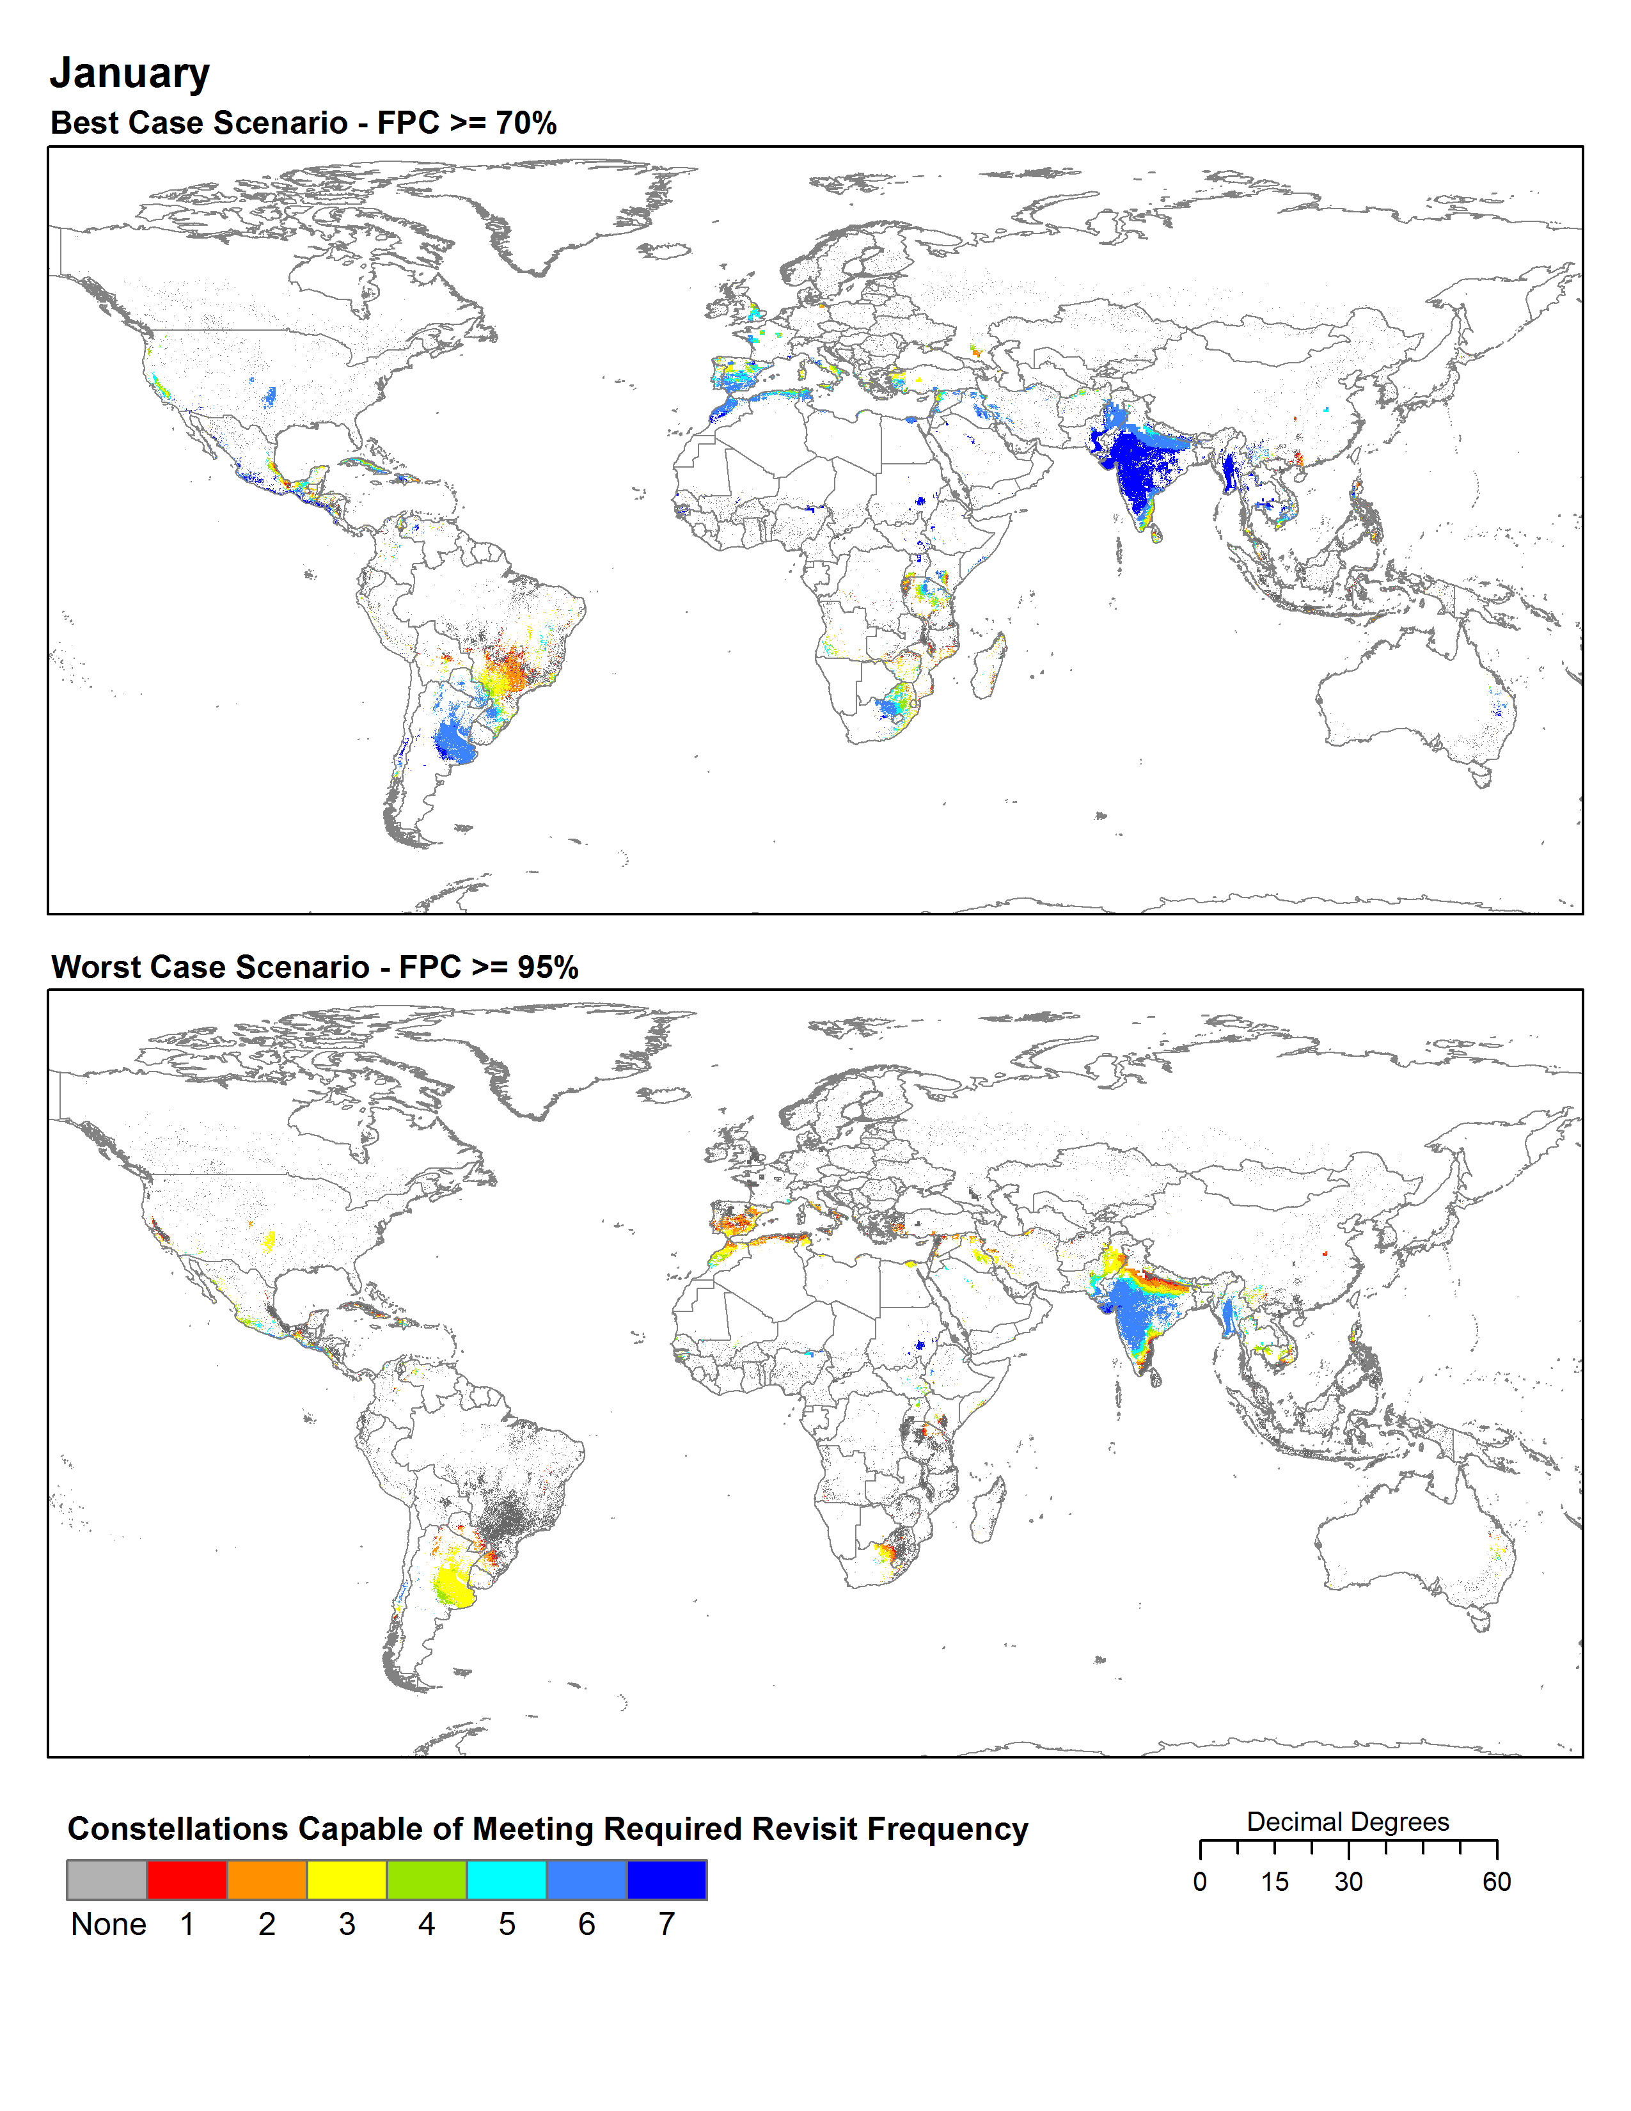
Requirement #5
Meeting the Requirement for a view ≥ 70% Cloud Free within 8 days
(over global in season croplands)
Meeting the Requirement for a view ≥ 95% Cloud Free within 8 days
(over global in season croplands)
# | Satellites
1 | L8, S2A, S2B, R2
2 | L7, L8, S2A, R2
3 | L7, L8, R2
4 | L7, L8, S2A, S2B
5 | L8, S2A, S2B
6 | L7, L8, S2A
7 | L7, L8
Whitcraft et al., (2015b), Rem. Sens.
Notes:
We compared these overpass capabilities with the revisit frequency requirements for moderate spatial resolution within 8 days during the growing season.
Where you see any color, one or more of these constellations can meet the revisit frequency required to meet a 70% clear view (top) or 95% clear view (bottom)
Constellations are ranked – 1 is best performing, can meet everything 2-7 can
Where you see dark blue, all of the constellations can meet it, because 7 has the least frequent revisit
Where you see red, only that constellation (#1 – L8, S2A, S2B, R2) can meet
Where you see gray… none of these constellations can meet. Obviously, because the bottom is a more stringent requirement, you see more gray there.
The plots show you global success rates (where the hypothetical constellations can meet the revisit frequency requirements), and regional success rates for southeast Asia – the point being during certain times, obtaining at least 70% clear is not even possible with these constellations.
The last map shows you the number of months where these revisit frequencies exceed the capabilities of the hypothetical constellations – this is where we will have gaps and need to consider alternative data types (like SAR).

Slide 11
2016-Present GEOGLAM Requirements “Refresh” – Why update?
Evolution of the state of the science (via R&D – JECAM, Sen2Agri, Asia-RiCE, SIGMA)
  Also, new missions (e.g. SAR) and continuity concerns for existing products
Evolution of the state of operational monitoring systems
  What decisions are they empowering? What information do they require?
  What challenges have they encountered with respect to data (access, quality, processing)? Where/when/what are the gaps?
More holistic approach
  “end-to-end” considering data input, access capacity, analytic requirements/capacity, and ties to information delivery.
Also – in 2012, we were constrained by acquisition of data at appropriate resolutions
Now – in 2017, we are in a “big data” world, constrained by access and use (computational environments)

Slide 12
2016-Present GEOGLAM Requirements “Refresh” – Status
6th September – reviewed progress from multiple JECAM site surveys of data used
Take away messages from group discussions:
  1. Need to be crystal clear about what decisions we are trying to support – means starting with the operational user
  2. This will help identify gaps in data acquisition, data provision (e.g. pre-processing), and data access/use (e.g. compute environments and methodologies)
  3. This will drive the R&D agenda and can help identify the true holistic requirements
Holistic requirements:
  EO data characteristics: spatial, spectral, temporal, radiometric
    Work with agencies and related to communities on technical specifics (e.g. BRDF, SNR, scanline, co-registration accuracy, etc.)
    Can also divide into “minimum” and “preferred” system requirements
  Complementary data needed: e.g. in situ and agromet
  How to get it to users to empower the data application to inform decisions
So… GEOGLAM ExCom will be working to plan a workshop of operational users for 2018

Slide 13
So, how might LSI-VC do this for Carbon?

Slide 14
Approach for Carbon
A carbon working group decides on:
  Scope of eventual activity
  Key priority variables with which to start (e.g. Wetlands, Permafrost, Mangroves, Forest…)
    Maybe prioritized by importance to climate change
    Maybe prioritized by gaps in current understanding or observation capacity (e.g. we know that lidar is needed for forest carbon…)
    Maybe prioritized by overlap in terms of EO with GFOI and GEOGLAM
    Maybe prioritized by political mandate
  This group should be composed of EO-users who have a good understanding of informational requirements (what decisions can be empowered through EO?)
    e.g. NASA CMS; JRC (Dowell) and others in the community

Slide 15
Information
Wetland Carbon Flux
Order of operations
CO₂ Emissions
Land Cover Conversion
Methane Emissions
Variable
Data Type 2
Data Type 1
Daily
Data Type 3
7-16 Days
Data Type 4
Cloud Free Frequency
Observations
Data Type 5
Monthly

Slide 16
A Framework for Characterizing and Evaluating Requirements: CARBON
1. Policy Driver
WHY do we need to monitor? → Information needs
  What decisions are supported? → this is the key point of departure
WHAT variables? → Monitoring application’s data needs, to derive Information
WHAT instrument characteristics? → Spatial, Spectral
WHAT purpose? → R&D agenda? Firm operational needs?
WHERE? → Target features
WHEN? → Target periods
HOW OFTEN? → inc. Latency
  Every year? Every 5 years? Every decade?
  How many times per year?
PRIORITY?
2. Tabular Best Practices, Community Insight
Spatial Datasets:
Depends on variables chosen!
3. Tabular
+
Spatial Datasets
4. Mission capacity & gap analyses
Notes:
So back to this slide again – start from the top and move through the list… but the key is making sure you are answering the question being asked.

Slide 17
Some thoughts on the value of this activity for LSI-VC & agencies
Result of Carbon requirements could be a similar table to GEOGLAM’s
  Empowers tabular & spatial representation of common needs
    Where do we have critical gaps across MULTIPLE applications?
    Which observations have a high bang-for-their-buck return on investment?
    Acquisition planning for non-systematic sensors across multiple apps
    Future mission design & justification
Tie-ins to ARD and FDA work → common denominator of sorts
  What standard pre-processed products have utility across multiple activities?
  Are multiple communities experiencing the same gaps?
  Iterative learning from one anothers working groups under LSI-VC umbrella
Carbon Priority Products/Variables
Priority

Slide 18
Questions? Comments?
Let’s Discuss!
Feel free to contact me: akwhitcraft@geoglam.org

