Slide 1
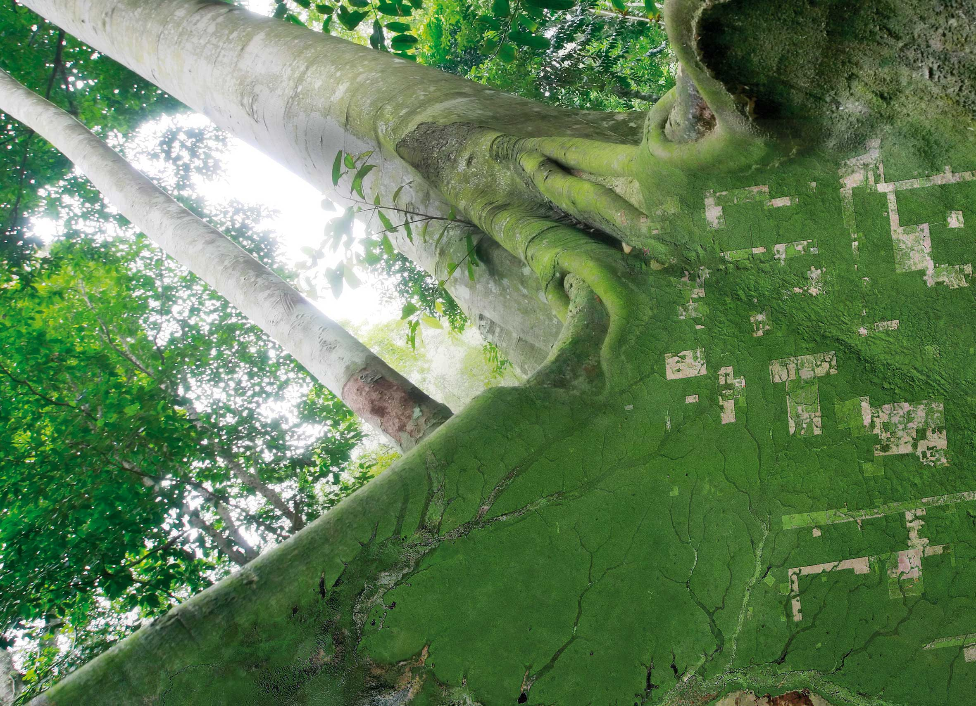
Joint LSI / SDCG / GEOGLAM Review of Global Data Flows Study
ESRIN, 6 September, 2017

Slide 2
History
GDF study initiated 2015; completed 2016
Basic Premise:
With data supply strong, data flow is arguably now the top priority role for SDCG
GDF study pre-empted the broader FDA strategy which continues to evolve
Brief review of conclusions and recommendations of relevance to joint meetings

Slide 3
Study Provenance and Trajectory
SDCG 2016-2018 Work Plan – Outcome 2
# | Outcome | 2016 | 2017 | 2018
2 | Efficient and effective global flows of data | Complete global data flow study in cooperation with USGS, ESA/EC and SDCG Exec | Implement processes and tools for efficient and effective global flows of data | Efficient and effective global flows of data for development of GFOI standard products

Slide 4
Conclusions Highlights (1/2)
Increase in satellite data volumes resulting from new capacity is outstripping the capacity of the national data handing infrastructure of GFOI many countries.
BAU approach is considered unsustainable, and in general a move towards centralized data handling is viewed as a potential solution to make satellite-data support sustainable.

Slide 5
Conclusions Highlights (2/2)
Increased volumes and number of data sources require more effective data discovery and access tools.
Cost/burden of preprocessing data needs to be minimized to foster uptake. Agency-backed ARD products and tools are steps in that direction.
Mechanisms will vary, but quality of ARD products needs to be assured by agencies.

Slide 6
Recommendations
Three groupings
Space Data Providers ← most overlap here
Capacity Building Partners
Users and Countries
Joint meeting topic overlap

Slide 7
ARD, Interop, Pilots, Cloud
Widely accepted ARD defn’s and specs
Promote community uptake of ARD
LS-8 and S-2 interoperability
Pilots to exercise enabling elements
Support ARD for CB and tech partners
Support to ongoing pilots
Role of tech giants i.e. cloud store, compute
Promotion and communication of ARD

Slide 8
Recommended Reading!
“Seminal” Jan 2008 article on how ”the internet” started to come to terms with “free”
“When copies are free, you need to sell things which can not be copied.”
Eight Generatives Better Than Free: Immediacy, Personalization, Interpretation, Authenticity, Accessibility, Embodiment, Patronage, Findability
http://kk.org/thetechnium/better-than-fre/

Slide 9
Questions?

