Slide 1
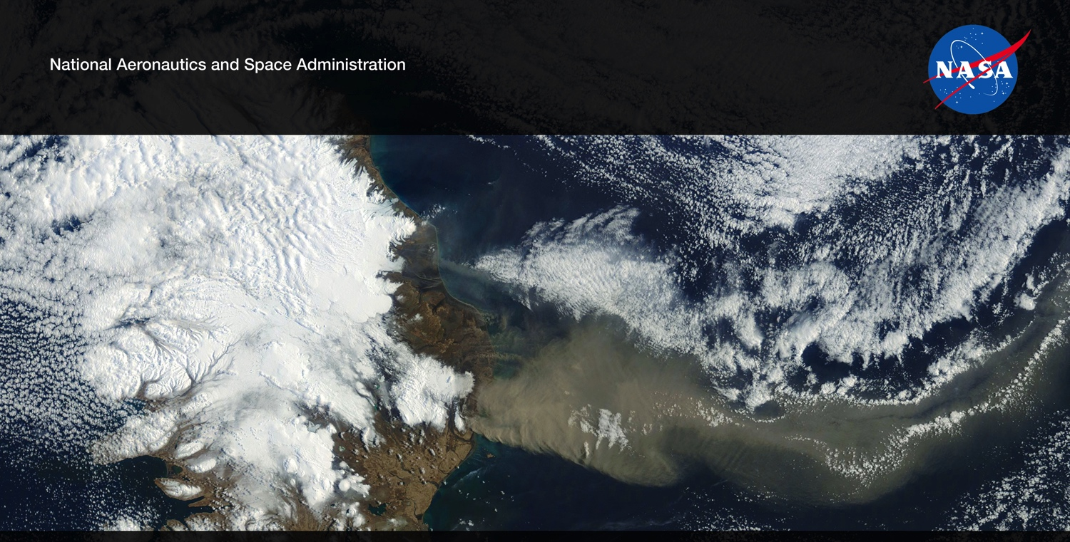
Future US Land Imaging
Jeffrey Masek, NASA GSFC
Harmonized Landsat/Sentinel-2 (HLS) Project
Jeff Masek, Junchang Ju, Eric Vermote, NASA GSFC
Martin Claverie, Jean-Claude Roger, Sergii Skakun, University of Maryland
Jennifer Dungan, NASA ARC
CEOS Joint Meeting, Frascati, September 2017
NASA Agency Update – CEOS LSI-VC-2
July 20-22, 2016
Dave Jarrett, NASA HQ
Jeff Masek, NASA GSFC

Slide 2
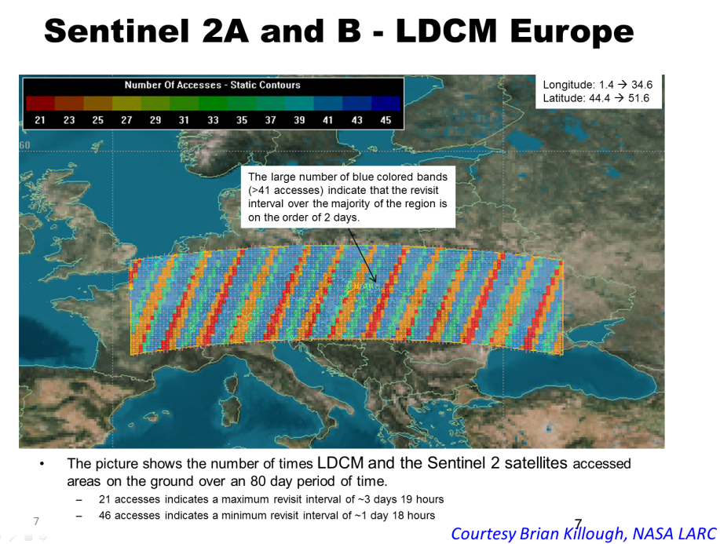
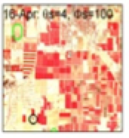
Harmonized Landsat Sentinel-2 (HLS) Project
Merging Sentinel-2 and Landsat data streams can provide 2-3 day global coverage
Goal is “seamless” near-daily 30m surface reflectance record including atmospheric corrections, spectral and BRDF adjustments, regridding
Project initiated as collaboration among GSFC, UMD, NASA Ames

Slide 3
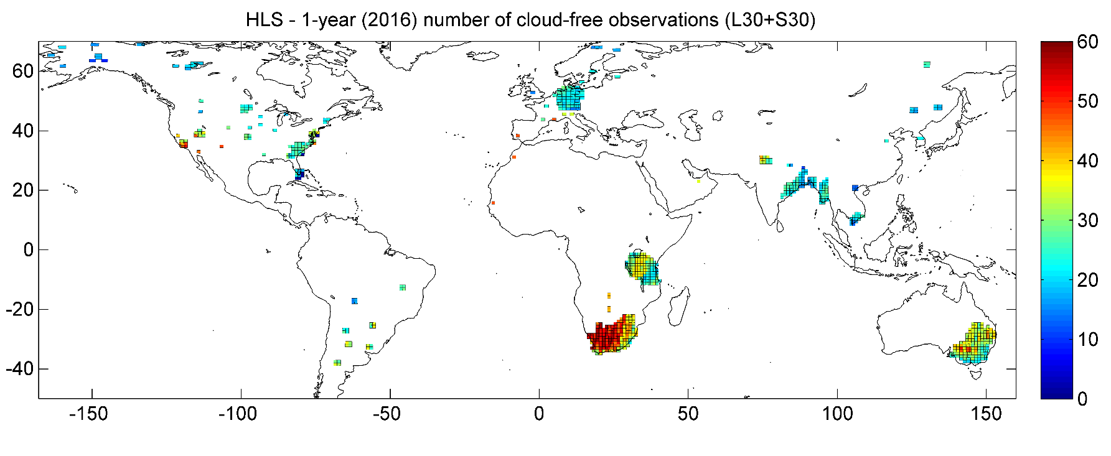
HLS Test Sites
69 Test sites (45 from NASA MuSLI team)
783 MGRS tiles
>7.5 million sq. km2
Landsat-8 data set: 147k products From Mar-2013 to Dec-2016
Sentinel-2 data set: 47k products From Jun-2015 to Dec-2016
Alaska / NW Canada: 16
NE Asia: 11
Europe: 15
(w/o Germ.)
Germany: 62
S Asia: 122
Africa: 6
(w/o SA and TZ)
North America: 95
Tanzania: 121
South America: 28
South-Africa: 166
SE Australia: 141

Slide 4
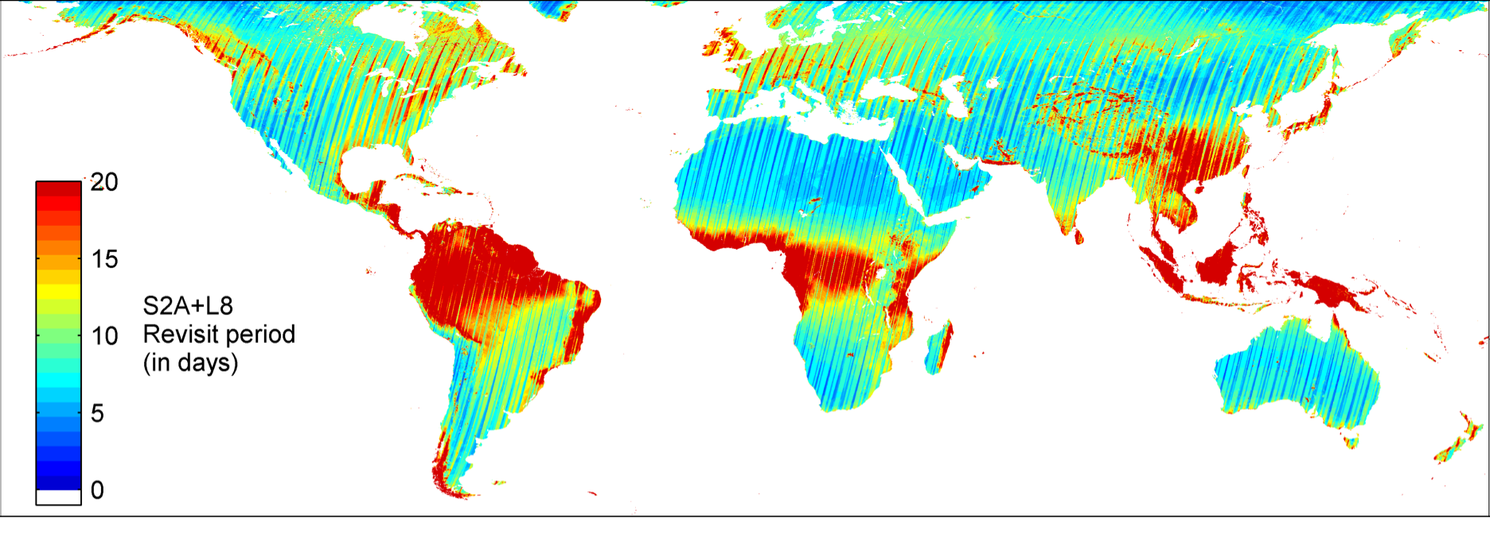
Expected Cloud-Free Observations
Sentinel-2a + Landsat-8 revisit w/ cloud cover from MODIS CMG
18
36
Observations/yr
72

Slide 5
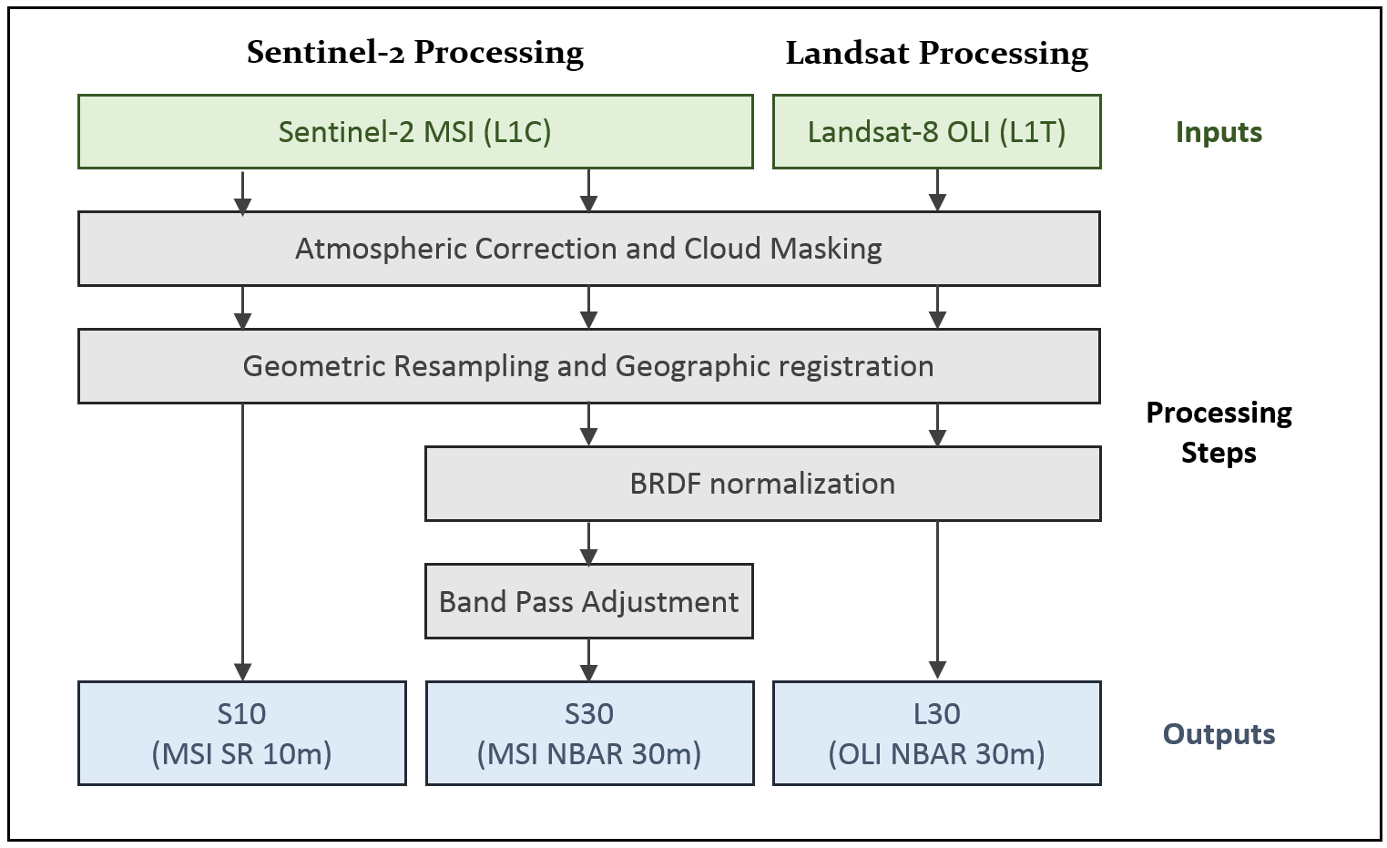
HLS Algorithm Flow
Atmospheric Correction | LaSRC/6S approach (image-based aerosol) | Vermote et al. (2016)
BRDF | corrected to nadir view / latitude-dependent solar angles using fixed coefficients | Roy et al. (2016)
Spectral bandpass | Linear regression using global training set from EO-1 Hyperion | Claverie et al., (in review)
Cloud/shadow mask | Landsat: output from LaSRC; S2: Boston University Fmask algorithm | Zhu et al. (2015)

Slide 6
Results

Slide 7
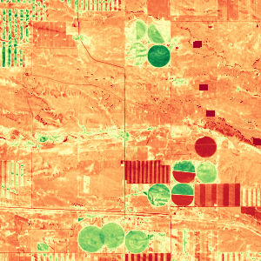
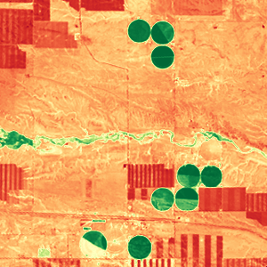
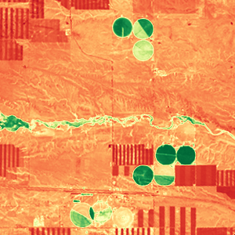
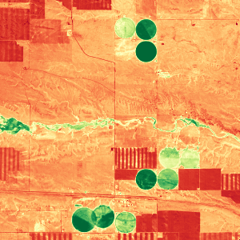
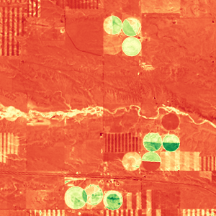

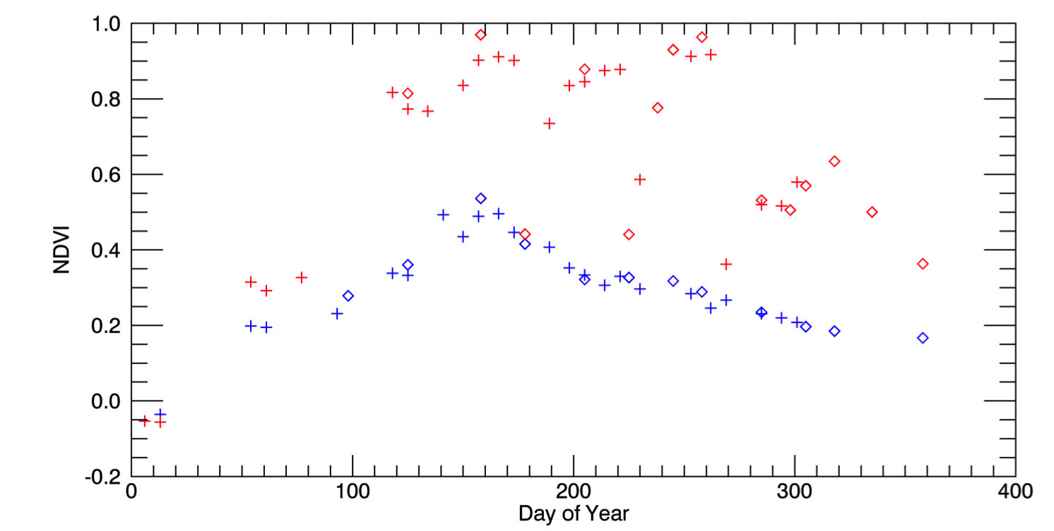
Harmonized Landsat / Sentinel-2 Products
Laramie County, WY
May 4, 2016 (S2)
Aug 8 (L8)
Aug 17 (L8)
Sep 1 (S2)
Oct 20 (L8)
3km
0.1 NDVI 0.9
Seasonal phenology (greening) for natural grassland (blue line) and irrigated alfalfa fields (red line) near Cheyenne Wyoming observed from Harmonized Landsat/Sentinel-2 data products. The high temporal density of observations allows individual mowing events to be detected within alfalfa fields. HLS Products available from https://hls.gsfc.nasa.gov
Sentinel-2
Landsat-8
+
Alfalfa
NDVI
mowing
Grassland
Day of Year

Slide 8
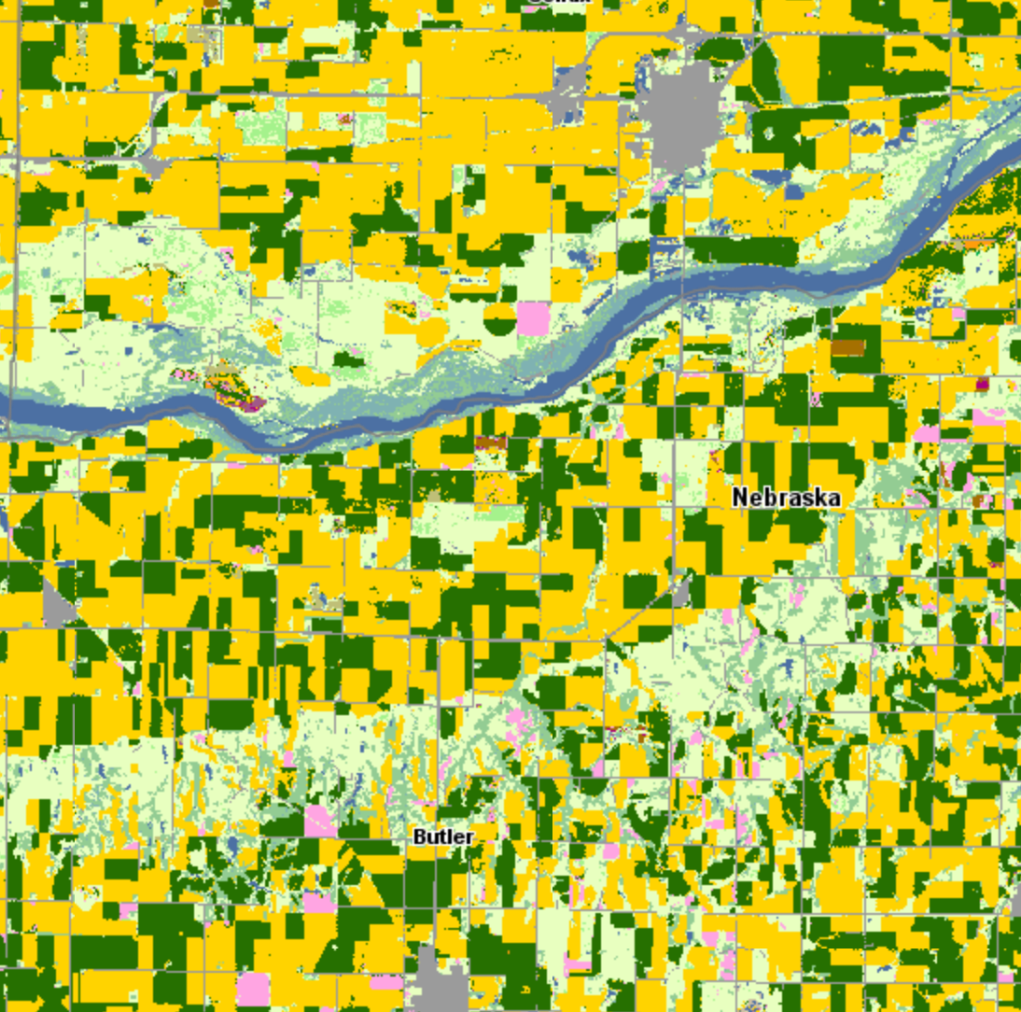
55
Schuyler,
Nebraska
USDA 2016 Cropscape
5km

Slide 9
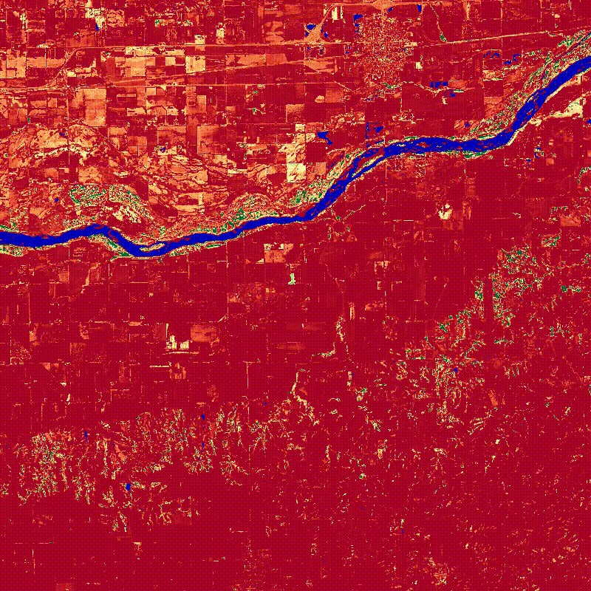
Schuyler,
Nebraska
HLS NDVI
Filtered, interpolated to daily time step
1.0
0.0

Slide 10
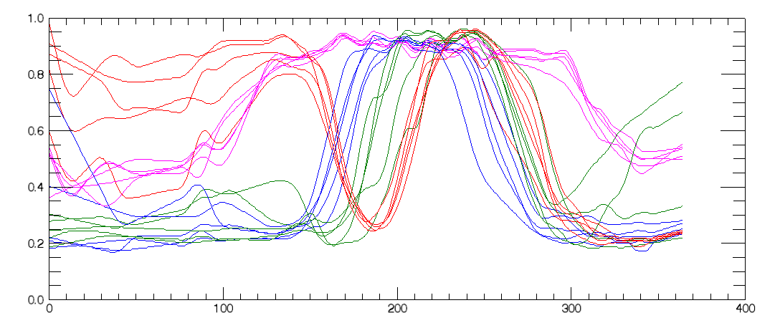
Crop NDVI Phenology
Delaware, USA - crop type examples from USDA Cropland Data Layer (CDL)
HLS data interpolated and smoothed (10-day window)
NDVI
DOY (2016)
Corn
Soybean
Double (Wheat/Soy)
Deciduous Forest

Slide 11
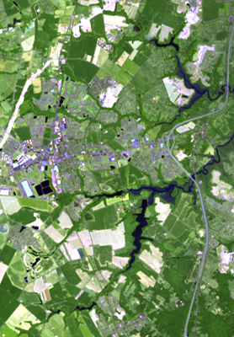
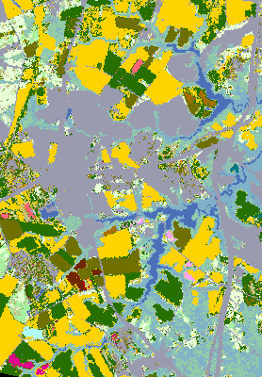
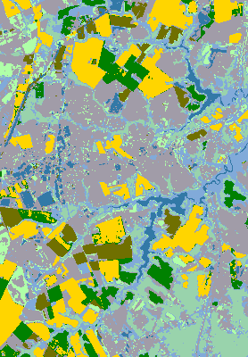
Crop Classification
Supervised classification (SVM) of HLS NDVI trajectories in Delaware, using USDA CDL as training
RGB image
USDA CDL
HLS Classification
4km
water
soybean
wetland
developed
corn
wheat/soy
forest

Slide 12
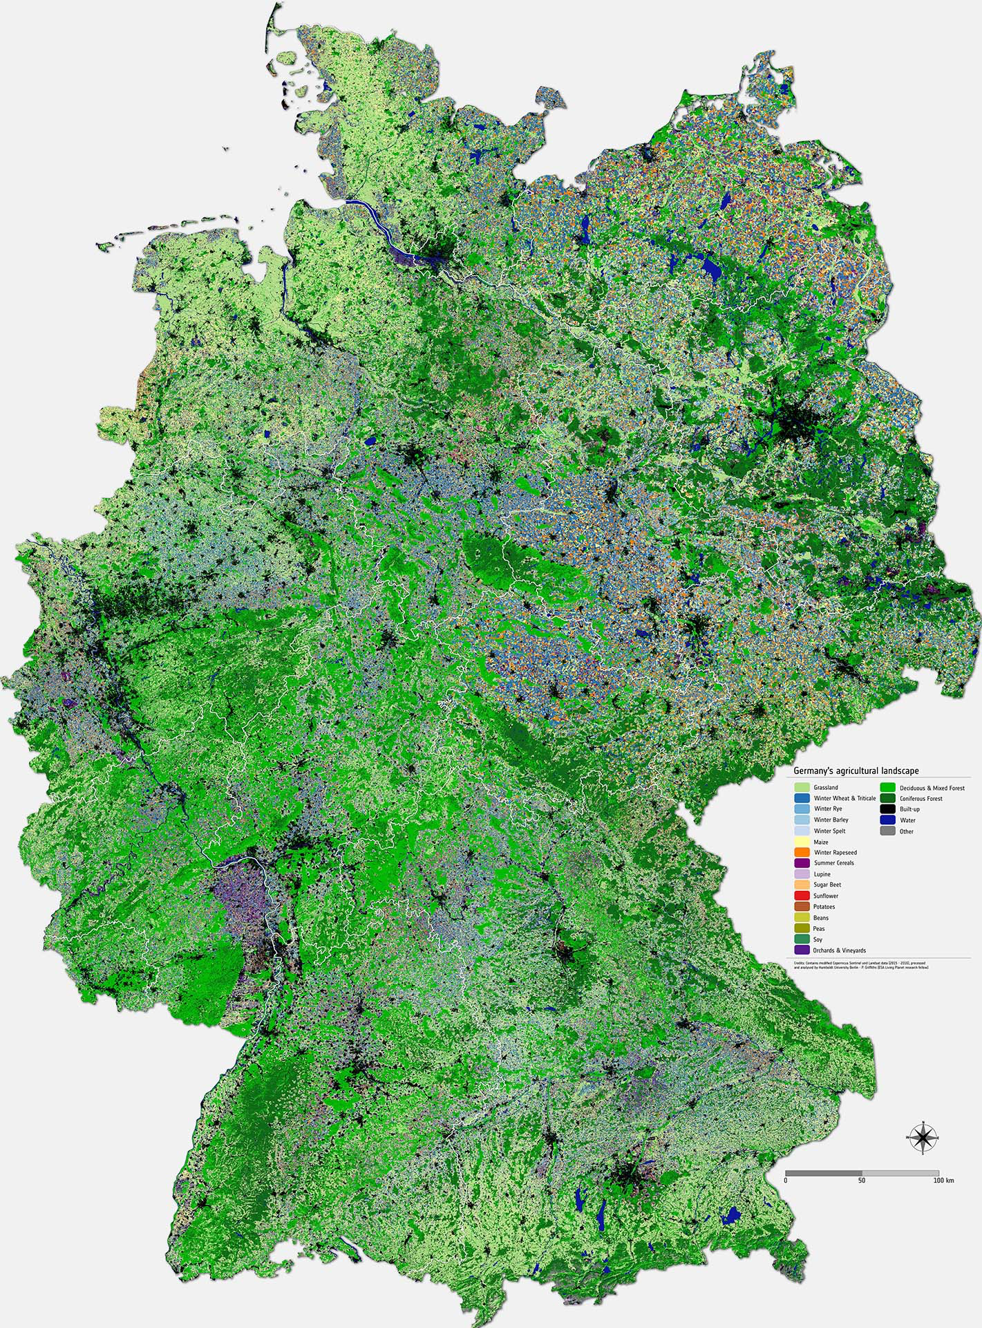
Crop Type Map for Germany
Crop type map derived from analysis of HLS imagery by Humboldt University/P. Griffiths (ESA Living Planet Research Fellow)
Based on data from Oct 2015-Dec 2016
21 land cover classes, 15 crop types
Overall accuracy 76%, several crop types >90% accuracy
http://www.esa.int/spaceinimages/Images/2017/08/Mapping_Germany_s_agricultural_landscape

Slide 13
QA/QC & Validation
We distinguish between:
Product QA/QC – should the granule (or pixel) be flagged as of low or questionable quality?
Validation or Uncertainty Estimation – what is the uncertainty (bias, precision) of any observation relative to a standard?
HLS currently implements Product QA via three methods:
Comparison with daily MODIS CMG NBAR products
  Dataset & granule level metric
  Used to eliminate HLS granules with high number of discrepant 0.05° CMG reflectance values
Per-pixel time series smoothness
Other per-pixel attributes (cloud mask, shadow mask)

Slide 14
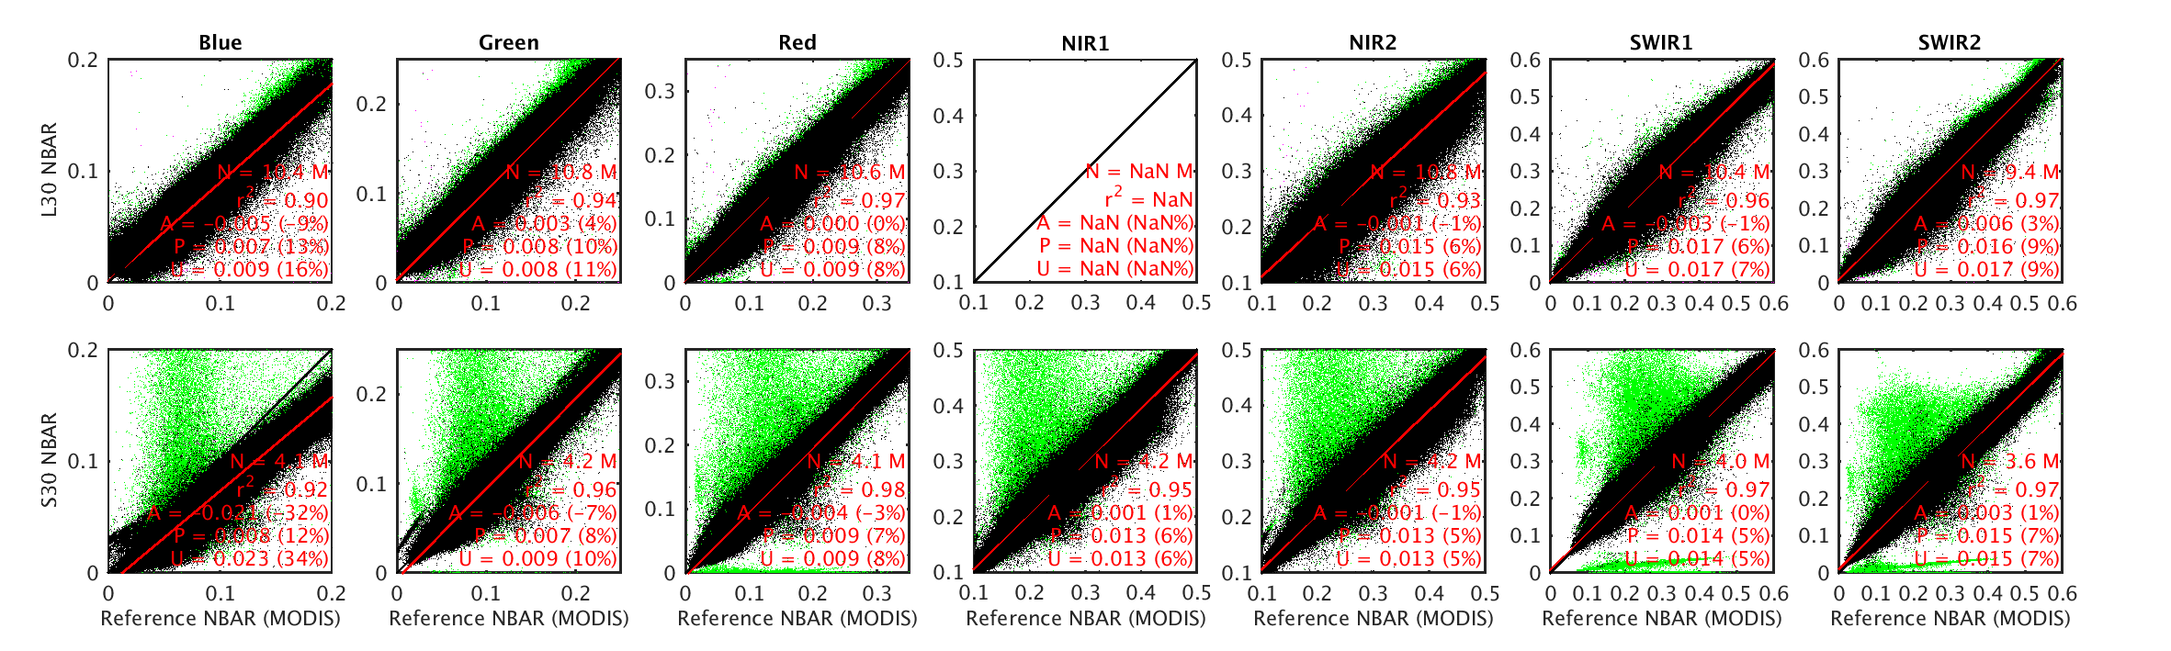
QA: HLS v1.3 MODIS CMG Comparison
~1% S2a tiles rejected due to cloud mask

Slide 15
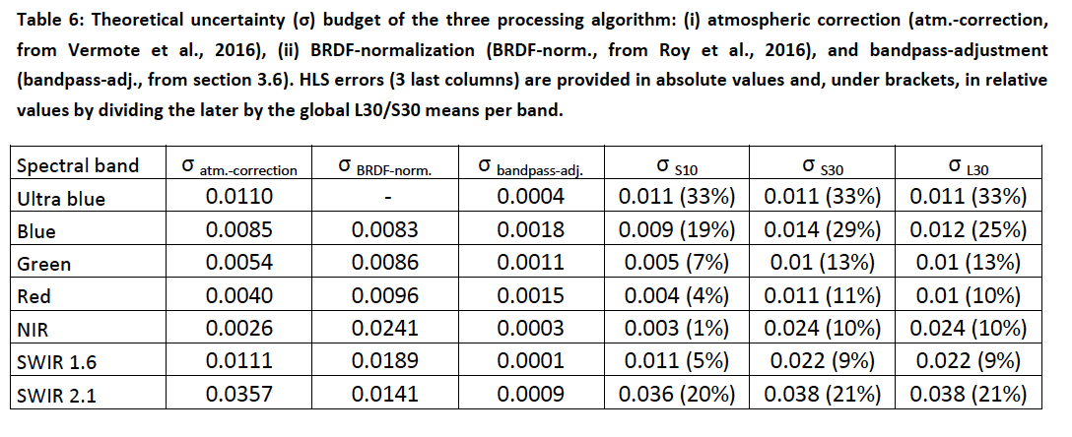
HLS Uncertainty Estimation
Component “roll up” uncertainty budget based on:
LaSRC/6S atmospheric correction results (Vermote et al., 2016)
Roy et al (2016) BRDF error relative to MODIS MOD43
Calibration uncertainties
Spectral band regression tree errors
Note: BRDF uncertainty includes errors due to atmospheric correction as well, and thus could be overestimated.

Slide 16
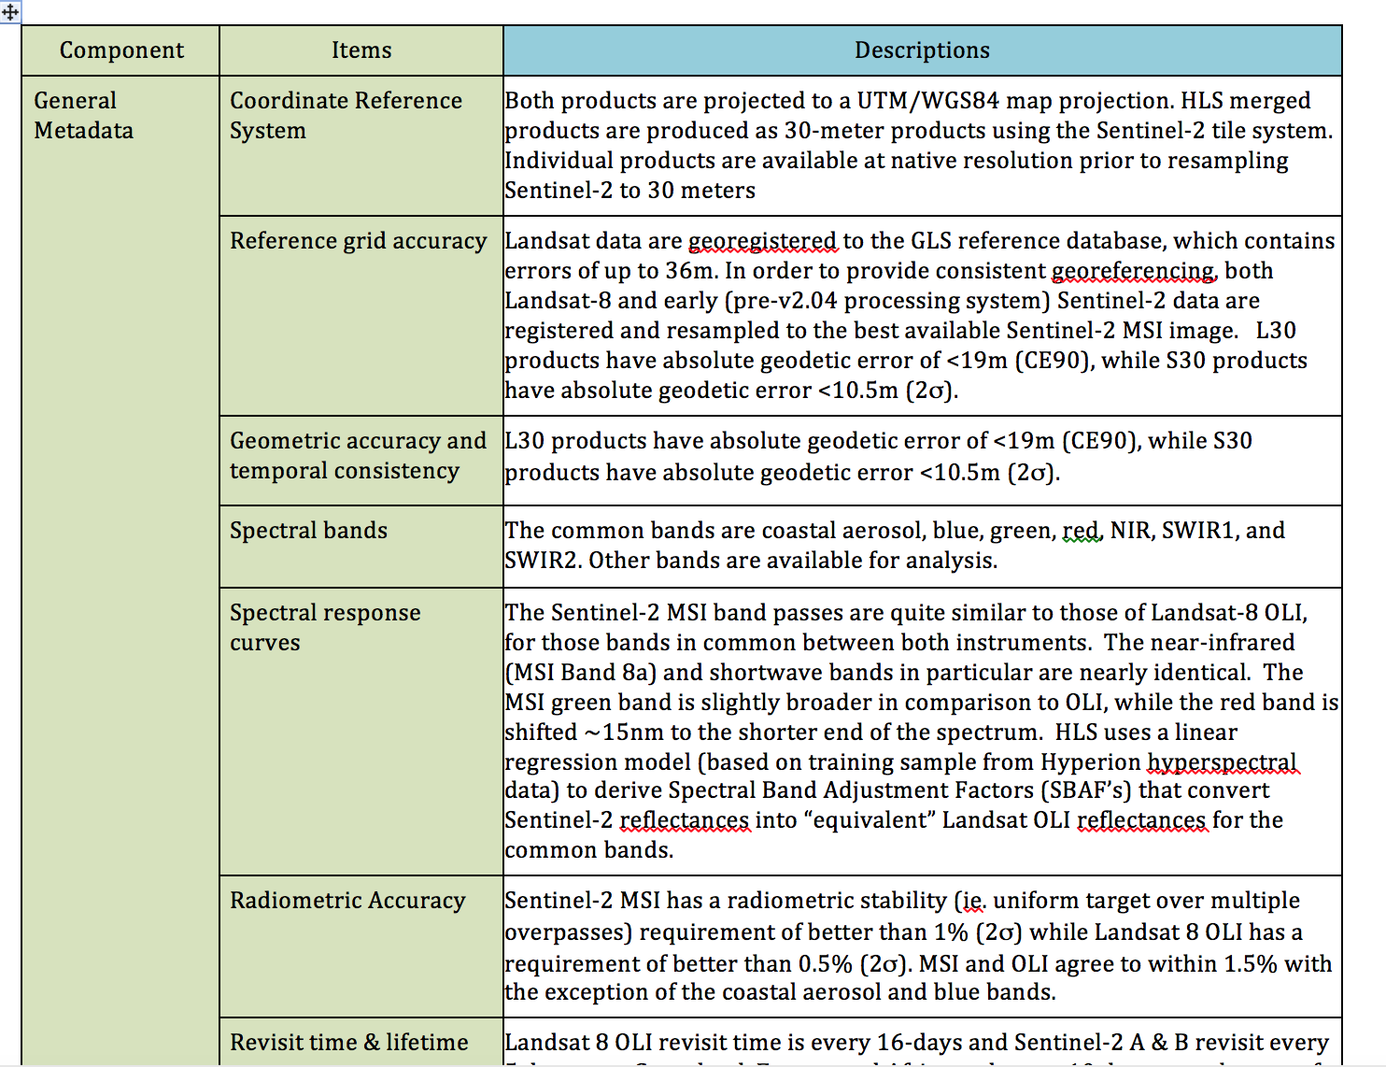
HLS Crosswalk to MRI Framework
Included as Appendix to Draft MRI Framework Document

Slide 17
Lessons Learned / Issues
NASA/USGS/ESA collaboration on Landsat & Sentinel-2 radiometric calibration extremely valuable
Geolocation errors
  Landsat GLS Errors
  S2 yaw problem (pre-2.04 processing)
  HLS co-registers all data to a “reference” MSI image (~GRI)
S2 cloud masking problematic without thermal IR
  ACIX extension to cloud masks will be useful
Validation framework for surface reflectance products is weak
  In-situ data lacking
  BRDF-adjustments to NBAR may confound problem

Slide 18
Status and Future Directions
Version 1.3 released July 2017
  Paper submitted to RSE special issue on Sentinel-2 Applications (Claverie et al, in review)
Version 1.4 to be released end-2017
  Wall-to-Wall North America + global test sites
  Incorporates Collection 1 Landsat and S2b data
  < 7 day latency
  Processing & data access via Amazon Web Services (AWS)
2018: global processing?

Slide 19
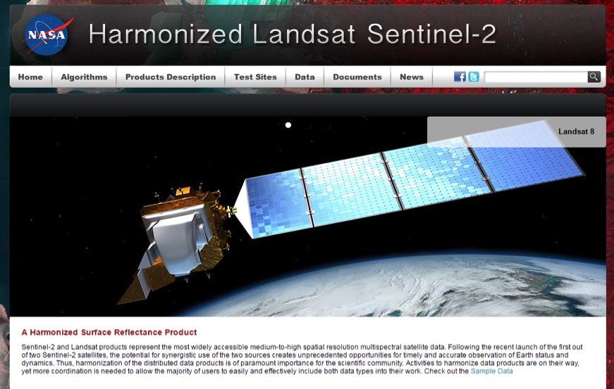
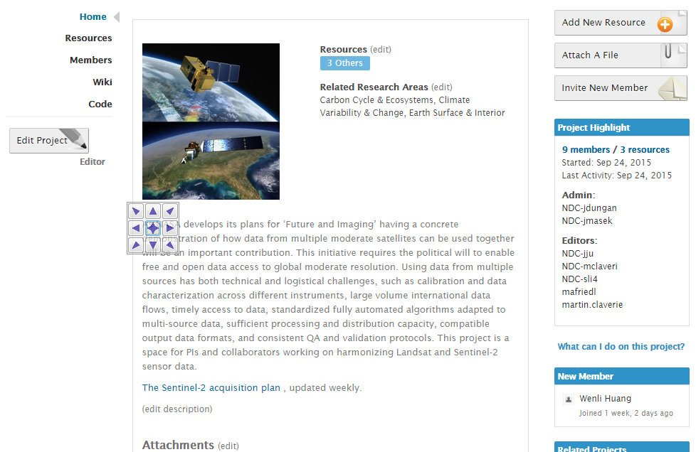
Websites and Public Interface
HLS website
NEX project page
https://hls.gsfc.nasa.gov
Public access
Sample data available (via FTP)
Algorithm & Product descriptions
Request new sites
https://nex.nasa.gov/nex/projects/1371
Registered user access
All HLS data available
Documents (slides, user guides)

Slide 20
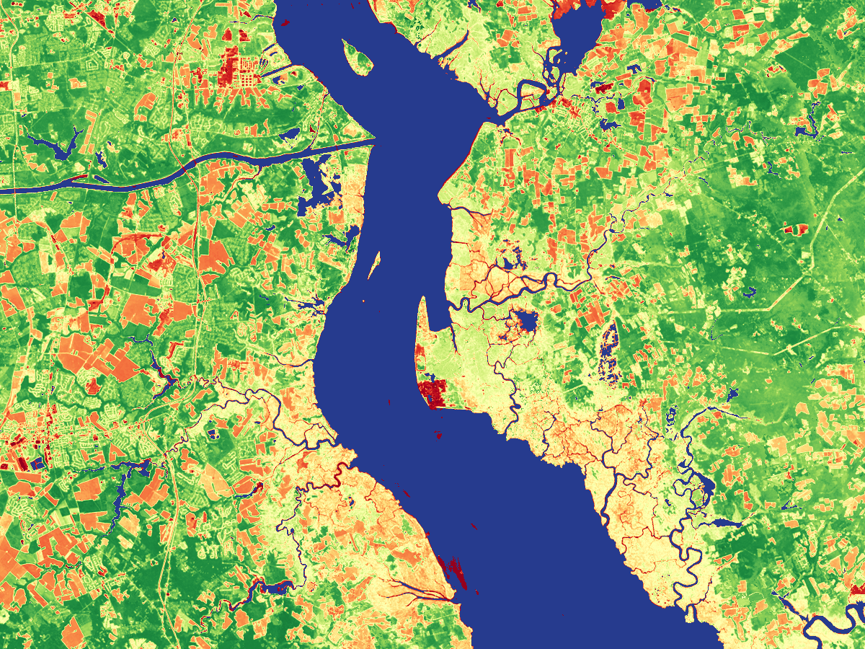
Thank You
Delaware / New Jersey

Slide 21
Backup

Slide 22
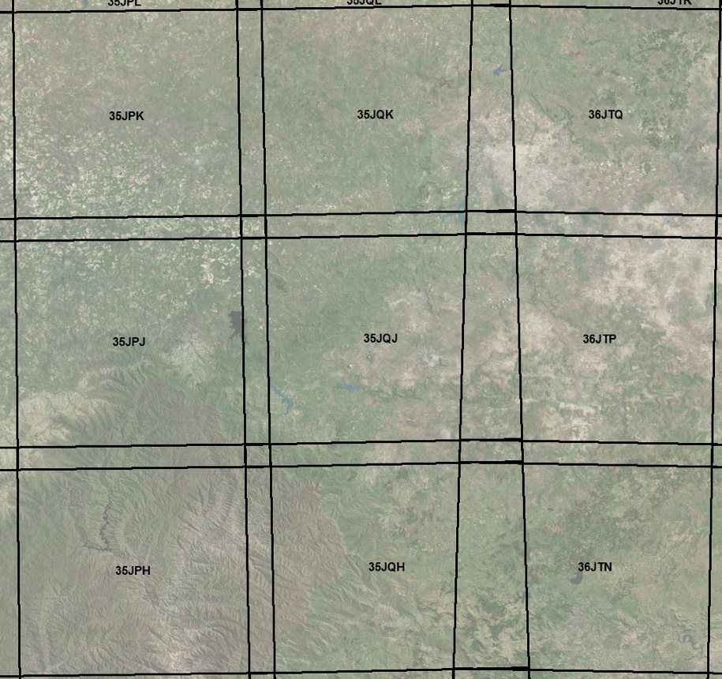
HLS Products Specification
All 4 products are aligned on the S2 Tiling system (Military Grid Reference System), following UTM zones + 3 letters defining a grid
Tiles are 110km square with 10km overlap for same UTM zone adjacent tiles
S10
Spatial: 10m, 20m, 60m
Spectral Bands: All MSI
Temporal: All Sentinel-2 L1C granules
NBAR: No
L30
Spatial: 30m
Spectral Bands: All OLI
Temporal: All Landsat-8 L1T granules
NBAR: Yes
S2 Tiles system
109,080m
S30
Spatial: 30m
Spectral Bands: OLI-like + MSI Red Edge
Temporal: All Sentinel-2 L1C granules
NBAR: Yes
M30
Spatial: 30m
Spectral Bands: OLI-like + MSI Red Edge + TIRS TOA
Temporal: 5-day “best pixel” based on min AOT
NBAR: Yes
Overlap area
UTM zone 35
UTM zone 36

Slide 23
HLS Algorithm Flow
Landsat-8 (L1T)
Geographic registration
Sentinel-2 (L1C)
Atmospheric Correction
Atmospheric Correction
S10
(MSI SR 10m)
Geometric Resampling
Offset
coefficients
Geometric Resampling
L30
(OLI SR 30m)
BRDF Adjustment
BRDF Adjustment
Temporal Compositing
Band Pass Adjustment
S30
(MSI NBAR 30m)
M30
(5-day composite NBAR)
Algorithm | Current (V1.2) | Other Options
Geographic registration | AROP (Gao et al. 2009, JARS) | -
Atmospheric Correction | OLI and MSI: Landsat-8 6S algorithm | CNES MACCS
Cloud/Shadow Mask | OLI: Landsat-8 6S algorithm output MSI: BU MSI Fmask | CNES MACCS
BRDF Adjustment | Fixed BRDF (Roy et al. 2016, RSE) | Downscaling MODIS BRDF + Fixed BRDF as Backup
Band Pass Adjustment | Fixed, per-band linear regression | Regression-tree (based on spectral shape)
Temporal Compositing | TBD | -

Slide 24
HLS Algorithms
Atmospheric Correction
  Uses operational Landsat LaSRC approach (Vermote et al., 2016)
  Based on 6S radiative transfer model w/image-based aerosol retrieval
BRDF (view/solar angle) adjustment
  Uses Roy et al (2016) fixed BRDF shape
  Adjusted to nadir view and fixed, latitude-dependent solar angle (aka NBAR)
Spectral adjustment uses linear regression based on Hyperion hyperspectral images
Cloud mask
  Landsat: output from LaSRC atmospheric correction
  Sentinel-2: Boston University Fmask (non-TIR)

Slide 25
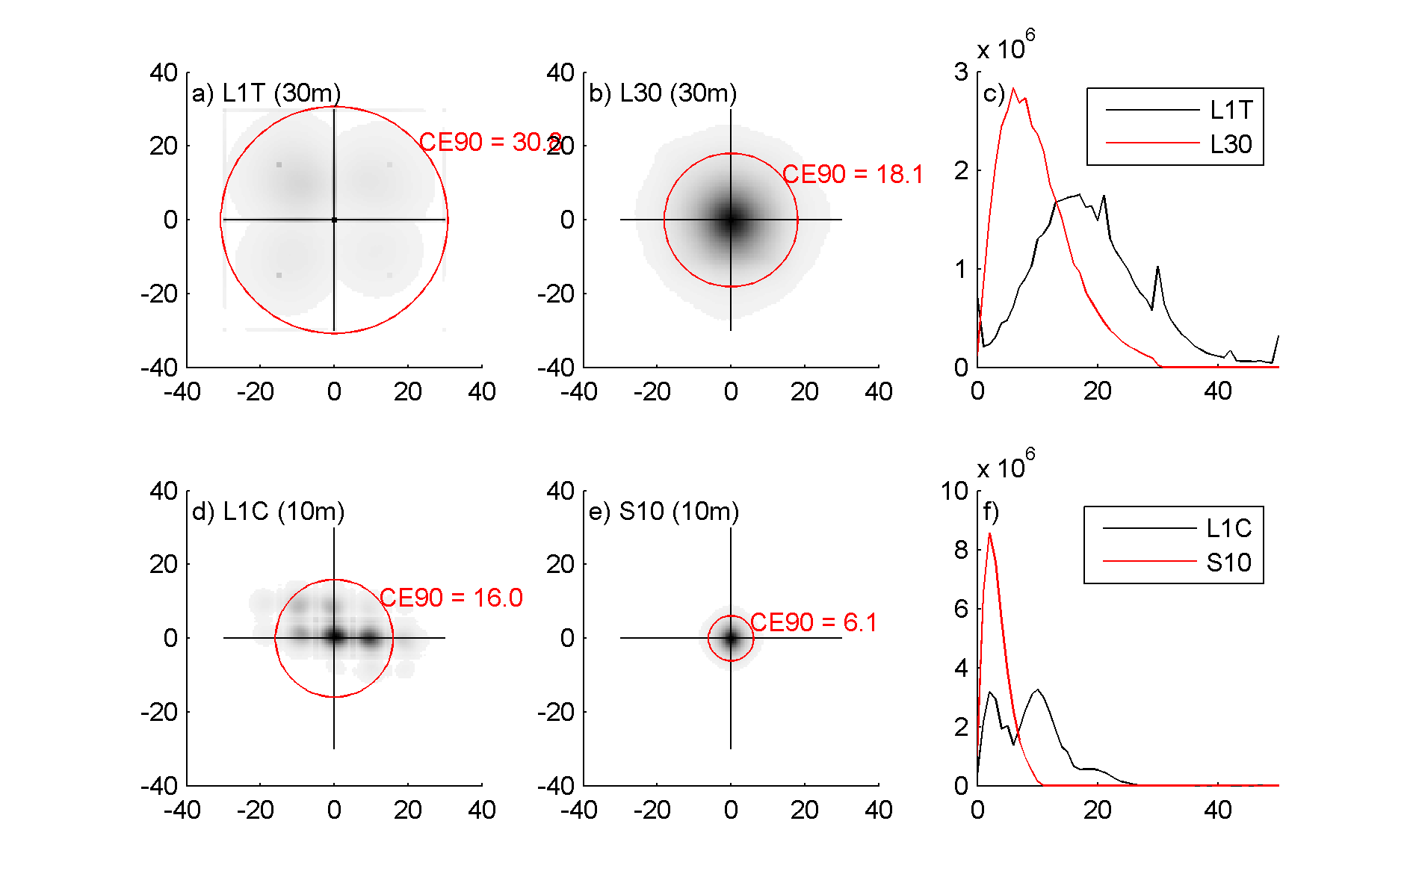
S2 / L8 Registration Issues
Mis-registration between Landsat and Sentinel-2
  Up to 35m mismatch due to some areas of relatively poor Landsat ground control (Storey et al, 2016, RSE)
  USGS will improve Landsat ground control in ~2018-19
  For now, users can use automated cross-correlation algorithms to co-register and/or resample L8 to S2.
Mis-registration among early Sentinel-2
  S2a data (processed before June 2016) showed relative misregistration between adjacent orbits due to error in yaw processing
  Corrected with Sentinel-2 v2.04 processing
HLS uses a single Sentinel-2 image as reference for each time series & AROP to co-register
Improvement in Landsat L30 registration after referencing to MSI

Slide 26
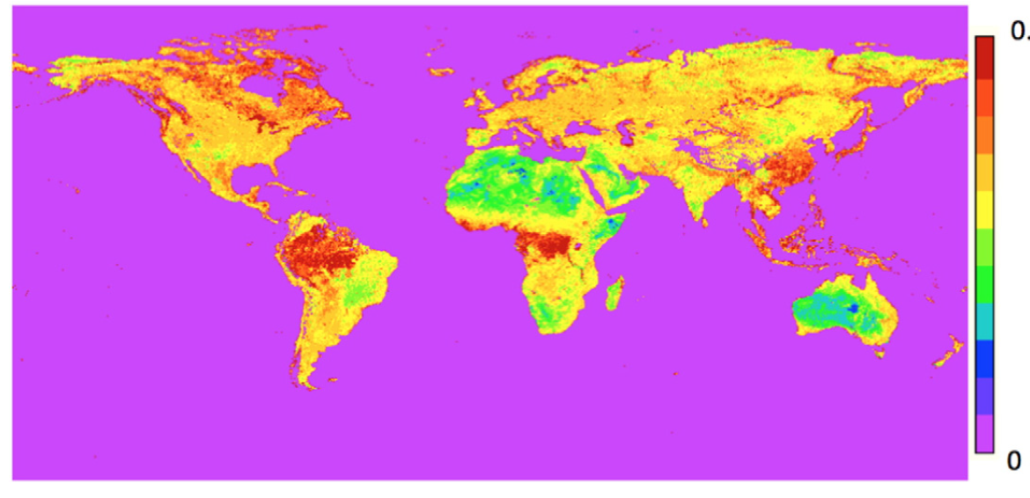
LaSRC Atmospheric Correction
Similar to MODIS Collection 6 approach & previous LEDAPS
Uses 6S radiative transfer model to correct for scattering (Rayleigh, Mie) and gaseous absorption
  MODIS water vapor
  NCEP GDAS ozone and surface pressure
  Aerosol optical thickness derived via fixed red/blue ratio observed in MODIS SR for every land location
Red/Blue ratio derived from MODIS (Vermote et al., 2016, RSE)

Slide 27
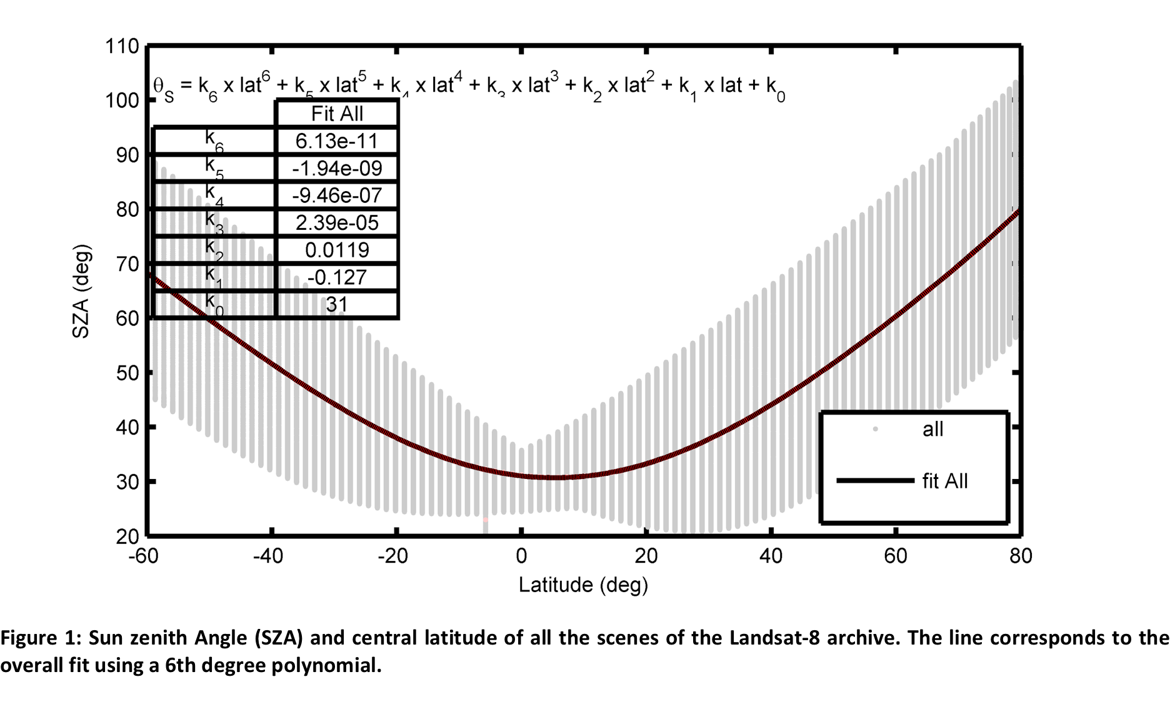
BRDF Correction
Uses “fixed” coefficients of Roy et al (2016)
  Over narrow view angles, little improvement with using local or landcover-dependent kernel
Corrects to a fixed view (nadir) and solar (latitude-dependent) solar elevation
  Similar to MODIS NBAR but variable solar elevation

Slide 28
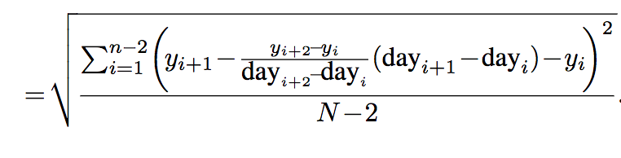
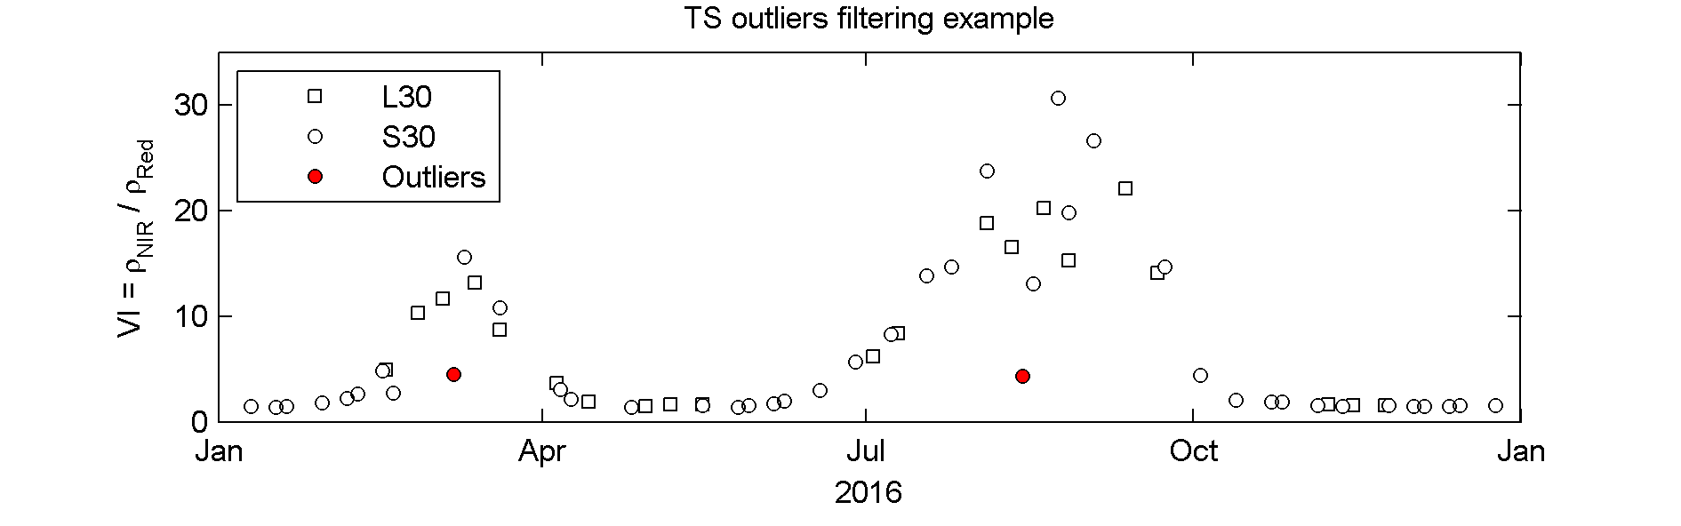
HLS QC: Temporal Smoothness
Approach based on variance among cloud-free VI triplets (Vermote et al., 2009)
Per-pixel metric calculated from median of all triplets (N>6) in time series
VI (y)
Noise
day

Slide 29
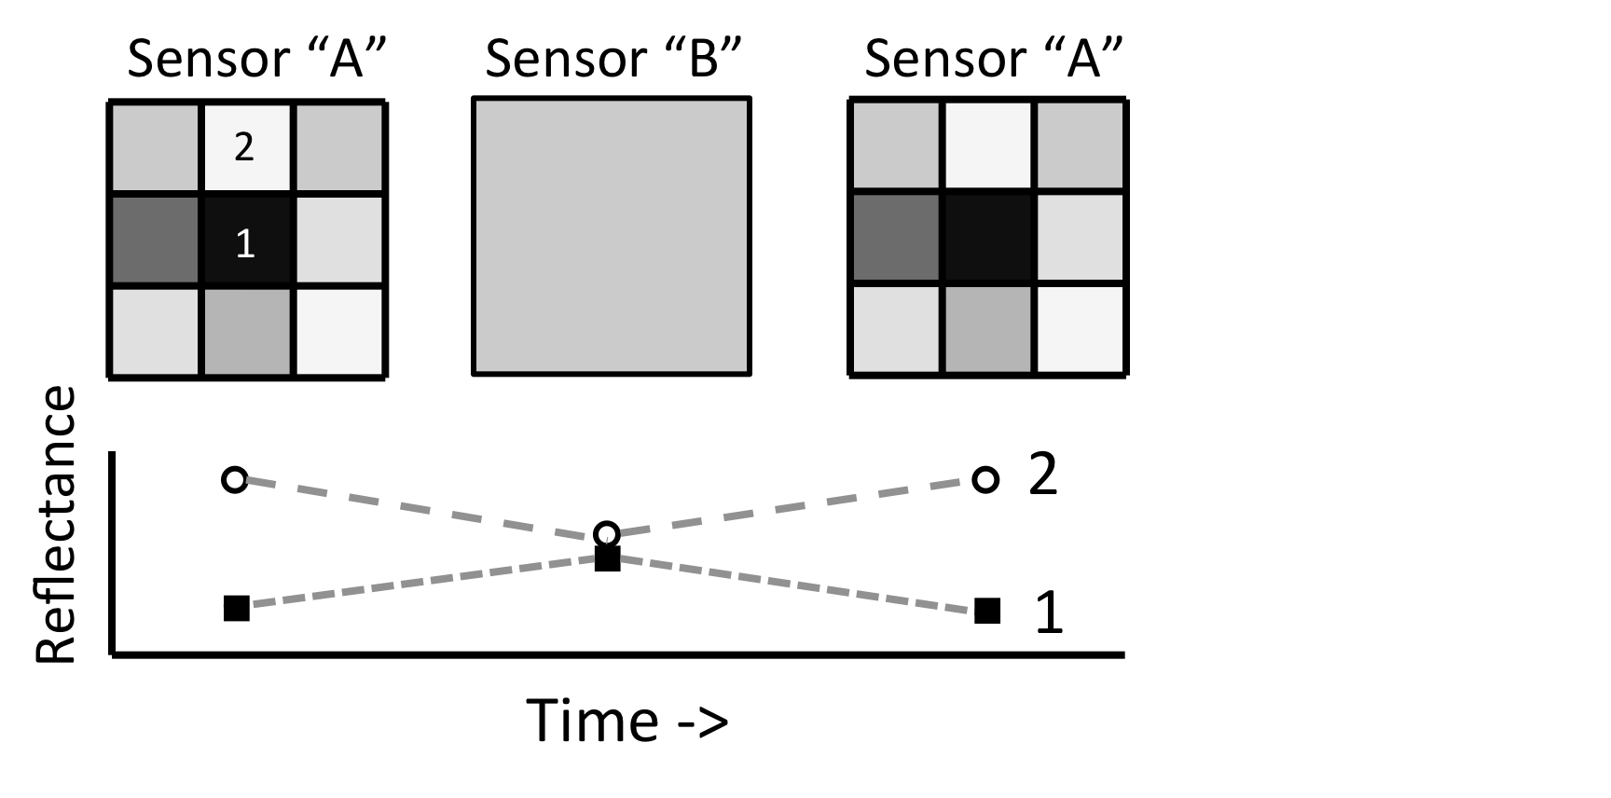
Why 30m HLS?
Example of reflectance time series from fine-resolution sensor (Sensor A) and coarser-resolution sensor (Sensor B). Over heterogeneous areas, the native-resolution time series shows temporal variability for pixels 1 and 2 even though the landscape is not changing, simply due to the fact that Sensor B averages the spatial response. Instead, HLS elected to average Sentinel-2 MSI data to the coarser, 30m resolution of Landsat-8 OLI.

