Slide 1
LSI-VC Unified Approach to User Requirements
Committee on Earth Observation Satellites
LSI-VC-3
Session 10.28
Frascati, Italy
20-21 March 2017

Slide 2
LSI-VC Objective
Facilitate coordinated and optimized land surface imaging contributions from CEOS agencies to enable access to fundamental measurement products in support of confirmed/validated requirements linked to adopted CEOS priorities.
Drawing together validated requirements identified by downstream user communities to:
Identify opportunities to better optimize, and increase resilience of, land surface imaging programs
Identify current and potential data gaps (both in terms of geographic and temporal coverage, and in land monitoring requirements)

Slide 3
LSI-VC Requirements Approach
LSI-VC exploring adoption and generalization of the CEOS ad hoc Working Group on GEOGLAM approach to apply to other thematic areas
Ensuring capture of both observational requirements and downstream product/service requirements
Utilize existing ad hoc teams for eliciting requirements from communities of practice and augment as needed
Look at CEOS Carbon Strategy for pilot implementation

Slide 4
GEOGLAM Process
Notes:
Identifying target products and tracing bact to the types of mission that meet it. We want to make this generic to apply to various areas

Slide 5
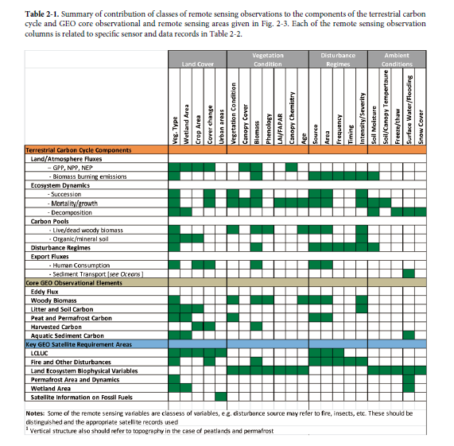

Slide 6
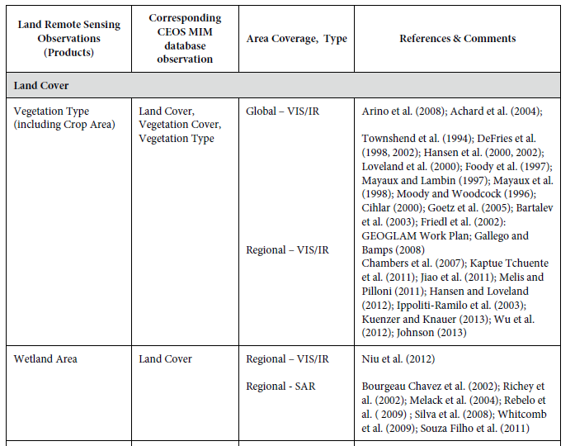
Adapting Carbon Strategy to GEOGLAM Process

Slide 7
Questions to Consider
Are the CEOS MIM database the right products to use for the why (monitoring application)?
Do we need to account for frequency of the measurement?
Since field size is not applicable, should that be scale (global, regional), or is scale dependent on the product?
Do we need to account for priority of the measurements?
Assume a row will need to be added for Lidar

