Slide 1
LSI-VC-3 Session 23, 24
CARD4L Overview and Specifications
Objectives
Agree on a process to take agreed CARD4L Specifications to Plenary 2017
Timepoints:
March LSI-VC-3
April SIT
September LSI-VC-4 / joint meeting
October Plenary

Slide 2
LSI-VC-3 Session 23, 24
CARD4L Overview and Specifications
Overview
Concepts
Definitions / Product families / Specifications / Assessments
Work through v0 Specifications for
Surface Reflectance product family
Surface Temperature product family
Develop Specifications for the backscatter intensity product family
Develop the assessment framework for guide data providers to successful production of CARD4L

Slide 3
CARD4L Concepts
Overview
Concepts
Definitions / Product families / Specifications / Assessments
Work through v0 Specifications for
Surface Reflectance product family
Surface Temperature product family
Develop Specifications for the backscatter intensity product family
Develop the assessment framework for guide data providers to successful production of CARD4L

Slide 4
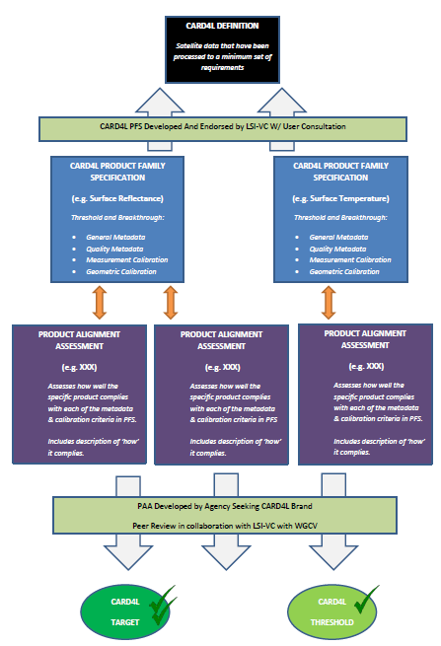
Overall framework,
(as discussed 2017-02-16)
On the LSI-VC document management area of the web site
Definition of CARD4L
Product families with specifications
Providers self-assess how well their products meet the specifications
Peer review
CARD4L stamp !

Slide 5
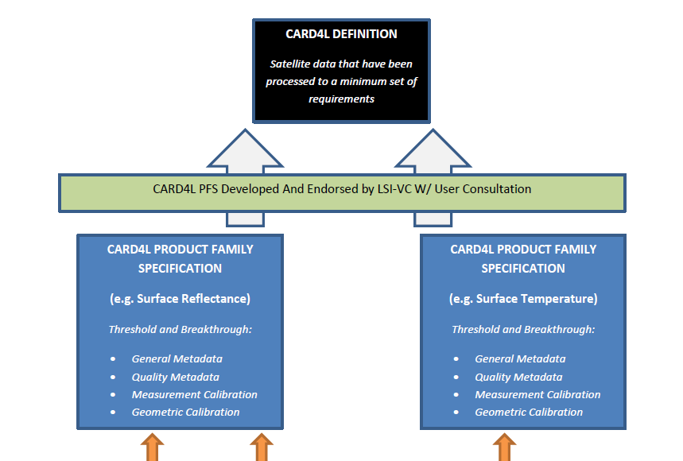

Slide 6
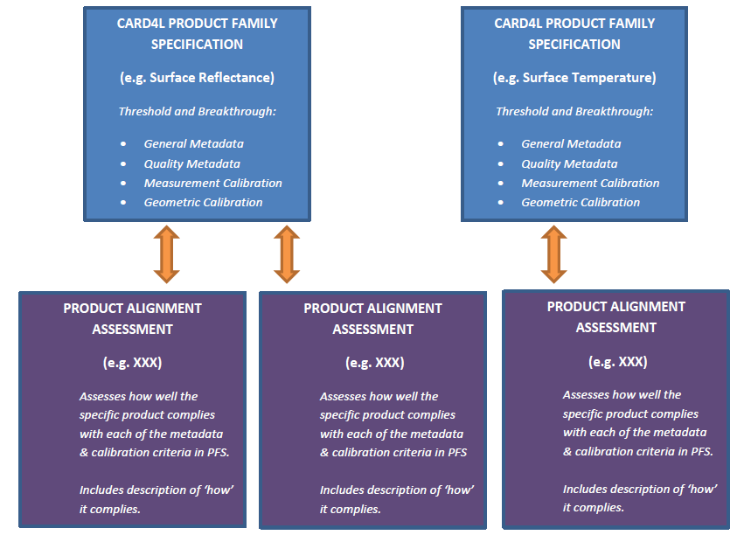

Slide 7
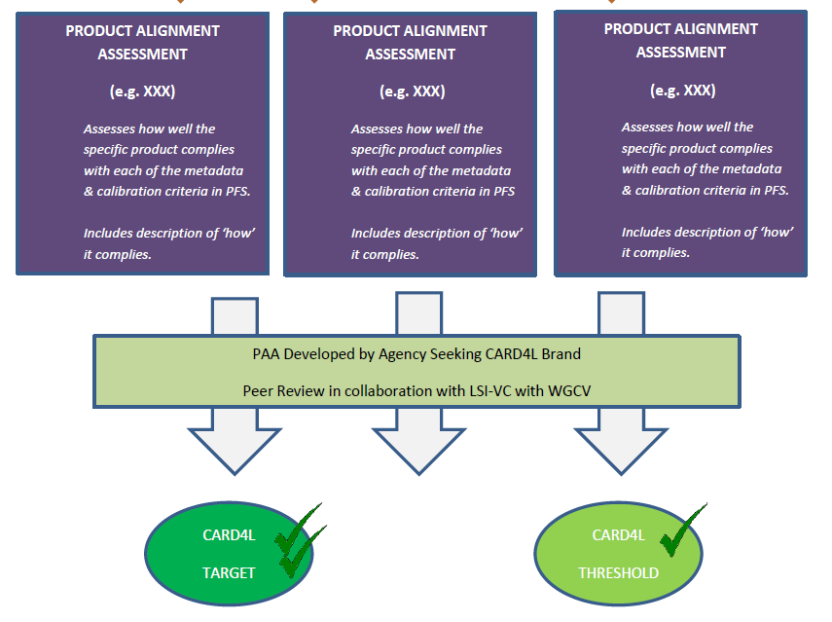

Slide 8
What’s new?
Families of CARD4L
Surface Reflectance
Surface Temperature
Backscatter
There will be many instruments relevant to each CARD4L family
More families can be added
There is a Product Alignment Assessment step
PAA supports providers
Allows for peer review
No longer in spreadsheets.
Each Family specification is a word document – more accessible and a better format to review and refine

Slide 9
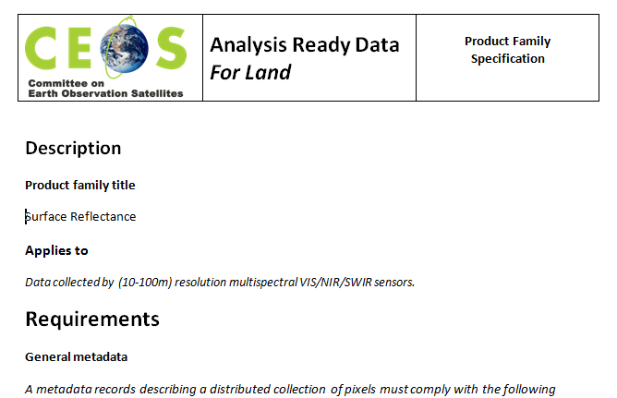
Product family specification draft
Available on the LSI document management system

Slide 10
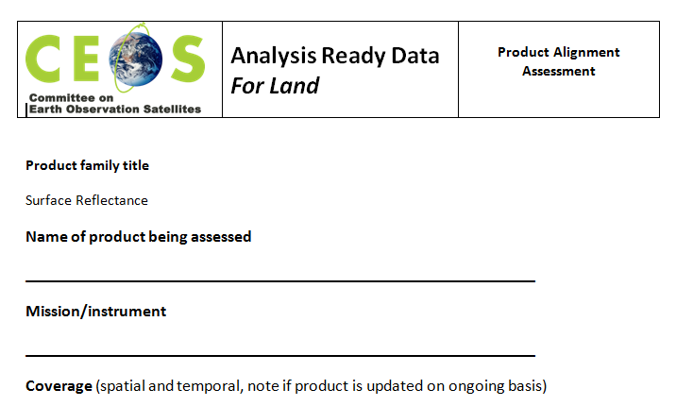
Product Alignment Assessment
Available on the LSI document management system

Slide 11
Next steps
Session 8_23:
Review the Product Family Specification for Surface Reflectance
Review the Product Family Specification for Surface Temperature
Draft a Product Family Specification for Backscatter
Session 8_24:
Review the Product Alignment Assessment
Consider how the PAA would be applied in practice
Agree next steps

