Slide 1
Geoscience Australia:
Advances on Analysis Ready Data (ARD)
Surface Reflectance from Landsat, Sentinel-2, SPOT
Surface Brightness Temperature from Landsat 5,7,8
Land Surface Imaging Virtual Constellation meeting #3 (LSI-VC3),
Frascati, March 20-21, 2017
15 minutes

Slide 2
The demand for ARD is growing – radar time series

Slide 3
The demand for ARD is growing – landcover

Slide 4
The demand for ARD is growing – multi-sensor approaches are replicating pre-processing chains!

Slide 5
The demand for ARD is growing – per pixel metadata

Slide 6
And there are benefits to users
Time saved using [GA] for all of the calculations;
The team that participated in the trial has estimated a 30% time saving, compared to current work practices. This is based on work done on the two trial areas.
… However once the team has access to Version 2, and become more familiar with the platform, productivity time will improve significantly
… Efficiencies will come from obtaining the standard products of the data cube and being able to use indices which are not being used in current projects.

Slide 7
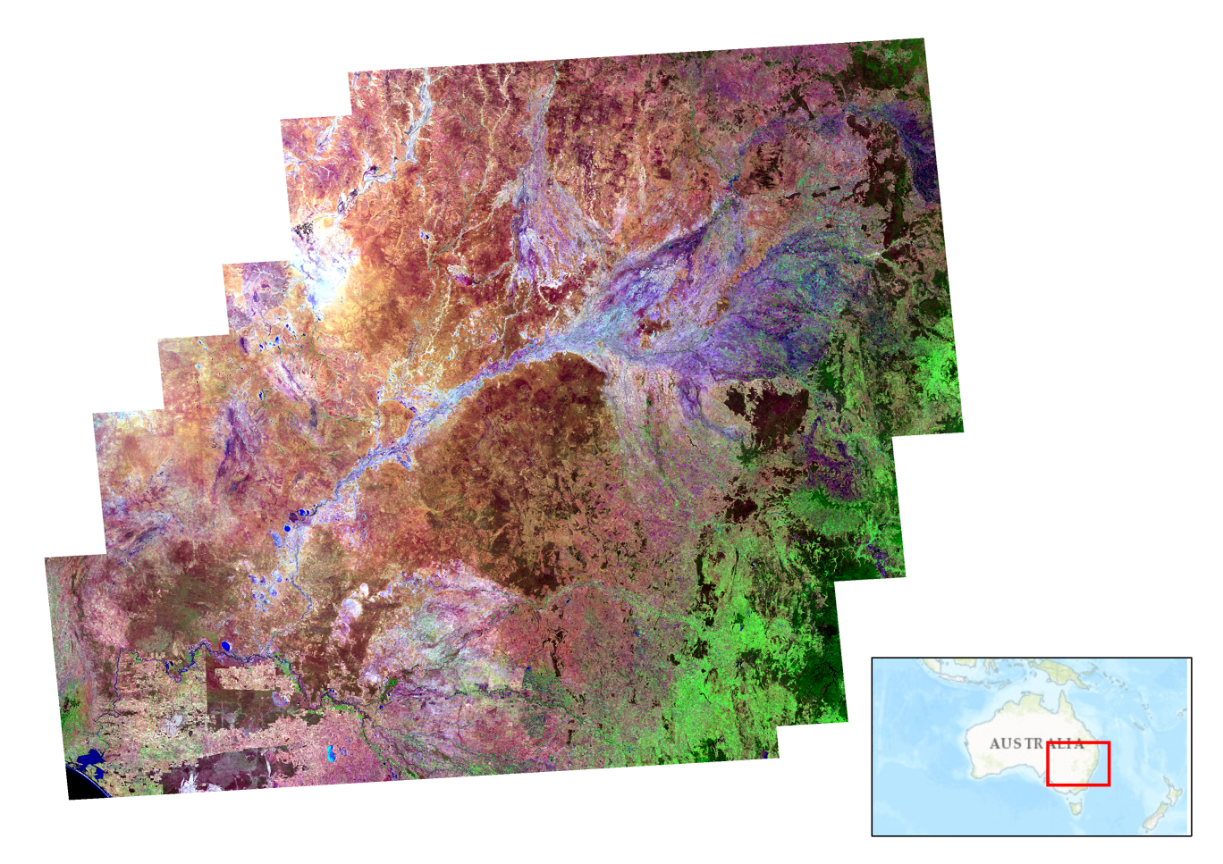
Analysis Ready Data for the Murray Darling Basin
Geometric median of Landsat 8 SR
No visible artefacts (satellite passes are not visible in the data!)
Standardisation of the illumination and view angles is effective.
NBAR corrections are applied
2015 calendar year
Bands 6,5,3
Notes:
The geometric median of Landsat 8 observations for the 2015 calendar year over the Murray Darling Basin,
Displayed as band 6, 5, 3 false colour (that is SWIR on red channel, NIR on green channel, Green on blue channel).
The geometric median is a high dimensional median that preserved the spectral character of the observations
They are derived and provides a summary of median conditions for the entire basin.
Without ARD this would
Show scene edges,
Variance in illumination and
Other conditions that impact the creation of composites.

Slide 8
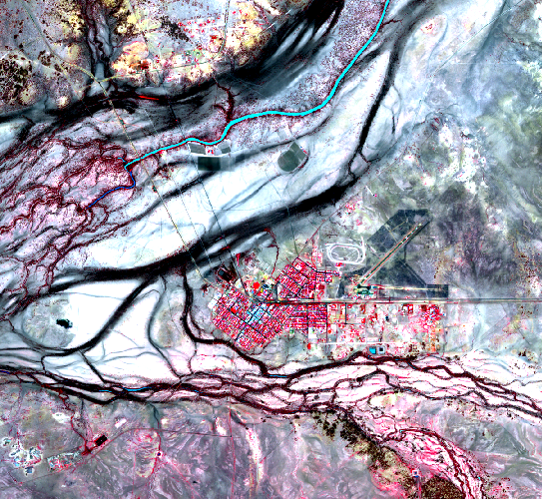
Sentinel-2 SR Longreach QLD
Corrections applied to Landsat
can be applied also to Sentinel-2
Geoscience Australia – in development
Queensland Uni – well advanced (separate presentation)

Slide 9
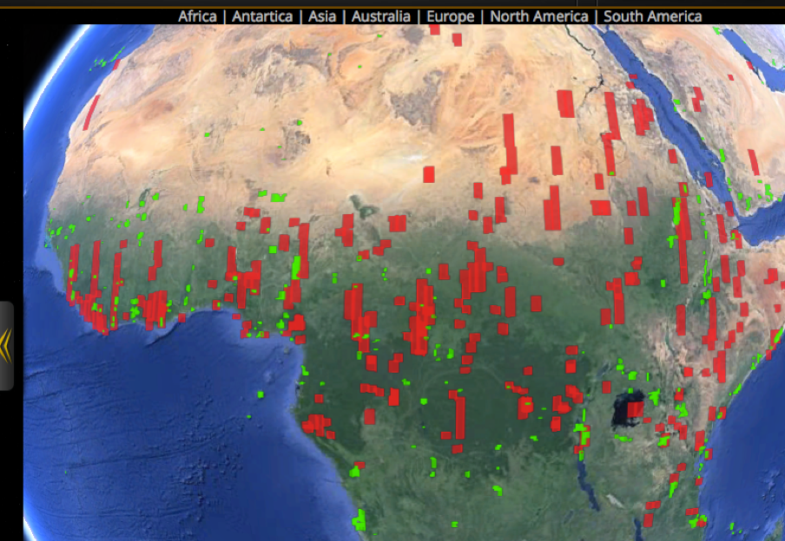
SPOT-5 ARD
Stuart Phinn (Queensland Univ.) has a process for atmospheric correction, terrain correction and NBAR for SPOT-5.
The SEO team was planning to send him a few SPOT-5 files over Kenya to process into Surface Reflectance (SR). We would select an area where we have Kenya data cube content.
Stuart would process the data into SR products. The SEO team would test them in QGIS (visual inspection against Landsat data). If the data looks promising, we will need to create a document for the processing steps, create a Python script for users to perform the same processing, and create a Data Cube ingestor.
Example on right is SPOT-5 over Africa in Jan 1-8, 2014 (RED) using the COVE tool.
*Supplied by Brian Killough,
CEOS Systems Engineering Office (SEO)

Slide 10
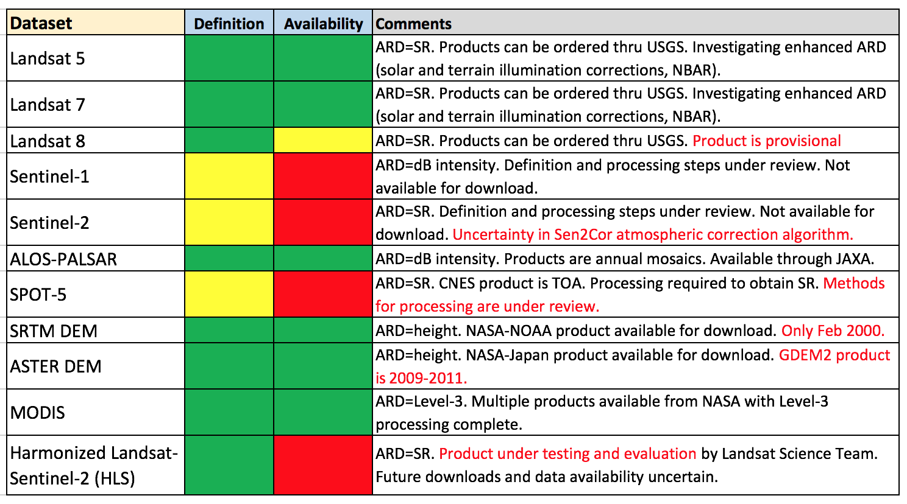
CEOS ARD Status for Data Cubes
*Supplied by Brian Killough, CEOS Systems Engineering Office

Slide 11
Surface Brightness Temperature (SBT) and Analysis Ready Data
Surface Brightness Temperature (TB) is another family of analysis ready data proposed as Threshold CARD4L by Geoscience Australia and USGS.
TB can be retrieved from thermal channels on Landsat (L5, 7, 8) using radiative transfer models (MODTRAN 5).
The key input is globally available ancillary atmospheric data.
Geoscience Australia compared approaches in 2015 with 60 m Landsat. The study used 3 dates x 3 sites, x 4 global datasets
Sites included Darwin (coastal, 12.5 S), Moree (inland, 29.5 S), Wollongong (coastal, 34.4S)
Target CARD4L would require use of Land surface emissivity corrections

Slide 12
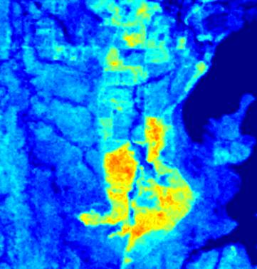
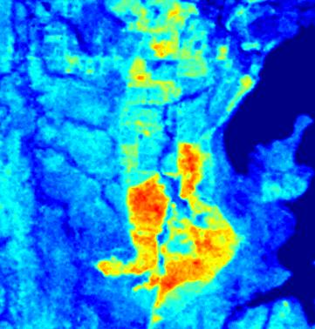
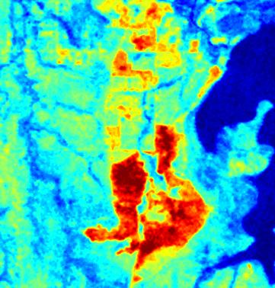
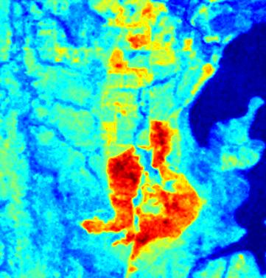
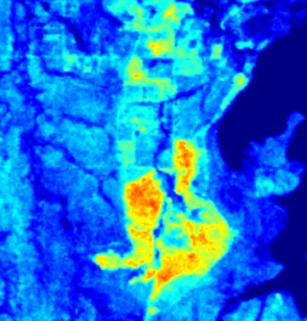
Surface Brightness Temperature in K (02/05/2003)
Balloon coincident, ground released (this is the reference)
NCEP1
NCEP2
MERRA
ECMWF (best overall)
NCEP1 (NOAA NCEP/NCAR Reanalysis I data)
NCEP2 (NOAA NCEP-DOE Reanalysis II)
MERRA (NASA Modern Era Retrospective-Analysis for Research and Applications)
ECMWF (European Centre for Medium-Range Weather Forecasts)
Reference: Li et al., 2015 Land surface brightness temperature retrieved from
Landsat data. http://www.mssanz.org.au/modsim2015/L11/li.pdf
Notes:
Land surface brightness temperature retrieved from
Landsat data
F. Li a, D. L. B. Jupp b, M. Thankappan a, L-W. Wang a, J. Sixsmith a, A. Lewis a and A. Held b
a National Earth and Marine Observations Branch , Geoscience Australia, GPO Box 378, ACT, 2601,
Australia
b CSIRO, Land and Water, GPO Box 3023, ACT 2601, Australia
Email: Fuqin.Li@ga.gov.au
Abstract: Land Surface Temperature (Ts) is an important boundary condition in many land surface
modelling schemes. It is also important in other application areas such as hydrology, urban environmental
monitoring, agriculture, ecological and bushfire monitoring. Many studies have shown that it is possible to
retrieve Ts globally using thermal infrared data from satellites. Development of standard methodologies that
routinely generate Ts products would be of broad benefit to the utility of remote sensing data in applications
such as hydrology and urban monitoring.
AVHRR and MODIS datasets are routinely used to deliver Ts products. However, these data have a 1 km
spatial resolution, which is too coarse to detect the detailed variation of land surface change of concern in
many applications, especially in heterogeneous areas. Higher resolution thermal data from Landsat (60-120
m) is a possible option in such cases.
To derive Ts, two scientific problems need to be addressed, the first of which is the focus of this paper:
• Remove the atmospheric effects and derive surface brightness temperature (TB),
• Separate the emissivity and Ts effects in the surface brightness temperature (TB).
For single thermal band sensors such as Landsat 5, 7 and due to a stray-light issue on Landsat-8, the multiband
methods used to derive TB, such as the split window methods used for NOAA–AVHRR data (Becker &
Li, 1990) and the day/night pairs of thermal infrared data in several bands used for MODIS (Wan et al.,
2002) are not available for correcting atmospheric effects. The inputs used for retrieval of surface brightness
temperature TB from Landsat data therefore need more attention, as the accuracy of the TB retrieval depends
critically on the ancillary data, such as atmospheric water vapour data (precipitable water). In the past, it has
been more difficult to retrieve a reliable TB product routinely from Landsat due to limited availability (time
and space) of accurate atmospheric water vapour information.
To test the possibility for retrieving a good quality TB product routinely from Landsat, in this paper, TB
products are derived from four current and routinely available global atmospheric profiles, namely the NASA
Modern Era Retrospective-Analysis for Research and Applications (MERRA); the National Center for
Environmental Prediction (NCEP) reanalysis I, the National Center for Environmental Prediction reanalysis
II and the European Centre for Medium-Range Weather Forecasts (ECMWF) Interim reanalysis. These
products were evaluated against the TB derived from the near coincident ground-released radiosonde data
(balloon data) using a physically based radiative transfer model MODTRAN 5. The results from this
comparison have found:
• The global data sets NCEP1, NCEP2, MERRA and ECMWF can all generally give satisfactory TB
products and can meet the 1 K accuracy levels demanded by many practitioners.
• The ECMWF data set performs best. The root mean square difference (RMSD) for the 9 days and 3 test
sites are all within 0.4 K when compared with the TB products estimated using ground-released
radiosonde measurements.
The results show that using single thermal band Landsat, accurate TB can be delivered operationally using a
robust physically based radiative transfer model such as MODTRAN 5 and operationally available global
atmospheric profiles, particularly the ECMWF interim reanalysis data.
Keywords: Surface brightness temperature, Landsat, atmospheric correction, precipitable water
628 L11.

Slide 13
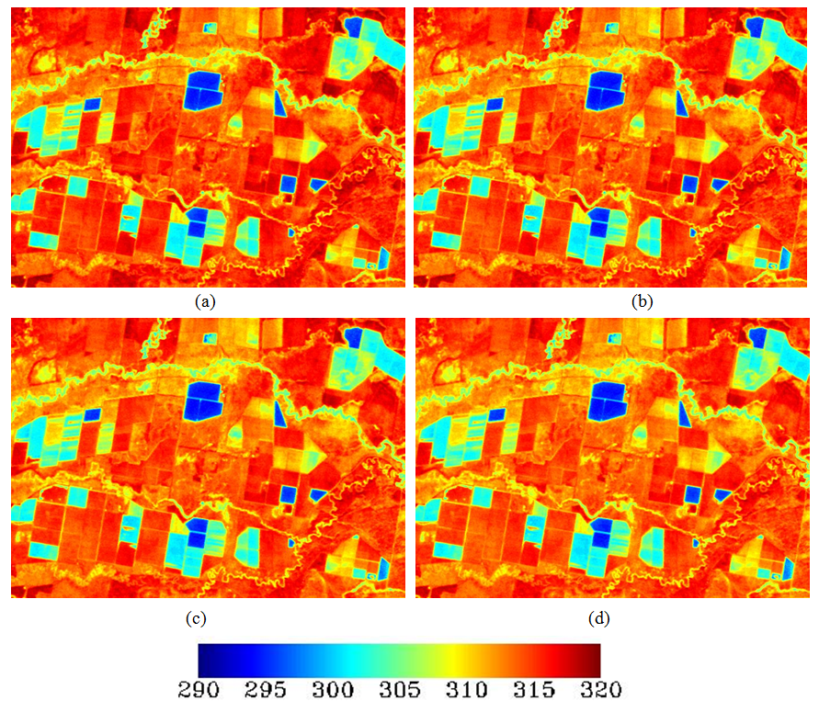
Landsat Surface Brightness Temperature
(ºK) image of Landsat 7 image on October 6, 2000;
using ground based radiosonde (atmospheric profile) measurements;
(b) using MERRA atmospheric profile;
(c) using NCEP1 atmospheric profile and;
(d) using NCEP2 atmospheric profile
Notes:
Landsat 7 for October 6, 2000 at Moree site (path 91, row 80).
The figures do not show very large differences when different atmospheric profiles are used in the relatively dry Moree area.
Therefore, to quantitatively analyse the impact of different atmospheric profiles on the atmospheric correction accuracy, four brightness temperature images of 9 days were compared.
Assuming that the ground measurements (radiosonde data) are accurate, the products from ground radiosonde data can then be regarded as the ground truth.
The differences can then be calculated between the brightness temperature derived from the radiosonde data and those from the global data sets (MERRA, NCEP1 and NCEP2).

Slide 14
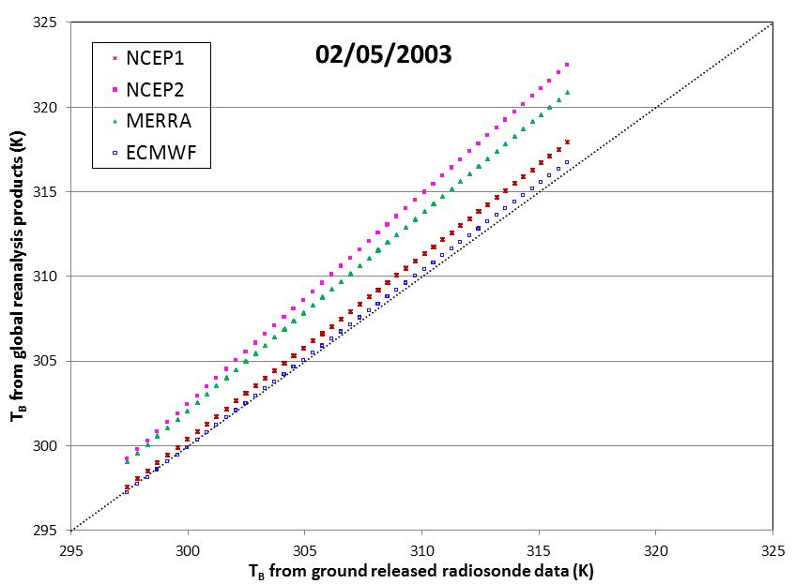
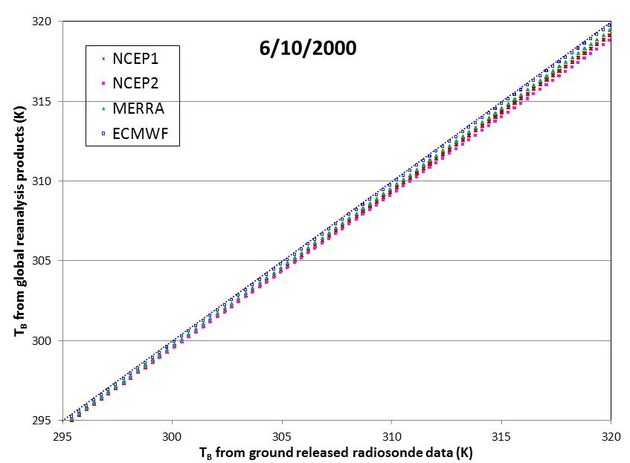
Brightness temperature comparison
Worst results, Darwin, 2003
Best results, Moree, 2000
* Presented in Land Surface Brightness Temperature Retrieval from Landsat Data at 21st International Congress on Modelling and Simulation
Notes:
The global data sets NCEP1, NCEP2, MERRA and ECMWF can all generally give satisfactory Brightness Temperature (T_{B} ) products and can meet the 1 K accuracy levels demanded by many practitioners.
The ECMWF data set performs best. The root mean square difference (RMSD) for the 9 days and 3 test sites are all within 0.4 K when compared with the T_{B} products estimated using ground-released radiosonde measurements (balloon data).
May need to adjust for terrain shadow impacts on mountain areas.
The approach needed to derive an effective emissivity product and the associated land surface temperature (LST) is being evaluated in the next phase of the project.

Slide 15
Data Cube Ingestion and Interoperability

Slide 16
Analysis Ready Data, Ingestion and Indexing
User
This saves users expertise and resources! ($)
User
Analysis Ready Data
Raw data
User
This allows the time series to be leveraged
Ingester
User
Data Cube
User
User
Data Provision
Data Exploitation
Notes:
Key point:
Data Provision, then Data Exploitation.
Ingestion is not the data provider’s job, comes after the production of ARD.

Slide 17
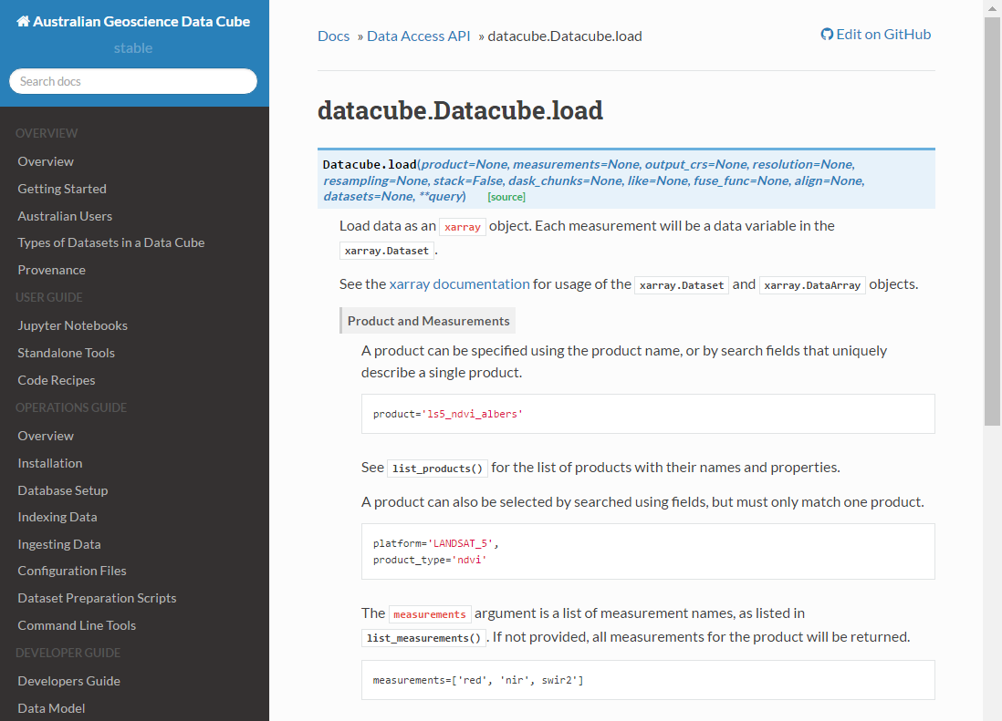
Ingestion to Open Data Cube is a simple process
Longitude latitude range
s2a_l1c = dc.load(product='s2a_level1c_granule',x=(147.36, 147.41), y=(-35.1, -35.15), measurements=['04','03','02'], output_crs='EPSG:4326', resolution=(-0.00025,0.00025))
Spectral bands / measurements of interest
Analysis grid representation
http://agdc-v2.readthedocs.io/en/stable/index.html
Notes:
Ingesting data is a simple process
Across multiple scenes.
Some band math.
Is this easy to use? Yes it is.

Slide 18
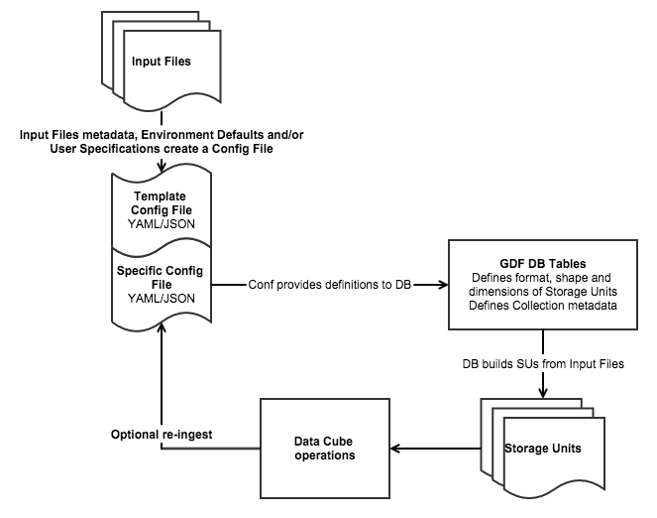
Open Data Cube Ingest
1) Decode existing data files
Read multiple file formats
2) Define translation of data files to Storage Units
Target storage unit type, format and shape
Reproject or resample data if desired
Reformat or reshape if desired
3) Pass job to a Storage Unit Writer
Handle file locking etc
http://www.datacube.org.au/wiki/Ingest

Slide 19
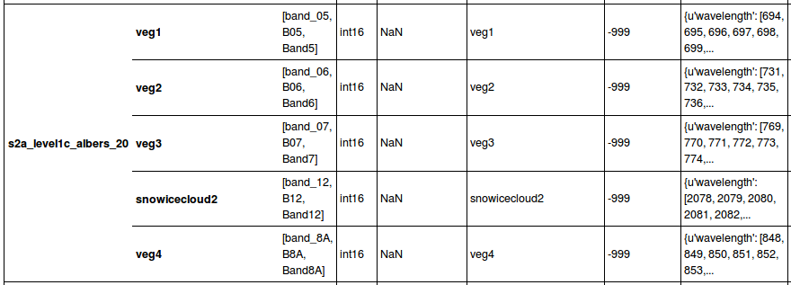
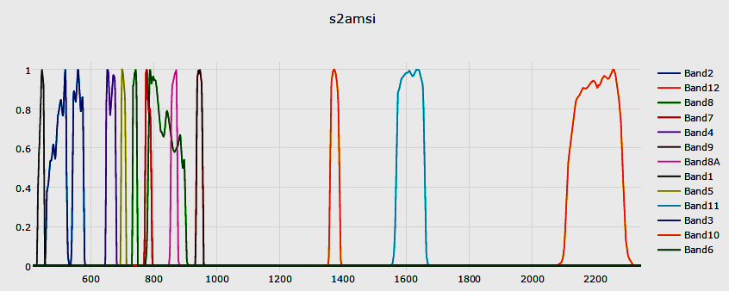
How Sentinel-2 bands (20m) would ‘look’ in the AGDC database
Band names from S2 User Guide
JSON Spectral response for “Spectral Ignorance tools”
Alias band name

Slide 20
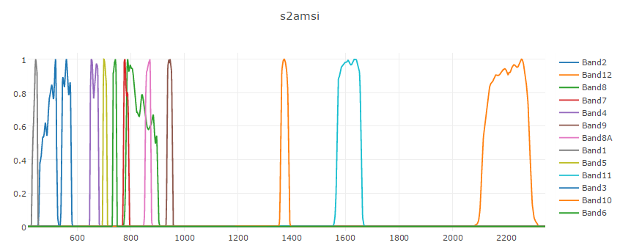
Sentinel-2A sensor relative spectral response included

Slide 21
Spectral Ignorance concept, sensor band equivalence
Supporting multi-sensor AGDC
Sentinel-2A Band 2 (Blue) and Landsat 5 TM Band 1 (Blue)
Notes:
Smooth histogram of how different sensors respond to the same target.
Shows how you would convert between the two for data continuity.
X axis is wavelength
Y axis is surface reflectance

