Slide 1
Data Interoperability Summary
LSI-VC-3 Meeting
ESA-ESRIN, Frascati, Italy
March 20-21, 2017
Brian Killough
CEOS Systems Engineering Office
NASA Langley Research Center

Slide 2
SEO Interoperability Test Plans
Demonstrate Landsat 7+8, Sentinel-1 (S1) and ALOS-PALSAR data interoperability in a Vietnam Data Cube.
Native spatial resolutions are S1=10m, Landsat=30m, ALOS=25m.
S1 data will be ingested in native EPSG:4326 (WGS 84) projection. Landsat SR data will be resampled from UTM to EPSG:4326.
ALOS-PALSAR will be resampled from 25-meter resolution, Lat-Lon (GRS 80) projection to 30-meter resolution EPSG:4326 (WGS 84) projection.
The first goal is to evaluate the spatial alignment of the 3 datasets within a nested grid data cube. Each Landsat and ALOS pixel should align. There will be nine (9) S1 pixels within each Landsat/ALOS pixel.
After resampling, what are the geolocation errors of each dataset? Can CEOS WGCV help evaluate these errors? Typical RSM errors are < 12m for Landsat (1/3 pixel) and < 2m for S1 (1/5 pixel).
If we are able to calculate these errors for the multi-sensor data cube, then users will be able to assess how the errors might impact their applications.

Slide 3
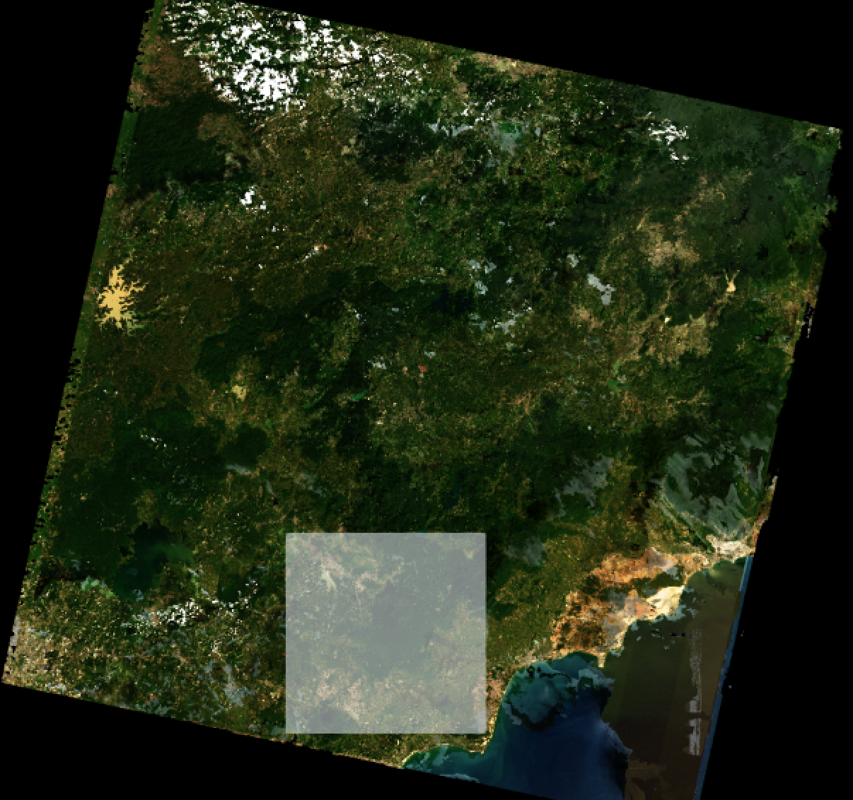
First look at the data …
Southern Vietnam
Near city of La Gi
Full scene:
Path-Row=124/52
Sample area:
Lat: 10.75-11.25
Lon: 107.5-108.0
Median Mosaic
Year 2015

Slide 4
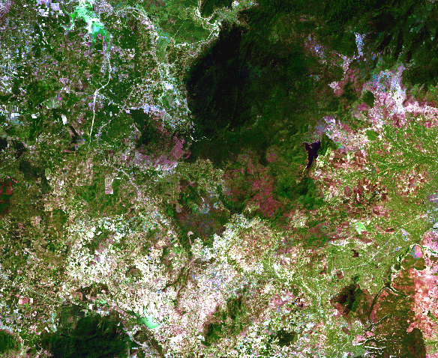
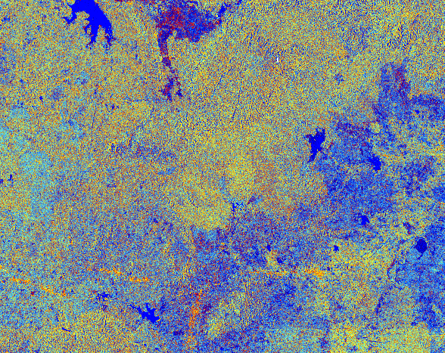
Landsat and Sentinel-1
Landsat 8 Mosaic, RGB: Bands 3,2,1
Sentinel-1 Mosaic, RGB: VV,VH,VV/VH

Slide 5
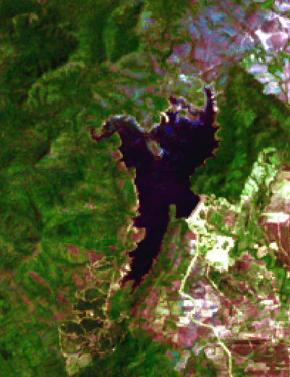
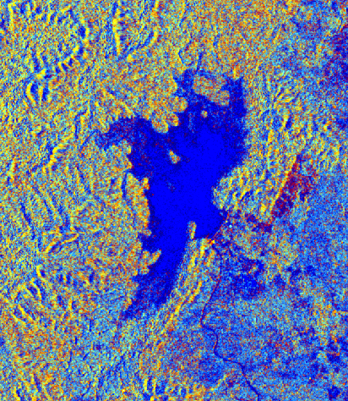
L8 and S1 in a Data Cube
Landsat 8 Mosaic, RGB: Bands 3,2,1
Sentinel-1 Mosaic, RGB: VV,VH,VV/VH

Slide 6
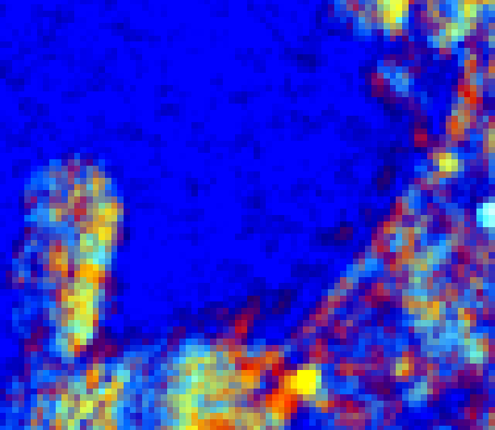
L8 and S1 in a Data Cube
Landsat 8 Mosaic, RGB: Bands 3,2,1
Sentinel-1 Mosaic, RGB: VV,VH,VV/VH

Slide 7
Water Application
With the 3-sensor, spatially aligned data cube, we will investigate a water detection application.
Water is a HIGHLY desired application. Since optical datasets have issues with clouds, the use of radar data as a primary or supplemental data source is desired.
Our plans ... perform a water detection analysis where we use WOFS on Landsat data (truth) and then compare that with an optimized (machine learning) Sentinel-1 algorithm. We will also compare WOFS to the histogram of band thresholds corresponding to the water mask in the FNF product of the ALOS-PALSAR dataset.
Known issues ... wind and rain impact radar backscatter and the spatial resolution of S1 is 3x better than Landsat/ALOS.
How do the results compare? Can S1 or ALOS data fill gaps in Landsat data for water detection or be used independently with confidence? Are the geolocation errors acceptable in the combined data cube?
Can JAXA release the water mask as an open source contribution for users?
Most of this work will be performed by a Yale University summer student in May-July 2017.

Slide 8
Clustering Application
With the 3-sensor, spatially aligned data cube, we will investigate a k-means clustering application for land classification.
Clustering is a common first-step in the land classification process. The ability to use optical and radar datasets is desired, due to cloud issues.
Our plans ... perform k-means clustering on all 3 datasets.
How do the results compare? Are the spatial clustering regions similar for L8 and ALOS, as their spatial resolutions are the same?
Can these datasets be used together or separately (within the same cube) for land classification work?

Slide 9
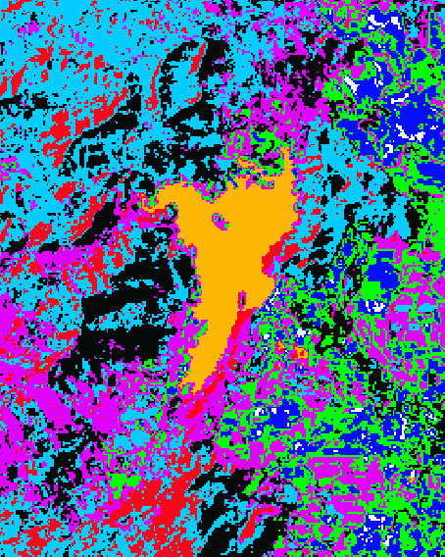
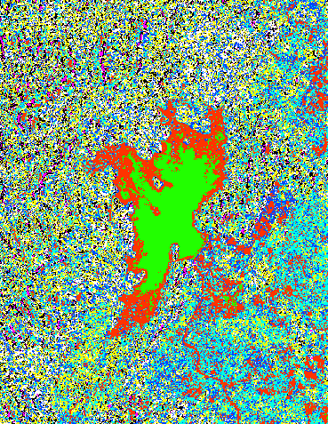
Landsat and Sentinel-1
Landsat 8 – 8 class clustering
Sentinel-1 – 8 class clustering

