Slide 1
Moderate Resolution Sensor Interoperability: Framework
Committee on Earth Observation Satellites
LSI-VC-3
Session 5: Item 15
Frascati, Italy
20 March 2017

Slide 2
Moderate Resolution Sensor Interoperability (MRI)
This initiative addresses the CEOS strategic objective to encourage complementarity and comparability among the increasing number of Earth observing systems in the moderate resolution class for both optical and SAR sensors and the data received from them.
This presentation:
Introduces the MRI framework;
Elicits feedback from the LSI-VC team; and
Seeks endorsement from the LSI-VC team.
Notes:
This presentation will take about 10 minutes following which there is time for discussion
LSI-VC

Slide 3
2017 Deliverables
The framework for moderate resolution interoperability addresses components such as radiometry, geolocation, per-pixel metadata, and image metadata needed to support the analysis of multi-sensor science data and the search and discovery of science data.
Existing case studies will be identified, and summarized (and new studies encouraged) to document parameters, thresholds and metadata to support interoperability with an initial emphasis on Landsat and Sentinel-2. Case studies planned and initiated by space agencies to meet their specific agency needs are crucial to the success of the initiative.

Slide 4
MRI Framework
The MRI Framework is an LSI-VC activity closely tied to the CARD4L specification and will evolve in parallel to the CARD4L specification.
CARD4L identifies for products
threshold information needed to be considered minimally Analysis Ready and
target information needed to be fully Analysis Ready
The MRI team will work closely with WGCV, WGISS and with the thematic communities to identify case studies to advance and implement the CARD4L specification.
The focus of the MRI framework is on multi-sensor interoperability.
The CARD4L specification provides necessary, but not sufficient information to meet multi-sensor interoperability requirements

Slide 5
MRI Case Studies
The MRI case studies build on the requirements of Future Data Architectures, while continuously advancing products for the current user community.
The user community is rapidly transitioning to surface reflectance, surface temperature and terrain-flattened gamma naught SAR products.
The user community is slowly transitioning to the analysis of deep and dense multi-sensor time series stored as data cubes.
The 2017 MRI initiative case study deliverable is the results from the Sentinel-2 Landsat Case Study

Slide 6
MRI Coordination

Slide 7
LSI-VC, WGCV and WGISS
Among the challenges of Future Data Architecture and Analysis Ready Data is the requirement to make data comparable through time and across sensors.
The MRI initiative provides a framework within which interoperable solutions can be identified and documented.
The LSI-VC MRI, FDA and CARD4L teams share many members supporting synergy across the teams.
The WGCV is instrumental in coordinating the calibration and validation of sensors
The WGISS is versed in metadata standards that describe image data for use in analysis and for search and discovery
LSI-VC agencies work with GEO and other user communities, such as GFOI and GEOGLAM, to evaluate and implement solutions. FDA pilot projects seek to exploit these opportunities.

Slide 8
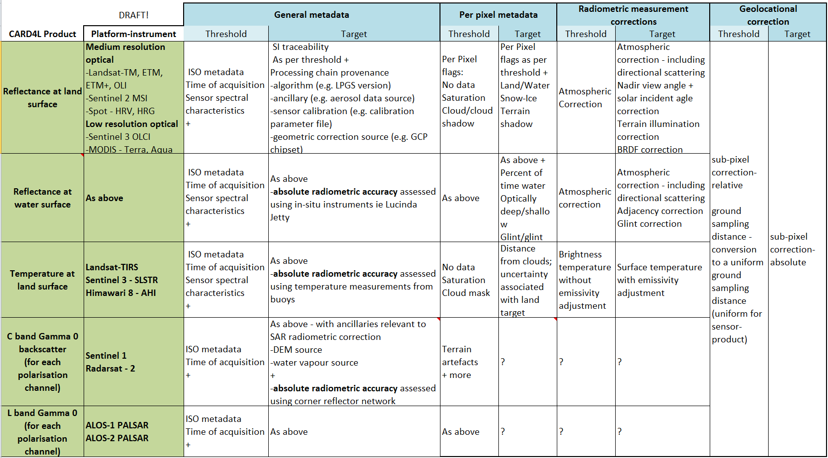
Framework background: MRI and CARD4L
CARD4L defines the minimal Thresholds and optimal targets that need to be met before a data product is considered Analysis Ready.
The MRI Framework extends CARD4L and other definitions to multi-sensor interoperability.
For example,
CARD4L specifies the pixel size and RMSE.
MRI describes the consequences of different pixel sizes and RMSE
CARD4L specifies the spectral response
MRI describes the consequences of different spectral responses
Notes:
This table illustrates the type of structure that we are thinking of
Update the table.
Link the spreadsheet to the requirements process that LSI-VC.
We have responses from JAXA, CSA, ESA and NASA indicating willingness to participate in a SAR team to progress ARD for SAR, a call will go out including through WGCV.
The work on ARD is likely to feed into further work on FDAs: There is a demand for implementations of ARD and demonstration datasets for use in FDA.

Slide 9
Instrument Characteristics
A non exclusive high-level summary of moderate resolution sensors with global observation missions with an emphasis on data with open and free data policies and open access to the image archive.
Characteristic summaries
Band categories
Pixel size
Mission life
Mission documentation

Slide 10
General Metadata
Adopt common OGC or ISO metadata standard
Product-specific metadata are constant for all images in the product line
Image-specific metadata are specified for each image
Image-specific metadata are also aggregated from pixel-level data
General metadata specified within CARD4L are compared between products to establish interoperability using MRI guidelines

Slide 11
Per Pixel Metadata
Interoperability issues include documented algorithms and accuracies for
Cloud cover and shadow
Land, water and vegetation
Terrain shadow
Atmospheric model inputs, including aerosols
Saturation and other data quality

Slide 12
Data Measurements
Interoperability issues
Compensate for available bands
Compensate for spectral band differences
Share atmospheric correction with compensation for available bands
BRDF corrections
View angle correction

Slide 13
Geolocation
Interoperability issues
Compensate for different pixel size
Spatial RMSE
Share reference grid and accuracy
Share DEM and accuracy
Discrete Global Grid System (DGGS)

Slide 14
Verification & Validation of target parameters, thresholds and metadata
Case studies are needed to test, evaluate and implement the solutions needed create and advance CARD4L products. Each of the framework components captured in the CARD4L specifications need quantitative analysis leading to implementable solutions.
The MRI framework will summarize the results of case studies.
Targets identified within CARD4L require definition, verification and validation. The maturity level of the targets are highly variable.
Expertise to address these issues reside within agencies associated with WGCV and WGISS. The intent is to leverage existing agency activities.

Slide 15
Multi-sensor implementations
Cooperation among agencies is needed to support interoperability.
Adopt Standards
OGC/ISO metadata standards
Shared reference grids and DEMs
Reflectance and atmospheric models
Common general and per pixel metadata
Compensate for differences
Pixels sizes
Spectral band differences
Spectral band availability
The MRI initiative supports Future Data Architecture studies and studies at agencies evolving implementation strategies. These strategies may be physical higher level products or models designed to use well defined lower level products as inputs. When standards cannot be adopted, compensation for differences is needed.

Slide 16
Goals
The goals of MRI are
to establish a framework to identify and document multi-sensor interoperability challenges, while supporting the consistent specification of individual products; and
to identify interoperability gaps and suggest case studies needed to support the analysis of deep and dense time series of satellite data.
The initial case study is the implementation of interoperable Sentinel-2 and Landsat data products and methodologies.

Slide 17
The MRI Team
Co-leads
Team members
Gene Fosnight | USGS | USGS chair team co-lead, Landsat, LSI-VC, SDCG
Cindy Ong | CSIRO | WGCV co-lead, imaging spectroscopy
Richard Moreno | CNES | WGISS co-lead, Copernicus
Jeff Masek | NASA | Landsat Sentinel-2 Case study, LSI-VC
Zoltan Szantoi | JRC | Landsat Sentinel-2 Case study, LSI-VC
Adam Lewis | GA | LSI-VC, FDA, CARD4L
Paul Briand | CSA | LSI-VC, GEOGLAM, SAR
Yves Crevier | CSA | SDCG, GEOGLAM, SAR
Brian Killough | NASA | SEO, LSI-VC, SDCG, FDA, CARD4L
Debajyoti Dhar | ISRO | Optical/SAR data fusion
Takeo Tadono | JAXA | LSI-VC, CARD4L, SAR
Amanda Regan | EC | User needs for satellite constellations
Nigel Fox | UKSA | WGCV IVOS
Kurt Thome | NASA | WGCV
Andy Mitchell | NASA | WGISS
Kerry Sawyer | NOAA | Represent SIT vice chair
Kevin Gallo | NOAA | LSI-VC, LPCS data integration
Eric Wood | USGS | Represent USGS Chair Team

Slide 18
Time lines
Kickoff telecon on the 2-3 March 2017
Presentation of framework for endorsement at LSI-VC-3 on 20 March 2017
Presentation of work plan with emphasis on metadata at WGISS in April 2017
Presentation of work plan at SIT-32 in April 2017
Presentation of work plan with emphasis on data at WGCV in May 2017
Initial presentation of 2017 results at LSI-VC-4 and SIT TW in September 2017
Presentation of 2017 results at CEOS Plenary in October 2017

