Slide 1
The Sentinel-3(A) Mission:
Mission status
Susanne Mecklenburg, ESA Sentinel-3 Mission Manager
ESA and EUMETSAT Sentinel-3 development and operations teams

Slide 2
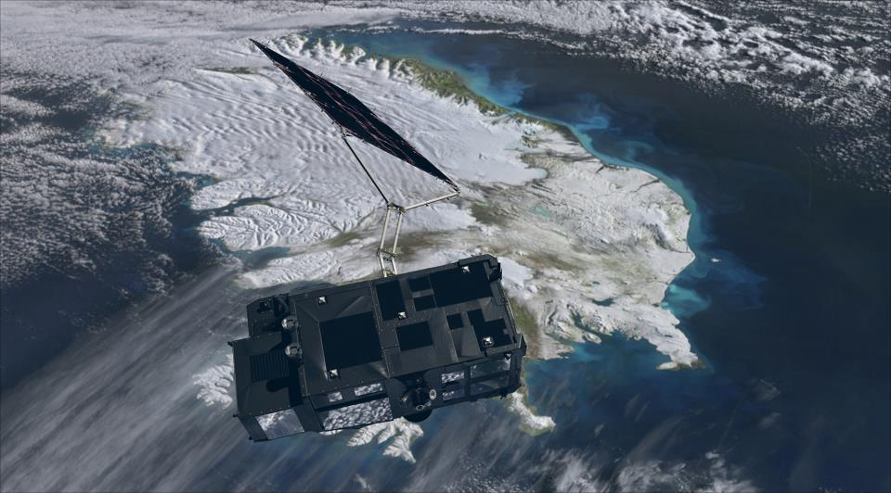
SENTINEL-3 MISSION OVERVIEW
Operational mission in high-inclination, low Earth orbit
Full performance achieved with 2 satellites in orbit (S-3A,-3B)
Topography Mission Payload providing
  Sea surface topography data, through a Topo P/L including a Ku-/C-band Synthetic Aperture Radar Altimeter (SRAL), a bi-frequency MicroWave Radiometer (MWR), and a Precise Orbit Determination (POD) including
    GNSS Receiver
    DORIS
    Laser Retro-Reflector
Optical Mission Payload providing
  Sea and land color data, through OLCI (Ocean and Land Color Instrument)
  Sea and land surface temperature, through the SLSTR (Sea and Land Surface Temperature Radiometer)
In addition, the payload design will allow
  Data continuity of the Vegetation instrument (on SPOT4/5),
  Enhanced fire monitoring capabilities, river and lake height, atmospheric products

Slide 3
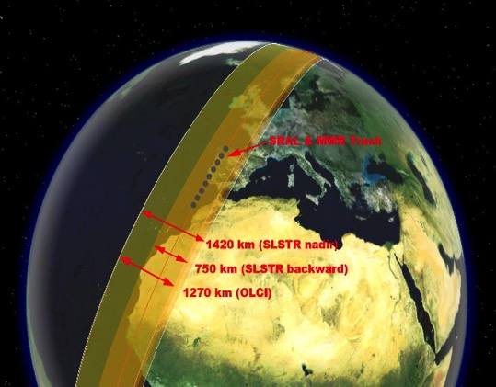
NEW FEATURES - optical payload
100% overlap between SLSTR and OLCI
Increased number of bands compared to both AATSR and MERIS allowing
  Synergy between OLCI and SLSTR measurements
  Enhanced fire monitoring capabilities
Broader swath
  OLCI: from 1150 km to 1270 km
  SLSTR: Nadir view 500km → 1400km, Oblique view: 500km → 740km
Optical payload < 2 days global coverage (with 2 Satellites) in view of the substantially increased swath
Increased spatial resolution:
  OLCI: 300m for land and ocean
  SLSTR: 500m for VIS-SWIR, 1km for IR-Fire
  Mitigation of sun glint by tilting cameras 12.5 deg in westerly direction
  Near-Real Time (< 3 hr) availability of L2 core products
Instrument Swath Patterns
SRAL (>2 km) and MWR (20 km) nadir
track
1400 km SLSTR (nadir)
740 km SLSTR (oblique)
1270 km OLCI
Orbit type
Repeat cycle
LTDN
Average altitude
Inclination
Repeating frozen SSO
27 days (14 + 7/27 orbits/day)
10:00
815 km
98.65 deg

Slide 4
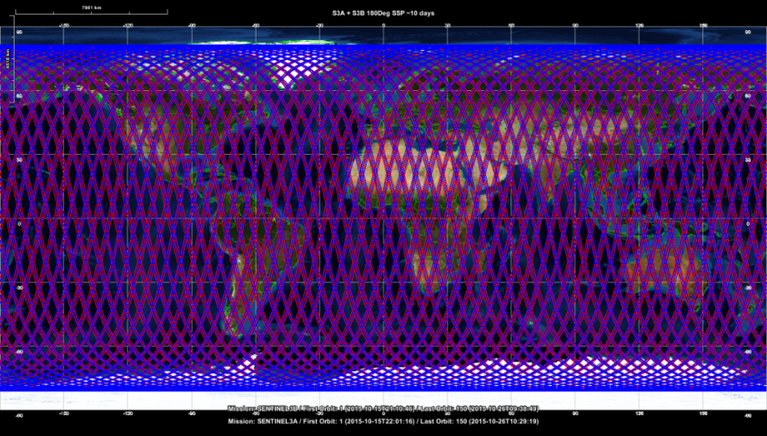
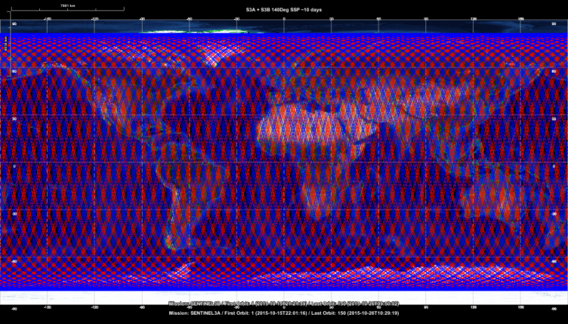
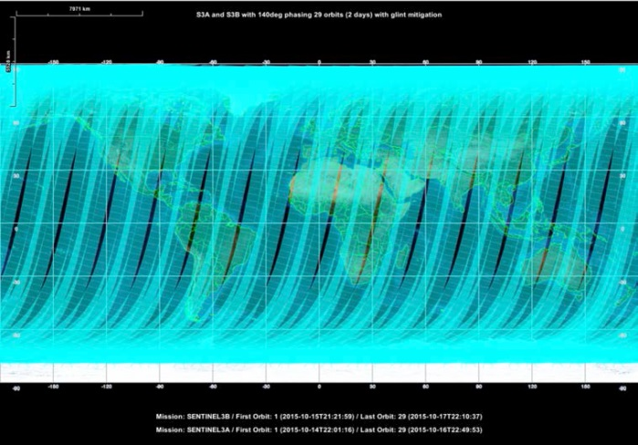
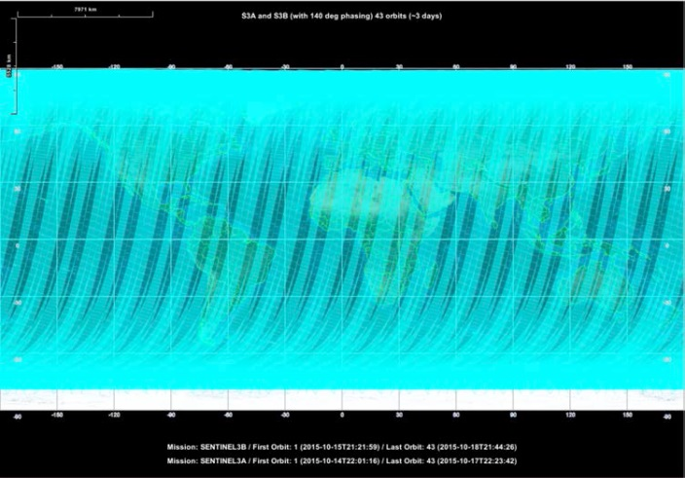
OPTIMISED ORBIT PHASING OF S3A/B AND C/D
Copernicus Marine Environment Monitoring Service (CMEMS) asked for optimising orbit phase shift to improve interleave between S3A and S3B for improved SRAL meso-scale sampling at 4-7 days
Solution of 140° separation recommended by ESA, and confirmed by EUMETSAT assessment.
EC has confirmed implementation for S3B
Minimal impact on optical mission
  Over ocean
    OLCI: global coverage <2 days but parts of the swath will be impacted by sun-glint. Sun-glint free coverage by OLCI will be attained in ~3 days over the ocean.
    SLSTR: coverage and revisit of the SLSTR remains compliant with requirements.
  Over land (sun glint unproblematic, unless inland water) OLCI and SLSTR coverage is expected to remain compliant with requirements.
180 degree phase shift
140 degree phase shift
S3A+S3B, 140 deg: 2-day coverage
(gaps due to sun glint)
S3A+S3B, 140 deg: 3-day coverage (mitigation of sun glint)
Notes:
What is separation on ground: 180 deg 107 km for S3A and 57 for S3B; 140 363 at equator.
“A preliminary analysis by ESA suggests that an optimal phasing between S3A and S3B to improve the use of the S3B satellite in the topography mission is found using a satellite phase separation of 140°. In this scenario, after 4 days the longitude difference between the LTAN of S3A and S3B is rather constant: nominally 3.27° (~363 km at the equator). “
CMEMS requesting an assessment of S3B orbit phase optimisation through EC change request procedure
Current baseline orbit phasing between S3A and S3B is a 180° angle phase separation on the same orbital plane
Optical mission: chosen to minimise coverage revisit time.
Topography mission: essentially duplicates the information acquired by S3A at the mesoscale (25-50 km): measurements are separated by 2 days and 50 km and are consequently highly correlated.
ESA and EUMETSAT have investigated the EC’s request and made recommendations.
Future baseline:
Primary driver: Improve the interleave of S3A and S3B ground track that provides significantly improved SRAL mesoscale sampling at a temporal scale of 4-10 days → orbit phase configuration of 140° separation for the S3A and S3B satellites is recommended.
Ground tracks of S3A and S3B to be coincident with the Permanent Altimeter Calibration Facility (transponder) based in north west Crete → condition met.
Revised orbit phasing of S3A and S3B shall have a minimal impact on the optical mission revisit and coverage → OLCI will attain ocean global coverage in <2 days but parts of the swath will be impacted by sun-glint. Sun-glint free coverage will be attained in ~3 days over the ocean.
OPTICAL MISSION
Acquisitions by OLCI will attain ocean global coverage in <2 days but parts of the swath will be impacted by sun-glint. Sun-glint free coverage by OLCI will be attained in ~3 days over the ocean.
Ocean coverage and revisit of the SLSTR remains compliant with requirements.
For the land surface, where sun glint is not a problem (unless the target is inland water), OLCI and SLSTR coverage is expected to remain compliant with requirements.
OLCI coverage figures:
Two-day coverage of OLCI after mitigation of sun-glint with S3B set in 140° phasing with S3A. Clearly seen are gaps in the coverage due to sun-glint (OLCI will acquire data in these regions).
Complete coverage of OLCI after mitigation of sun-glint with S3B set in 140° phasing with S3A is reached after 3 day

Slide 5

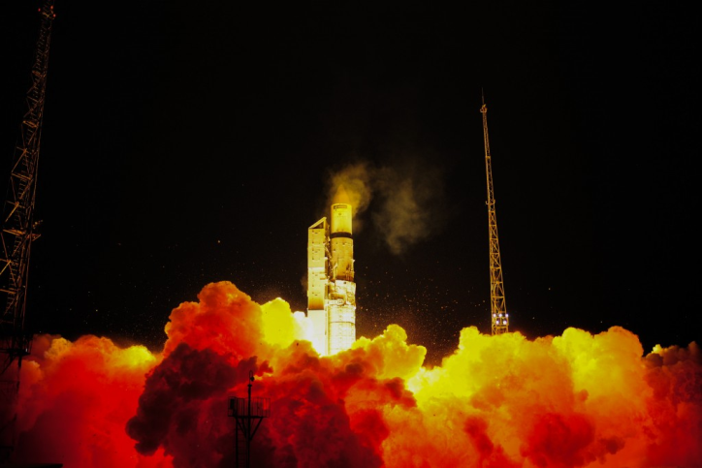
What happened since launch …
16 Feb | Successful Launch
18 Feb | LEOP phase concluded successfully Perfect orbit injection from the launcher Rapid and smooth Solar Array deployment Only one minor anomaly encountered (Star Tracker depointing due to incorrect quaternion data), rapidly identified and corrected
26 Feb | Platform In-Orbit Verification completed
4 March | Payload In-Orbit Verification completed All instrument ON and operating (except SLSTR in decontamination mode, as planned) Level-0 products being generated
7 March | Cal/Val Phase of S3 commences
April/May | Mid-Term-Reviews for OLCI, SLSTR and SRAL
mid- May | Release of sample products to all users for familiarisation
28-30 June | Expert users meeting – first feedback from S3 validation teams
11/12-July | In-Orbit Commissioning Review (IOCR)– successful completion of commissioning phase, start of ramp-up phase (initial operations)
13 July | ESA internal handover from development to operations team; Handover of flight operations from ESA to EUMETSAT
10 October | Handover of Marine PDGS from ESA to EUMETSAT
Q3 2016 | Progressive release of Level 1 data
Till RORR | Progressive release of Level 2 data
Dec 2016 | Mid-term review check point for ramp-up phase
May 2017 | Start of routine operations phase – Routine Operations Readiness Review (RORR)
Sentinel-3A successfully launched from Plesetsk Cosmodrome (Russia) on 16 February 2016
Spacecraft and all instruments in nominal operational mode and functioning well.

Slide 6
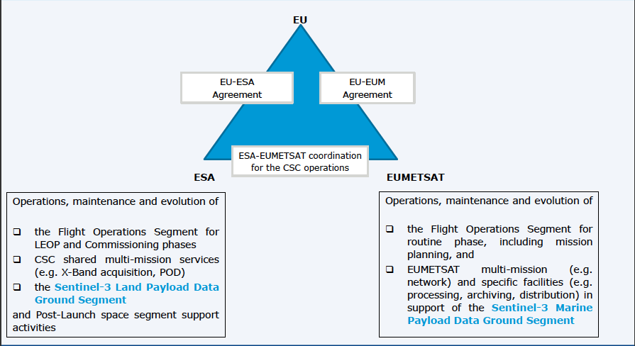


ESA & EUMETSAT SHARE OPERATIONS
EU Copernicus Regulation: full, open and free data policy, defining responsibilities for ESA and EUMETSAT and overall financial envelope
Dedicated EU-ESA and EU-EUMETSAT Copernicus agreements

Slide 7
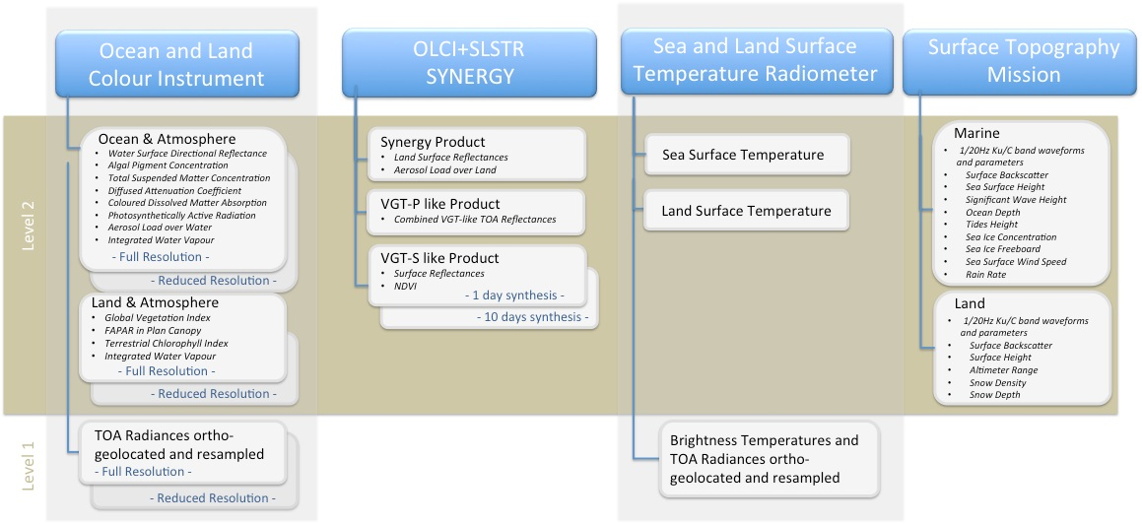
Sentinel-3: core data products

Slide 8
STATUS OF CORE OPTICAL DATA PRODUCTS

Slide 9
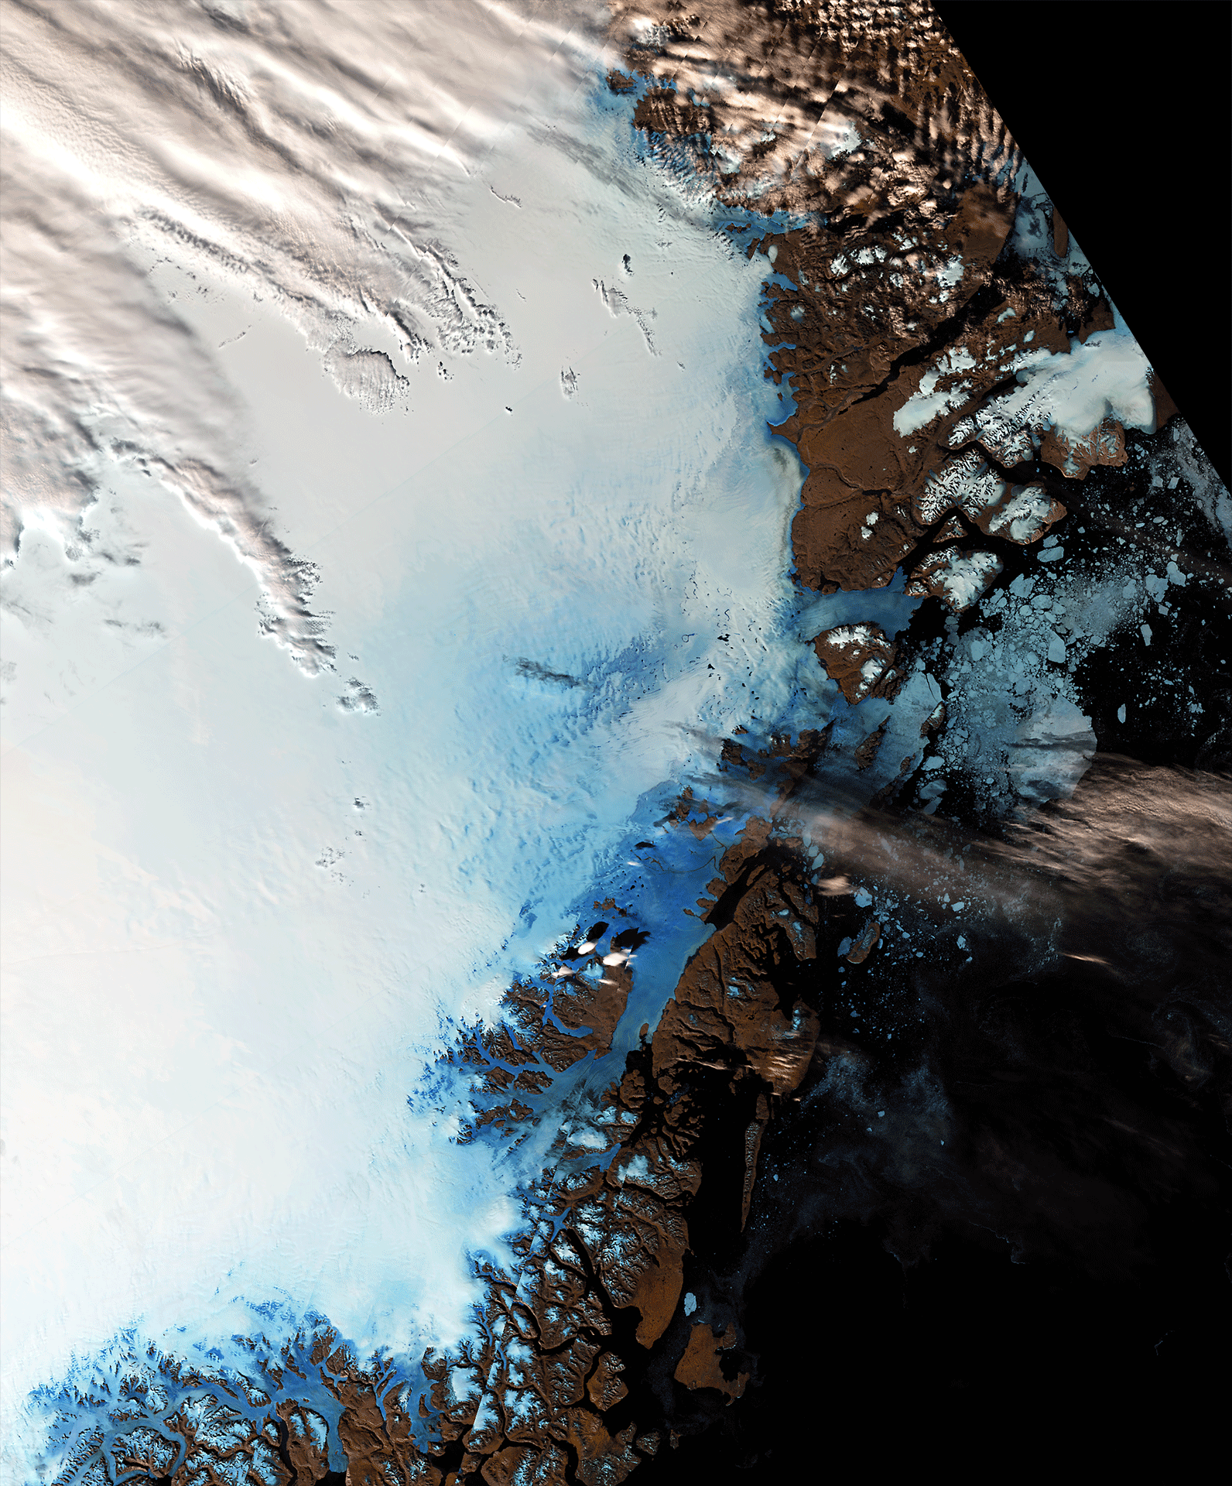
OLCI: Status Level 1
(TOA radiances)
Ocean and Land Colour Instrument (OLCI) designed for observation with high absolute (relative) accuracy of 2 (1) % in reflectance, providing continuity for MERIS (Envisat)
Level 1 performance
  Radiometry: on-board radiometric calibration based; SNR is compliant with specification; calibration gains show some time variability but stability seems to improve with time; vicarious calibration shows spectrally/spatially/dynamically/X-track consistent results, however a ~+3% bias (yaw steering maneuvers for diffuser BRDF characterization)
  Spectrally: fully compliant; pre-flight characterisation confirmed for all cameras in-flight (<0.15nm); small temporal trends since beginning of the mission (comparable to MERIS)
  Geometry: fully compliant (60m @ Nadir); bi-monthly check that thermo-elastic model is accounting for seasonal variations.
Switch on | 29 Feb 2016
Sample L1/L2 data available | May/June 2016
L1 data release | 20 Oct 2016
L2 data release | Spring 2017
Notes:
BRDF: bidirectional reflection distribution function – in flight correction, BRDF characterised before launch, important for cal coefficients for sun cal to know what on detectors from sun spectrum arrives, yaw steering changes the direction of incoming radiation, cal of BRDF; series of manoeuvres for changing sun geometry
TOA radiances: radiometrically corrected, calibrated and spectrally characterised, quality controlled, ortho-geolocated (latitude and longitude coordinates, altitude) and annotated with satellite position and pointing, landmarks and preliminary pixel classification (e.g. land/water/cloud masks). Products are generated in FR (300 m) and in RR (1.2 km) for the whole globe with the same coverage.
L2 OC4Me Chlorophyll (Chl): OLCI bands 443, 490, 510 and 560 nm are used to estimate the Chlorophyll concentration, Chl, according to a semi-analytical algorithm developed by Morel et al

Slide 10
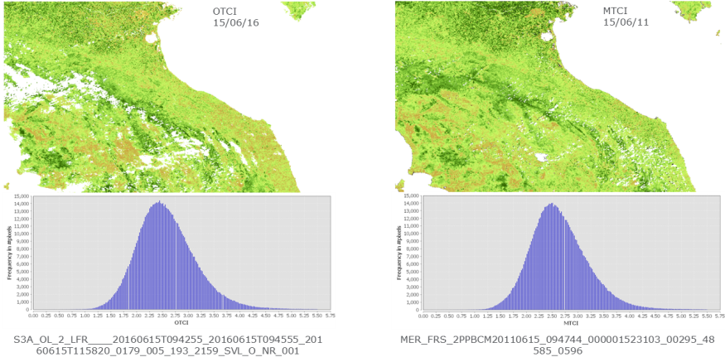

OLCI: Status Level 2 LAND
(FAPAR/OGVI, OTCI)
OLCI and MERIS Terrestrial Chlorophyll Index
Level 2 product status
Cloud flag needs improvement
L2 products unavailable for inland waters
Improving standard product flags
Level 2 product validation on-going, comparisons between
OLCI and MERIS Terrestrial Chlorophyll Index shows good consistency
OLCI and MODIS FAPAR (at 250m) over selected sites show good agreement
OLCI and in-situ Terrestrial Chlorophyll Index shows good agreement
ESA VAL4VEG project planned for vegetation relevant data products from S2 and S3 (2017)
OLCI and in-situ Terrestrial Chlorophyll Index
Credit: J.Dash, University of Southampton
Notes:
VAL4VEG = Validation for Vegetation = FRM4VEG
FAPAR/ OGVI: Fraction of Photosynthetically Active Radiation (FAPAR) absorbed by the plant canopy. The rectified channels are also provided (681 nm, 865 nm), OLCI Global Vegetation Index
OTCI: OLCI Terrestrial Chlorophyll Index: (OTCI) Estimates of the Chlorophyll content in terrestrial vegetation from Rayleigh corrected reflectance. Aims at monitoring vegetation condition and health
IWV: Total amount of water vapour integrated over an atmospheric column

Slide 11
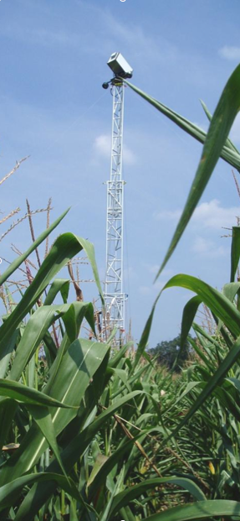
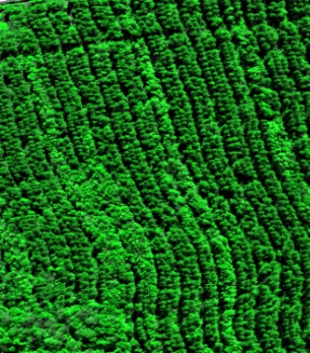
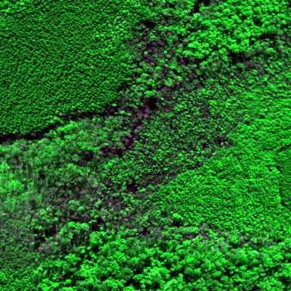
Fiducial Reference Measurements for Vegetation Products(VAL4VEG)
Aim To establish and maintain SI traceability of Fiducial Reference Measurements (FRM) for land vegetation products (Cab, FAPAR and Surface Reflectance).
  Laboratory and field individual measurement characterization experiments
  Round-robin performance assessment of Cab, FAPAR and Surface Reflectance measurement methods at OLCI pixel scale
  Kick-OffQ2 2017

Slide 12
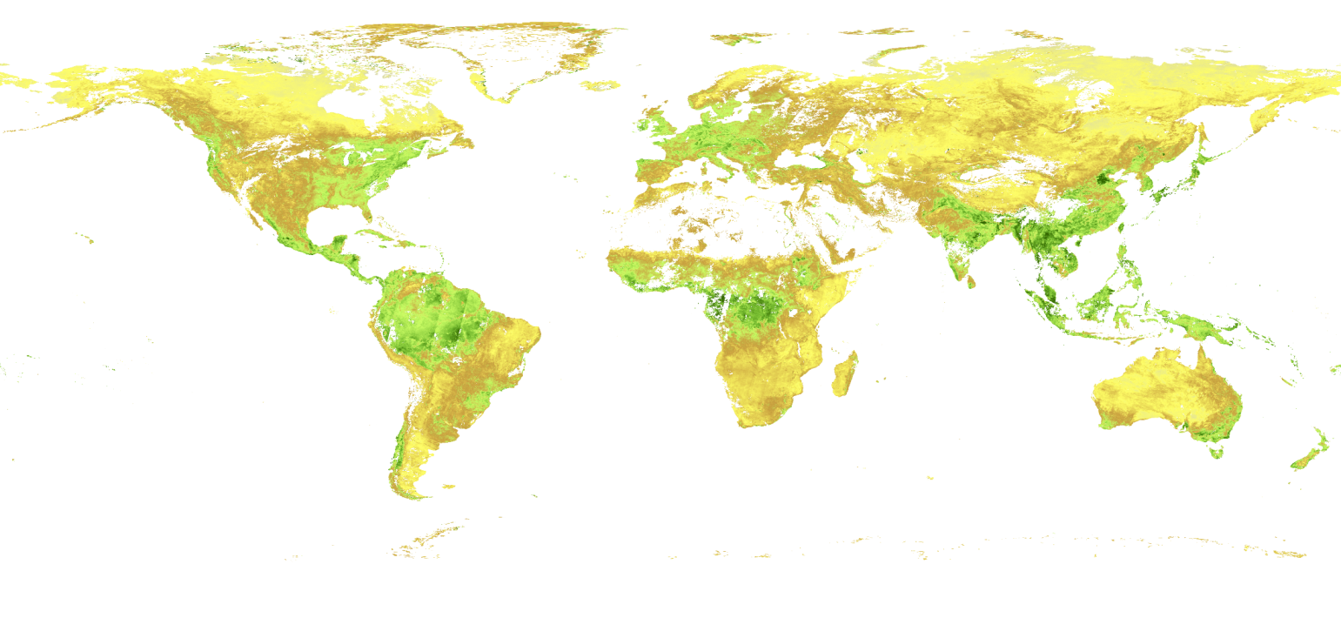
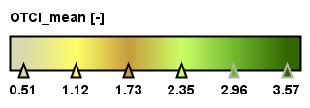
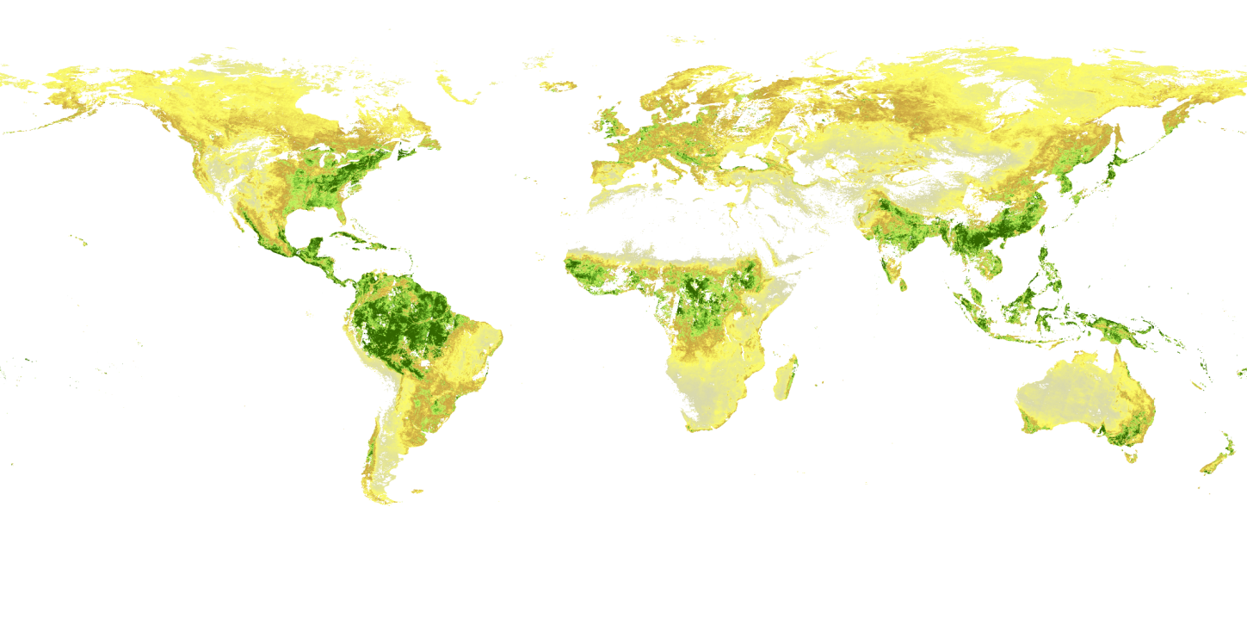
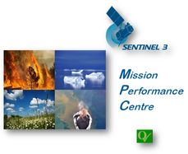

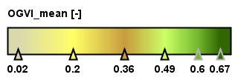
Global Land Products
OTCI (global mean, 20-23 September 2016)
OGVI (global mean, 20-23 September 2016)

Slide 13
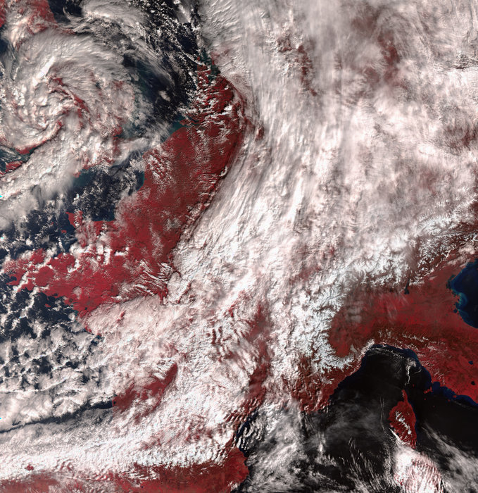
SLSTR: Status Level 1
(TOA radiances)
Sea and Land Surface Temperature Radiometer (SLSTR) designed for observations with high radiometric accuracy <2% (BOL)/<5% (EOL); < 0.2K (0.1K goal), providing continuity for(A)ATSR (Envisat); 100% overlap with OLCI
Nighttime acquisitions for S1-S4 (“day channels”) over Siberia and Gulf of Guinea in Jan 2017 to be characterize gas flares (9 collocation with VIIRS)
Level 1 performance
  Corrections to Basic Cloud Screening - improved
  SWIR calibration – improved, residual of 10%
  Geometric calibration corrections in Nadir and Oblique –March 2017
  Saturation thresholds – improved
  Co-registration of fire channels and their nominal channels (F1/S7 and F2/S8)– end 2017
  Co-registration of VIS and SWIR – March 2017
Switch on | 2 March 2016
Sample L1/L2 data available | May/June 2016
L1 data release | 17 Nov 2016
L2 data release | Spring 2017
Notes:
TOA radiances: Calibrated and ortho-geolocated radiances computed from instrument source packets in the short wave, visible channels and thermal channels. The radiances are provided on regular image grid at 500m resolution. The BT are provided on regular image grid at 1 km resolution.
The “nadir” and “oblique” view are collocated in space. The lat/lon/alt is given for each pixel in image grid.
The “orphan pixels” are also provided
Anomaly: Root cause: ice on the detector which will require a decontamination and mission data outage.
Night time acquisitions: improve retrieval of gas flares with SLSTR data, at moment not measuring at night from VIS channels, but VIRS does, i.e. develop European expertise, Fit Planck curve to spectrum to improve gas flare detection, needs a few measurements to improve retrieval.
MPI Johannes Kaiser support to his VIRS work, demonstrate European capacity for gas flare retrieval improvement in case SLSTR S1-4 would measure also in night time.
A FPU trap anomaly re-occurred on SLSTR on 25 July 2016 at 03:44:04z. Immediate recovery actions were taken. Following the stabilisation of the SLSTR IR detector temperatures, assessments of the SLSTR Sea Surface Temperature (SST) product quality have concluded that similar SST quality can be expected from 1st August onwards, to that found prior to the anomaly on 25th July. The impact of the slight increase in SLSTR instrument detector temperature (~1K) on the quality of SLSTR radiances and the retrieved products is being assessed but the product quality appears to have reached an equivalent level as that seen prior to the anomaly.

Slide 14
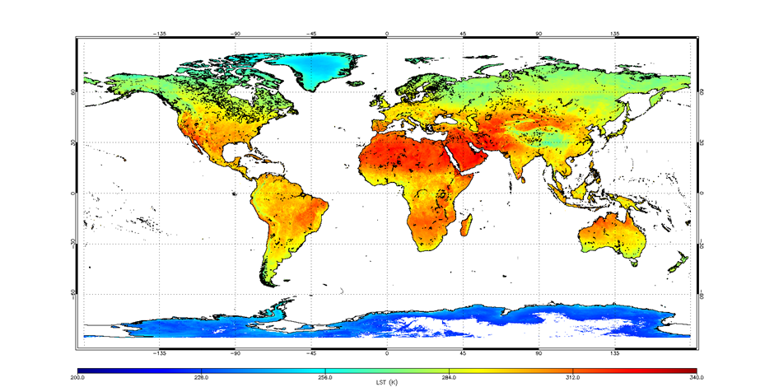
SLSTR: Status Level 2
(Land Surface Temperature)
Level 2 product status
Improvements for Level 1
LST coefficients continuously fine-tuned
Uncertainty estimates to be improved (future work: use GlobTemperature approach)
A probabilistic cloud mask will be introduced for better cloud flagging performance
Level 2 validation on-going
Initial validation using SURFRAD sites shows LST product is near to the mission requirement. The retrieval accuracy varies from 0.6 to 1.6 (MRD requirement < 1K)
Intercomparison with respect to GlobTemperature MODIS indicates product has very small overall differences
  Differences correlated with orography and biome
  Larger differences in bare soil regions where solar insolation is high
Next validation steps in S3 MPC/ESL will be further comparisons with MODIS and SEVIRI
Land Surface Temperature monthly composite for September 2016 (D. Ghent, University of Leicester)
Notes:
Future work (from Darren’s presentation):
Improved uncertainty model – based on GlobTemperature approach
Transient snow masking (NDSI, Istomina, IMS …)
Dynamic water vapour from met files
Dynamic fractional vegetation
Separate day/night d and m parameterisation
SURFRAD: NOAA, surface radiation network sites, global verteilt, AERONET principle = fixes land sites

Slide 15
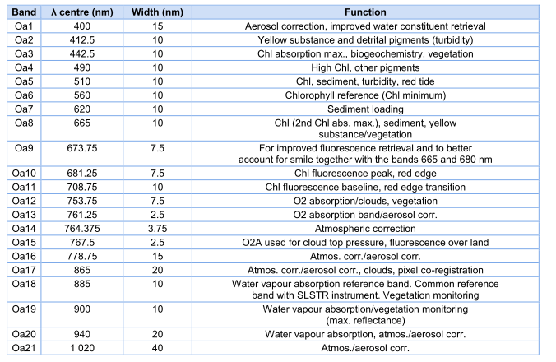
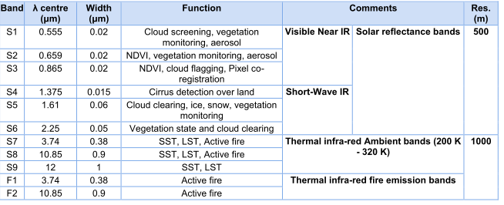
Combining OLCI and SLSTR radiances
= SYNERGY/VGT products
Camera 1
Camera 2
Camera 3
Camera 4
Camera 5
OLCI L1B Instrument and image grid
Combining all OLCI (but O2/H2O absorption) channels and SLSTR S1, 2, 4-6
Rational for combination: Covering larger spectral range and collocate different info from 2 complementary instruments
oblique view acquisition
nadir view acquisition
co-registration channel
SLSTR L1B Instrument nadir view and oblique view and image grid
Notes:
Each OLCI camera has all channels
Oa17 = co registration channel
Using all (but 14/15, O2/H2O absorption channels ) OLCI channels + S1, 2, 4-6 SLSTR
Rationale for combination: larger spectral range (S4-6) and collocate different info from 2 complementary instruments in same spectral range (S1/2), with OLCI providing the spectral information and SLSTR having the observation geometry
What is added value of combining radiometer and spectrometer: OLCI = more powerful spectral capacity, SLSTR = observation geometry with nadir/oblique view to remove e.g. atmosphere
Different viewing geometry: OLCI pushbroom spectrometer whereas SLSTR is circular scanning

Slide 16
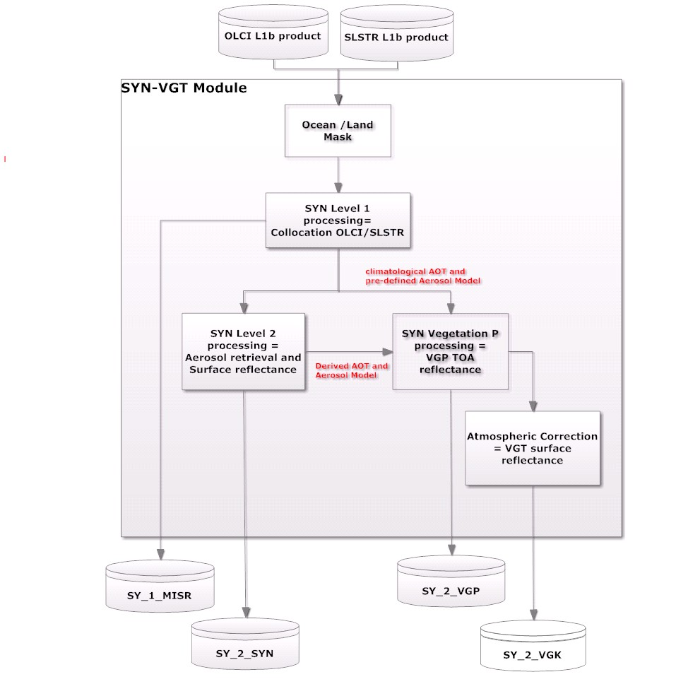
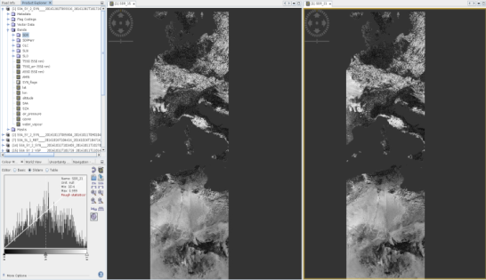
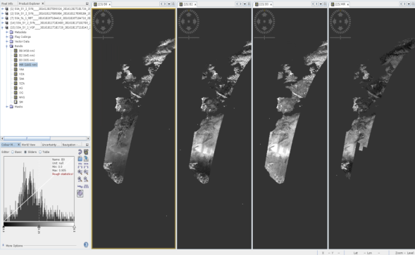
S3 SYN-VGT algorithm overview
SYNERGY (SY_2_SYN) Atmospherically corrected land surface reflectance at all OLCI and SLSTR wavebands (both nadir and oblique views), other than within gaseous absorption bands (O2, H2O)
Resolution 300 m, contains:
Surface Reflectance (per channel on OLCI grid)
Aerosol Optical Thickness + associated error
Aerosol Angstrom Exponent
Aerosol Model File
Contextual parameters = Lat, long, time, quality flags
Sub-sampled Contextual parameters = Lat, long, solar and viewing angles, meteo
VEGETATION (VGT SY_2_VGP (P/S1/S10): Top of Atmosphere Reflectance product provided for the continuity of the SPOT VGT-P product. Generated from OLCI and SLSTR channels interpolated to VGT bands.
Resolution 1 km Plate Carrée grid (for continuity with Spot-5/ Proba-V continuity, but 300m option
Based on OLCI/SLSTR data interpolated on to 4 channels from Spot-5/Proba-V (= Real heritage product) Both OLCI and SLSTR, contains:
VGT TOA Reflectance
NDVI
1km Sub-sampled Contextual parameters : VZA; VAA, SAA, SZA, AOT, O₃, TCWV
USER PRODUCTS: SYNERGY and VEGETATION Sample products expected May 2017, official release summer 2017
Sample SYN L2 product; Surface reflectance at 865 nm derived from OLCI channel and SLSTR nadir channel Credit: C.Henocq/ACRI/MPC
:
Credit: C.Henocq/ACRI/MPC
Notes:
How is collocation done of OLCI and SLSTR
2 chains, 1) SYN for aerosol retrieval and surface reflectance (had this before with MERIS/AATSR as demonstrator) and 2) vegetation = TOA reflectance
Why not distributing other products? Sy_1_MISR = too big, but available on request from S3VT but not core product
NEW AOD: similar but better surface and aerosol model
L2 SYN:
Atmospherically corrected land surface reflectance at all OLCI and SLSTR wavebands (both nadir and oblique views), other than within gaseous absorption bands (O2, H2O). The reflectance is given together with the Aerosol load, expressed in optical depth at a given wavelength (550 nm).
VGT-P:
Swath - Top of Atmosphere Reflectance product at 1 km resolution provided for the continuity of the SPOT VGT-P product. Generated from OLCI and SLSTR channels interpolated to VGT bands. It is provided as a Stripe mapped on a Plate Carrée projection.
VGT-S1 – VGT-S10:
Daily/“ten days composite” 1 km resolution fully atmosphere-corrected Surface Reflectance for the four SPOT channels, synthesised from OLCI and SLSTR channels (nadir view only). This is a SPOT VGT continuation product.
It is provided with Daily/“ten days” composite Normalised Difference Vegetation Index derived from for the four SPOT channels synthesised from OLCI and SLSTR channels (nadir view only). This is a SPOT VGT continuation product.
VALIDATION
SYN: S3VT proposals , based on AERONET mainly , PI: North, VITO,
In principle validation done by comparison with
Other sensor (MODIS, VIIRS)
Stats/ trend of your own product (MPC)
Model (JRC vegetation model TOA reflectance and then compare to sat
In-situ
VGP: Comparing with similar sensors mainly Proba/SPOT etc/

Slide 17
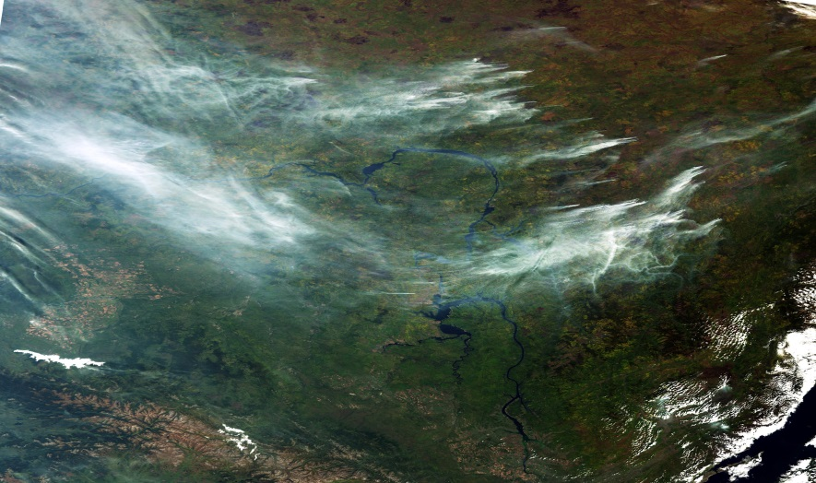
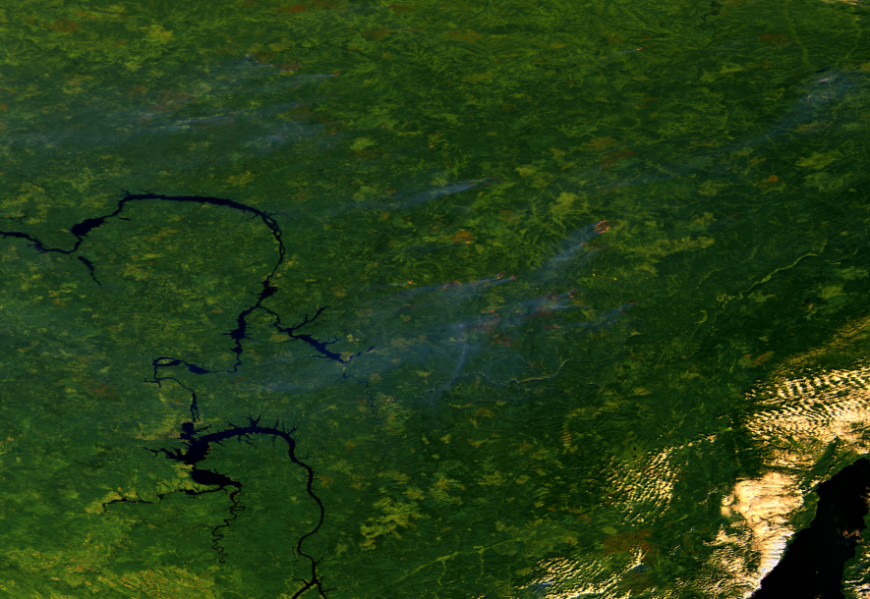
NEW PRODUCTS
Aerosol Optical Depth (AOD)
AOD NRT: Based on P.North (2002): “ Estimation of aerosol opacity and land surface bi-directional reflectance from ATSR-2 dual-angle imagery: operational method and validation’; Validated with AATSR data within ESA’s CCI: provides best results when compared with AERONET and over bright surface.
AOD NTC: Based on above algorithm adapted for SYNERGY products including spectral capacities of OLCI (North et al., 2010); Validated using MERIS and AATSR.
The above algorithms will need to be extended to cover the retrieval of aerosol properties over ocean.
Implementation on-going, available in mid-2017 in NRT from EUMETSAT and NTC from ESA
Fire Radiative Power (FRP)
Current algorithm based on Wooster et al. (2005) JGR D21111:doi: 10.1029/2005JD006318 ; SLSTR algorithm : Wooster et al. (2012) Remote Sens. Environ, 120, 236-254.
Needs to be extended to include detection of fire over sea surface in coastal areas and in known oil-gas producing areas.
Database of land and ocean gas flare and volcano masks will be included in the data product to provide a hotspot classification/type to users.
Implementation on-going, available in end-2017 in NRT from EUMETSAT and NTC from ESA
Fires in Siberia, September 2016
OLCI, smoke plumes
SLSTR, brightness temperatures

Slide 18
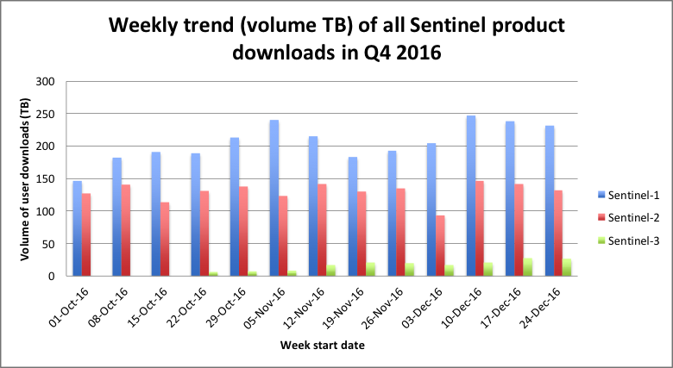
ESA Sentinels Data Distribution - Volumes
Approx. 4,6 MILLION products were downloaded during Q4-2016 (4,6 PB of data)

Slide 19
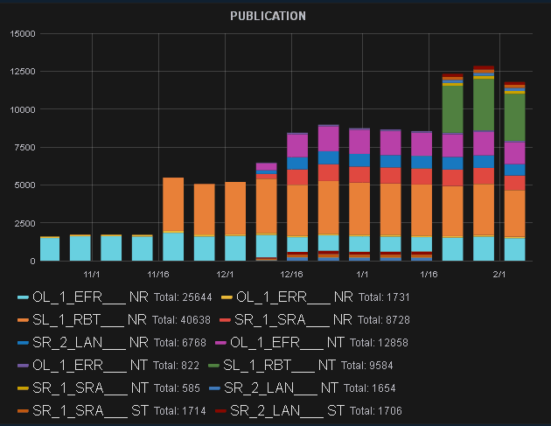
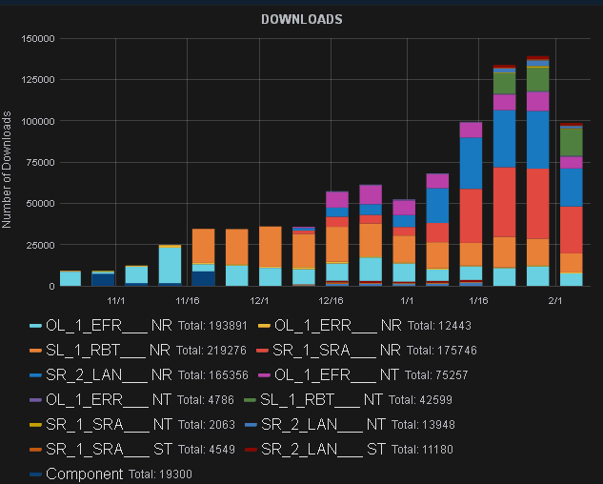
ESA Sentinel-3 pre-ops Hub
Publication of products (#) 20 Oct 2016 – 8 Feb 2017
Download of products (#)
20 Oct 2016 – 8 Feb 2017

Slide 20
Update on Sentinel-3B
Sentinel-3B activities restarted in Q2 2016 after Sentinel-3A launch in Feb 2016
Implementation of Return of Experience (REX) from S3A on-going
Instrument status
  Topography payload fully available and integrated, no open issues
  SLSTR Proto-Flight Model assembly and testing progressing according to plan: Instrument now at RAL for calibration tests before delivery to Prime planned mid-Feb 2017
  OLCI-B model experienced major anomaly (same as for A instrument) during instrument TVAC in July 2016; decision to refurbish all 5 cameras, with new gluing process; delivery of OLCI-B for S/L integration by mid June 2017
In view of late delivery of OLCI, Sentinel-3B S/L Integration and test activities reorganised to fit launch schedule
Sentinel-3B Flight Acceptance Review planned for Set/Oct 2017, with a launch of Sentinel-3B on Rockot currently scheduled for Nov 2017

Slide 21
Sentinel-3A and -3B Tandem Phase
MOTIVATION
GCOS Climate Monitoring Principles (GCMP): need to fully understand biases between satellite missions
“Take steps to make radiance calibration, calibration-monitoring and satellite-to-satellite cross-calibration of the full operational constellation a part of the operational satellite system”
“A suitable period of overlap for new and old satellite systems should be ensured for a period adequate to determine inter-satellite biases and maintain the homogeneity and consistency of time -series observations”
Improved data quality for climate (CDR) and operational applications alike
TECHNICAL PLANNING
Operate S3A and S3B in Tandem for ~4-5 months at start of mission
One satellite follows the other with 30 sec separation: minimum oceanographic and atmospheric variability reducing uncertainty in comparing measurements from both satellites
Tandem and drift phase into final orbit separation of 140 degree between S3A/B separation completed by launch + 7 months
Full operational capacity reached by launch + 9 months

Slide 22
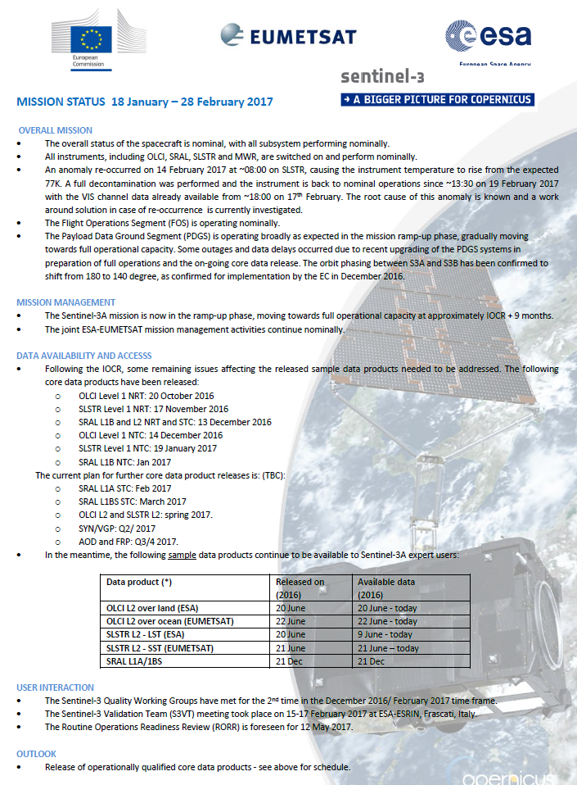
MAIN MESSAGES
S-3A in ramp-up phase
All instruments are switched on and working well.
Official data release
  OLCI Level 1 NRT: 20 October 2016
  SLSTR Level 1 NRT: 17 November 2016
  SRAL L1B and L2 NRT and STC: 13 December 2016
  OLCI Level 1 NTC: 14 December 2016
  SLSTR Level 1 NTC: 19 January 2017
  SRAL L1B NTC: Jan 2017
  SRAL L1A: 6 March 2017
  SRAL L1BS STC: end- March 2017
  OLCI L2 and SLSTR L2: spring 2017.
  SYN/VGP: Q2/ 2017
  AOD and FRP: Q3/4 2017.
Product evolution
  Land product harmonisation/synergy (Proba-V, S3, S2)
  Improvements to vegetation products
  Snow cover: SEOM project
    Data access in operations
      L1/L2 LAND: ESA through the Sentinel Data Hub, Copernicus Services Hub, Collab Hub etc
      L1/L2 MARINE: EUMETSAT’s Earth Observation Portal (EUMETSAT’s ODA, Data Centre, EUMETCast)
Sentinel-3B launch planned for end 2017
Weekly mission status on https://sentinel.esa.int/web/sentinel/missions/sentinel-3/mission-status
Notes:
Change Detection Map (CDM) Level 2B Product
Leaf Area Index (LAI) Level 2B Product
Fraction of Vegetation Cover (fCover) Level 2B Product
Leaf Chlorophyll Content (Cab) Level 2B Product
Leaf Water Content (Cw) Level 2B Product
Snow Cover (SC) Level 2B Product
Burn Scars (BS) Level 2B Product
Fuel Load (FL) Level 2B Product
Structural Fire Index (SFRI) Level 2B Product
Crown Density (CD) Level 2B Product
Forest Age (FA) Level 2B Product
Specification of Flood Monitoring (FRM) Level 2B Product
Land Cover (LC) Level 2B Product

Slide 23
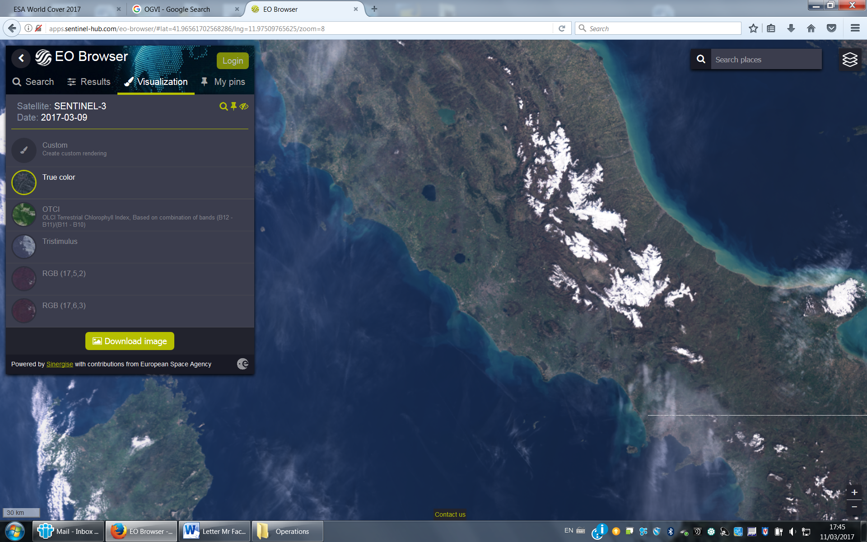
New tool for Sentinel-2, Sentinel-3, Landsat, data visualisation: http://apps.sentinel-hub.com/eo-browser/
(Sinergise, Slovenia)

Slide 24
THANK YOU
Susanne Mecklenburg
Susanne.mecklenburg@esa.int

