Slide 1
Rationalising the CEOS Land Surface Imaging Activities
Committee on Earth Observation Satellites
Stephen Ward, SIT Chair Team LSI-VC-3 (remotely)
20 March 2017

Slide 2
Contents
Background and status
Issues for consideration
Next steps

Slide 3
Background and status
Ongoing discussion for years around opportunity
Agencies represented in LSI, SDCG, GEOGLAM keen
Side meeting at Brisbane Plenary – trial meeting agreed as way forward
Discussion Paper followed
Leadership telcon 22nd Feb – strong consensus to proceed and assumption ‘it will happen’

Slide 4
Objectives
A more holistic approach to overall requirements and observing strategy
Efficiencies in travel and representation

Slide 5
Issues to consider
Format and goals for the Trial Meeting
Future meeting cycle & calendar
Representation & leadership
Joint Work Plan
Road Map

Slide 6
Trial Meeting
6-8 Sep, with SDCG (at least) on 5th
Approximate shape
Half day together at start
Two half day sessions in parallel (some time on each group’s business, some to prep maybe for final session)
Trial by doing
Work out practical and strategic issues

Slide 7
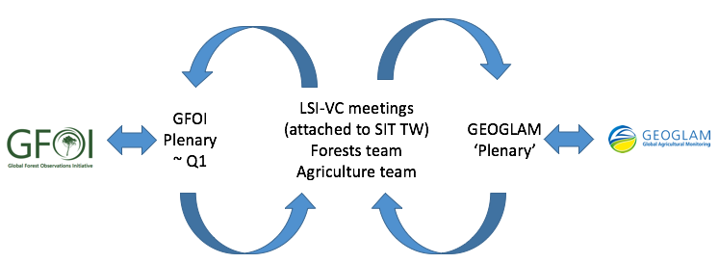
Meeting Cycle & Calendar
‘Forest’ and ’Ag’ teams have to continue to engage with their constituencies and motherships
SDCG meeting cycle constraints: attending annual GFOI Plenaries; week prior to SIT TW ($$)
GEOGLAM meetings less frequent
Propose following baseline annual cycle:

Slide 8
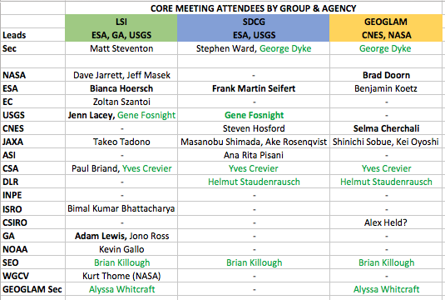
Representation & Leadership

Slide 9
Representation & Leadership
For GFOI purposes, best to keep ‘SDCG’ name at least for external purposes? Keep identity for purposes beyond CEOS - even if known as LSI ‘Forest Team’
Existing management could be retained but agency representation might dictate changes
SDCG asks all core agencies to stay the course with GFOI entering start of Phase 2
Evolve to integrated/clustered reporting to key CEOS meetings (keep GFOI and GEOGLAM reports but with LSI reports)?

Slide 10
Joint Work Plan
Trial meeting and its prep can begin serious focus on joint work plan, but expect:
unified requirements & observing strategy
ARD
pilot activities
Global Data Flows

Slide 11
Road Map
Have the trial meeting, work out the practicalities and establish consensus on approach
Report to SIT TW on outcomes
Implement meeting cycle in 2018
Feb/Mar 2018 SDCG meeting
Sep 2018 integrated meeting (week before SIT TW USA?)
Continue to draw on SIT Chair Team capacity to support prep & coordination (at least through to Nov)

