Slide 1
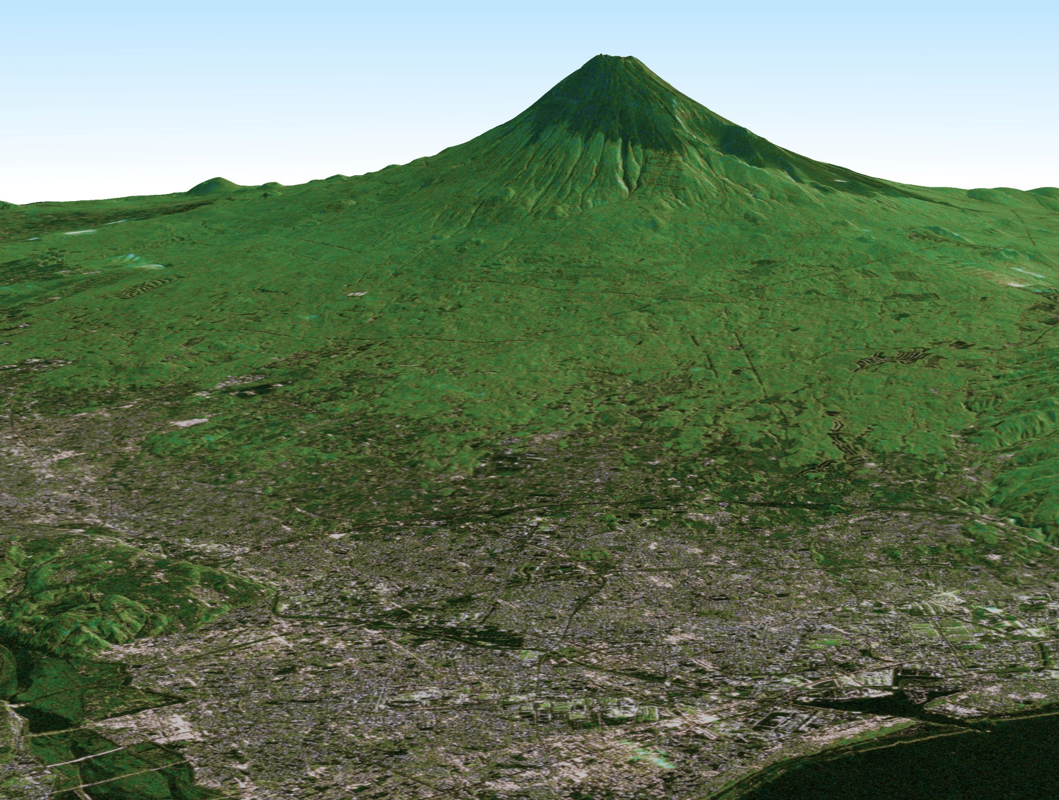
CEOS LSI-VC #3 Meeting, ESA ESRIN, Frascati, Italy
JAXA’s Analysis Ready Data (ARD)
JERS-1, ALOS, ALOS-2, and Future
20-21 March, 2017
Takeo Tadono¹, Masanobu Shimada^{1,2}, and Ake Rosenqvist³
¹ Earth Observation Research Center (EORC)
Japan Aerospace Exploration Agency (JAXA)
² Tokyo Denki University, Japan
³ SoloEO, Japan

Slide 2
Contents
JAXA’s EO Status
  History of L-band SARs: JERS-1, ALOS, ALOS-2, and future
Analysis Ready Data (ARD) Production Status
  Case study for forest observations “GFOI”
Description of SAR ARD
Summary

Slide 3
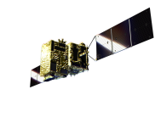
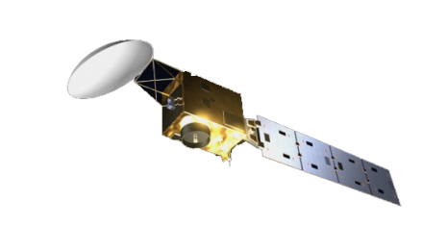
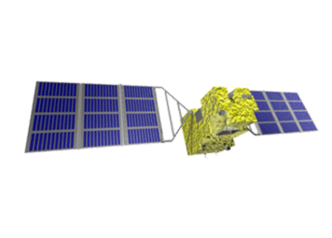
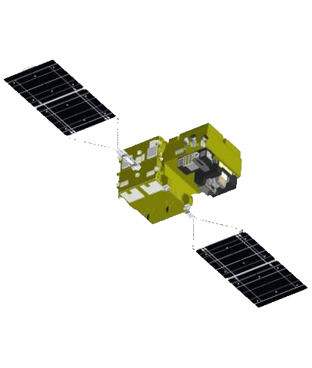
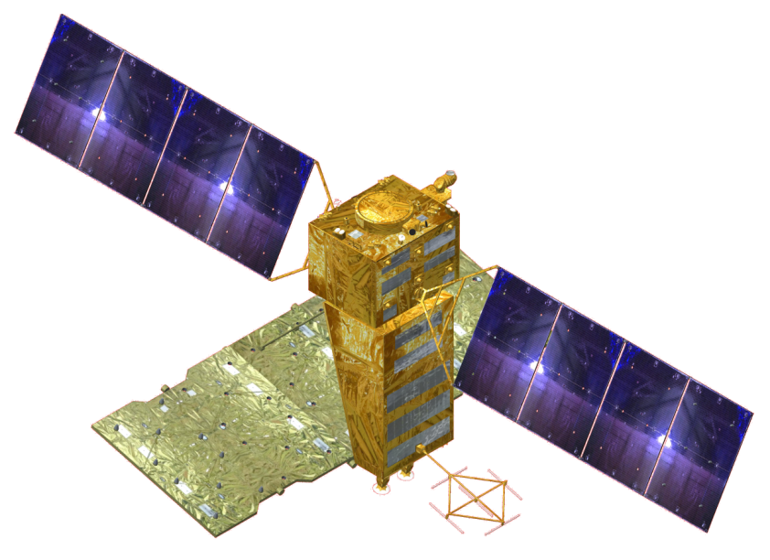


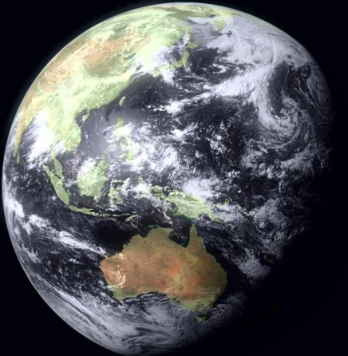
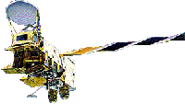
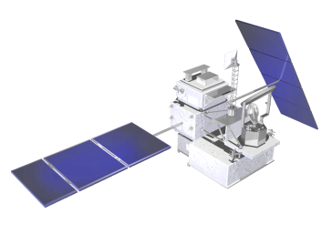
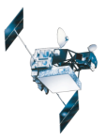
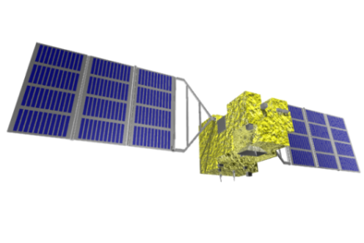
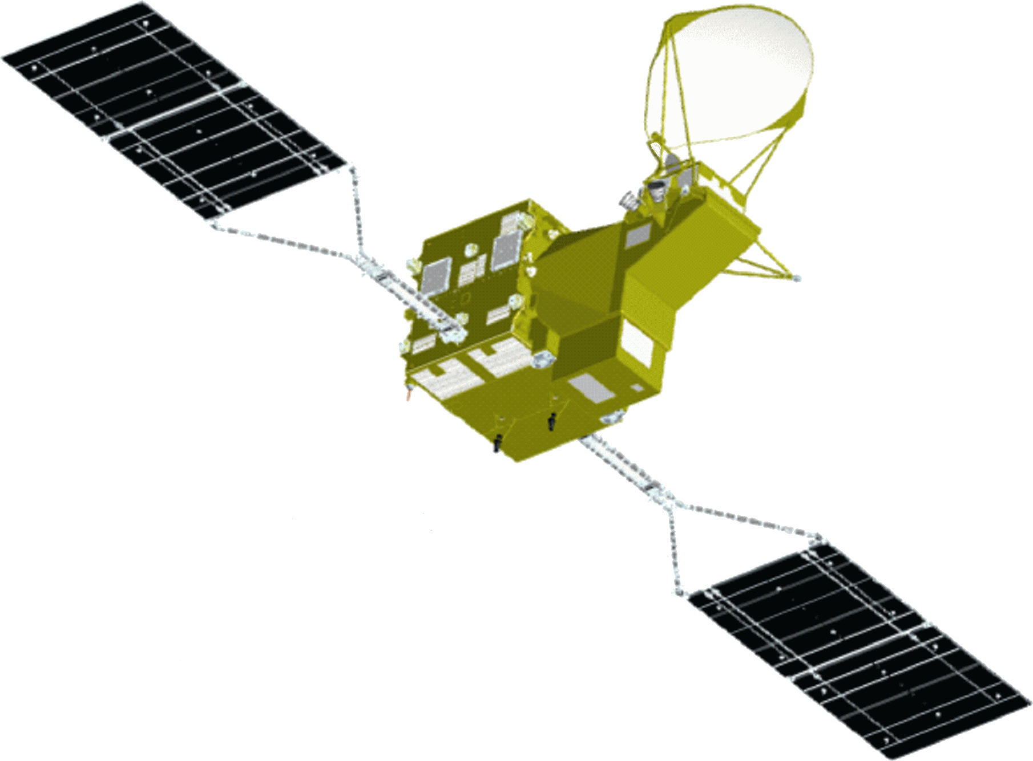
JAXA’s EO Satellites
JAXA’s Past, Current and Future Satellite/Sensor Activities
Advanced Optical Satellite
Earth CARE/CPR
(JFY2020)
GOSAT-2
(JFY2018)
(JFY2018)
GCOM-C
(JFY2017)
ALOS-2
Advanced SAR Satellite
(JFY2014)
(JFY2020)
DAICHI (ALOS)
GPM/DPR
(JFY2005)
(JFY2013)
Aqua/AMSR-E
(JFY2002)
ADEOS-II
SHIZUKU
(GCOM-W)
(JFY2002)
TRMM/PR
JERS-1
MOS-1
(JFY2012)
(JFY1997)
(JFY1991)
(JFY1986)
IBUKI (GOSAT)
(JFY2008)

Slide 4
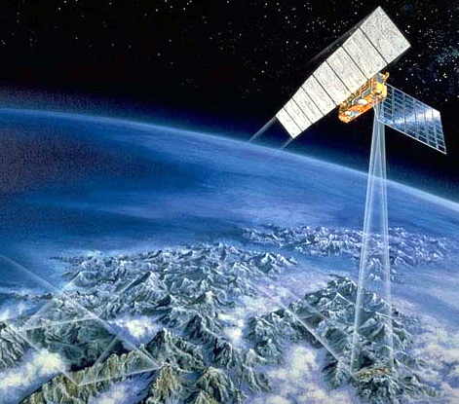
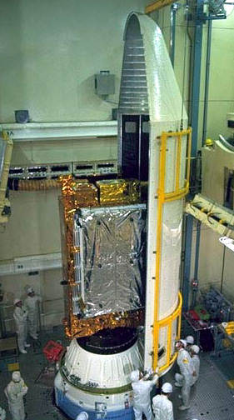
Japanese Earth Resources Satellite-1
(JERS-1, “FUYO”)
Japanese Earth Resources Satellite-1 (JERS-1)
Feb. 1992 - Oct. 1998
Launcher: H-I
Orbit: Sun-Shyncronous
Altitude: 568 km
Inclination: 98°
Revisit: 44 days
Weight: 1,340 kg
SAR
L-band (1.275 GHz)
HH
Resolution: 18 m
Swath: 75 km
OPS (Optical Sensor)
VNIR (Visible and Near Infrared Radiometer) 3ch,
SWIR (Short Wavelength Infrared Radiometer) 4ch,
18×24 m, 75 km

Slide 5
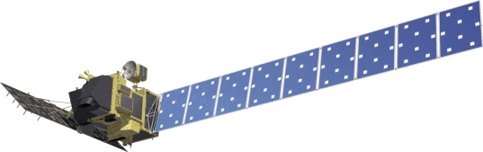
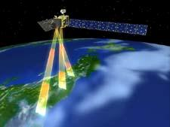
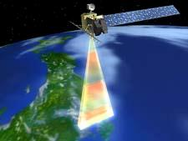
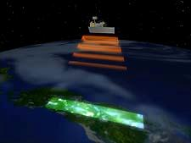
Advanced Land Observing Satellite
(ALOS, “DAICHI”)
Operation
24 Jan. 2006 by H-2A Rocket #8
12 May 2011 Mission ended
~22 Apr. 2011: Low Load Mode (LLM)
> 1,934 days=5.3 years > 12 mil. scenes
Objectives
  Cartography (1/25,000 scale)
  Regional environmental monitoring
  Disaster monitoring, etc.
PRISM
AVNIR-2
PALSAR
PRISM
Panchromatic Remote sensing
Instrument for Stereo Mapping
AVNIR-2
Advanced Visible and Near-Infrared Radiometer type 2
PALSAR
Phased Array type L-band
Synthetic Aperture Radar
PRISM can acquire triplet stereo imageries by nadir-, forward-, and backward-radiometers with 2.5 m spatial resolution in 35 km swath.
AVNIR-2 can observe with 10 m resolution in 70 km swath, and it can be changed the observation area by pointing capability within +/-44 deg. in across track.
PALSAR can acquire the data in not only daytime but also nighttime as well as cloudy and rainy whether conditions.

Slide 6
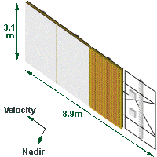
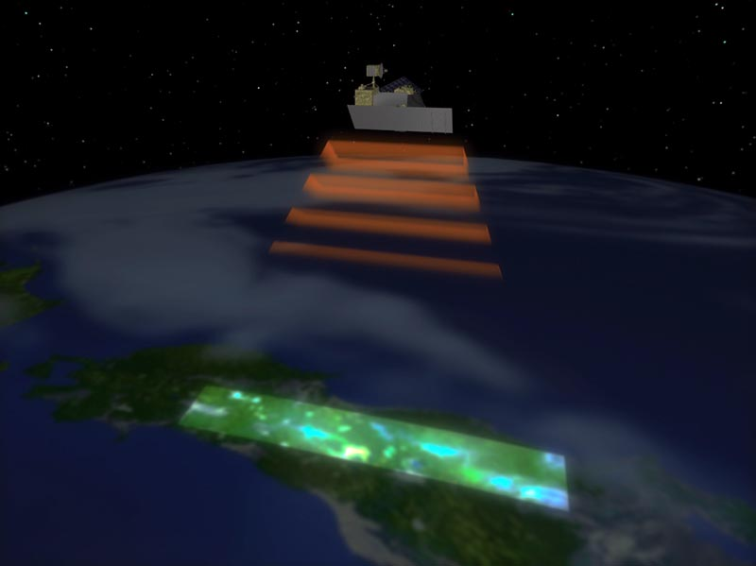
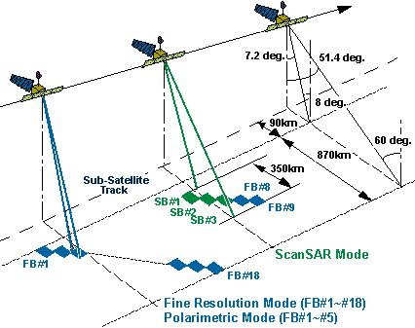
ALOS PALSAR
Phased Array type L-band Synthetic Aperture Radar
L-band (1.27 GHz)
Fine Resolution Mode
8.0-60.0 deg.
HH or VV / HH+HV or VV+VH
7.0-44.3m / 14.0-88.6m
40-70km / 40-70km
ScanSAR Mode
18.0-43.0 deg.
HH or VV / 100m / 250-350km
Polarimetric Mode
8.0-30.0 deg.
HH + HV + VH + VV
24.1-88.6m / 20-60km

Slide 7
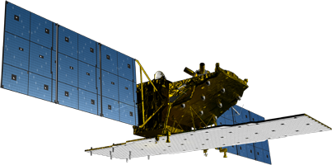
Advanced Land Observing Satellite-2
(ALOS-2, “DAICHI-2”)
Orbit | Orbit |  | Sun-Synchronous Sub-Recurrent (Repeat cycle: 14 days)
 | Altitude |  | 628 km (at Equator)
 | Local sun time |  | 12:00 (noon) at Equator (Descending)
Design Life |  |  | 5 years (target: 7 years)
Launch |  | Date | May 24, 2014
 |  | Rocket | H-IIA FY24
Satellite |  | Mass | Approx. 2 ton
 |  | Paddle | Dual wing solar paddle
Mission data transmit |  |  | Direct and via. DRTS
SAR |  |  | L-band (1.2 GHz range)
Mode | Spotlight |  | Resolution: 1-3 m, Swath: 25 km
 | Stripmap |  | Resolution: 3 / 6 / 10 m Swath: 50 / 50 / 70 km
 | ScanSAR |  | Resolution: 100 / 60 m Swath: 350 / 490 km
Y
X
Flight
Z
16.5m
Earth
3.7m
10m
L-band Synthetic Aperture Radar-2
（PALSAR-2）
Overview of ALOS-2 (Daichi-2)
The compact infrared camera (CIRC) and SPAISE2 for detecting ships are carried as a technology demonstration payload.

Slide 8
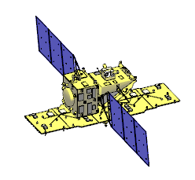

Advanced Land Observing Satellite-2
(ALOS-2, “DAICHI-2”)
Flight direction
Incidence angle: 8-70 deg.
同一地点を連続観測
Flight direction
70°
Nadir
8°
25 km x 25km
8°
350 or 490km
Un-observable area
80 km
50 or 70km
Spotlight
Swath: 25 km
Observable area
Approx. 1,160 km
70°
ScanSAR
Swath: 350 or 490 km
New observation mode
Stripmap
Swath: 50 or 70 km
PALSAR-2 Observation Geometry.
Continuity from ALOS/PALSAR

Slide 9
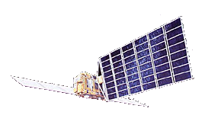
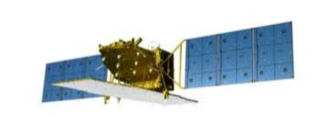
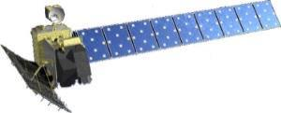
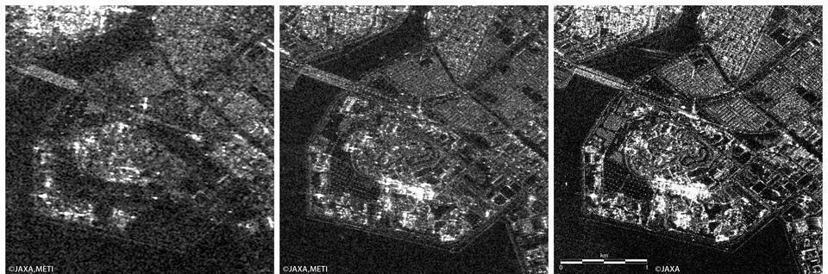
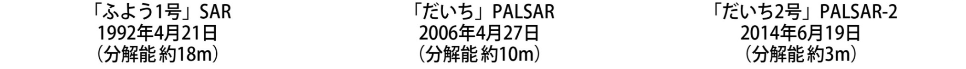
History of Japanese L-band SARs
JERS-1 SAR
1992 - 1998
ALOS PALSAR
2006 - 2011
ALOS-2 PALSAR-2
2014 -
Transmit power:
~1.5 kW
~2 kW
~6.1 kW
Resolution:
18 m
10 m / 100 m
3 m / 100 m
Swath width:
75 km
70 km / 350 km
50 km / 490 km
Polarization:
Single
Single, Dual, Quad
Single, Dual, Quad
Obs. direction:
Right
Right
Right or Left

Slide 10
Definition of ARD
The definition of the Analysis Ready Data (ARD) is depends on the application as well as the objective.
E.g., “the Global Forest Observations Initiative” (GFOI)*:
1) Radiometry (Information Units - comparable through time and across sensors): Atmosphere, solar illumination and viewing angle corrected, and cross-calibrated;
  a. Optical: Absolute calibration and surface reflectance:
    i. Landsat TM, Landsat ETM+, Landsat OLI/TIRS, SPOT 1-5, Sentinel-2
    ii. Caveats: Spectral band differences must be accounted for when comparing multiple sensors. The differences between Landsat and Sentinel-2 bands can be significant (see figure). Differences exist for most bands and differences may increase when bands are used to create derived products such as indices. Most time series algorithms do not currently accommodate spectral differences.
  b. SAR: Backscatter correction:
    i. Absolute calibration (calibration constant supplied by data provider)
    ii. Radiometric correction for topography by DEM
    iii. Normalisation of cross-track (near-far range) incidence angle variation
    iv. JERS-1/ALOS/ALOS-2 PALSAR global mosaics provide an example of analysis ready Radar data.
* Global Data Flow Study for the Global Forest Observations Initiative (GFOI), Ver. 0.11,24 Nov. 2015.

Slide 11
Definition of ARD
2) Geometry (Optical and SAR): Geolocation - pixels need to be aligned with a common origin and spatially nested;
  a. Orthorectification, coregistration, reprojection: Image to image registration accuracy, resampling method, pixel origin, and projection must be known
  b. Caveats: The miss-registration to a reference database should be kept below a half pixel, preferably below a quarter pixel. If different reference databases exist then the errors will be a function of both individual errors. The resampling algorithm, the number of times resampled and map projection all will impact the comparability of the data through time. Miss-registration will be reflected in the data values.
3) Data organization - users must be provided efficient access to a defined structure of tiled data. Pixel-level metadata identifying clouds, shadows, shadow/layover (for SAR) and sensor artifacts are also best provided by space agencies.
  a. Provenance, quality and cloud metadata
  b. Data reformatting and reorganization: for example, Data Cube. Data should be stored on line so direct access to the data is possible and tools must be available to extract spatial, spectral and temporal subsets of the data.
4) Methodologies
  a. Earth Observation variables (e.g., NDVI, greenness, bareness, wetness)
  b. Cloud-free Mosaics (e.g., annual, seasonal, monthly)
  c. Classification and change detection (e.g., Continuous Change Detection and Classification)
  d. Classification
  e. Validation and update of existing classification
* Global Data Flow Study for the Global Forest Observations Initiative (GFOI), Ver. 0.11,24 Nov. 2015.

Slide 12
JAXA’s SAR ARD Productions
Pre-processing (Multiple path processing):
SLC generation, Ortho-rectification+
Slope correction
Multiple raw data
DEM preparation
Multiple ortho generations
Mosaic (processing)
One examples for generating a mosaic image
Flowchart of producing a mosaic product.

Slide 13
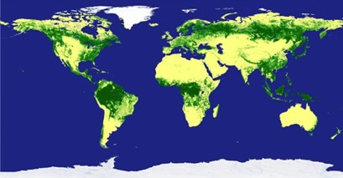
JAXA’s SAR ARD Productions
Download: JAXA’s SAR ARD (analysis ready Data), available from the web site:
http://www.eorc.jaxa.jp/ALOS/en/palsar_fnf/fnf_index.htm
Contents:
  Satellite: JERS-1/SAR (1996), ALOS/PALSAR (2007-2010), and ALOS-2/ PALSAR-2 (2015-)
  Frequency: Annual summer data (June-September)
  Data: gamma-zero image and forest/non-forest (FNF), ancillary data (local incidence, mask, etc.), spaced in 0.8 arcsec (approx. 25 m) and averaged in 100 m, ortho-rectified, and slope corrected
  Geometric accuracy: 10 m
  Expression: 2 byte data (unsigned short integer) for amplitude image
  Area: Global Land
  Download unit: 1 x 1 deg. or 5 x 5
  degrees in lat/long unit
Access:
  Free of charge
  E-mail registered

Slide 14
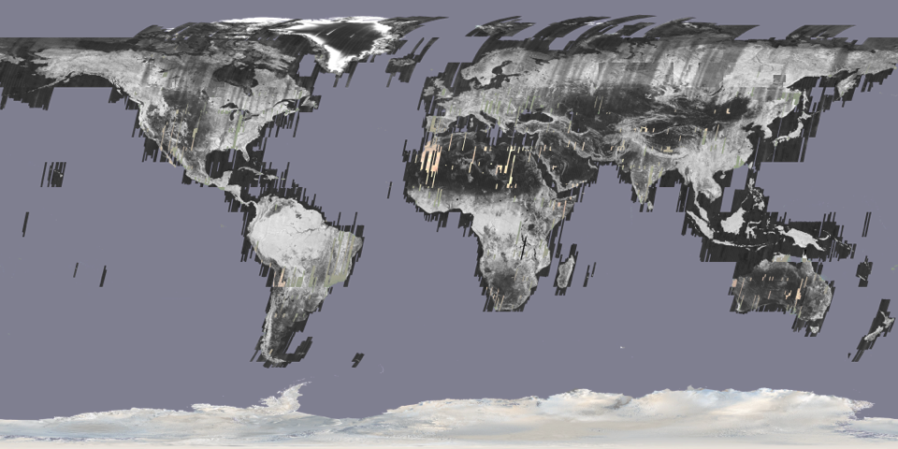
JAXA’s SAR ARD Productions
JERS-1 25 m global mosaic dataset (HH): 1992 - 1998

Slide 15
JAXA’s SAR ARD Productions
ALOS PALSAR 25 m global mosaic dataset (HH, HV): 2007 - 2010
Global 25 m mosaic (Ortho+slope correction)
Global 25m Forest/non-forest map

Slide 16
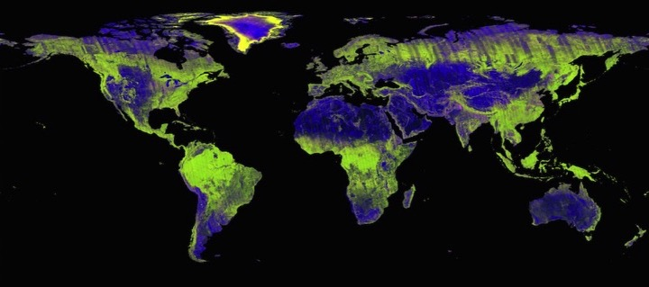
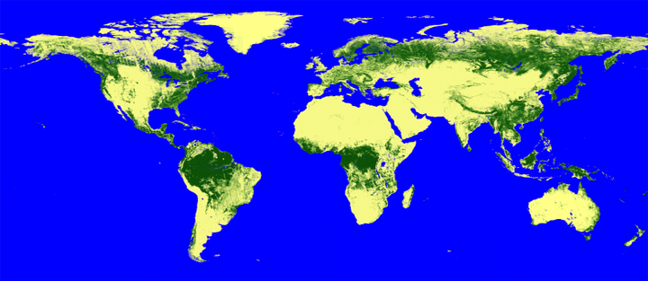
JAXA’s SAR ARD Productions
ALOS-2 PALSAR-2 25 m global mosaic dataset (HH, HV): 2015 -
Global 25 m mosaic (Ortho+slope correction)
Global 25m Forest/non-forest map

Slide 17
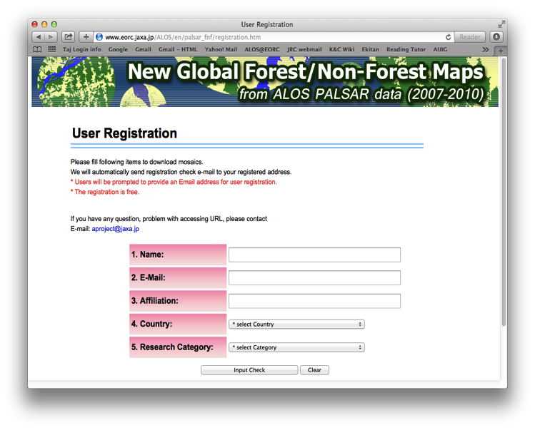
JAXA’s SAR ARD Productions
Online registration for download : JERS-1, ALOS PALSAR, ALOS-2 PALSAR-2 25 m global mosaic datasets open release:
http://www.eorc.jaxa.jp/ALOS/en/palsar_fnf/registration.htm
User ID and Password are sent to registored e-mail address automatically

Slide 18
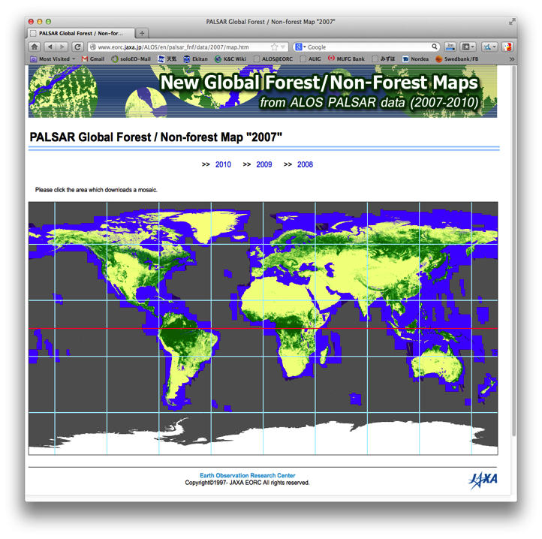
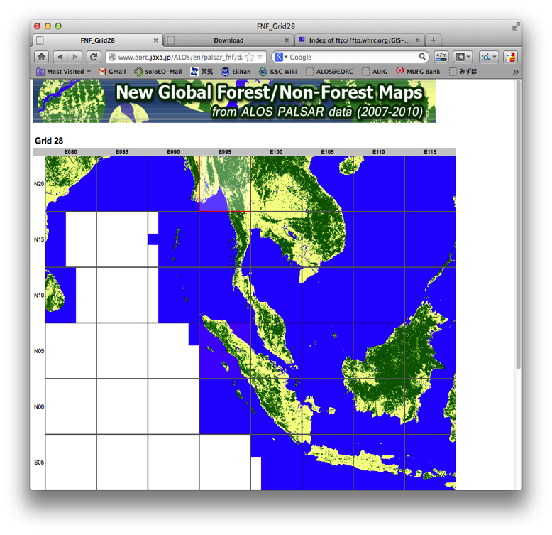
JAXA’s SAR ARD Productions
Browse of FNF can be confirmed after login and select preferred dataset:

Slide 19
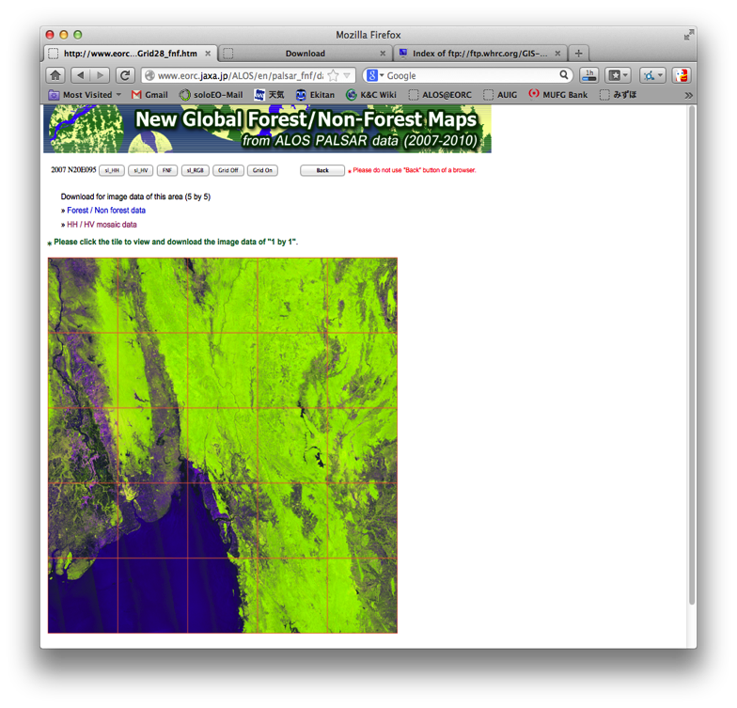
JAXA’s SAR ARD Productions
Download the dataset in 5 x 5 degrees or individual 1 x 1 deg. tile:
Bulk download of data
over 5 x 5 degrees region (25 tiles)
Click on a tile in the grid to download the individual 1 x 1 deg tile

Slide 20
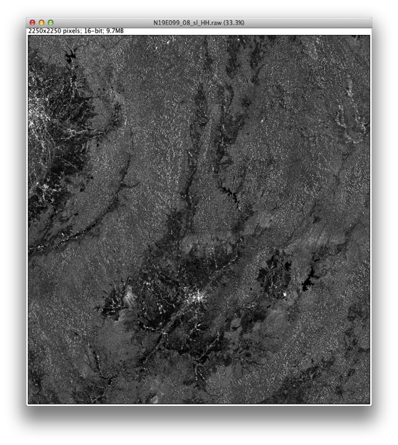
Contents of SAR ARD
PALSAR, PALSAR-2, and JERS-1 25 m global mosaic dataset:
Backscatter image (HH)
Radar backscatter, normalised for incidence angle ( γº = σº/cosθ_{i} )
Radiometric and geometric corrections for topography
16 bits (Unsigned INT)
ENVI header information

Slide 21
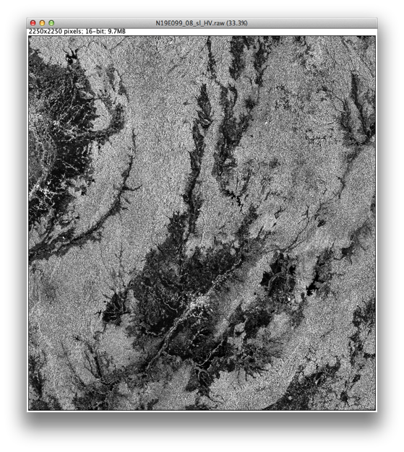
Contents of SAR ARD
PALSAR and PALSAR-2 25 m global mosaic dataset:
Backscatter image (HV)
Radar backscatter, normalised for incidence angle ( γº = σº/cosθ_{i} )
Radiometric and geometric corrections for topography
16 bits (Unsigned INT)
ENVI header information

Slide 22
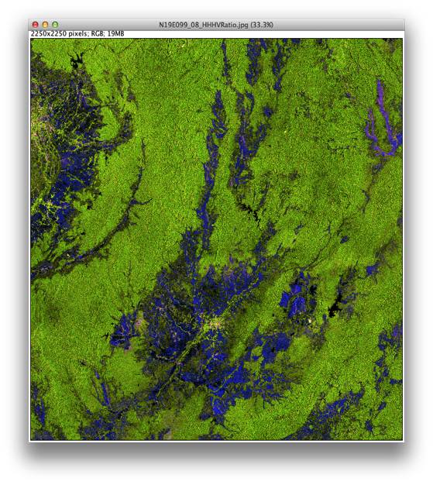
Contents of SAR ARD
PALSAR and PALSAR-2 25 m global mosaic dataset:
Backscatter image
Faulse color composite
R: HH
G: HV
B: HH/HV

Slide 23
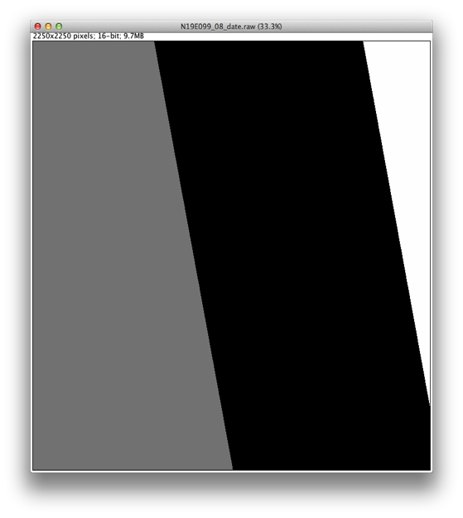
Contents of SAR ARD
PALSAR, PALSAR-2, and JERS-1 25 m global mosaic dataset:
Observation date layer
Data layer showing the acquisition date for each pixel in the image
Date = [Launch date] + DN
11/2/1992 for JERS-1,
24/1/2006 for ALOS, and
24/5/2014 for ALOS-2
16 bits (Unsigned INT)
DN=975
25/09/2008
DN=917
29/07/2008
DN=854
27/05/2008

Slide 24
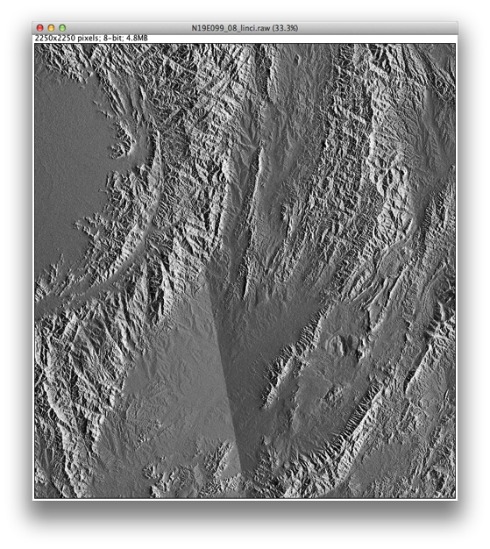
Contents of SAR ARD
PALSAR, PALSAR-2, and JERS-1 25 m global mosaic dataset:
Incidence angle layer
Layer with local incidence angle for each pixel
8 bits

Slide 25

Contents of SAR ARD
PALSAR, PALSAR-2, and JERS-1 25 m global mosaic dataset:
Mask information layer
Ocean and no-data areas: layover and shadow
8 bits

Slide 26
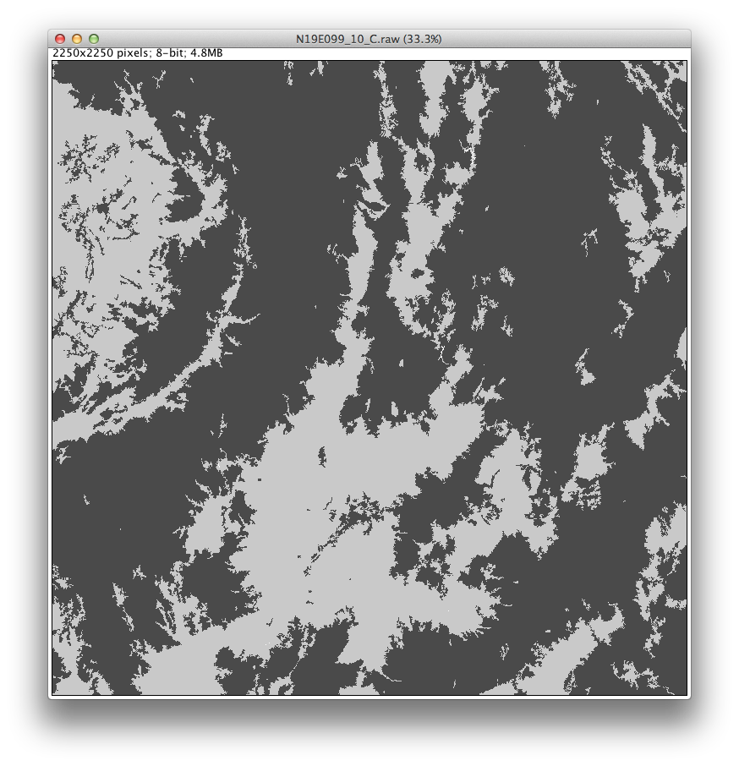
Contents of SAR ARD
PALSAR and PALSAR-2 25 m global mosaic dataset:
Forest and Non-Forest Classification
8 bits

Slide 27
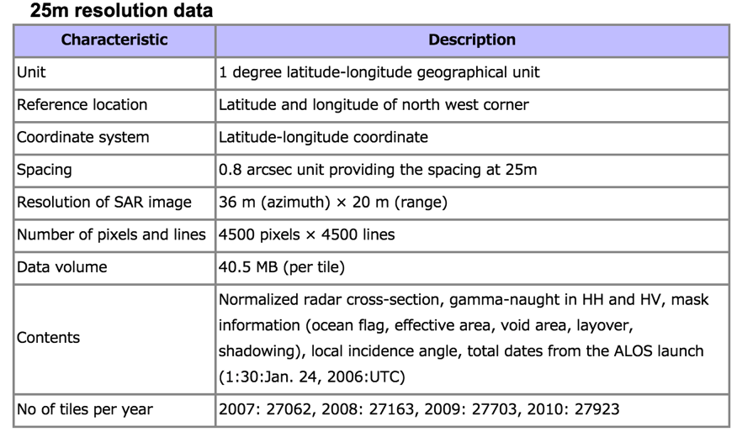
Contents of SAR ARD
PALSAR, PALSAR-2, and JERS-1 25 m global mosaic dataset:
Specifications and ancillary information (for PALSAR)

Slide 28
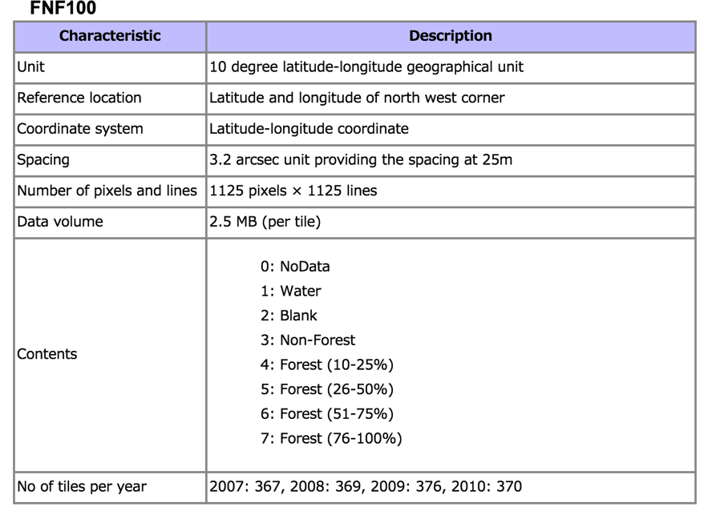
Contents of SAR ARD
PALSAR, PALSAR-2, and JERS-1 25 m global mosaic dataset:
Specifications and ancillary information (for PALSAR)

Slide 29
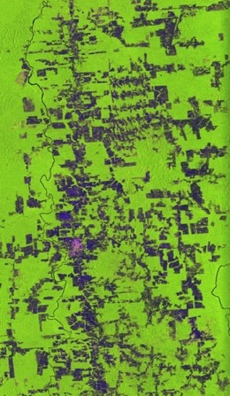
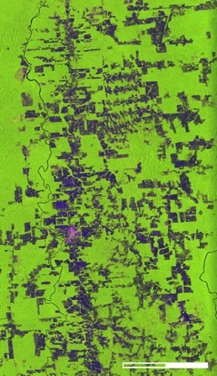
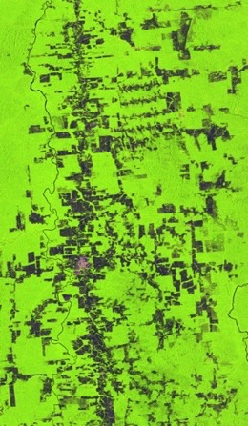
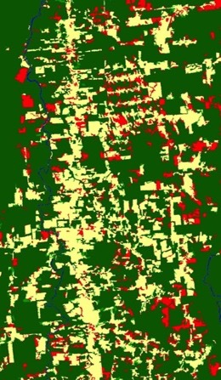
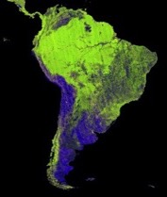
FNF Spatial and Temporal Change
Comparison between PALSAR and PALSAR-2 (JERS-1 in future):
0 30km
PALSAR-2 2015
PALSAR 2010
FNF change 2015-2010
South America
(Brazil)
●: Forest
●: Non-Forest
●: Deforestation
●: Reforestation

Slide 30
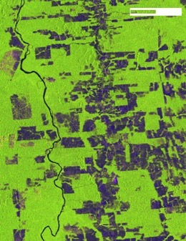


FNF Spatial and Temporal Change
0 10km
PALSAR-2 2015
PALSAR 2010
FNF change 2015-2010
South America
(Brazil)
●: Forest
●: Non-Forest
●: Deforestation
●: Reforestation

Slide 31




FNF Spatial and Temporal Change
0 5km
●: Forest
●: Non-Forest
●: Deforestation
●: Reforestation
PALSAR-2 2015
PALSAR 2010
South America
(Brazil)
FNF change 2015-2010

Slide 32







Future Missions
Advanced Optical Satellite
Advanced SAR Satellite
Crucial Deformation
Modeling
Rising Magma
Magma Chamber
Hazard Map
Estimate situation of magma chamber under the ground and faulting
Take a decision for evacuation
© GSI
Observation
High Precise 1/25,000 Map
© GSI

Slide 33
Summary
JAXA’s ARD production and release status reported:
  L-band SARs: JERS-1, ALOS, ALOS-2. Hope in the future
ALOS-2/PALSAR-2 operation very well and global data acquisitions ongoing with the excellent performance (high resolution, low noise level, polarimetry) to monitor the earth environment.
Optical image ARD: Global ortho-rectified ALOS AVNIR-2
JAXA will continue to produce the high level products.

