Slide 1
SEO Future Data Architecture (FDA) Activities: CEOS Data Cube and 3-Year Work Plan
LSI-VC Meeting #2
Los Angeles, CA
July 21, 2016
Brian Killough
CEOS Systems Engineering Office
NASA Langley Research Center

Slide 2
The latest trends in international satellite data
Free and open data
Growing data volumes
Improved computing technologies
Open source software
Pre-processed products

Slide 3
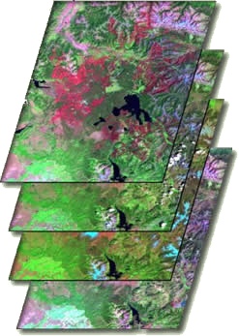
What are Data Cubes?
Data Cube = Time-series multi-dimensional (space, time, data type) stack of spatially aligned pixels ready for analysis
Proven concept by Geoscience Australia (GA) and the Australian Space Agency (CSIRO) and planned for the future USGS Landsat archive.
Shift in Paradigm ... Pixels vs Scenes
Analysis Ready Data (ARD) ... Dependent on processed products to reduce processing burden on users
Supports an infinite number of applications, reduces data preparation time, allows time series analyses, increases interoperability of multiple datasets.
Open source software approach allows free access, promotes expanded capabilities, and increases data usage.
Open Source Software https://github.com/data-cube
TIME

Slide 4
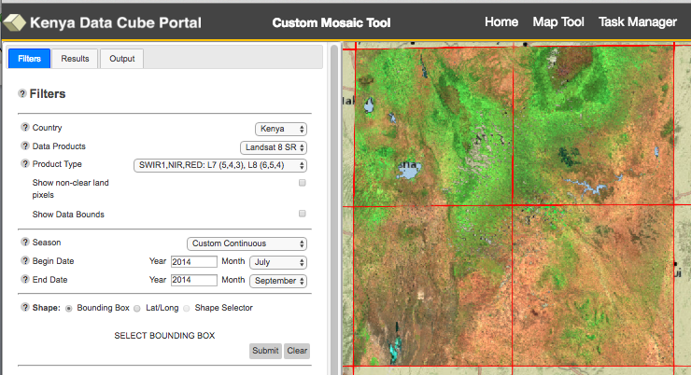
Custom Mosaic Tool
Filter Selections
Country: Kenya or Colombia Data Product: L7 or L8
Product Type: 11 options
Non-clear pixels: RED flag
Dates: Continuous or Multiple Months
Bounding Box or Lat-Long

Slide 5
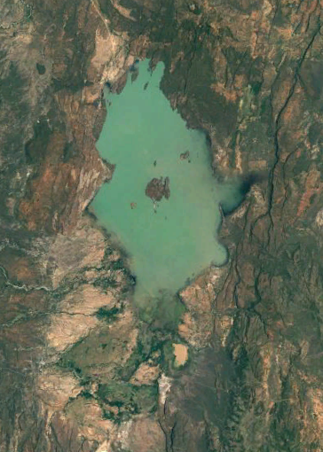
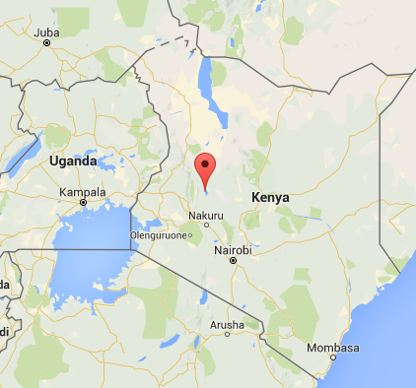
Water Detection Demo
Kenya
Lake Baringo National Park

Slide 6
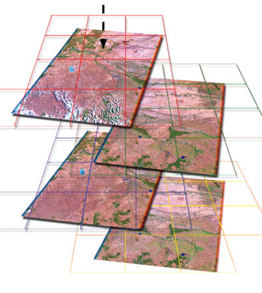
Preparation and Analysis
Data Preparation
Landsat 7, January 2005 to April 2016
169 original scenes (202 GB of data)
1x1 degree Data Cube “stack” with annual storage unit “chunks”
3710 x 3710 x 169 = 2.3 billion pixels total
37 GB NetCDF data volume (~ 5:1 compression)
Data Analysis
3.5 GHz Intel processor (4-core), 64GB RAM, Linux computer
Modified Australian water detection algorithm uses multiple Landsat bands for 97% accuracy
1-2 minutes for an annual analysis and ~30 minutes for a full time series (11+ years) analysis

Slide 7
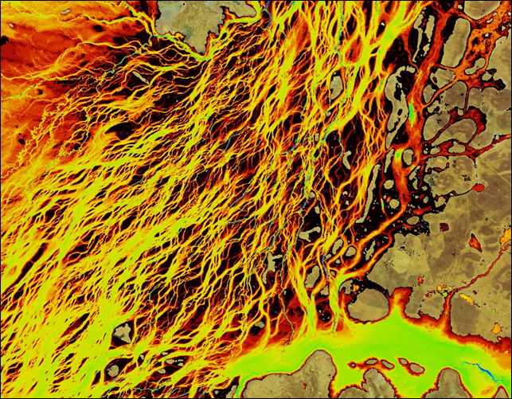
Australian WOFS Algorithm
WOFS = Water Observations from Space
Braided river network of Coopers Creek in Queensland, Australia
Blue = permanent water
Red/Yellow = infrequent flood events
CEOS has implemented the 23-step WOFS algorithm to produce results similar to those shown here
Braided river networks and flood extent is very difficult to map with traditional methods

Slide 8
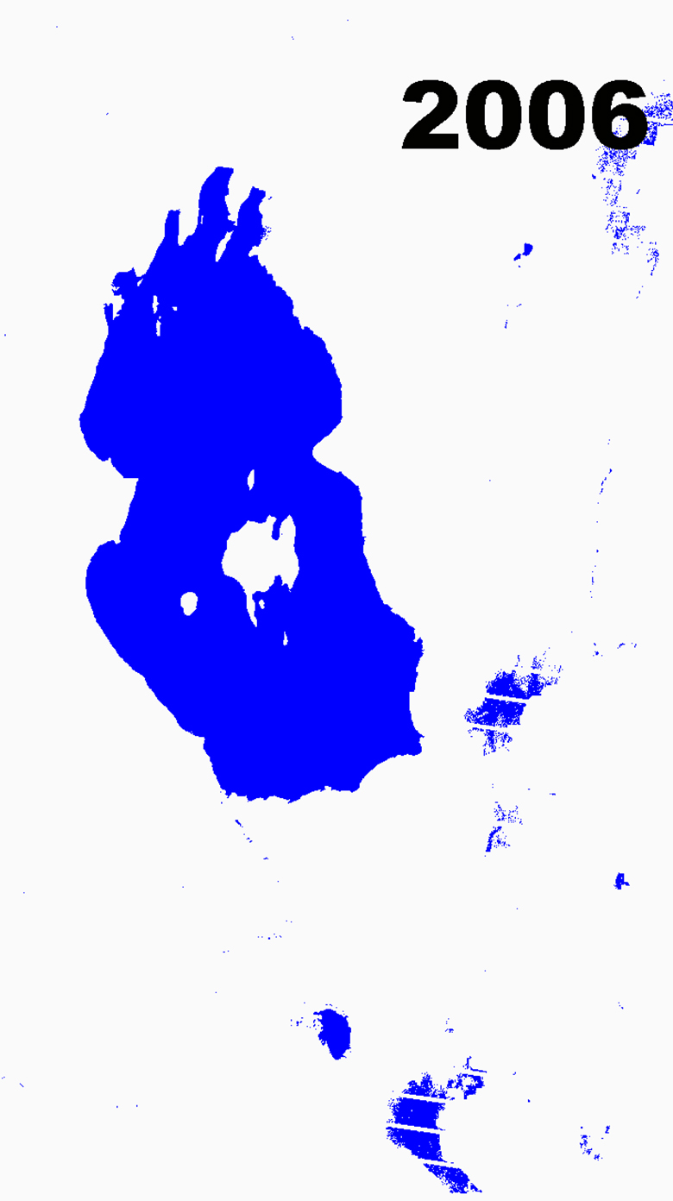
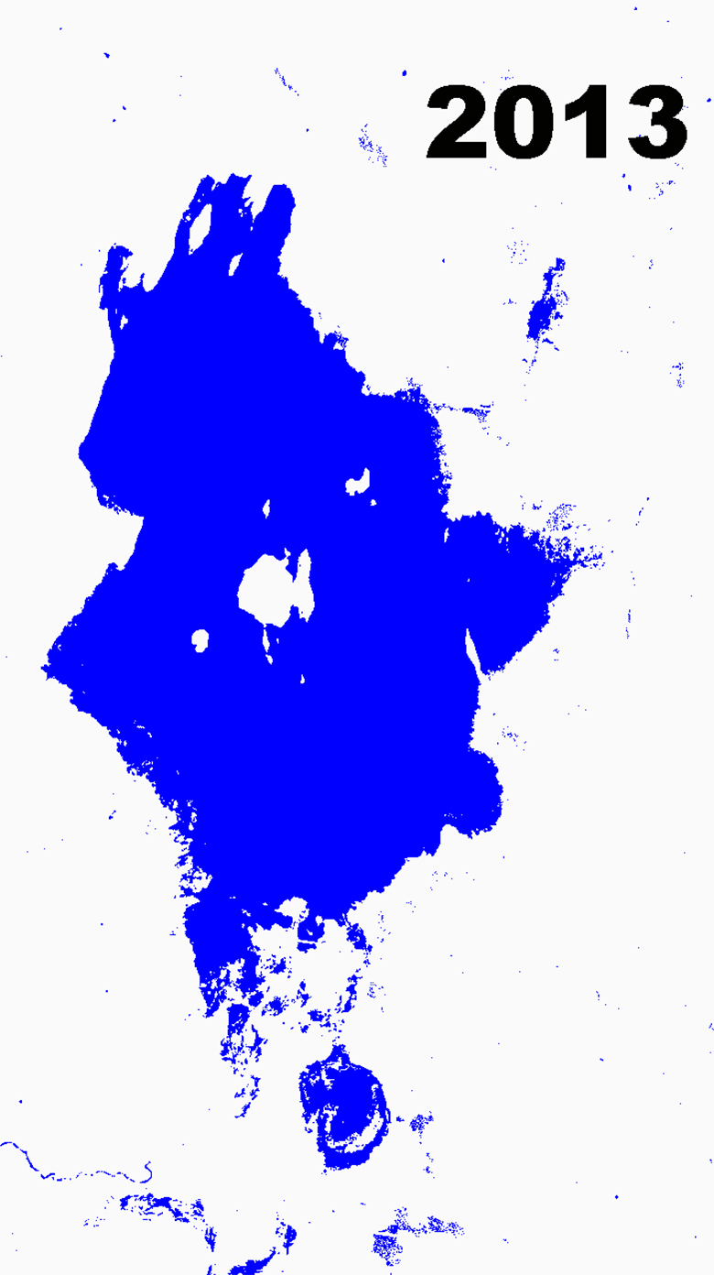
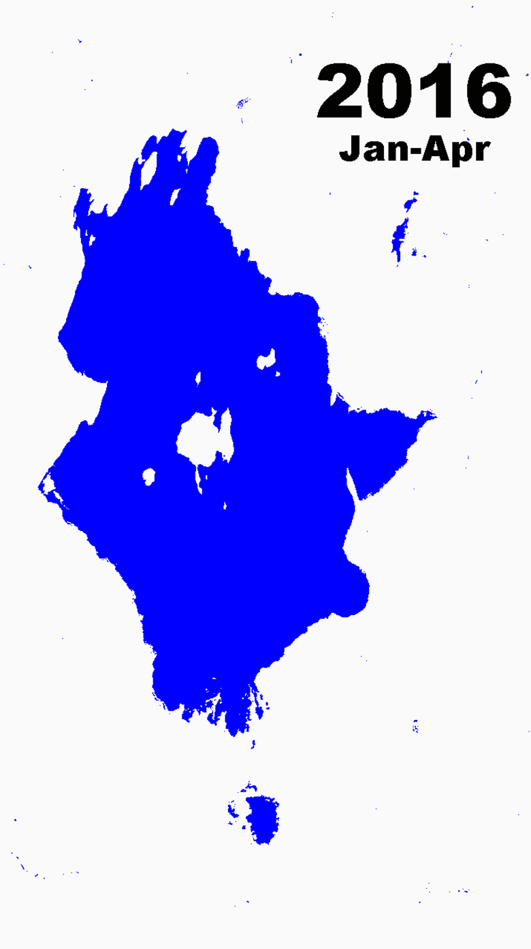
Lake Baringo, Kenya Annual Water Extent Analysis
Landsat
“banding”
Extreme droughts in the Baringo region in 2009 had severe impacts on pastures and farming
Extreme floods displaced 600 families and swept away livestock near Lake Baringo in 2013
4 months of dry season data resulted in little water detected outside the lake boundary

Slide 9
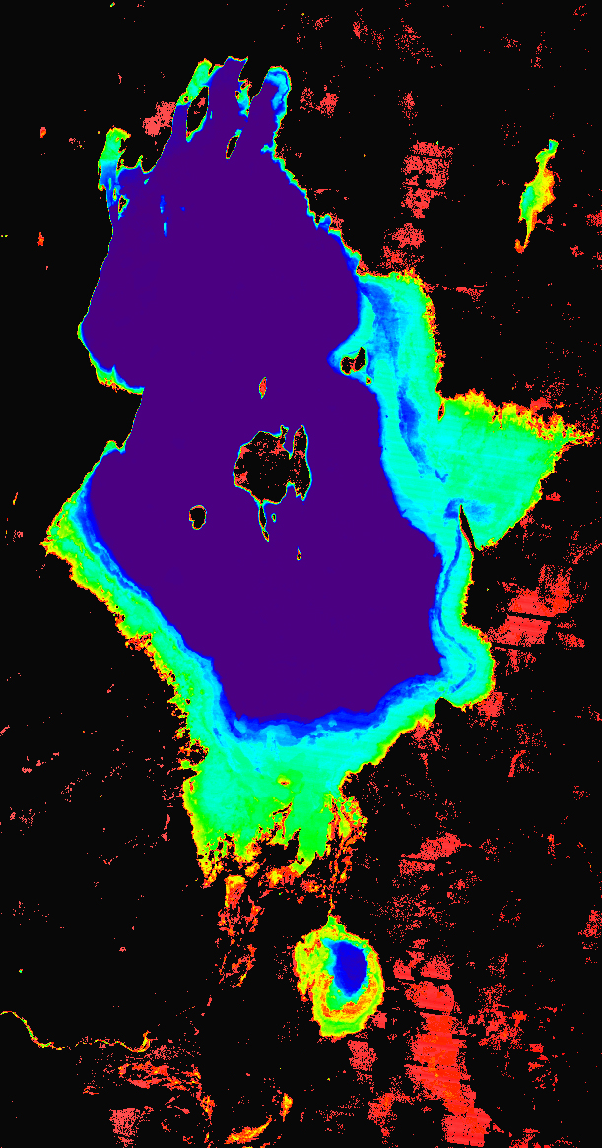
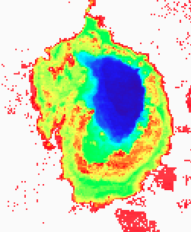
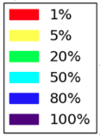
Lake Baringo, Kenya 11-year Time Series Results
Percent of observations detecting water from Jan-2005 to Apr-2016.
32 minutes execution time
Flood risk can be easily inferred from WOFS analysis results. 30-meter Landsat resolution allows detailed assessments that are far better than MODIS (250-m).

Slide 10
Country Demonstrations
Prototype Data Cube projects are under development in Colombia and Kenya
The Colombia team is growing capacity ... The Colombia project is supported by CSIRO and IDEAM (Institute of Hydrology, Meteorology and Environmental Studies). They have demonstrated use of the software to expand the data in their mini-cube and they have modified the user interface to add mosaics, change detection and NDVI-based forest/non-forest maps. They are interested in more applications such as water resource management.
The Kenya team is getting off to a slow start ... The project is supported by the Australian Government and the Clinton Foundation (CCI and SLEEK). Versions of the full-country Data Cube (11TB of data, 7500 scenes) are located locally and on the Amazon cloud. They are currently utilizing scene-based methods to complete historic forest maps for UN reporting and will move to a Data Cube implementation in 2017.

Slide 11
3-Year Work Plan
Provides a reference for internal and external Data Cube activities as there is great interest in FDAs and Data Cubes
Provides a reference for CEOS agency contributions and discussion by CEOS leadership regarding coordination to ensure outcomes
Informal document that is not meant for formal endorsement by CEOS
The large majority of the work is managed and funded by the SEO.
The SEO works closely with Australia (CSIRO and GA) to utilize elements of the AGDC development and communicates with USGS regarding its plans for LCMAP.
The document captures expected outcomes, task descriptions and target dates of completion.

Slide 12
Work Plan Outcomes
There are 5 major categories of Data Cube (DC) outcomes:
(1) Core Technology
General Software Development – version 2, ingestors, APIs
QGIS interface – Boston Univ., TSTools (CCDC), DC plugin
ArcGIS interface – ESRI, SERVIR hubs
Custom Mosaic Tool – Version-1 demo running, v2 soon
Water Detection Tool – Australian WOFS, adding water quality (TSM), adding Python notebooks ... demand from World Bank for Africa
Data Cube Creation Tool – simple UI and instructions vs. current Python scripting
(2) Data Preparation and Formatting
ARD definition – LSI-VC
Sentinel data ingestors – S1 and S2, but need ARD
ALOS-PALSAR mosaic training manual – GFOI, end of 2016
Ground based climate data – precipitation, temp
SPOT-5 data – processing, ingestors, for Kenya

Slide 13
Work Plan Outcomes continued
(3) User Requirements and Engagement
GFOI and FAO – future country demo (Colombia?), SEPAL integration
GEOGLAM – possible Asia-Rice demo in Asia (Australia working), RAPP fractional cover demo in Caramagua, Colombia
(4) Prototypes
Local Deployment – upgrading local systems for testing
Amazon Web Services (AWS) Deployment – testing thru Feb 2017 using grant funds
SERVIR Deployment – possible tests in East-Africa (Kenya) and Mekong (Thailand).
Colombia – moving along VERY well
Kenya – delayed until early 2017
Asia-Pacific – support for Asia-Rice (TBD)
Canada – possible GEOGLAM test (TBD)
GEONETCast – possible future testing (TBD) for local remote deployments
Landsat International Cooperator Ground Station Networks – possible deployment testing as a regional hub (TBD)

Slide 14
Work Plan Outcomes continued
(5) Capacity Building
Deployment Documentation – major need, early 2017
World Bank – heavy interest after 2 meetings, primary focus on water, possible prototype near Lake Chad
SilvaCarbon – exploring data cube needs for forests at regional workshops ... no specific plans to date
CEOS WGCapD – planning to discuss regional data cube training coordinators at 2017 meeting

Slide 15
Closing thoughts ...
What should be the LSI-VC role in the Data Cube activity?
Here are several proposed roles for discussion ...
ARD definition and facilitating the provision of ARD for users and Data Cube creation
Feedback on the Data Cube work plan and priority inputs
Facilitating agency contributions to the Data Cube work plan outcomes
Facilitating regional data cube training and testing

