Slide 1
Global Forest Observations Initiative
Gene Fosnight(USGS / Landsat Data Acquisition Manager),
21 July 2016, LSI-VC-2/ Los Angeles

Slide 2
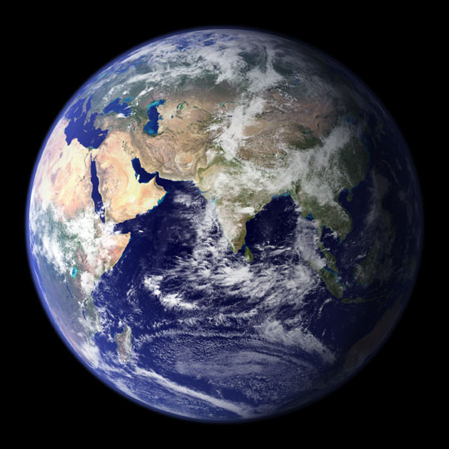
What is GFOI?
“Through collaborative action, GFOI seeks to foster forest monitoring and assessment that is robust, reliable, and achievable at reasonable cost, and supports planning for national development priorities including, climate change mitigation and adaptation.”
Notes:
As we know, the world is a big place. And thankfully we still have quite a bit of forest to monitor and a lot of capacity to build to allow initiatives such REDD+ to realize their full potential.
There is a growing need for improved forest monitoring, not only to meet reporting needs coming out of the Paris Agreements and other international reporting forums but also to help countries generate credible information to inform their decision making on improved forest management strategies and the implementation of emissions reductions activities such as REDD+.
Given the size of this challenge, there is no single organisation that can meet this demand alone. No single organisation as the physical resources to support this global demand nor the breadth of expertise to support the many and varied components of forest monitoring. For example, developing, launching and maintaining satellite missions to capture time-series consistent EO data of the entire world is a different task to working intensively with countries to build sovereign technical and institutional capacity in forest monitoring. These two tasks require very different resources, skillsets and workplans but when you bring them together you have a more holistic and specialized package of support than any one organisation could deliver on their own.
In recognizing this, GFOI partners are consolidating their considerable global resources to provide more streamlined and ultimately useful support for non-annex I countries on forest monitoring.

Slide 3




Global Forest Observation Initiative
fostering the sustained availability and use of satellite data for forest monitoring to better manage forest resources
Coordinating systematic observations
assisting countries in the use of satellite data
Capacity Building in coordination with others such as UNREDD
Research & Development to address practical problems
CEOS (Committee on Earth Observation Satellites) has setup a Space Data Coordination Group (SDCG)
Methods & Guidance on use of satellite and ground data to estimate GHGs
Assists with country specific requirements
Assures annual, wall-to-wall, worldwide long-term data

Slide 4
Principles
Wall-to-wall monitoring
Consistency with UNFCCC and IPCC
Affordable and Practical
Co-operation with Partners
Integration of ground data and remote sensing
Capture small changes
Follow IPCC guidelines
Vital for reporting REDD+ and GHGs to UNFCCC
Maps 5 REDD+ categories onto IPCC methods
Based on medium resolution data (10-30m)
Can use higher resolution data if needed
FAO, World Bank and others to coordinatie capacity development
GOFC-GOLD
IPCC and UNFCCC
Captures leakage
Based on widely useable methods
http://gfoi.org/

Slide 5

Partners
Founded under Group on Earth Observations (GEO) in 2011
  First work plan was 2012-13
  Operational ever since
Lead partners: currently Australia, Norway, USA, FAO & CEOS
Experts from UNFCCC, IPCC, World Bank FCPF, universities, technical and policy experts and other
Open to new partners

Slide 6
GFOI Leads Group
Representation from all major contributing organisations. Overall responsibility for GFOI.
  Australia: Anthony Bennie
  CEOS: Shimada Masanobu
  FAO: Anssi Pekkarinen
  Norway: Henrik Fliflet
  USA: Doug Muchoney
**Open to new members with additional contributions**

Slide 7
Components
Space Data
GFOI works with space agencies through CEOS to ensure the long-term, global acquisition of core satellite data
Capacity Building
GFOI provides capacity building in cordination with others such as UN-REDD. It supports the use of satellite and ground data to monitor forests, and estimate GHG emissions.
Methods and Guidance
Guidance on integrating remote-sensing and ground-based observations for estimation of emissions and removals of greenhouse gases in forests.
Research and Development
Identifying and promoting R&D needed for improved practical, global implementation of National Forest Monitoring.
GFOI Office at FAO, Rome
Provides overall coordination and administrative support to the GFOI Leads, components, activities and partners.
Helps countries to meet their individual data needs.
http://gfoi.org/

Slide 8
Space Data Coordination
Implementation of Baseline Global Data Acquisition Strategy
Space Data Services Available
Data Supply in Support of GFOI R&D Activities
At least one annual national cloud-free optical coverage over each country.
Based on publicly open satellite data – “core data”
A coordinated strategy for national data acquisitions accommodating countries’ specific technical requirements, heritage, or experience.
Covers a wider range of satellite data sources, including commercial.
Includes support for science studies assisting the development and evolution of the MGD for GFOI.
Assuring the availability and continuity of consistent time-series of optical and radar (SAR) satellite data over global forest cover.
Demonstrating data exploitation solutions e.g. data cube, Analysis Ready Data.

Slide 9
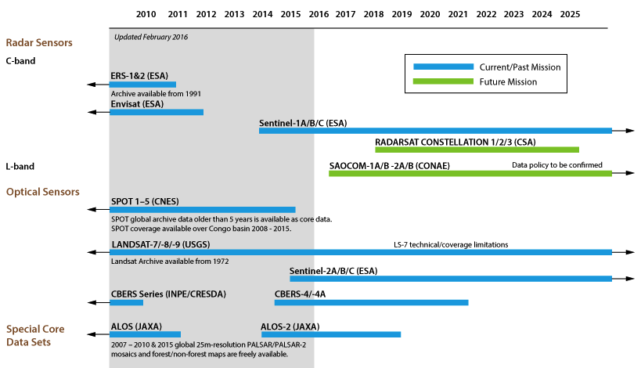
Global Baseline Core Satellite Data

Slide 10
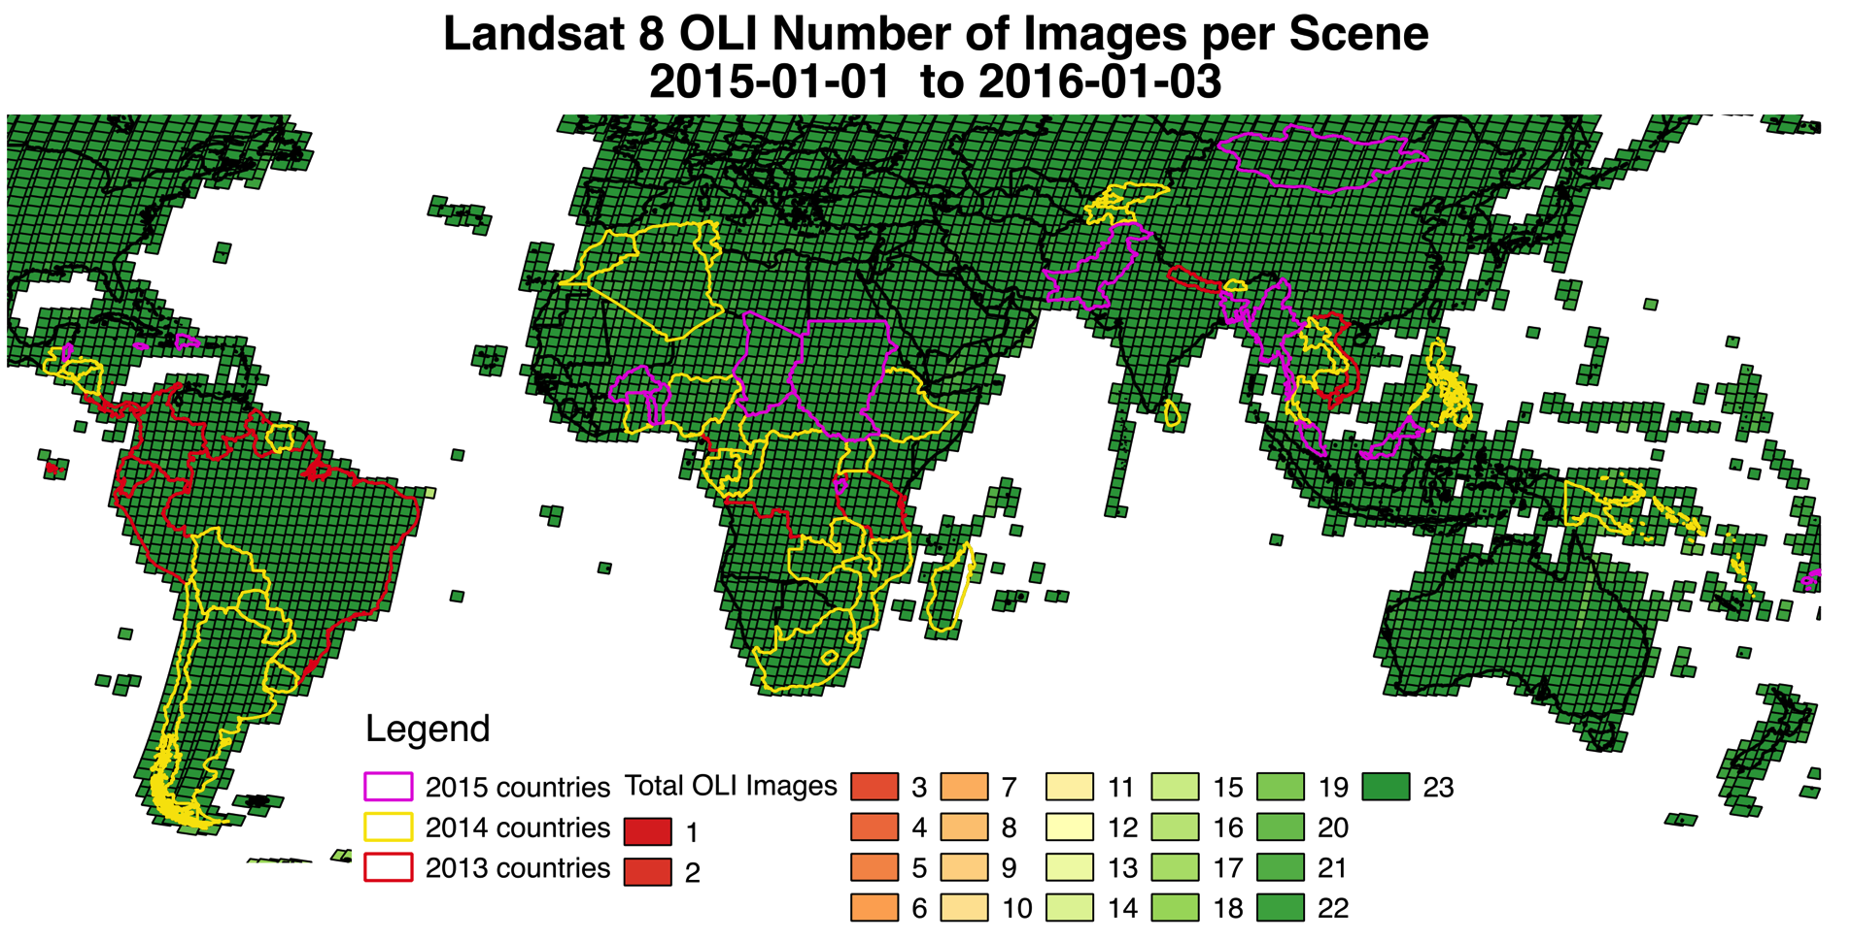

Landsat Global Core Data

Slide 11
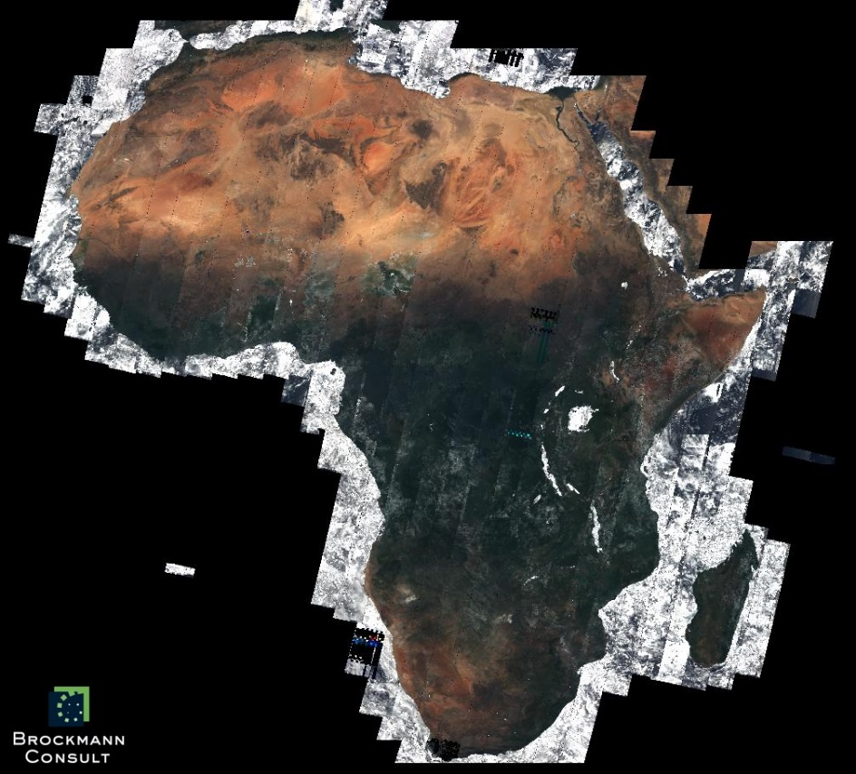
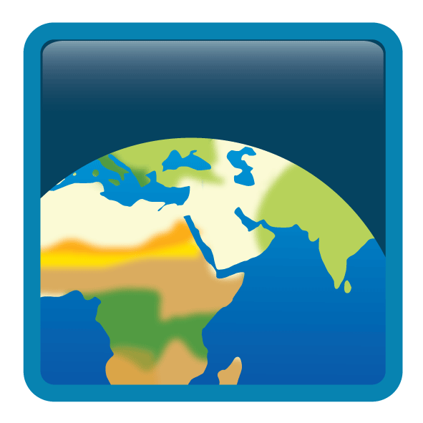

First CCI Land Cover Sentinel-2 TOA reflectance composite over Africa
Max-NDVI composite
of TOA reflectance from all available Sentinel-2 images (~7000) acquired
from August 2015
to April 2016
( ~32 TByte of data)

Slide 12
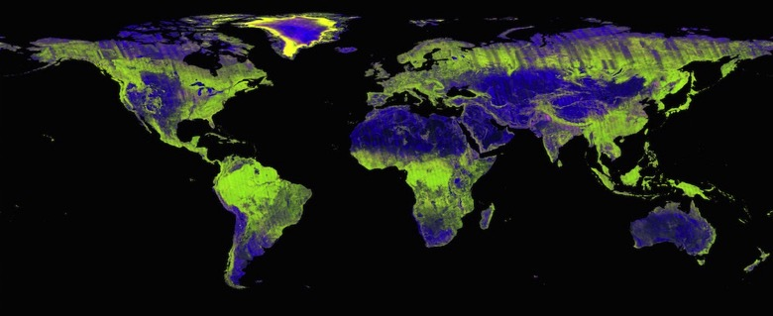
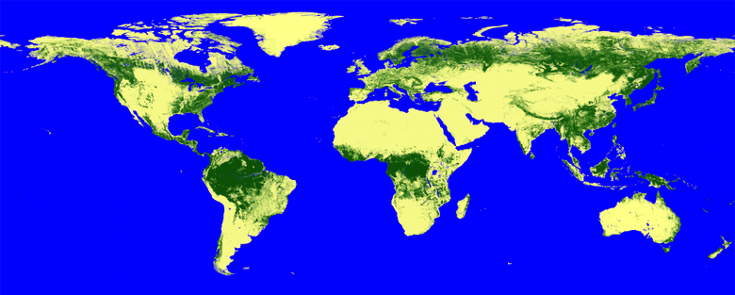
ALOS-2 PALSAR-2 Global Mosaic
25 m resolution
Freely
available

Slide 13
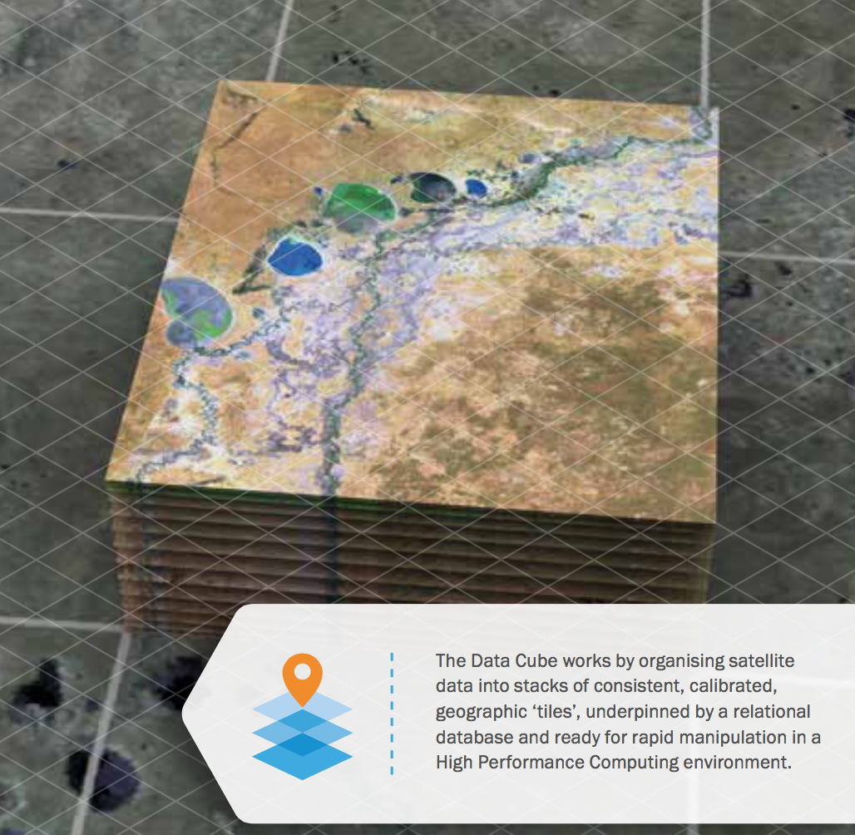
Space Data Services
Removing obstacles to country uptake of satellite data through cloud computing, storage, novel computing and database technology
Countries can focus on data
applications and not handling
Pilot projects underway, e.g.
  Kenya Cube
  Colombia Cube
  SDMS – Space Data Management
  System
  SEPAL by FAO
  ESA’s Thematic Exploitation
  Platform on Forestry
Notes:
We see broader potential for CEOS

Slide 14
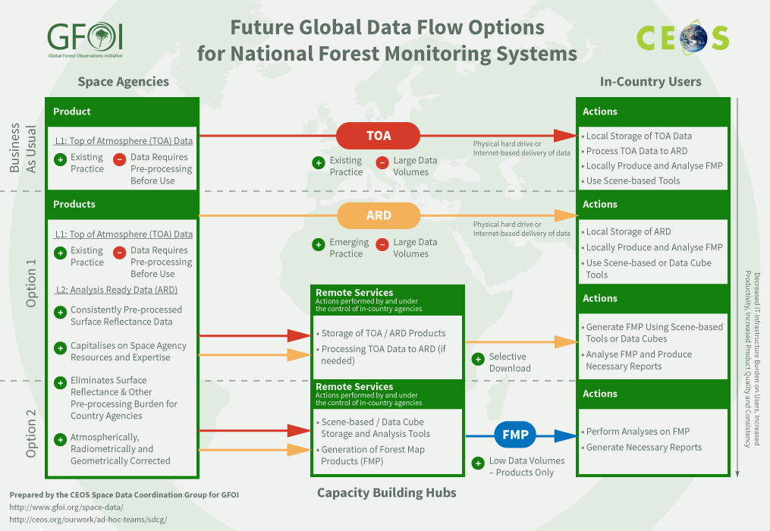
Global Data Flow Study
Notes:
We see broader potential for CEOS

Slide 15
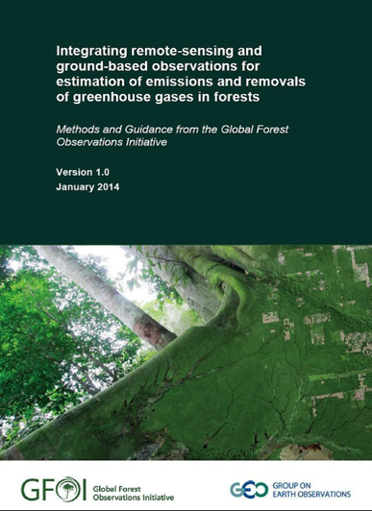
Methodological Advice from GFOI
GFOI Methods and Guidance Document (MGD) intended to form the backbone of GFOI;
Logical and systematic guide for countries to follow in developing their national forest monitoring systems;
Consistent with UNFCCC Paris Agreement and Warsaw Framework on REDD+;
Provides operational link between IPCC methods and
all REDD+ activities identified by UNFCCC
Consistent with the annual review of scientific
developments provided by GOFC-GOLD Sourcebook
Aimed at technical implementers, negotiators
and national responsible for REDD+ implementation;
V1 first published in Jan 2014 and updated V2 in June 2016
New web application REDDcompass available at
www.gfoi.org/REDDcompass

Slide 16

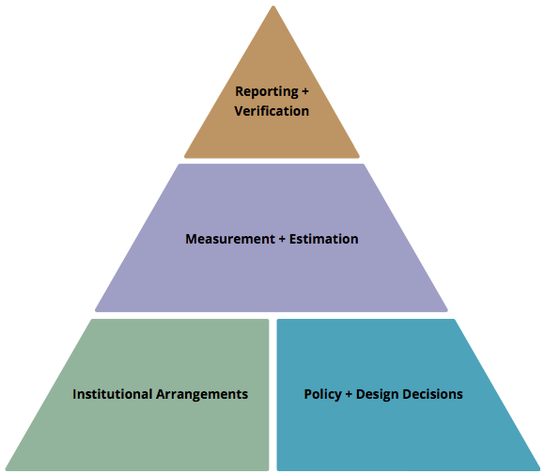

REDDcompass – Guiding you through REDD+
REDDcompass guides users through core themes, concepts and actions involved in the development of National Forest Monitoring Systems (NFMS) for Measurement,
Reporting and Verification (MRV).
it provides contextual links to GFOI methods
and guidance, space data resources,
references and tools, training materials
and advances in research and
development as users work through
the pyramid framework.
available in English, French and
Spanish
www.gfoi.org/REDDcompass

Slide 17
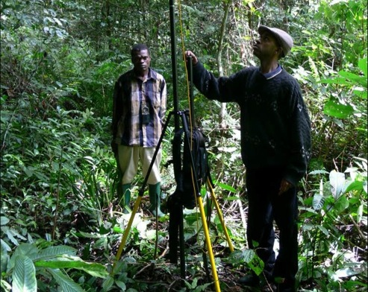
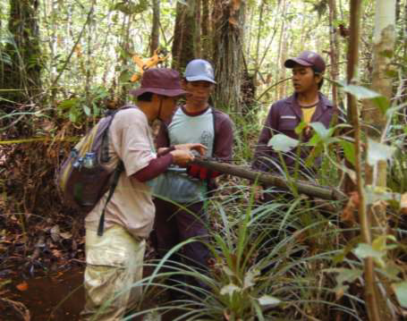
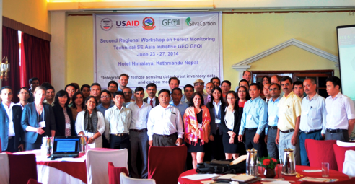
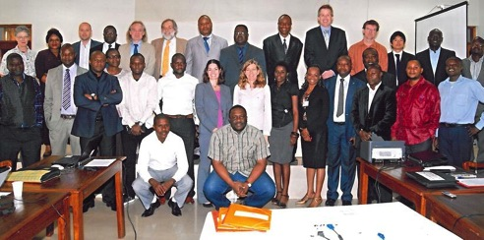
Capacity Building
Interface of GFOI with REDD countries;
Jointly implemented through US SilvaCarbon, and UNREDD at FAO;
Builds upon their existing work programmes and country partnerships and includes bilateral activities from Australia and Norway;
Tailored to meet country needs and requests;
Aims to build up networks of experts in countries;
Intended to use MGD as core syllabus;
Workshops, one-on-one training, in-country experts, training trainers, webinars and open sources tools;

Slide 18

Training Material for REDD+ Monitoring and Reporting
REDD+ background and design
  1 UNFCCC context and requirements and introduction to IPCC guidelines
  M. Herold, E. Romijn, B. Mora
  2 Framework for building national forest monitoring systems for REDD+
  E. Romijn, M. Herold, B. Mora
  3 Assessing and analyzing drivers of deforestation and forest degradation
  E. Romijn, M. Herold
  4 Monitoring activity data for forests using remote sensing
  J. Miettinen, A. Langner, F. Achard, B. Mora
  5 Monitoring activity data for forests remaining forests (incl. forest degr.)
  C. Souza, S. Brown, J. Miettinen, F. Achard, M. Herold
  6 Estimating emission factors for forest cover change (def. and degr.)
  S. Brown, L. Murray, F.Casarim
  7 Incorporating community based approaches in national REDD+ monitoring
  M. Skutsch, A. Balderas Torres
  8 Estimation of carbon emissions from deforestation and forest degradation
  S. Brown, L. Murray
  9 Estimation of GHG emissions from biomass burning
  L. Boschetti
  10 Estimation of uncertainties
  G. Grassi, S. Monni, F. Achard, A. Langner, M. Herold
  11 Overview and status of evolving technologies
  B. Mora, E. Romijn
REDD+ measuring and monitoring
REDD+ assessment and reporting
  12 National data organization and management
  E. Romijn, V. De Sy
  13 Data and guidance on developing REDD+ reference levels
  M. Herold, E. Romijn, S. Brown
  14 Guidance on reporting REDD+ performance using IPCC Guidelines and Guidance
  G.Grassi, E. Romijn, M. Herold

Slide 19
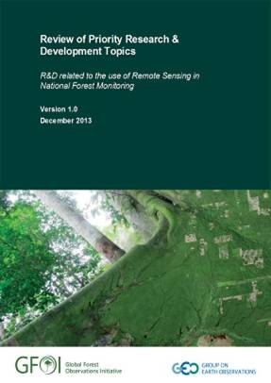
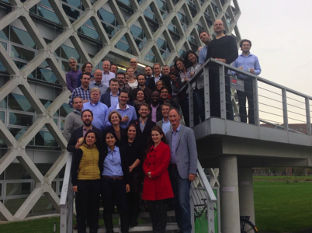
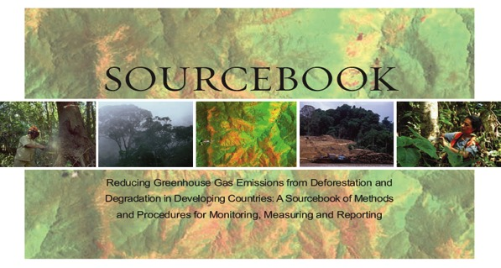
GFOI R&D Component
Coordinate global R&D activities on forest monitoring
to help meet country needs
Prioritizing remote sensing
topics for the use in NFMS, e.g.
  Forest degradation
  Biomass estimation
  Sensor interoperability
  Use of global data sets
  Accuracy assessment and uncertainty;
Country focus through development of
MGD modules
Conducting Expert Workshops and
supporting R&D sites
A sourcebook of methods and procedures for monitoring and reporting anthropogenic greenhouse gas emissions and removals associated with deforestation, gains and losses of carbon stocks in forests remaining forests, and forestation
A sourcebook of methods and procedures for monitoring and reporting anthropogenic greenhouse gas emissions and removals associated with deforestation, gains and losses of carbon stocks in forests remaining forests, and forestation

Slide 20
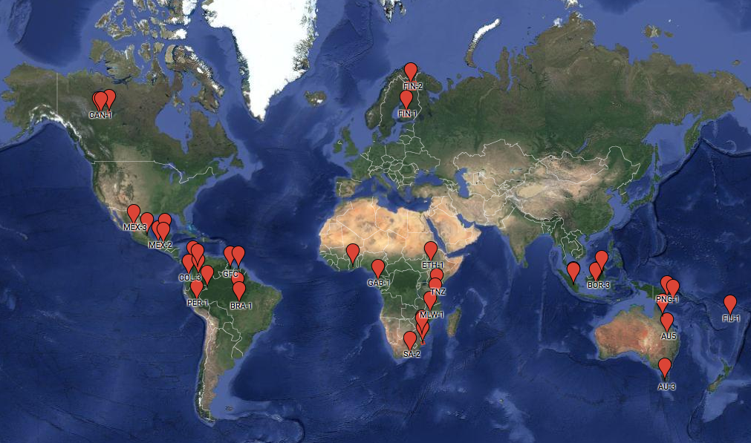
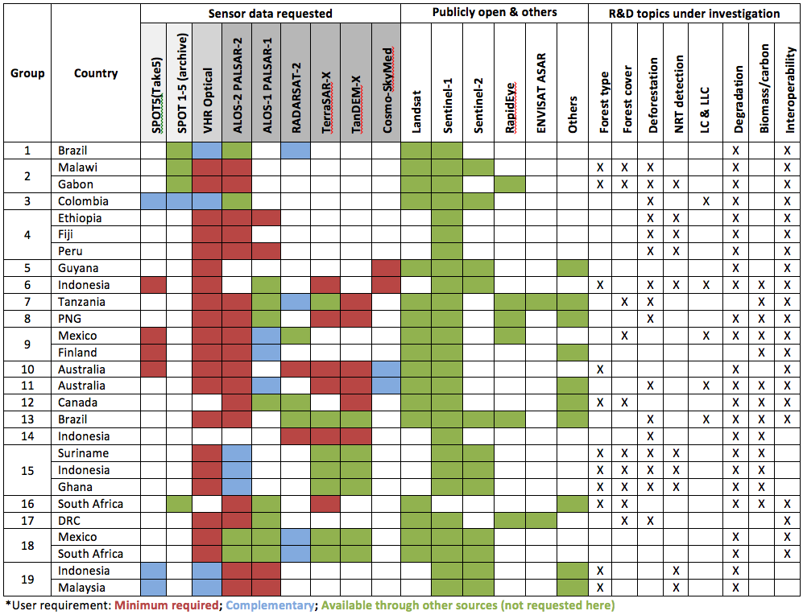
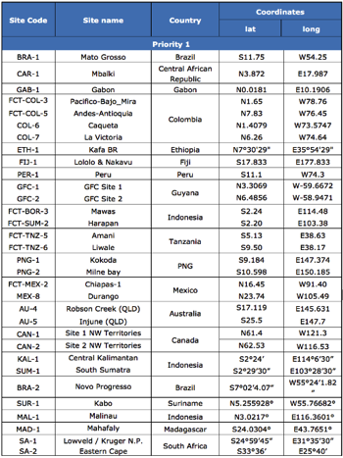
GFOI R&D Sites
Currently 19 teams looking after 32 multi-disciplinary sites, addressing multiple GFOI Priority R&D topics

Slide 21
Components
Space Data
GFOI works with space agencies through CEOS to ensure the long-term, global acquisition of core satellite data
Capacity Building
GFOI provides capacity building in cordination with others such as UN-REDD. It supports the use of satellite and ground data to monitor forests, and estimate GHG emissions.
Methods and Guidance
Guidance on integrating remote-sensing and ground-based observations for estimation of emissions and removals of greenhouse gases in forests.
Research and Development
Identifying and promoting R&D needed for improved practical, global implementation of National Forest Monitoring.
GFOI Office at FAO, Rome
Provides overall coordination and administrative support to the GFOI Leads, components, activities and partners.
Helps countries to meet their individual data needs.
http://gfoi.org/
Notes:
So all in all GFOI is a unique initiative. However it based on that very simple theory of Comparative Advantage. It allows experts to specialize in what they’re good at and partner with others to deliver their specialized expertise and thereby provide a more holistic and specialized nature of support, than they would otherwise be able to deliver on their own.
This not only provides a far more streamlined and ultimately useful support for countries, but it can also help to reduce transaction costs from participating in REDD+.

Slide 22
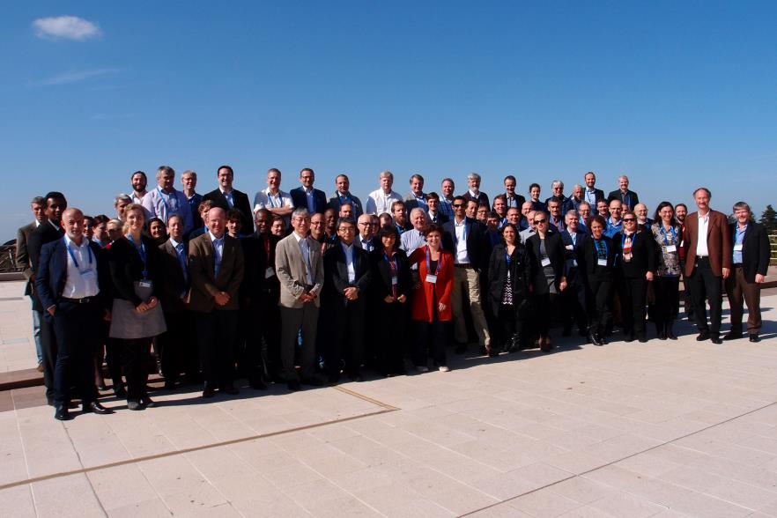
What is it?
GFOI Open Forum @ ESA in Frascati Italy, Feb 2016
Notes:
GFOI is essentially a network of international partners who work together to provide coordinated support on forest monitoring and MRV for REDD+.
We are a group of practitioners from different organisations, expertise and backgrounds who work together under the one common goal, of supporting developing countries to better monitor their forests.

Slide 23
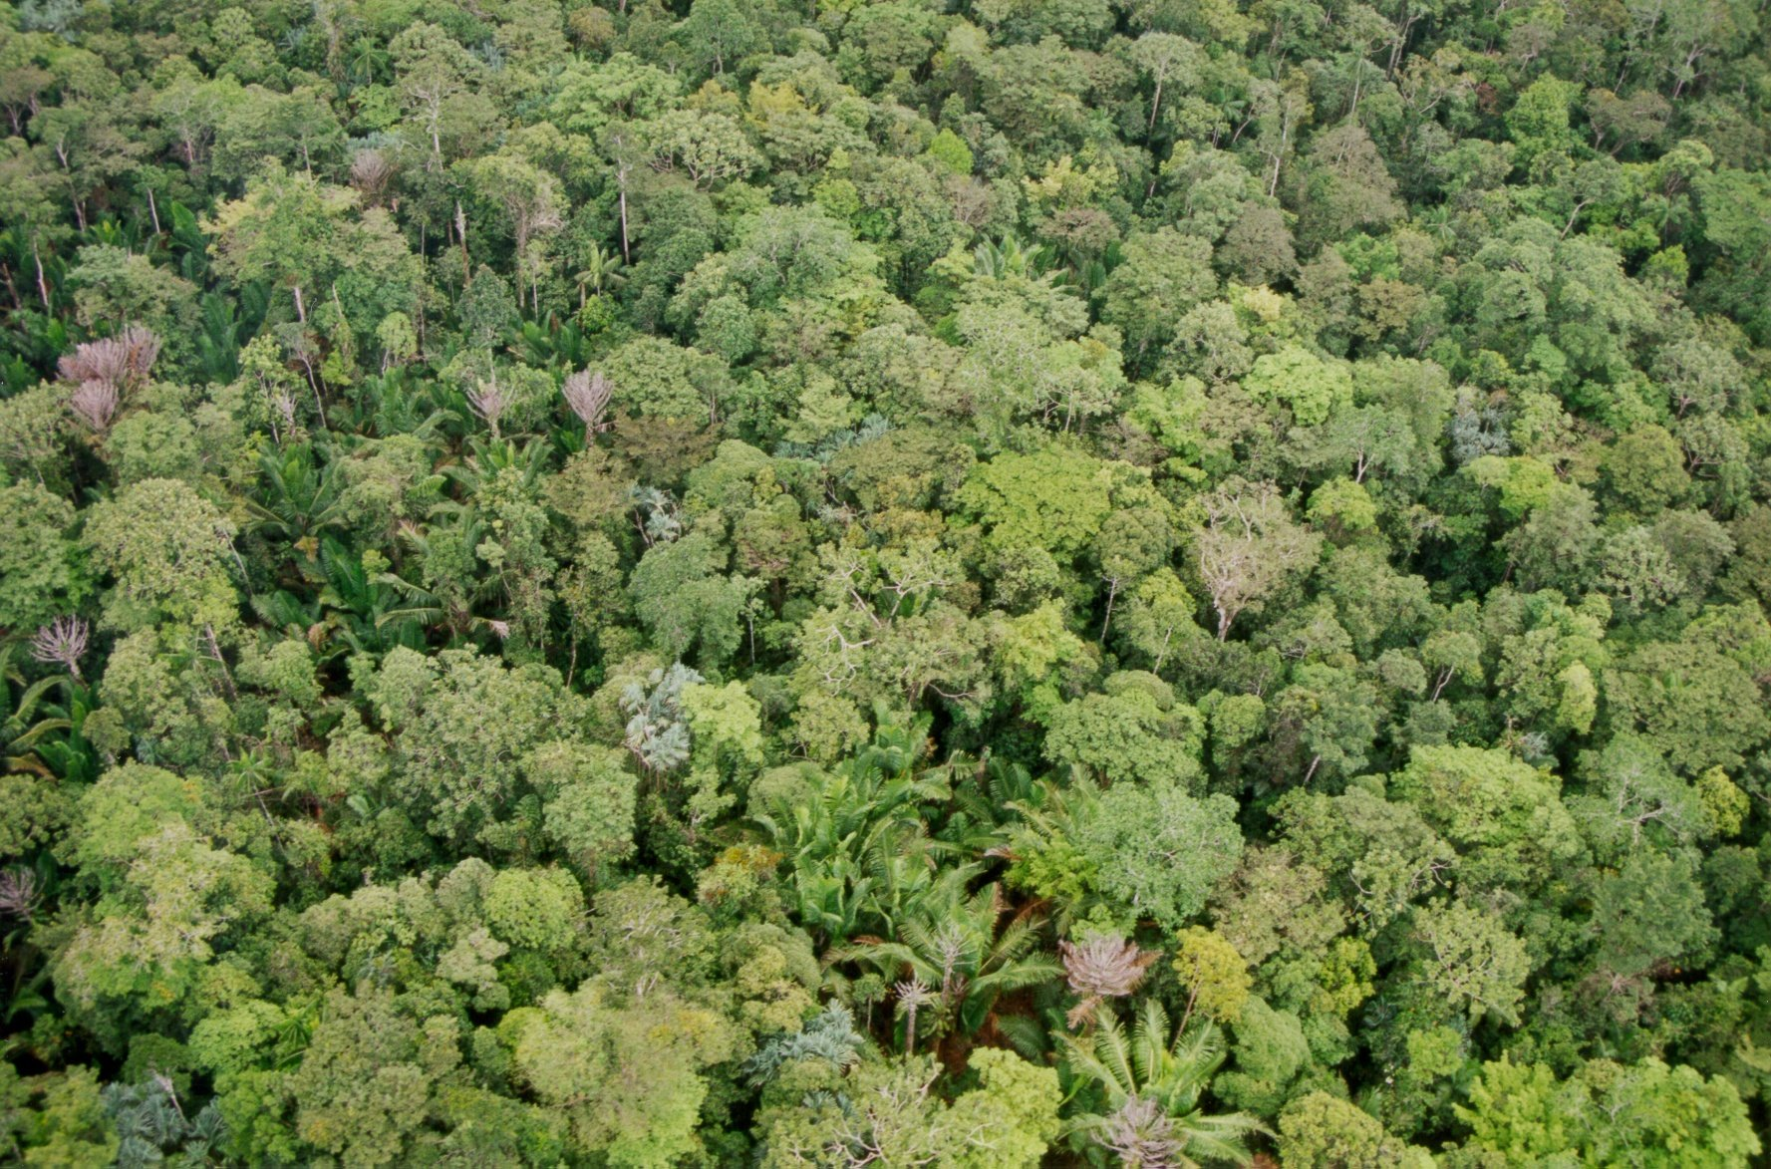



More Information
gfoi.org
facebook.com/gfoi1
twitter.com/gfoi_forest
office@gfoi.org
© F. Siegert (RSS)
Notes:
As we know, the world is a big place. And thankfully we still have quite a bit of forest to monitor and a lot of capacity to build to allow initiatives such REDD+ to realize their full potential.
There is a growing need for improved forest monitoring, not only to meet reporting needs coming out of the Paris Agreements and other international reporting forums but also to help countries generate credible information to inform their decision making on improved forest management strategies and the implementation of emissions reductions activities such as REDD+.
Given the size of this challenge, there is no single organisation that can meet this demand alone. No single organisation as the physical resources to support this global demand nor the breadth of expertise to support the many and varied components of forest monitoring. For example, developing, launching and maintaining satellite missions to capture time-series consistent EO data of the entire world is a different task to working intensively with countries to build sovereign technical and institutional capacity in forest monitoring. These two tasks require very different resources, skillsets and workplans but when you bring them together you have a more holistic and specialized package of support than any one organisation could deliver on their own.
In recognizing this, GFOI partners are consolidating their considerable global resources to provide more streamlined and ultimately useful support for non-annex I countries on forest monitoring.

