Slide 1
Geoscience Australia – data cube progress
Adam.Lewis@ga.gov.au

Slide 2
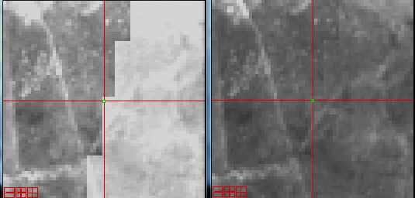
Sentinel-2 BRDF and terrain correction

Slide 3
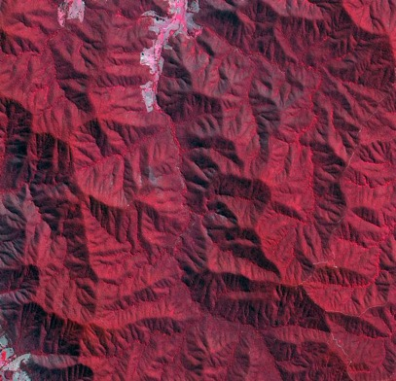
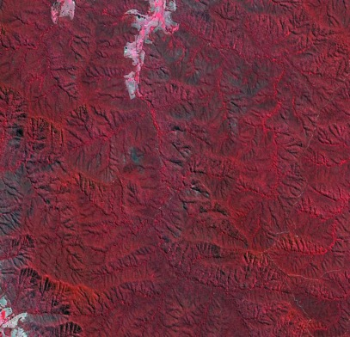
Sentinel-2 BRDF and terrain correction

Slide 4
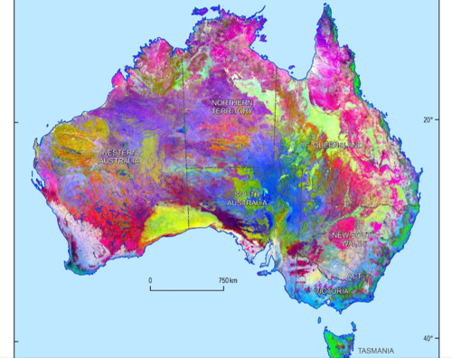
BRDF corrections

Slide 5
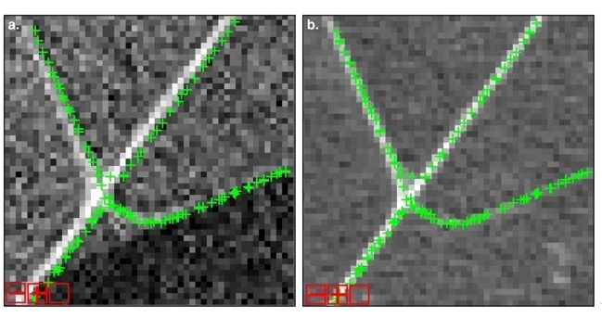
Stack-ability and GCPs
Reference image has allowed us to progressively improve the GLS

Slide 6
Stack-ability and GCPs
On-going work in this area.
Video demonstrates that we are not there yet
(Some artefacts in this video may be also be due to nn resampling)

Slide 7

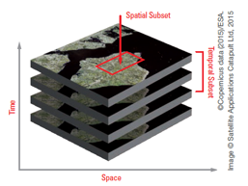
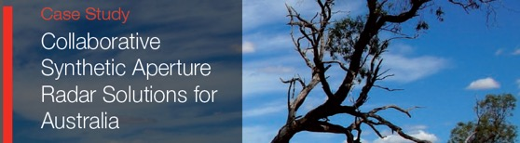
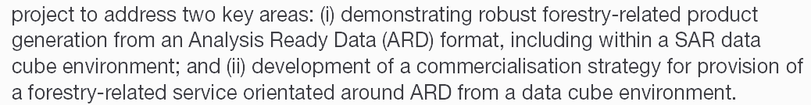
Catapult - RADAR Cube & ARD

Slide 8
Regional Copernicus Data Hub
Established the Hub at the National Computing Infrastructure
Co-funded by:
Geoscience Australia, New South Wales Government, Queensland Government, Western Australian Government, CSIRO
S1,S2,S3 – Land : ← Scihub/Inthub
S3 - Ocean : ← EuMetcast
Cooperating with USGS data node

Slide 9
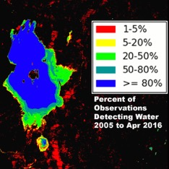
AGDC-v2
AGDCv2 Now released as open source code
Successful adoption by NASA-SEO (and implementation of WOfS)
Chris Holden Boston University :
I've worked my way through creating a "data cube" of my own with the latest AGDC release and have started prototyping the code to create a proper driver in TSTools for it. I'm loving the API -- it saves me so much I/O code and the ingest process is much easier than our current preprocessing workflows (19.7.2016)

Slide 10
AGDC-v2
Re-processing of entire Australian Landsat archive will be completed by July 31
Sensor interoperability – can ingest S2

Slide 11
Monitoring – Maule’s creek

Slide 12
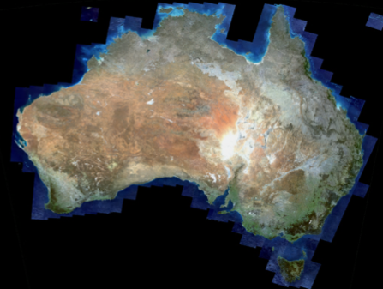
National mosaics
Median surface reflectance
10,000 scenes of L8 OLI
Median surface reflectance
Winter months 2014-15

Slide 13
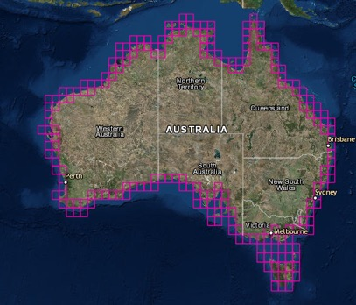
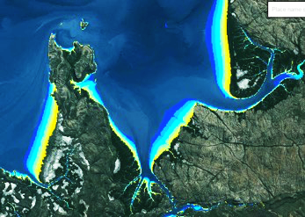
Intertidal product from AGDC
Completed a national analysis of the coastline using 27 years of data – intertidal extent
Notes:
http://np.ga.gov.au/interactive-maps/#/theme/earthobservation/map/intertidal

Slide 14
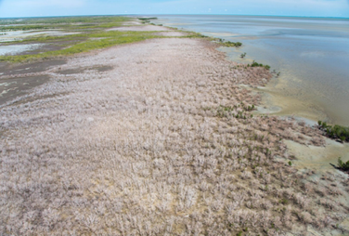
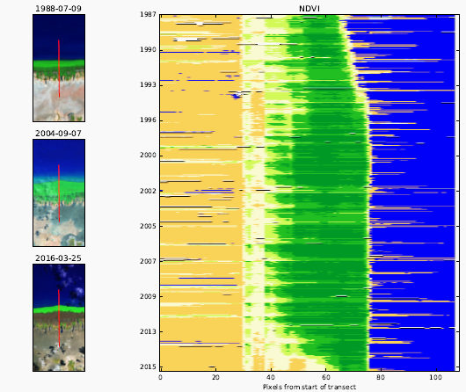
Mangrove die-back time series

Slide 15
Data needs and impact
Continuing work on routinely assessing:
national dependency on and needs for data
the economic contribution of EO

Slide 16
Conclusions
Continuing to progress
improvements in data calibration (radiometric, geometric)
AGDCv2 progressing well and getting good reviews
Collection management approaches
Producing new national geospatial products (intertidal mapping) that are changing users approach to their work and what they see as their needs
The next limiting factor is the availability of ‘brains’ to work with the information products

