Slide 1

Landsat Operations
USGS Agency Status
Jenn Lacey
21 July 2016
U.S. Department of the Interior
U.S. Geological Survey

Slide 2
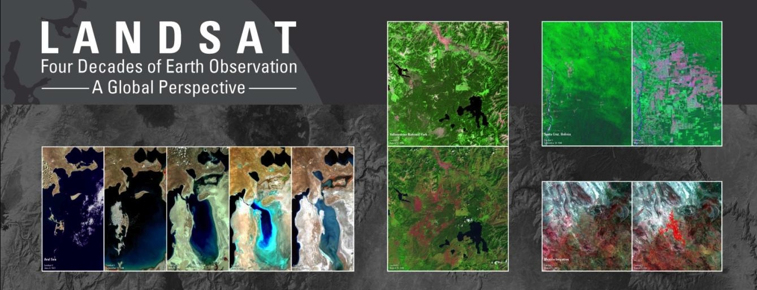
Landsat – the longest and most comprehensive record of the Earth’s condition ever assembled
The EROS Landsat archive: more than 6+ million images (205 billion sq. km) from 1972 to the present – and spanning the globe
All Landsat images are available to anyone at no cost
  Each year nearly 5 million images are distributed to users in over 180 nations and territories
Notes:
An unprecedented record.

Slide 3
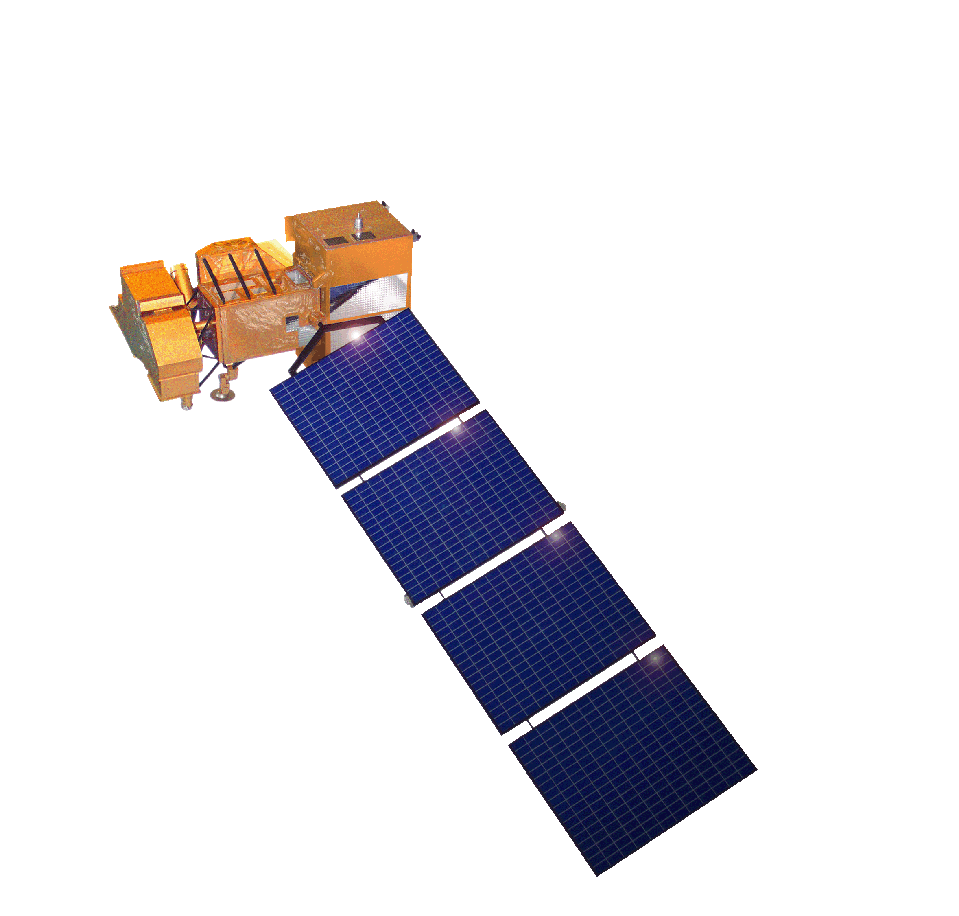
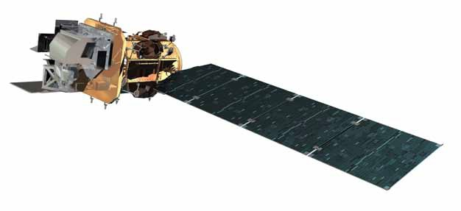
Mission Status
Landsat 7
  Acquiring at a rate of ~470 scenes/day with continental acquisition strategy
    Implemented 105% duty cycle for ETM+ in order to increase data acquisition in support of Northern Hemisphere growing season imaging, along with increased acquisitions over the African Continent and Central America
    No spacecraft anomalies since LGSOWG #43
  Conducting end of mission planning – targeting overlap with Landsat 9 launch readiness
    Considering extended mission life potential (July 2021)
Landsat 8
  On-orbit performance of Landsat 8 observatory continues to be outstanding; acquiring up to 740 plus scenes per day
    Mission data management effective - on-board recorder averaging 70% margin
  Currently 3 LGN stations and 15 certified stations
    Testing expanded ground network operations concept for NSN and ASN
  TIRS Scene Select Mirror (SSM) Encoder Circuit B-side alternative operations concept performing well
    Science data processing updates in support of TIRS processing complete
  MOC march to steady state operations on-going
Notes:
Final

Slide 4
Landsat 7 End of Mission Planning
Landsat 7 End of Mission planning is in-progress
  Ideally end of mission is driven by fuel availability and disposal orbit requirement
  Spacecraft or instrument anomalies may also result in premature end of science mission
  Approval of disposal orbit critical to completing next steps of end of mission planning
Assuming spacecraft and instrument health and safety are not factors, project has developed an optimized approach to maximize 8-day repeat coverage
  Orbit lowering target of 8km to disposal orbit of 697km in order to ensure stewardship of orbit
  Maximizes potential to overlap with Landsat 9 LRD & commissioning
    Extends science mission potential to July 2021 based on acceptance of 9:15 MLT crossing
    Will lower at Landsat 9 LRD minus two months assuming launch is prior to July 2021
      Unless Landsat 9 under-fly desired for cross calibration

Slide 5
Recent Activities
Landsat 8 TIRS B-side encoder current anomaly recovery complete
Testing integration of international ground stations to augment the Landsat Ground Network (LGN)
Implementing Landsat Collection Management & Versioning
Products enhancements underway: Landsat Product Roadmap, Architectures enabling Analysis Ready Data (ARD)
Supporting a USGS initiative to support Land Change Monitoring, Assessments, and Projections (LCMAP)
Notes:
Up-date based on PDB

Slide 6
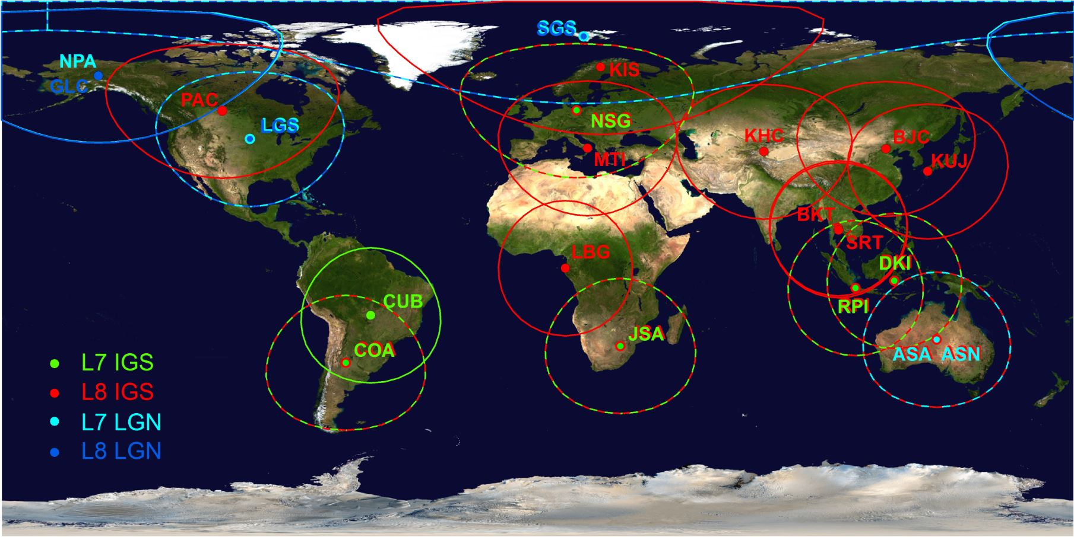
Active Landsat Ground Stations
10 Active L7 Stations 18 Active L8 Stations

Slide 7
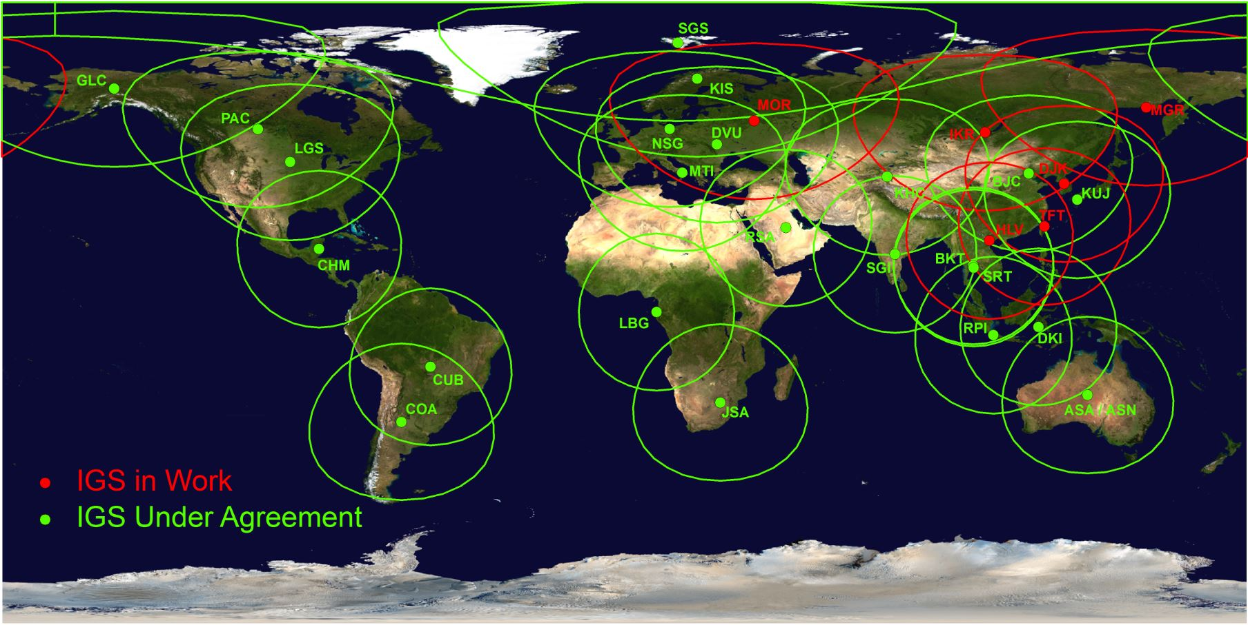
Potential Landsat 8 International Ground Stations
22 Countries 24 Organizations 29 Ground Stations

Slide 8
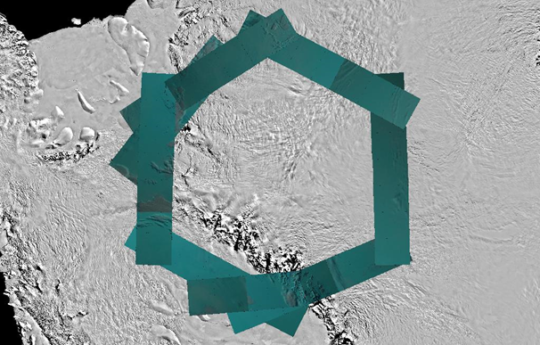
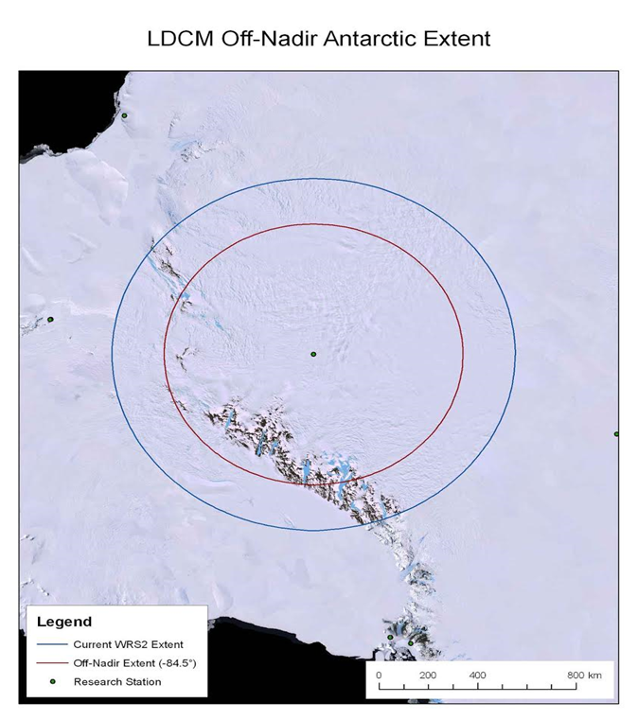
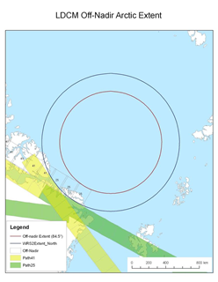
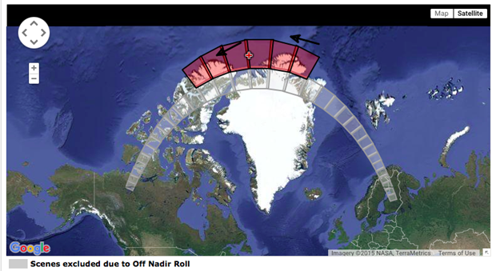
Antarctic and Arctic Off-Nadir Requests
Antarctica (Complete Feb 2016)
  6 off-nadir paths 60 degree steps
  2 off-nadir paths to cover ends of Transantarctic Mountains
  Expect to repeat variation annually
  No impact to routine image acquisition
Arctic (Jul-Aug 2016)
  1 off-nadir path
  Impacts Canada and Scandinavia, but with 8 day ascent & descent revisit time
  No impact to routine image acquisition anticipated

Slide 9
Daily Image Acquisitions Example

Slide 10
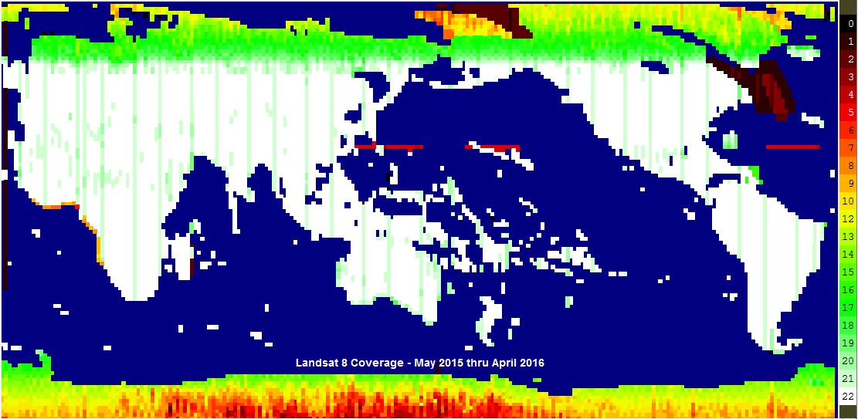
L8 Day 1-year Coverage

Slide 11
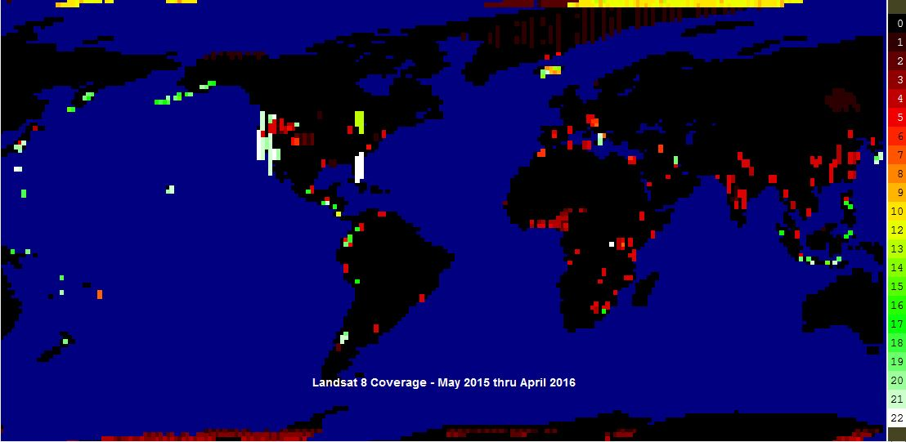
L8 Night 1-year Coverage

