Slide 1
Canadian Space Agency
LSI-Related Activities
Paul Briand, Yves Crevier
LSI VC 2 meeting
July 20-22, 2016
Paul.briand@canada.ca
Yves.crevier@canada.ca

Slide 2
Presentation Content
Canadian Context
Priorities and focused areas of interest

Slide 3
EO-Based Terrestrial Monitoring
Provides geographical information on land cover and on variables related to the vegetation state, the water cycle, energy budget, etc. It supports applications in a variety of domains such as spatial planning, forest management, water management, agriculture and food security, etc.
Recurrent, systematic and coherent observation of Canada’s land mass over time (from coast to coast to coast)
Long term repeatable observation strategy in support of a broad spectrum of information needs

Slide 5
Issues
Despite the availability of data (from dozens of radar, multi- and hyper-spectral sensors), Canada has yet to exploit the full potential of satellite-based EO to detect and monitor environmental pressures in an integrated, repeatable, and standardized manner.
While Canada is recognized as a leader in the global remote sensing for landscape characterization and ecosystem research, large gaps in monitoring and mapping still exist and are not being addressed at a national scale in order to better meet departmental mandates.
Large number of players, diversified list of requirements, scale, policy, mandates, etc.

Slide 6
Opportunities
Requested for national scale, long-term, standardized, and spatially complete information for effective monitoring and management (NRCAN, AAFC, ECCC, PC, PKC, Stats Can, TC, PHC, etc.).
Monitoring, reporting, and science‐based policy support are core activities of several federal agencies in Canada.
Sector‐specific objectives associated with terrestrial monitoring can often be met using the same or similar datasets.
Earth Observation (EO) data enables large‐area characterization of terrestrial ecosystems in a systematic, repeatable, and spatially exhaustive manner.
Still need to understand
  Contribution of the C-Band radar for Terrestrial Monitoring
  Interoperability and complementarity
  Need for a coherent imaging strategy for understanding status and trends
  Need analysis ready products and services to support user requirements
  Availability and accessibility

Slide 7
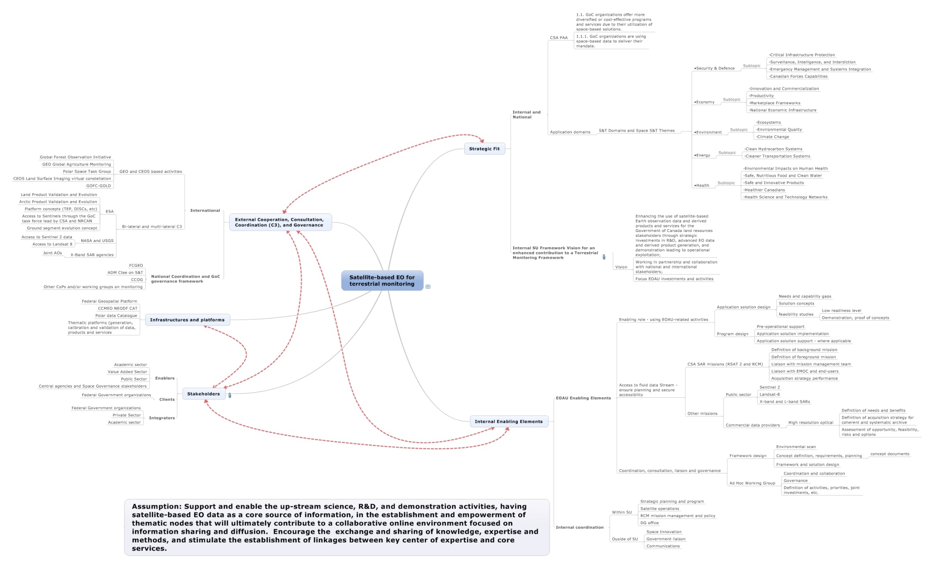
Land Surface / Terrestrial Monitoring
Ecosystem in Canada

Slide 8
Canadian Space Agency
Priorities
To support science and R&D activities demonstrating unambiguously the contribution of C-Band data in an individual, interoperable and complementary basis.
To enable end-users to exploit the large amount of SAR data that is now or will soon be available in support of their programs for land surface monitoring
To support the development of documented, validated and repeatable algorithms directed to the development of products on terrestrial attributes
    This should avoid the constraints related to restricted data policy
    In line with the concept of ARD (various levels)
  To support the development of a Geospatial Data Cube including virtual front-end toolboxes

Slide 9
CSA Focused Areas of Interest in Support of Land Surface Imaging
Use C-Band:
As an individual / repeatable source of data (individual data collection)
Under a sensor interoperability framework - obtaining the same thematic results from different sensor (required coordination)
  Full interoperability: Same thematic results (i.e. RADARSAT 1 and 2, Sentinel 1 A and B)
  Partial interoperability: Varying range of similarity (i.e. RADARSAT 2 and Sentinel 1)
Under a sensor complementarity framework -obtaining additional thematic information through the (synergistic) use of two or more different sensors (required coordination)
  SAR / Optical missions
  SAR / SAR missions – multi-frequency
9
Notes:
9

