Slide 1
Applying CEOS information systems (e.g. CEOS DB) to LSI gap analyses
Facilitator – Tom Cecere (USGS)

Slide 2
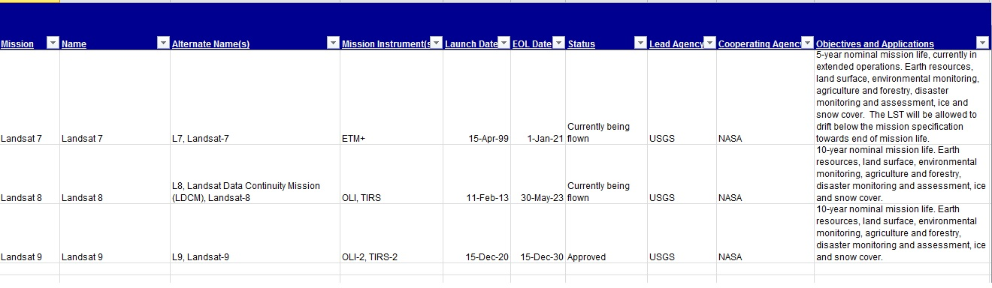
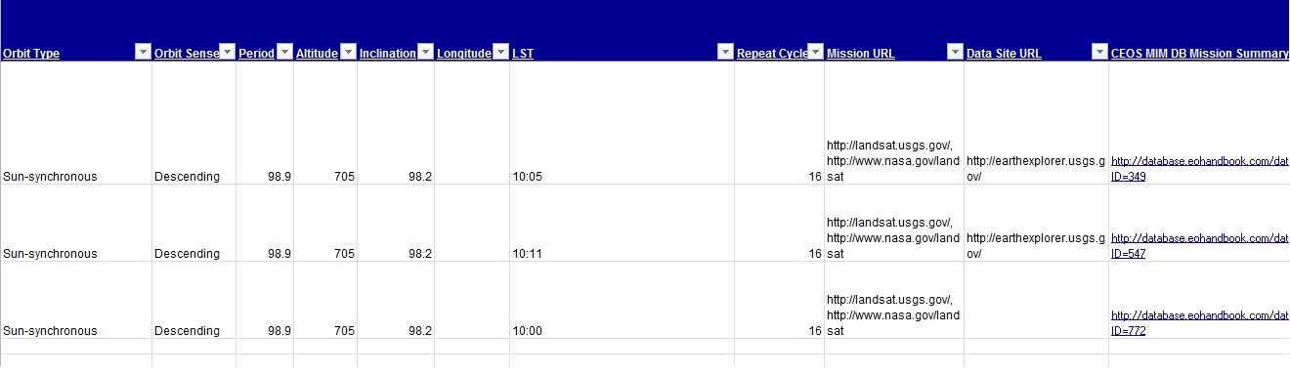
MIM Dbase – Missions TAb

Slide 3
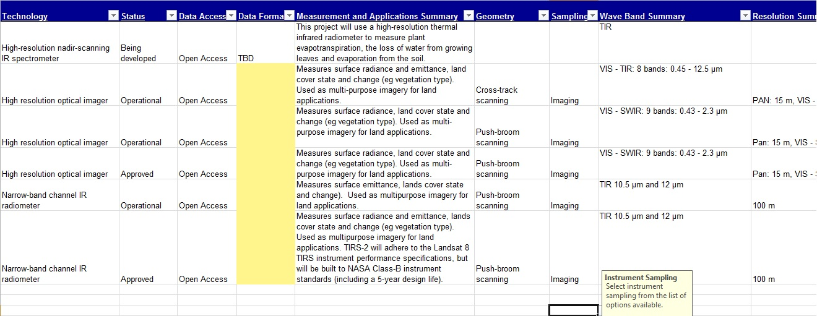
MIM Dbase - Instruments

Slide 4
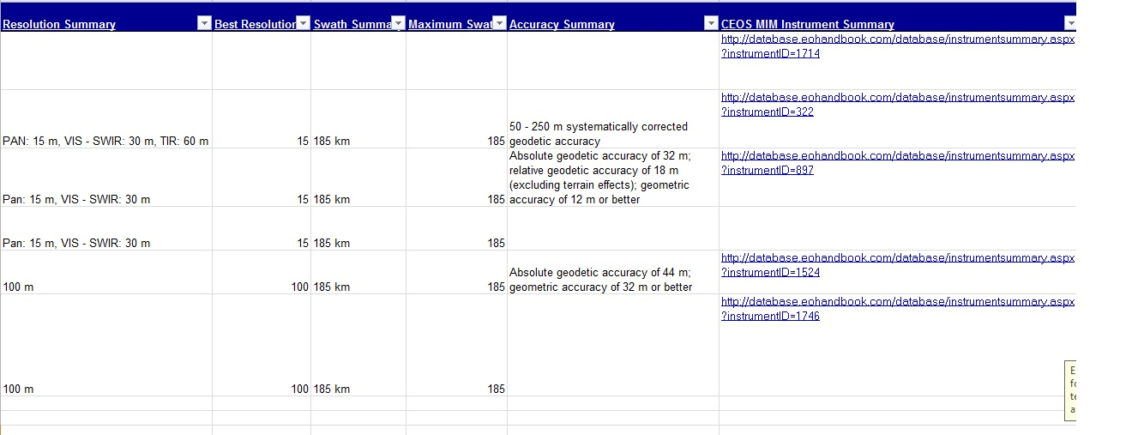
MIM Dbase – Instruments (cont.)

Slide 5
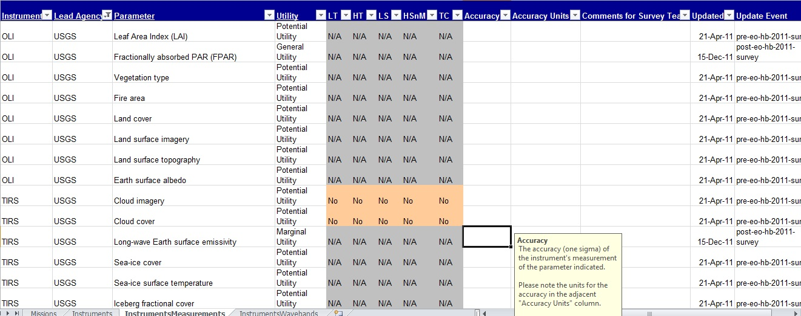
MIM – Instrument Measurements

Slide 6
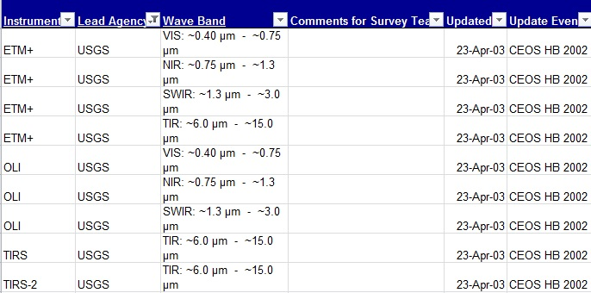
MIM – Instrument Specifications

Slide 7


