Slide 1


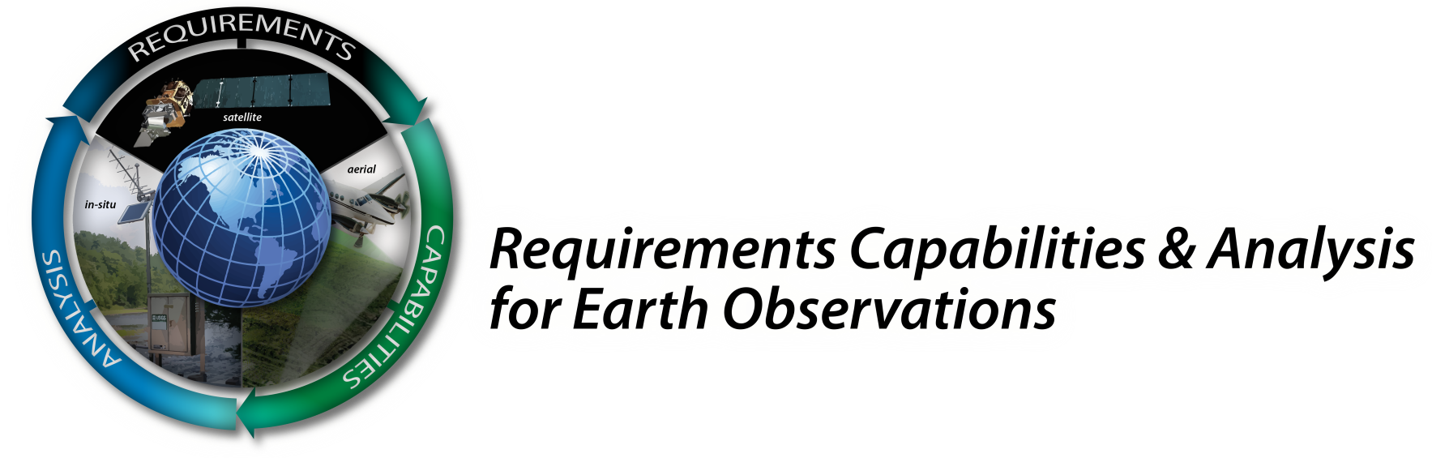
Understanding EO Requirements and Capabilities for GEOSS
LSI-VC, Los Angeles, CA, 7/20/2016
Department of the Interior
U.S. Geological Survey

Slide 2
Agenda
Why ( 3 minute video)
Overview and Status
  History
  EORES
  Requirements
  Capabilities
  Analysis
Requirements analysis for CEOS

Slide 3
Purpose of RCA-EO
RCA-EO provides data and analyses to help optimize investments in Earth observing technology and products to better meet user needs – USGS and beyond
Notes:
Earth Observation – generally refers to gathering information about planet Earth's physical, chemical and biological systems via remote sensing and terrestrial technologies

Slide 4
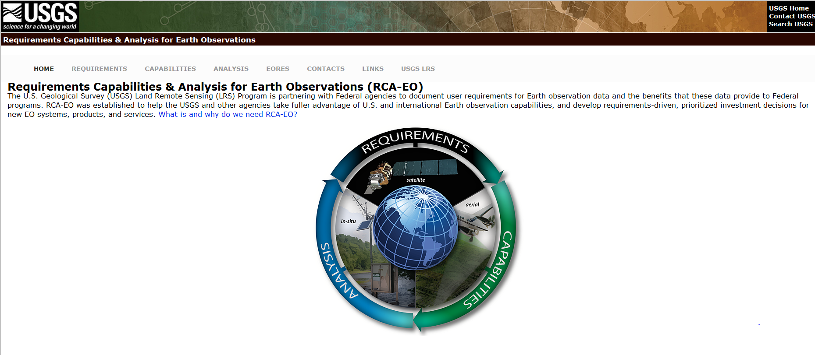
RCA-EO Web Page http://remotesensing.usgs.gov/rca-eo/
Requirements
Provide a comprehensive view of Federal science and operational needs for Earth observations
Capabilities
Provide a consolidated source of information about Earth observing capabilities and data
Analysis
Provide databases and tools to enable data-driven decision making by managers and practitioners
RCA-EO - Introduction to the Vision - YouTube
RCA-EO Achieving the Vision - YouTube

Slide 5


Requirements Capabilities & Analysis for Earth Observations (RCA-EO)
  RCA-EO is a USGS Land Remote Sensing (LRS) Program activity that collects and interprets Federal EO needs and capabilities to:
    Provide a detailed view of EO user requirements & EO systems capabilities
    Match EO user needs to a range of potential EO system and data solutions
    Enable user and data-driven decision making for Earth Observing programs to inform the development of systems, products and services
    Assess the relative value of EO systems, products, and services to agencies and societal interests
    Inform future investments in EO systems and their design characteristics
  Partnership between USGS and the National Oceanic and Atmospheric Administration (NOAA) for developing next generation system and analytical toolsets
  Leverages NOAA’s excellent legacy efforts (12+ years)
  Detailed joint project plans and development teams for RC& A

Slide 6
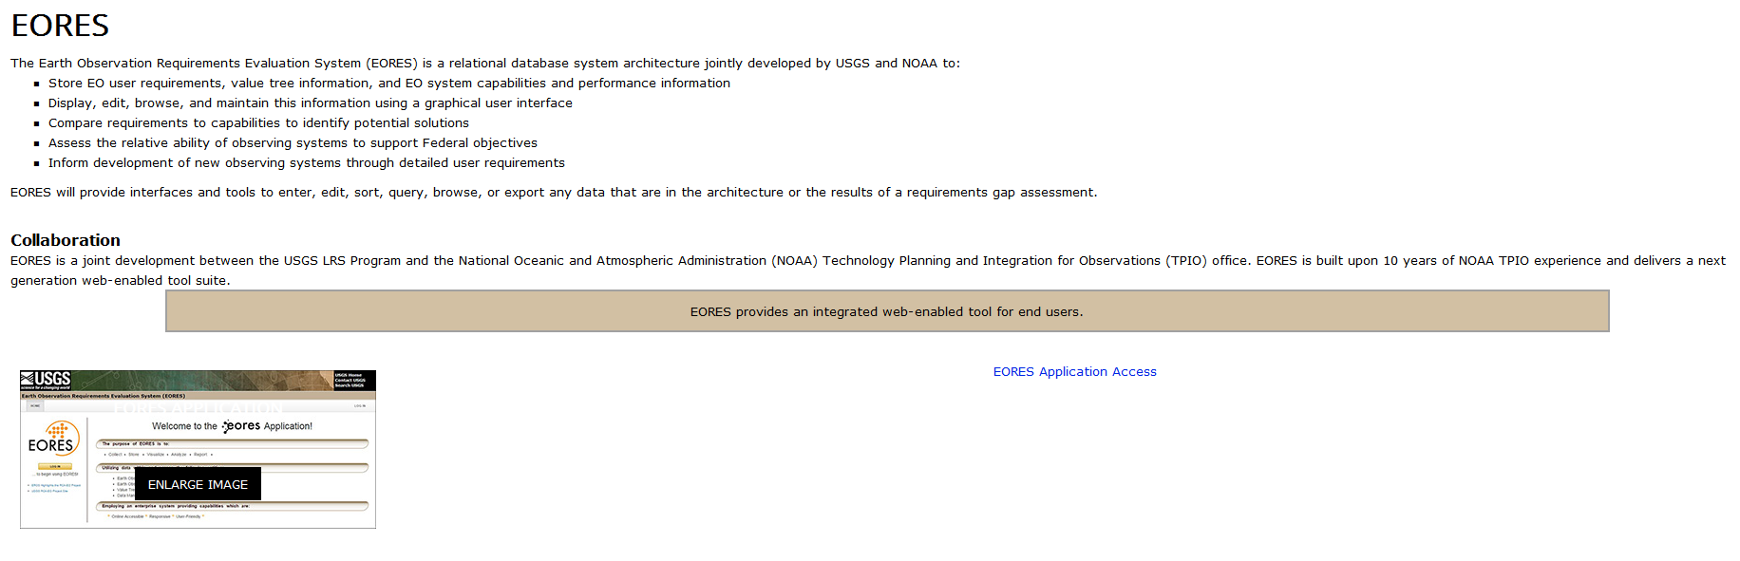
EORES page - http://remotesensing.usgs.gov/rca-eo/eoresinfo

Slide 7
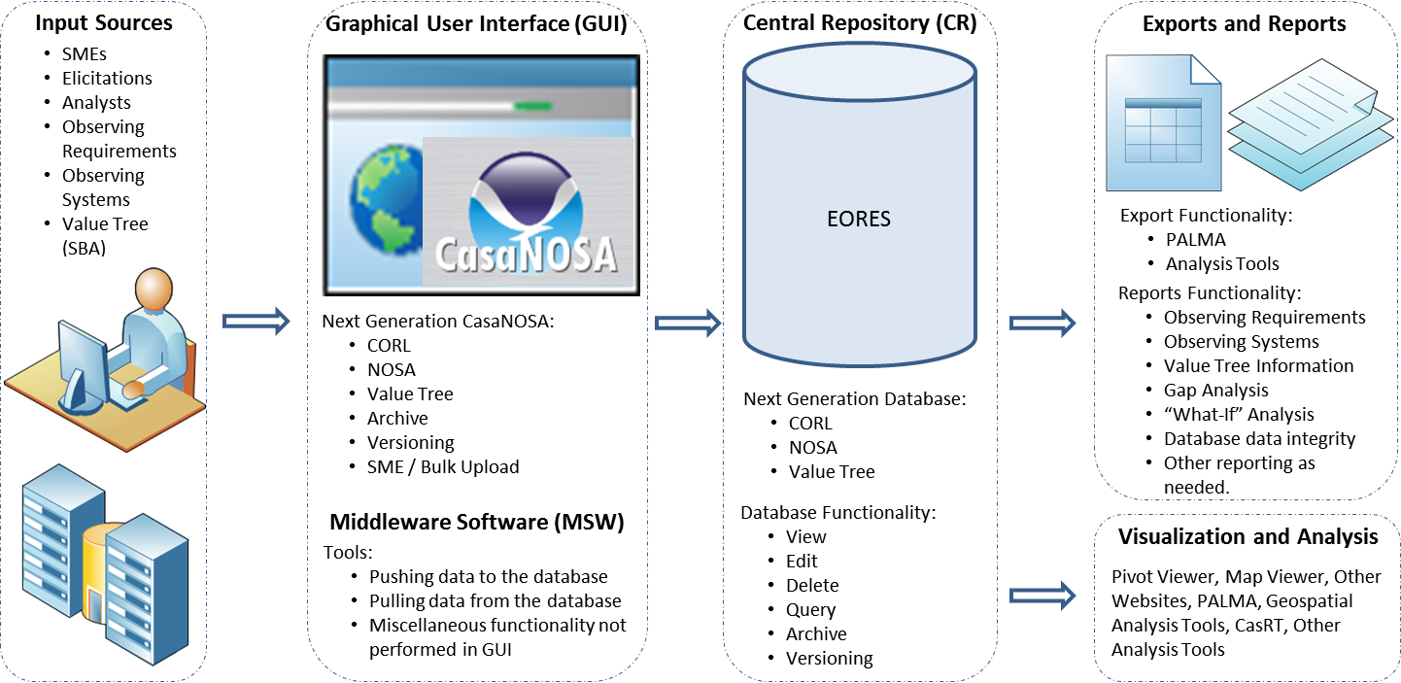
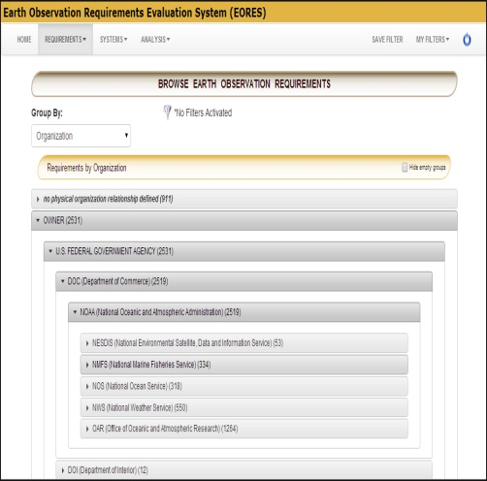
EORES Components
Notes:
This is an EORES Project overview with some very NOAA legacy system references.
1st Production Earth Observation Requirements Evaluation System (EORES) release completed in July
NOAA has moved their Observing Systems databases and tools into the EORES baseline, and will be turning off the old systems
Elicitation of user requirements from the EO community, including a plan for supporting EOA II in conjunction with USGEO and OSTP
Continued development and use of next generation analytical tool suite to provide EO Requirements and Capabilities Analyses and Reporting

Slide 8
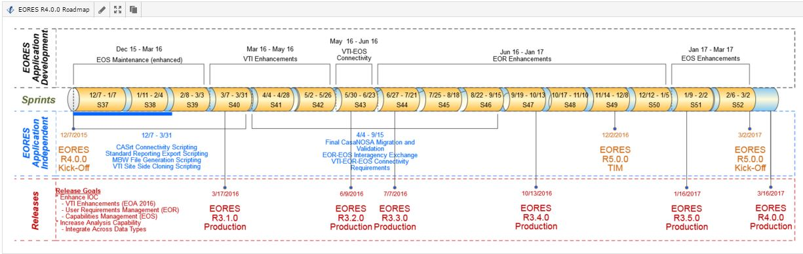
EORES Timeline
Agile development process information, subject to change

Slide 9
RCA-EO Components
RCA-EO Components
EORES
User Requirements
        Database of system-independent user needs
Observing Systems Capabilities
        Database of current and future Earth observing systems
Requirements
Capabilities
Analysis
Value Tree Information (VTI)
        Organizational program of Earth observing input and capabilities mapped to the organization’s goals and objectives
Value
Tree
Earth Observation Requirements Evaluation System (EORES) and Analysis
Using EOA VTI to elicit User Requirements
        Across all Civil Federal Agencies
RCA-EO is driving toward a user needs driven business management process to address mission priorities, and incorporate evolving Earth observing technology
9

Slide 10
RCA-EO Information
Value Tree
Links Earth Observing systems to USGS and DOI goals in a strategic framework
DOI Strategic Plan Mission Areas, Goals, Strategies..
Requirements
Capabilities
USGS Science Strategy Goals
Topography
Land Use/Land Cover
Precipitation/Temperature
Streamflow rate
Soil Moisture
…
Key Products and Services Example:
Future Water Availability Studies
Current and future
Earth observing capabilities
Capabilities used now
Airborne Lidar
NAIP
Landsat
USGS Streamgages
Others EOS
VTI through 2015:
27 USGS Programs elicited
> 500 scientists engaged
345 Key Products/Services evaluated
Over 1000 data sources identified and assessed
8
Notes:
Value Tree to User Requirements and Analysis. This summarizes the whole picture of RCA-EO: how an agency is mapped in a tree structure, how requirements are generated from KPS, how capabilities are matched with the requirements, and how analysis can support current EO capabilities assessment and future capabilities planning.

Slide 11
VTI vs. User Requirements
Value Tree Information (VTI)
  Elicitation of data sources and products used by subject matter experts
  Organizational program of Earth observing input and capabilities mapped to the organization’s goals and objectives
  Not user requirements
  Provide impact value of current product of service
  User satisfaction assessment
User Requirements
  The specification of an observed feature and necessary attributes, including spatial and temporal resolution, accuracy, geographic coverage, latency, etc.
  System Agnostic and Technology independent so that requirements can be mapped to multiple earth observations
  Mapped to environmental parameter
  Requirements nomenclature based on NASA Global Change Master Directory (GCMD) lexicon
  3 tiers performance needs
  Not system development specifications or requirements
Notes:
VTI Plan:
Goal to be as complete/ comprehensive as possible
Ensure USGS represented across all relevant SBAs in EOA 2016
Relative impact of EO sensors and products need to be assessed in the context of everything else
Req Plan:
Conduct selective data collection based on established priorities
cover breadth of Land imaging
Expand elicitation over time (complete partial requirements sets, continue to build across range of applications)

Slide 12
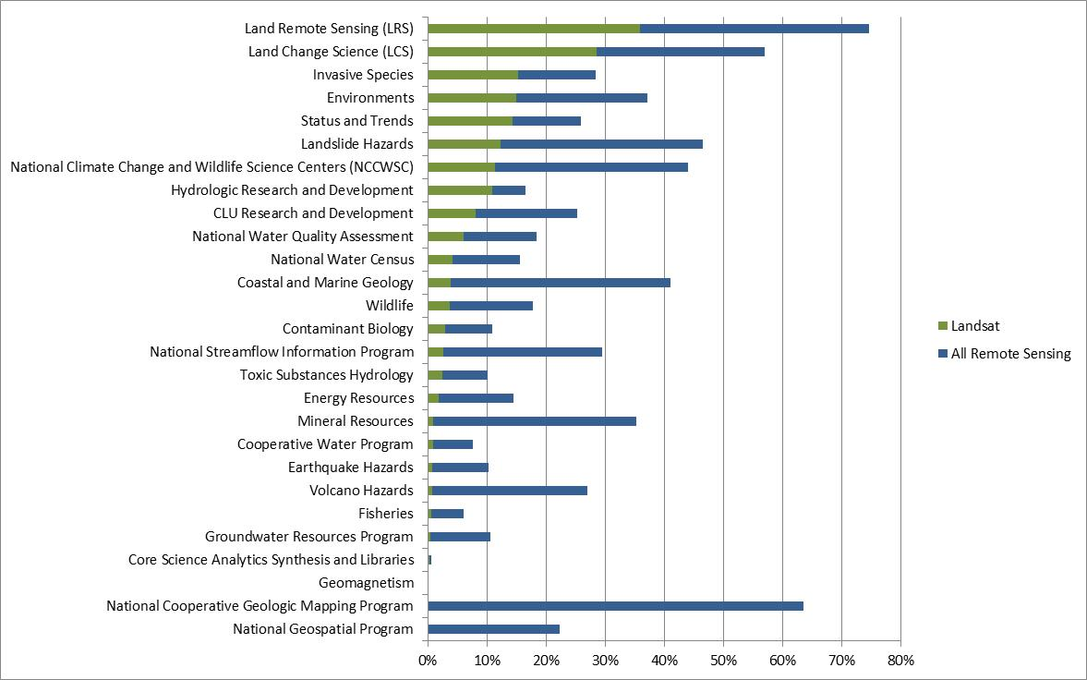
Remote Sensing Impact on
USGS Program Performance*
Impact of loss of capabilities on USGS Programs,
Preliminary information
Notes:
USGS programs rely on a range of data sources including remote sensing data of various types
•Impact scores represent the relative utility of Landsat versus all other remote sensing sources
•Subject matter experts across USGS provided an evaluation of the expected impact should a an individual data source become unavailable
Inform and facilitate collaboration among programs
Expected drop in performance if a system is lost. Current usage of data, and doesn’t reflect needs. Doesn’t mean that a high impact system is critical – could be replaced by other systems (but it’s used right now and it has great impacts).
Update: Decompose intermediate products, include all KPSs. The following slides show the type of analysis that we can do using USGS VTI, but results are not final yet.

Slide 13
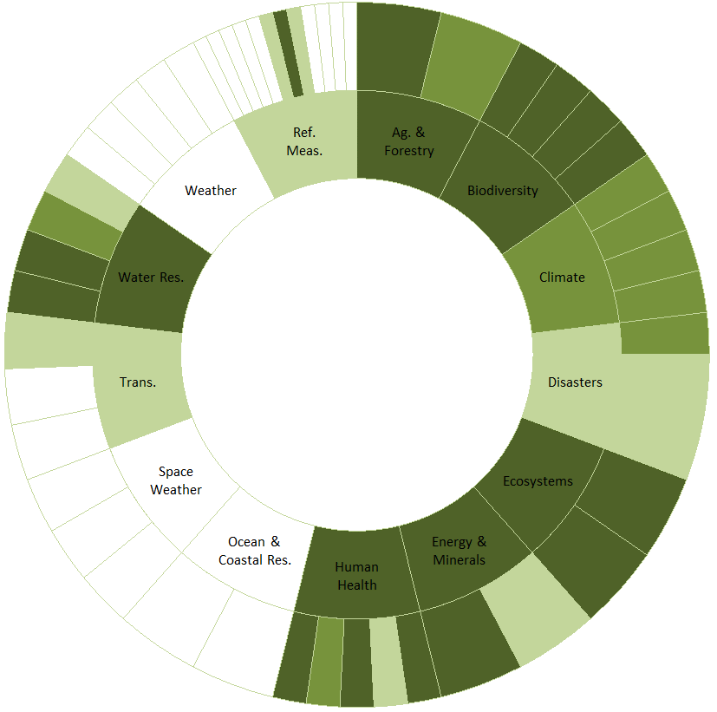

Landsat – EOA 2012 Results
Assessment of 362 US Earth Obs. Systems (EOS) (space, air, land, and sea platforms) contributions to 13 Societal Benefit Areas (SBAs)
Landsat was 3rd out of total, and Landsat 2nd “most critical SBA impact” of 132 satellite systems (GPS=1)
10 of 13 (77%) SBAs use Landsat data
Landsat has a Significant Impact on 6 SBAs;
  Ranked #1 for contributions in Biodiversity, Ecosystems, and Energy
  Ranked #2 for contributions in Agriculture/Forestry, Climate, Human Health, and Water
31 of 52 (60%) Sub-SBA Areas utilize Landsat
  Landsat had a Significant Impact on 15 Sub-SBAs and a Moderate Impact on 6 Sub-SBAs
Societal Benefit Areas (inner ring)
Sub-Societal Benefit Areas (outer ring)
LANDSAT
http://www.whitehouse.gov/sites/default/files/microsites/ostp/NSTC/national_plan_for_civil_earth_observations_-_july_2014.pdf

Slide 14
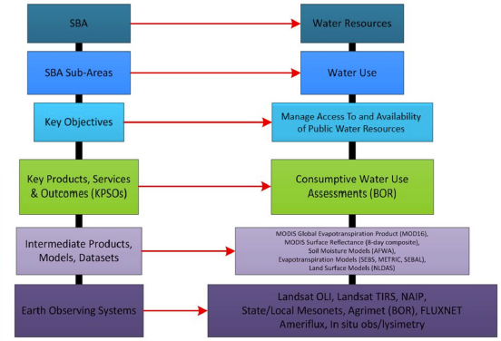
EOA - US Federal Agencies Value Tree
A hierarchical framework that establishes the connection from top‐level societal benefits to the set of observing systems that contribute to the Societal Benefit Area
• Intermediate levels provide a logical traceability
• Goal is to connect Earth observations with the value they provide (Societal Benefit delivered)
Notes:
EOA 2012
No KPSOs, workshops of HQs intermediate products…
EOA 2016, identify KPSOs, engage individual scientists
To be completed Jun 2016
2000 KPSOs, NOAA/USGS covers about ½ (1000 KPSOs)
KPSOs under key objectives

Slide 15
Snapshot of Federal Civil Earth Observation Data Use Completed
  Completed Snapshot of Earth Observation data use across USGS and other Federal Civil Agencies through EOA 2016
    ~1750 key products and research areas surveyed
    ~174 relied on Landsat data
  Identified user satisfaction and limitations for currently used data sources
  Have begun using data to respond to activities/decisions
Preliminary requirements information

Slide 16
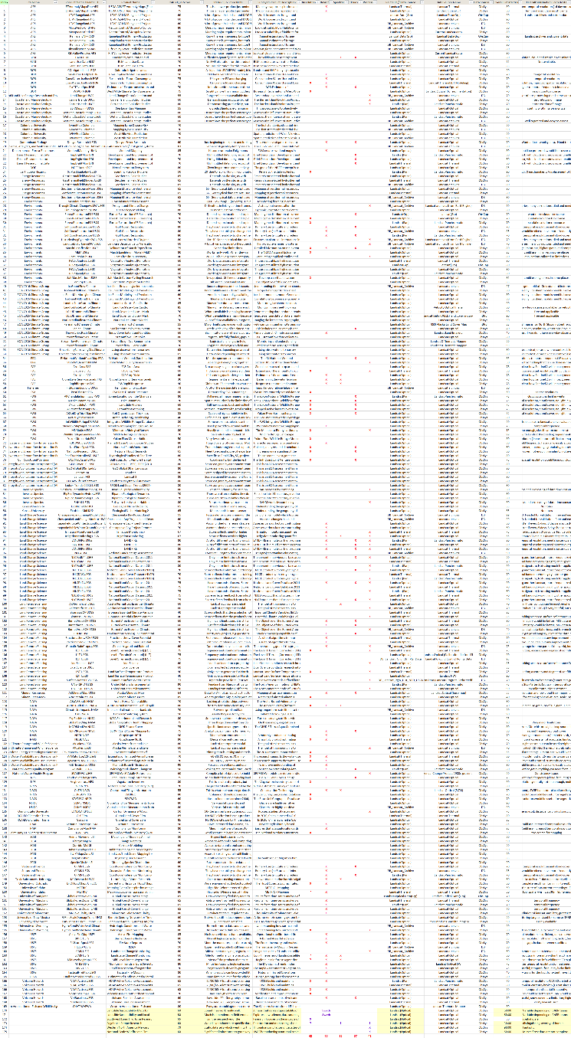
Initial EOA 2016 VTI Analysis
Preliminary Analysis Based on (Only) Users of Landsat Data and Products
  Will Expand to Cover other Optical/Thermal Spaceborne Sensors in Subsequent Analyses
174 Separate Projects from Multiple Agencies
  Also Includes University/Academic Partners
  32 Projects Using Landsat Historical Data
  27 Projects Using Thermal Data
  6 Projects Using Landsat L2+ Products, e.g. – Surface Reflectance, etc.
Of 238 Applications Surveyed (Includes use of Each Sensor or Product Separately):
  42 Requests for Higher Spatial Resolution
  73 Requests for Higher Temporal Sampling (Revisit)
  13 Requests for Increased/Different Spectral Coverage
  37 Comments About Cloud Cover (Consider as Revisit)
  41 Comments About Processing, Additional L2+ Products, or Distribution Improvements
Preliminary requirements information

Slide 17
Requirements Collection Plans
Focus on a broad range operational and science application requirements where land imaging is a key data input
    Data collection is underway to document user requirements related to applications
    Initial focus on Landsat applications identified using USGS RCA-EO and EOA 2016 information
    Work with Landsat team to identify any missing applications and supporting requirements
    Add applications that rely on a broader range of land imaging platforms/sensors
    Cross-check priority applications areas being identified by the OSTP Earth Observation Assessment

Slide 18
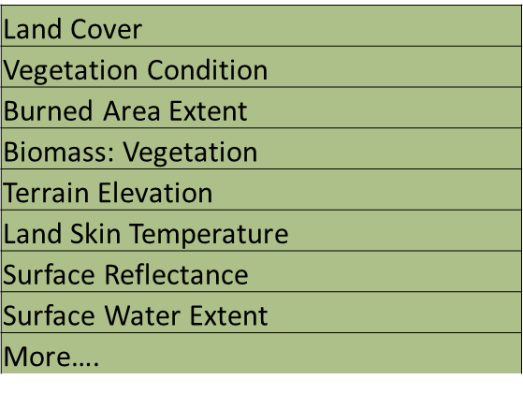
Requirement Attributes
Requirements captured by “Environmental Parameter” –the fundamental information needed for the application – examples -
For each Environmental Parameter, a variety of attributes are captured:
Geographic Coverage
Horizontal Resolution
Vertical Resolution (if applicable)
Sampling Interval
Accuracy
Data Latency
Conditions for Sampling
Length of the Data Record
Spectral Characteristics
Data Services, Access and Formats
For each of these attributes we capture a value, the units, and comments/rationale for the chosen values (to the degree the SMEs are able to provide the information)
For each requirement there are 3 potential levels:
  Threshold
    The minimum specification to be met to ensure that an Earth observation (EO) dataset or service is useful
  Breakthrough
    An intermediate requirement level which, if achieved, would result in a significant improvement in capability against the targeted application
  Target
    The value above which further improvement of the EO dataset or service would provide only limited improvement in performance for the application in question
Notes:
It’ll help us to understand your needs by getting questions from you.
Threshold
The minimum specification to be met to ensure that an Earth observation (EO) dataset or service is useful. Below this minimum level, the data either provides no value or the benefit derived does not compensate for the additional cost involved in using the dataset or service.
Breakthrough
An intermediate requirement level which, if achieved, would result in a significant improvement in capability against the targeted application. The Breakthrough level may be considered to be optimum from a cost-benefit point of view when planning, designing, or creating an EO dataset or service.
Target
The value above which further improvement of the EO dataset or service would provide only limited improvement in performance for the application in question. The cost of improving the dataset or service beyond the target requirement would not be matched by a corresponding benefit.

Slide 19
Requirements Examples
Some Tableau screen shots showing range of resolutions, etc. for a sample requirements set
Preliminary, partial requirements information for example only

Slide 20
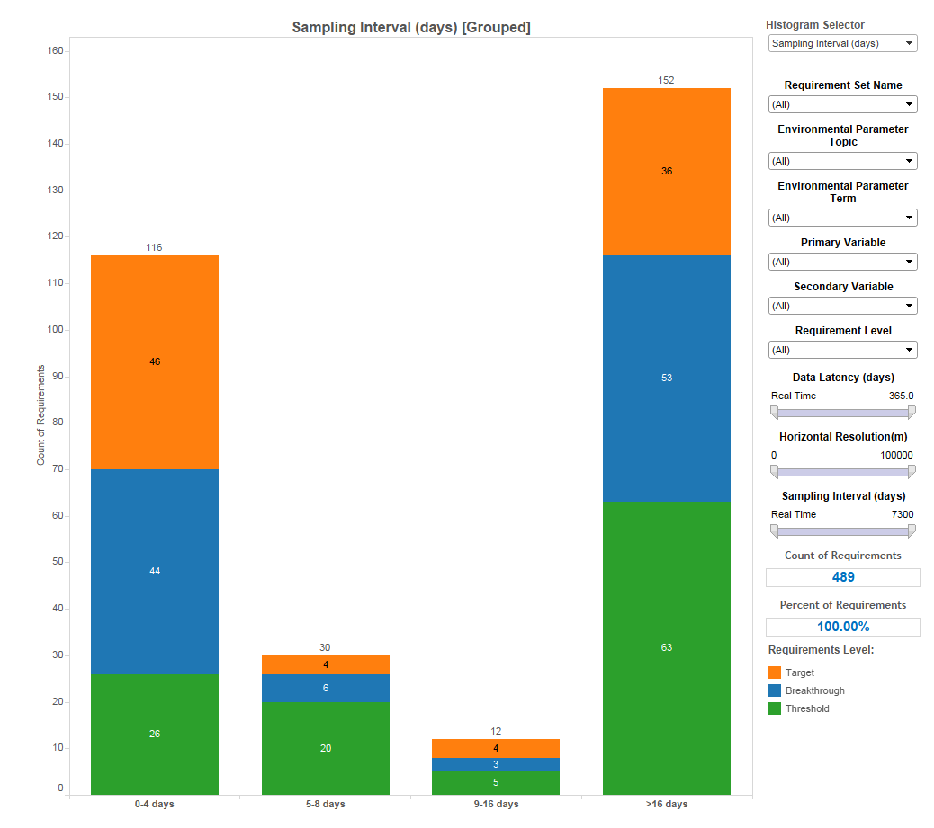
Preliminary, partial requirements information for example only

Slide 21
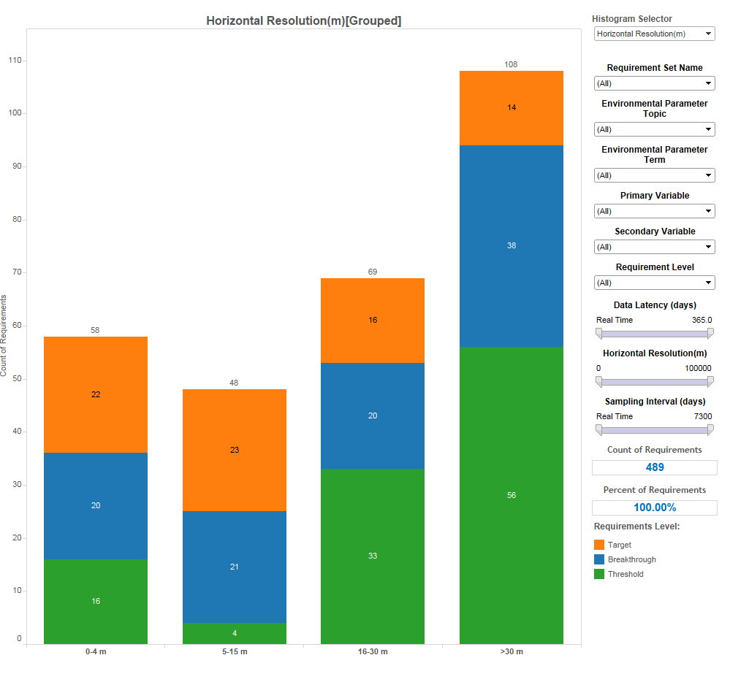
Preliminary, partial requirements information for example only

Slide 22
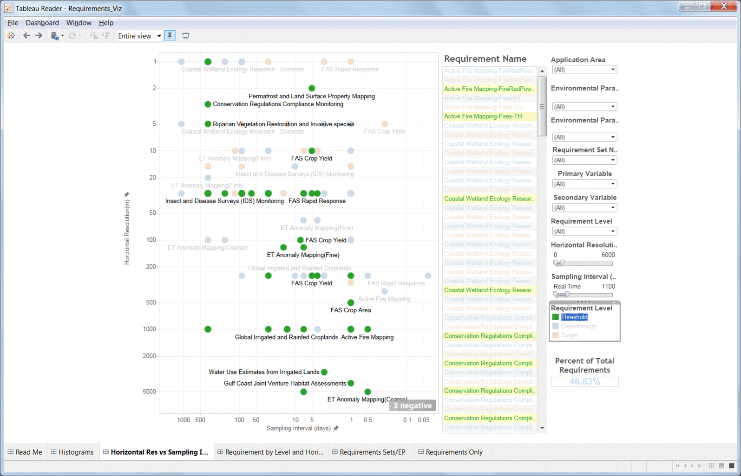
Requirements Trend Animated Example
Preliminary, partial requirements information for example only

Slide 23
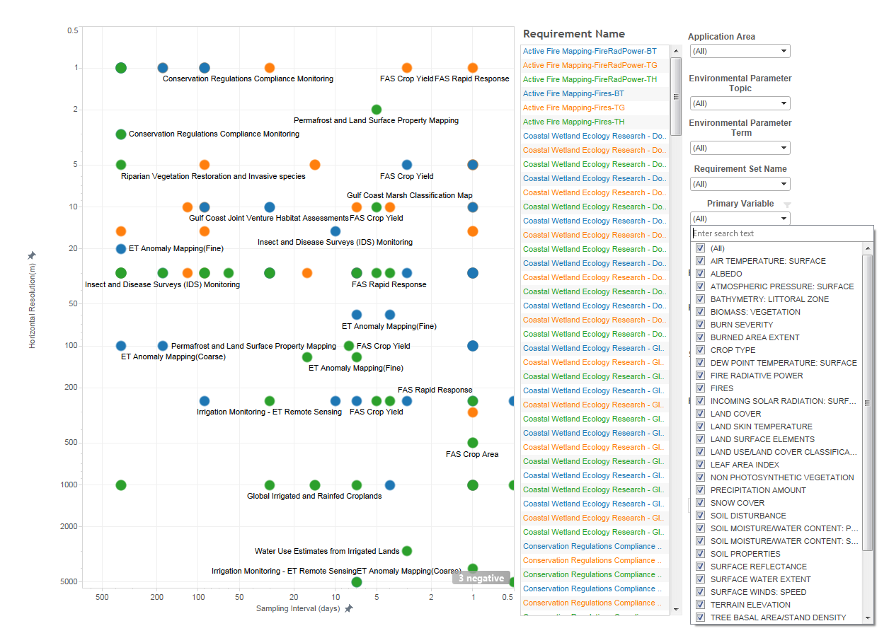
Preliminary, partial requirements information for example only

Slide 24
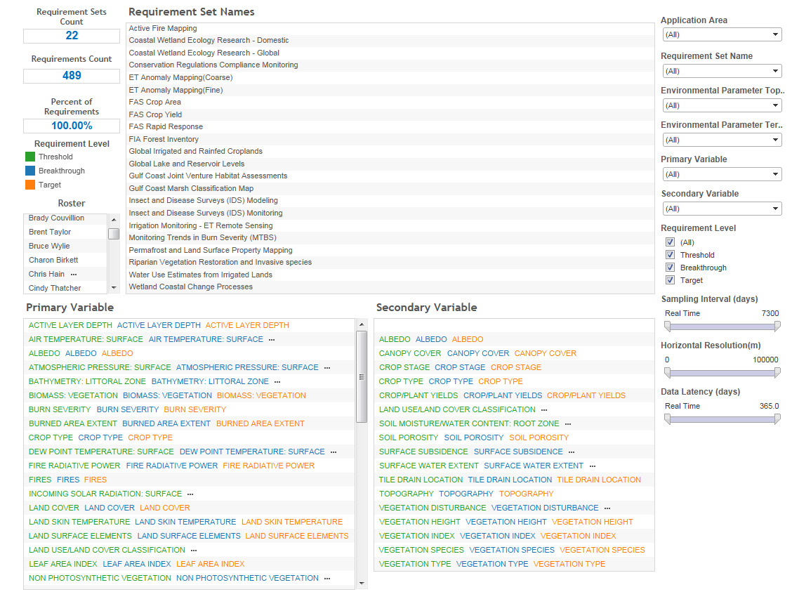

Slide 25
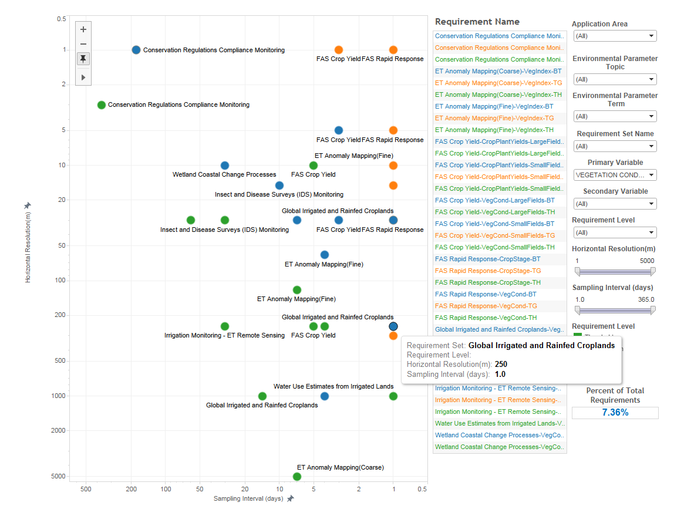
Preliminary, partial requirements information for example only

Slide 26
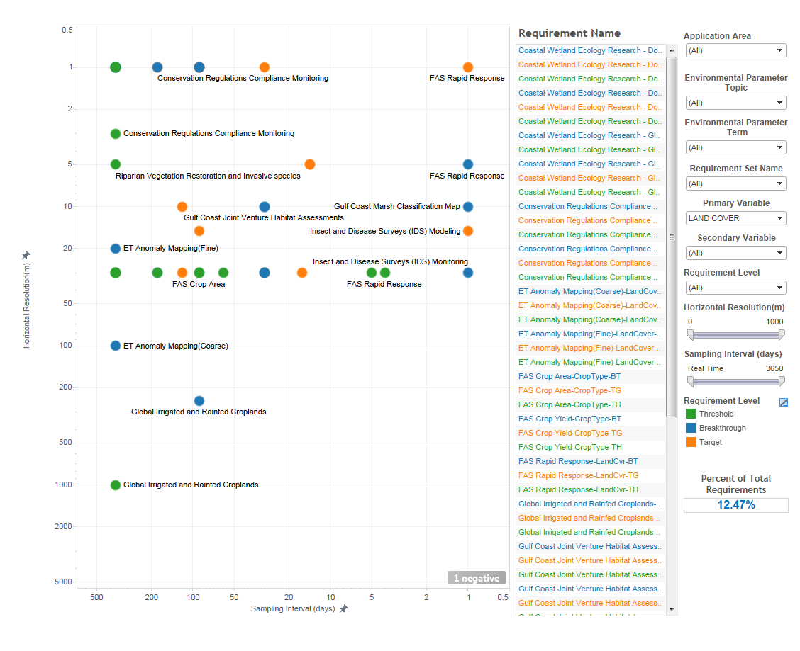
Preliminary, partial requirements information for example only

Slide 27
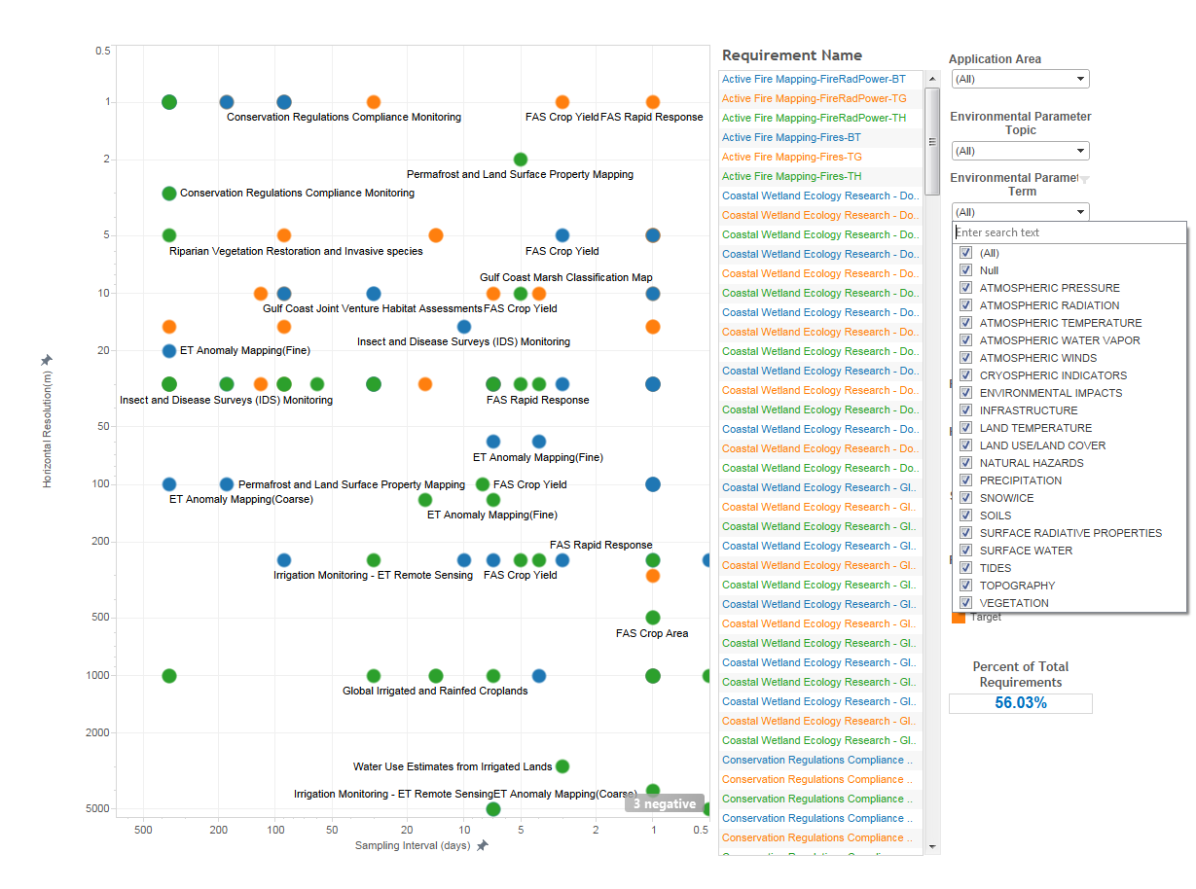
Preliminary, partial requirements information for example only

Slide 28
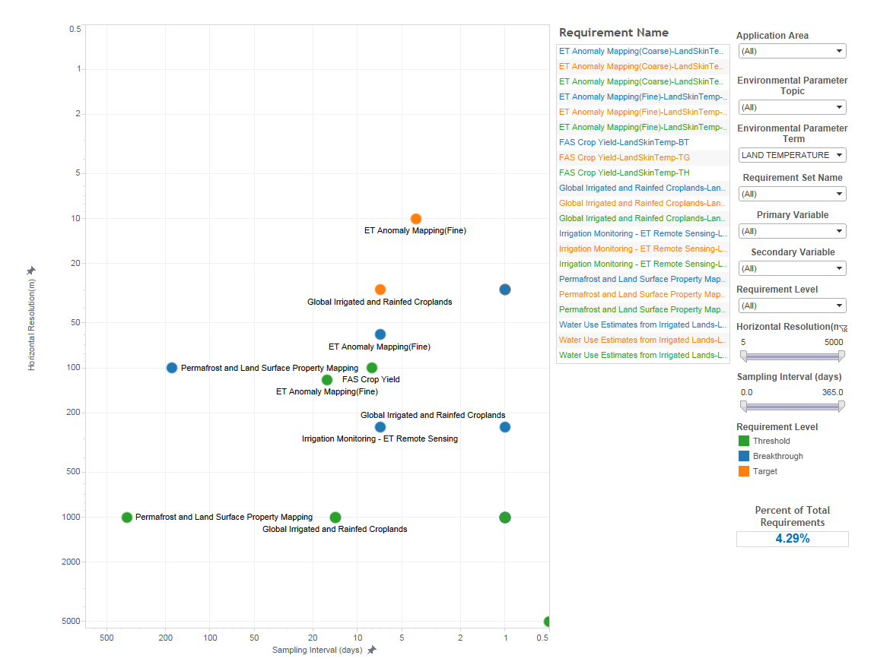
Preliminary, partial requirements information for example only

Slide 29
Capabilities
Established a USGS – NOAA Capabilities Work Group
  Assignment of resources based on agile development process
  Releases
    Phase 1 - Moderate and High Res Satellites (V1 complete)
    Phase 2 – High priority land imaging systems
    Phase 3 – USGS Systems
    Phase 4 – Other Land Imaging Systems
    Utilize NOAA EOS where applicable – NOAA update structure baseline
NOAA and USGS working capabilities together
  NOAA refresh on-going establishing common attributes
  Long term O&M plan
Input welcome on detailed capabilities and requirements fields and interaction (using same attribute fields as requirements with some additional key fields for analysis)

Slide 30
Notes:
Note this contains data only on a representative selection of satellites.
The white numbers within a timeline indicates the number of satellites in a multi-satellite “constellation”
Points worth noting: “Free and open” data policies are tied to government satellites only, and also with more spectral capability whole-earth-survey systems.
Whole-earth-survey systems tend to be lower-res. Planet Labs is the exception.
Only two launches of PlanetLabs Dones are to Sun-synchronous orbit: Flock 1c and the future Flock 2 (name unsure, but ~150 Doves!) that is to be launched in 2016
It is hard to find any current information regarding ResourceSat-3. It seems ISRO has pulled back from their initially ambitious goals for Earth Observation.
Final data prices and policy for the German EnMap mission have not yet been announced but, based on previous satellites, we expect it to be somewhat limited (this is a research mission).

Slide 31
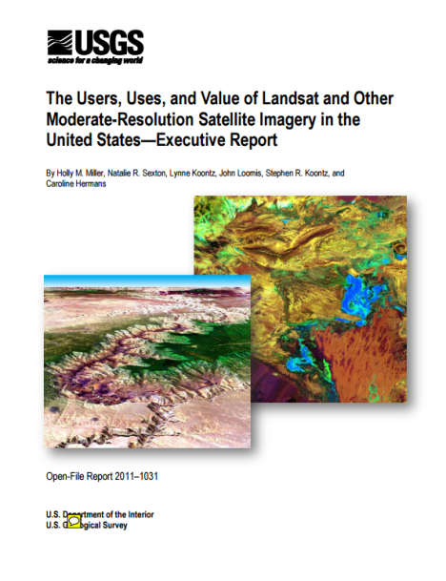
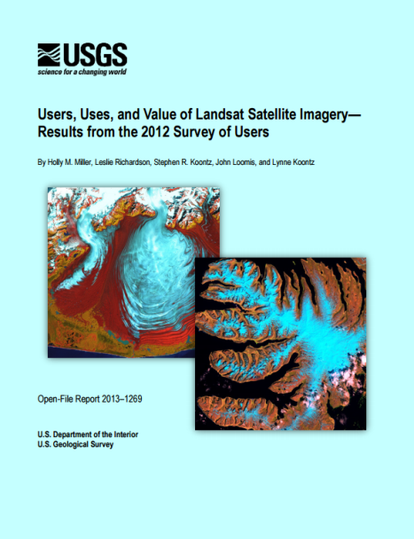
USGS User/Use Analysis
  Working with USGS Ft. Collins to verify breadth/depth of Landsat community
  Looking across application groups
  Fed vs non-Fed
  US vs International
Analysis of USGS EROS Registration and User Survey Data to Inform Landsat 10 Requirements Efforts: Comparison of U.S. Federal Users to Other Users

Slide 32
CEOS Requirements and Capabilities
CEOS Capabilities
  CEOS EO Handbook/MIMS
  Ability to use capacities database
CEOS Requirements
  Represent CEOS base with current user effort
  Expand methods to include other CEOS agencies
  SEO efforts
  VCs
Gap Analysis
  Capabilities against Requirements Groups
Integration with data access, product access?

Slide 33
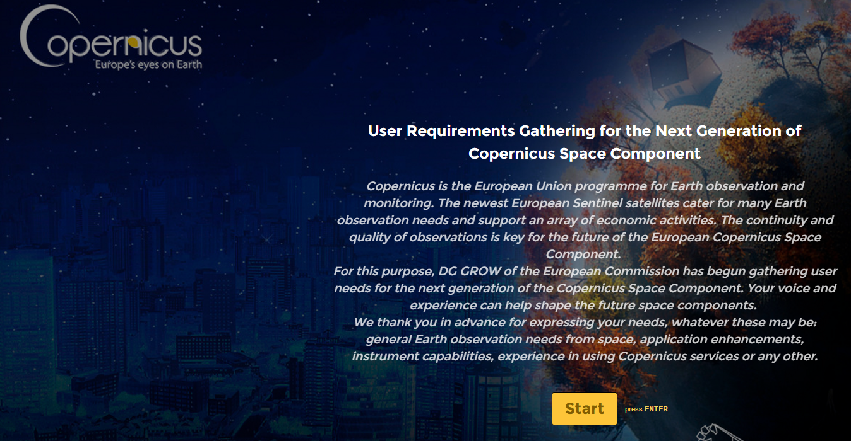
CSIRO, ESA and others
New ESA User requirements page
  https://technology.typeform.com/to/jGtmco
  Attributes and Database structure
  simon.jutz@esa.int

Slide 34
Comments?
Notes:
It’ll help us to understand your needs by getting questions from you.

Slide 35
Backups

Slide 36
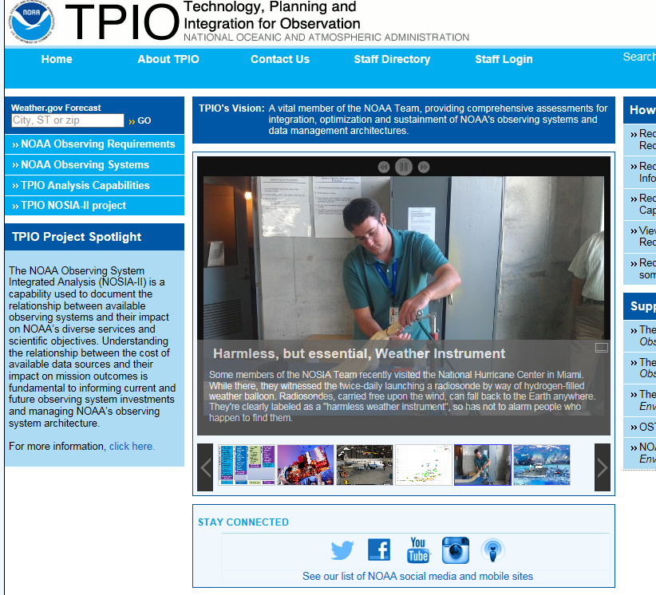
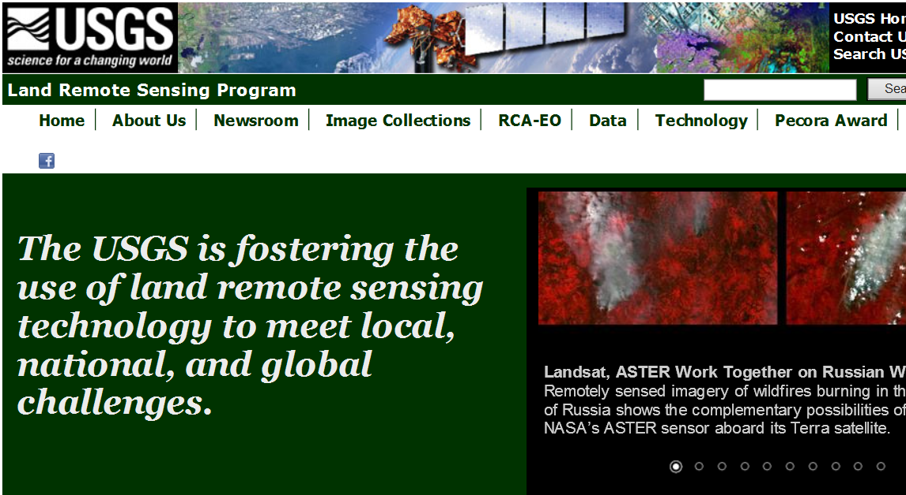
USGS – NOAA Partnership
http://remotesensing.usgs.gov/
https://nosc.noaa.gov/tpio/

Slide 37
Impact Assessment and Insights:
Landsat
All 7 Mission Areas use Landsat data
24 of 27 programs use Landsat data/products
Nearly a quarter of all USGS products and services use Landsat data
Over 100 USGS SMEs provided information on Landsat data/products usage
Landsat ranks 5th among all data sources supporting USGS programs
Landsat ranks 1st among all remote sensing data sources supporting USGS programs
Legend
High Impact
Medium Impact
Low Impact
No Impact
Preliminary requirements information

Slide 38
How representative is our RCA-EO data collection – focus on Landsat
How representative are Federal needs compared to non-Federal users?
Few differences exist between the relative percentages of Federal users and other users in primary applications
However, Federal users are underrepresented in common applications: education, agriculture, and geology
There may be differences in user requirements within applications where no significant differences were found in this analysis
Next steps…
  Further research
  Leverage other sources of existing information
  Potentially publish RCA-EO requirements as an RFI for public comment
  Other methods?
Notes:
Need to ask tom how to lighten this slide…

Slide 39
What’s ahead
VTI
  Expand VTI Analysis to Consider Other Spaceborne Sensors to Assess Needs and Usage that a L10 with Expanded Capabilities Could Support
  Correlate information for Temporal and Spatial Resolution and Spectral Coverage with Elicited Requirements to Determine Specific Parameter Values
Requirements
  Continue building set of user requirements across the broader range of land imaging applications
  Complete Requirements Elicitation and Validation Work
  Visualization(s) of Requirements
  Work with ESTO/SLI to Develop Possible L10 Configurations for Gap Analysis Against Elicited Requirements
  Conduct Gap Analysis, and needed assessments and analyses
  Other assessments?
Notes:
Hyperspectral applications
Additional thermal applications
Higher resolution applications (~5-30 m range)
Higher revisit applications

Slide 40
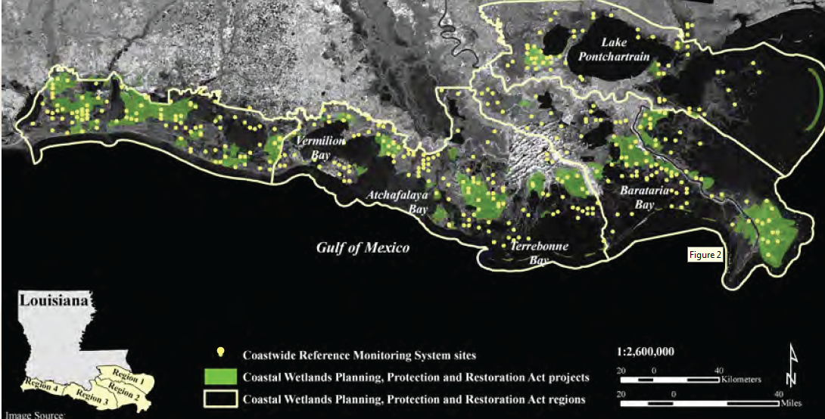
Value Tree Information for a USGS Key Product
Coastwide Reference Monitoring System (CRMS)
USGS Ecosystems Status and Trends Program
40

Slide 41
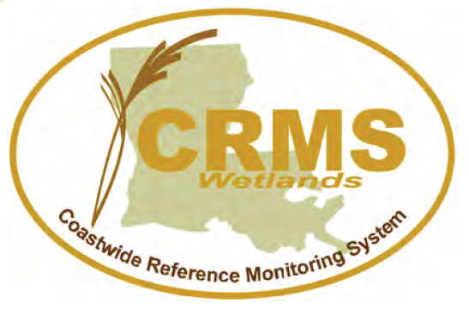
Coastwide Reference Monitoring System (CRMS)
USGS Ecosystems Status and Trends Program
Remote sensing provides the wetland change information along the coast
  – Landsat optical and triennial collection of 1 meter airborne imagery
    Current imagery and historical Landsat archives
    Desire increased temporal resolution for wetland change detection (currently get only 2-3 clear images/year)
High
Low
Preliminary requirements information
  Future needs:
  SAR imagery
  CoNED and LiDAR
  NLCD – Greater differentiation of wetland types
Notes:
Landsat optical is the primary remote sensing tool along with triennial collection of 1 meter airborne imagery
Increased temporal resolution would facilitate assessment of wetland change at finer time scales
Landsat Impact = 66%
For CRMS, the surface observations category has: weather station data and data from the CRMS Monitoring Network. The CRMS network has various components that measure/monitor everything from hydrologic properties (water levels, chemistry, temperature, etc.) to vegetation (% cover, species, etc) plots to soil/sediment sampling.

Slide 42
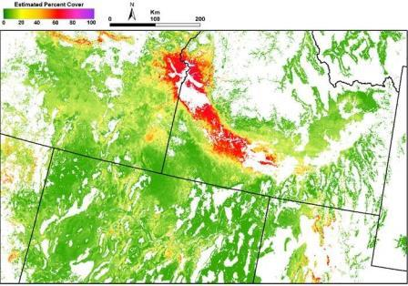
Remote Sensing Impact on the Land Change Science Program
Land Change Science (LCS):
Overall remote sensing impact: High
LCS
21 products surveyed
21 scientists engaged
Primary reliance on Landsat and both higher resolution and lower resolution imagers
Airborne Lidar is also an important contributor
Preliminary requirements information
Notes:
Overall remote sensing impact: MODERATE (35%)
Landslide Susceptibility Maps for Post Wildfire Debris Flows (98% Landsat impact)
Landslide Susceptibility and Local Warning Research (25% Landsat impact)
Landslide Hazards: Some other main data sources for this are field work, weather/precipitation data, and seismic data.
Other details:
Use both satellite and airborne SAR data
Use airborne imagery from FEMA and the NAIP program
Would like to have greater access to UAS’ to support their activities
Groupings
Landsat
Landsat(Optical)
Landsat(Pan)
Landsat(Thermal)
Commercial High Res Satellite Imagery
Comm_HiRes_Sat_Imagery_GeoEye1
Comm_HiRes_Sat_Imagery_IKONOS
Comm_HiRes_Sat_Imagery_Pleiades
Comm_HiRes_Sat_Imagery_Quickbird
Comm_HiRes_Sat_Imagery_Rapideye
Comm_HiRes_Sat_Imagery_Worldview1/2/3
Low-Mod Resolution Imagery
METOP(AVHRR)
POES(AVHRR)
TERRA(MODIS)
AQUA(MODIS)
NPP(VIIRS)
All other Satellite Data
RADARSAT
TerraSAR-X(SAR)
COSMO-SkyMed(SAR)
SPOT
SPOT 5
SPOT 6
TERRA(ASTER)
EO-1(HYPERION)
EO-1(ALI)
Nat_Tech_Means
Airborne Geophysical Data
Airborne_Electromag_Field_Surveys
Airborne_Gamma_Ray_Surveys(soil/rock)
Airborne_Geophysical
Airborne_Grav_Field_Surveys
Airborne_Mag_Field_Surveys
Airborne Lidar
Airborne_LiDAR(Comm)
USGS_EAARL_Airborne_LiDAR
Other Airborne Data (Imagery, Hyperspectral, SAR, IfSAR, Wildlife Surveys UAS)
Airborne_Contract_Commercial_IR
Airborne_HiRes_Imagery
Airborne_HiRes_Oblique_Photo
Airborne_HiRes_Oblique_Photo_Pictometry
Airborne_HiRes_Stereo_Imagery
Airborne_Hyperspectral
Airborne_NOAA_Post-storm_Imagery
Airborne_Protected_Species/Wildlife_Surveys
Airborne_SAR/IfSAR
SEBASS_HS/TIR
UAS_HiRes_Imagery
UAS_Surveys/Surveillance
USGS_Raven_UAS

Slide 43
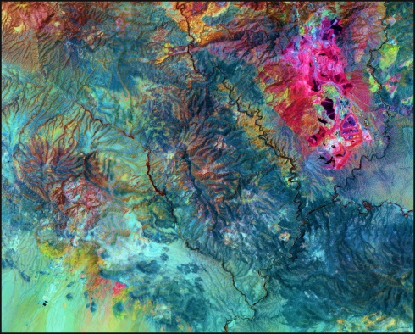
Remote Sensing Impact on the Minerals Resources Program
Mineral Resources Program (MRP):
Overall remote sensing impact: Moderate
MRP
8 products surveyed
22 scientists engaged
Primary reliance on satellite-based & airborne hyperspectral data, as well as airborne geophysical data
Limited use of Landsat for surface mineral mapping; require higher spatial and spectral resolution to be useful for this application.
Preliminary requirements information
Notes:
Overall remote sensing impact: MODERATE (35%)
Landslide Susceptibility Maps for Post Wildfire Debris Flows (98% Landsat impact)
Landslide Susceptibility and Local Warning Research (25% Landsat impact)
Landslide Hazards: Some other main data sources for this are field work, weather/precipitation data, and seismic data.
Other details:
Use both satellite and airborne SAR data
Use airborne imagery from FEMA and the NAIP program
Would like to have greater access to UAS’ to support their activities
Groupings
Landsat
Landsat(Optical)
Landsat(Pan)
Landsat(Thermal)
Commercial High Res Satellite Imagery
Comm_HiRes_Sat_Imagery_GeoEye1
Comm_HiRes_Sat_Imagery_IKONOS
Comm_HiRes_Sat_Imagery_Pleiades
Comm_HiRes_Sat_Imagery_Quickbird
Comm_HiRes_Sat_Imagery_Rapideye
Comm_HiRes_Sat_Imagery_Worldview1/2/3
Low-Mod Resolution Imagery
METOP(AVHRR)
POES(AVHRR)
TERRA(MODIS)
AQUA(MODIS)
NPP(VIIRS)
All other Satellite Data
RADARSAT
TerraSAR-X(SAR)
COSMO-SkyMed(SAR)
SPOT
SPOT 5
SPOT 6
TERRA(ASTER)
EO-1(HYPERION)
EO-1(ALI)
Nat_Tech_Means
Airborne Geophysical Data
Airborne_Electromag_Field_Surveys
Airborne_Gamma_Ray_Surveys(soil/rock)
Airborne_Geophysical
Airborne_Grav_Field_Surveys
Airborne_Mag_Field_Surveys
Airborne Lidar
Airborne_LiDAR(Comm)
USGS_EAARL_Airborne_LiDAR
Other Airborne Data (Imagery, Hyperspectral, SAR, IfSAR, Wildlife Surveys UAS)
Airborne_Contract_Commercial_IR
Airborne_HiRes_Imagery
Airborne_HiRes_Oblique_Photo
Airborne_HiRes_Oblique_Photo_Pictometry
Airborne_HiRes_Stereo_Imagery
Airborne_Hyperspectral
Airborne_NOAA_Post-storm_Imagery
Airborne_Protected_Species/Wildlife_Surveys
Airborne_SAR/IfSAR
SEBASS_HS/TIR
UAS_HiRes_Imagery
UAS_Surveys/Surveillance
USGS_Raven_UAS

