Slide 1
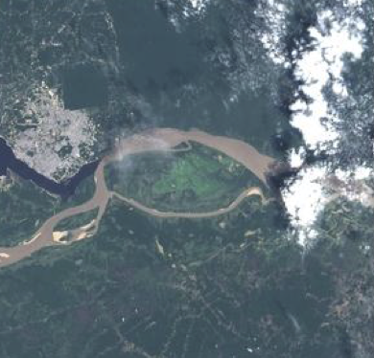
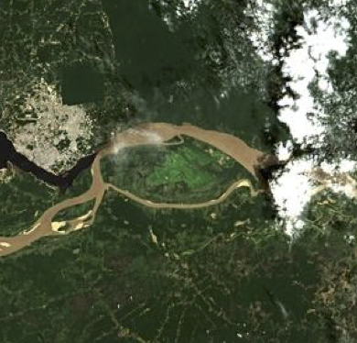
ACIX Atmospheric Correction Inter-comparison eXercise
Georgia Doxani | Serco for ESA/ESRIN, Georgia.Doxani@esa.int
Ferran Gascon | ESA/ESRIN, Ferran.Gascon@esa.int
Jean-Claude Roger | University of Maryland, roger63@umd.edu
Éric Vermote | NASA, eric.f.vermote@nasa.gov

Slide 2
- What?
International collaborative initiative to inter-compare a set of atmospheric correction (AC) processors for high-spatial resolution optical sensors
Focus on Landsat-8 and Sentinel-2 imagery
Better understanding of the different uncertainty contributors and help in improving the AC processors
Notes:
The inter-comparison of the derived Bottom-of-Atmosphere (BOA) products is expected to contribute to the understanding of the different uncertainty contributors and help in improving the AC processors.

Slide 3
- Why?
Free and open access policy to Landsat-8 and Sentinel-2 imagery has stimulated the development and operational use of AC processors for generating Bottom-of-Atmosphere (BOA) products
ACIX results are expected to point out:
strengths & weaknesses
commonalities & differences
of AC processors for their further improvement
Notes:
The inter-comparison of the derived Bottom-of-Atmosphere (BOA) products is expected to contribute to the understanding of the different uncertainty contributors and help in improving the AC processors.

Slide 4
- How?
ACIX will be performed in three phases:
Definition of the inter-comparison protocol:
Participants are invited to provide their feedback on the suggested protocol for the AC processors inter-comparison. All the proposals will be discussed at the 1st workshop and the final inter-comparison procedure will be agreed by all participants.
Application of the AC processors:
Participants will apply their AC schemes for a set of test sites keeping the processing parameters constant. The results will be submitted for analysis to ACIX coordinators.
Analysis of the results:
ACIX coordinators will process the results submitted by all participants and will assess the inter-comparison outputs based on the agreed metrics. All the results will be presented and discussed during the 2nd ACIX workshop.
Notes:
1. The number and type of the test sites, the number of scenes and the metrics for models inter-comparison will be proposed before the 1st ACIX workshop.

Slide 5
- When?
IMPORTANT DATES
1st Workshop Announcement | 25 January 2016
1st Workshop Registration Deadline | 15 March 2016
1st Workshop Preliminary programme | 30 April 2016
Proposals for AC inter-comparison protocol Deadline | 31 May 2016
1st Workshop of CEOS-WGCV Atmospheric Correction Inter-comparison Exercise | 21-22 June 2016
Results Submission Deadline | 15 October 2016
Results Analysis Report | 15 December 2016
2nd Workshop of CEOS-WGCV Atmospheric Correction Inter-comparison Exercise | 1st quarter of 2017

Slide 6
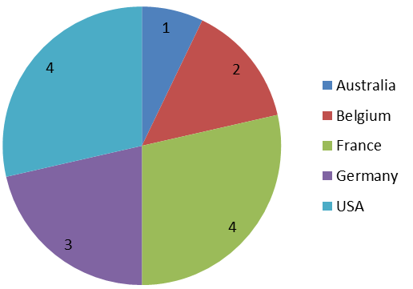
- Who?
14 atmospheric correction processors
15 organisations, institutes, universities, companies
5 countries: Australia, Belgium, France, Germany, USA

Slide 7
Registered Participants
Name |  | Organization/ Company | AC Processor | Country | Input Data
1 | Eric, VERMOTE | NASA, Maryland University | L8SR, name of S-2 TBD | USA | Landsat-8 & Sentinel-2
 | Jean-Claude, ROGER
2 | Jerome, LOUIS | Telespazio France | Sen2Cor | France | Sentinel-2
3 | Pflug, BRINGDRIED | DLR - German Aerospace Center | Sen2Cor, ATCOR | Germany | Landsat-8 & Sentinel-2
4 | André, HOLLSTEIN | Helmholtz-Zentrum Potsdam Deutsches GeoForschungsZentrum GFZ | SCAPE-M | Germany | Sentinel-2
5 | Oleg, DUBOVIK | LOA, University of Lille -1 | GRASP | France
6 | Steven, ADLER-GOLDEN | Spectral Sciences, Inc. | FLAASH | USA | Landsat-8 & (probably) Sentinel-2
7 | Larry, LEIGH | South Dakota State University | SMACAA | USA | Landsat-8 & (probably) Sentinel-2
8 | Erwin, WOLTERS | VITO | OPERA (An Operational Atmospheric Correction for Land and Water) | Belgium | Landsat-8 & Sentinel-2
 | Sterckx, SINDY
9 | Quinten, VANHELLMONT | Royal Belgian Institute for Natural Sciences | ACOLITE | Belgium | Landsat-8 & (most probably) Sentinel-2
 | Kevin, RUDDICK
10 | Antoine, MANGIN | ACRI-HE | LAC (for Land Atmospheric Correction) | France | Landsat-8 & Sentinel-2
11 | Olivier, HAGOLLE | CNES | MACCS | France | Landsat-8 & Sentinel-2
12 | Fuqin, LI | Geoscience Australia | GA-PABT | Australia
 | Lan-Wei, WANG
13 | David, FRANTZ | Trier University | lnd-prepro | Germany | Landsat-8 & Sentinel-2
14 | Grit, Kirches | Brockmann Consult | TBD | Germany | Landsat-8 & Sentinel-2
Notes:
The AC processors underlined with red are the ones will be applied on coastal\inland water.

Slide 8
- Where?
1st ACIX workshop (21-22 June 2016) venue:
College Park Marriott Hotel & Conference Center
2nd ACIX workshop venue:
At ESRIN during 1st quater 2017

Slide 9
- Outcomes of the 1st workshop
Definition of the protocol and procedures for inter-comparing products
Definition of test regions and time periods for quality assessment
Description of a coordinated plan for inter-comparison activities

Slide 10
What should be included in atmospheric correction ?
>> Mandatory run:
Rayleigh and aerosol scattering
gas absorption
adjacency effects (if it cannot be turned off)
>> Optional run:
Including any other correction, e.g.:
BRDF correction
adjacency effects
topography effects
sun glint effects (over water-surface)
cirrus/haze correction
Sample results will be submitted by 15/7/2016

Slide 11
TEST SITES |  | Zone | Land Cover | AERONET station
 |  |  |  | lon, lat
Temperate | Frioul [France] | MidlatitudeN | vegetated, bare soil, coastal | 5.293, 43.266
 | Davos [Switzerland] | Boreal | forest, snow, agriculture | 9.844, 46.813
 | Beijing [China] | MidlatitudeN | urban, mountains | 116.381, 39.977
 | Canberra [Australia] | MidlatitudeS | urban, vegetated, water | 149.111, -35.271
 | Pretoria_CSIR-DPSS [South Africa] | SubTropicalS | urban, semi-arid | 28.280, -25.757
 | Sioux_Falls [USA] | MidlatitudeN | cropland, vegetated | -96.626, 43.736
 | GSFC [USA] | MidlatitudeN | urban, forest, cropland, water | -76.840, 38.992
 | Yakutsk [Russia] | Polar | forest, river, snow | 129.367, 61.662
Arid | Banizoumbou [Niger] | Tropical | desert, cropland | 2.665, 13.541
 | Capo_Verde [ Capo Verde] | SubTropicalN | desert, ocean | -22.935, 16.733
 | SEDE_BOKER [Israel] | MidlatitudeN | desert | 34.782, 30.855
Equatorial Forest | Alta_Floresta [Brazil] | Tropical | cropland, urban, forest | -56.104, -9.871
 | ND_Marbel_Univ [Philippines] | Tropical | cropland, urban, forest | 124.843, 6.496
Boreal | Rimrock [USA] | Boreal | semi-arid | -116.992, 46.487
Coastal Sites | Thornton C-power (Belgium) | Boreal | water, vegetated | 2.955, 51.532
 | Gloria [Romania] | MidlatitudeN | water, vegetated | 29.360, 44.600
 | Sirmione_Museo_GC (Italy) | Boreal | water, vegetated , urban | 10.606, 45.500
 | Venice (Italy) | Boreal | water, vegetated , urban | 12.508, 45.314
 | WaveCIS (USA)???
Notes:
*Selected considering the AERONET data availability. The nomenclature for the site names is according to AERONET sites.
**The nomenclature for latitude region was specified according to the ones from Nasa Goddard for the Landsat global dataset used for ACCA validation ( i.e. Polar > 60°, Boreal > 45°N, MidlatitudeN > 30°N, SubtropicalN >15°N and 15°N < Tropical < 15°S) and equivalent for southern hemisphere latitudes.

Slide 12
Analysis

Slide 13
- Inter-comparison of the BOA products
>>
Visualization of Inter-comparison Results
Histograms per date, band and AC approach
Profile plots across the images per date, band and AC approach
Time series plots of the estimated Surface Reflectance
>>
NDVI calculation and comparison: indicator for relative inter-band differences
>>
Quantification of Inter-comparison Results
Distance matrix N x N >> N = AC processors, d = normalized distances between the resulting BOA values of a 9 km x 9 km subset averaged over the available dates
 | AC Processor 1 | AC Processor 2 | AC Processor 3 | … | AC Processor n
AC Processor 1 | 0 | d₁₂ | d₁₃ | … | d_{1n}
AC Processor 2 | d₂₁ | 0 | d₂₃ | … | d₂₁
AC Processor 3 | d₃₁ | d₂₁ | 0 | … | d_{3n}
…. | … | … | … | … | …
AC Processor n | d_{n1} | d_{n2} | d_{n3} | … | 0

Slide 14
- Comparison with AERONET corrected data
>>
Atmospherically corrected data will be generated by a radiative transfer model, like libRadtran or 6S, using AERONET data
>>
Pixel-by-pixel comparison between each of the spectral bands and the corresponding AERONET corrected surface reflectance data will be done for all the 9 km × 9 km subsets
>>
Only the non-saturated, non-cloudy and non-missing pixels will be considered in the comparison (Quality flags will be provided by the participants)

Slide 15
- Comparison with MODIS (MOD09CMG) daily SR products
Pixel-by-pixel comparison between each of the spectral bands and the corresponding most similar MODIS band. Due to the different satellite orbits, the direct comparison of the SR could deliver misleading results. Therefore, the adjustment of MODIS bidirectional reflectance distribution function to the corresponding Landsat-8 and Sentinel-2 sun and view geometry is required.
>>
>>
Same metrics as before (residuals, accuracy, uncertainty, etc.)

Slide 16
Thank you for your attention!
ACIX website:
https://earth.esa.int/web/sppa/meetings-workshops/acix

