Slide 1
LSI-VC-16
Surface Reflectance Quality Consistency and Equivalence
Simon Oliver,
Medhavy Thankappan,
Geoscience Australia
Agenda Item 9.1
LSI-VC-16, Canberra
23 - 25 September 2024

Slide 2
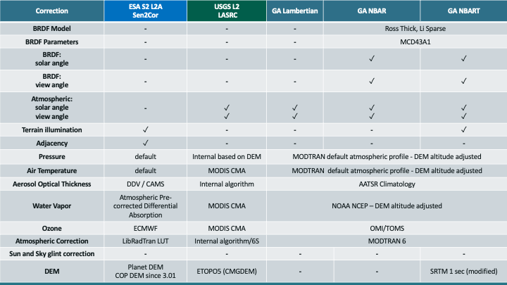
Issue
The CEOS-ARD Surface Reflectance PFS provides a good starting point for interoperability of multi-sensor SR products but there are some differences among CEOS-ARD SR products.

Slide 3
Why do we care?
Inconsistency in surface reflectance products from different providers limits combined use of multi-sensor data, performing impactful analyses and gaining deeper insights.
CEOS agencies' efforts in producing NASA HLS and ESA Sen2Like demonstrate the need to improve the compatibility of SR measurements across providers.
Planned major Collection upgrades (e.g. USGS – Landsat C3) provide an opportunity for input in support of better alignment and harmonisation of SR products.
CEOS-ARD is only the first step in the ‘interoperability continuum’, we need to plan the next steps to advance CEOS interoperability objectives.
Now CEOS-ARD

Slide 4
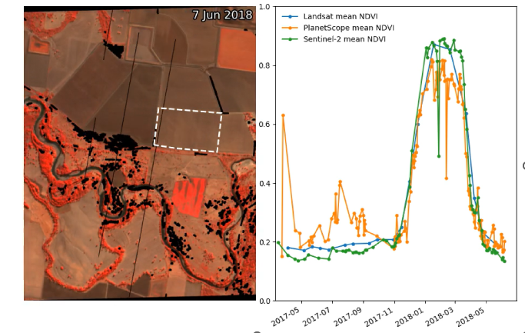
Data inconsistency
Variability in Normalised Difference Vegetation Index time-series profiles for the same area derived from Landsat, Sentinel-2 and PlanetScope data

Slide 5
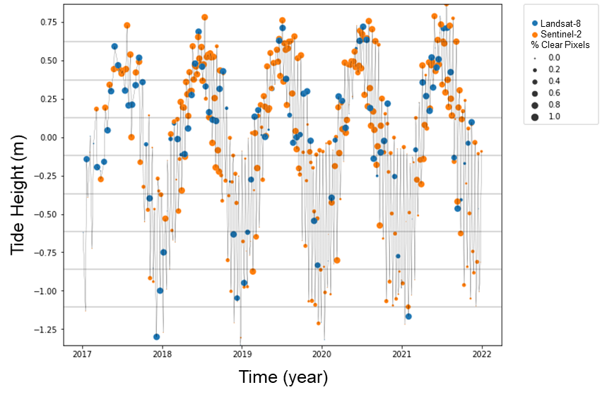
Harmonisation: Synergies
By combining Landsat (blue) and Sentinel-2 (orange) data processed through the same workflow, a set of observations that best represent the tidal range in coastal northern Australia was achieved.
Credit: Robbi-Bishop Taylor, Geoscience Australia

Slide 6
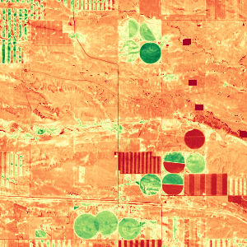
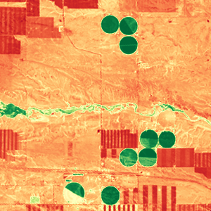
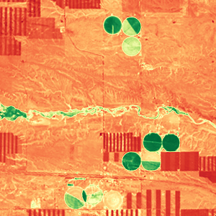
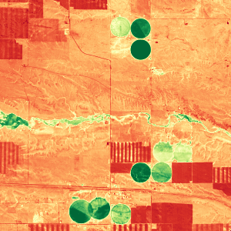
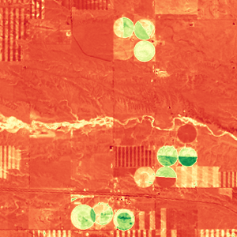

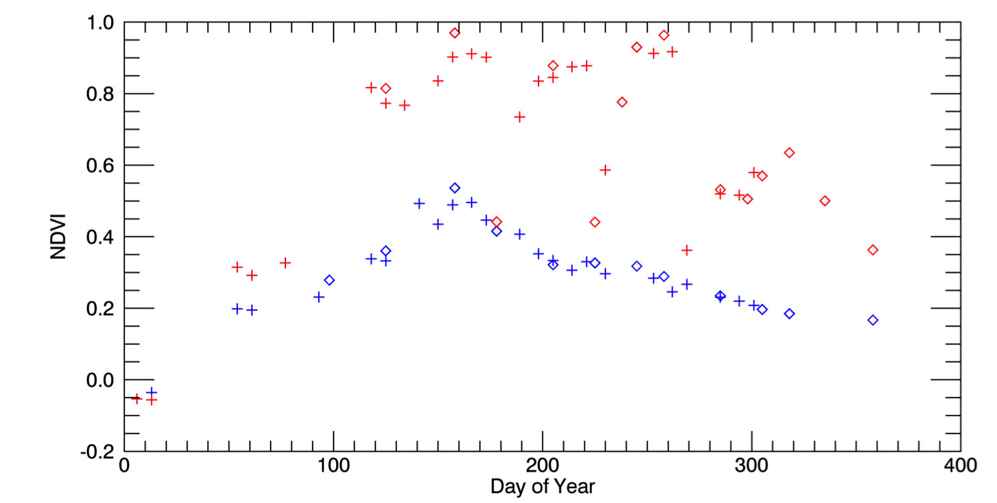
Harmonisation: Better insights
Better insights into seasonal phenology could be achieved from Harmonised Landsat / Sentinel-2 data with high temporal density of observations
May 4, 2016 (S2)
Aug 8 (L8)
Aug 17 (L8)
Sep 1 (S2)
Oct 20 (L8)
3km
0.1 NDVI 0.9
Example from the US: Seasonal phenology (greening) for natural grassland (blue line) and irrigated alfalfa fields (red line) near Cheyenne Wyoming observed from Harmonized Landsat/Sentinel-2 data products. The high temporal density of observations allows individual mowing events to be detected within alfalfa fields. HLS Products available from https://hls.gsfc.nasa.gov
Credit: Jeff Masek, NASA
Sentinel-2
Landsat-8
+
Alfalfa
NDVI
mowing
Grassland

Slide 7
Proposal
Build on CEOS-ARD achievements so far, take next steps to achieve multi-sensor interoperability.
Unambiguous characterisation of the SR quantity in the context of CEOS-ARD products.
Identify a set of inputs, corrections, associated parameters and tolerances for achieving SR equivalence in support of harmonising CEOS-ARD SR products.

Slide 8
Benefits
Consistent time-series across sensors, steps towards enhanced harmonisation amongst CEOS-ARD SR products.
Focused effort on value-adding with a common foundational measurand and improve the results from multi-sensor analyses, gain better insights.
Reduced duplication of effort, cost savings, increased global applicability of algorithms, higher return on investment.

Slide 9
Key objective
Describe a surface reflectance (Passive Satellite Viewed Bottom of Atmosphere Surface Reflectance) quantity, the applicable steps for consistent quality, model parameters and their tolerance, required to achieve equivalence between like bands from different sensors, for generating harmonised SR products.

Slide 10



Conceptual model (current)
Illumination conditions
A
B
A
Datasets A and B
Reflectance
B
A B
Atmospheric correction
BRDF correction
Terrain Illumination correction
Adjacency correction
Solar angle normalization
Target characteristics
Time
Surface Reflectance Profiles

Slide 11
Conceptual model (desired)
Reflectance
A+B
Harmonised datasets
A B
Atmospheric correction
BRDF correction
Terrain Illumination correction
Adjacency correction
Solar angle normalization
Time
Surface Reflectance Profile

Slide 12
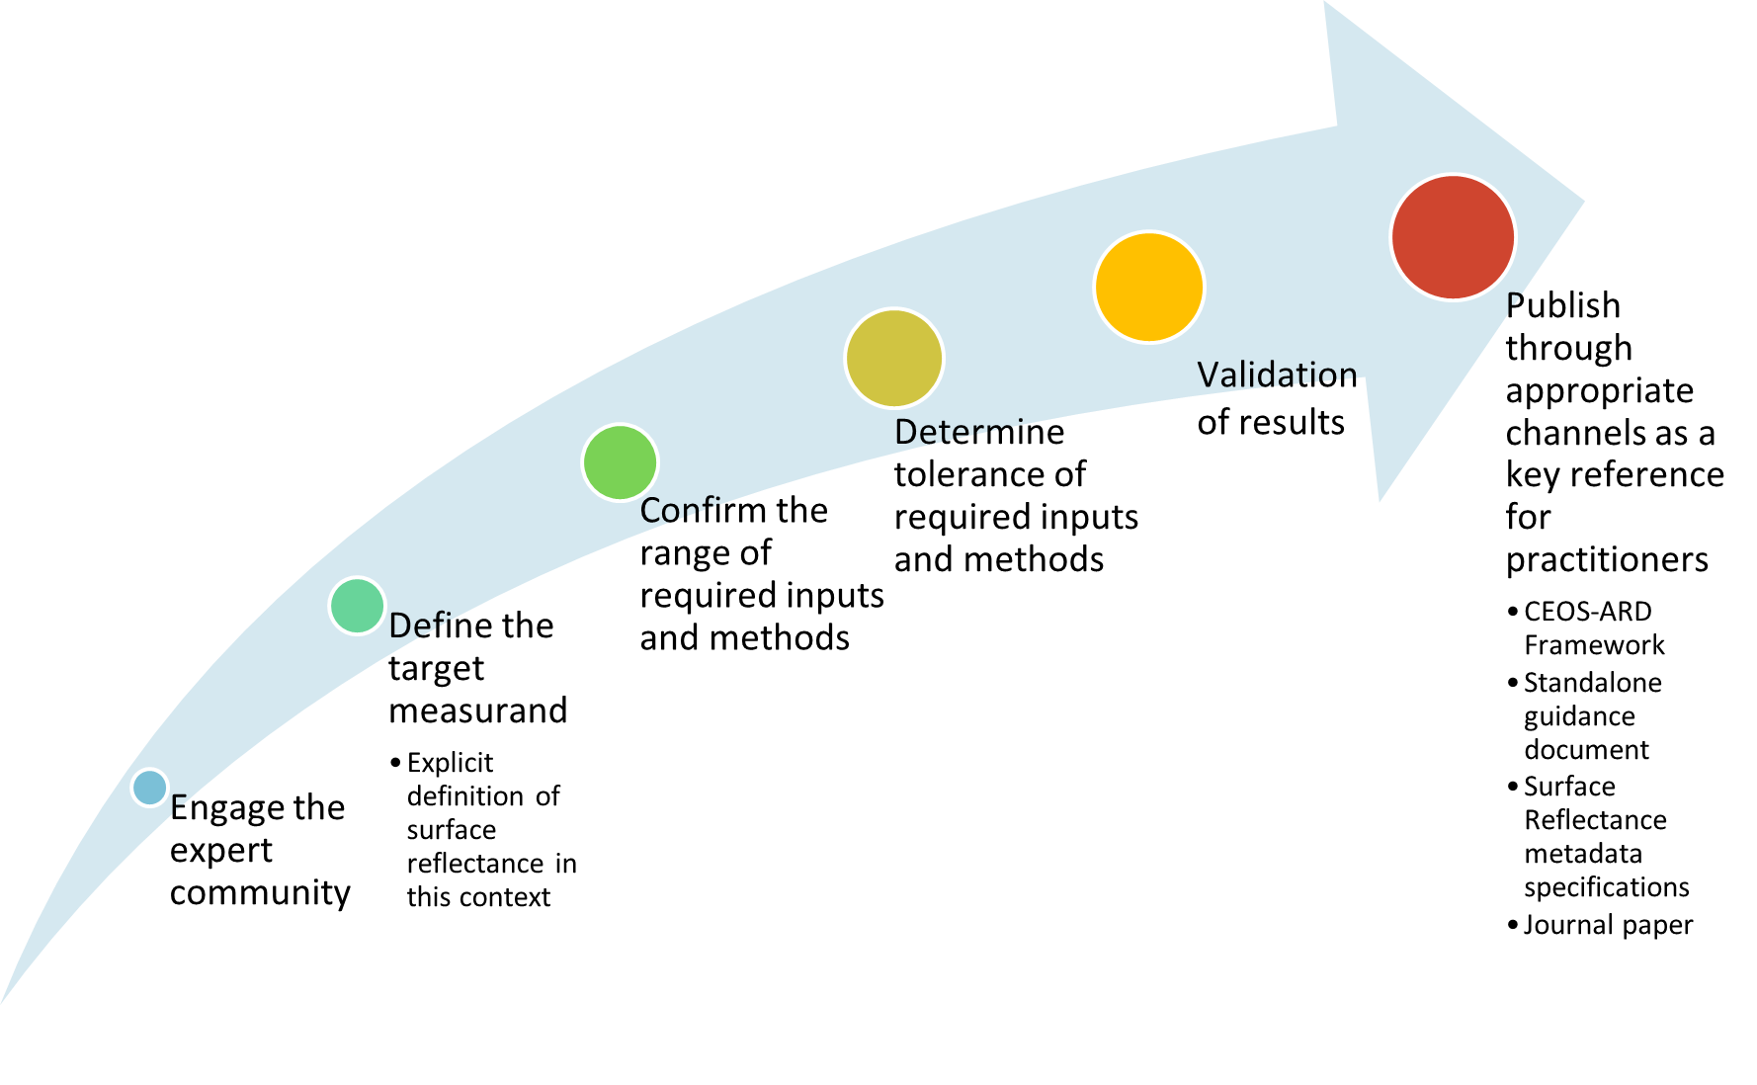
Plan of action

Slide 13
Progress so far
Original concept first presented at ARD23 Workshop, exposure document of the concept presented at WGCV-52, in June 2023, then at LSI-VC 14 in October 2023
A revised concept paper presented at WGCV-53 in March 2024.
Following feedback, engaged the expert community after a call for ‘Expressions of Interest’ to participate in the Surface Reflectance Quality, Equivalency and Consistency initiative.
Fortnightly meetings of the expert group continue, initial discussions focussed on terminology to enable shared understanding of objectives for the work.
Subsequent effort to document the discussions that could support interoperability initiatives within CEOS (Interoperability Framework, Handbook 2.0, led by WGISS).
A guidance document on the SR equivalence initiative is in development with contributions from the expert group.

Slide 14
Document purpose
Serve as a reference for organisations considering reprocessing of Earth observation Collections of moderate resolution (10m - 2km) passive optical satellite data (300-2500 nm) with an aim of contributing to a virtual constellation of interoperable surface reflectance measurements.

Slide 15
Document structure
Introduction
  Definition: Equivalence for two surface reflectance measurements
Step/corrections needed to achieve equivalence
  Distinguishes harmonisation from homogenisation
Surface Reflectance Quantity (characterisation)
Applicable Parameter Thresholds #TODO
CEOS-ARD
Discussion

Slide 16
Contributors
Contributor | Organisation
Eric Vermote | NASA
Martin Bachmann | DLR
Peter Strobl | EC
Robert (Bob) Ryan | I2R
Mary Pagnutti | I2R
Raquel delos Reyes | DLR
Simon Oliver | GA
Medhavy Thankappan | GA
Dani Schläpfer | ReSe
Rudolf Richter | DLR
Fuqin Li | GA
David Jupp | CSIRO
Cody Anderson | USGS
Sebastien Saunier | Telespazio
Steve Covington | USGS
Sabrina Pinori | Serco
Danika Wellington | USGS
Symbios facilitating fortnightly meetings
USGS considerations for Landsat Collection 3 – 2028/29
Current working draft

Slide 17
Discussion
Seeking feedback on the work so far
CEOS support for the work moving forward
Suggestions / ideas for further engagement

