Slide 1
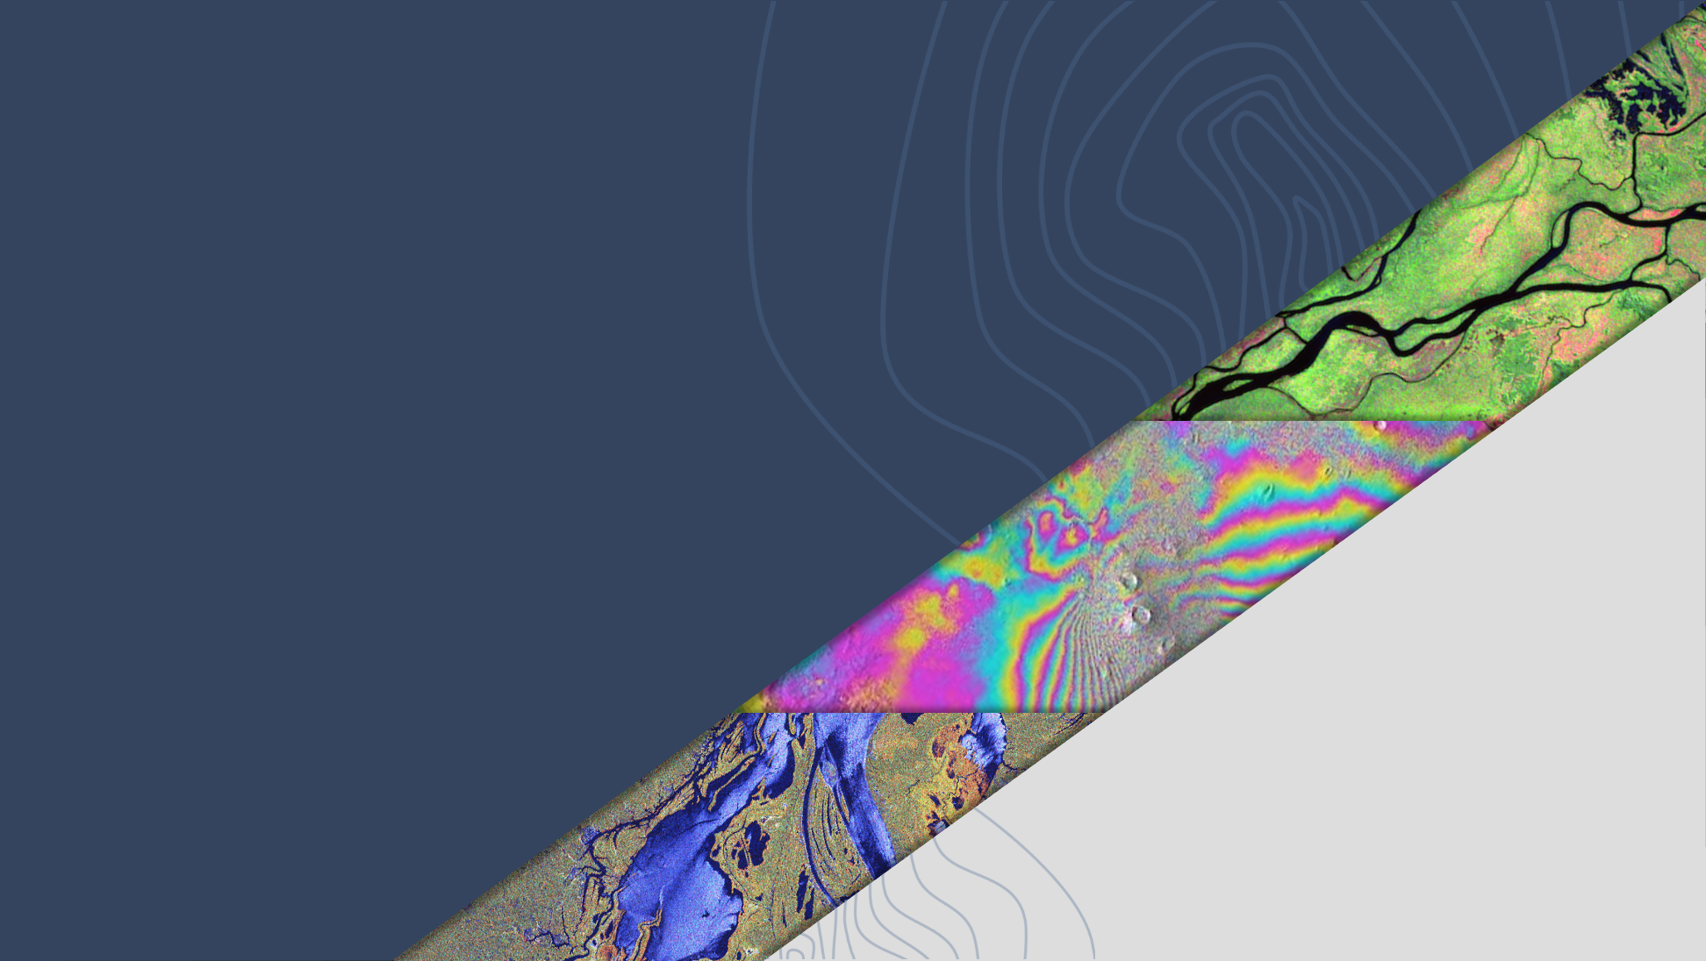
LSI-VC-16
Status update: Quad-pol and Multi-frequency data requests from the ESA POLINSAR Workshop 2023
Magdalena Fitrzyk,
Francesco Sarti, ESA
Agenda Item 8.6
LSI-VC-16, Canberra
23 - 25 September 2024

Slide 2
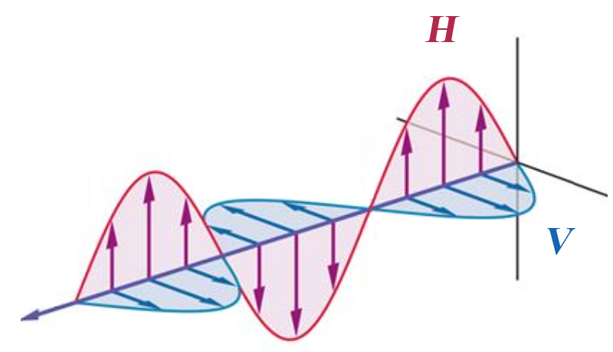
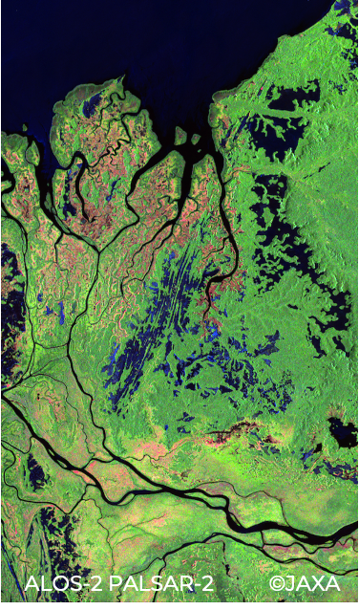
Background
Fully polarimetric, quad-polarisation (QP), data provides information about both backscatter amplitude and backscatter phase - for each polarisation combination (HH/HV/VH/VV)
Polarimetric phase varies depending on the ground target → enables enhanced retrieval of target structural parameters
Time-series of QP data enables interferometric analysis of changes in polarimetric phase (Pol-InSAR)
Radar wavelength (λ) directly correlated with target size → multi-frequency (multi-wavelength) data enables enhanced retrieval of target structural parameters
ALOS-2 PALSAR-2 (JAXA) Processing: Y. Yamaguchi (U. Niigata)

Slide 3
Background
Despite great potential – POLINSAR research and applications still underdeveloped
Complexity of polarimetric processing → high entry level for new users
Lack of consistent time-series of QP data for R&D
Lack of (near)coincident, multi-sensor, multi-frequency datasets
Lack of analysis-ready polarimetric datasets.
Scarcity of software tools for POLINSAR analysis
SAOCOM-1 (CONAE) Processing: CONAE

Slide 4
LSI-VC PolInSAR Team recommendations to SIT-39
Establishment of an agreed set of CEOS POLINSAR reference sites.
Regular acquisition of fully polarimetric and multi-frequency SAR data over these sites (with a view towards increasing scope and integration of polarimetry in ongoing strategic background mission observation plans).
Simplified access to data and tools for R&D purposes (shared repository of R&D data, CEOS-ARD, CEOS Analytics Lab, etc.)

Slide 5
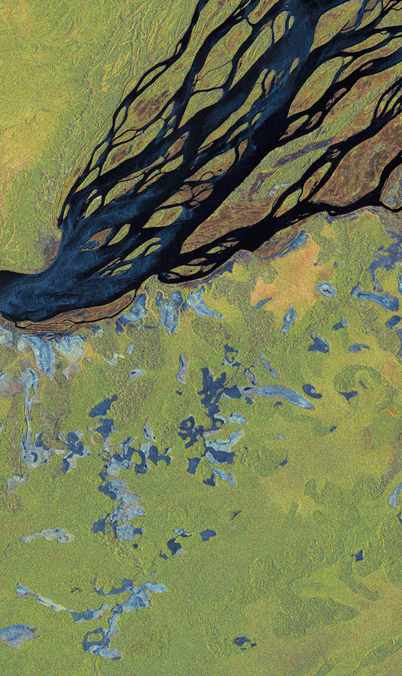
Actions after SIT-39
CEOS SAR agencies to designate a Point of Contact for engagement in an LSI-VC Polarimetric Interferometric Synthetic Aperture Radar (PolInSAR) Team (email from JAXA SIT Chair Team sent 14/08/2024)
Establishment of CEOS PolInSAR Science Team
Designation of PolInSAR Reference Sites for systematic polarimetric monitoring by CEOS SAR missions (best effort basis)
IMPORTANT NOTES
ALOS-4 successfully launched July 1, 2024
NISAR launch ~February 2025
BIOMASS launch ~May 2025
Next POLINSAR Workshop late 2025/early 2026
Please send nominations to LSI-VC:
ake.rosenqvist@soloEO.com and matthew@symbioscomms.com
ALOS-2 PALSAR-2 (JAXA) Processing: soloEO

