Slide 1
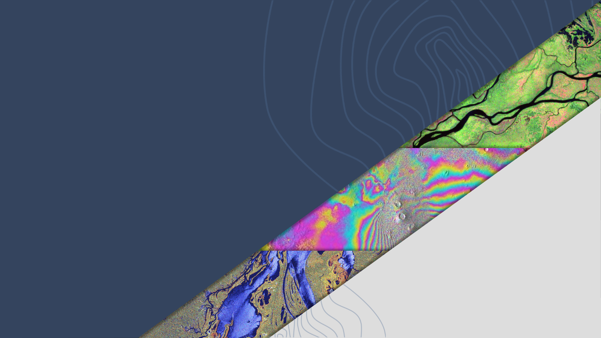

LSI-VC-16
DLR Progress on Sentinel-1 ARD Production
John Truckenbrodt, DLR
Agenda Item 8.5
LSI-VC-16, Canberra
23 - 25 September 2024

Slide 2
ESA/DLR SAR ARD background
Past ESA activities
  2021-2022: develop Sentinel-1 NRB product for ESA/Copernicus (University of Jena, Germany)
  2022-2023: development of an NRB product for ERS-1/-2 and ENVISAT (Telespazio UK)
  2023: development of Sentinel-1 ORB product (DLR)
Current ESA activities
  ROSE-L SAR ARD development (B-Open, Italy)
  Sentinel-1 Level-1 processor reengineering (B-Open)
  Sentinel-1 NRB processor operationalization (B-Open)
Future ESA activity
  ERS-1/-2 and ENVISAT NRB processor operationalization
Current DLR activity
  Operationalization of Sentinel-1 processor from past ESA activities for in-house production

Slide 3
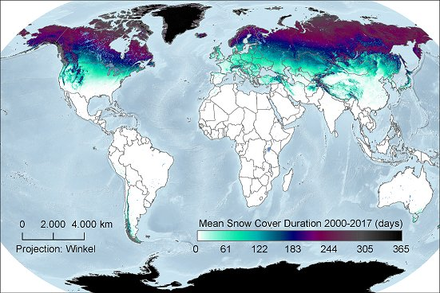
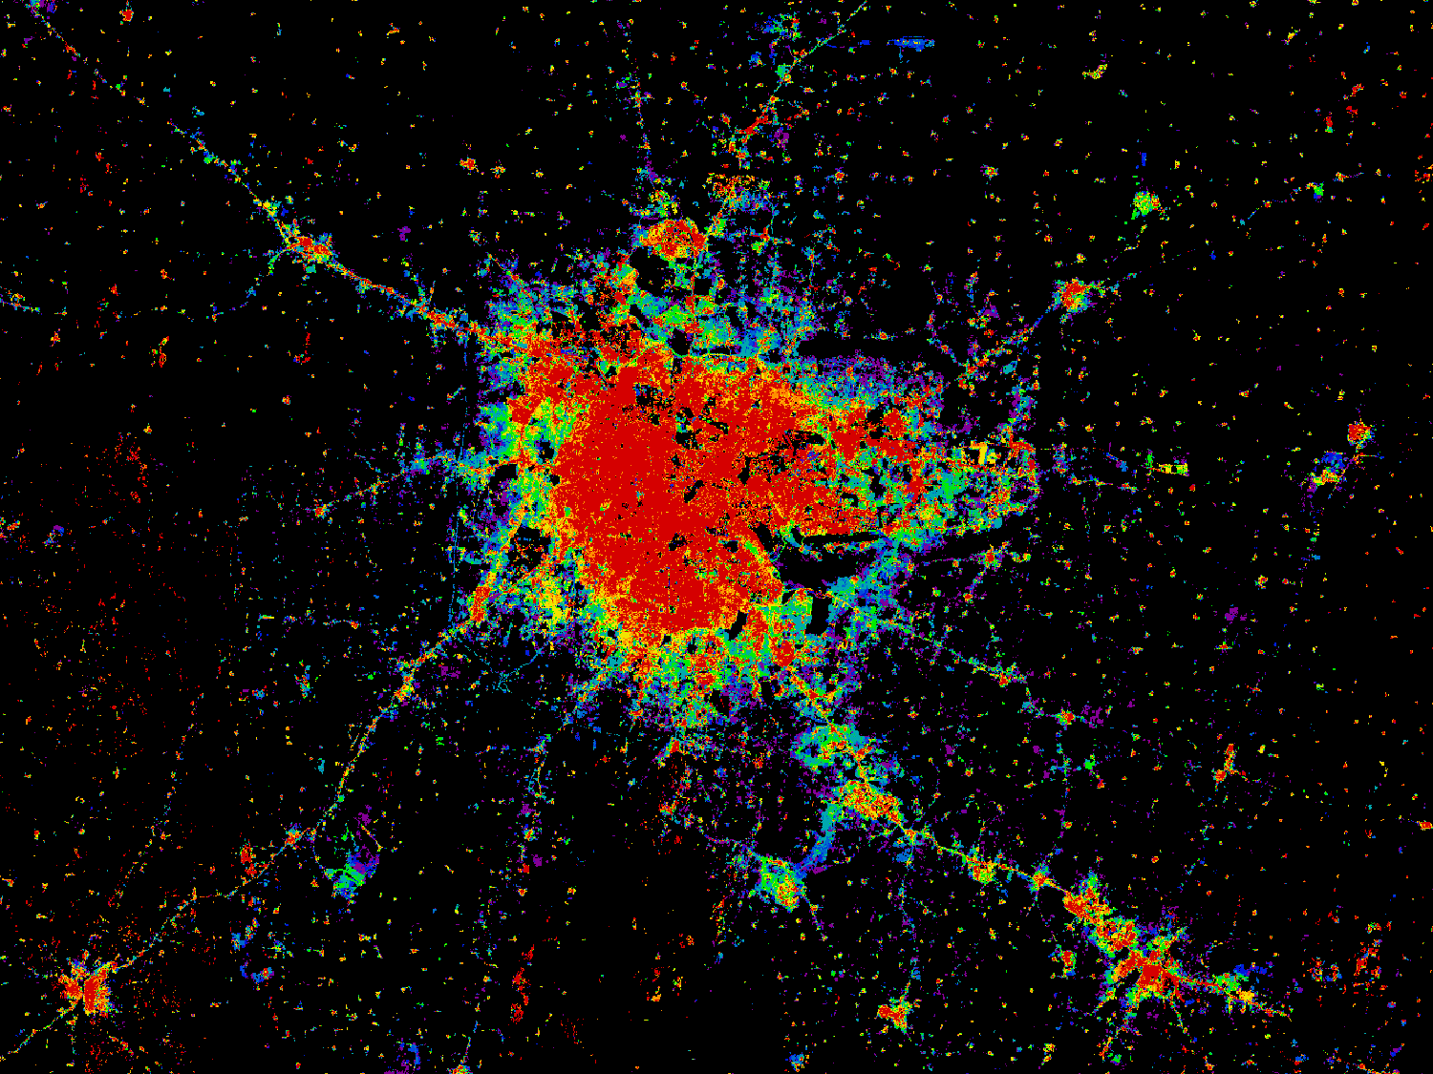
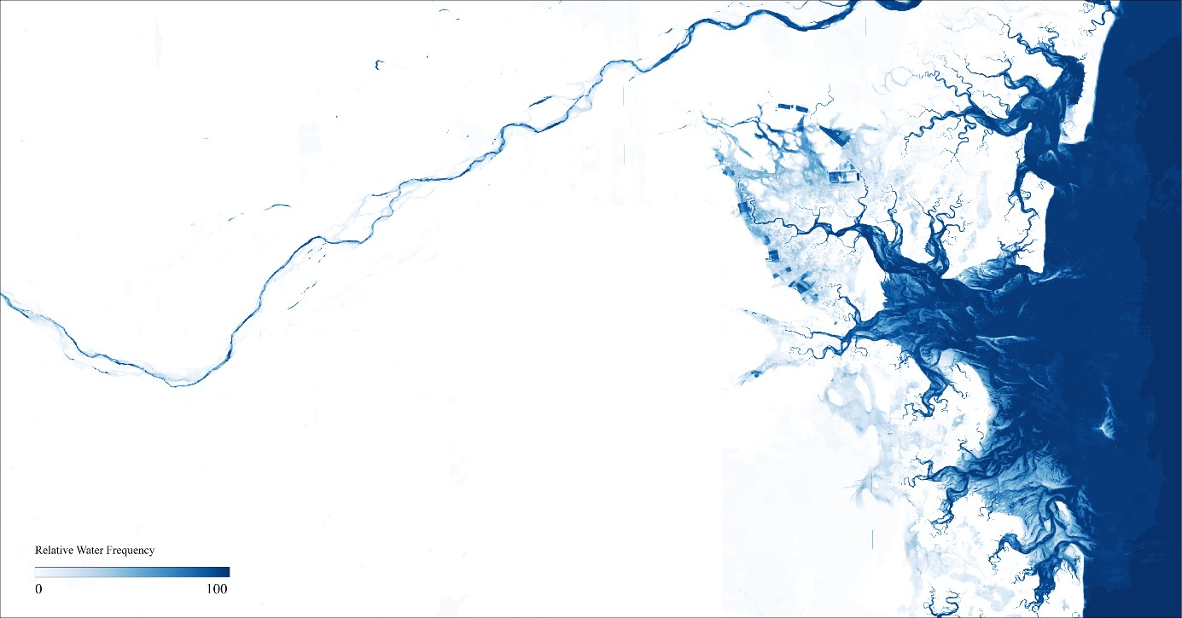
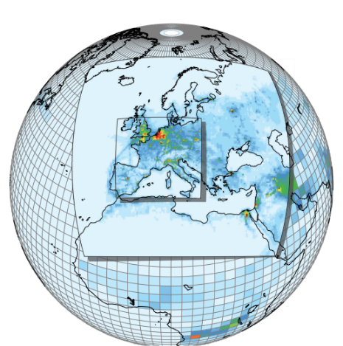
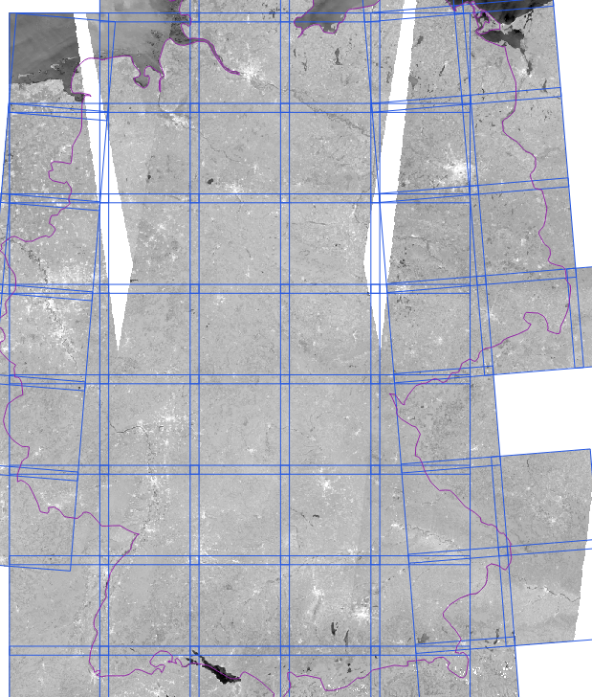
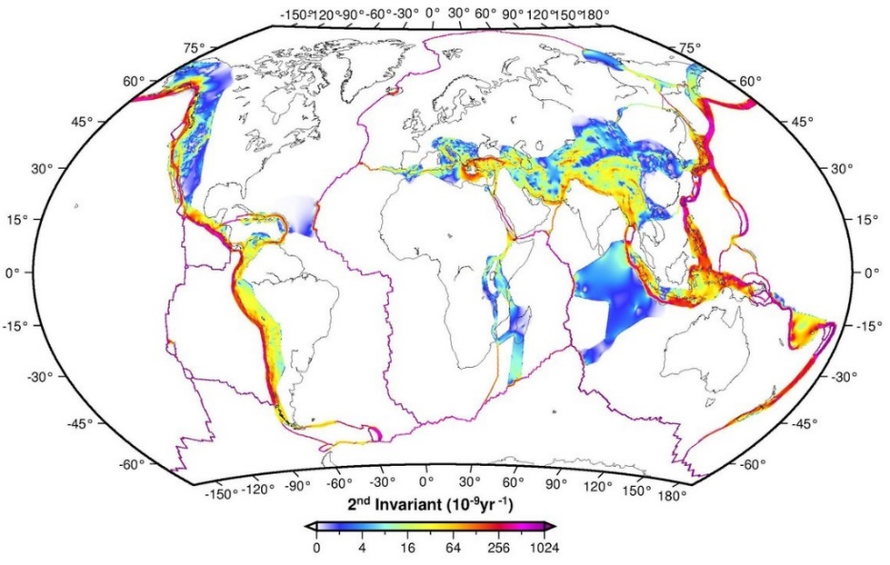
DLR user requirements
Global research and production of EO data
Global Snow Pack
World Settlement Footprint
Global Flood Monitoring
Global & regional chemistry
climate and air quality modelling
Deformation maps
Analysis Ready Data

Slide 4
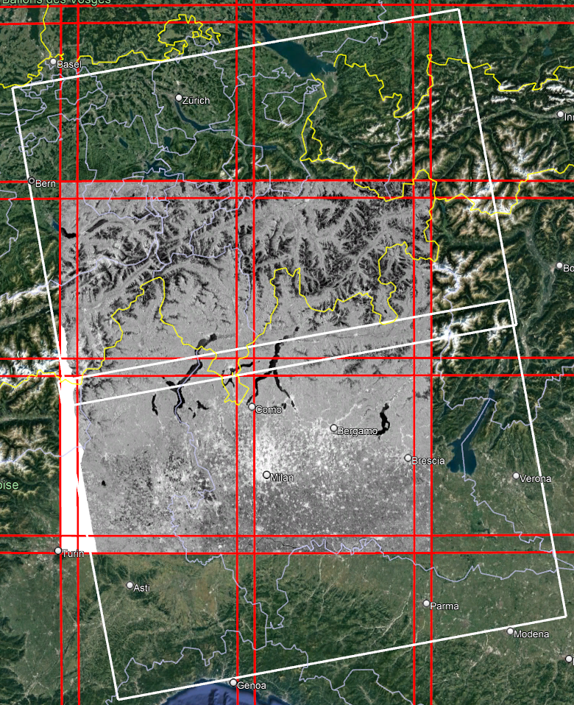
ESA-DLR NRB Product Characteristics
Seamless mosaics of multiple source scenes
→ many-to-many relationship
Exact extent of Sentinel-2 grid cells
(based on Military Grid Reference System MGRS)
UTM projection (UPS over poles)
10 m spacing
100 km tile plus overlap:
  10980 * 10980 pixels
  109.8 * 109.8 km
Cloud Optimized GeoTIFF (COG)
  512 * 512 tiling
  Overview levels: 2, 4, 9, 18, 36
“LERC_ZSTD” Raster Compression
https://sentinel.esa.int/web/sentinel/sentinel-1-ard-normalised-radar-backscatter-nrb-product
[Acknowledgement: Copernicus/EU]

Slide 5
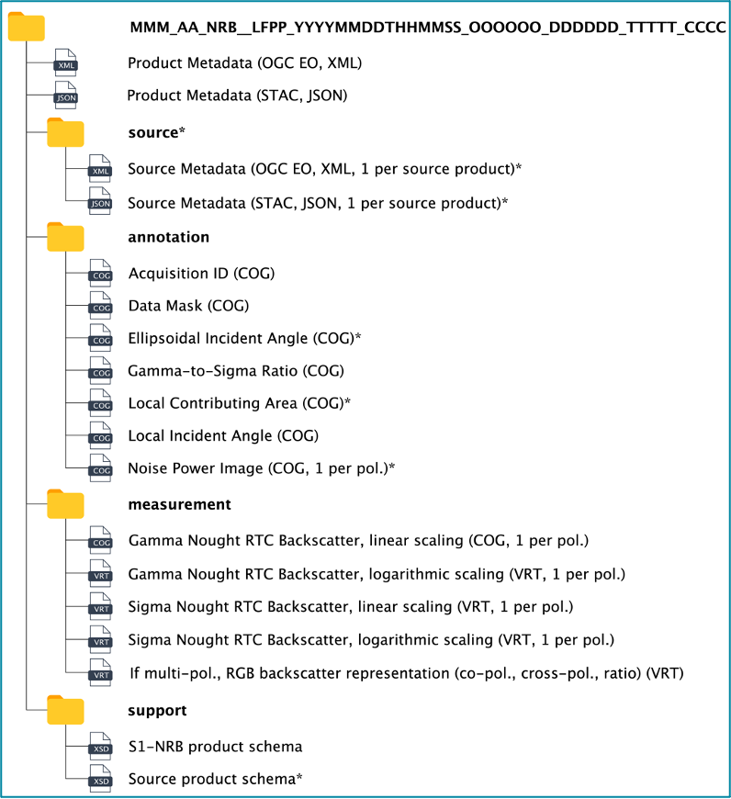
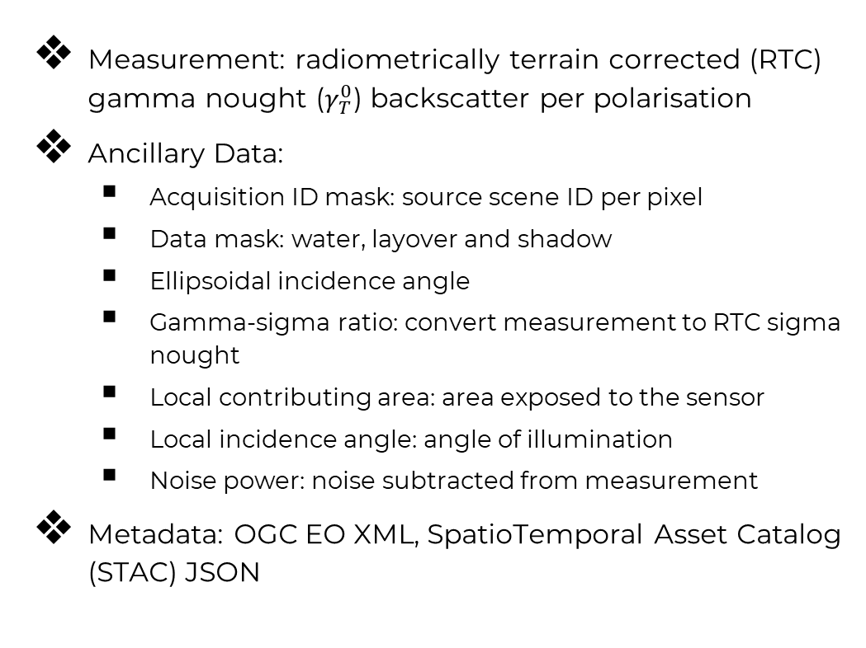
Sentinel-1 NRB: Product content
Measurement: radiometrically terrain corrected (RTC) gamma nought ($γ_{T}^{0}$) backscatter per polarisation
Ancillary Data:
  Acquisition ID mask: source scene ID per pixel
  Data mask: water, layover and shadow
  Ellipsoidal incidence angle
  Gamma-sigma ratio: convert measurement to RTC sigma nought
  Local contributing area: area exposed to the sensor
  Local incidence angle: angle of illumination
  Noise power: noise subtracted from measurement
Metadata: OGC EO XML, SpatioTemporal Asset Catalog (STAC) JSON
To be confirmed in operational products

Slide 6
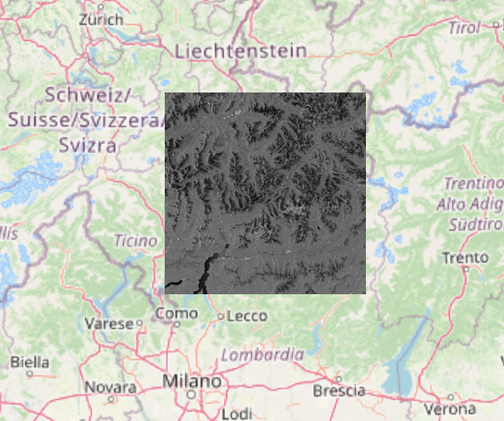
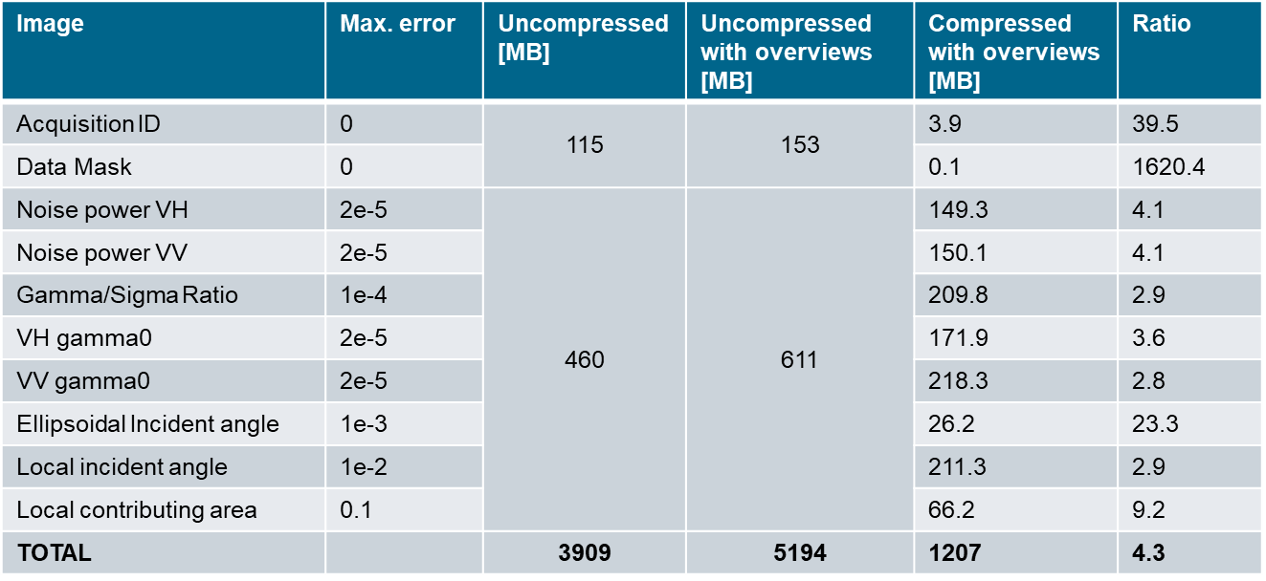
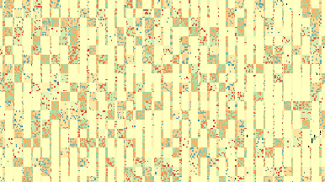
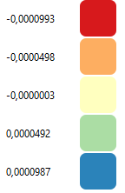
Product Data Volume
Example product over the Alps (tile 32TNS)
“worst case scenario” with full data coverage and strong terrain variation
Higher ratios in flat terrain (due to higher auto-correlation)
Near-linear decrease of product size with reduced data coverage
Overall volume: ca. 2.5 x GRD (→ ca. 9 PB) (MGRS tile overlap, ancillary layers)
Tile location
LERC compression artifacts (tile overlap difference) with 1e-4 error

Slide 7
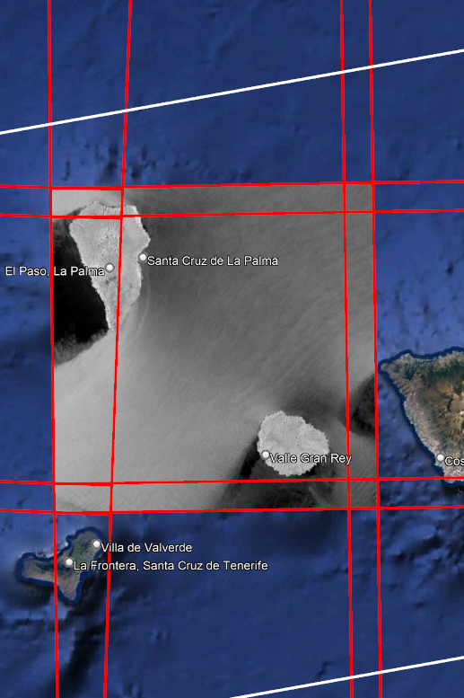
Ocean Radar Backscatter (ORB)
The CEOS ARD ORB specification was published in 09/22
A follow-up activity extended the ESA-DLR S1 NRB product specification to ORB (04/23 – 11/23)
Formation of a new working group of domain experts
Difference to NRB:
  Sigma naught RTC instead of gamma naught RTC
  No local contributing area
  No ellipsoidal incident angle
  No Gamma-to-Sigma ratio
  Added look direction angle
  Added wind normalization
Use cases: ship detection, wind speed, wave height

Slide 8
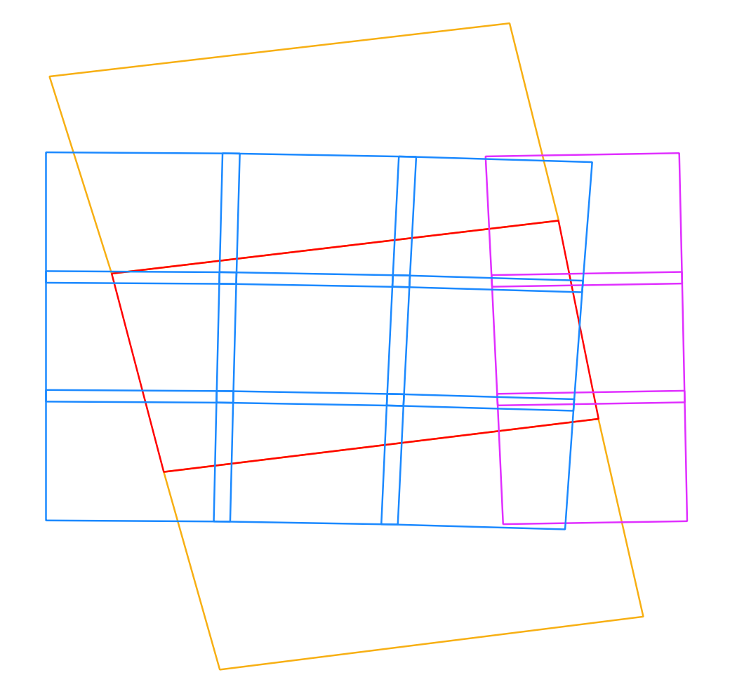
Many-to-many relationship of products
Many MGRS tiles are overlapping with a single Level-1 Sentinel-1 GRD/SLC scene (red)
These tiles usually cover multiple UTM zones (increasing number of zones towards the poles) (blue, purple)
For processing the full extent of a single Level-1 scene to NRB, at least three scenes need to be processed (red+yellow)
The scenes cannot be geocoded once to a single grid; rather, subsets of it have to be geocoded to individual grids
The situation becomes even more complicated when processing from GRD…

Slide 9
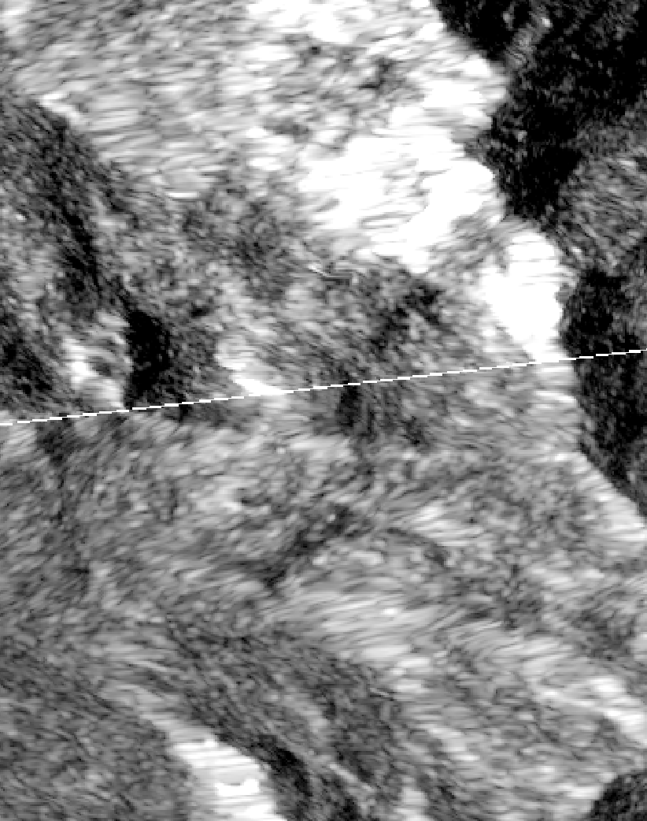
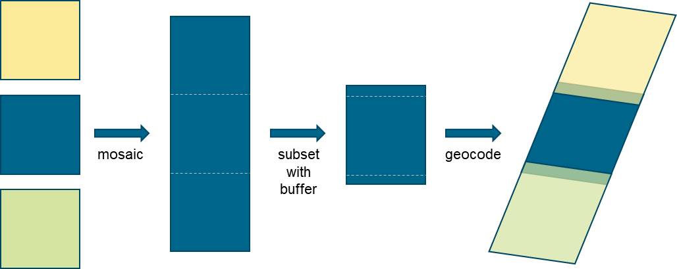
How to avoid GRD processing gaps?
Contrary to SLCs, GRDs do not overlap along-track
Processing GRDs separately results in thin data gaps between the geocoded products (see right image)
Solution: introduce an overlap by buffering scenes with data from neighboring scenes:

Slide 10


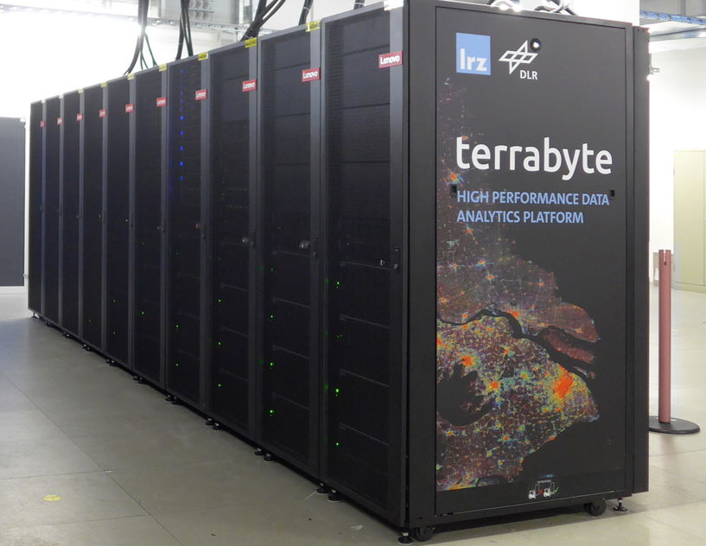


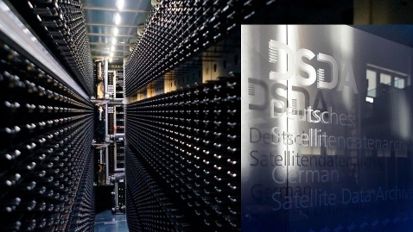
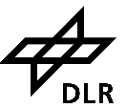

DLR: terrabyte platform
External data sources
terrabyte @ LRZ
Processing
to ARD
DLR EO long-term archive
≈50 PB net storage
44000 vCPUs, 188 GPUs
330 TB RAM
  100 PB archive storage
https://docs.terrabyte.lrz.de/

Slide 11
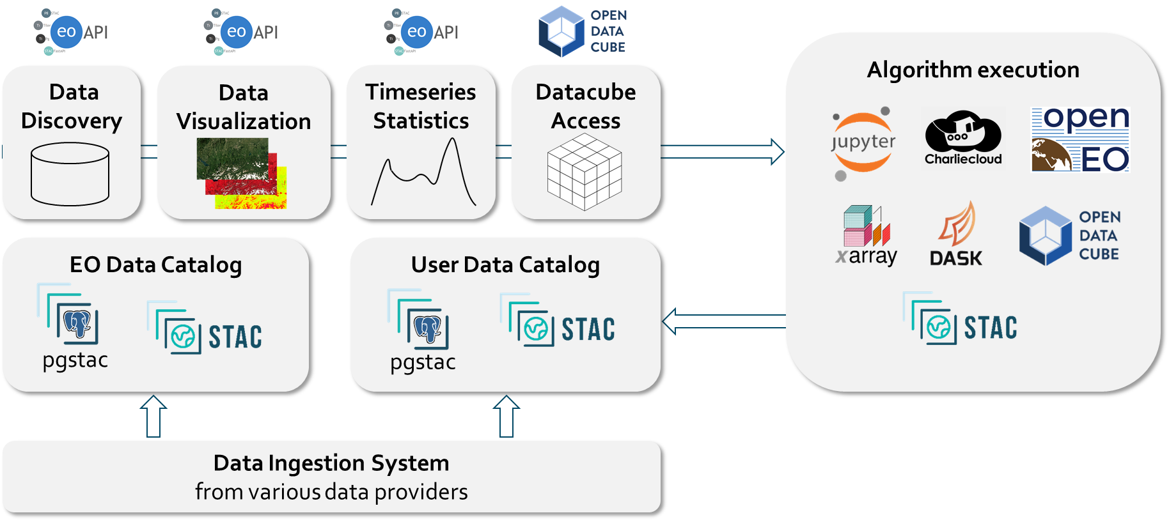
Discovery & analysis of EO data
STAC/Metadata-oriented architecture

Slide 12
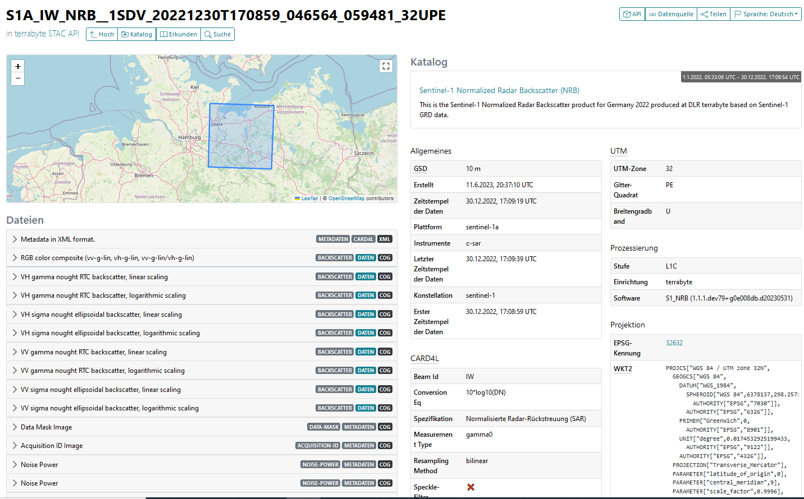
STAC Metadata
https://stac.terrabyte.lrz.de/browser/

Slide 13
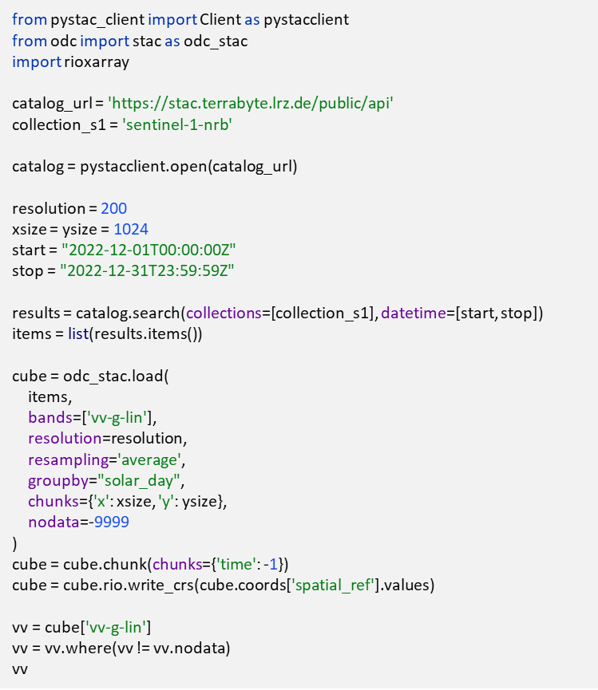
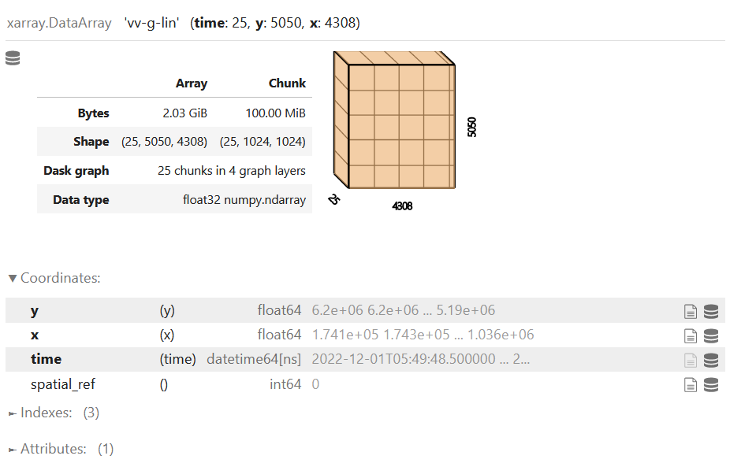
STAC Metadata for Data Cubes
https://github.com/DLR-terrabyte/demo-bids23

Slide 14
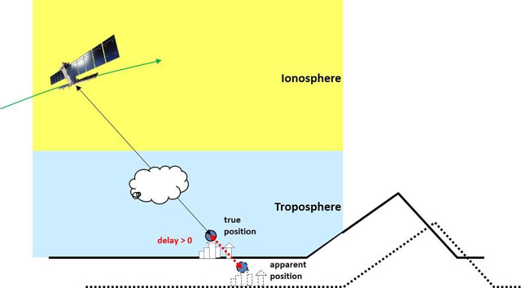
Extended Timing Annotation Dataset (ETAD)
Geolocation accuracy of Sentinel-1 is approx. 3 m (non-geocoded)
Main factors for inaccuracies:
  Atmospheric delay
  Solid earth tides
  Instrument movement
Accuracy can be improved to 0.1 m by utilising the ETAD product
A new Sentinel-1 product can be created from an existing one and the corresponding ETAD product
ETAD products are openly available for acquisitions from July 2023 forward
https://sentinel.esa.int/web/sentinel/missions/sentinel-1/data-products/etad-dataset

Slide 15
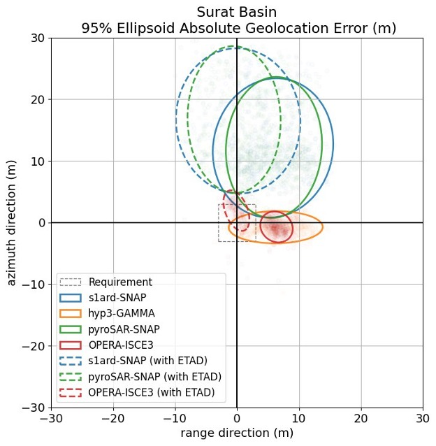
Assessment of geolocation accuracy
Geolocation accuracy of own NRB product has not yet been assessed
The SLC product accuracy is very high but additional errors are introduced by the DEM and the terrain correction
Recent findings by Geoscience Australia indicate a low accuracy of the open-source ESA SNAP software
Discussions are ongoing to consolidate findings
Own processor s1ard orchestrates processing and ARD formatting, plugin of other SAR processors foreseen
Figure provided by Alex Bradley, Geoscience Australia
https://github.com/s1tools/s1-etad/discussions/4
https://github.com/SAR-ARD/s1ard

Slide 16
Summary
The Sentinel-1 NRB and ORB products have been prototyped.
The ESA NRB product in currently being consolidated with the objective to be generated systematically.
The timeline of availability and characteristics of an ESA/Copernicus ARD product are not finally decided.
In the meantime, DLR will produce an own NRB product to satisfy internal user demands (first individual user requests, then global).
DLR continues to develop the ARD processor s1ard and investigates SAR processing options.
DLR continues to participate in standardization activities (CEOS-ARD, STAC) to further shape the SAR ARD landscape and give users the best experience.

