Slide 1
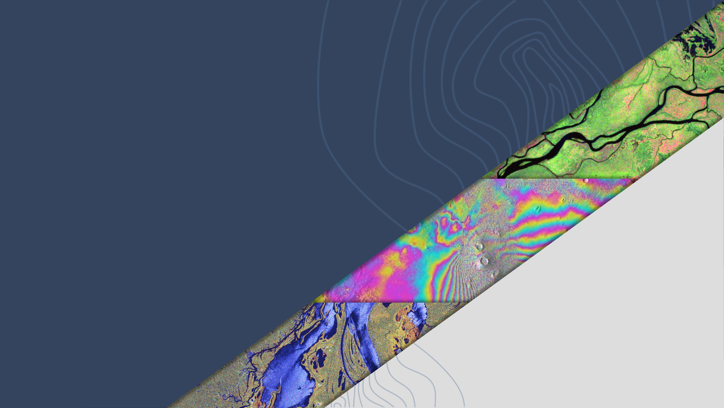
LSI-VC-16
ISRO SAR CEOS-ARD Report
P.V. Jayasri, Raghav Mehra, V.M. Ramanujam, H.S.V Usha Sundari
ISRO
Agenda Item # 8.4
LSI-VC-16, Canberra
23 - 25 September 2024

Slide 2
ISRO SAR CEOS-ARD
Capabilities of EOS-04 (follow-on mission of RISAT-1 – C-band SAR):
Imaging Modes: Stripmap, ScanSAR and Sliding-Spotlight
Polarizations: Single, Dual, Compact (CP) & Full (FP)
Swath Coverage: 10 Km to 223 Km
Spatial Resolutions: 1m to 50m
ISRO has submitted Self-assessment report for 8 EOS-04 Normalized Radar Backscatter (NRB) products on the consolidated SAR PFS (v1.0) for the following product list to CEOS-ARD team:
1) 18m (MRS) ScanSAR HH Polarisation 2) 36m (CRS) ScanSAR HH Polarisation 3) 18m (MRS) ScanSAR HH-HV Polarisation 4) 36m (CRS) ScanSAR HH-HV Polarisation 5) 18m (MRS) ScanSAR RH-RV Polarisation 6) 36m (CRS) ScanSAR RH-RV Polarisation 7) 18m (MRS) ScanSAR HH-HV-VH-VV Polarisation
8) 36m (CRS) ScanSAR HH-HV-VH-VV Polarisation
EOS-04 CEOS - ARD NRB is designed for the ScanSAR Imaging mode .
Medium Resolution ScanSAR (MRS):18 meters spacing, scene-based
(Level-2B ARD) Single, Dual, Circular and Full -polarization single-date
products.
Coarse Resolution ScanSAR (CRS):36 meters spacing, scene-based
(Level-2B ARD) Single, Dual, Circular and Full -polarization single-date
products.
EOS04–NRB (Normalized Radar Backscatter) data products for MRS and CRS ScanSAR imaging modes are presently CEOS ARD compliant NRB products for SAR PFS V1.0 during 2nd quarter of 2024.
EOS-04 NRB Data Products are available at ISRO’s Data Hub “Bhoonidhi” for FREE Download to User community
https://bhoonidhi.nrsc.gov.in/

Slide 3
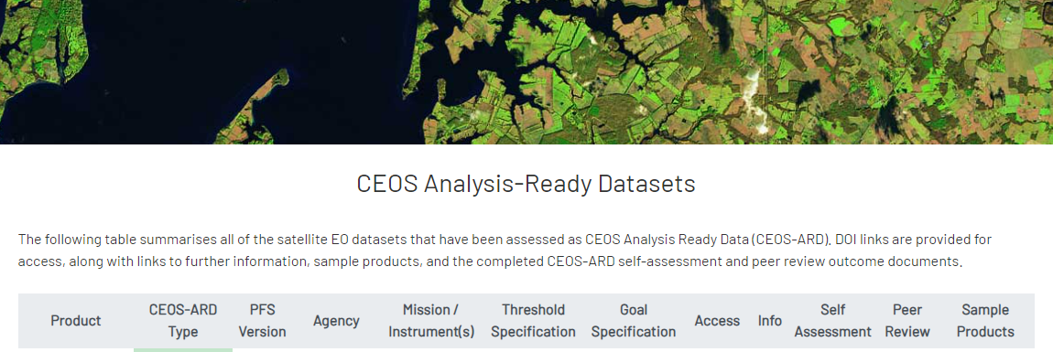
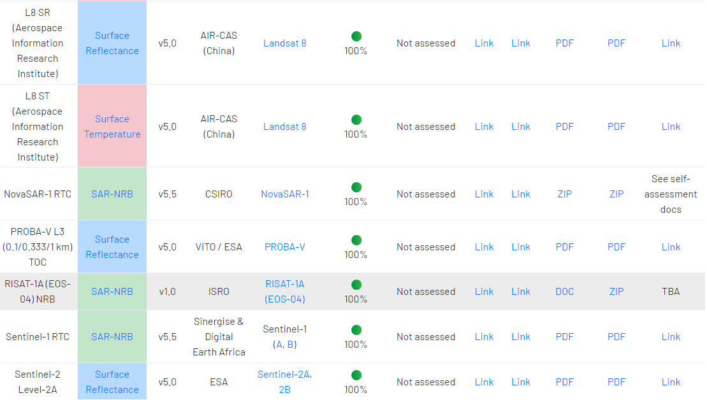
DOI will be shared for EOS-04 NRB to CEOS ARD committee
https://doi.org/10.46693/NRSC/10/E04_MRS_STUC00ZTD

Slide 4
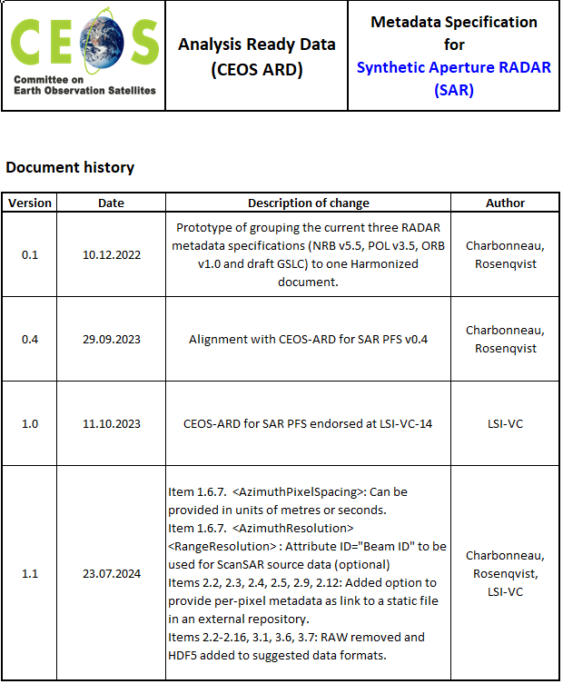
EOS-04 India Mosaic Product Self-Assessment for CEOS ARD NRB v1.1 compliance
Medium Resolution ScanSAR (MRS) India Mosaic - 18 meters spacing, 1 deg X 1 deg tile-based NRB-ARD Dual HH-HV -polarization multiple-date products.
EOS-04 India Mosaic ARD product from MRS systematic coverage acquisitions is available as set of 809 1 deg. X 1 deg. tiles every 17 days.
India Mosaic products can be utilized for performing efficient Time Series analysis with terrain Normalized ARD mosaic tiles
India Mosaic product contents and meta data are made in compliance to CEOS NRB ARD specifications PFS V1.1 and is submitted for CEOS –ARD team for endorsement.

Slide 5
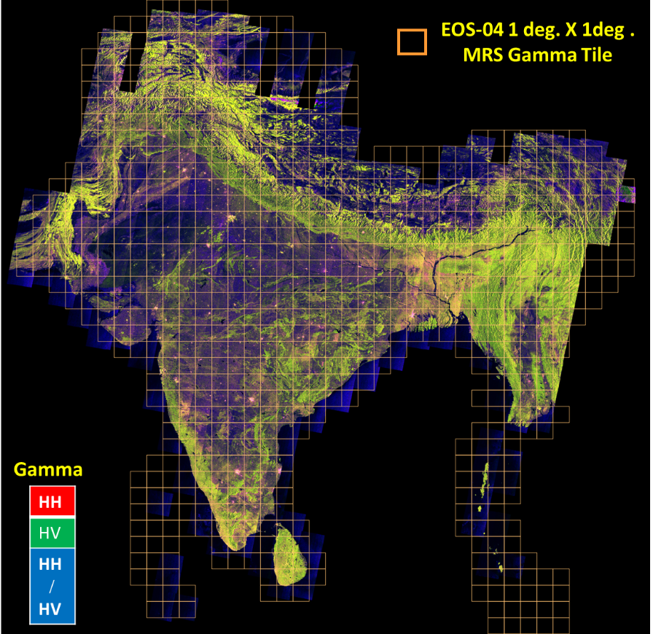
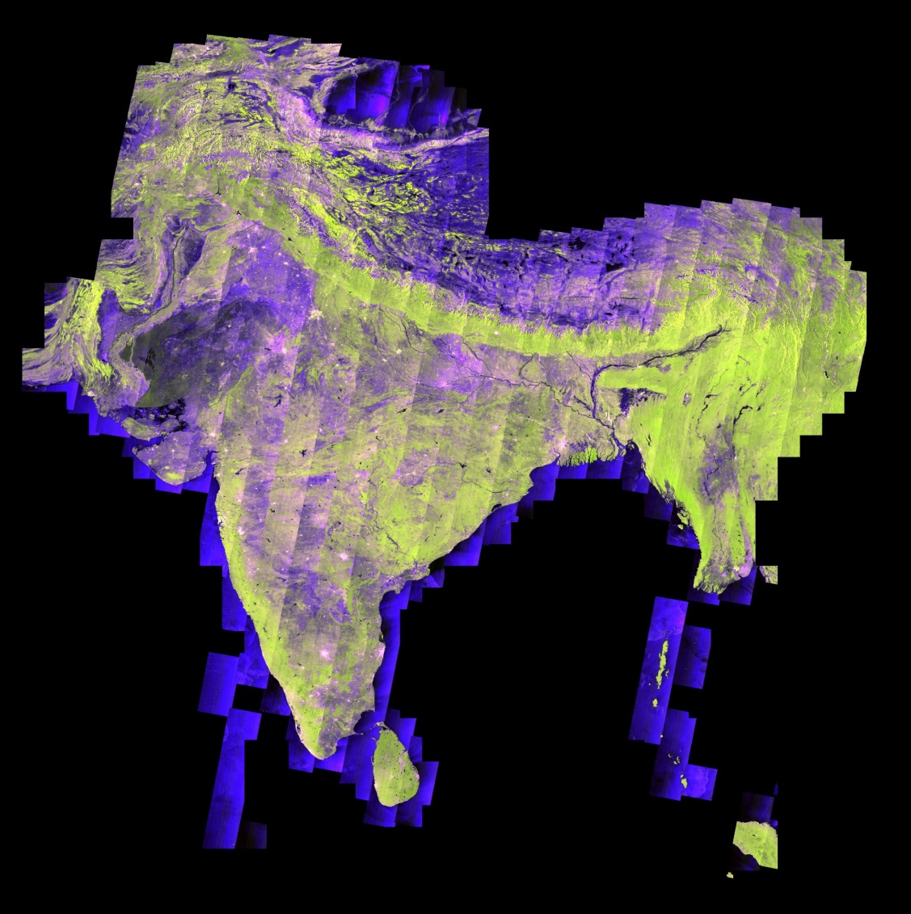
EOS-04 India Mosaic Product – One Cycle

Slide 6
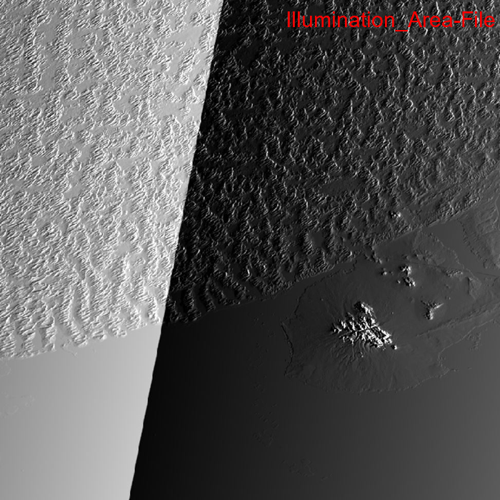
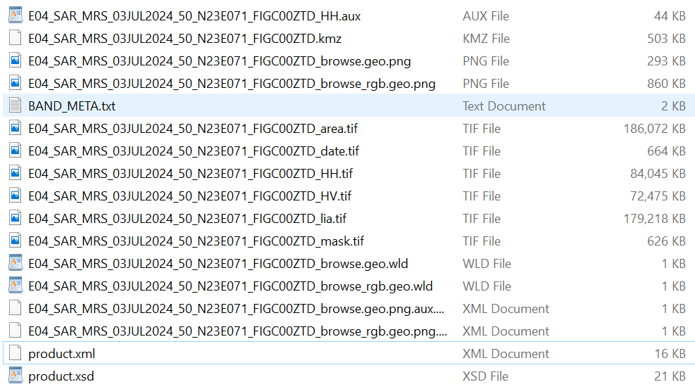
EOS-04 India Mosaic NRB Data product
India Mosaic Product Structure
Total 16 files

Slide 7
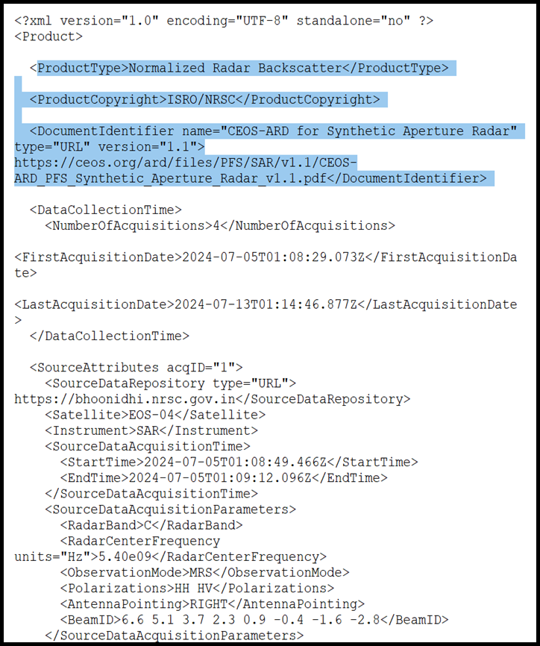
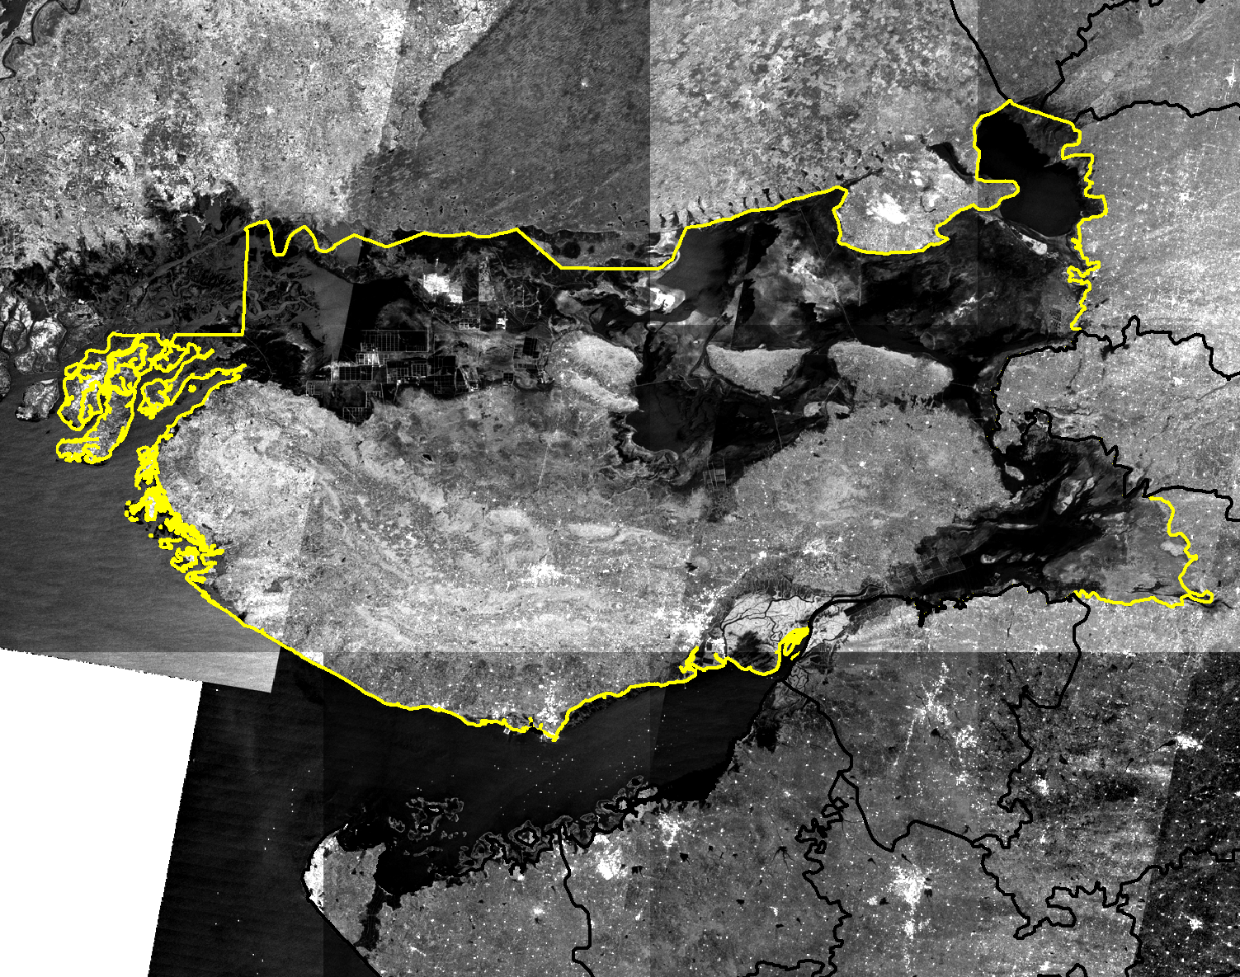
Sample India Mosaic Product for a particular District in Gujarat State, India.
Sample XML file of India Mosaic Tile

Slide 8
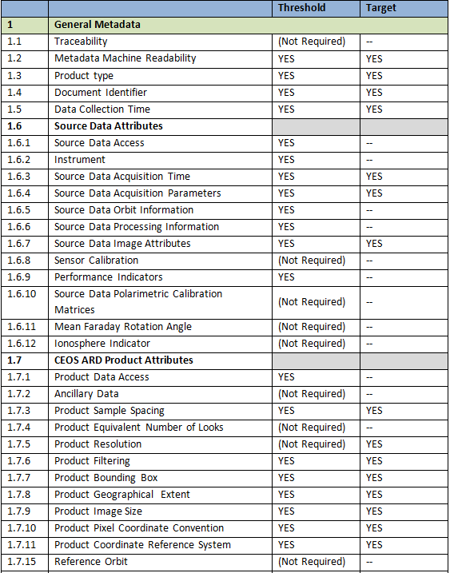
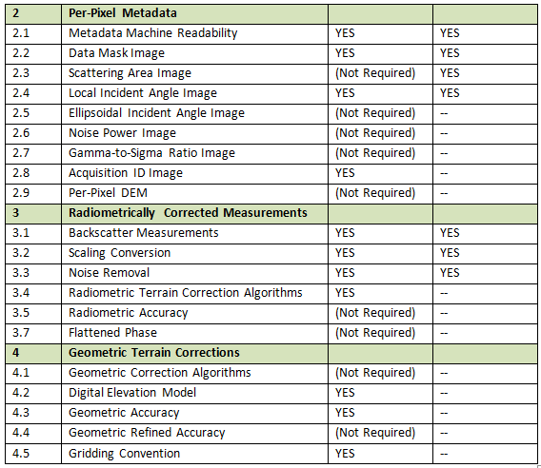
Summary Self-Assessment Table - EOS-04 India Mosaic NRB data product as per CEOS PFS v1.1

Slide 9
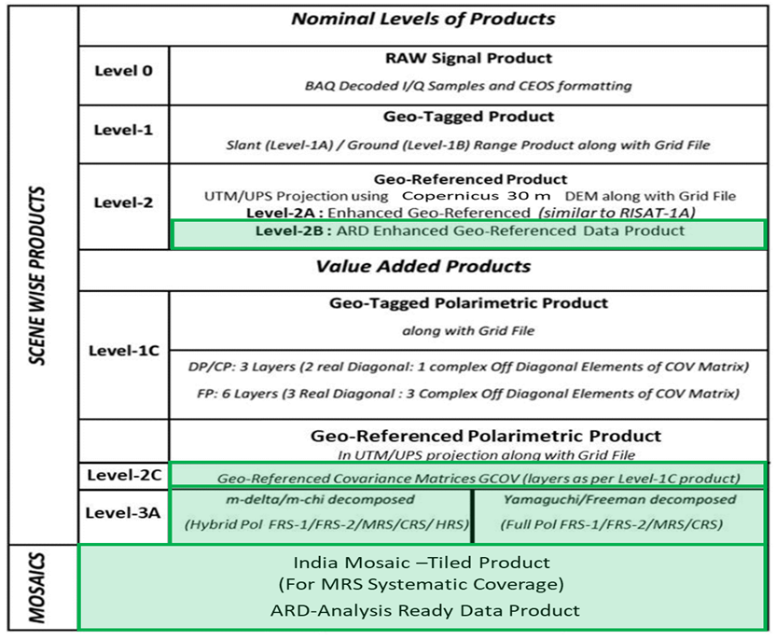
EOS-04 (RISAT-1A) – Levels of Data Products
Highlighted are ARD products
CEOS ARD compliant [NRB] products for SAR PFS V1.0
- Completed
CEOS ARD compliant [CovMAT] products for SAR PFS V1.1
- Validation phase at designer level
CEOS ARD compliant [PRD] products for SAR PFS V1.1
- Validation phase at designer level
CEOS ARD compliant NRB products for SAR PFS V1.1
- Submitted for Self-Assessment to CEOS

Slide 10
ISRO CEOS-Compliant ARD Product Generation – A Road Map
SNO | ARD Product | Sensor | Product Type | Timeline | CEOS Endorsement Status
1 | Normalised Radar Backscatter | EOS-04 / EOS-09* (RISAT-1A / RISAT-1B) | Level2B[NRB] | 2024 / 2025* | Completed
 |  | EOS04/ EOS-09* | India Mosaic[NRB] (Tiled Product) | 2024 / 2025* | Submitted to CEOS for self-assessment
2 | Polarimetric Radar | EOS04/ EOS-09* | Geocoded Polarimetric Decomposition Products (Level-3B) [PRD] | 2025 | Design level product package is under validation at ISRO
 |  | EOS04/ EOS-09* | GCOV (Geocoded Covariance Product) [CovMAT] | 2024 / 2025* | Design level product package is under validation at ISRO
 |  | NISAR | GCOV (Level-2) | 2025 | -
3 | Geocoded Single Look Complex | NISAR | GSLC (Level-2) | 2025 | -
4 | Interferometric Products | NISAR | GUNW (Geocoded – Unwrapped Interferogram) | 2025/26 | -
* - Launch planned in first quarter of 2025 - EOS-09 ( follow-on of EOS-04 C-band SAR)

Slide 11
Summary
EOS04–NRB (Normalized Radar Backscatter) data products for MRS and CRS ScanSAR imaging modes are presently CEOS ARD compliant NRB products for SAR PFS V1.0 from second quarter of 2024. DOI for the same will be submitted to CEOS in the end of September 2024.
CEOS-ARD Self Assessment for EOS-04 India Mosaic Product is completed.
India Mosaic product contents and meta data are made in compliance to CEOS NRB ARD specifications PFS V1.1 and is submitted for CEOS –ARD team for endorsement.
Geocoded Polarimetric Decomposition Products (Level-3B) [PRD] and GCOV (Geocoded Covariance Product) [CovMAT] of EOS-04 are at design level product package and under validation at ISRO.
NovaSAR NRB data product is at design level packaging and will be submitted for endorsement.
Cross validation with CSIRO NovaSAR NRB ARD products has been performed at ISRO and they are in line.

Slide 12
Thank You….
Indian Space Research Organization, ISRO
Department of Space

