Slide 1
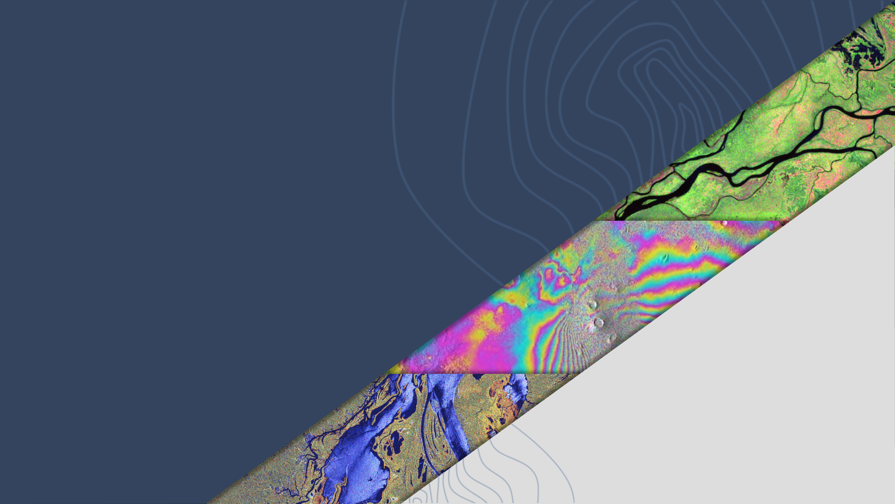
LSI-VC-16
CEOS SEO commercial SAR CEOS-ARD assessment
Dave Borges, SEO
Ake Rosenqvist
Agenda Item 8.2
LSI-VC-16, Canberra
23 - 25 September 2024

Slide 2
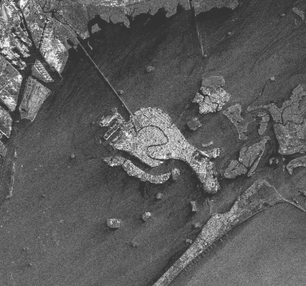
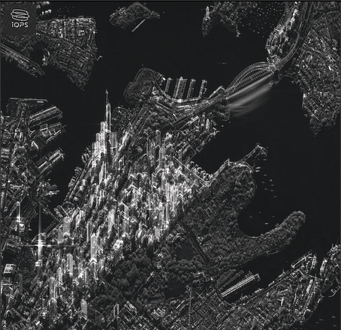
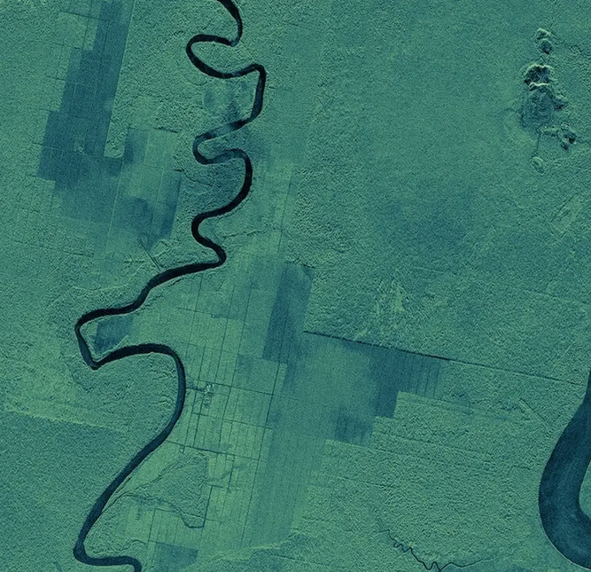
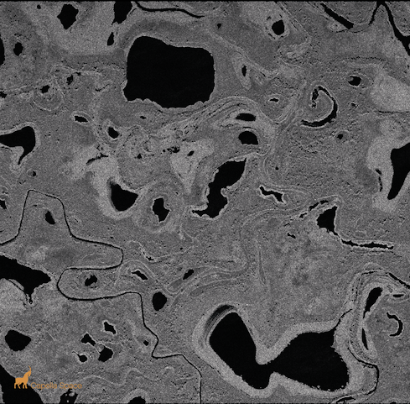
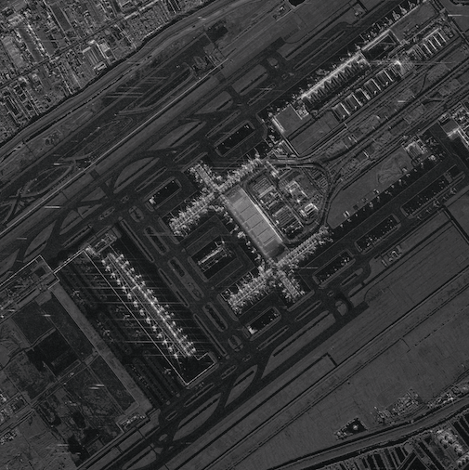
New Space SAR – SEO assessment
Increase in small commercial “New Space” SAR companies
X-band SAR systems
Light-weight, low cost
Large satellite constellations (10~50 satellites)
Very high spatial resolution (0.15~2 m)
Very high temporal revisit capacity (daily/sub-daily)
Main market segment: defence, security
Targeted observations per user requests
Strategic background observation plans - probably not
Current (SAR) actors:
Capella Space (USA) [9]
ICEYE (Finland) [32]
iQPS (Japan) [3]
Synspective (Japan) [2]
Umbra (USA) [7]
Others?...
Image credit: Synspective
Image credit: iQPS
Image credit: ICEYE
Image credit: Capella
Image credit: Umbra

Slide 3
Purpose and Objectives
New Space Task Team explored the potential for collaboration between the so called ‘New Space’ and public space sectors
White paper presented at CEOS Plenary 2023 had five recommended deliverables, including:
(D5) The CEOS Systems Engineering Office should demonstrate the integration of New Space data into the CEOS Analytics Lab and evaluate its interoperability with common CEOS datasets.
CEOS Work Plan deliverable OUT-24-6: Integrate New Space data into the CEOS Analytics Lab
First assessment results of deliverable D5 presented here, focused on offerings from five commercial SAR data providers from the New Space sector.

Slide 4
New Space SAR Assessment Phases
First Phase (current):
Preliminary assessment of commercial sample SAR data made available online, assessing accessibility and product suitability for CAL ingestion
Ingestion of sample New Space SAR data products into the CAL
Indexing experimentation
Subsequent Phases:
Detailed analysis of the products and metadata, including possible assessment against the CEOS-ARD SAR PFS
Interoperability assessment of New Space SAR data products with CEOS agency datasets (ALOS-2, Sentinel-1) in the CAL
Publish CAL indexing examples (TBC)

Slide 5
Summary
Provider | Observations | Products | Licence | Hosting and Access
Umbra USA | X-band, 25cm finest | - CPHD - SLC - GEC | CC by 4.0 | AWS S3
Capella USA | X-band, 50cm finest | - CPHD - SLC - GEC - GEO | CC by 4.0 | AWS S3
ICEYE Finland | X-band, 25cm finest | - SLC - GRD | ICEYE Evaluation EULA | Direct download
Synspective Japan | X-band, 1m finest | - SLC - GRD - SR-GRD |  | Direct download
iQPS Japan | X-band, 25cm finest

Slide 6
Products assessed
Data products from the open data programs were assessed.
Product levels provided:
(1/5) Raw data format: Compensated Phase History Data, CPHD):
(5/5) Single Look Complex (SLC): Data with complete information about backscatter amplitude and phase (complex data) - further processing is required for the data to be useful for analysis and for display
(5/5) Ground Range Detected (GRD): Backscatter amplitude data with geometric correction using an Earth ellipsoid model - geolocation approximate with further processing required for analysis
(1/5) Geocoded Terrain Corrected (GEO): Backscatter amplitude data with geometric (ortho) correction using a DEM, suitable for direct analysis.
(0/5) Radiometric Terrain Correction - GEO + radiometric slope correction
Suitable for CAL import trial
Suitable for CEOS ARD

Slide 7
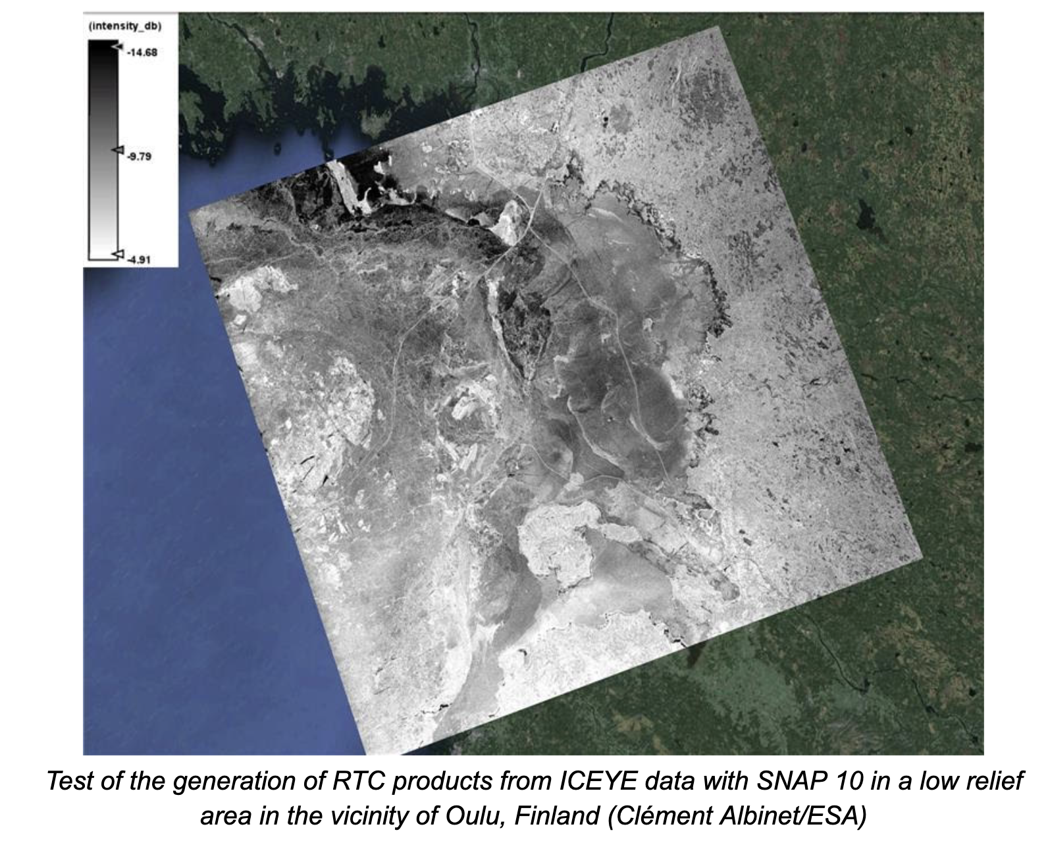
RTC- ICEYE SNAP Example

Slide 8
Notes from Preliminary Assessment
Providers not overly quick in their response times to our queries
Generally helpful, generally did respond
Support commensurate with free tier
Products delivered commonly reference Geospatial Intelligence (GEOINT) Standards
Compensated Phase History Data (CPHD)
Sensor Independent Complex Data (SICD)
Sensor Independent Derived Data (SIDD)
https://nsgreg.nga.mil/
Open data programs feature data over selected sites only. Useful for assessments of data formats and general image quality, but lack of data over user defined sites mean the data are of limited use for actual analysis.
Not openly stated what DEMs these providers use for their further processing
Copernicus 30m
Custom DEMs
…?

Slide 9
CAL Indexing Experimentation
Initial Observations
Capella (https://registry.opendata.aws/capella_opendata/):
Data available in COG format (GEC product)
STAC records available
STAC records combine multiple product types (GEC, SICD, etc)
STAC assets do not define polarisation
Umbra (https://registry.opendata.aws/umbra-open-data/):
Data is not available in COG format
STAC records available
STAC records for each product type
STAC assets listed by polarisation
ICEYE, Synspective, iQPS public data program access FTP only - not on cloud
Capella and Umbras have specific issues which prevent easy integration.
Capella issues are only related to metadata, which can be fixed by modifying our workflows
Umbra requires data to be converted to COGs and re-stored in our own buckets

Slide 10
Possibility of tasking new acquisitions
TBD - NRO’s Commercial Systems Program Office (CSPO)
Proposed study sites:
Kedah, Malaysia
Riau, Indonesia
Preah Sihanoukville, Cambodia
Goals:
Trial ingest of acquired products (data formats, product levels, STAC, etc.)
Interoperability tests with CEOS SAR data

Slide 11
Initial Observations and Conclusions
“New Space” SAR companies focused on X-band
Aimed at high resolution market
X-band antenna design smaller, simpler, cheaper
None of the products in the datasets assessed (free, open data programs) have progressed to creating CEOS-ARD
Free products only assessed; presumably paid products could be further processed
On a technical basis, all the datasets assessed could be used as the basis to create CEOS-ARD with further processing
Potential next step in the assessment
The Capella free GEO product could be ingested into the CEOS Analytics Laboratory
Assessment relevant to the ongoing discussion within the CEO- ARD SAR PFS team
Whether processing high resolution datasets to CEOS ARD standards is a useful proposition

Slide 12
Next Steps
Trial ingestion of the data into CAL
Capella GEO product is the first/best candidate for this
NovaSAR-1 a possible option
Learn and further develop relationship by doing
Interoperability assessment of New Space SAR data products with CEOS agency datasets (ALOS-2, Sentinel-1) in the CAL
Engage with the other data providers to see if they would be willing to provide a geometrically terrain corrected sample product to ingest into CAL
request further processing of an existing scene; or
we could consider doing this processing ourselves using Gamma or SNAP
Future
Based on understanding built, consider how these datasets could best complement other datasets to address CEOS needs
Engage providers in CEOS-ARD self assessment process
Other non-SAR data providers (e.g. optical, hyperspectral, thermal, etc.)

