Slide 1
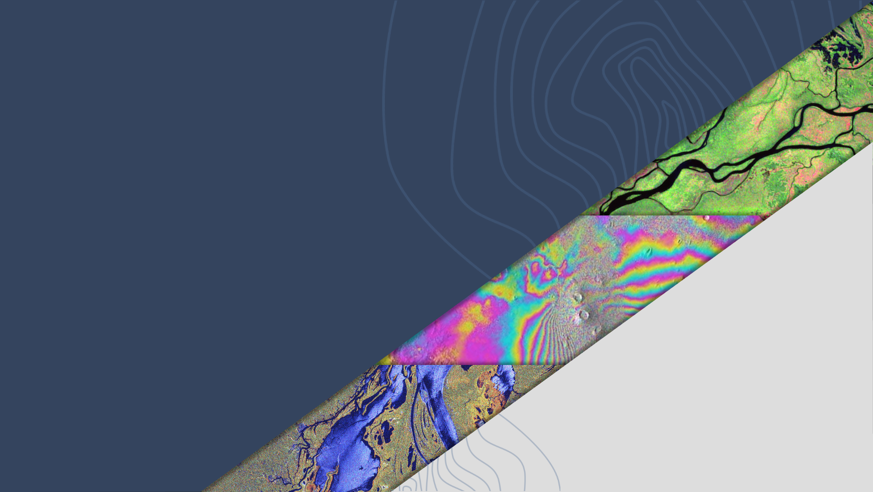

LSI-VC-16
SAR CEOS-ARD Update
Ake Rosenqvist, JAXA
Agenda Item 8.1
LSI-VC-16, Canberra
23 - 25 September 2024

Slide 2
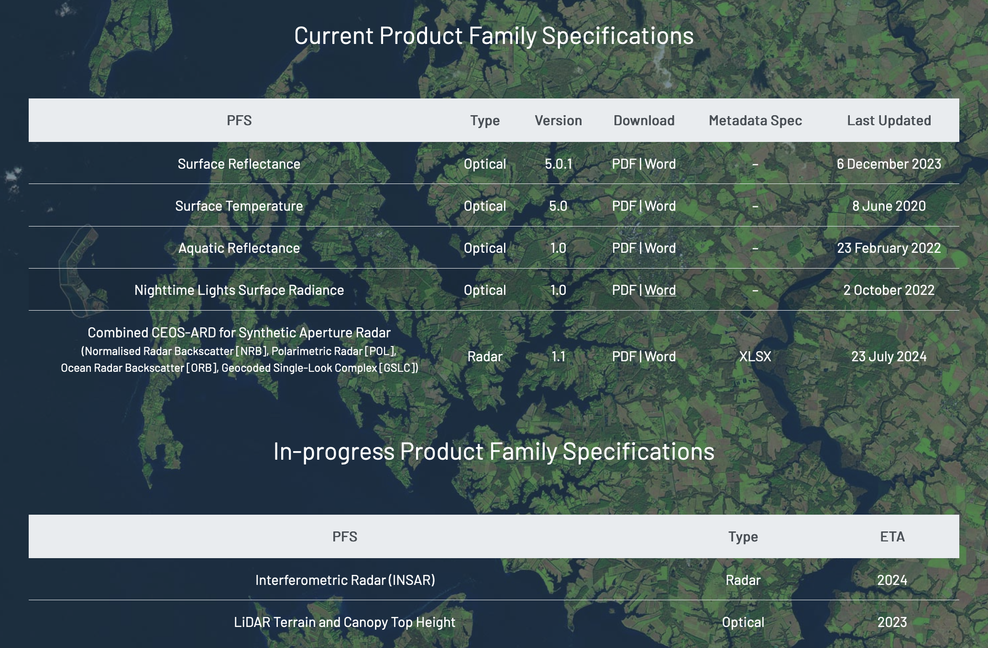
CEOS-ARD for Synthetic Aperture Radar
Combined CEOS-ARD for SAR:
Normalised Radar Backscatter (NRB v5.5)
Polarimetric Radar (POL v3.5)
Ocean Radar Backscatter (ORB v1.0)
Geocoded SLC (GSLC)
Next in line (~ LSI-VC-17):
Interferometric Radar (INSAR)
Dot update – v1.1 (23 July 2024):
Item 1.6.7 (Source Data Image Attributes): Azimuth Pixel Spacing can be provided in units of metres or seconds.
Item 1.7.9 (Product Image Size): Text clarification of Number of pixels per line
Item 2.1 (Metadata Machine Readability): Alignment of with description in Item 1.2.
Items 2.2–2.16, 3.1, 3.6, 3.7: RAW removed and HDF5 added to suggested data formats.

Slide 3
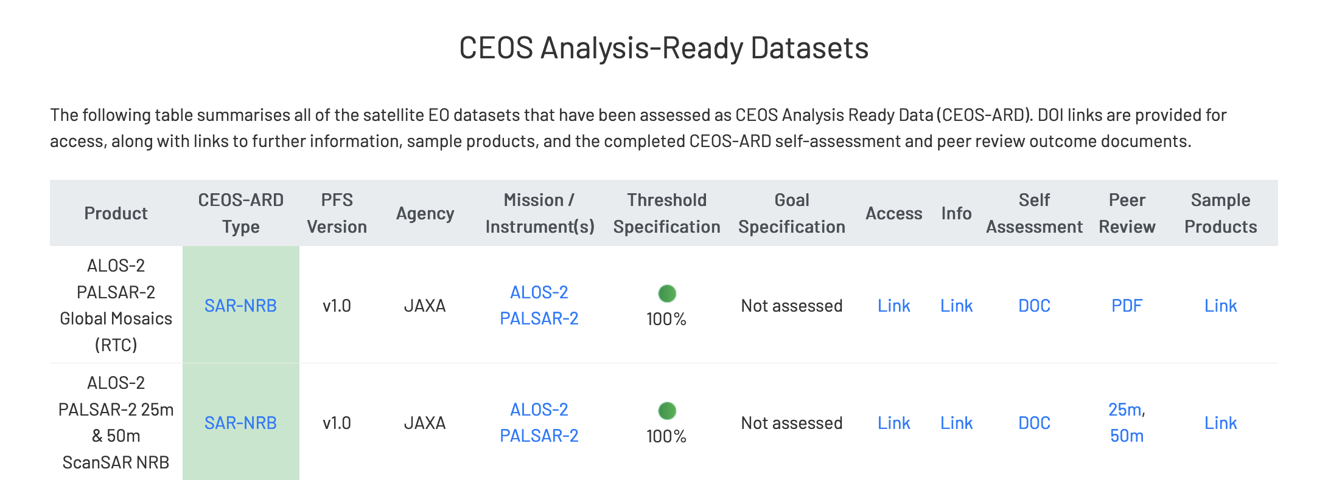
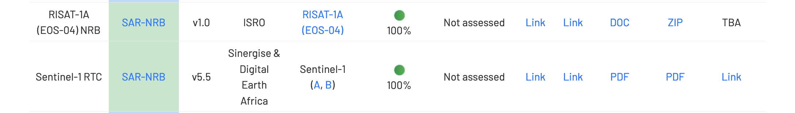
CEOS-ARD for SAR: Community Uptake
Ongoing NRB self-assessments
NASA/JPL (OPERA S-1)
ISRO (EOS-04 mosaics)
In preparation:
CONAE (SAOCOM-1A/B)
ESA (S-1, ENVISAT, ERS, ROSE-L, BIOMASS)
DLR (S-1)
KARI (KOMPSAT-5)
Commercial:
CATALYST/PCI (S-1)

Slide 4
CEOS-ARD SAR Team work topics
Interferometric Radar (INSAR) PFS
* All but finalised. Awaiting outcomes/experiences of parallel ESA development of InSAR products
* Potential completion of INSAR PFS by LSI-VC-17?
Multi-source NRB PFS
* Averaged composite products
- Pixel values no longer unique to one source datatake
- Certain per-pixel metadata no longer defined (e.g. data mask; local inc angle)
Special considerations for VHR (metre/sub-metre) SAR products:
            * Is Radiometric Terrain Correction meaningful?
            - Mismatch between publicly available DEMs and VHR pixel spacing
            - Even with VHR DEMs, RTC designed for distributed target backscatter. May for certain targets introduce backscatter artefacts
            🡪 Special NRB PFS required for VHR SAR?

Slide 5
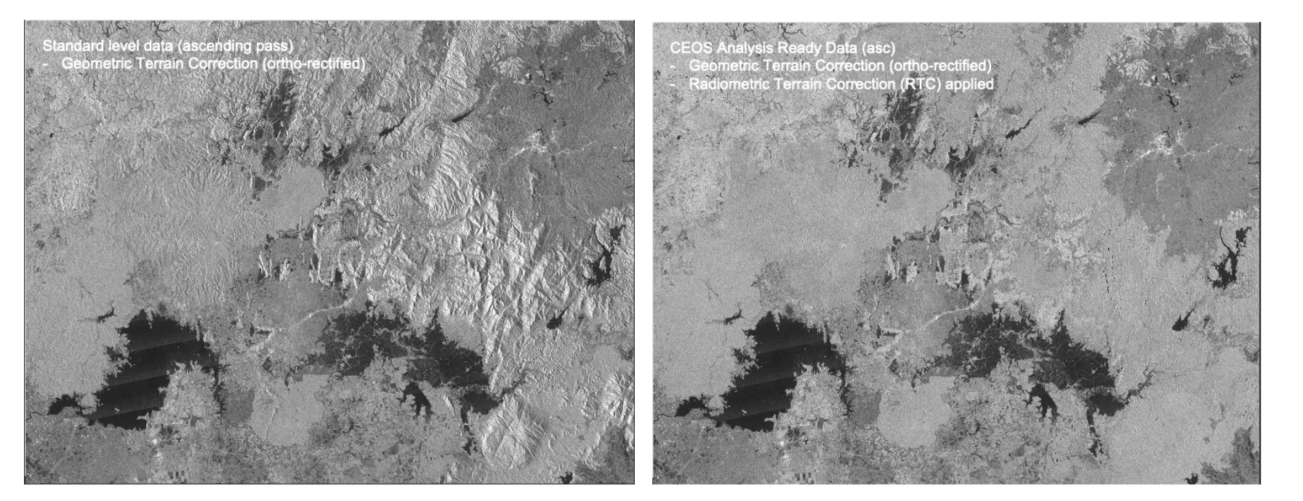
Radiometric Terrain Correction
Radiometric terrain correction (RTC) is a requirement for CEOS-ARD (Normalised Radar Backscatter). Currently not available by any New Space data provider
The effects of RTC (ALOS-2 PALSAR-2). Left: GTC only, Right GTC + RTC (right)

Slide 6
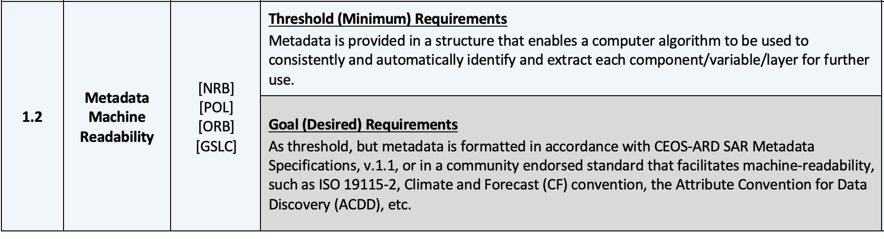
CEOS-ARD SAR Team work topics
Other considerations for next SAR PFS update:
* Requirement for XML metadata moved from Threshold to Goal?
* Requirement for Scattering Area per-pixel metadata moved from Threshold to Goal?

Slide 7

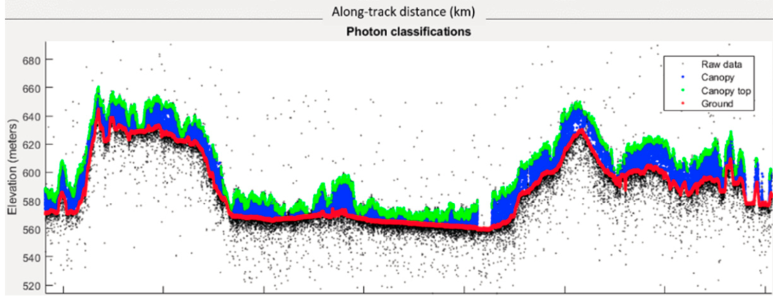
CEOS-ARD for (Spaceborne) Lidar
PFS: Lidar Terrain & Canopy Height
Footprint (1D single-source) product
Gridded (2D multi-source) product – under discussion
Prime focus on spaceborne Lidar
Accommodating full waveform and photon counting systems
Current ARD-Lidar team members
Lidar mission teams:
  GEDI, MOLI, ICESat-2
Data Providers:
  NASA LP-DAAC; NSIDC; USGS (TBC),
Science community
Schedule (easy does it...)
First PSF draft: Q1/2025
Lidar Terrain & Canopy Top Height PFS draft (based on CEOS-ARD PFS template)
Terrain & canopy top height from ICESat-2
(Neuenschwander et al, 2019)

