Slide 1
Aquatic Reflectance ARD Progress Report to CEOS SIT 18-19 Sep Sydney By Ewa Kwiatkowska (EumetSat) Aquatic includes Inland , Coastal and Ocean and everything in between!
Arnold Dekker
CSIRO Space & Astronomy
LSI-VC ARD Workshop 2024
Canberra, Australia
24 September 2024

Slide 2
Aquatic Reflectance ARD Team
2021-2022 Team (Inland and Near-Coastal): Steve Labahn, Christopher Barnes (USGS/KBR)
Arnold Dekker (SatDek), Barbara Bulgarelli (JRC-EC), Carsten Brockmann (Brockmann Consulting). Daniela Gurlin (Wisconsin DNR), Joseph D. Ortiz (Kent State), Igor Ogashawara (IGB Berlin), Anthony Vodacek (RIT), Nima Pahlevan (NASA), Sindy Sterckx, Liesbeth de Keukelare (VITO); Steef Peters (WaterInsight), Claudia Giardino (CNR), Tiit Kutser (WaterForCE).
Team 2024: (Inland, Coastal, Ocean): Matt Steventon & Harvey Jones (Simbios)
Arnold Dekker (CSIRO), Ewa Kwiatkowska Hayley Evers-King (EumetSat) ; Heidi Dierssen (Uni Conn.), Maycira Costa (Univ. Vic. Canada).), Claudia Giardino & Vittorio Brando (CNR); Peter Gege & Nicole Pinnel (DLR); Thankappan Medhavy & Peter Harris & Andreia Siqueira (GA), Carsten Brockmann (Brockmann-consult); Barbara Bulgarelli (JRC-EC); Francois Steinmetz (HyGeos), Shubha Sathyendranath (PML); Christopher Barnes &), Benjamin Page (USGS); Sean Bailey (NASA). Ferran Gascon Roca & Georgia Doxani & Marie-Helene Rio (ESA), Raisha Lovindeer (IOCCG).
Arnold Dekker
CSIRO Space & Astronomy
LSI-VC ARD Workshop 2024
Canberra, Australia
24 September 2024

Slide 3
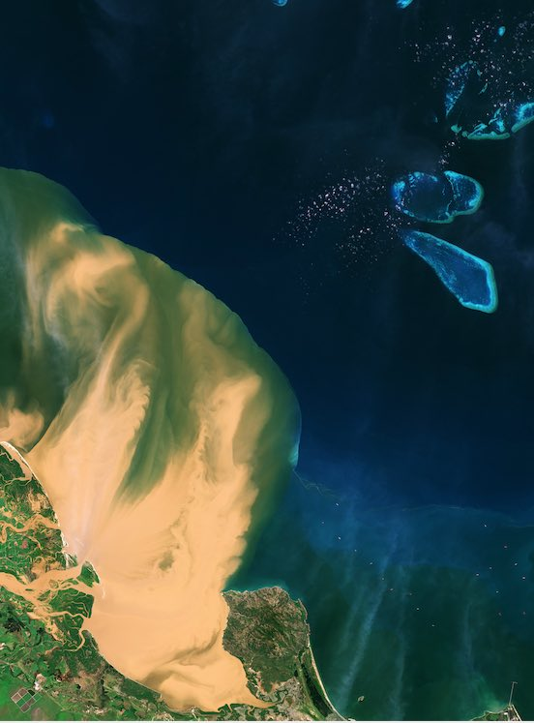
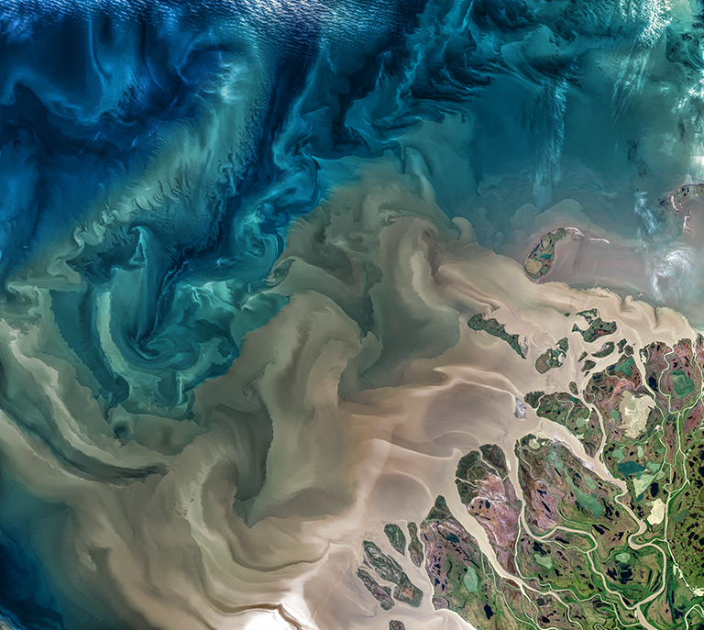

Slide 4
Summary presented last week at OCR-VC at CEOS SIT by Ewa Kwiatkowska Eumetsat
General metadata was not changed in the inland and near coastal PFS vs 1 of 2022. With the inclusion of oceans and seas in 2024 many General Metadata fields are no longer considered correct – what are consequences for other ARD PFS’s??
How to coordinate this process across many ARD PFS’s?

Slide 5
Summary CEOS-SIT Aquatic Reflectance CEOS-ARD Product Family Specification
Aquatic Reflectance ARD PFS delivered in 2022, focused on inland water bodies and nearshore coastal regions, including optically shallow water
Extended approach in development, to define a single consolidated Aquatic Reflectance ARD PFS covering inland, coastal, seas and oceanic waters in 2024

Slide 6
Summary Aquatic Reflectance CEOS-ARD approach
PFS originally written with an emphasis towards higher resolution inland and coastal water products
Now in review to expand applicability to ensure coverage of all aquatic domain
Group is currently meeting every two weeks and includes representatives from agencies, service providers, research and commercial spheres
Careful consideration of specification thresholds and goals

Slide 7
Summary Aquatic Reflectance CEOS-ARD points of discussion
Metadata on processing, DOIs
Single landing pages to trace data provenance, processor changes
Product Guides (versions?) vs technical docs vs ATBDs (versions?) vs peer reviewed papers (latter two less frequently updated/updatable)
Flags
Optically shallow water. Can this be readily defined? Threshold = information on assumptions made in processing, Goal = flag with a defined method (currently many)
Turbid water – common definition? Some significant differences across missions.
Floating vegetation/scum
Ice cover (incl. snow cover, is sea ice different from river or lake ice? Not for ARD purposes)
Corrections
BRDF – as goal
Atmospheric Adjacency corrections – sub-group discussions ongoing-rapid development in SOA
Additional atmospheric correction components

Slide 8
Summary Aquatic Reflectance CEOS-ARD points of discussion
Terminology issues: we are replacing all mentions of accuracy with uncertainty (GUM:Guide to the Expression of Uncertainty in Measurement)
Can Geolocation over large waterbodies be done with terrestrial methods?
Gridding and sampling frames? (impacts several parts of specification)
Removed superfluous phrases. E.g. in the metadata sections repeating phrase “the metadata indicates” in each field can be removed
Aiming for December 2024 end date

Slide 9
Specific Per Pixel Metadata issue: Aquatic Reflectance CEOS-ARD points of discussion
Per Pixel Metadata 2.2.: DEM vs Bathymetry vs Depth of Water: NOAA: Topographic maps show elevation of landforms above sea level; bathymetric maps show depths of landforms below sea level.
IHO.int: 2.3 Horizontal Reference Frame:…the name and epoch of the datum should be specified and the datum should be tied to a global (e.g. ITRF2018, WGS84(G1762)) or a regional (e.g. ETRS89, NAD83) reference frame. …….2.4 If the vertical component of the positions is referenced to a local vertical datum, the name and epoch of the datum should be specified. The vertical component of the positions (e.g. depths, drying heights) should be referenced to a vertical reference frame that is suitable for the data type and intended use. This vertical reference frame may be based on tidal observations (e.g. LAT, MWL, etc.), on a physical model (i.e. geoid) or a reference ellipsoid.
Water depth is depth to bottom from water surface (water surface can be from ~6500 m altitude to –minus 430 m altitude!!!!

Slide 10
4 Categories: focus here on General Metadata
General Metadata (17 sub fields)
Per–Pixel Metadata (20 sub fields)
Radiometric and Atmospheric Correction Metadata (14 sub fields)
Geometric Corrections Metadata
Note: Summary Self-assessment table needs updating once all Metadata fields are approved

Slide 11
General Metadata (17 sub fields)
General comments:
Data format specifications missing (e.g. NetCDF with CF compliant metadata etc.)
Data accessibility and distribution means unspecified
Tools for visualisation and analysis unspecified
Accuracy should be named uncertainty based on acknowledged metrological standards
DOI: Do we need DOI for continuous changing dynamic cal-val results?

Slide 12
General Metadata (17 sub fields)
1.0. Version of CEOS –ARD PFS Compliance:
required as ARD providers cannot be expected to continuously update as the PFS updates.
1.1. Traceability: (Does it have to be a DOI or just a landing page. A DOI implies a published article. Are SI reference standards citable? "single DOI landing page" seems a bit overprescriptive HD
Single DOI might be a bit of challenge with reprocessing to consider…... HEK
1.4. Geographical Area: why is one "surface location" and the other "geographic area." Probably best to stick to either "surface" or "geographic." The main difference then is whether you have 4 corner points or points defining a bounding polygon. Why "closely" bounding.
No idea what this last sentence is differentiating from Threshold or bounding polygon.

Slide 13
General Metadata (17 sub fields)
1.4. Geographical Area: continued:
1.4 states: “..accepted coordinate reference system” is this superfluous as and 1.5 specifies the coordinate reference system ?
1.7. Geometric Correction Methods:
Re.: “as a single DOI landing page”: from a practical perspective, this is very detailed information to put in a single page (which would assumedly have a lot of other more user friendly information), would clear links to details documents be acceptable?

Slide 14
General Metadata (17 sub fields)
1.8. Geometric Uncertainty of the Data:
Propose: metrics on the uncertainty in the geodetic data rather than "accuracy" and leave off the "independent verification" whatever that means. Leave the Uncertainties.
What are the specific benefits of DOI for all instrument data specs, including the ones that vary dynamically over time?
Could this be just a website address with the information maintained by an agency? Is DOI a good approach for dynamic information, where cal/val activities are ongoing and results change continuously through the mission lifetime?
Could this be just a website address with the information maintained by an agency? Is DOI a good approach for dynamic information, where cal/val activities are ongoing and results change continuously through the mission lifetime?

Slide 15
General Metadata (17 sub fields)
Binary description of calibrated / not calibrated only
1.11 Sensor Calibration: Propose:
Binary description of calibrated/not calibrated only
Including history of on-board calibrations
Except for spectral response function, calibration is not required?
Propose
New field proposed between 1.11 and 1.12: Radiometric Encoding:
Range and bit depth are provided

Slide 16
General Metadata (17 sub fields)
1.12. Radiometric Uncertainty:
Cross reference with IN-Situ OCR, NPL, GUM
Terminology consistency with FRM
Split into absolute and vicarious calibration
uncertainty is a characteristic of each individual measurement and usually depends on the measured value. So stating a single value for the 'absolute radiometric uncertainty' (in percent reflectance) for an entire dataset, as required for 'general metadata' is difficult and not meaningful.
Secondly, uncertainty is a distribution function and it should be stated which metric is relevant here, e.g. standard or expanded uncertainty.
Best would be to move it to 'per pixel' metadata and clarify that ideally the standard uncertainty should be retrievable in units of the measurand value.

Slide 17
General Metadata (17 sub fields)
1.13 Algorithms:
=led to much discussion in Aquatic AR group:: can ARD be provided though non-disclosed processes? Doesn't that undermine the principle of open and accessible and verifiable methods?
1.14 Auxiliary data:
This is very land-centric. Please add/change: atmospheric pressure, relative humidity, ozone, wind speed, water vapor etc.
1.15 Processing Chain Provenance:
For threshold we propose: same as Goal: very hard to do anything with consistency without knowing if processors have changed

Slide 18
General Metadata (17 sub fields)
1.17 Percentage of valid observations:
Should we delete “Machine readable metric”?as 1.2. already discusses this?
The threshold seems a little ambiguous. Is compliance achieved if at least one flag or the flag set is applied? Is it even possible to achieve compliance considering the challenges associated with some of the flags?
Delete “ high quality flag set from section 2 (per pixel metadata) as this is not defined in section 2
Note: the preceding slides were NOT a comprehensive analysis of general metadata -this is a first cut. Should be done at CEOS ARD Oversight Committee level? For discussion!!

Slide 19
Discussion Time?

