Slide 1

4.1: Optical PFS Developments and Consolidation
Session Overview
Matt Steventon
LSI-VC Secretariat
LSI-VC-16
23 September 2024

Slide 2
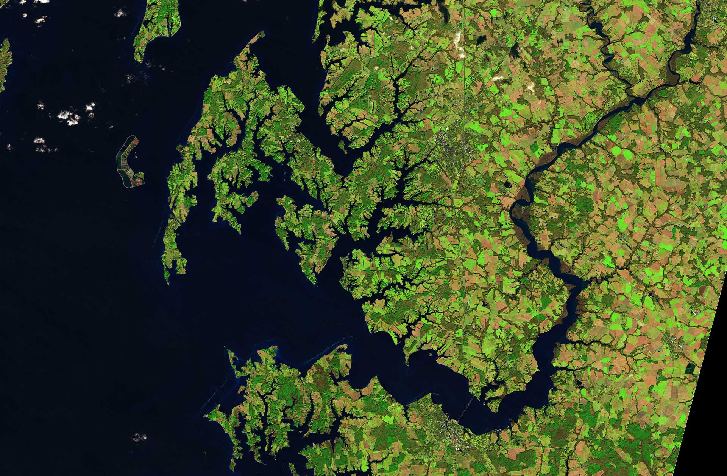
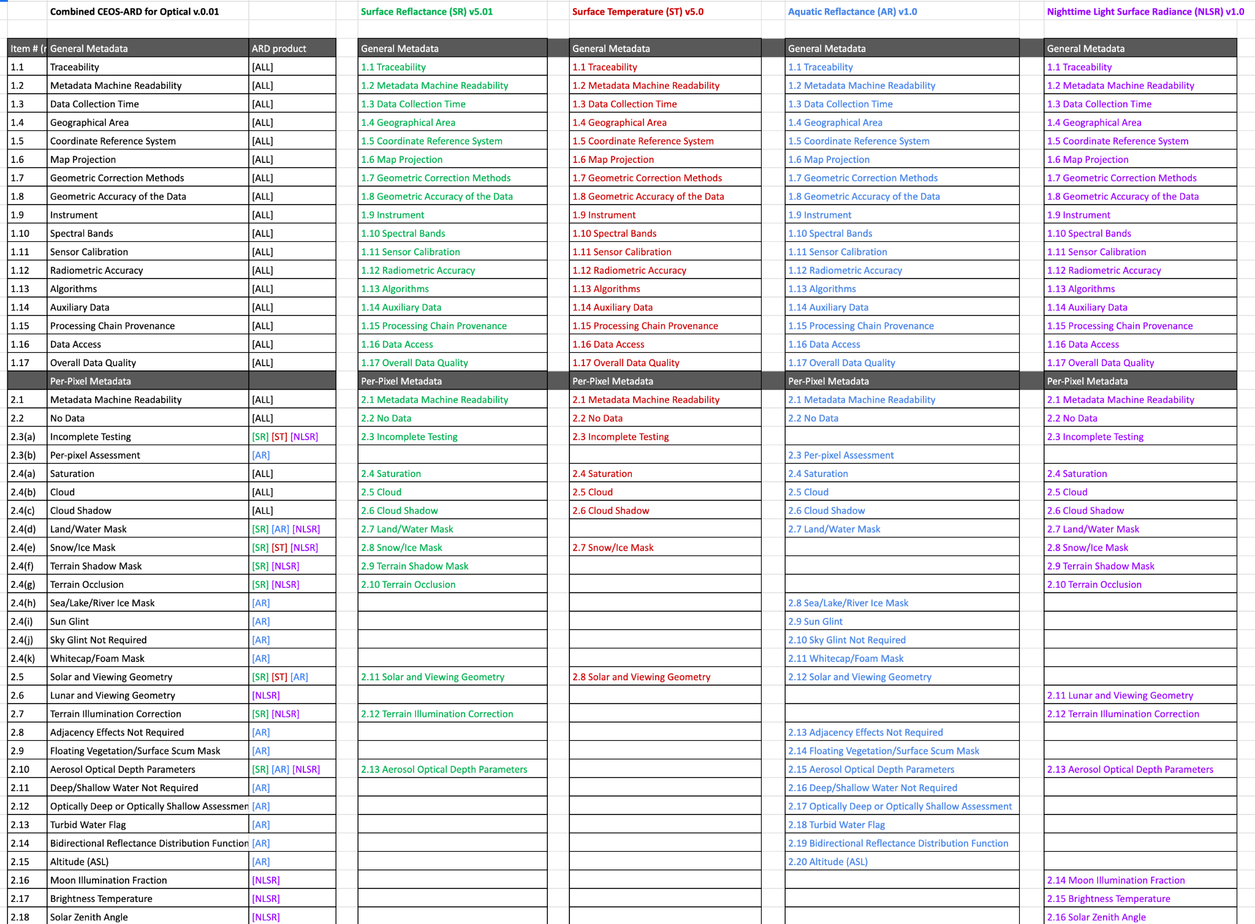
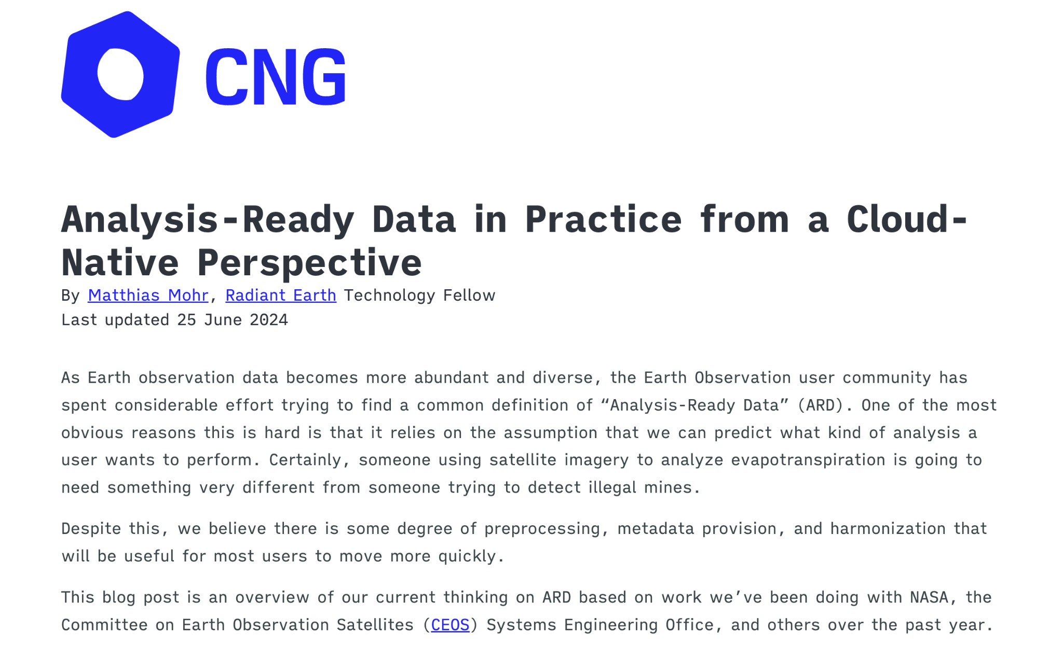
Overview
Lack of consistency across the PFS – Parameters, requirements, terminology
Updating the PFS is now daunting and complicated – consistency, versioning, reaching consensus
Seen the benefits of consolidated PFS with SAR – what can we learn and do on optical side?
  Surface Reflectance; Surface Temperature; Aquatic Reflectance; Nighttime Lights Surface Radiance
Prelim PFS Mapping
And can we further consolidate optical + SAR ?
Is the ‘building block’ / modular approach the way to ease this consolidation?
Ocean Reflectance PFS development
  Expansion from coastal and inland waters to oceans
  But also raising many fundamental questions about the nature of the optical PFS:
    Summary of discussions here
    Algorithms (peer review requirement); accuracy vs uncertainty; references to ‘metadata’; Target/Goal; self-assessment versioning; data collection time; instrument identification; radiometric encoding; chapter titles, streamlining requirement descriptions; pixel saturation;
    Tidying up ‘loose language’ – “if possible”
    DOIs
    BRDF;
  Tricky to discuss and get consensus
PFS taxonomy / hierarchy – Product Levels, standards, geophysical parameter vs instrument
Metadata specifications

Slide 3
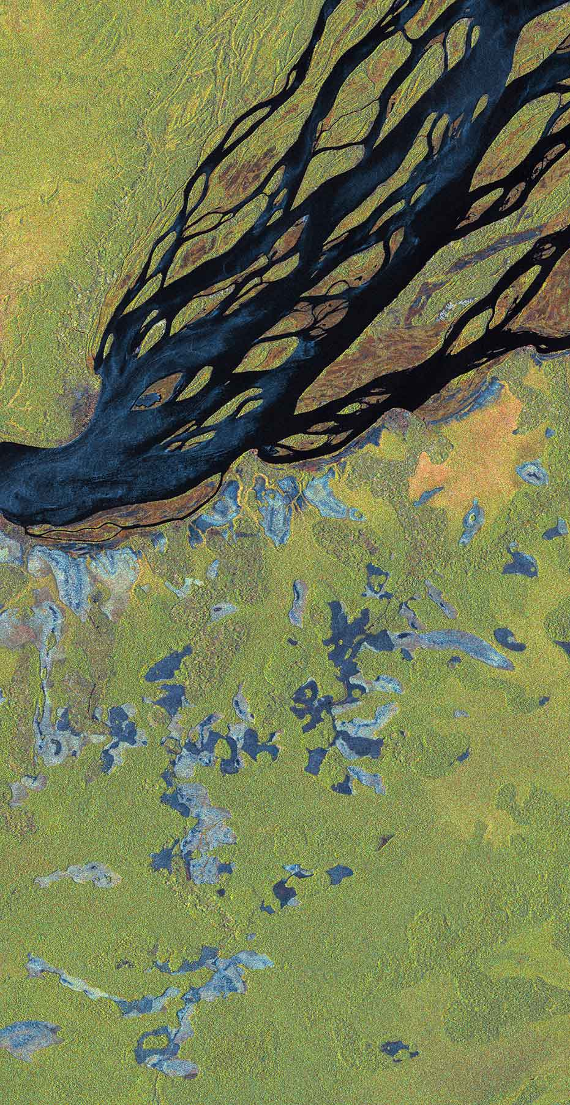
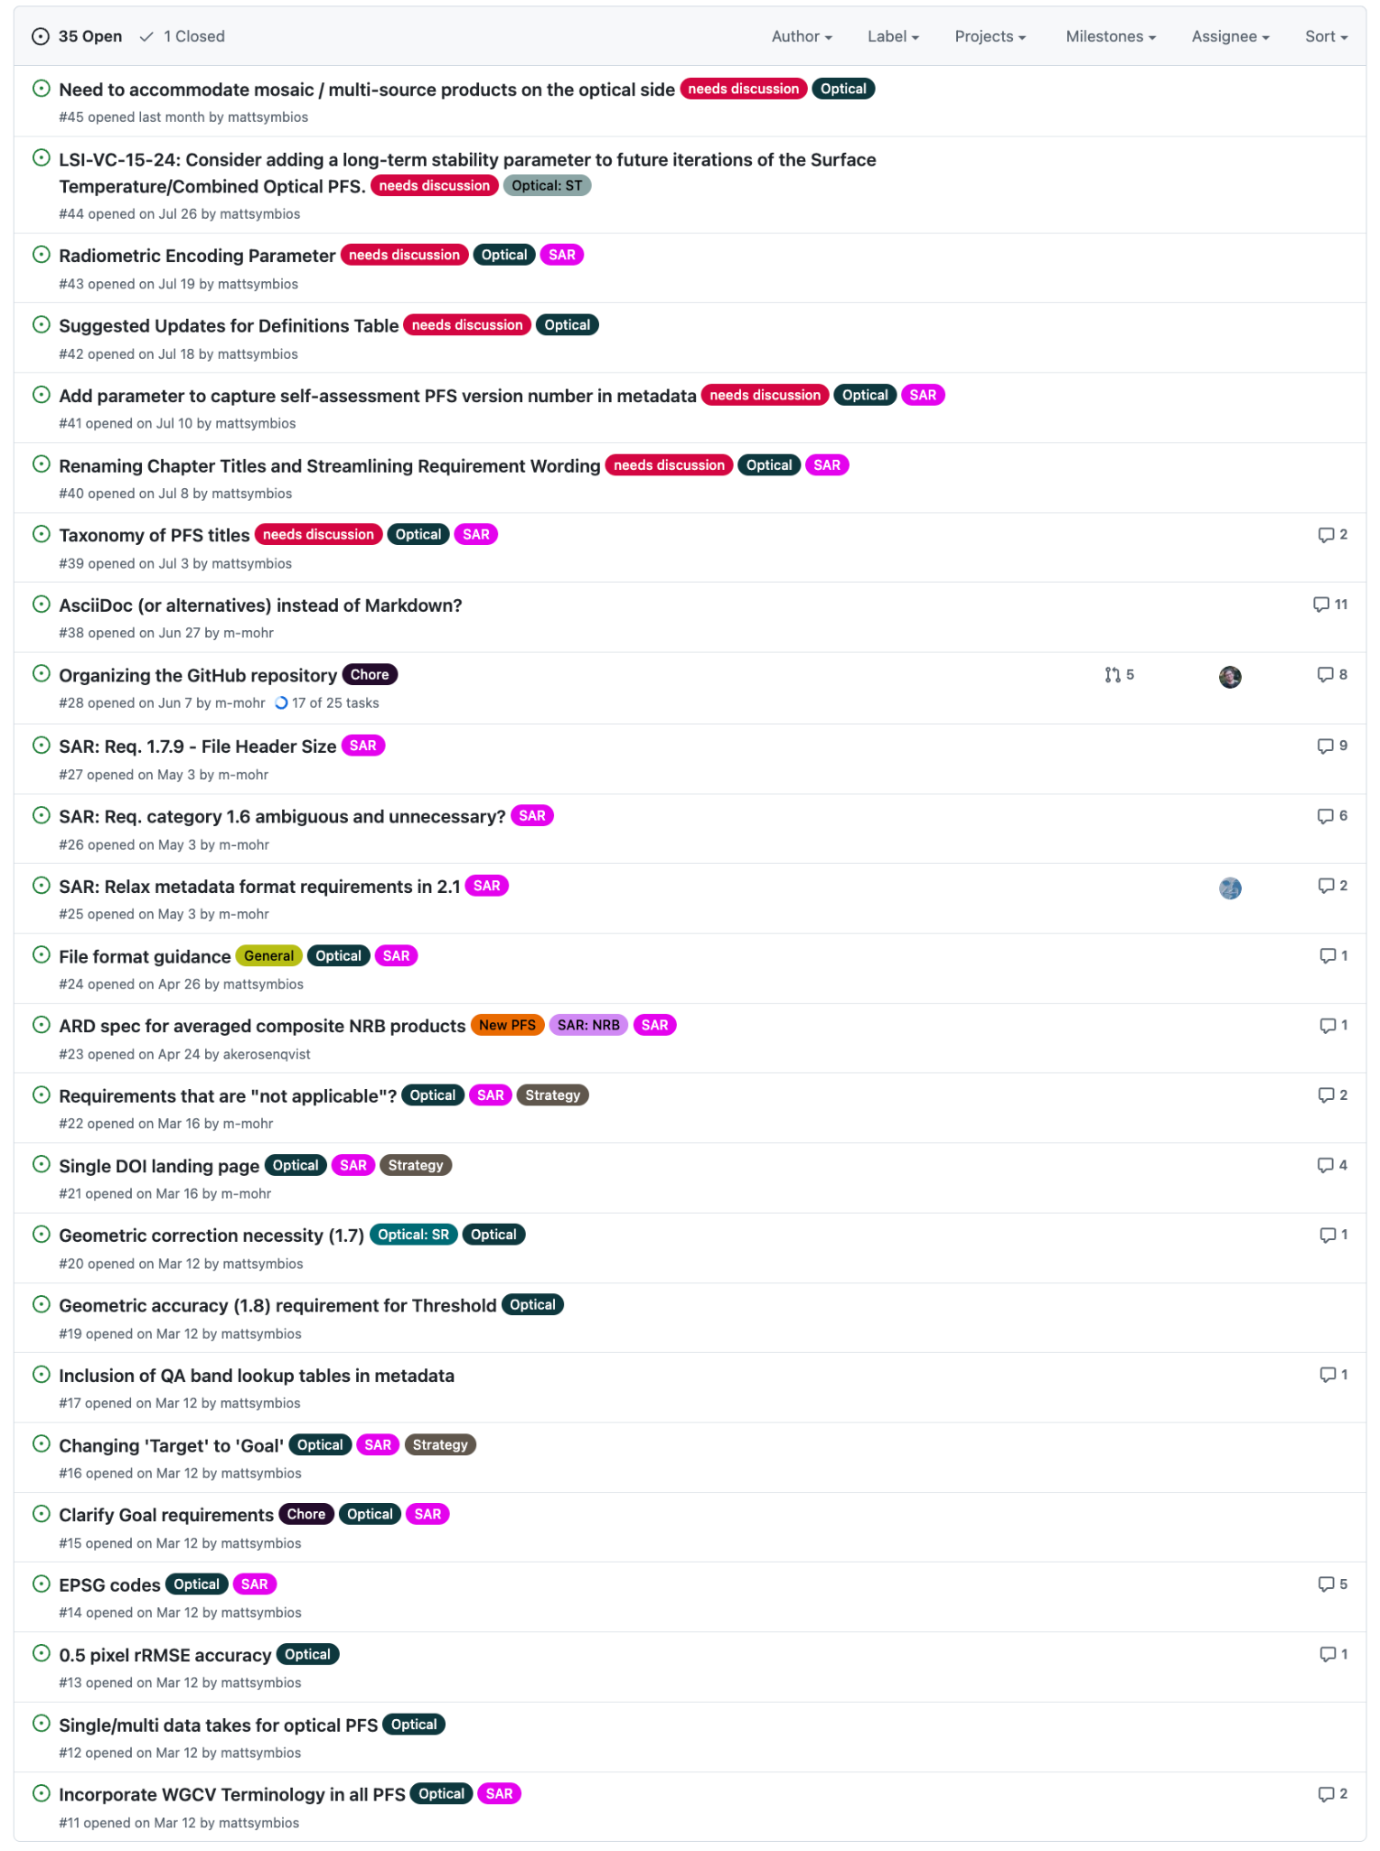
Other considerations…
Accommodating mosaic / multi-source products
Long-term stability parameter (climate)
Definitions
Self-assessment versioning (metadata)
Geometric accuracy and high resolution datasets
Target to Goal
AI/ML ready data
And many more…
Need to sort out our framework and consolidation so we can start picking some of these off systematically – currently frozen

Slide 4
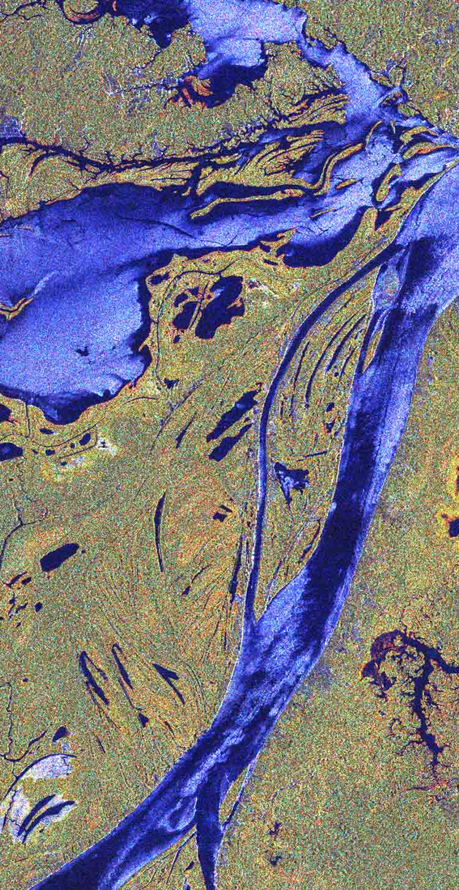
Session Overview and Objectives
Presentations:
Expansion of the Aquatic Reflectance PFS to cover the oceans (Dekker)
USGS initial assessment of a PFS consolidation (Barnes)
CEOS-ARD Functional Taxonomy/Ontology/Hierarchy (Strobl)
Proposed ‘Building Block’ Approach to constructing PFS (Mohr)
Session Objectives:
Decide whether the building block approach is the desired easy forward
Define a suitably extensible hierarchy as a starting point?
  Top-level categorisation of PFS
  Processing Levels
  Terminology
  Overall, seek to add a logical structure into the way EO data is classified and described, starting with CEOS-ARD.
Record decisions on specific fundamental questions raised by oceans team
Action to get a first consolidated optical PFS into GitHub using existing endorsed texts?
  Then we can propose pull requests for various discussed changes..?
Agree timeline for future development
Assign actions across the team

