Slide 1
LSI-VC-16
CEOS-ARD
GA Perspective
Medhavy Thankappan
Geoscience Australia
Agenda Item 2.1
LSI-VC-16, Canberra
23 - 25 September 2024

Slide 2
Background
GA has been associated with the CEOS-ARD initiative from its conception and remains a strong supporter of the CEOS-ARD Strategy.
CEOS-ARD has been very successful, in terms of its adoption by CEOS member agencies, and continues to attract interest from the industry sector, but more industry engagement is needed.
Through LSI-VC and WGCV in CEOS, GA continues to support CEOS-ARD self-assessments for compliance against Product Family Specification (PFS) which remains a strong basis for achieving interoperability.
Achieving interoperability of multi-source data streams remains a high priority for the success of our Digital Earth programs (Australia, Africa, Antarctica), combined use of multi-source data provides better insights, and return on investment.

Slide 3
Interoperability Drivers
Consistent time-series data across sensors, steps towards harmonisation / homogenisation.
Focuses effort on value-adding with common baseline data, improves results from multi-sensor analyses, helps gain better insights.
Reduced duplication of effort, cost savings, increased global applicability of algorithms, higher return on investment.
New opportunities for EO in our region.

Slide 4
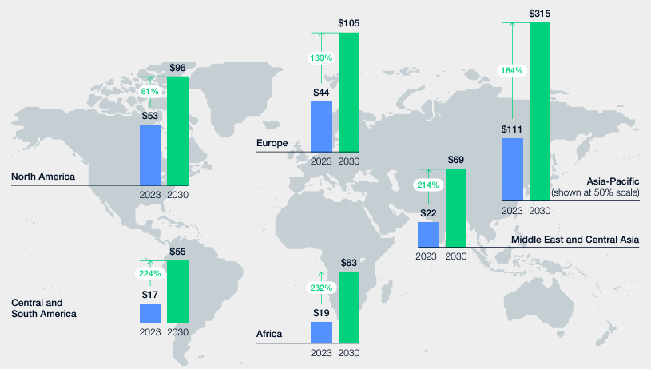
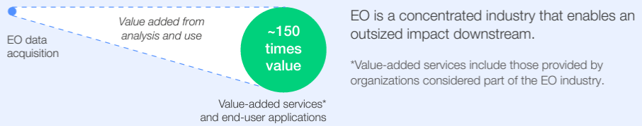
EO Value Creation Potential
The Asia Pacific region is projected to capture the largest share of value with a potential of $315 billion.
Value creation results from analysis and application of EO data.
Interoperability of multi-source data streams can amplify value creation
Source: Amplifying the Global Value of Earth Observation - Insight Report (May 2024)

Slide 5
Landsat Next Partnership
New investment by the Australian Government in a full value chain partnership to ensure that benefits of Landsat Next are realised by Australians, Americans and in the Indo-Pacific ($AUD448.7M to 2034-45, then ~43.2M per year ongoing).
Enhanced Alice Springs Ground Station Capability
Ka/X/S-band, highly redundant
Permanent operational instrumented cal/val facilities
2 in Aus, 1 in Pacific
Indo-Pacific Regional Data Hub
Landsat, Sentinel and other high-quality trusted data
Operational Data Quality and Integrity Monitoring Facility
Foreign government and commercial missions
First Nations Technical Training and Research Programs
Including ground station skills
New, open, science and next-generation analytics technology
Including AI
Field data collection programs
Training and validation data
Interoperability engagement and uplift
Including through CEOS

Slide 6
What’s Next?
The CEOS-ARD PFS framework tolerates different approaches, which means surface reflectance data could be slightly different across providers.
Differences in surface reflectance data (e.g. CEOS-ARD) from different providers impedes combined use, analyses, and gaining deeper insights.
CEOS-ARD is only the first step in the ‘interoperability continuum’, more work is needed (and being proposed) to achieve interoperability among multiple data streams (details in Session 9 on Wednesday).
CEOS-ARD is the term we use now in place of CARD4L

Slide 7
Thank you

