Slide 1
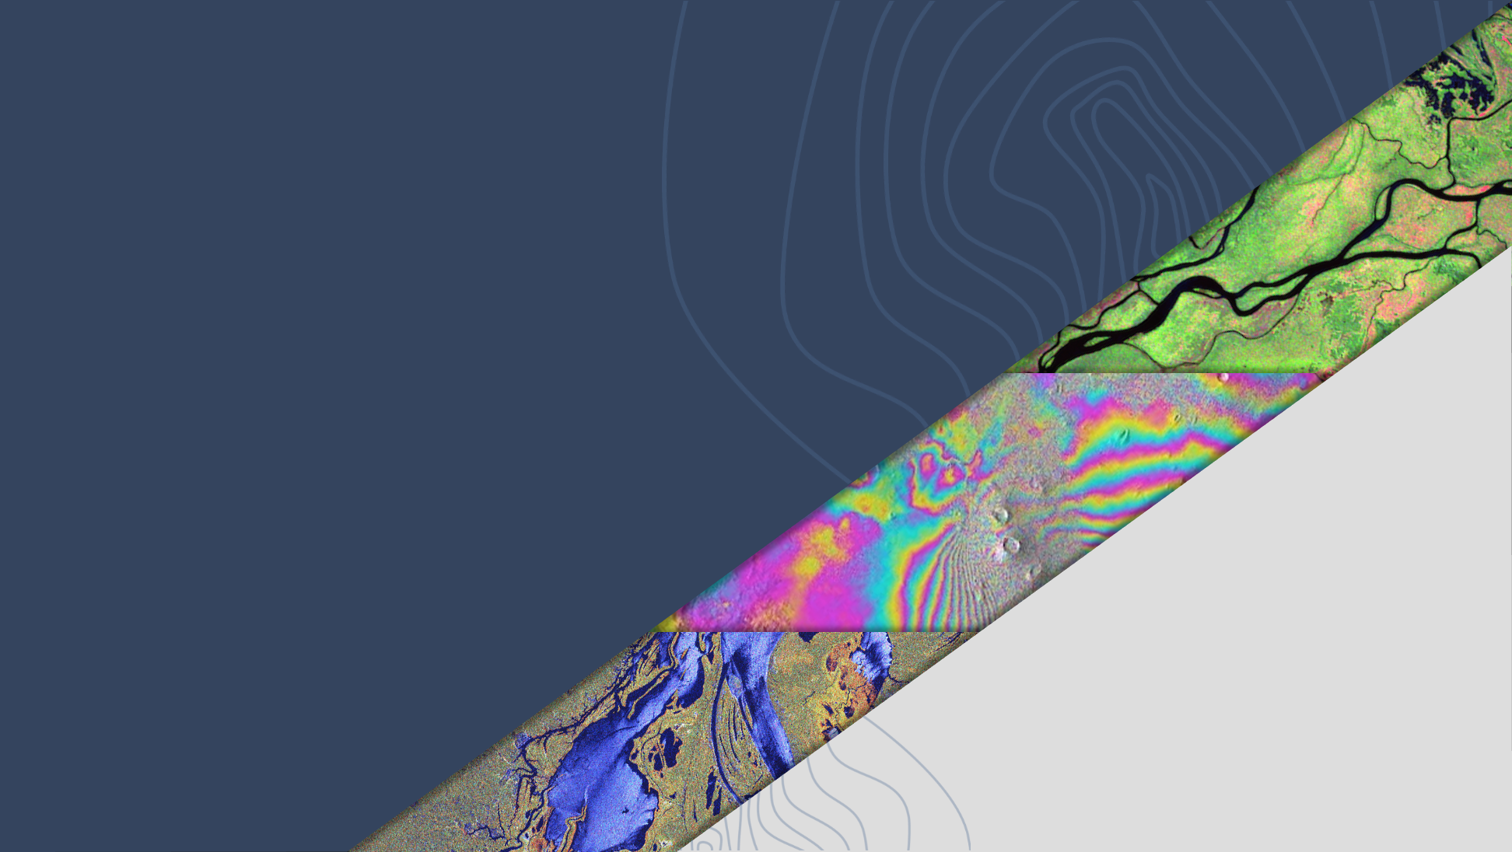

LSI-VC-16
Wetlands and EO
Ake Rosenqvist, JAXA
Agenda Item 11.1
LSI-VC-16, Canberra
23 - 25 September 2024

Slide 2

The Ramsar Convention
The Ramsar Convention on Wetlands
Established 1971 in Ramsar, Iran
20 years before the UN Rio Conventions (UNFCCC, CBD, UNCCD)
172 Contracting Parties
Conference of the Parties (COP) every 3 years – next in July 2025
Ramsar Convention Strategic Plan:
          Goal 1 - Addressing the drivers of wetland loss and degradation
          Goal 2 - Conservation and management of the Ramsar Site Network
          Goal 3 - Wise use* of all wetlands
          Goal 4 - Enhancing implementation of the Convention
          * Wise use: conservation and sustainable use of wetlands and all the services they provide, for the benefit of people and nature.

Slide 3
The Ramsar Convention
Bodies of the Convention
The Conference of the Parties (the COP)
The Standing Committee
The Ramsar Secretariat (SG: Dr Musonda Mumba)
The Scientific and Technical Review Panel (STRP)
The STRP
The “Ramsar SBSTA”
Develops scientific and technical guidance to the COP
JAXA and ESA Observer Organisations to STRP

Slide 4
The Data Gap
STRP-25 (@RamsarSec, Switzerland, Feb 2024):
Only a fraction of Contracting Parties fulfil their reporting req.
“Critical need” for improved wetland mapping and inventory.
Gap of adequate and up-to-date data on wetlands – both for Ramsar Sites and wetlands globally – major impediment to effective implementation of the Convention (Strategic Goal 4).
→ Ad-hoc Task to initiate consultation with the Earth Observation community proposed by SRTP to the Ramsar Standing Committee (June 2024)

Slide 5
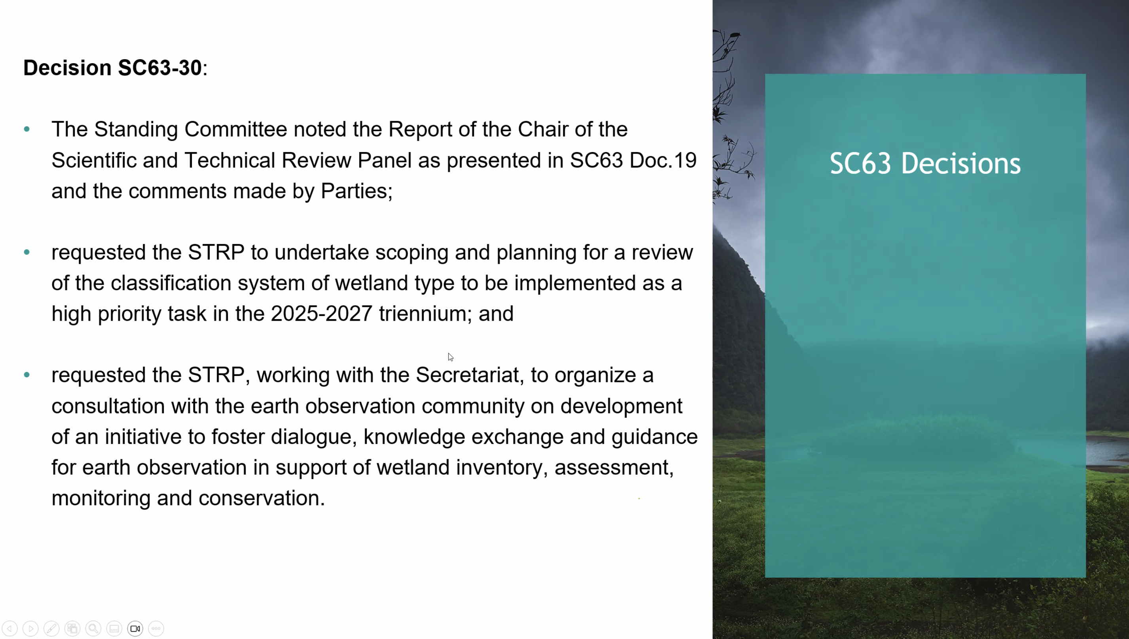

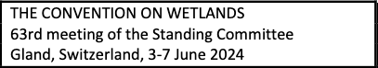
Consultation with the EO community

Slide 6
Consultation with the EO community
EO Day in connection with STRP27 in Dec 2024
Ramsar looking at reviewing its wetlands classification system and possible alignment/crosswalk with the IUCN Global Ecosystem Typology (GEF) v2.0
Considering EO as a Priority Task in the next triennium STRP Work Plan 2026-2028.
Opportunity for CEOS to provide input to the Work Plan wording

Slide 7
Misc
CEOS already supporting UNFCCC, UNCCD, UNCBD and the SDGs
  - Opportunity to support the Ramsar Convention
Support Ramsar STRP develop wetland information requirements & translation to EO requirements
Possible alignment with the CEOS Biodiversity Study Team proposed at SIT TW?
More CEOS agencies encouraged to become STRP Observer Organisations during next Ramsar triennium (2026-2028)

