Slide 1
CEOS Analysis Ready Data (CEOS-ARD)
Matt Steventon
LSI-VC Secretariat
LSI-VC-16
23 September 2024

Slide 2
CEOS-ARD Origins
2016: Needed to define something - address the ambiguity of ‘ARD’
Open Data Cube – Digital Earths
Space agency experience
What do most ‘non-expert’ users want?
Sensor agnostic geophysical variables
Define key parameters and corrections for different types of geophysical products
Ensuring documentation, rather than prescribing methods

Slide 3
Motivations

Slide 4
Motivations
Easing the use of satellite EO data to reach new non-expert users and increase data uptake and use
Provision of analysis-ready geophysical measurements
Reduce pre-processing burden for users
Facilitate analysis in the cloud
Reduce egress and processing
Provide a first step for interoperability
Open and transparent
Common starting point; consistency
Promote clear documentation of processing steps
Capitalise on space agency expertise and experience
Best available science and high quality processes

Slide 5
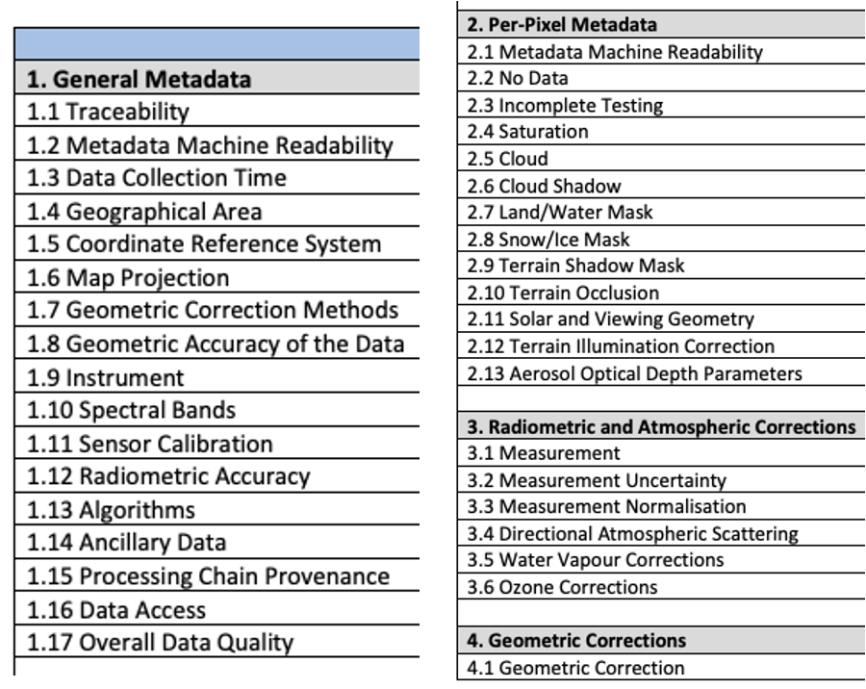
Motivations
Product Family Specifications (PFS)
Specifications for each geophysical measurement
Detail ‘Threshold’ and ‘Target’ / ‘Goal’ requirements for a variety of parameters

Slide 6
Current + In-development CEOS-ARD Specifications
Land
Inland and Coastal Waters
Oceans
Harmonised to a single specification in 2023
Optical
Surface Reflectance
Surface Temperature
Nighttime Lights Surface Radiance
LiDAR Terrain and Canopy Top Height
Radar
Normalised Radar Backscatter
Polarimetric Radar
Geocoded Single-Look Complex (GSLC)
Interferometric Radar (INSAR)
Aquatic Reflectance
Ocean Radar Backscatter
Harmonised to a single specification in 2023
http://ceos.org/ard/index.html#specs

Slide 7
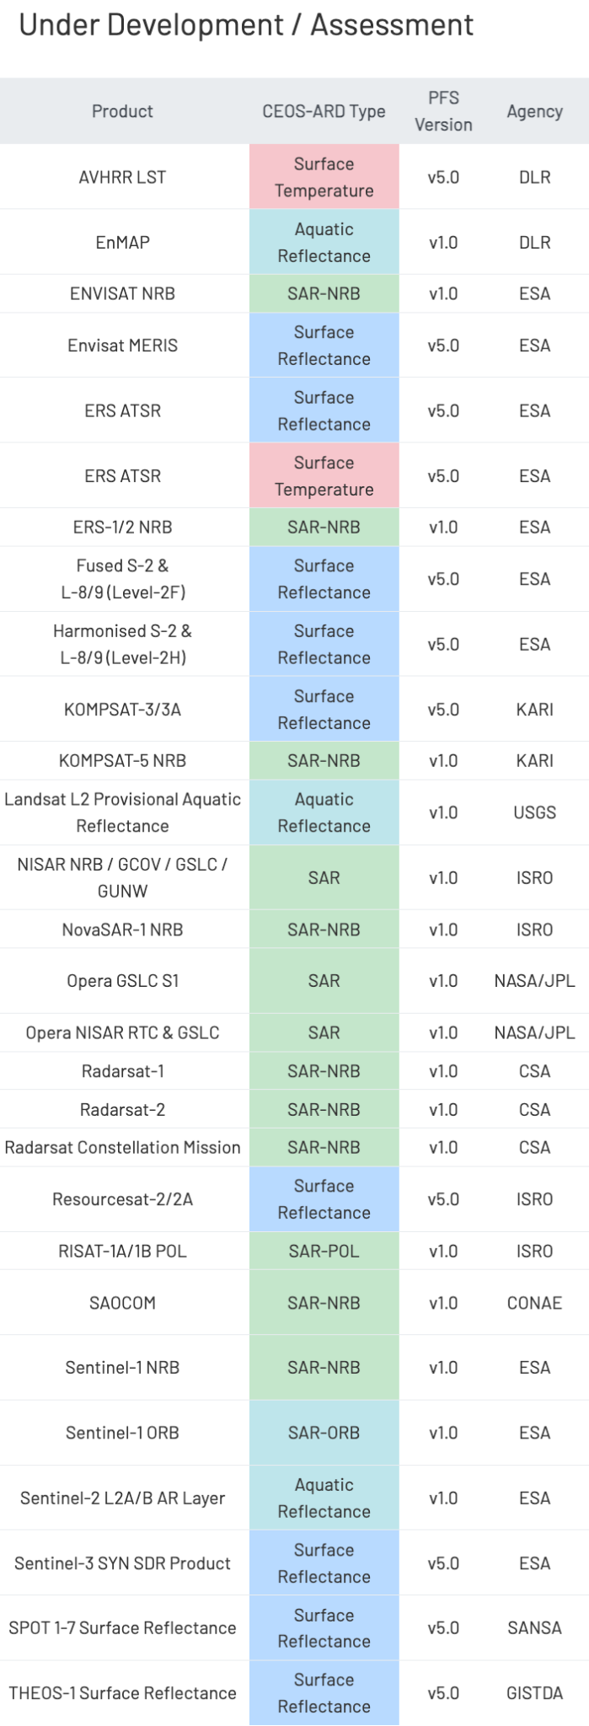
Recent updates…
Recent CEOS-ARD Endorsements
ISRO EOS-04 (RISAT-1A) NRB (Combined SAR PFS v1.0) [2 April 2024]
JAXA ALOS-2 PALSAR-2 Normalised Radar Backscatter (NRB) (Combined SAR PFS v1.0 update) [17 April 2024]
Ongoing self-assessments and peer reviews
DESIS L2A (DLR), Gaofen-1/6 SR (AIR-CAS), Opera RTC S1 Products (NASA)
Recent / Upcoming engagements on commercial providers
NSI, Tellus, Synspective, AxelSpace, Planet, EarthDaily Analytics, Catalyst
Esper Satellite Imagery, Geospatial Intelligence, Arlula, Eartheye Space Technologies, Descartes Labs/EarthDaily
SEO trial CEOS-ARD assessments
Ongoing development of an Ocean Reflectance PFS (with OCR-VC)
Combine Optical PFS (SR, ST, AR, & NLSR) (USGS)
Surface Reflectance Equivalence project (GA)

Slide 8
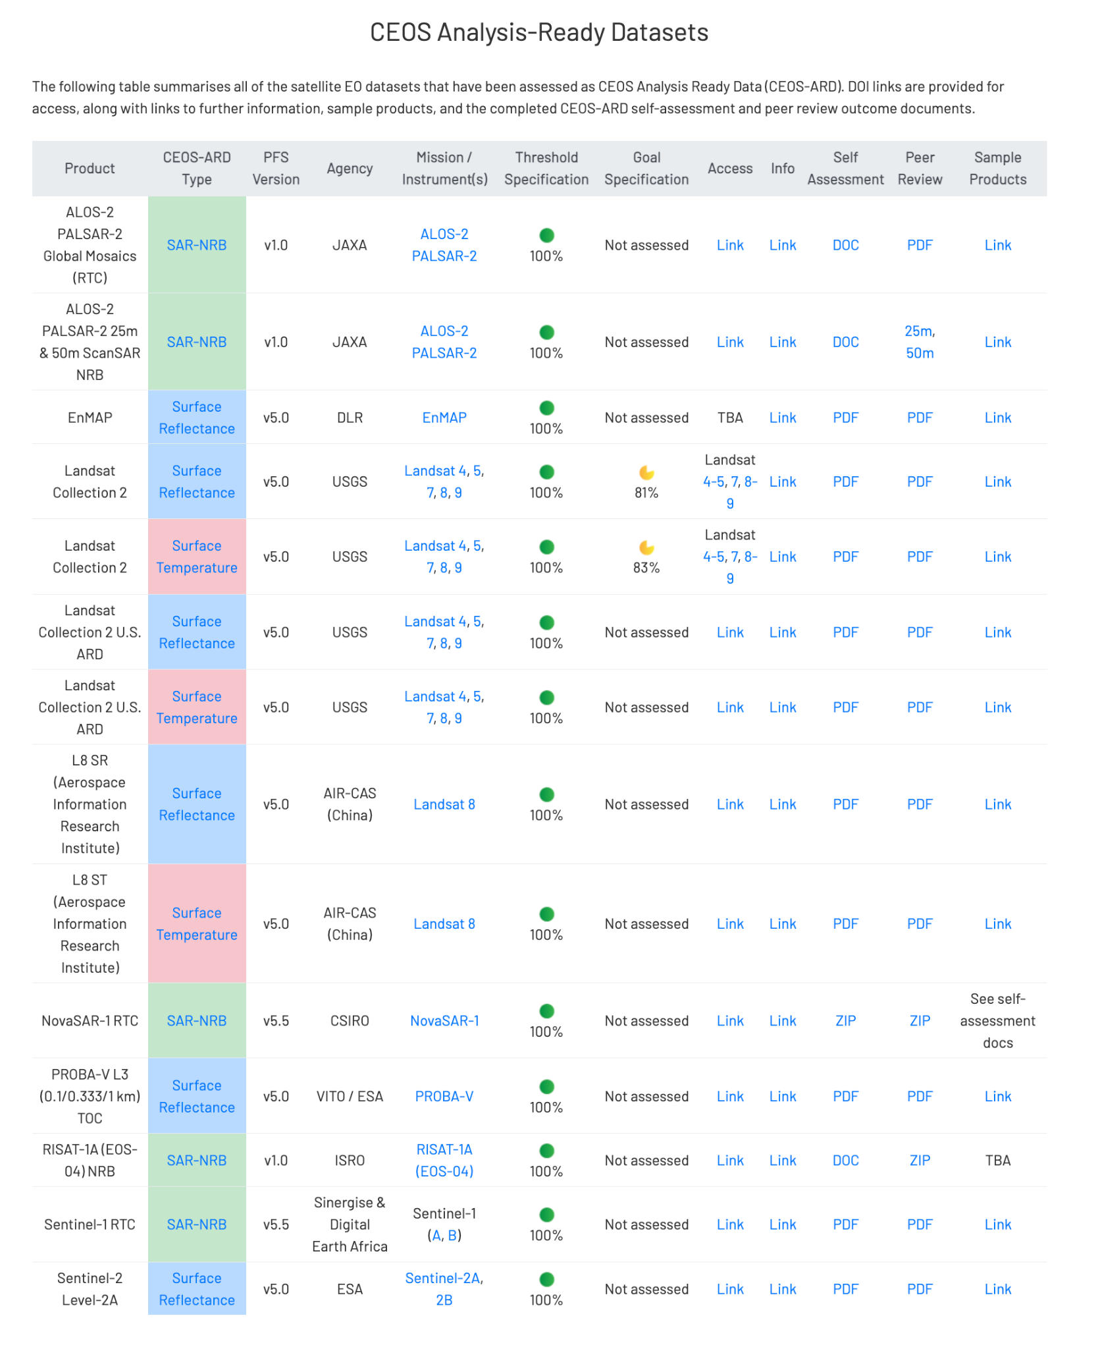
See: ceos.org/ard

Slide 9
How is a product assessed?

Slide 10
CEOS-ARD Assessment
Completed Self-assessment Table
Blank table in the specification
Includes references to metadata, DOIs, methods, etc.
CEOS Working Group on Cal/Val
Peer review
For Threshold – simplified checks
For Target/Goal – Review Panel
Iterative
CEOS-ARD Secretariat
Initial checks
CEOS-ARD
Sample Products
Incl. metadata
More Details
Guide to CEOS-ARD Self-Assessments
ceos.org/ard
CEOS-ARD Framework

Slide 11
CEOS-ARD Strategy 2024
Update to past editions from 2019 and 2021
Reflect on the progress to date, take stock of future directions and needs, and confirm our strategy for the next few years
Lots happening – Strategy captures and organises all of these threads
Covers the ‘what’ and ‘why’ – ‘when’ and ‘how’ to be decided and added to future CEOS Work Plans
A broad portfolio of CEOS-ARD that is easily discovered, accessed and utilised is the ultimate goal.
Link: Draft CEOS-ARD Strategy 2024

Slide 12
CEOS-ARD Strategy 2024
The Strategy activities are categorised into six broad themes:
CEOS-ARD Availability, Product Diversity, and Representation
CEOS-ARD Framework and Specification Advancement
Discovery, Access, Utilisation, and Interoperability
Community Engagement
Research, Test Cases, and Pilot Activities
Commercial Engagement

Slide 13
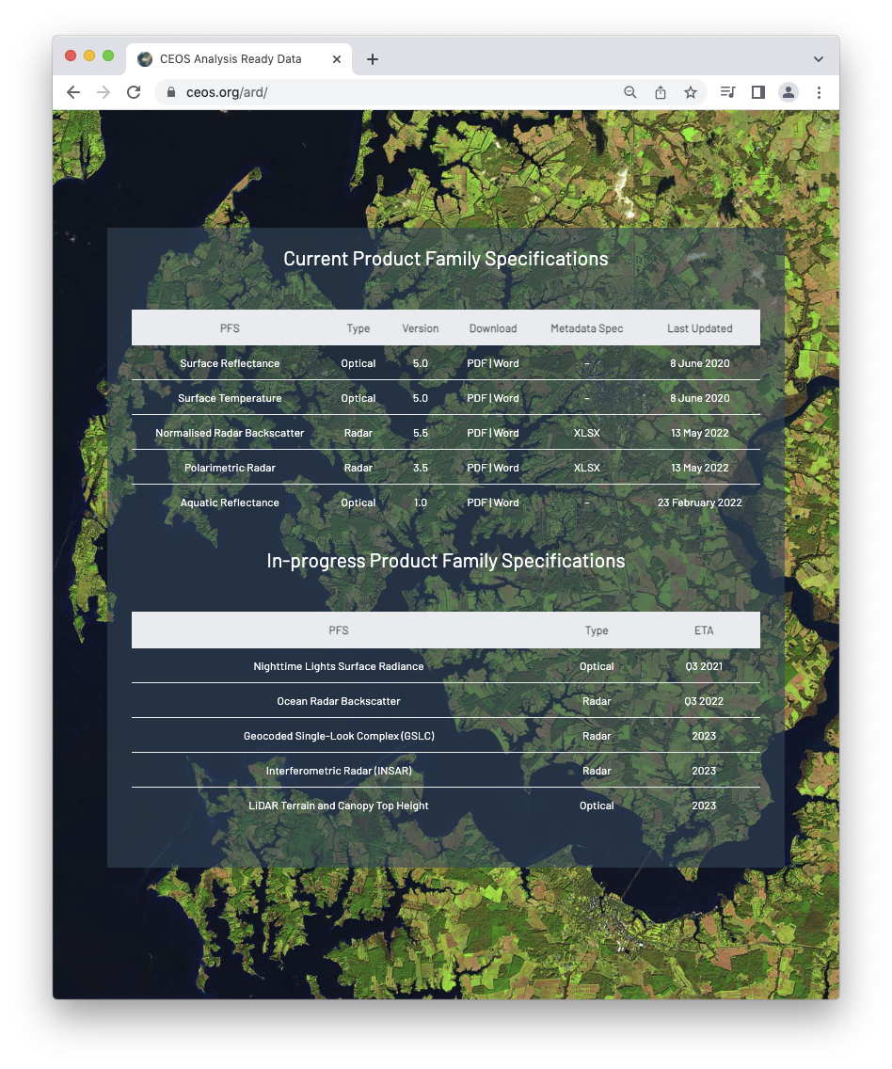
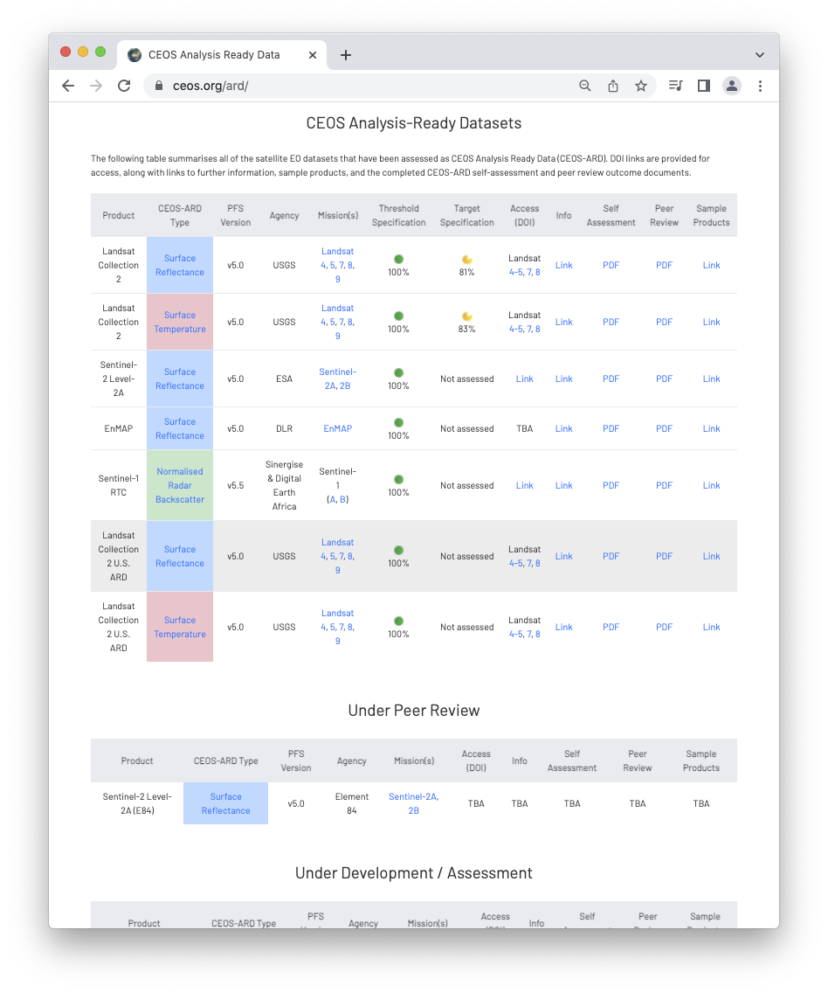
More information
ceos.org/ard
CEOS-ARD GitHub
CEOS-ARD Newsletter Sign-up
Past issues: https://ceos.org/ceos-ard-newsletter/
https://twitter.com/CEOSARD
Contacts:
matthew@symbioscomms.com
ard-contact@lists.ceos.org

Slide 14
Thank you!

