Slide 1

Introduction, Meeting Overview
LSI-VC Co-Leads
LSI-VC-16
23 September 2024

Slide 2
Acknowledgement of Country
We acknowledge the Ngunnawal people as Traditional Custodians of the ACT and recognise any other people or families with connection to the lands of the ACT and region. We acknowledge and respect their continuing culture and the contribution they make to the life of this city and this region.

Slide 3



CEOS Overview
Established in 1984
Comprises the world’s major civil space agencies
34 Members
29 Associate Members
63 Agencies operating 201 satellites
All of whom contribute to CEOS on a ‘best efforts’ and voluntary basis.
https://ceos.org/

Slide 4
LSI-VC
Land Surface Imaging Virtual Constellation (LSI-VC)
Maximise value of CEOS Agency land surface imaging assets and activities
Facilitate coordinated and optimized land surface imaging contributions from CEOS Agencies
Enable access to fundamental measurement products in support of confirmed/validated requirements linked to adopted CEOS priorities.
Land Surface Imaging Virtual Constellation (LSI-VC) Terms of Reference (3 July 2024).
LSI-VC Co-Chairs
Christopher Barnes
U.S. Geological Survey (USGS)
Andreia Siqueira
Geoscience Australia (GA)
Peter Strobl
European Commission Joint Research Centre (EC/JRC)
Takeo Tadono
Japan Aerospace Exploration Agency (JAXA)

Slide 5



















LSI-VC CEOS Agency Members
Non CEOS Members/Associates are also very welcome to join!

Slide 6


LSI-VC Subgroups
Forests and Biomass
GFOI and SDCG Heritage
CEOS AFOLU Roadmap
USGS Silvacarbon
Biomass harmonisation
Agriculture
GEOGLAM heritage and leadership
Essential Agriculture Variables
With WGCV LPV Subgroup:
  Good Practices for Cropland and Crop Type Mapping Validation

Slide 7
LSI-VC-16 Overview
Session with representatives from the Australian EO sector
  Digital Earth Africa
  CSIRO’s Earth Analytics Science and Innovation platform (EASI)
Review ongoing CEOS-ARD assessments and LSI updates
CEOS-ARD Strategy 2024
CEOS Interoperability Framework / Handbook 2.0
Refining CEOS-ARD functional taxonomy/ontology/hierarchy.
CEOS-ARD and Product Family Specification (PFS) Development
  GitHub → define a clear roadmap and timeline & an initial set of implementation practices/guidelines.
Synthetic Aperture Radar ARD updates
Ocean Reflectance PFS
Surface Reflectance Quality, Equivalency and Consistency Project.
Optical PFS consolidation, building blocks approach
GEOGLAM subgroup governance and membership
CEOS AFOLU Roadmap Actions and LSI-VC’s role in tracking implementation
Wetlands and EO
United Nations Convention to Combat Desertification (UNCCD) + OGC GRI SWG

Slide 8
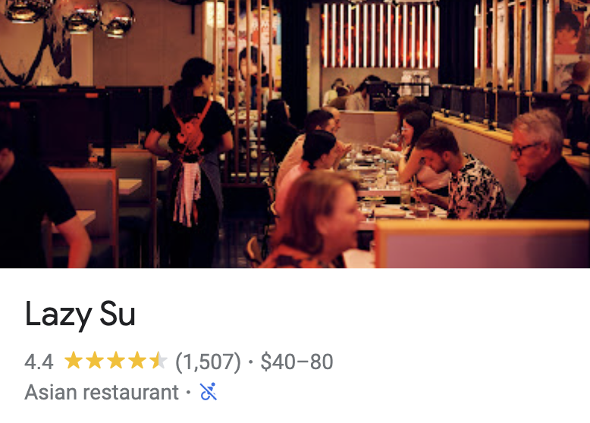
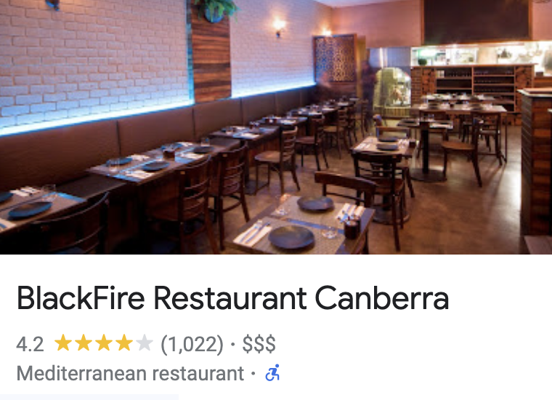
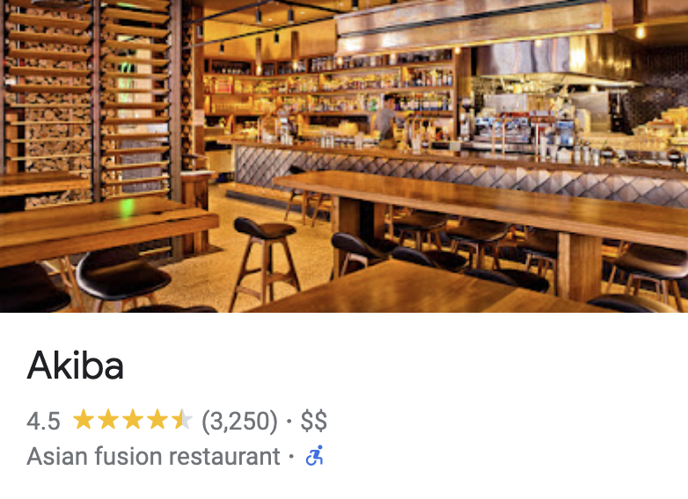

Socials
Links:
Lazy Su
BlackFire
Akiba
Meat & Wine Co.
POLL – Pick 2!

Slide 9
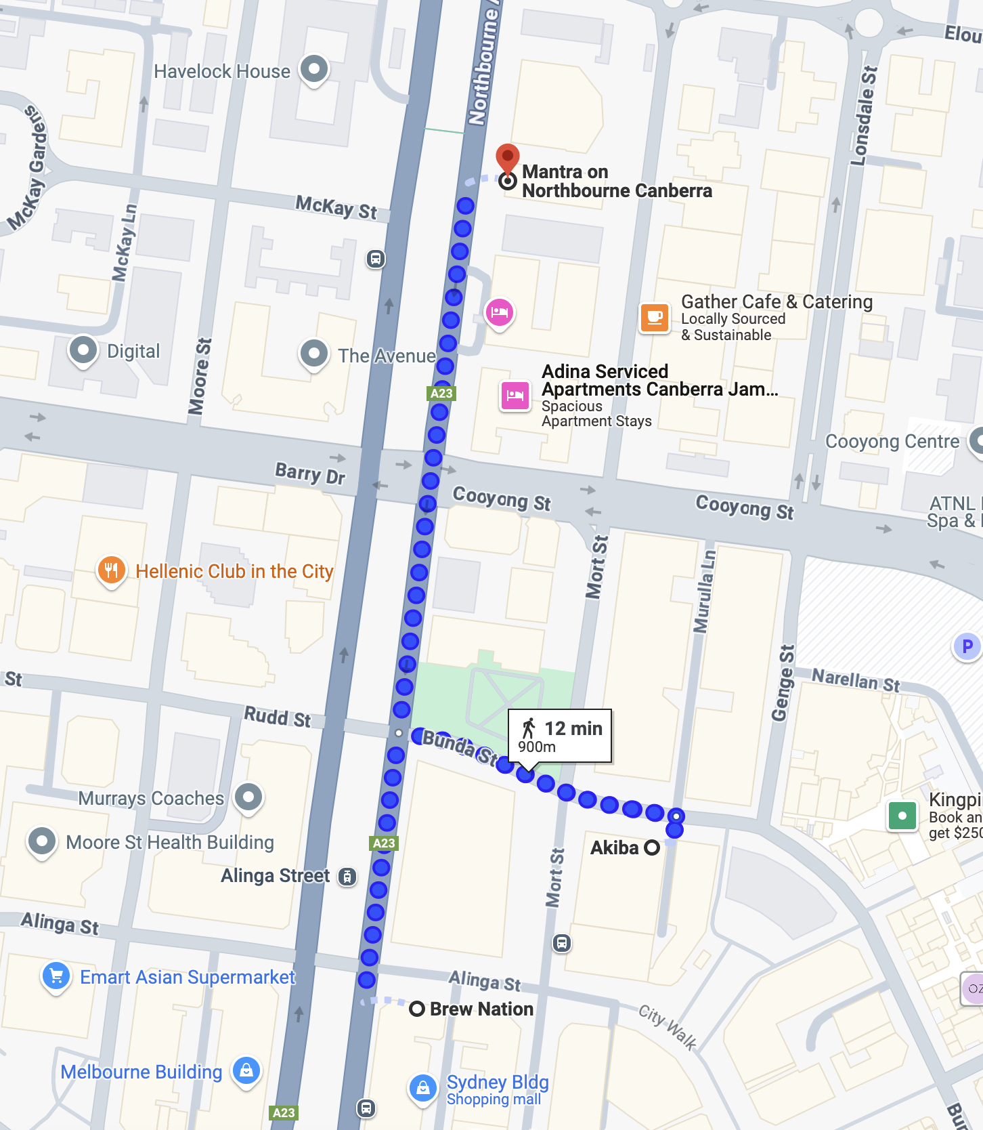
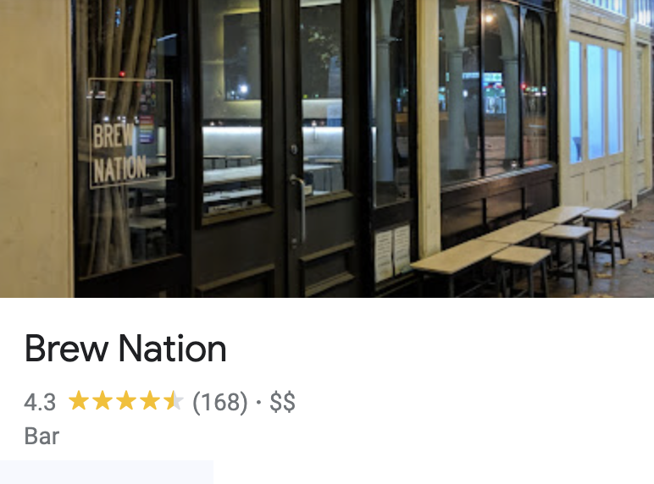
Socials 23 sept
Link
Link

