Slide 1
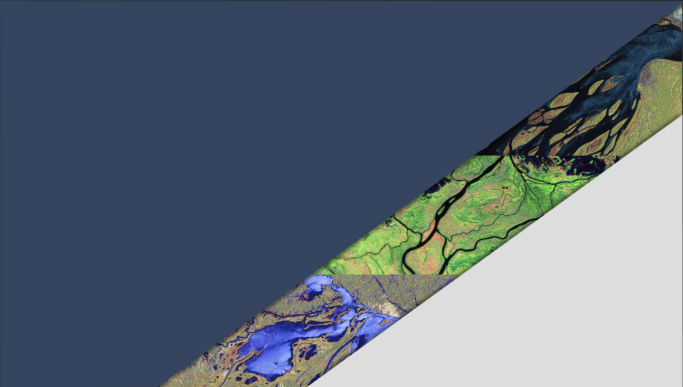

CEOS-ARD for Synthetic Aperture Radar
Ake Rosenqvist^{1,2}, Takeo Tadono², Francois Charbonneau³, Clément Albinet⁴, Bruce Chapman⁵, Danilo Dadamia⁶
Guillaume Hajdush⁷, Josef Kellndorfer⁸, Marco Lavalle⁵,
Tom Logan⁹, Franz Meyer⁹, Nuno Miranda³, Paolo Pasquali¹⁰; Marko Repse¹¹, Hari Priya Sakethapuram¹², Andreia Siqueira¹³; David Small¹⁴, Medhavy Thankappan¹³, John Truckenbrodt¹⁵,
Fang Yuan¹⁶, Howard Zebker¹⁷, Zheng-Shu Zhou¹⁸
1 – soloEO; 2 – JAXA; 3 – NRCan; 4 – ESA; 5 – NASA JPL; 6 – CONAE; 7 – CLS group; 8 – EBD; 9 – ASF; 10 – sarmap;
11 – Sinergise; 12 – ISRO; 13 – Geoscience Australia;
14 – Univ. Zürich; 15 – DLR; 16 – Digital Earth Africa;
17 – Stanford Univ; 18 – CSIRO
LSI-VC-15
Commercial Engagement Session
Tokyo, Japan, April 5, 2024
Notes:
So what is “Analysis Ready Data”?
ARD is a term used widely by satellite data providers nowadays. A common definition is lacking, but it broadly refers to a data product provided at a processing level that accommodates utilisation for the application(s) the data provider in question has in mind. Without coordination however, it follows that while ARD products from one data provider can be expected to be internally consistent, ARD products from different providers most probably cannot. The lack of common standards is a lost opportunity for interoperability
CEOS Analysis-Ready Data for Land, CARD4L, is a joint effort by CEOS to develop a set of well- defined ARD specifications that data providers can opt to include in their suites of satellite data products offered to users. A CARD4L product is defined as “satellite data that have been processed to a minimum set of requirements and organised into a form that allows immediate analysis with a minimum of additional user effort, and provides interoperability both through time and with other datasets” [1].
A specific objective of CARD4L is to broaden the EO user community by provision of data products that do not require expert knowledge to ingest and analyse. This is perhaps particularly relevant for Synthetic Aperture Radar, where the potential to contribute to today’s great environmental challenges with unique information is significant, but with the SAR user community remaining small and expert-oriented even after 25 years of operational SAR missions.

Slide 2
Analysis Ready Data (ARD) &
CEOS Analysis Ready Data (CEOS-ARD)
Why Analysis Ready Data?
Recognition by satellite data providers of the need – and expectations – for Earth Observation (EO) data products that do not require expert knowledge to ingest and analyse.
EO user community:
  Increase in non-expert users
  Move from R&D towards operational applications with requirements for Big Data
Analysis Ready Data (ARD)
  Term frequently used by satellite data providers today but common ARD standard lacking
  No common standards → lost opportunity for interoperability
CEOS Analysis Ready Data (CEOS-ARD)
  Previously referred to as “CARD4L” (CEOS ARD for Land)
  CEOS effort to develop a set of well-defined ARD specifications for key sensor types (optical, SAR, Lidar) which data providers – CEOS organisations and private sector – can opt to include in their suites of satellite data products offered to users.
  Key driver – help broaden the EO user community
Notes:
So what is “Analysis Ready Data”?
ARD is a term used widely by satellite data providers nowadays. A common definition is lacking, but it broadly refers to a data product provided at a processing level that accommodates utilisation for the application(s) the data provider in question has in mind. Without coordination however, it follows that while ARD products from one data provider can be expected to be internally consistent, ARD products from different providers most probably cannot. The lack of common standards is a lost opportunity for interoperability
CEOS Analysis-Ready Data for Land, CARD4L, is a joint effort by CEOS to develop a set of well- defined ARD specifications that data providers can opt to include in their suites of satellite data products offered to users. A CARD4L product is defined as “satellite data that have been processed to a minimum set of requirements and organised into a form that allows immediate analysis with a minimum of additional user effort, and provides interoperability both through time and with other datasets” [1].
A specific objective of CARD4L is to broaden the EO user community by provision of data products that do not require expert knowledge to ingest and analyse. This is perhaps particularly relevant for Synthetic Aperture Radar, where the potential to contribute to today’s great environmental challenges with unique information is significant, but with the SAR user community remaining small and expert-oriented even after 25 years of operational SAR missions.

Slide 3
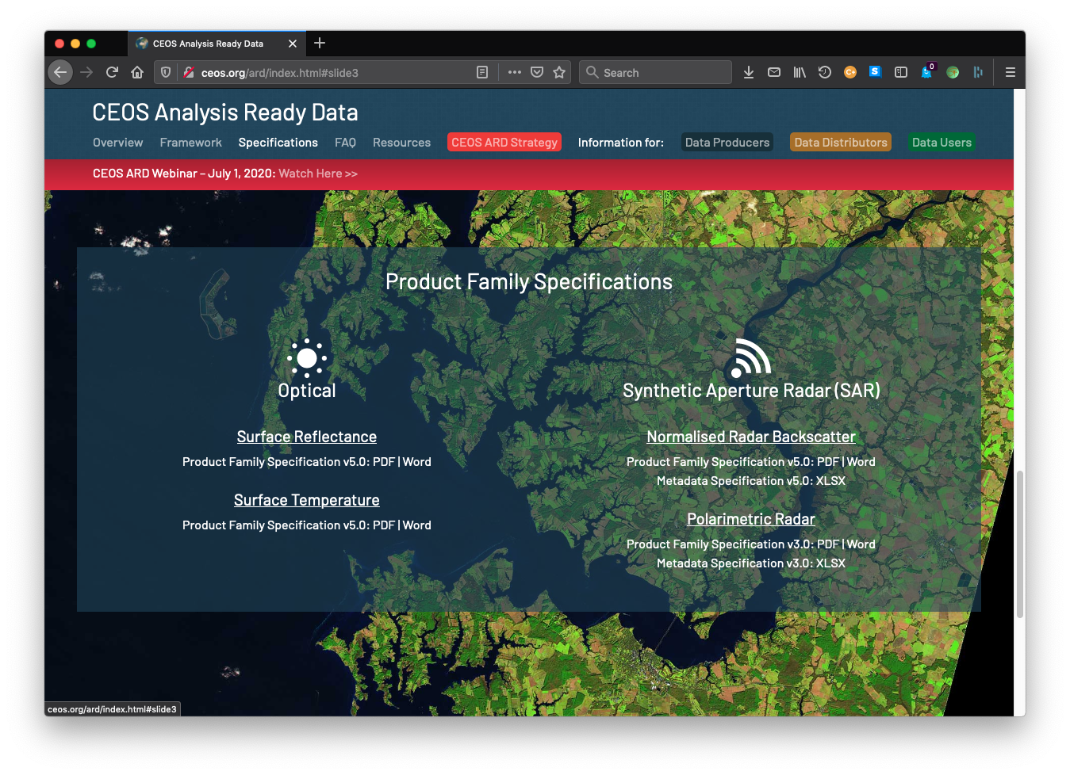

CEOS ARD for SAR
Current status
CEOS ARD specifications for Synthetic Aperture Radar (SAR) products:
Endorsed and available at http://ceos.org/ard
CEOS-ARD for Synthetic Aperture Radar
  Normalised Radar Backscatter (NRB)
  Polarimetric Radar (POL)
  Ocean Radar Backscatter (ORB)
  Geocoded SLC (GSLC)
Surface Reflectance (SR)
Surface Temperature (ST)
Nightlight Radiance (NLSR)
Aquatic Reflectance (AR)
In the pipeline:
Interferometric Radar (INSAR)
Lidar Terrain & Canopy Height

Slide 4

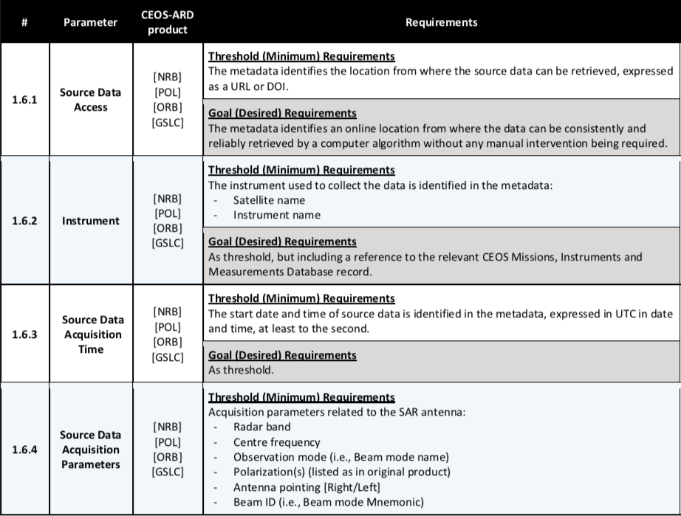
CEOS-ARD for SAR
Specifications for Data Providers
CEOS-ARD specs
(a.k.a. Product Family Specifications – PFS)
“Guidance document” for data providers:
  Geometric corrections
  Radiometric corrections
  General meta (ancillary) data
  Per-pixel (image) meta data
Two levels of requirements
  Threshold (mandatory) requirement
  Goal (optional) requirement
Extract from CEOS-ARD NRB specification document
Notes:
So what do the CARD4L specs look like?
The specification documents - referred to as “Product Family Specifications” – can be seen as guidance documents for Data Providers aiming to develop CARD4L compliant SAR products.
The CARD4L specifications detail 'Threshold’ and 'Target’ requirements for geometric and radiometric corrections, general metadata (such as what is shown to the left), and per-pixel (or image-) metadata,.
In order for a product to be approved as “CARD4L compliant”, all Threshold requirements must be met (for the NRB there are 44 requirements specified). Target requirements are optional for the data provider

Slide 5
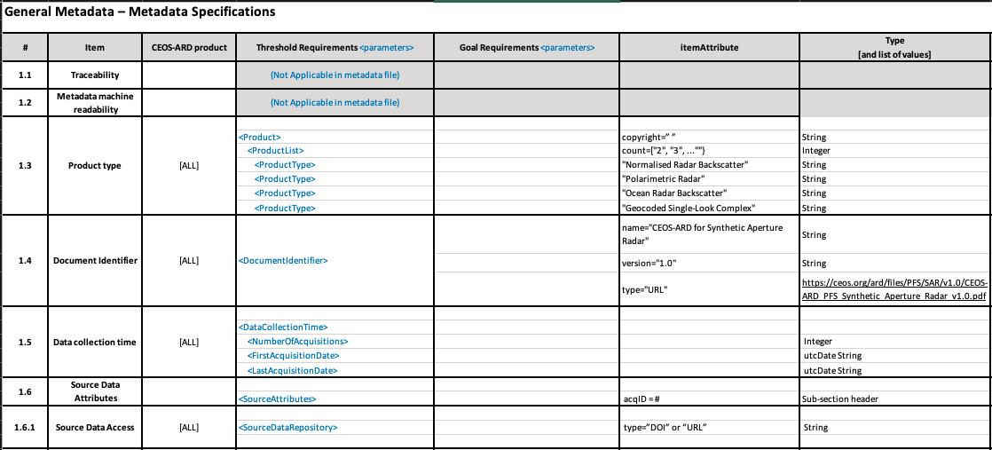
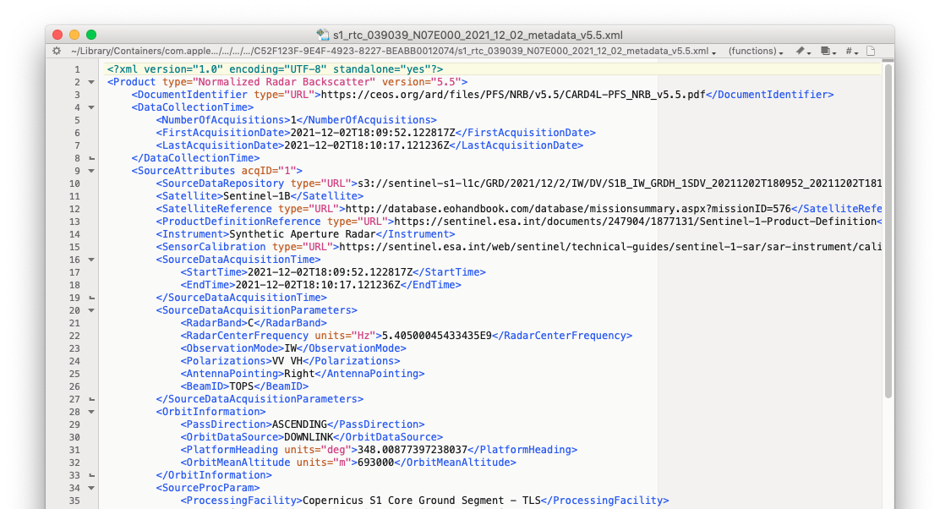
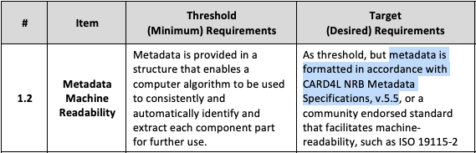
CEOS-ARD for SAR
Metadata
Metadata Specifications
Metadata specification developed to accompany each Radar PSF
Consistent mapping of parameter names between PFS and metadata
Specs for XML format but data provider may select other metadata formats (yaml, json, etc.)
Non-mandatory (Goal req.), yet broad uptake by SAR agencies
Extract from XML metadata file for a POL CARD4L product

Slide 6
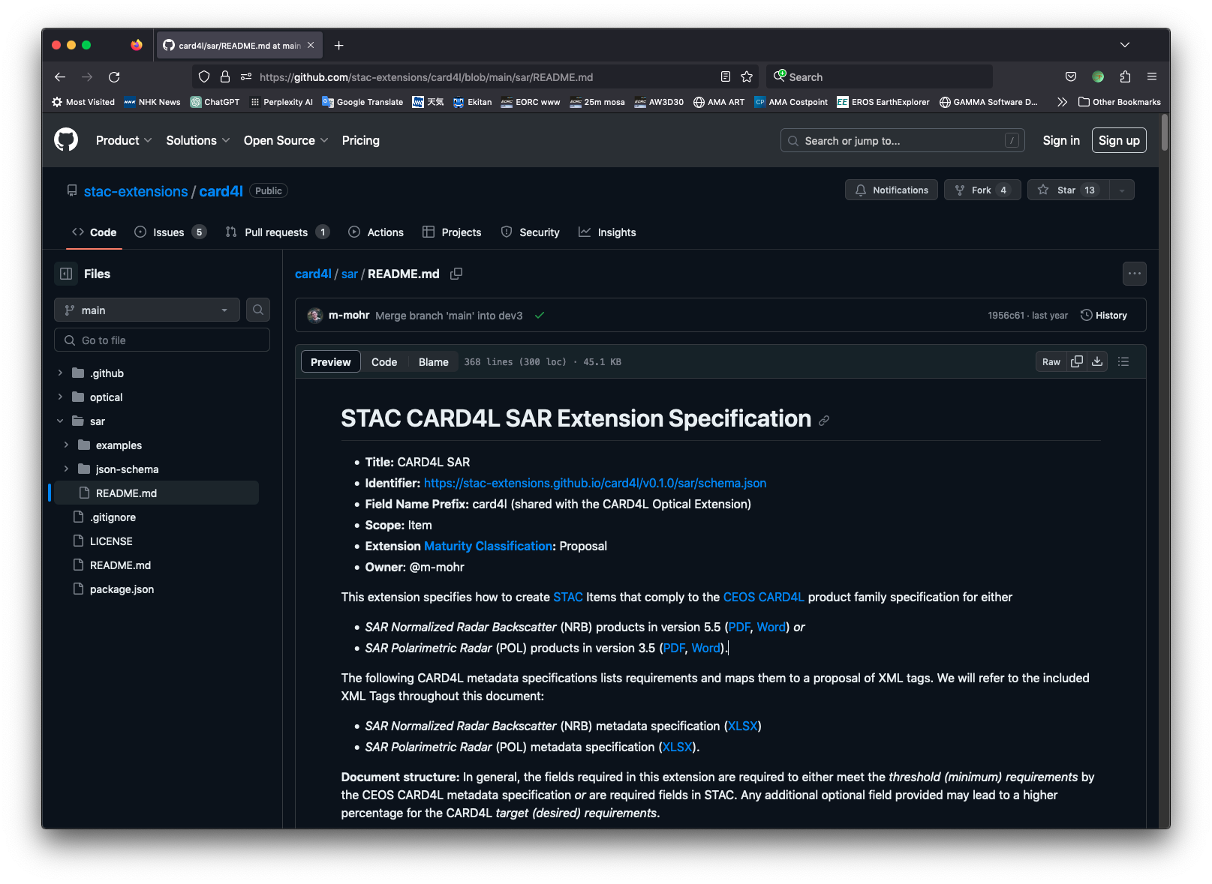
STAC CARD4L SAR Extension
STAC extensions
Developed in 2021 for optical and SAR (NRB & POL) PFSs
Name change: CARD4L → CEOS-ARD
Major revision in 2024

Slide 7
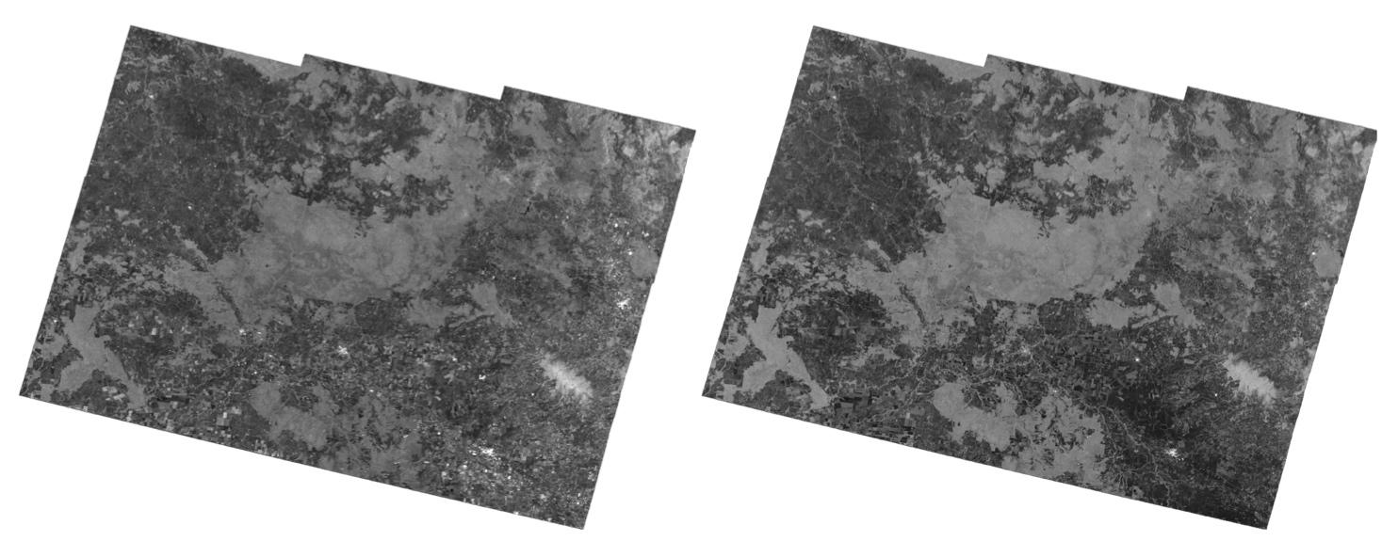
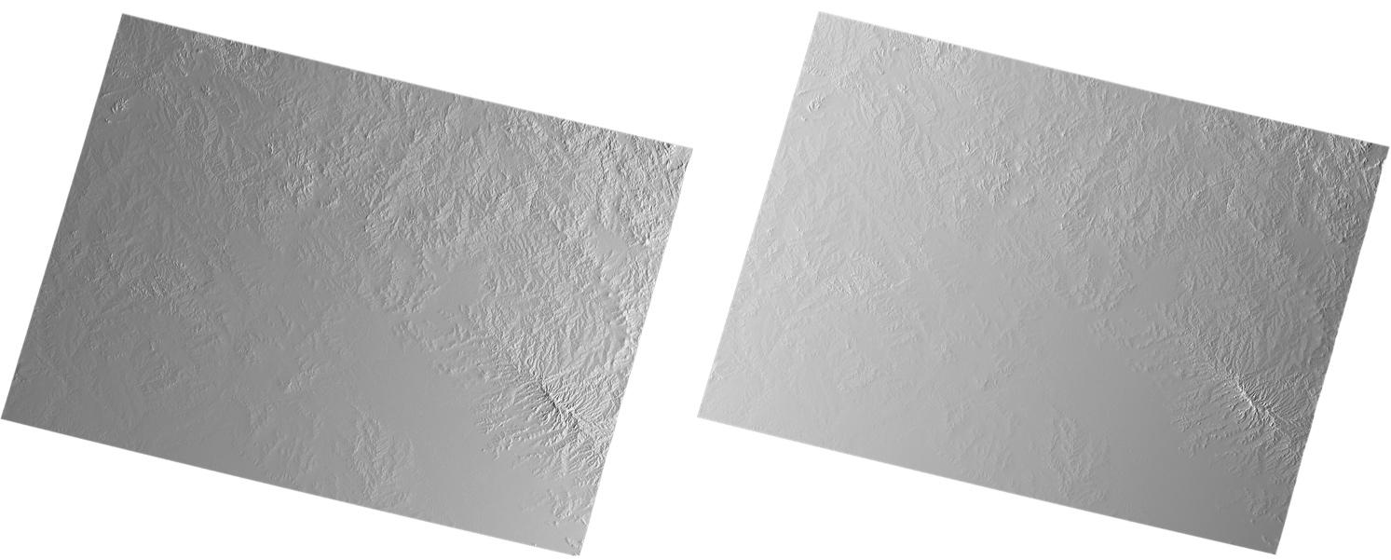

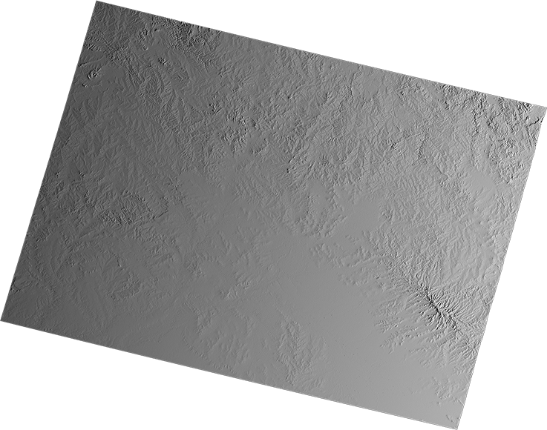
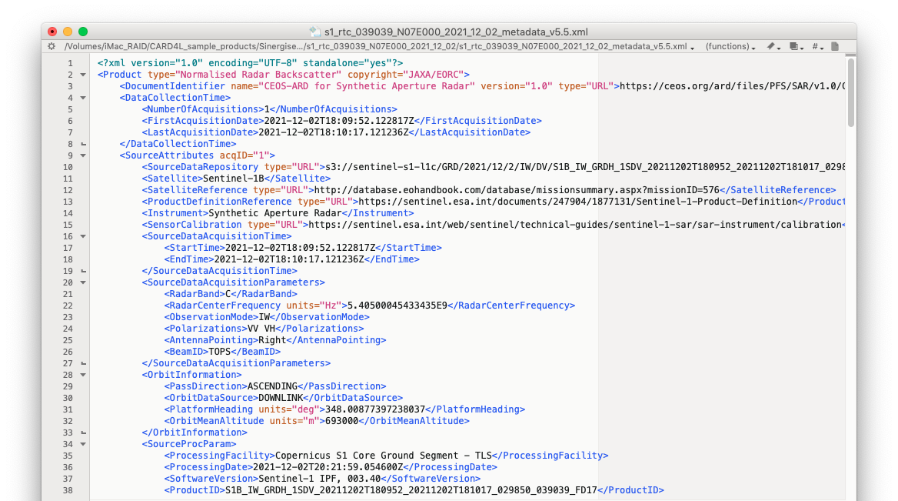



CEOS-ARD for SAR
General PFS structure
1. Radar Measurements
Radiometric and Geometric specs
2. Per-Pixel Metadata (image data)
Local Inc Angle (Target)
Scattering Area (Goal)
3. General Metadata
Data Mask (Target)
Sigma-to-Gamma ratio (Goal)
Sentinel-1 (Copernicus)
Processing:
Z-S Zhou, CSIRO
Noise Power (Goal)
Ellipsoid Inc Angle (Goal)

Slide 8
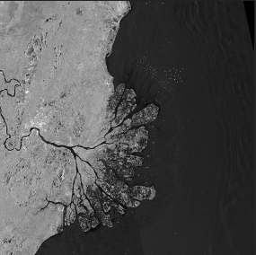
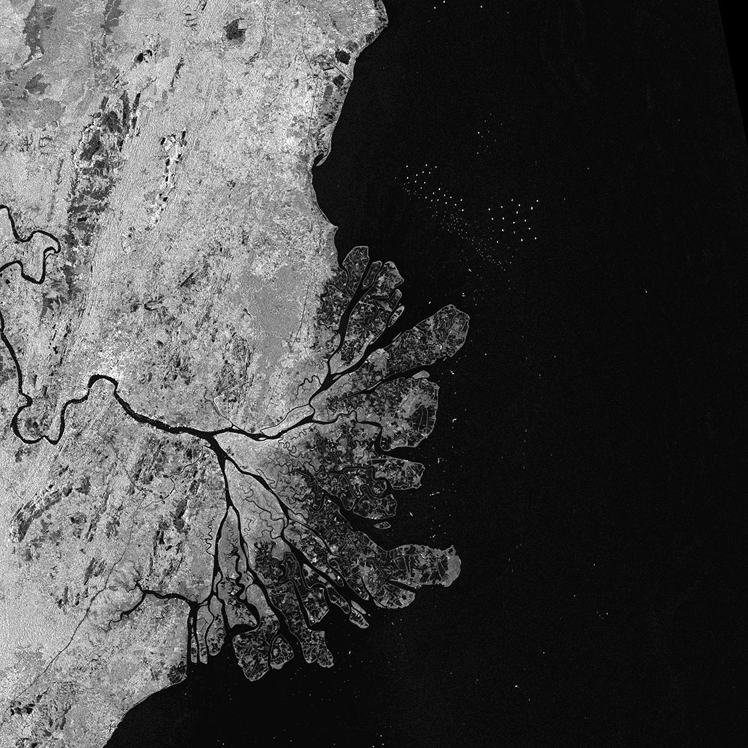
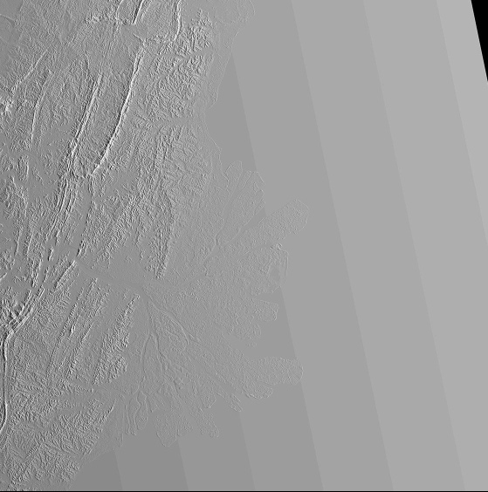

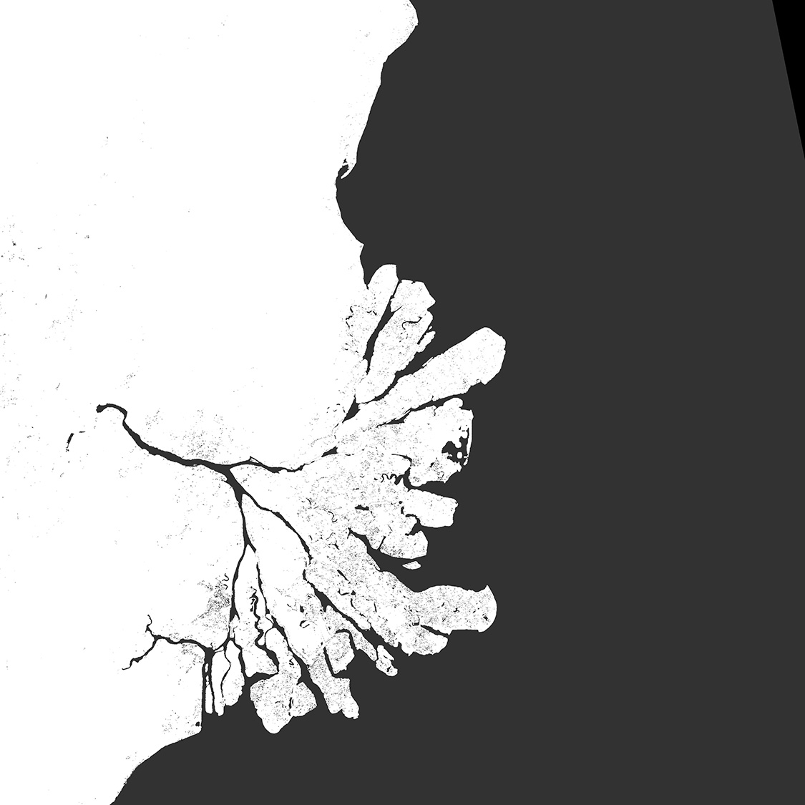
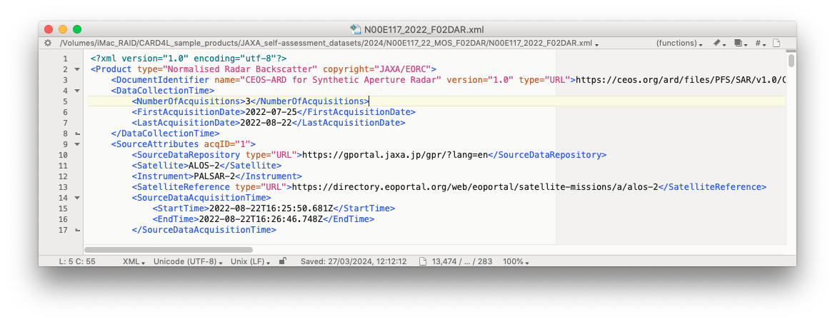
CEOS-ARD for SAR
Normalised Radar Backscatter (NRB)
CEOS-ARD NRB
Radar Measurement data:
  Geometric Terrain Correction (ortho)
  Radiometric Slope Correction
  Backscatter expressed as gamma-nought, γ⁰
Per-pixel metadata:
  Threshold (required):
    Local Incidence Angle image
    Mask image
    Acquisition ID image (for composite products)
  Goal (optional):
    Scattering Area image
    Gamma-to-Sigma ratio image
    Ellipsoid Inc. Angle image
    Noise power image (if applied)
    Per-pixel DEM
General metadata:
  Detailed specs about source data and (CEOS-ARD) product (44 entries).
  Metadata XML format spec provided (Target)
γ⁰ Backscatter (HH)
γ⁰ Backscatter (HV)
ALOS-2 PALSAR-2
(Global mosaic)
Processing: JAXA EORC
Local Inc. Angle
Acquisition ID
Data Mask
Notes:
Polarimetric Radar (POL) – objective to make radar polarimetry accessible
to enable users to explore
CARD4L POL covers two product types:
The first one is Polarimetric Decomposition product – which is comparable to the standard backscatter product, but where the polarimetric information has been enhanced – for instance to separate different scattering mechanisms from each other – by the use of various decomposition techniques. Which decompositions to include is not prescribed in the CARD4L specification, but for Data Providers to decide. which ones to offer to users (e.g. Eigen value; Pauli, Freeman-D; Yamaguchi, etc.)
The second POL product is the Polarimetric Covariance Matrix, which is a set of complex images from which the full polarimetric phase and amplitude can be derived. It is for a bit more advanced users, and can be applied for e.g. polarimetric time-series analysis and Pol-InSAR applications
The CARD4L POL structure is based on NRB, with similar requirements for geometric and radiometric accuracy, and general and per-pixel metadata.

Slide 9
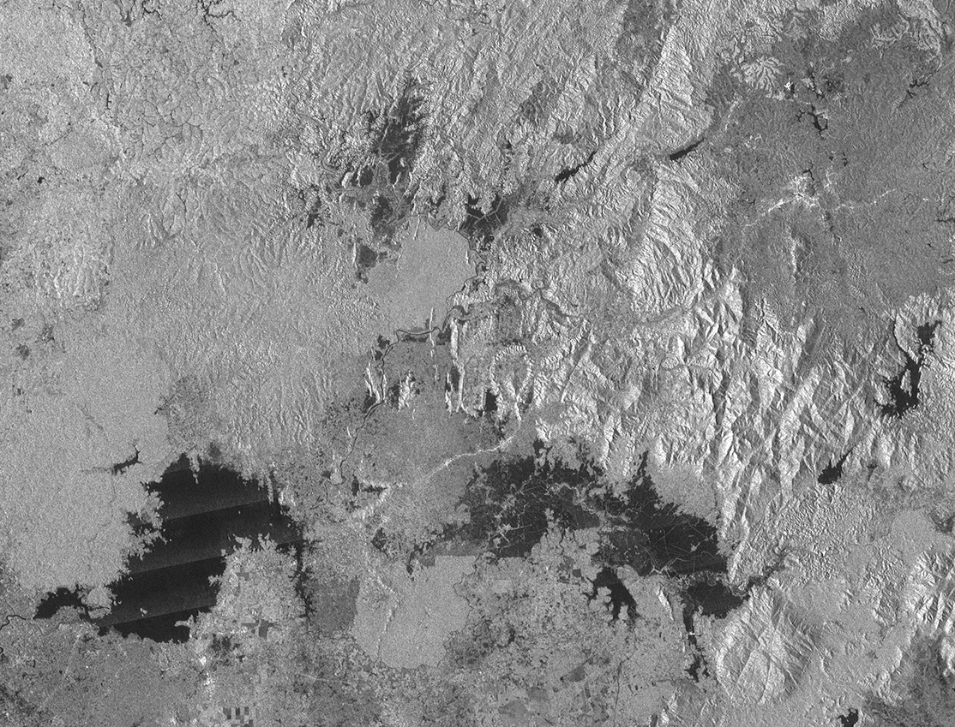
CEOS-ARD / SAR
Normalised Radar Backscatter (NRB)
Standard level data (ascending pass)
Geometric Terrain Correction (ortho-rectified)
Notes:
Polarimetric Radar (POL) – objective to make radar polarimetry accessible
to enable users to explore
CARD4L POL covers two product types:
The first one is Polarimetric Decomposition product – which is comparable to the standard backscatter product, but where the polarimetric information has been enhanced – for instance to separate different scattering mechanisms from each other – by the use of various decomposition techniques. Which decompositions to include is not prescribed in the CARD4L specification, but for Data Providers to decide. which ones to offer to users (e.g. Eigen value; Pauli, Freeman-D; Yamaguchi, etc.)
The second POL product is the Polarimetric Covariance Matrix, which is a set of complex images from which the full polarimetric phase and amplitude can be derived. It is for a bit more advanced users, and can be applied for e.g. polarimetric time-series analysis and Pol-InSAR applications
The CARD4L POL structure is based on NRB, with similar requirements for geometric and radiometric accuracy, and general and per-pixel metadata.

Slide 10
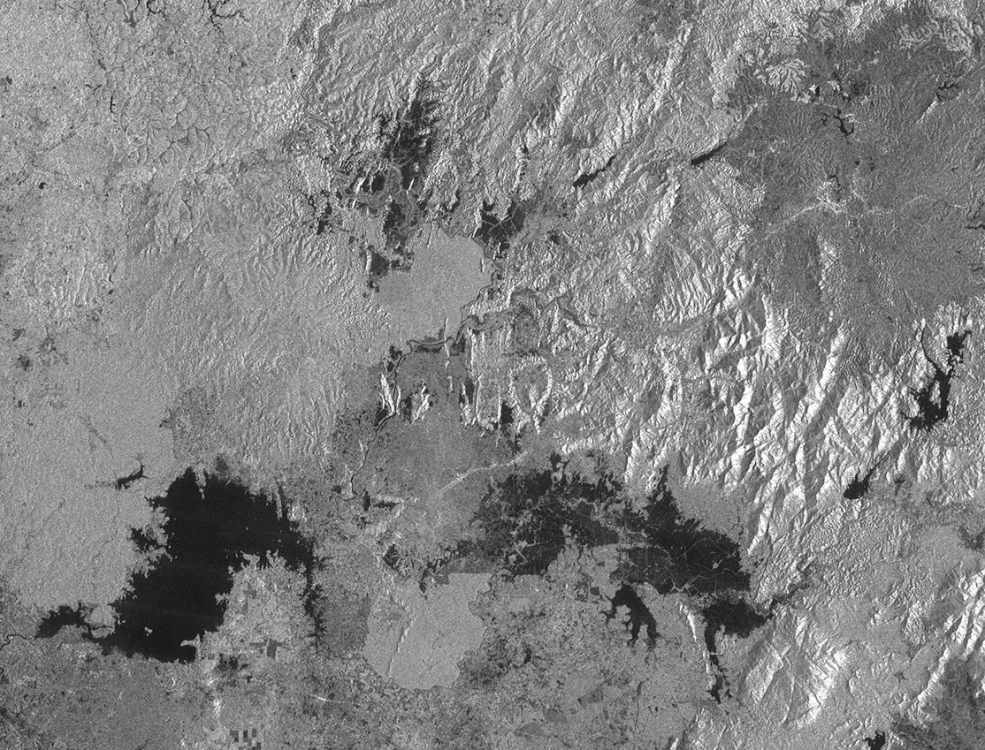
CEOS-ARD / SAR
Normalised Radar Backscatter (NRB)
Standard level data (descending pass)
Geometric Terrain Correction (ortho-rectified)
Notes:
Polarimetric Radar (POL) – objective to make radar polarimetry accessible
to enable users to explore
CARD4L POL covers two product types:
The first one is Polarimetric Decomposition product – which is comparable to the standard backscatter product, but where the polarimetric information has been enhanced – for instance to separate different scattering mechanisms from each other – by the use of various decomposition techniques. Which decompositions to include is not prescribed in the CARD4L specification, but for Data Providers to decide. which ones to offer to users (e.g. Eigen value; Pauli, Freeman-D; Yamaguchi, etc.)
The second POL product is the Polarimetric Covariance Matrix, which is a set of complex images from which the full polarimetric phase and amplitude can be derived. It is for a bit more advanced users, and can be applied for e.g. polarimetric time-series analysis and Pol-InSAR applications
The CARD4L POL structure is based on NRB, with similar requirements for geometric and radiometric accuracy, and general and per-pixel metadata.

Slide 11
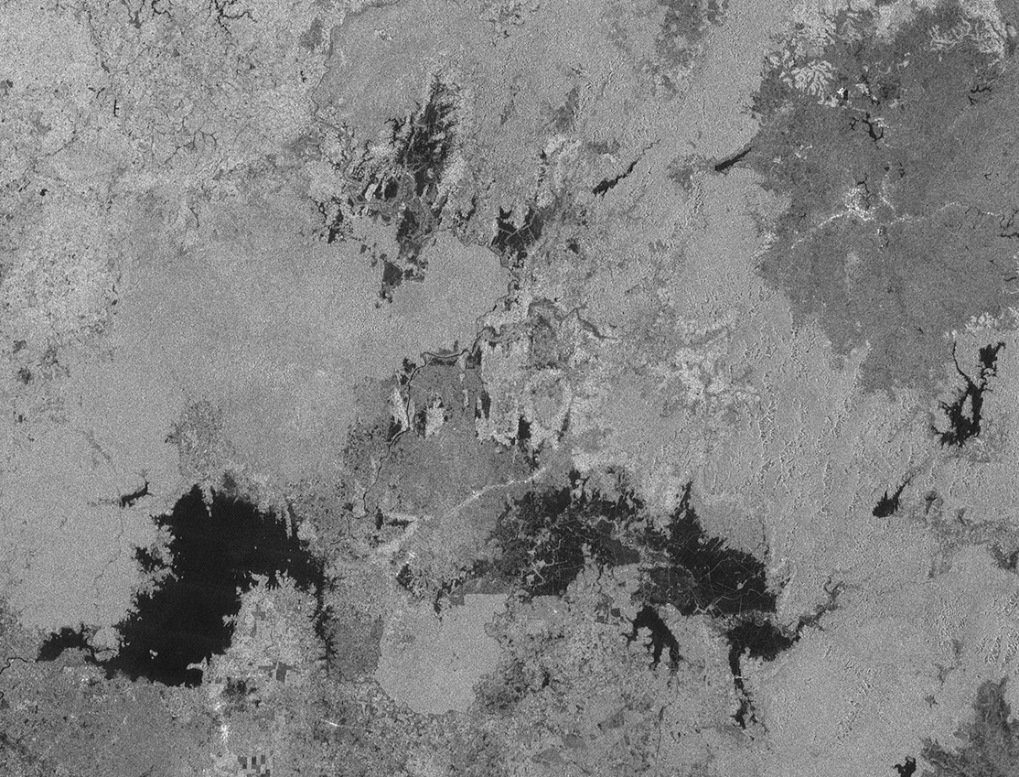
CEOS-ARD / SAR
Normalised Radar Backscatter (NRB)
CEOS Analysis Ready Data (desc)
Geometric Terrain Correction (ortho-rectified)
Radiometric Terrain Correction (RTC) applied
Notes:
Polarimetric Radar (POL) – objective to make radar polarimetry accessible
to enable users to explore
CARD4L POL covers two product types:
The first one is Polarimetric Decomposition product – which is comparable to the standard backscatter product, but where the polarimetric information has been enhanced – for instance to separate different scattering mechanisms from each other – by the use of various decomposition techniques. Which decompositions to include is not prescribed in the CARD4L specification, but for Data Providers to decide. which ones to offer to users (e.g. Eigen value; Pauli, Freeman-D; Yamaguchi, etc.)
The second POL product is the Polarimetric Covariance Matrix, which is a set of complex images from which the full polarimetric phase and amplitude can be derived. It is for a bit more advanced users, and can be applied for e.g. polarimetric time-series analysis and Pol-InSAR applications
The CARD4L POL structure is based on NRB, with similar requirements for geometric and radiometric accuracy, and general and per-pixel metadata.

Slide 12
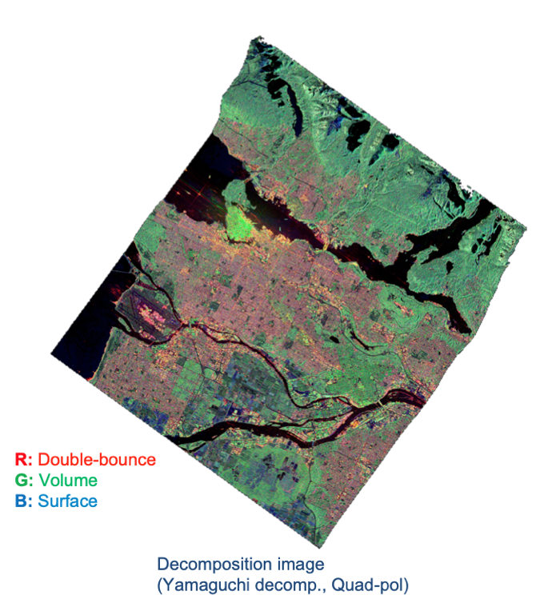
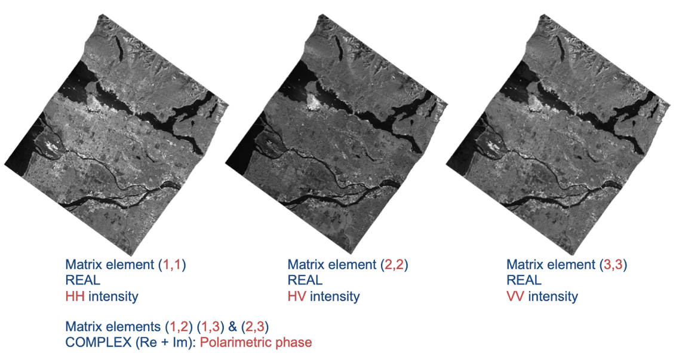
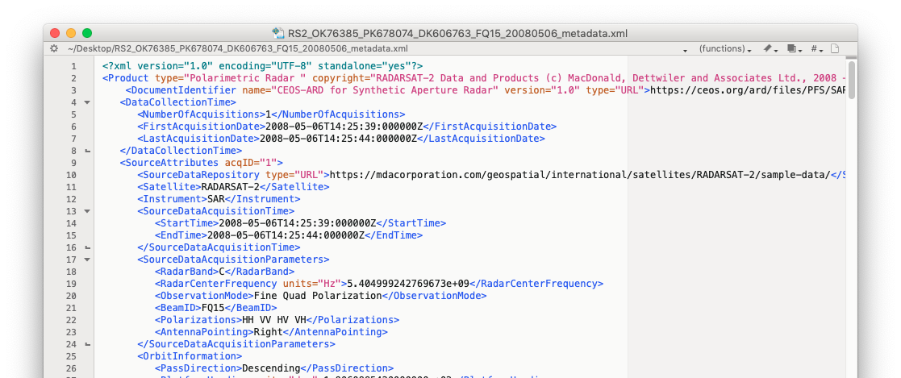
CEOS-ARD for SAR
Polarimetric Radar (POL)
CEOS-ARD Polarimetric Radar [POL]
  General Metadata, Per-pixel Metadata, Geometric & Radiometric corrections near-identical to NRB
POL Measurement Data covers two product types:
  Polarimetric Decomposition
    Data Providers to decide what decompositions to offer to users (e.g. Eigen value; Pauli, Freeman-D; Yamaguchi, etc.)
  Polarimetric Covariance Matrix
    Polarimetric phase and amplitude preserved
    For polarimetric time-series and Pol-InSAR applications
RADARSAT-2 (MDA) Processing: F. Charbonneau (NRCan)
12
Notes:
Polarimetric Radar (POL) – objective to make radar polarimetry accessible
to enable users to explore
CARD4L POL covers two product types:
The first one is Polarimetric Decomposition product – which is comparable to the standard backscatter product, but where the polarimetric information has been enhanced – for instance to separate different scattering mechanisms from each other – by the use of various decomposition techniques. Which decompositions to include is not prescribed in the CARD4L specification, but for Data Providers to decide. which ones to offer to users (e.g. Eigen value; Pauli, Freeman-D; Yamaguchi, etc.)
The second POL product is the Polarimetric Covariance Matrix, which is a set of complex images from which the full polarimetric phase and amplitude can be derived. It is for a bit more advanced users, and can be applied for e.g. polarimetric time-series analysis and Pol-InSAR applications
The CARD4L POL structure is based on NRB, with similar requirements for geometric and radiometric accuracy, and general and per-pixel metadata.

Slide 13
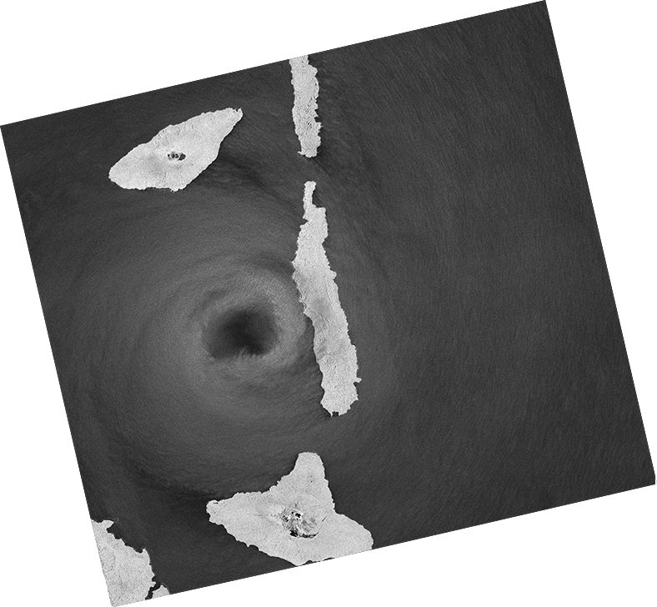

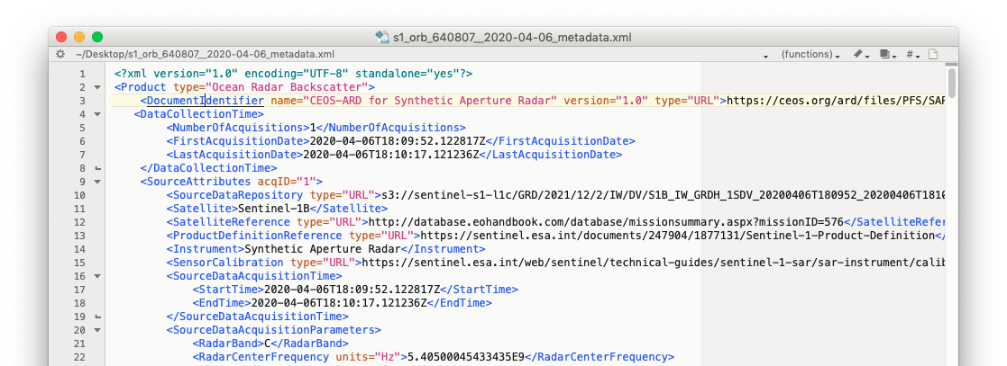
CEOS-ARD for SAR
Ocean Radar Backscatter (ORB)
CEOS-ARD ORB – Simplified version of the NRB product for ocean applications
Radar Measurement data:
  Geoid-corrected backscatter
  Expressed as σ⁰
Per-pixel metadata:
  Threshold (required):
    Geoid Incidence Angle image
    Mask image (including land mask)
    Acquisition ID image (for composite products)
  Target (desired):
    Noise power image (if applied)
    Per-pixel Geoid
    Look Direction image
σ⁰ Backscatter (VV)
σ⁰ Backscatter (VH)
Data Mask image
Geoid Inc. Angle image
Sentinel-1 IWS CEOS-ARD ORB (mock-up) (Processing: soloEO)
Notes:
Polarimetric Radar (POL) – objective to make radar polarimetry accessible
to enable users to explore
CARD4L POL covers two product types:
The first one is Polarimetric Decomposition product – which is comparable to the standard backscatter product, but where the polarimetric information has been enhanced – for instance to separate different scattering mechanisms from each other – by the use of various decomposition techniques. Which decompositions to include is not prescribed in the CARD4L specification, but for Data Providers to decide. which ones to offer to users (e.g. Eigen value; Pauli, Freeman-D; Yamaguchi, etc.)
The second POL product is the Polarimetric Covariance Matrix, which is a set of complex images from which the full polarimetric phase and amplitude can be derived. It is for a bit more advanced users, and can be applied for e.g. polarimetric time-series analysis and Pol-InSAR applications
The CARD4L POL structure is based on NRB, with similar requirements for geometric and radiometric accuracy, and general and per-pixel metadata.

Slide 14
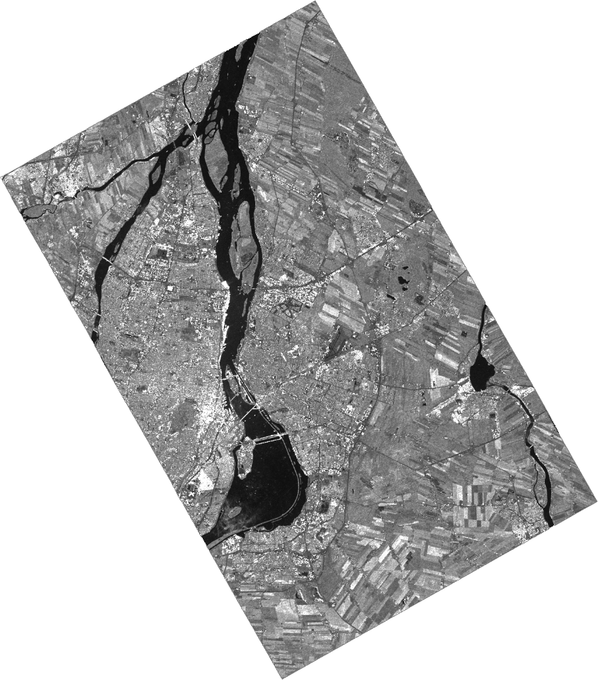
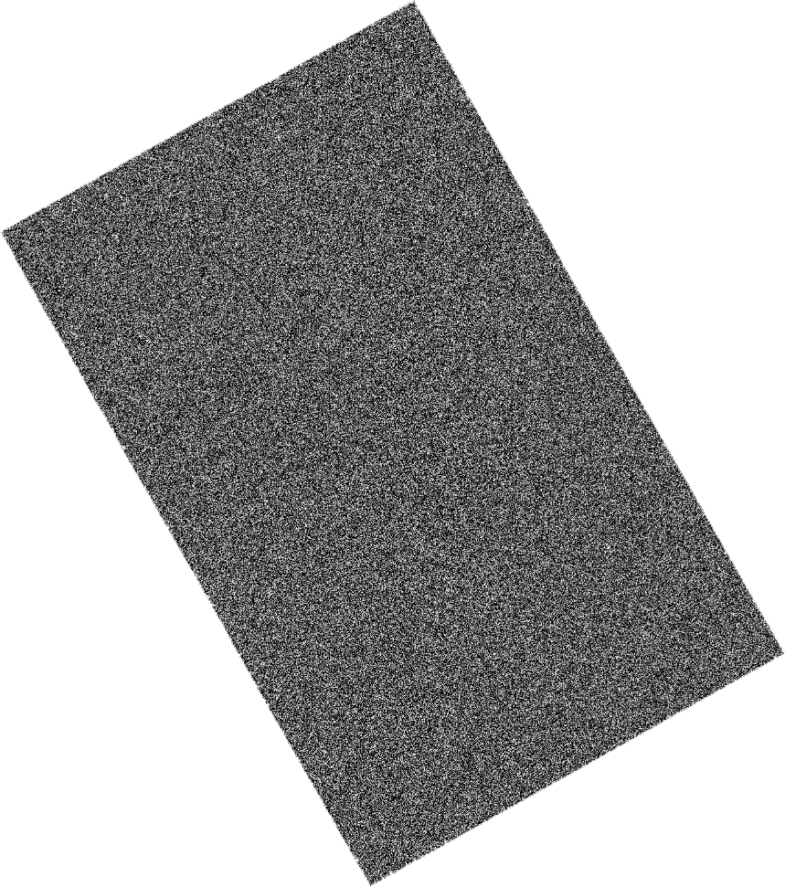
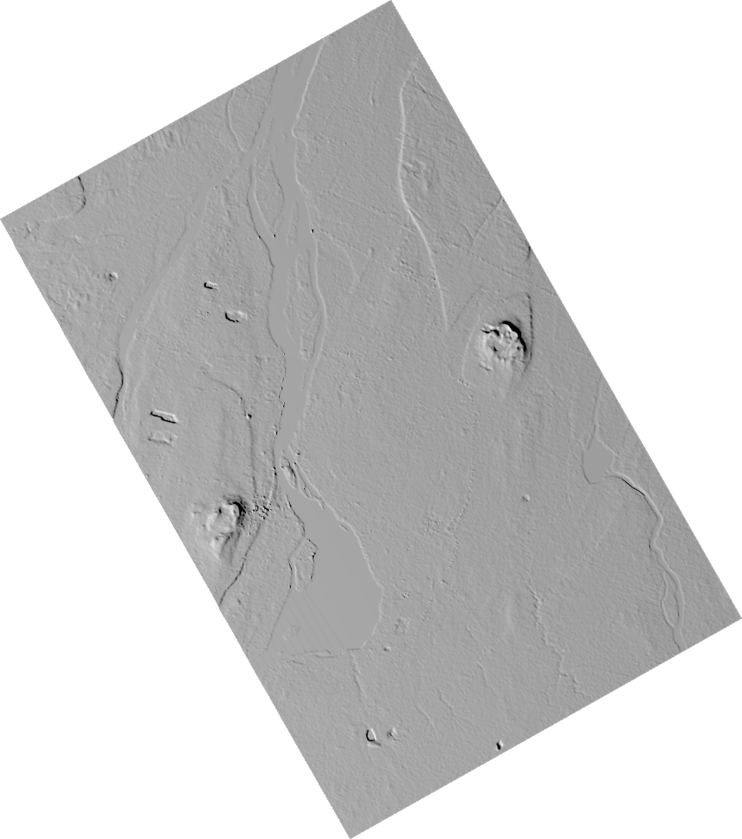

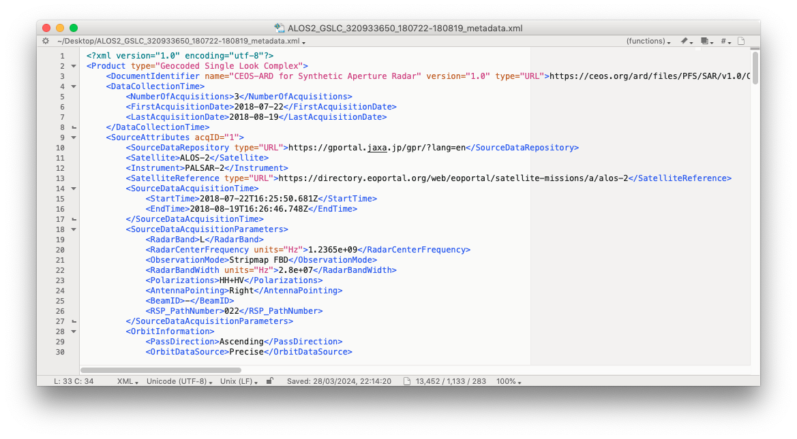
CEOS-ARD for SAR
Geocoded SLC (GSLC)
CEOS-ARD Geocoded Single-Look Complex [GSLC]
Radar Measurement data:
  Backscatter in complex format (I+Q) from which both amplitude and phase can be derived
  Radiometry: Radiometric slope correction, expressed as γ⁰
  Geometry:
    Ground-based map projection (i.e. not slant range)
    Corrected relative to a common reference orbit → Co-registered GSLC images in a stack have same geometry → interferometric applications feasible by simple image math
Per-pixel metadata (Threshold):
  Local Incidence Angle image
  Mask image
  Acquisition ID image (for composite products)
Complex backscatter (γ⁰ )
InSAR phase
Gamma-to-Sigma ratio image
Radar Unit Look Vector Grid image
RCM1 ©CSA Proc. F. Charbonneau, NRCan
14
Notes:
Single Look Complex (SLC) is the standard Level-1 SAR image product. It comprises information about the amplitude and phase of the received radar energy, provided as a complex number.
SLC are given in slant range geometry and require additional processing software and a fair amount of radar expert knowledge to be used.
The CARD4L GSLC product on the other hand, is an enhanced pre-processed version of the SLC, that describes the complex radar signal at each point on the ground surface with all average propagational phases removed, so that the amplitude and phase values represent properties of the ground surface, without influence by the radar instrument
CARD4L GSLC products are presented in a common geographical coordinate system – such as e.g. UTM - rather than in slant range radar coordinates, to facilitate use by non-radar-specialists
The CARD4L GSLC product specification is still under development and we expect it to be completed within the next few months.

Slide 15
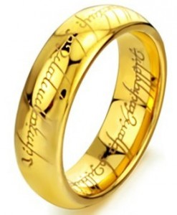
CEOS-ARD for SAR
One PFS to Rule Them All
CEOS ARD for Synthetic Aperture Radar (CARD4SAR) PFS
Single specification document for all CEOS-ARD SAR products:
  NRB, POL, ORB, GLSC
Goals:
  Ensuring consistent parameter names and specifications across all SAR PFSs
  Simplifying revisions and change tracking
  Maintains PFS clarity and readability while describing multiple products
  No changes to (Threshold) specifications for endorsed PFSs
The CEOS-ARD for SAR product specification was endorsed and released in October 2023
15
Notes:
CARD4L INSAR product specifies a suite of three products generated by InSAR processing of two observations of the same geographic area at different times:
Wrapped interferogram is an image showing the differential phase signals between the two complex images. The signal is ‘wrapped’ in quantities of 2*πι radians, giving an image with ‘fringes’.
The Unwrapped interferogram is an image where the wrapped fringes have been added up to give a continuous phase signal across the image. There are different approaches to do this unwrapping and CARD4L does not prescribe which methods to use.
Interferometric coherence is an image of phase coherence between two SLC images.
The CARD4L INSAR product specification also is still under development, and expected to be completed in the second half of 2021

Slide 16
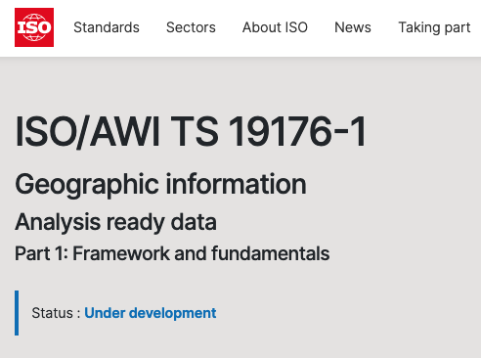
CEOS-ARD
Towards formal standardisation
Development of joint ISO-OGC standards
CEOS-ARD Product Family Specifications are not formal standards.
CEOS has been exploring the idea of formal standardisation of the concepts that make up CEOS-ARD to achieve broad uptake, particularly by the commercial sector.
Defining ARD through international standard bodies will also help promote the ARD concept and help avoid the divergence that can be caused by various groups working towards different interpretations of ARD.
OGC ARD standard working group (ARD-SWG) established in May 2023 to develop joint ISO-OGC standards on geospatial ARD – 19176-6.
16
Notes:
CARD4L INSAR product specifies a suite of three products generated by InSAR processing of two observations of the same geographic area at different times:
Wrapped interferogram is an image showing the differential phase signals between the two complex images. The signal is ‘wrapped’ in quantities of 2*πι radians, giving an image with ‘fringes’.
The Unwrapped interferogram is an image where the wrapped fringes have been added up to give a continuous phase signal across the image. There are different approaches to do this unwrapping and CARD4L does not prescribe which methods to use.
Interferometric coherence is an image of phase coherence between two SLC images.
The CARD4L INSAR product specification also is still under development, and expected to be completed in the second half of 2021

Slide 17
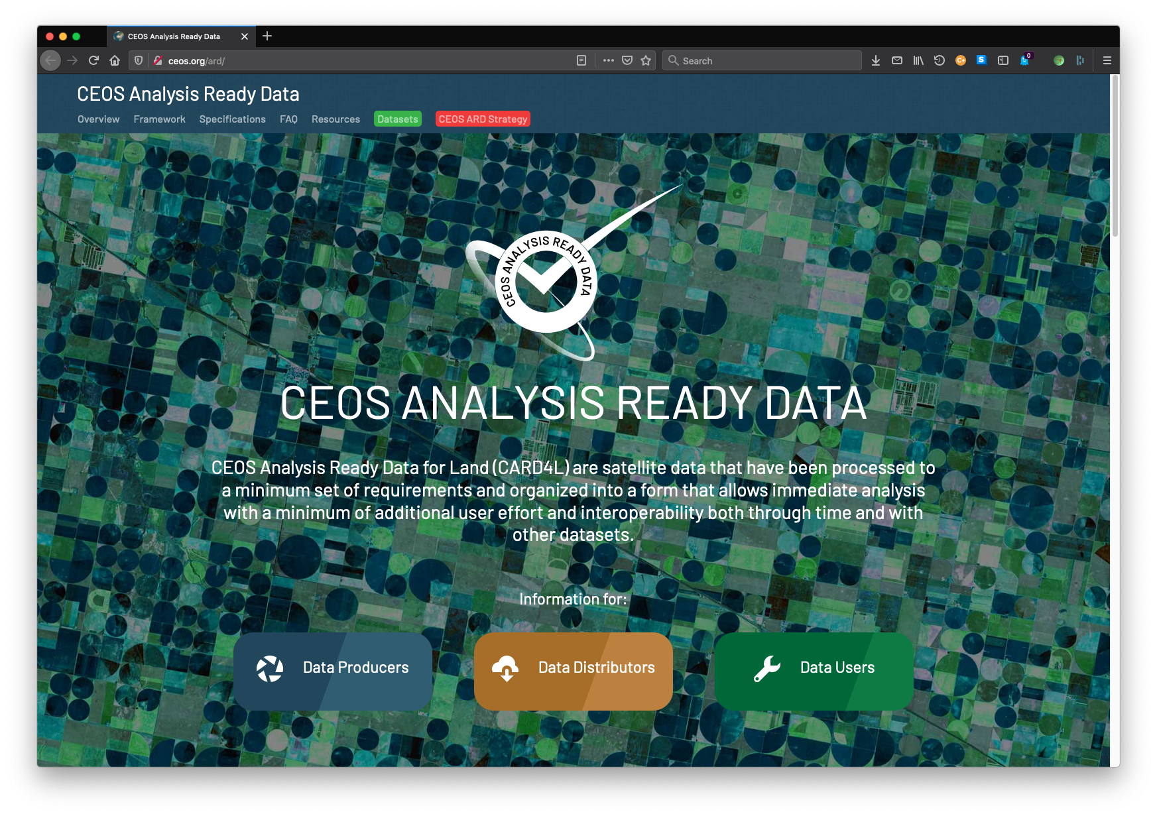
CEOS ARD
Synthetic Aperture Radar
More information at http://ceos.org/ard
CEOS-ARD sample products: https://gofile.me/6A5cs/t8W6ExxRA
Notes:
A number satellite data providers are working to develop CARD4L compliant SAR products to include in their product catalogues. We will hear from a few of them here today in the following presentations.
Thank you for your attention.

