Slide 1
CEOS Analysis Ready Data (CEOS-ARD)
Matt Steventon
CEOS-ARD Oversight Group & LSI-VC Secretariat
LSI-VC-15 Commercial Engagement Workshop
5 April 2024

Slide 2
CEOS Overview
Established in 1984
Comprises the world’s major civil space agencies
34 Members
29 Associate Members
63 Agencies operating 201 satellites
All of whom contribute to CEOS on a ‘best efforts’ and voluntary basis.
https://ceos.org/

Slide 3
What exactly is ‘analysis-ready’ anyway?

Slide 4
Needed to define something - address the ambiguity!
Open Data Cube – Digital Earths
Space agency experience
What do most ‘non-expert’ users want?
Sensor agnostic geophysical variables
Define key parameters and corrections for different types of geophysical products
Ensuring documentation, rather than prescribing methods

Slide 5
Motivations

Slide 6
Motivations
Easing the use of satellite EO data to reach new non-expert users and increase data uptake and use
Provision of analysis-ready geophysical measurements
Reduce pre-processing burden for users
Facilitate analysis in the cloud
Reduce egress and processing
Provide a first step for interoperability
Open and transparent
Common starting point; consistency
Promote clear documentation of processing steps
Capitalise on space agency expertise and experience
Best available science and high quality processes

Slide 7
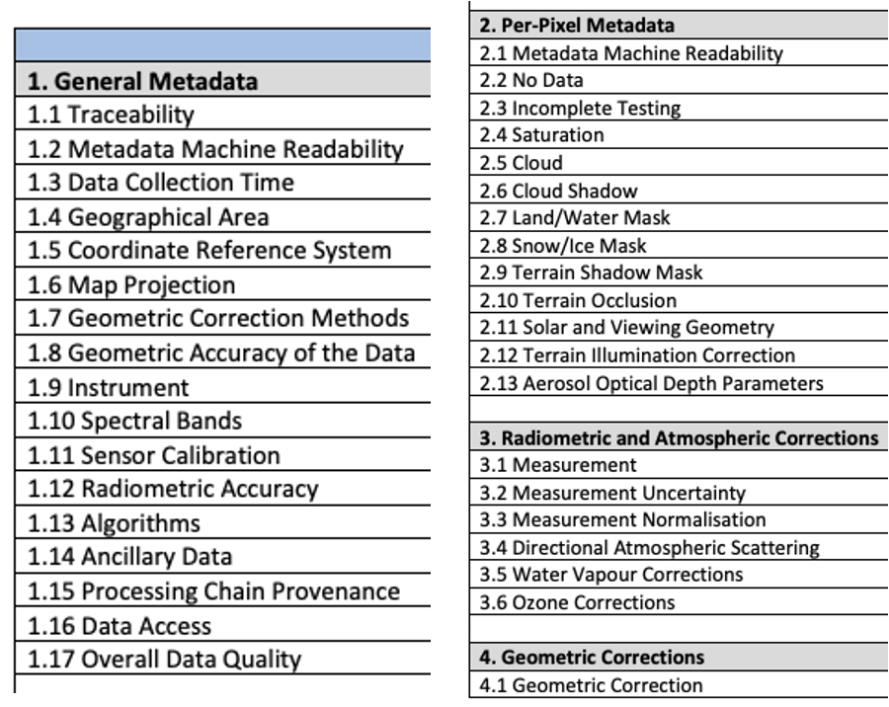
Motivations
Product Family Specifications (PFS)
Specifications for each geophysical measurement
Detail ‘Threshold’ and ‘Target’ requirements for a variety of parameters

Slide 8
Current + In-development CEOS-ARD Specifications
Land
Inland and Coastal Waters
Oceans
Harmonised to a single specification in 2023
Optical
Surface Reflectance
Surface Temperature
Nighttime Lights Surface Radiance
LiDAR Terrain and Canopy Top Height
Radar
Normalised Radar Backscatter
Polarimetric Radar
Geocoded Single-Look Complex (GSLC)
Interferometric Radar (INSAR)
Aquatic Reflectance
Ocean Radar Backscatter
Harmonised to a single specification in 2023
http://ceos.org/ard/index.html#specs

Slide 9
What next?
Sea Surface Temperature?
Precipitation?
Ocean Colour?
Atmospheric Composition Datasets?
Methane?
Active discussion by CEOS Virtual Constellations and CEOS-ARD Oversight Group. User demand is key.

Slide 10
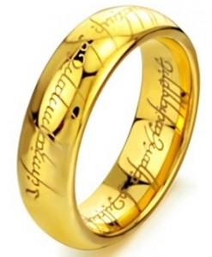
CARD4SAR – One PFS to Rule Them All
Single PFS for all CEOS-ARD SAR products:
NRB, POL, ORB, GSLC
Benefits:
Ensure consistent parameter names and specifications across all SAR PFSs
Simplify PFS revisions and change tracking
Simplifying interface with ongoing external standarisation frameworks (OGC/ISO, STAC)
Elegance:
CARD4SAR PFS facilitates the generation of one, several or all of the CARD SAR products – a true combined SAR ARD product
Reduces duplication of per-pixel metadata
CEOS-ARD for SAR

Slide 11
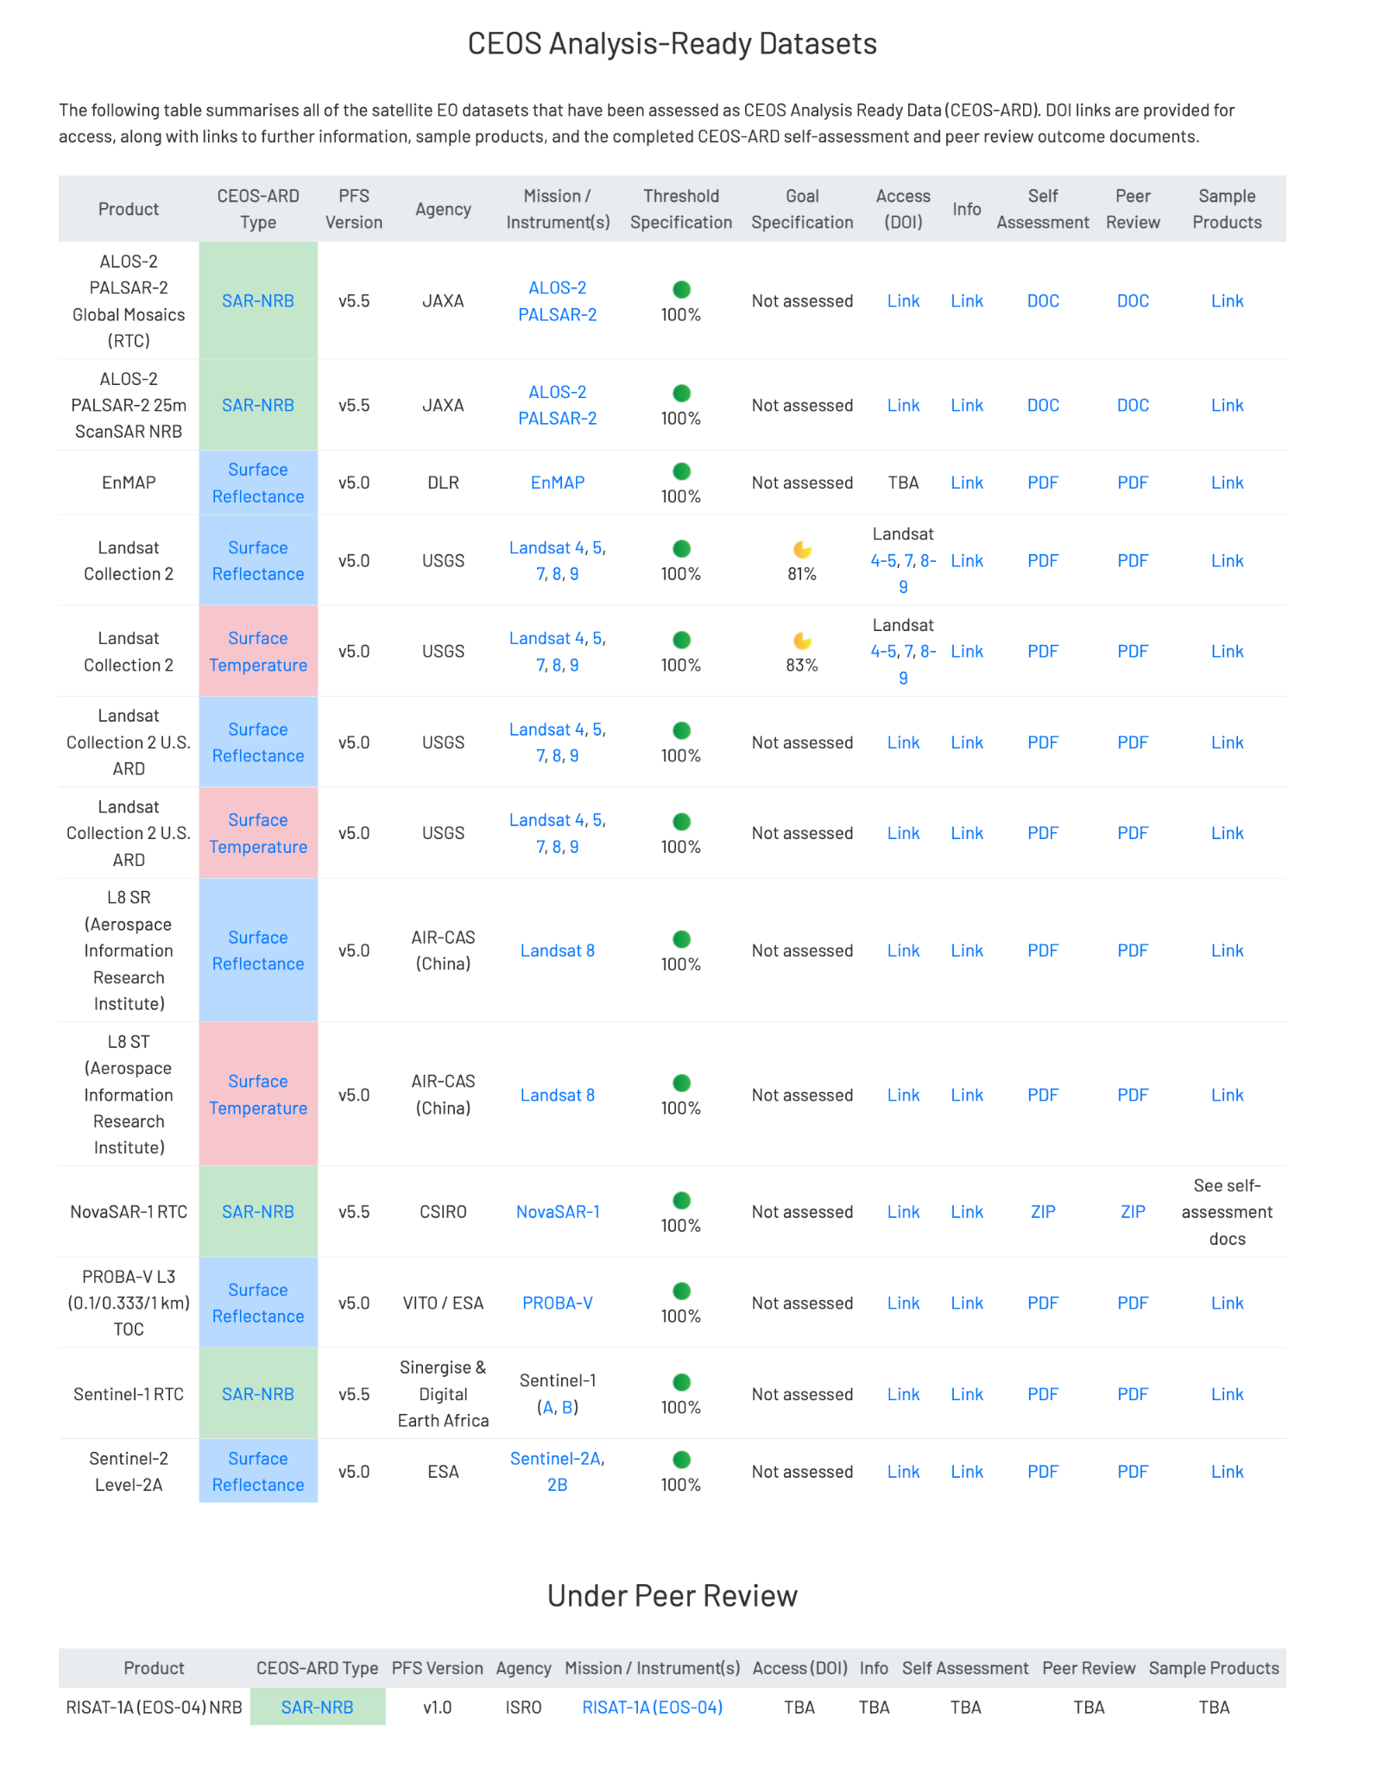
See: ceos.org/ard

Slide 12
Under Development
KOMPSAT-3/3A Surface Reflectance
KOMPSAT-5 Normalised Radar Backscatter
SPOT 1-7 Surface Reflectance
RISAT-1A (EOS-04) NRB SAR
Resourcesat-2/2A
NovaSAR
Gaofen-1/6 Surface Reflectance
SAOCOM
Radarsat-½
RCM
AVHRR LST Surface Temperature
DESIS L2A Surface Reflectance
EnMAP Aquatic Reflectance
Sentinel-1
OPERA project

Slide 13
Status of ESA CEOS-ARD Products
Mission | Product | PFS | Status | Availability Date
Sentinel-2 | L2A | SR | ✅ | January 2022
PROBA-V | Collection 2 | SR | ✅ | March 2023
Sentinel-2 | L2H | SR | Under Development | 2023 (pilot product), TBD (operational product)
Sentinel-2 | L2F | SR | Under Development | 2023 (pilot product), TBD (operational product)
Sentinel-2 | L2A | AR | Under Development | TBD
Sentinel-1 | NRB / ORB | NRB / ORB | Under Development | TBD
Sentinel-3 | SYN | SR | Under Development | TBD
ERS SAR | TBC | NRB | Under Development | TBD
ERS ATSR | TBC | LST | Under Development | 2024
Envisat ASAR | TBC | NRB | Under Development | TBD
Envisat MERIS | TBC | SR | Under Development | 2024
CHIME | L2A | SR | Under Development | 2029
CHIME | L2H/L2F | SR | Under Development | 2029 (pilot product), TBD (operational product)
LSTM | L2A | ST, SR | Under Development | 2029
LSTM | L2H/L2F | ST, SR | Under Development | TBD
ROSE-L | TBD | NRB…TBC | Under Development | TBD

Slide 14
How is a product assessed?

Slide 15
CEOS-ARD Assessment
Completed Self-assessment Table
Blank table in the specification
Includes references to metadata, DOIs, methods, etc.
CEOS Working Group on Cal/Val
Peer review
For Threshold – simplified checks
For Target/Goal – Review Panel
Iterative
CEOS-ARD Secretariat
Initial checks
CEOS-ARD
Sample Products
Incl. metadata
More Details
ceos.org/ard
CEOS-ARD Framework

Slide 16
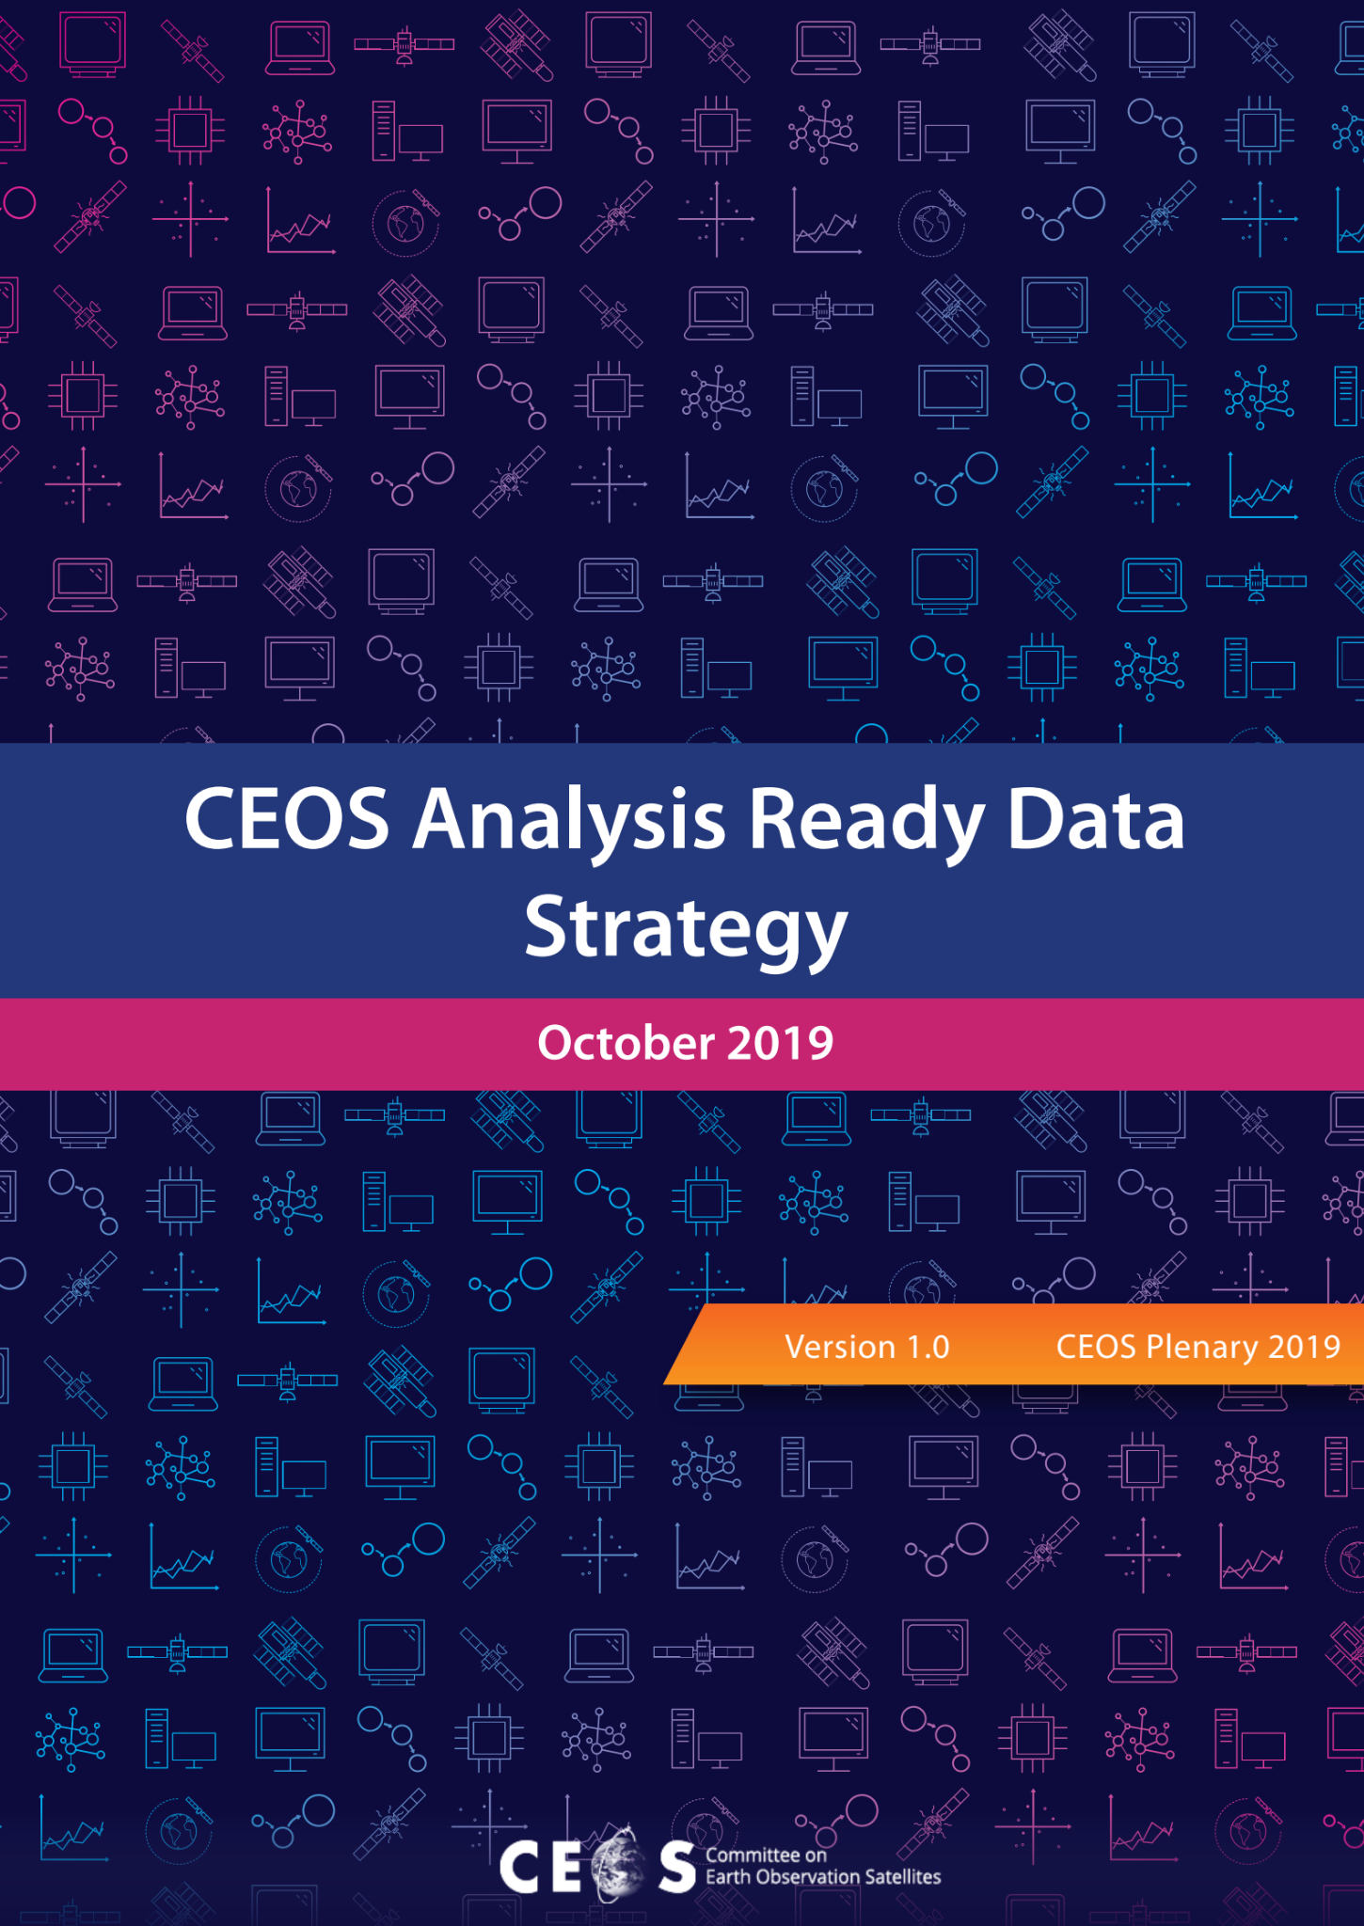
CEOS-ARD Strategy 2024
Update to past editions from 2019 and 2021
Reflect on the progress to date, take stock of future directions and needs, and confirm our strategy for the next few years
To achieve our stated objectives, a broad portfolio of CEOS-ARD that is easily discovered, accessed and utilised is the ultimate goal.

Slide 17
CEOS-ARD Strategy 2024
The Strategy activities are categorised into six broad themes:
CEOS-ARD Availability, Product Diversity, and Representation
Framework and Specification Advancement
Discovery, Access, Utilisation, and Interoperability
Community Engagement
Research, Test Cases, and Pilot Activities
Commercial Engagement

Slide 18
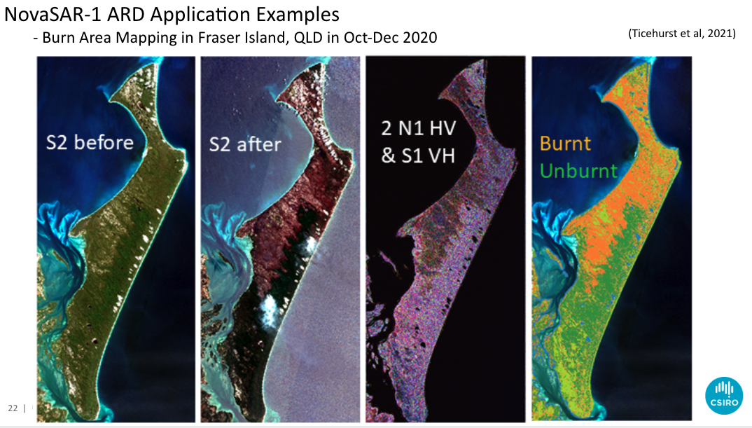
Applications
NovaSAR-1 ARD Application Examples
- Burn Area Mapping in Fraser Island, QLD in Oct-Dec 2020
Contact: <Zheng-Shu.Zhou@data61.csiro.au>
(Ticehurst et al, 2021)

Slide 19
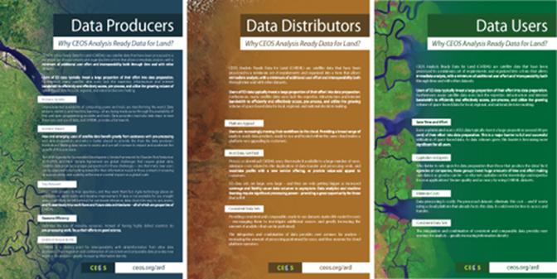
Community engagement
CEOS has been engaging with the broader community through various channels
OGC ARD SWG - incl. Co-chair from NASA
Workshops, webinars, conference sessions and abstracts
ARD23 Workshop, IGARSS 2023, CEOS-Industry ARD Workshop (TBC), Big Data from Space, VH-RODA, JACIE, etc.
CEOS-ARD Webpage
https://ceos.org/ard/
Documentation
CEOS-ARD Strategy
Framework
Specifications
https://2023.ieeeigarss.org/community_contributed_sessions.php (session: Analysis Ready Data: New Opportunities)

Slide 20
OGC-ISO ARD
Standards Working Group
Significant activity and discussion in the broader EO community around ‘Analysis Ready Data’
With its long heritage, experience, and expertise, CEOS has a key role to play in defining ARD for the community (Incl. ‘New Space’)
Feedback from industry (VH-RODA, JACIE, LPS, ARD2x) that formal standards are needed for ‘ARD’
Government and commercial sectors may not reference documents and commit funds unless they have gone through an open standards process (formal peer review, etc.)
Standards built on the CEOS-ARD foundation would be helpful
Increase reach of the concepts of CEOS-ARD

Slide 21
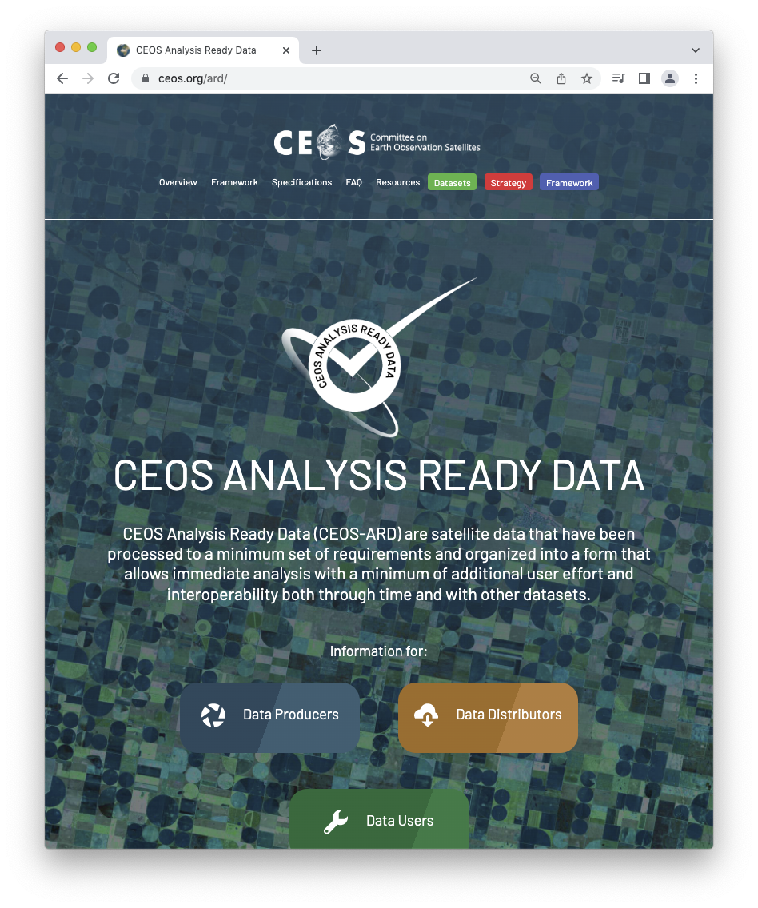
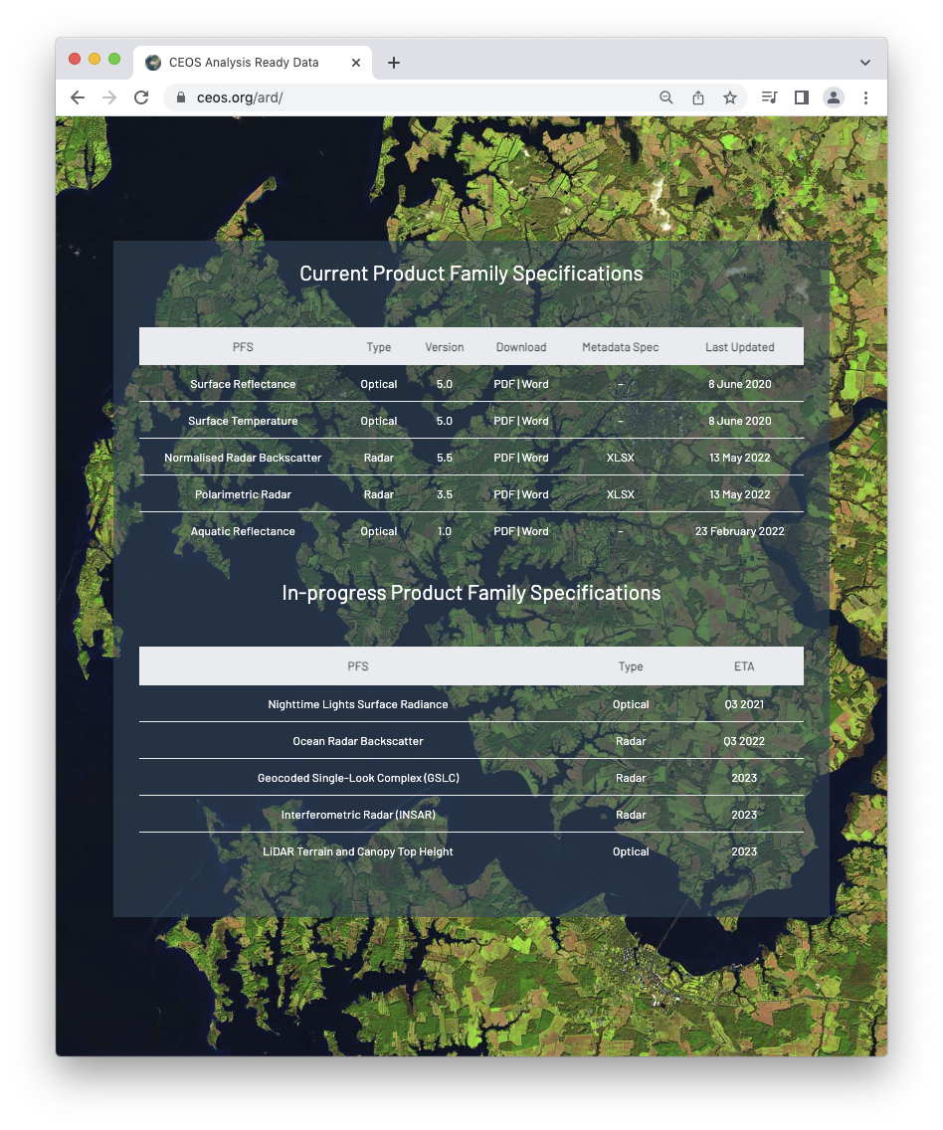
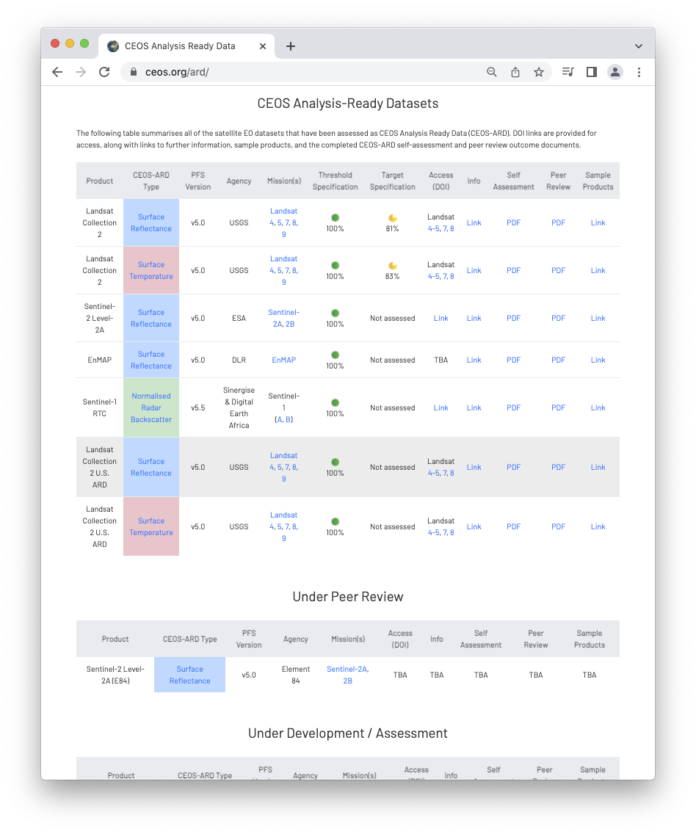
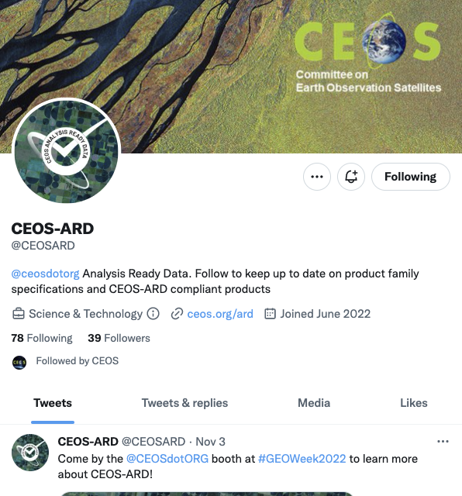
More information
ceos.org/ard
CEOS-ARD GitHub (new!)
CEOS-ARD Newsletter Sign-up
Past issues: https://ceos.org/ceos-ard-newsletter/
https://twitter.com/CEOSARD
Contacts:
Ferran.Gascon@esa.int
matthew@symbioscomms.com
ard-contact@lists.ceos.org

Slide 22
Thank you!

