Slide 1
LSI-VC-15
2024
LSI-VC Overview and Key Activities
Steve Labahn, USGS
Agenda Item 7-1.2
LSI-VC-15 2024, Tokyo
3rd - 5th April 2024

Slide 2
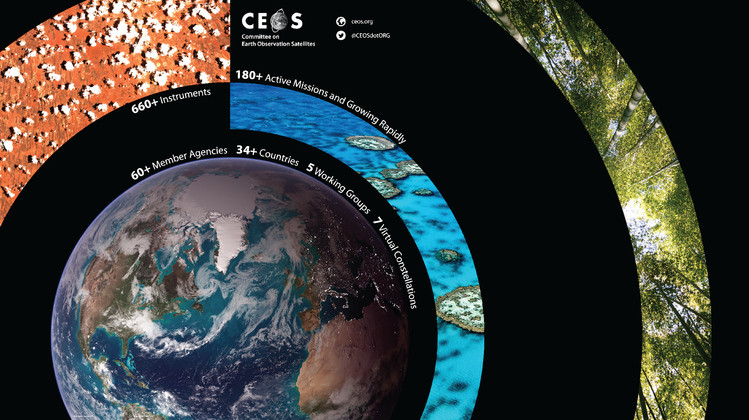
CEOS
CEOS ensures international coordination of civil space-based Earth observation programs and promotes exchange of data to optimize societal benefit and inform decision making for securing a prosperous and sustainable future for humankind.
Established under the auspices of the G-7 Economic Summit of Industrialized Nations (1984).
Operates through the best efforts & voluntary contributions of Members (space agencies) & Associates (UN Agencies, Phase A programs, or supporting ground facility programs).
Delivers on high priority objectives in support of the Group on Earth Observation (GEO) Tasks as the space component of the Global Earth Observation System of Systems (GEOSS).
https://ceos.org/

Slide 3
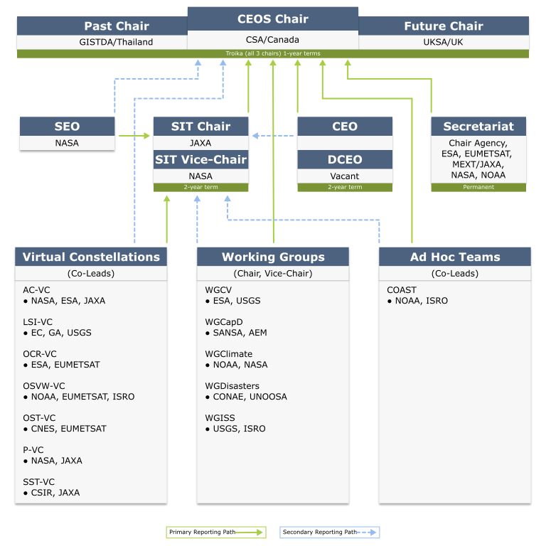
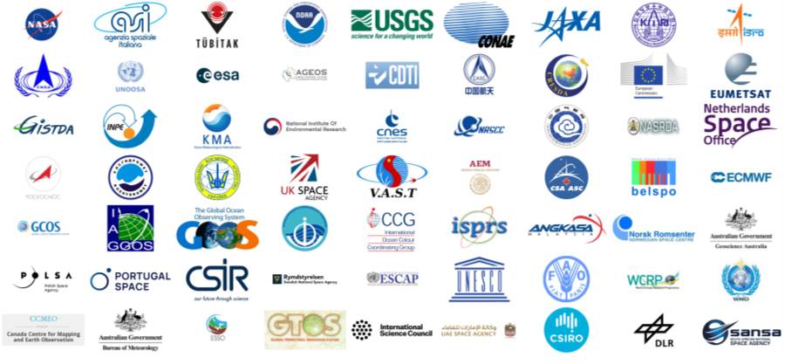



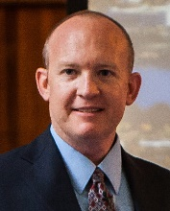
CEOS Organization https://ceos.org/about-ceos/organization/
34 Members / 30 Associate Members
https://ceos.org/about-ceos/agencies/
Land Surface Imaging Virtual Constellation (LSI-VC)
Andreia Siqueira, GA (Co-Lead)
Peter Strobl, EC/JRC (Co-Lead)
  Steve Labahn, USGS (Co-Lead)
  Matt Steventon, Symbios (Secretariat)

Slide 4
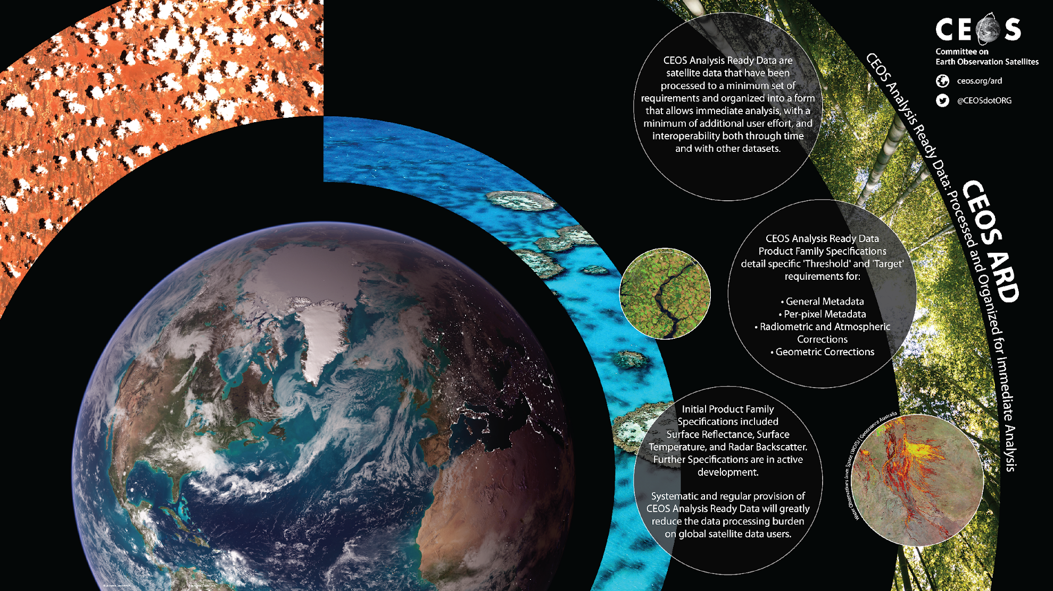
CEOS ARD
CEOS Analysis Ready Data (CEOS-ARD) are satellite data that have been processed to a minimum set of requirements and organized into a form that allows immediate analysis with a minimum of additional user effort and interoperability both through time and with other datasets.
The CEOS Land Surface Imaging Virtual Constellation (LSI-VC) served as the forum for developing the CEOS Analysis Ready Data definition, beginning with ‘Land’. CEOS-ARD for Land (CARD4L) underpins a large amount of the future data architectures work being progressed within CEOS. The CARD4L definition was endorsed by the CEOS Plenary in 2016.
The CEOS Land Surface Imaging Virtual Constellation (LSI-VC) has over 20 members representing 12 agencies (CNES, CSA, CSIRO, DLR, EC, ESA, GA, ISRO, JAXA, NASA, NOAA, USGS).
https://ceos.org/ard

Slide 5
LSI-VC Overview
Facilitate coordinated and optimized land surface imaging contributions from CEOS Agencies to enable access to fundamental measurement products in support of confirmed/validated requirements linked to adopted CEOS priorities
  Optimizing the use of these assets to maximize global coverage and minimize important data gaps
  Making it easier for users to interact with such vast amounts and diversity of collected data, challenged by the ever-increasing depth of satellite imagery collections over time
  Supporting downstream users to better enable them to seamlessly utilize the data generated from these various systems
Desired outcomes
  Harmonization of future and existing mission acquisition plans across major international land surface imaging programs based on a reliable understanding of domain-specific requirements
  Efficient use of very large land surface imaging datasets, enabled by suitable data architectures and non-domain specific land surface measurements that are ‘analysis-ready’ and interoperable
Helpful links
  CEOS Home Page: https://ceos.org/
  LSI-VC Home Page: https://ceos.org/ourwork/virtual-constellations/lsi/
  LSI-VC Terms of Reference: https://ceos.org/document_management/Virtual_Constellations/LSI/Documents/Terms%20of%20Reference/LSI-VC_Terms-of-Reference_20-Dec-2019.pdf
  CEOS-ARD: https://ceos.org/ard/

Slide 6

Key Activities
Approach for dealing with various higher-level product needs of thematic communities
Reviewing and updating CEOS-ARD Strategy 2024
Supporting agencies’ ongoing CEOS Analysis Ready Data (CEOS-ARD) self-assessments
Supporting the CEOS Ecosystem Extent Task Team Demonstrators (driving interoperability)
CEOS-ARD land specification technical discussions and advancement
  Accommodate High Resolution EO Datasets
  CEOS-ARD STAC Extensions
  CEOS-ARD GitHub
  Combined Optical PFS Discussions (increasing consistency)
LSI-VC members are major contributors to the OGC/ISO ARD SWG, discussion ongoing (ensuring alignment with CEOS-ARD)
Next steps for the Surface Reflectance Quality, Equivalency, and Consistency Project (further increasing interoperability of CEOS-ARD datasets)
Dedicated workshops with representatives from the commercial EO sector – collaboration on LSI-VC, CEOS-ARD, and interoperability - welcome to join LSI-VC meetings!

Slide 7
Thank You!
Steve Labahn
labahn@usgs.gov

