Slide 1
LSI-VC-15
2024
AxelGlobe
Nakano Shimpei
Krawczyk Lukasz
Agenda Item #2.1
LSI-VC-15 2024, Tokyo
3rd - 5th April 2024
Notes:
Short self-introduction

Slide 2
Presenter Guidelines 1
Presenters should name their file using the following convention:
AgendaItemNumber_LastName_Subject_Version (e.g., 1.1_Labhan_Welcome_v1)
Documents and presentations should be uploaded to the shared folder to allow for streamlined self service
Shared Presentation Folder (default view only, ask for upload/edit permission as required)
For support contact matthew@symbioscomms.com
Presentations should be submitted by 27 March
Meeting website: https://ceos.org/meetings/lsi-vc-15/
Please explicitly highlight the decisions, outcomes, or actions you are seeking. The more explicit you are, the better. i.e., feel free to provide text for a proposed action – it may be revised later, but this approach will help with the efficient preparation of the actions record of the meeting.

Slide 3
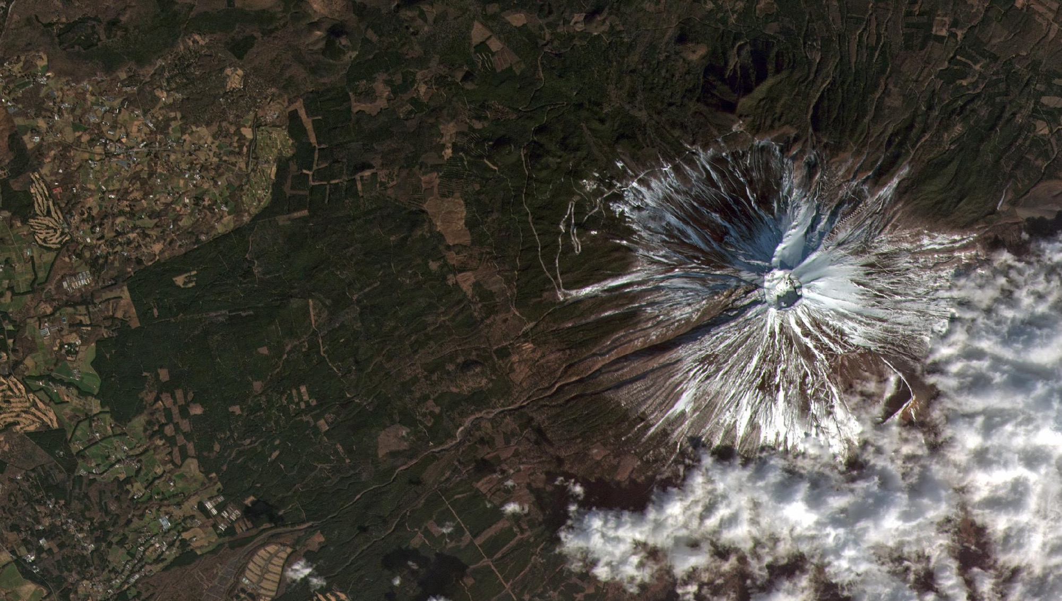
Our Vision:
Establishment: 2008
Capital Stock: 70 Million USD
Employee: 140 people
HQ: Tokyo in Japan
Space within Your Reach
“We started building microsatellites to make it possible for private companies to own one … ”

Slide 4
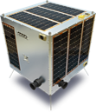
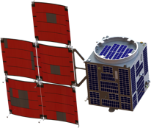
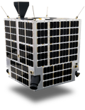
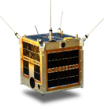
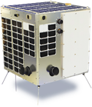
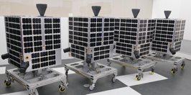
Track Record
2008
Founded
2013
WNISAT-1
2014年
Hodoyoshi-1
2017
WNISAT-1R
2018
GRUS-1A
2019
RAPIS-1
2021
GRUSB,C,D,E
2024
PIXYS
国内初
小型衛星のコンステーション実現
10 spacecrafts Developed & launched
1st Japanese Company
1. WNISAT
2. Hodoyoshi-1
3. WNISAT-1R
4. GRUS-1A
5. RAPIS-1
6. GRUS-1B
7. GRUS-1C
8. GRUS-1D
9. GRUS-1E
10. PYXIS
Established Constellation of small spacecrafts as 1st company in Japan

Slide 5
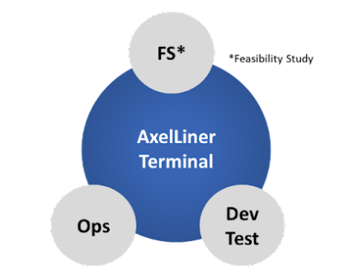
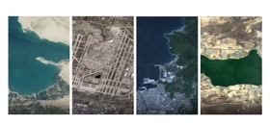
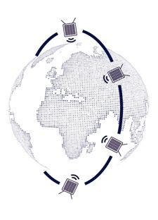
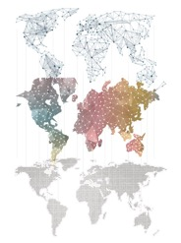
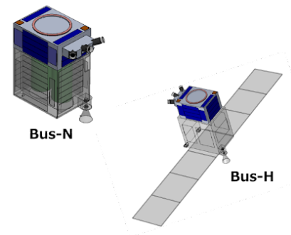
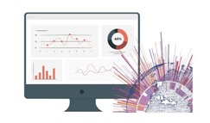
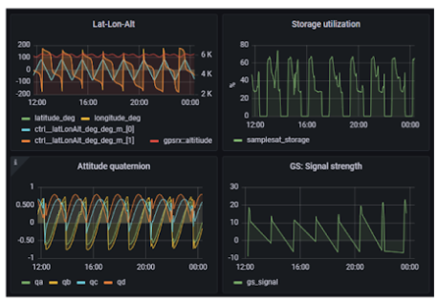
Our Business
Digitalized Standard Process
Offer Imagery
Versatile Satellite Platform
Automated Operation Software
Constellation of our own small satellites
Storage captured satellite imagery
Solution with AI Analytics
One Stop “Space Project as a Service”
Earth Observation Business by our own GRUS constellation Solution Provider with AI analytics

Slide 6
Agenda
AxelGlobe & GRUS-1
Lessons Learned
Current development & next steps

Slide 7
AxeGlobe & GRUS-1
AxelGlobe
Data Specifications
Product Line-up
Interface

Slide 8
1.1 AxelGlobe
Earth Observation Platform produced by Axelspace
Data Service
GRUS Constellation
Data capturing
Analytics / Product Service
Notes:
It is an earth observation platform that consistently covers satellite manufacturing, operation, data acquisition, distribution, and in some cases, data analysis.

Slide 9
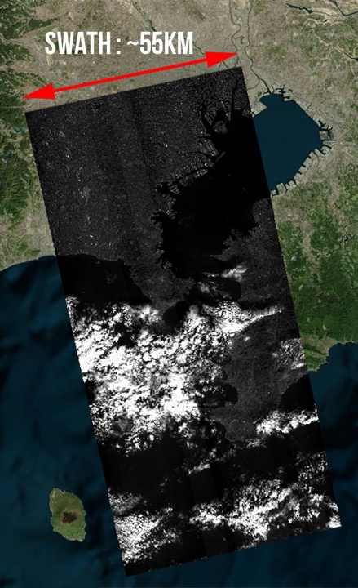
1.2 Data Specifications
GRUS-1 Sensor Specification
Name | Band | Ground Resolution | Data Format | Spectral Band (Wavelength Range) |  | Bit Depth | Projection
Multispectral | Panchromatic＋ Multispectral ( 5 bands ) | 2.5m(Pan)+ 5.0m(Multi) | GeoTIFF /JPEG2000 | Panchromatic Blue Green Red Red Edge Near Infrared | 450-900nm 450-505nm 515-585nm 620-685nm 705-745nm 770-900nm | 16 bit | UTM /WGS84
True Color | Pansharpen ( RGB,) | 2.5m |  |  |  | 8 bit
-15°
0°
+15°
1000 KM+
Temporal Resolution:
2 days
Geo-accuracy:
10m RMSE
Orbit:
Sun- Synchronous Orbit
Delivery Latency:
<24h from capture
Orbital Altitude:
583 km
Shootable Time:
10:40 – 11:00
Off Nadir: ±15°
Notes:
Too much information?

Slide 10
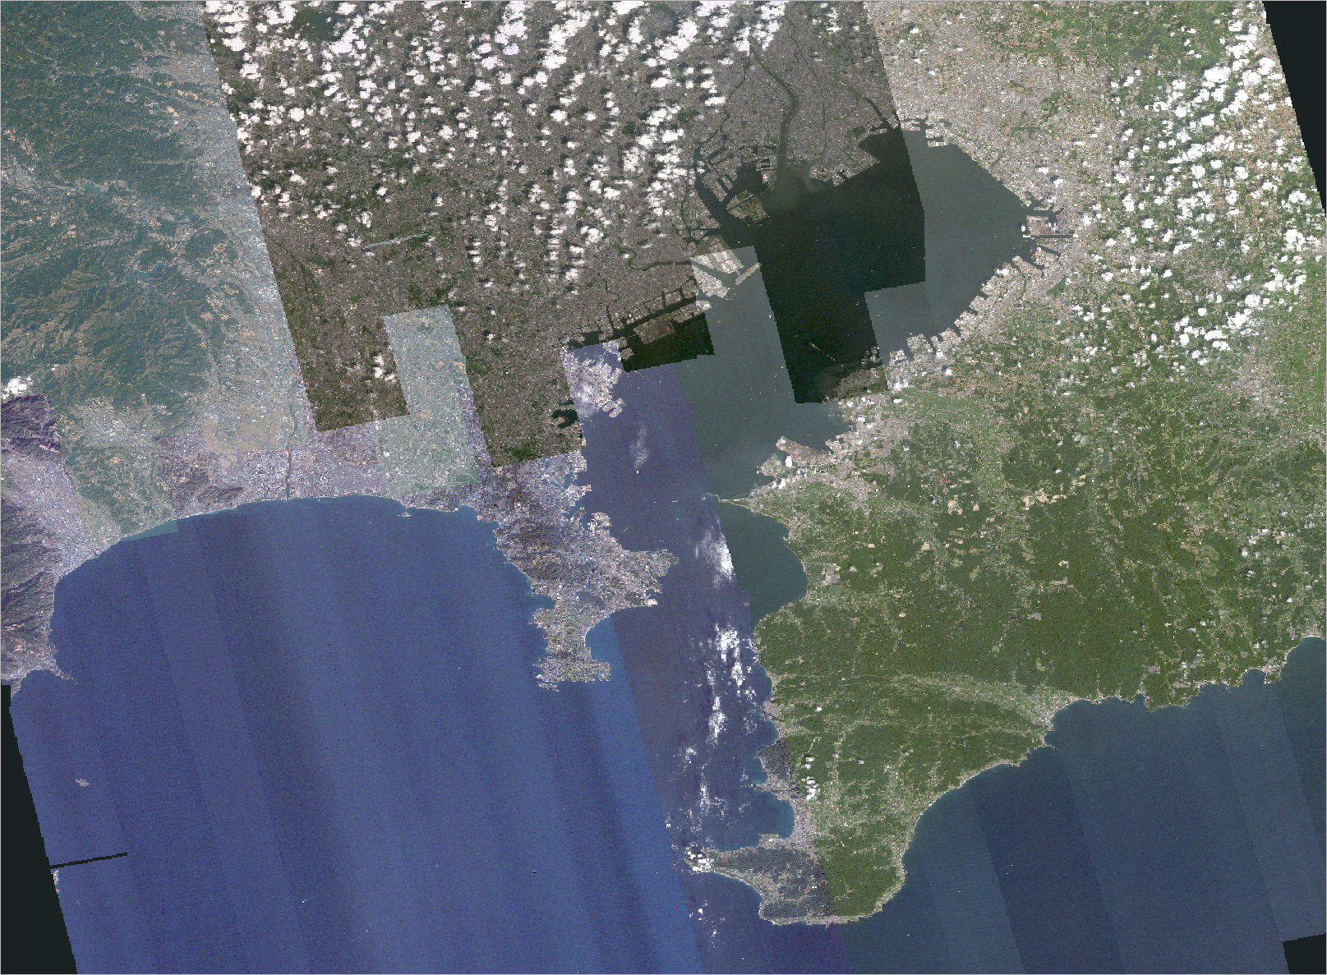
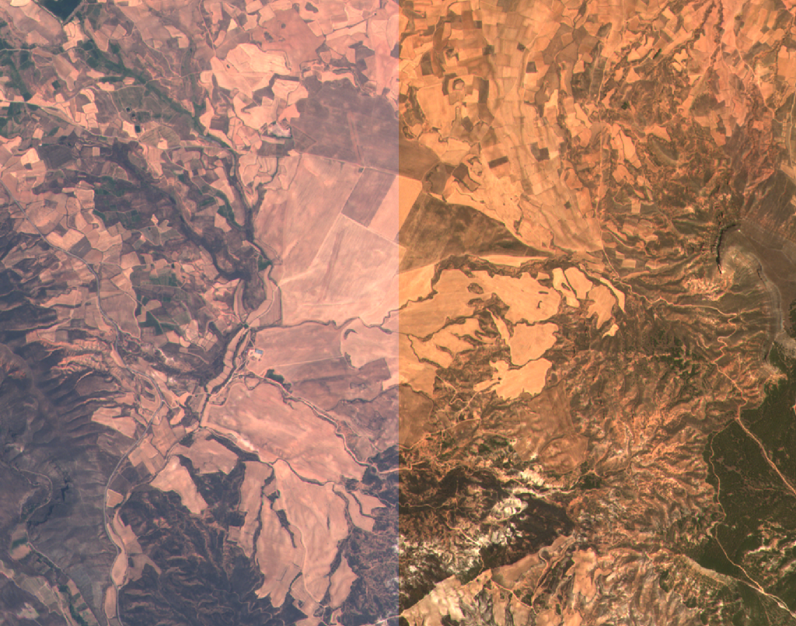
1.3 Product Lineup
Standard Product
Value-Added Product
Multispectral | Radiometric & Geometric Corrected
Surface Reflectance | Atmospheric Corrected
True Color Image | Pan-sharpened, Color Corrected
Cloudless Mosaic
On-demand mosaic product with wide coverage
TOA
SR

Slide 11
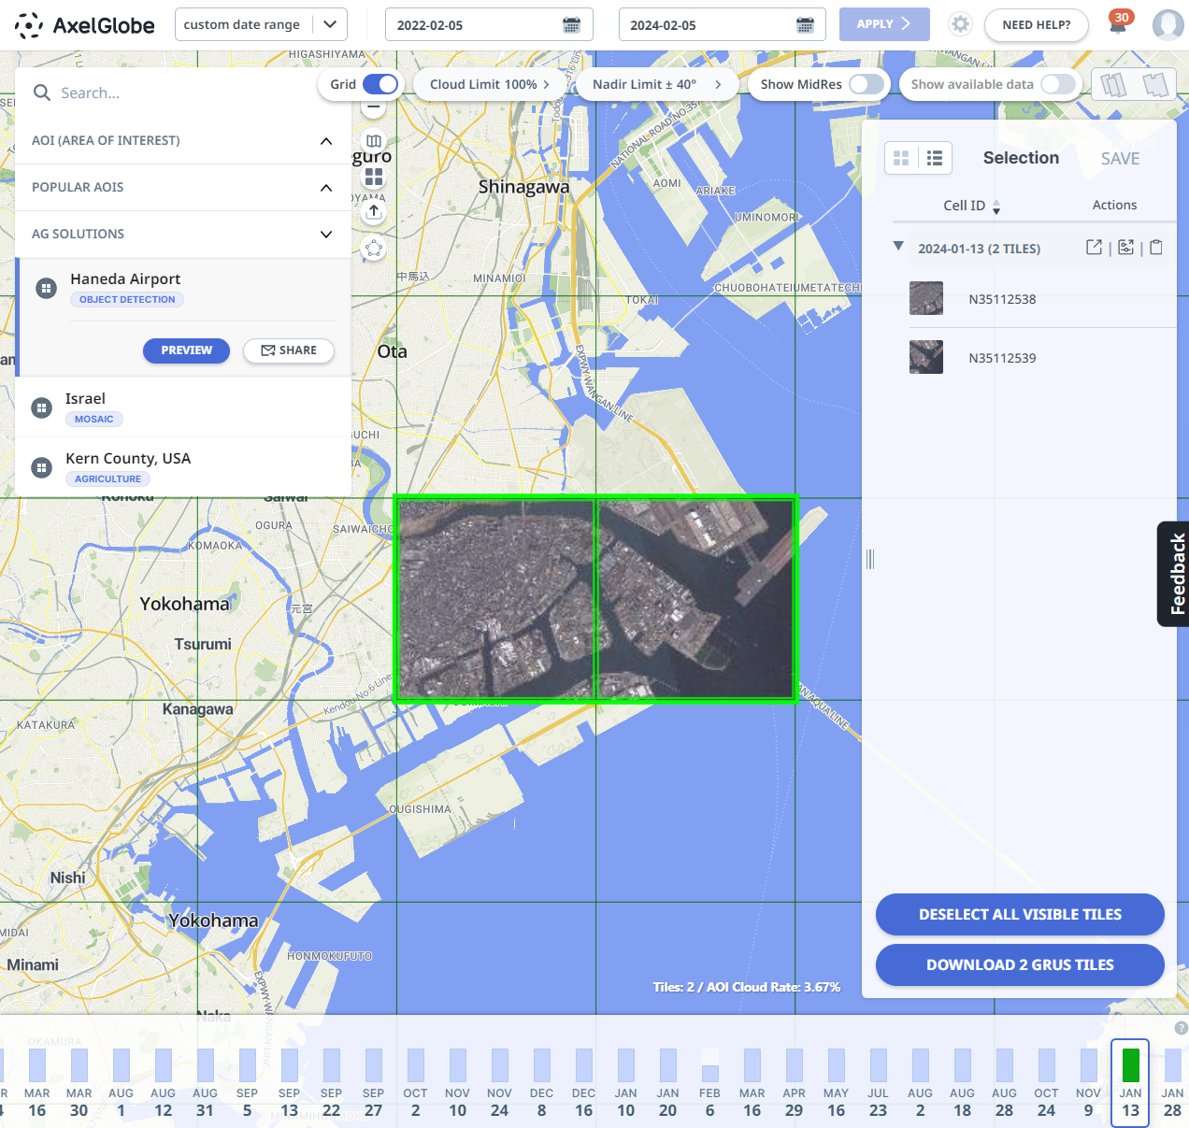
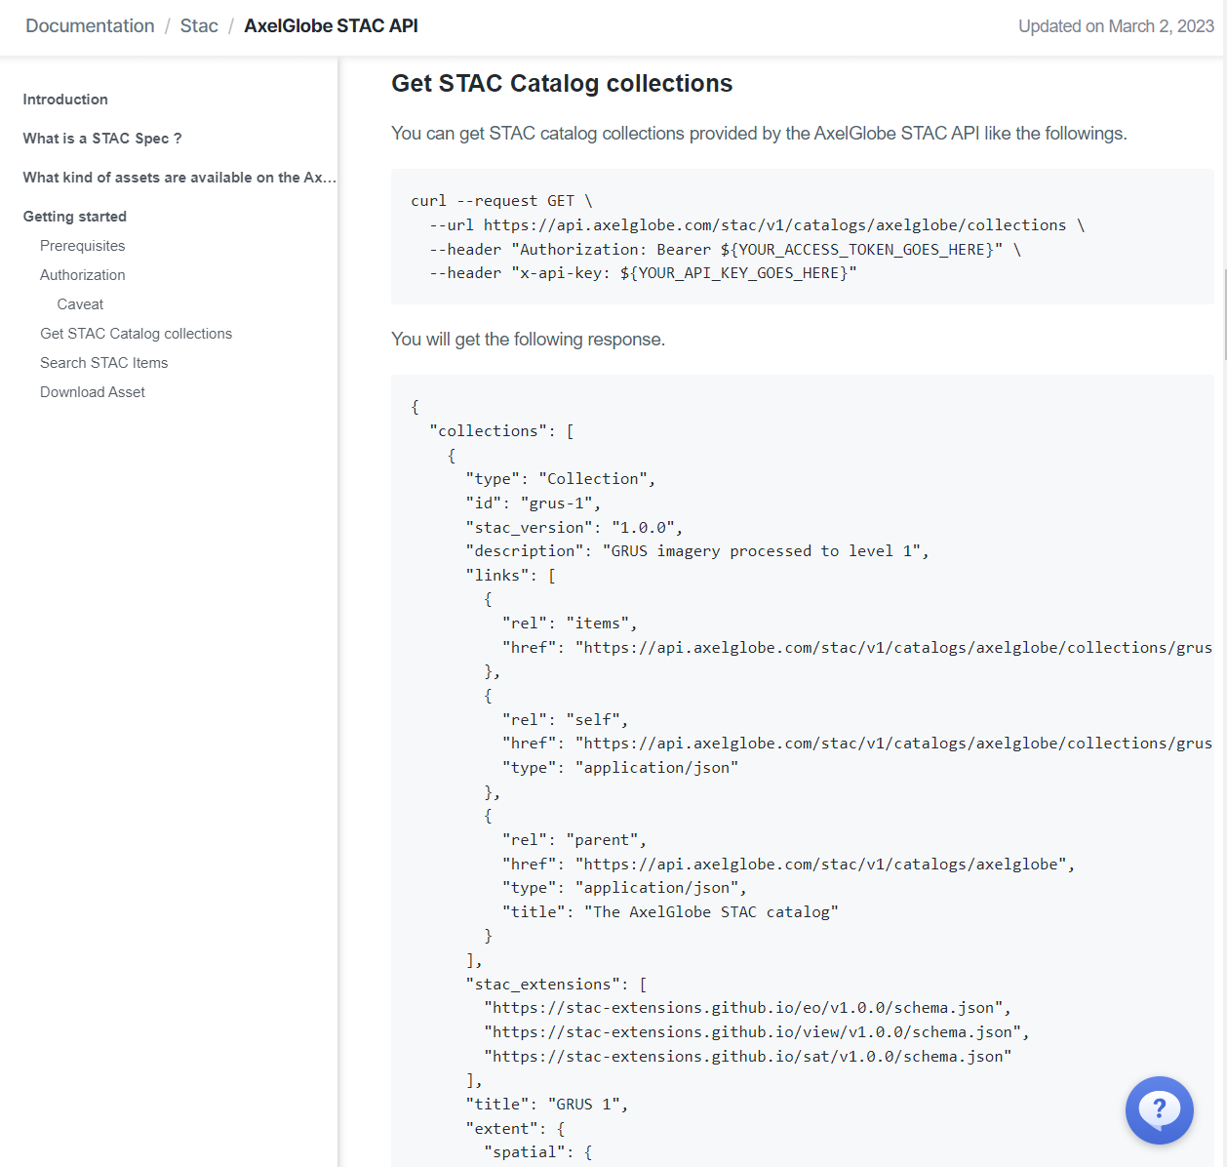
1.4 Interface
AxelGlobe Web Platform
Search & Tasking API
Interactive search & download
Compliant with STAC specifications
Notes:
AxelGlobeでは、インタラクティブなWebのUser Interfaceを通じて

Slide 12
2. Lessons learned
Machine-to-machine interfaces are necessary
Standardizing Processing Levels and metadata is crucial for interoperability
Transparency about the actual product quality is important

Slide 13
3. Current developments & next steps
Three areas of improvements
Accessibility: Enhanced interoperability and usability
Interoperability: Alignment with leading scientific Earth Observation satellite platforms
Data quality: Continuous quality improvements and rigorous calibration methods

Slide 14
Enhanced interoperability and usability
Standards for Machine Readability
Current developments
Data Products delivered as COGs via STAC
Benefits
Data from different sources can be easily integrated
Reducing time and resources needed for data preprocessing
Lowering the barrier to entry
{
"capture_timetamp": "2023-01-01T12:00:00.000000Z",
"geometry": {
"type" : "Polygon",
"coordinates" : [ ... ]
},
"solar_and_viewing_geometry": {
"solar_zenith_angle_deg": 45,
"solar_azimuth_angle_deg": 90,
"viewing_zenith_angle_deg": 45,
"viewing_azimuth_angle_deg": 90,
},
"slant_range_m": 500000,
"spatial_resolution_m": 2.0,
"sun_earth_distance_au": 1.0,
"sun_glint_angle_deg": 30,
"rpc": { ... },
"bands": [ ],
...
}

Slide 15
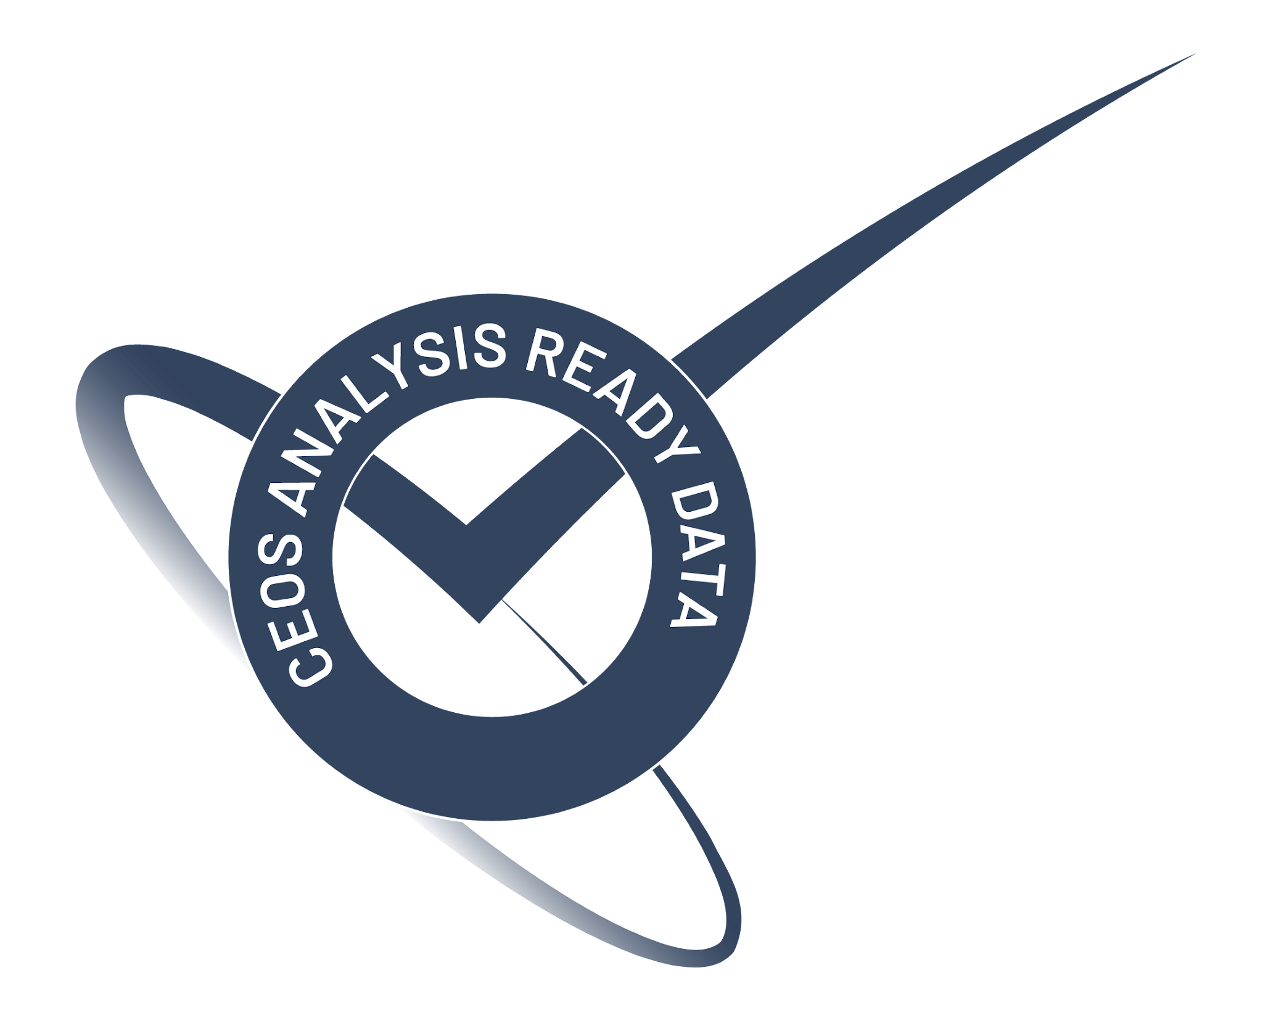
Enhanced interoperability and usability
Standards for Data Processing
Current developments
Implementation of the CEOS ARD
Benefits
Interoperability across various missions
Users can readily conduct analysis without the need for additional processing steps
Easier data comparison, combination, and analysis of data from different sources

Slide 16
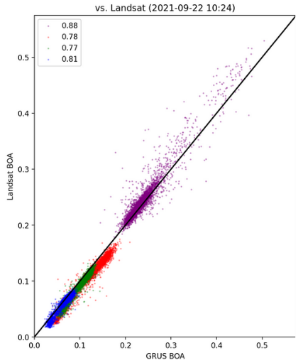
Enhanced interoperability and usability
Traceability & Reporting
Current developments
Documentation of the methodology, traceability
Regular quality assurance
Third party evaluation and certification
GRUS-1 EDAP report (2022)
FLARE report (2021)
Benefits
Closing the gap between government and commercial missions

Slide 17
Alignment with leading scientific Earth observation satellite platforms
Maximize interoperability between Next Generation GRUS and Sentinel-2
Alignment in terms of data characteristics, spectral range and accuracy
Reusing existing research, papers, indices, ML models
Reduce Initial Operation time and overall Time To Value via Cross Calibration (Simultaneous Cross-over Calibration)
Drop-in replacement for customers who already uses Sentinel-2

Slide 18
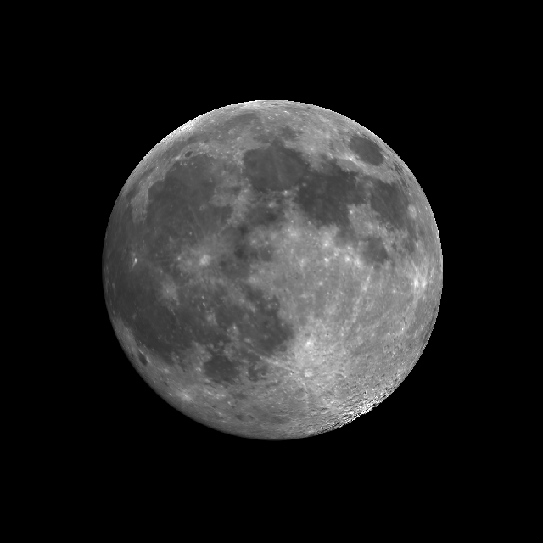
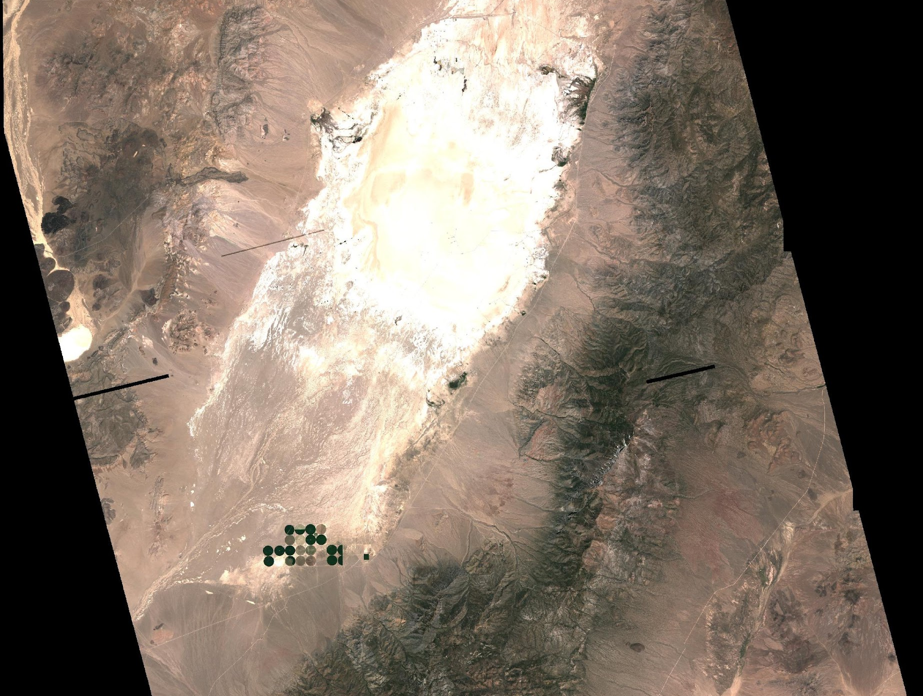
Rigorous calibration methods
Rigorous on-ground instrument characterization, calibration and validation
Response curve, PSF, thermal effects, alignment, distortions, stray light
Reports before the launch and after commissioning
Regular on-orbit calibration
Lunar Calibration & degradation monitoring
Fully automated Vicarious Calibration
Simultaneous Cross-over Calibration

Slide 19
Have questions? Please contact us!
axelglobe.com

