Slide 1
Session 4: Land Surface Imaging Requirements
WGClimate Background
Matt Steventon
CEOS-ARD Oversight Group & LSI-VC Secretariat
LSI-VC-15
4 April 2024

Slide 2
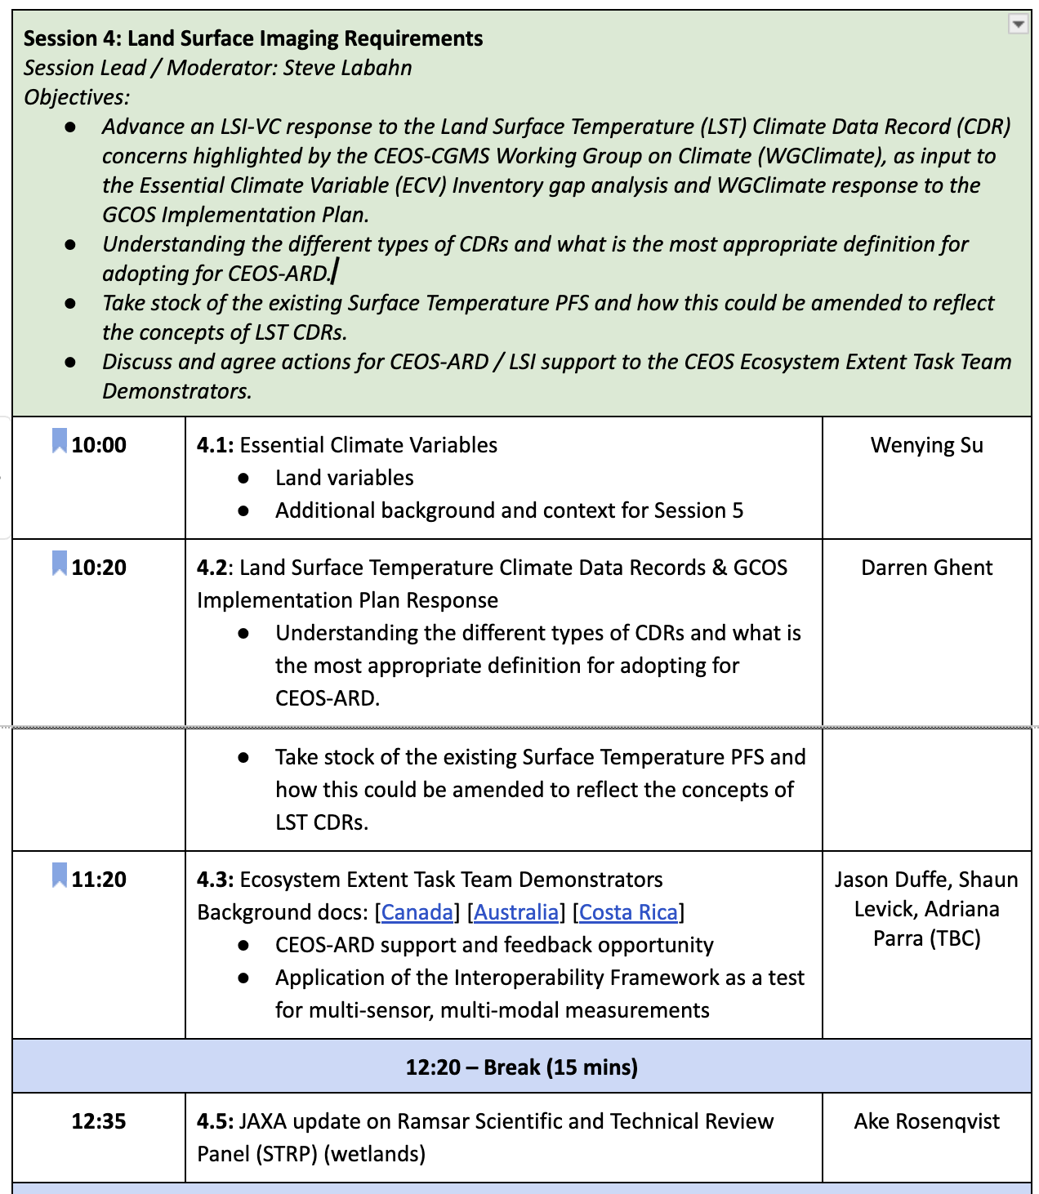

Slide 3
Overview
Two things:
Inputs to the WGClimate Coordinated Action Plan
Inputs to the Space Agency Response to the GCOS Implementation Plan

Slide 4
WGClimate Coordinated Action Plan
Latest doc shared 29 March:
https://docs.google.com/document/d/1tBNlg5bZvv0vHzxtboEJiOjRTcMQRG2lbby42xcuDLo/edit?usp=sharing
Basis for the actions contained in this document is the ECV Inventory Development Cycle #2:
Performed gap analysis on the ECV inventory to identify missing or endangered elements
Use the results of the gap analysis to generate a coordinated action plan to address such gaps/missed opportunities.
These are the actions that need to be performed to implement the recommendations contained in the ECV Inventory gap analysis report.

Slide 5
WGClimate Coordinated Action Plan
Sections 3.3.6 (Land Surface Temperature), 3.3.7 (Leaf Area Index), 3.3.8 (Above Ground Biomass)
Recommendation #19: The CEOS Land Surface Imaging-Virtual Constellation (LSI-VC) to coordinate on the formulation of future high resolution missions and seamless continuity of sustained Land Surface Temperature CDRs.
Recommendation #20: The CEOS Land Surface Imaging-Virtual Constellation (LSI-VC) together with WGCV and WGClimate to devise a way forward for the combined use of past, current and future instruments to create sustained Land Surface Temperature CDRs.
Recommendation #21: LSI-VC should assess the climate user community needs for LAI data records that are not currently being exploited from existing missions (e.g. Sentinel-2, Landsat), and inform WG Climate of their findings to enable further planning for needed LAI data records.
+ Various Above Ground Biomass recommendations (LSI-VC F&B relevance)

Slide 6
Space Agency Response to the GCOS IP
Identify POC within LSI-VC for each action to help drafting a response to GCOS Implementation Plan.
C5: ECV-specific satellite data processing method improvements
F1: Responding to user needs for higher resolution, near real time data: Improve biomass, land cover, land surface temperature, and fire data with sub-annual observations and improved local detail and quality.
F2: Improved ECV satellite observations in polar regions, Surface temperatures of all surfaces (sea, ice, land)

