Slide 1
LSI-VC-15
2024
Follow-up: Quad-pol and Multi-frequency data requests from the ESA POLINSAR Workshop 2023
Francesco Sarti, ESA
Magdalena Fitrzyk RSAC c/o ESA
Ake Rosenqvist, JAXA/soloEO
Agenda Item 6.1
LSI-VC-15, Tokyo, Japan, 3-5 April 2024

Slide 2
Recommendations POLINSAR
POLINSAR
International Workshop on Science and Applications of SAR Polarimetry and Polarimetric Interferometry
(organised by ESA every two years)
Gathering RS scientists working in various applications eg. agriculture, cryosphere, forestry, maritime, archeology, soil moisture who are using polarimetric data in their research

Slide 3
Recommendations POLINSAR

Slide 4
Recommendations POLINSAR
On-going joint research between JAXA and ESA on using SAR data products for selected areas and applications
Improvement of observation frequency and coordination in Japan and Europe
Explore synergies between C- and L-band
Data exchange via dedicated ftp-site under ESA responsibility
Project Implementation Plan (PIP) outlines specific Joint Research Activities to be conducted as part of the ESA-JAXA cooperation
Activities/agreement between ESA and CONAE (SAOCOM) for preparation of ROSE-L and investigate synergies
Acquisition coordination need between S1 NG and ROSE-L being taken into account

Slide 5
Recommendations POLINSAR
Some relevant mission managers (ESA, CONAE) have been informed. Adapting acquisition plans is a challenge, due to many different constraints
Action could be discussed also at CEOS level (LSI – VC?)

Slide 6
Recommendations POLINSAR

Slide 7
Recommendations POLINSAR
The scientific SAR polarimetry (POLINSAR) community is advocating since many years the creation of so-called supersites for polarimetry (and interferometry): a set of predefined sites, including various types of natural targets (forests, ice, snow, deserts, coastal areas, wetlands, agriculture etc.). Associated requirements:
In-situ data are regularly collected (plus lidar when relevant for the specific application)
Data from several different SAR missions (and airborne campaigns), at different frequencies, are acquired, including full-pol data, over appropriate time periods (multitemporal aspect)
Acquired datasets shall be harmonized and made available free & open for the scientific community
Airborne campaign data shall come in a standardized format
User-friendly open reference datasets (ideally coregistered on the same grid, at L1 & L2)
Providing a single data access to users for all data
Include characteristic sites like agricultural sites, forest, ocean, desert, covered with snow, coastal areas/wetlands

Slide 8
Possible actions: QP ref. SITES
More specifically:​
For FOREST supersites:​
Acquired data shall allow analysis of vertical forest structure from PolInSAR, TomoSAR and LIDAR. Data shall be well calibrated polarimetrically and interferometrically. Provision of 3D data would be also beneficial.​
Study of forest change requires multitemporal data, possibly PolTomo, gathered at well-characterized supersites and coincident Lidar and in-situ collection.​
For AGRICULTURE supersites:​
quad-pol is essential, possibly at high resolution and with large baseline to gain sensitivity on crop height​

Slide 9
Possible actions: QP ref.SITES
For SNOW supersites:​
campaigns/acquisitions shall allow to evaluate retrieval in various conditions (varying snow depth, dry/wet, temperature, topography).​
Acquired dataset shall have the right format/mode/level of processing in order to allow application of different methodologies (polarimetry, DEM differencing, DInSAR, Tomography)​
Data shall include SAR acquisitions in different bands, including high frequencies. Dedicated snow campaign should be launched for the investigation of higher frequencies, TomoSAR and mono/bistatic acquisitions.​
​
These requirements were gathered during the last two POLINSARs. In the same way we could gather requirements from the scientific community for the other types of supersites.​

Slide 10
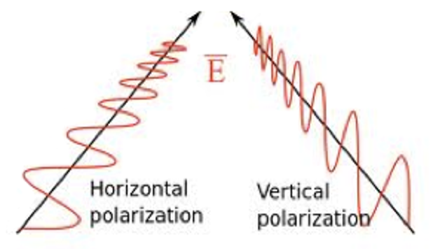
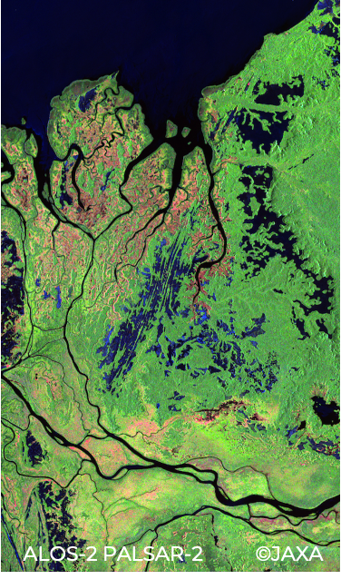
Why fully polarimetric data?
Fully polarimetric (“quad-pol”) data provides information about both backscatter amplitude and backscatter phase - for each polarisation combination (HH/HV/VH/VV)
Polarimetric phase varies depending on the ground target → enables enhanced retrieval of target structural parameters
PolSAR field still in its infancy - mainly due to lack of consistent time-series of QP data for R&D
Trade-off: QP-swath half of DP-swath → affecting temporal resolution or regional coverage
Need to justify that QP sacrifice (Catch 22)

Slide 11
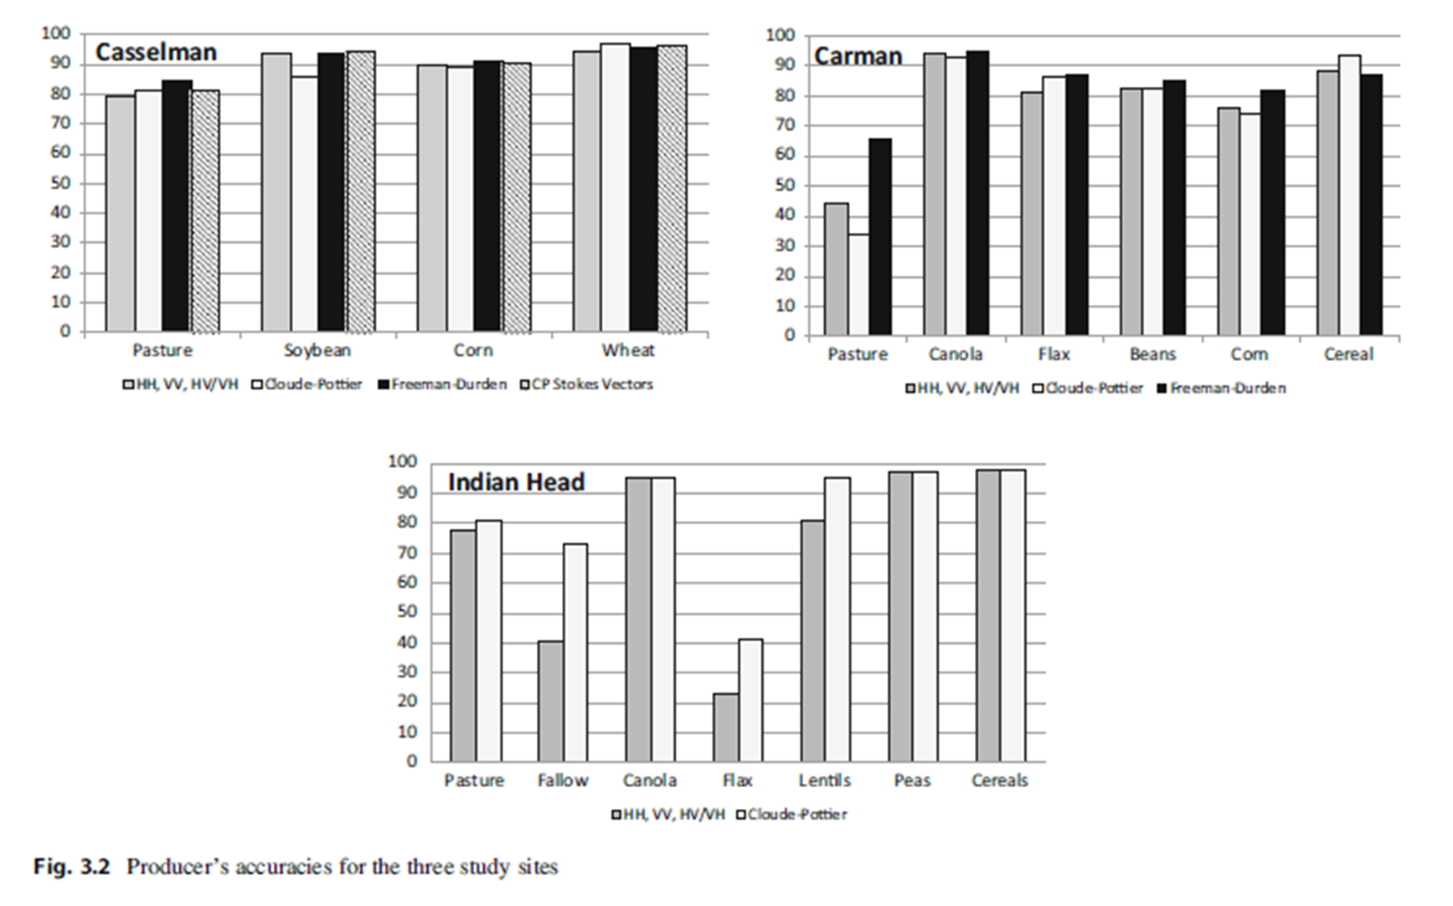
Why fully polarimetric data?
Classification accuracy when using time series of Radarsat 2 for crops
Using all the channels (HH, HV, VH, VV) or quad-pol decompositions or Stokes Vectors improves the performance compared to dual pol when dealing with some crops

Slide 12
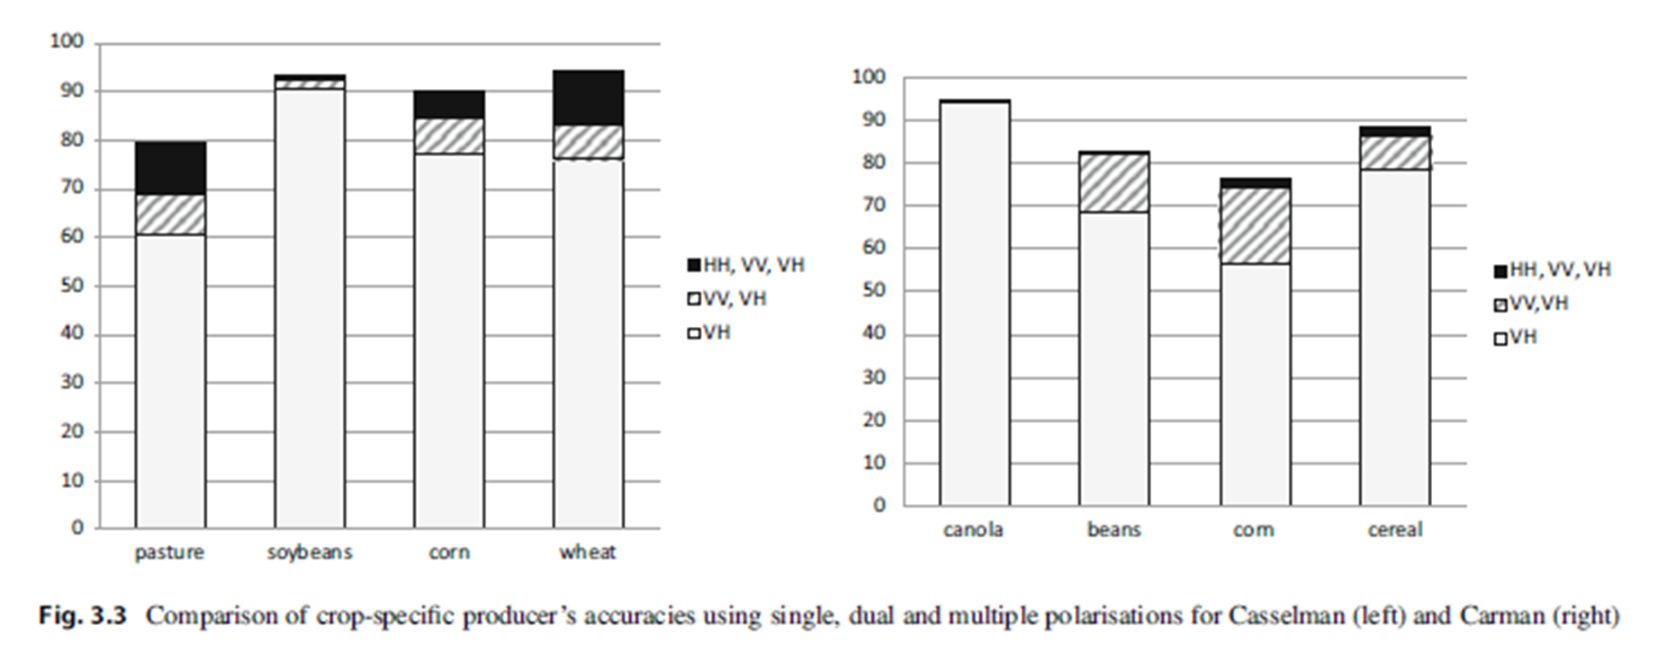
Why fully polarimetric data?

Slide 13
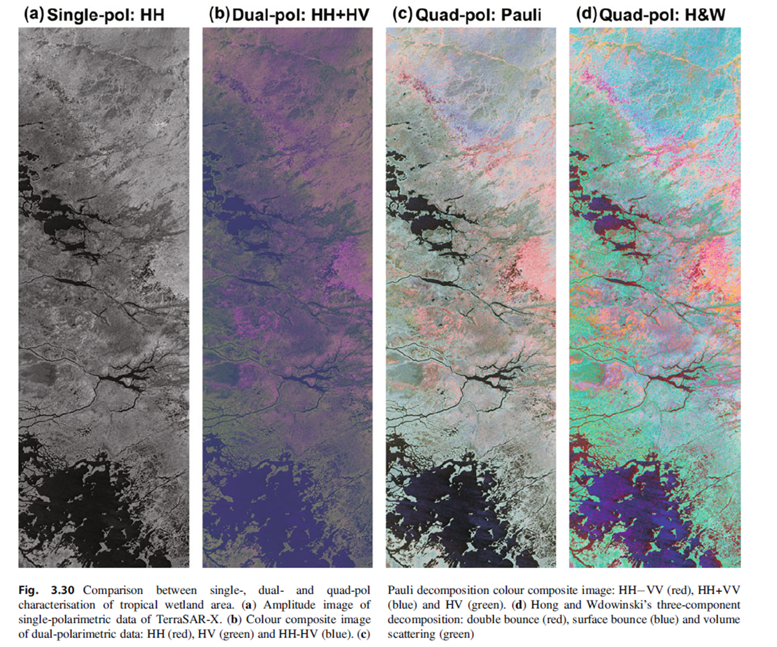
Why fully polarimetric data?
Radarsat 2 wetland observation
When having quad-pol we can obtain better target detection in the wetland area.

Slide 14
The way forward - long term
Collect information regarding on-going/planned QP/CP acquisitions over specific sites
Find common (geographically overlapping) areas
Coordinate future acquisitions (taking into account in-situ measurements)
Find a mechanism to share data with the community from single data sharing point

Slide 15
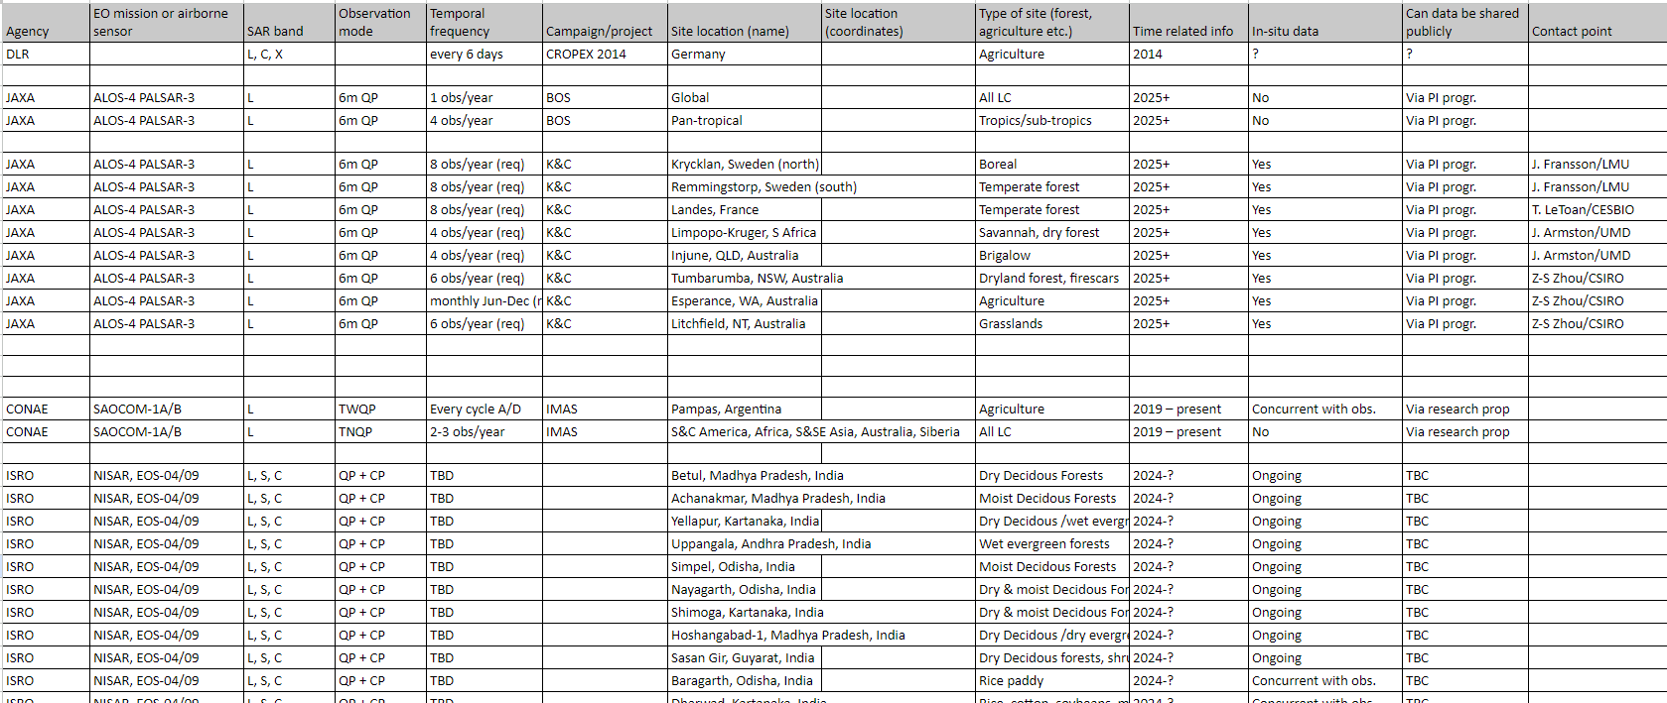
Planned and existing datasets
A global network of forest reference sites (forest census, airborne and terrestrial lidar) is currently established under GEO-TREES. All data will be open and free. Systematic EO data acquisition of these sites would foster R&D.​

Slide 16
The way forward - short term
Form small “CEOS PolSAR Team” from ongoing R&D projects (selected “willing” members from e.g. ESA POLINSAR team, JAXA K&C team, CONAE, CSA/NRCan, GEO-TREES, GEOGLAM, DLR airborne campaign team, ISRO, etc.)
Request multi-sensor QP/CP observations over QP Reference Sites selected by PolSAR Team
Start by using already archived QP/CP data (to hit the ground running when dedicated observations become available)
Aim: Demonstrate advantages of QP data over DP (needed to justify the additional “cost” of QP (temporal repeat, processing complexity, etc))
2025 ESA POLINSAR ws
Special session & interim reporting by PolSAR Team members
PolSAR Team coordination & planning meeting
How can we broaden the PolSAR/PolInSAR community to non-expert users?
Better TOOLS required! PolSAR analysis is not straight-forward. Improved functionality in e.g. SNAP, pyroSAR etc required
Promote generation of CEOS-ARD PolSAR products

Slide 17
Request for the SIT
Space Agencies to collect polarimetric (on best effort basis) data over a number of reference sites that are TBD
Work out a common mechanism to share the data over the reference sites with the community
....
(To be completed for the SIT)

