Slide 1

SIT-39
2024
GEOGLAM
Alyssa Whitcraft | GEOGLAM
Agenda Item # 3.5
SIT-39 2024, Tokyo, Japan
10th - 11th April 2024

Slide 2
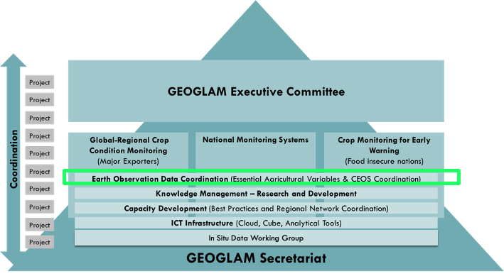
GEOGLAM’s Relationship with CEOS
GEOGLAM enjoys a long-term relationship with CEOS on coordination of EO data
GEOGLAM shares satellite data requirements:
  Acquisition:
    Spatial
    Spectral
    Temporal
    Radiometric
  Access & Compute
  Products??

Slide 3


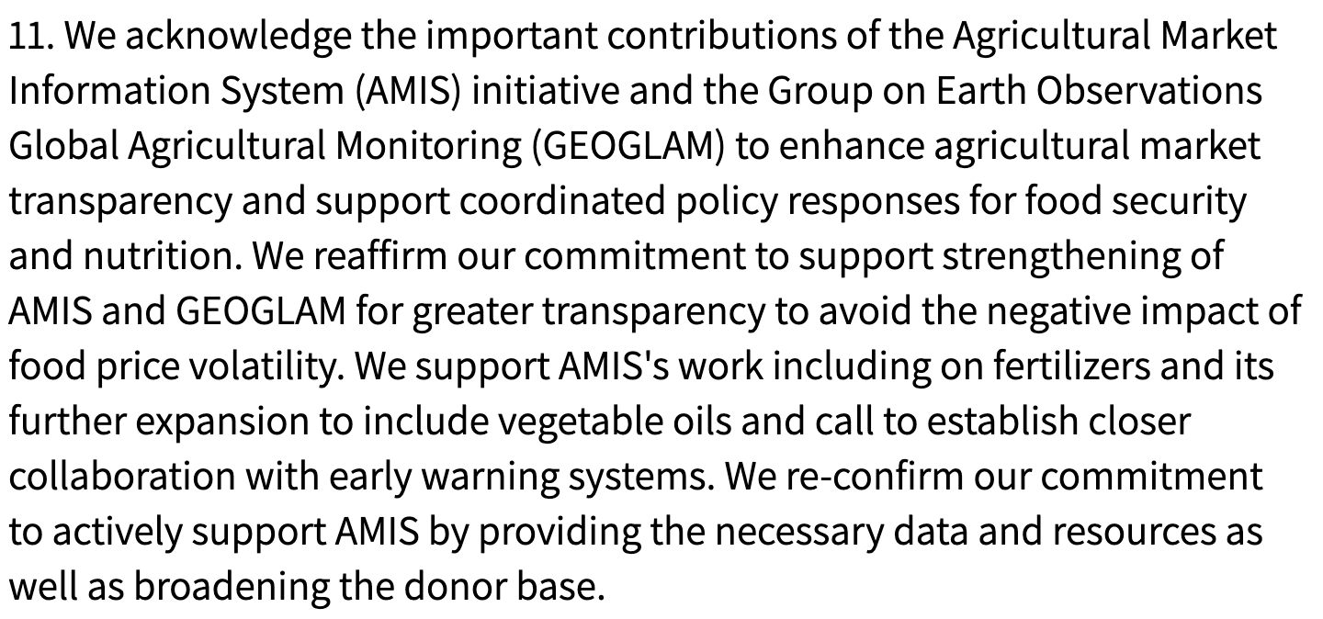
GEOGLAM General Update
New GEOGLAM Secretariat Director –
Sven Gilliams
  With thanks to Ian Jarvis for his 5 years as Director!
GEOGLAM Co-Chairs
  Wu Bingfang (Chinese Academy of Sciences)
  Chris Justice (University of Maryland)
  Bettina Baruth (European Commission)
  Jana Plogmann (German Ministry of Ag)
GEOGLAM again endorsed
by the G20 🡪
GEOGLAM also supporting national reporting, AFOLU, Sendai, SDGs, LDN…
CEOS is a key partner of GEOGLAM

Slide 4
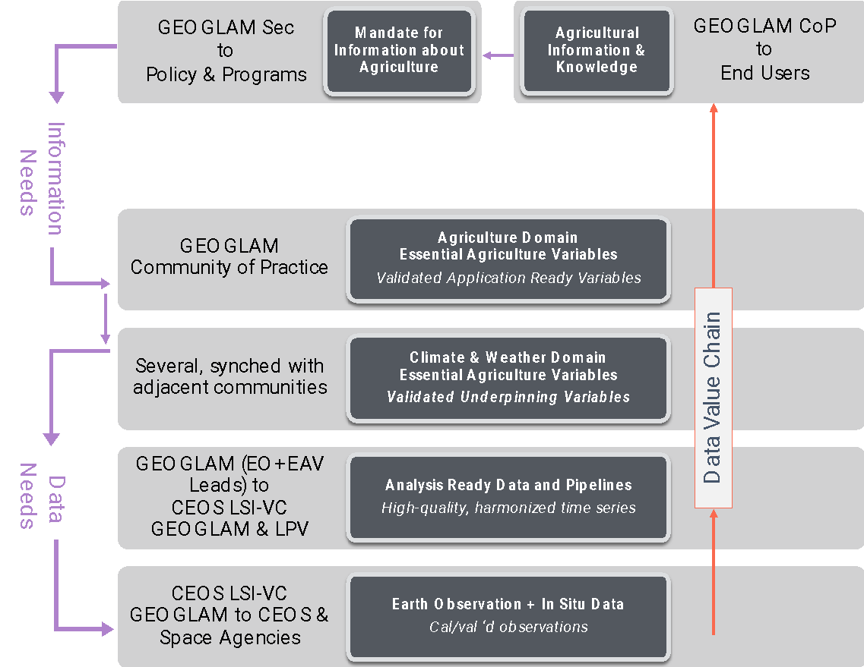
From a 2018 GEOGLAM community survey
(small sample, but representative)
From Ag Monitoring “End User” organizations:
All agreed that their organization would benefit from a greater use of EO data in their org’s decision making
Q: If your organization does not use satellite EO at any level of their decision making process, why is that the case?
“…org interested in EO, unsure how to incorporate”
“…org thinks EO data are too expensive or difficult to access…”
“…org thinks EO data are too unreliable to implement operationally…”
Other answers:
  Can’t keep up to date with which products are good
From EO-for-Ag practitioners:
<50% agreed that they had access to all of the EO they needed for their analyses
65% agreed they required additional technical support to download, process, or utilize EO (even seasoned EO practitioners!)
Strong indication of desire for standard products:
  Cloud-free, intercalibrated/harmonized time series (“ARD”)
  Essential Agriculture Variables like crop type map, crop calendar …
Most consistent boundary identified: lack of field data!
Whitcraft, et al. (2018)
Notes:
Recurring theme of difficulty in access/discovery as well as in perceived/actual unreliability.
New sensors, new methods 🡪 constant iteration
Need consensus voice 🡪 what’s real, what isn’t?

Slide 5
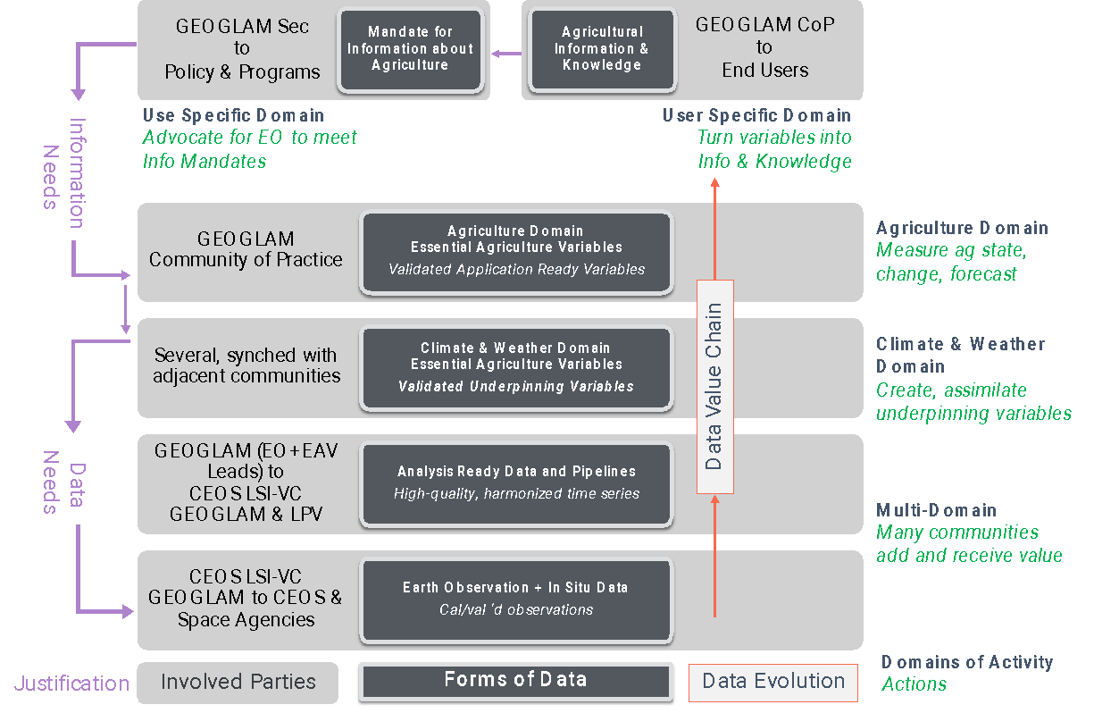

Satellite Data Value Chain
“Data produced must be policy-relevant and not exist for its own sake.” (UN Statistics Division, 2017)
  Clear mandate to harmonize and synergize
“Essential Agriculture Variables” (EAVs) emerged as a unifying framework to maximize EO value and meet multiple information and decision needs

Slide 6
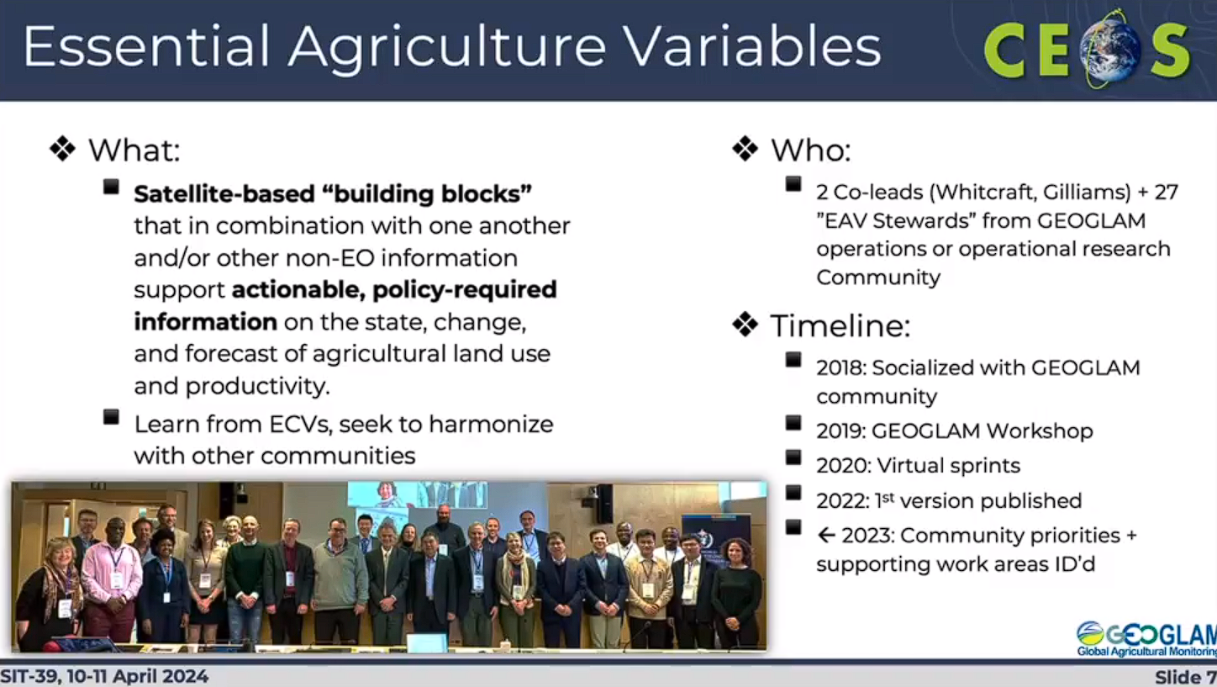

Slide 7
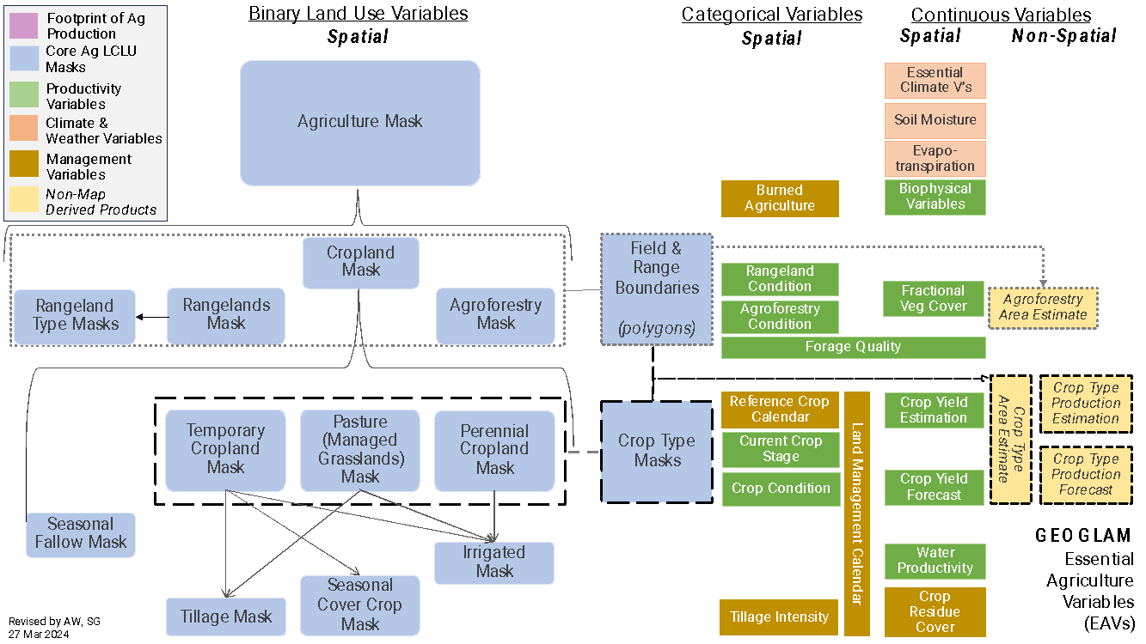

Slide 8
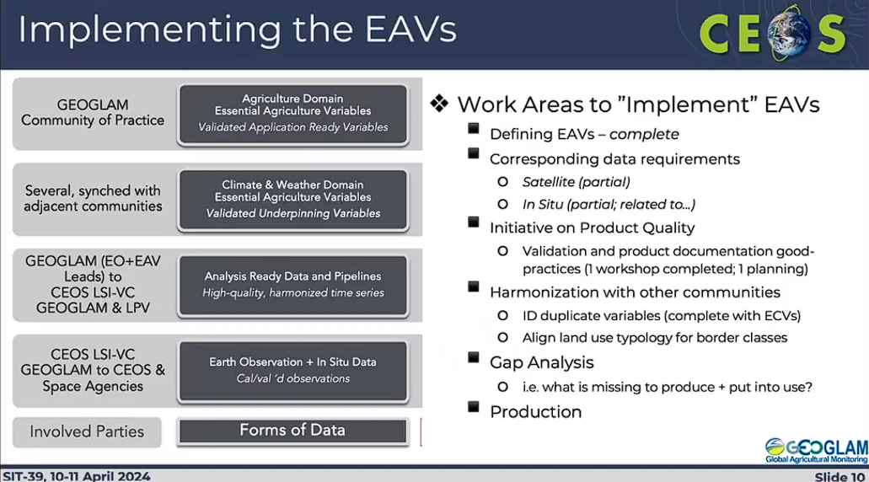

Slide 9
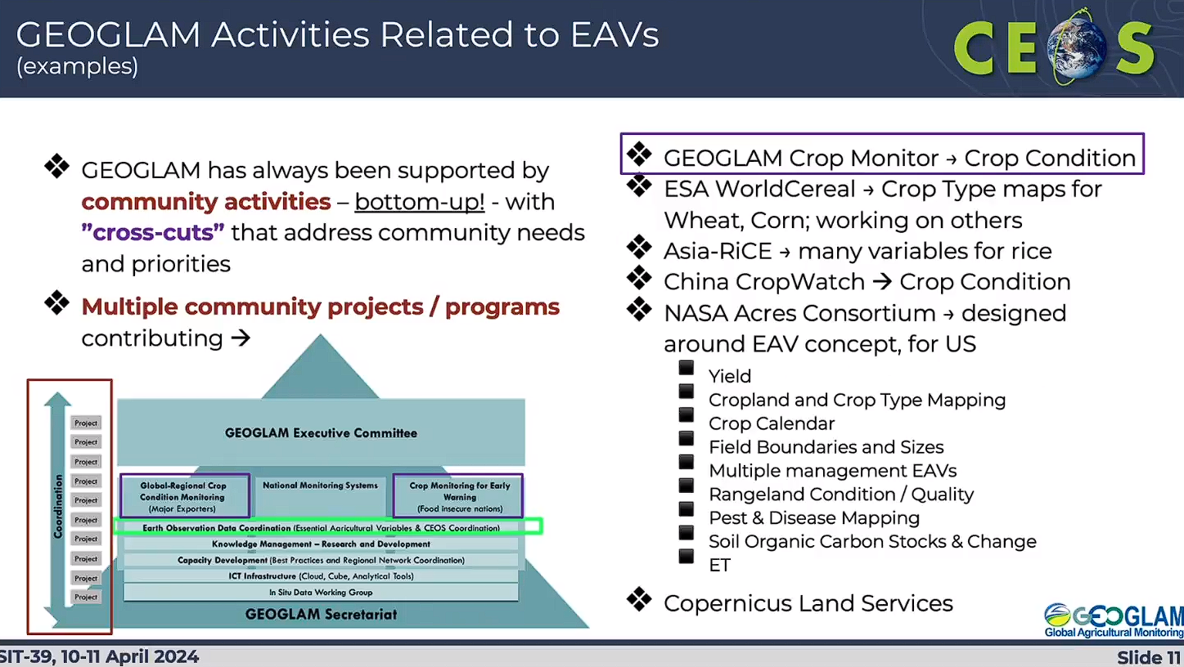

Slide 10
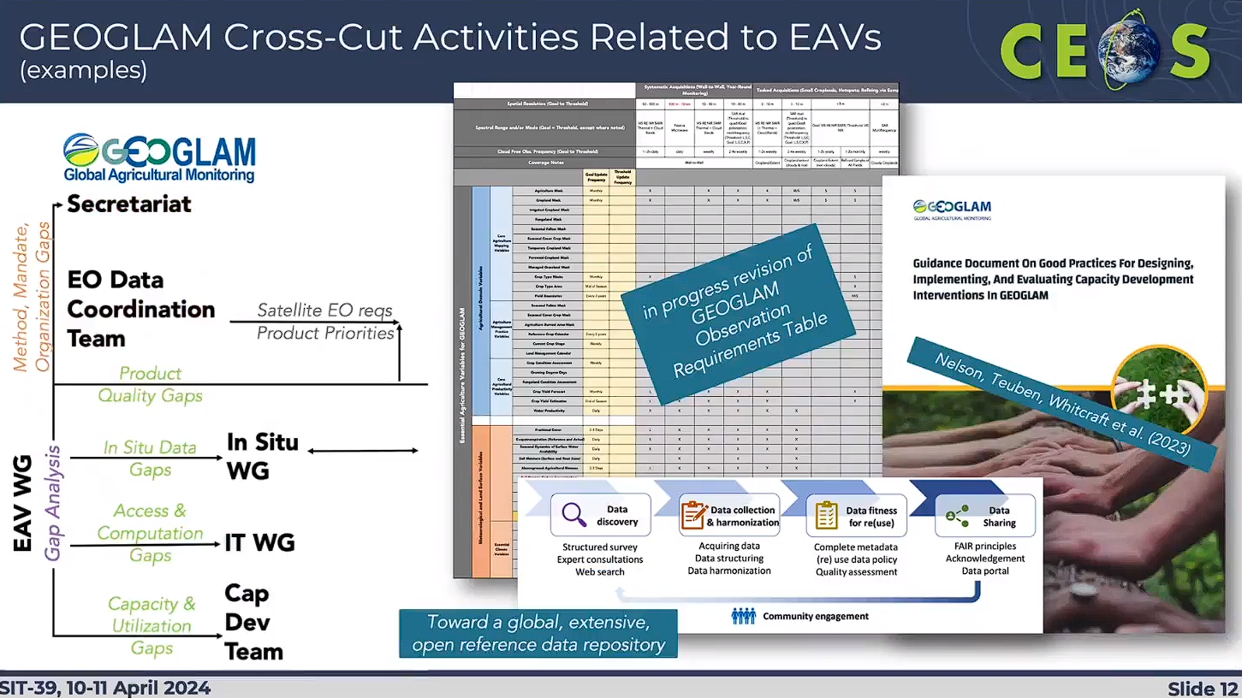

Slide 11
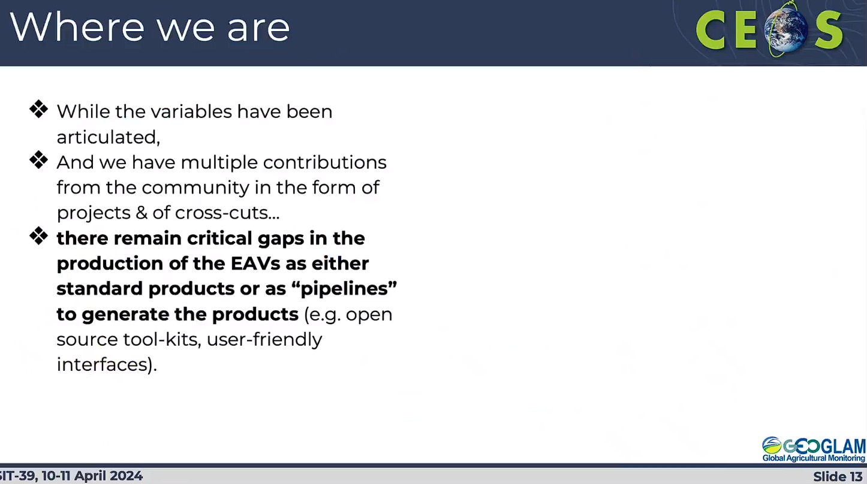

Slide 12
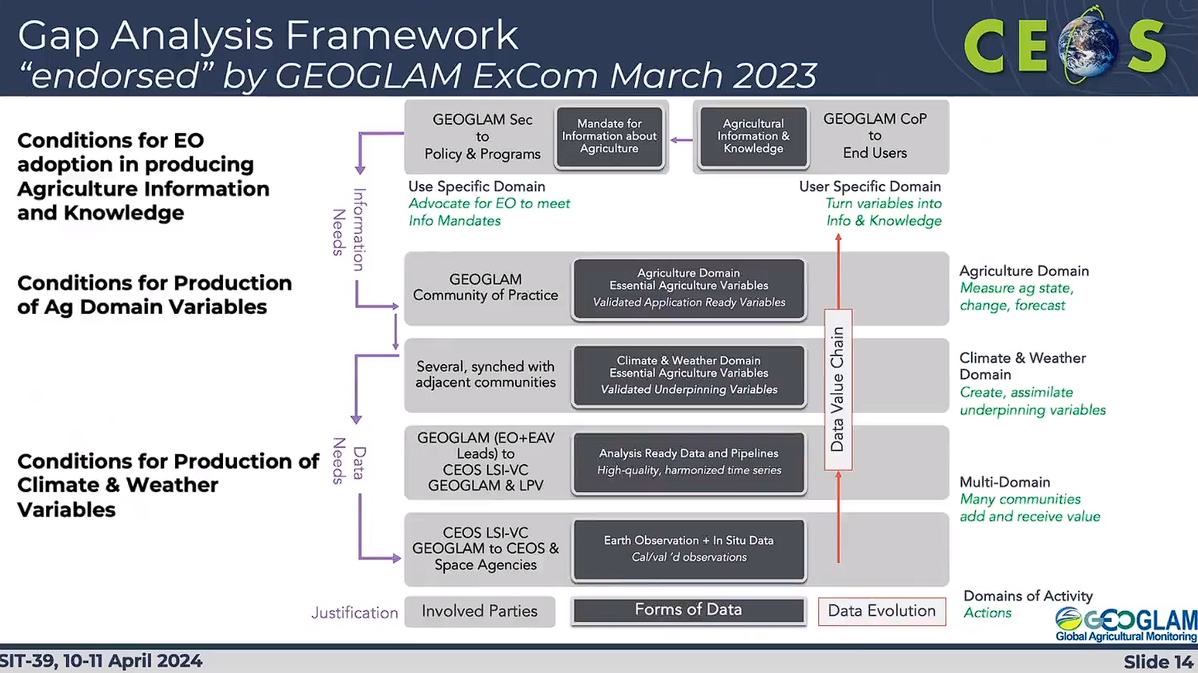

Slide 13
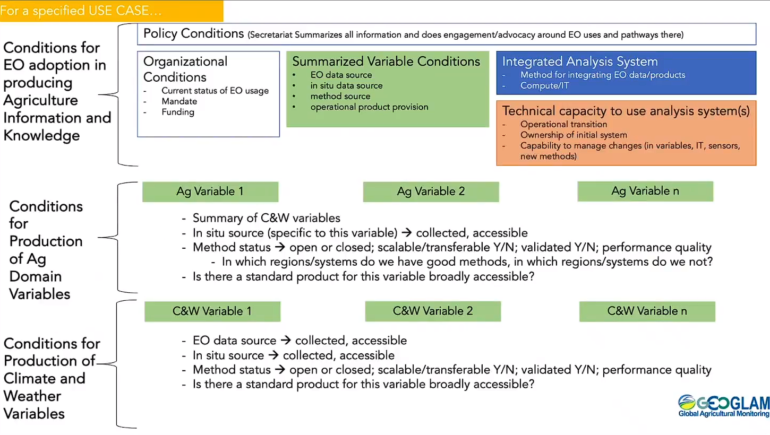

Slide 14
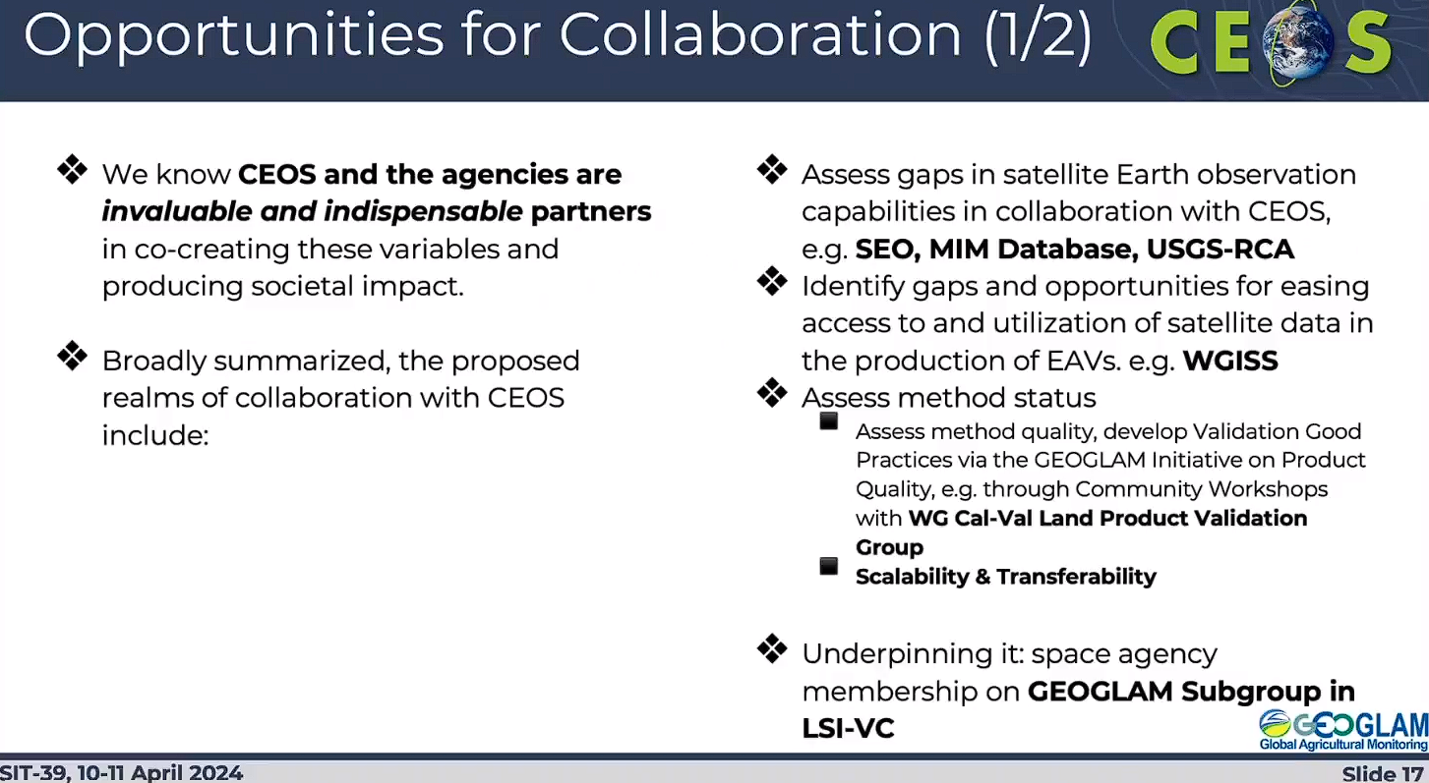

Slide 15
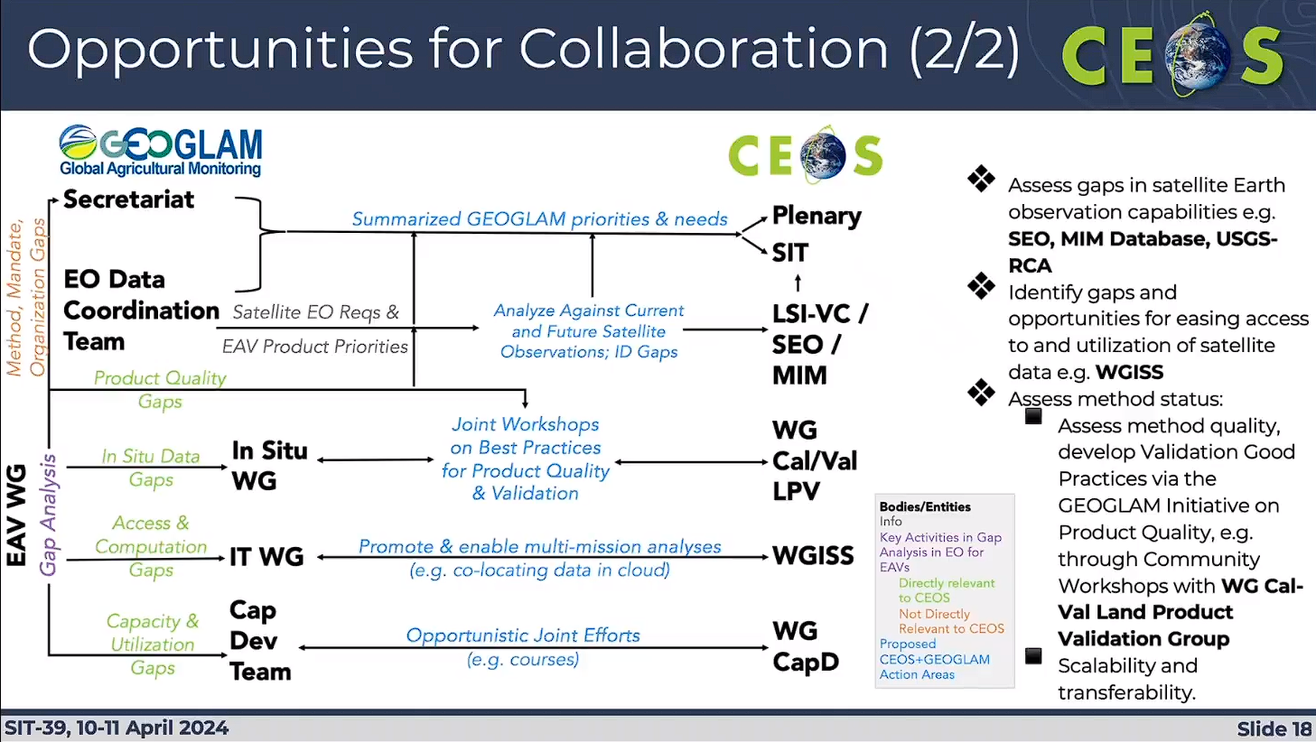

Slide 16
