Slide 1
Biodiversity
Exploring connections with LSI –VC
Gary Geller
NASA Jet Propulsion Laboratory
California Institute of Technology
Agenda Item 5.1
LSI-VC-15
3-5 April 2024
Tokyo
(c) 2024 California Institute of Technology. Government sponsorship acknowledged.

Slide 2
Agenda
Introduction and context
EBVs and product workflow
Challenges & possible scenarios
Thoughts from LSI-VC

Slide 3
Key messages
The biodiversity community has limited technical capacity
Derived, higher level products are needed
  EBVs and Indicators are always L3 or L4
Capacity limitation impact
  Algorithms & software
  Product generation

Slide 4

Background
Biodiversity: The variety of life on Earth
  Genes
  Species
  Ecosystem
Ecosystem Extent Task Team
  2022 Plenary: Approved
  2023 Plenary: white paper endorsed
  2024 Plenary: Demonstrator(s)
Overarching goal: Enduring CEOS engagement with biodiversity
  EO not yet fully exploited
Wikimedia Avoini

Slide 5
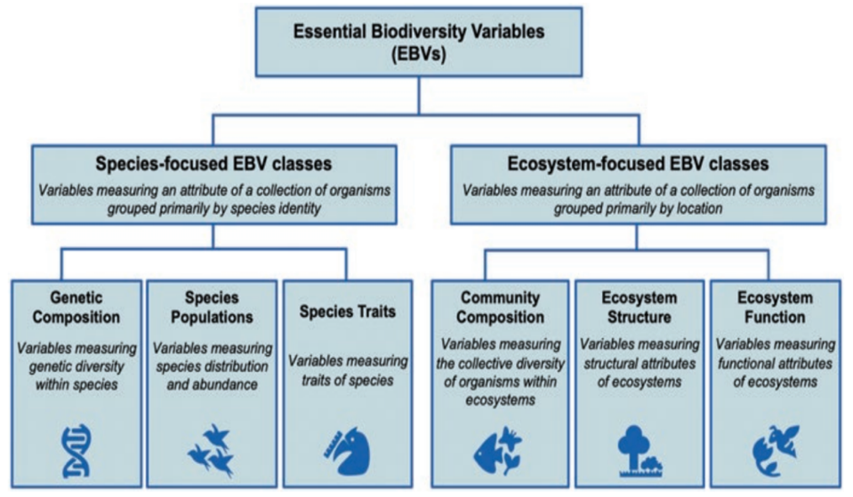
Essential Biodiversity Variables
Set of measurements to capture
the major dimensions
of biodiversity and how it is changing
Pereira et a. 2013, Fernandez et al 2020
Notes:
Slide from Kim and Navarro webinar 2020

Slide 6
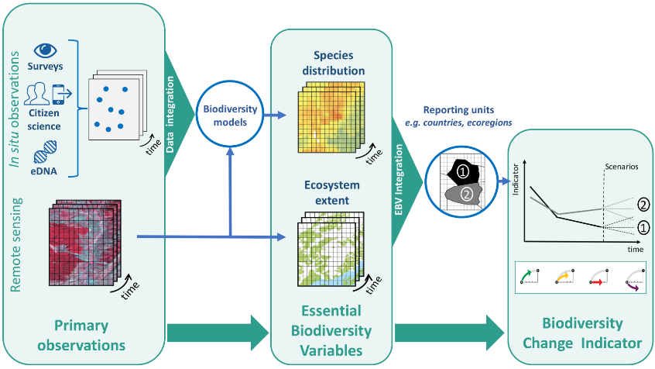



Conceptual workflow
Users
National Governments
Navarro et al. 2017 COES
Notes:
This is the overall workflow from observations to EBVs, indicators, and users…but, this is not commonly operationalized. GBiOS would facilitate that process.

Slide 7
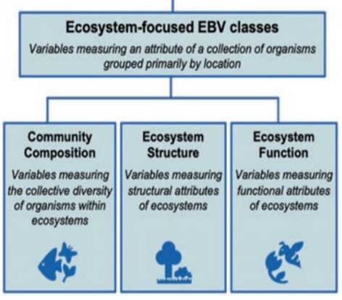
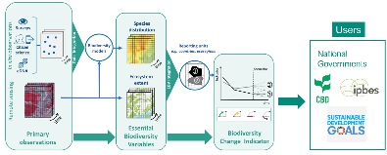
Example: Ecosystem Condition
Key input to many other products
Assessed via ecosystem components
Example products
  Structure: Height, vertical biomass profile, fragmentation
  Function: Phenology, traits (e.g., water content, lignin)
  Composition: Who lives there

Slide 8

However…Challenges
Workflows mostly not operationalized
Product algorithms often not available
Production resources limited
EO data usability & technical capacity of users
US National Park Service

Slide 9
Recommendation: Support for R&D
Develop algorithms for value-added biodiversity products
Release as open source software 🡺 existing toolkits
  BON in a Box; ESA Earth Online; others
User can then…
  Generate products on their own system
  Modify code if needed (e.g., for local conditions)
Only a partial solution
  Limited technical capacity (processing; code updates)

Slide 10
Some Solution Scenarios
Multi-faceted problem—no silver bullet
Dream world: agencies generate all EBVs and indicators
White paper recommendations
  Support algorithm development via R&D
    Could LSI-VC help coordinate R&D calls?
  Continue capacity building
Some product generation support
  Generate selected products (e.g., Copernicus; “MODISify Landsat”)
  Provide production options (e.g., like Copernicus DIAS)
  Could LSI-VC help coordinate to maximize impact at least overall cost?

Slide 11
Key messages
The biodiversity community has limited technical capacity
Derived, higher level products are needed
  EBVs and Indicators are always L3 or L4
Capacity limitation impact
  Algorithms & software
  Product generation
Several solution scenarios

Slide 12
Thoughts from LSI-VC?

Slide 13
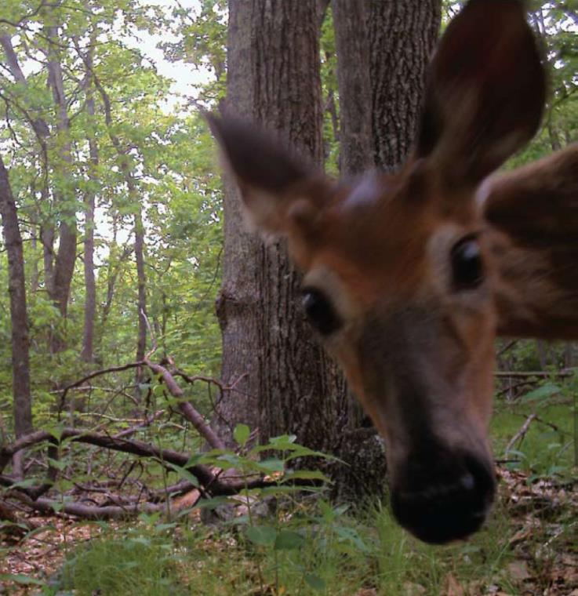
Thank you
US FWS

Slide 14
Backup

Slide 15
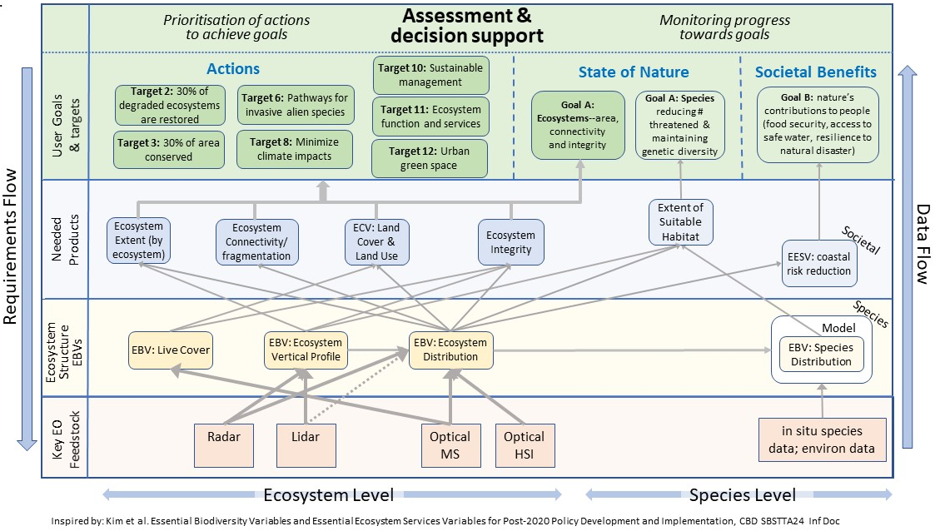
Observations, EBVs, Products…

Slide 16
User example: Key Biodiversity Areas
Areas of international biodiversity importance because of their species or their ecosystems
  Global standard
More than 16,000 KBAs
Many are remote, cannot be monitoring except by EO
Minimal technical and production capabilities
“We need something like World Resources Institute Global Forest Watch”

Slide 17
Additional resources
GEO BON website, and overview (slides and video)
Ecosystem Extent and Integrity (slides and video): key variables for which satellite EO is essential
UN SEEA: ecosystem accounting variables (extent, condition, services…)
Workshop linking EO and in situ for a global system
Example dashboard highlighting products ASEAN Biodiversity Dashboard
World Economic Forum Global Risks Report 2021
IUCN position paper for UNFCCC COP26

Slide 18
Recommendation Area 1
Thematic Recommendation
Specific Recommendations
1. User Engagement
Increase biodiversity community engagement with EO and CEOS through workshop(s) and other activities to improve ecosystem extent mapping.
Key organizations:
Convention on Biological Diversity
UN System of Environmental Economic Accounting
GEO Global Ecosystems Atlas initiative
Ramsar Convention on Wetlands
1a. Identify specific user requirements to guide EOs & identify products needed for ecosystem extent.
1b. Establish a sustainable communication channel between CEOS and user communities for continued interaction.
1c. Improve CEOS understanding of technological, socio-political, and cultural constraints for the biodiversity community to use EO data.

Slide 19
Recommendation Area 2
Thematic Recommendation
Specific Recommendations
2. Technical advances
Support development of technical advances to improve utilization of EO for ecosystem mapping.
2a. For each ecosystem, identify the key EOs and processing methods needed for its delineation.
2b. Facilitate combining data from different types of sensors to take advantage of their complementarity.
2c. Facilitate time series analysis and its application to ecosystem extent mapping.
2d. Explore ways to utilize EO to characterize ecosystem condition and its relationship to ecosystem extent.

Slide 20
Recommendation Area 3
Thematic Recommendation
Specific Recommendations
3. Capacity
Work to increase capacity of biodiversity users to utilize EO for ecosystem mapping and monitoring.
3. Identify opportunities for capacity development resources, e.g., a training or a Massive Open Online Course (MOOC) focused on the use of EO for ecosystem mapping and monitoring.

Slide 21
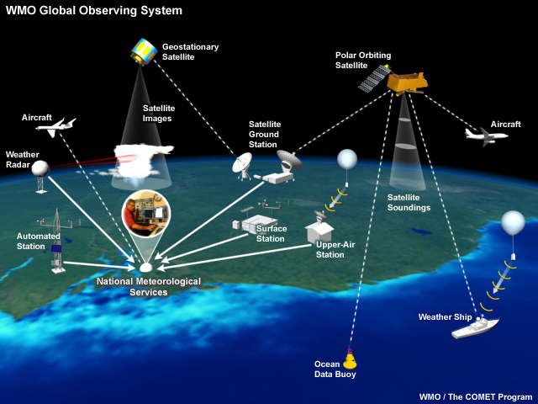
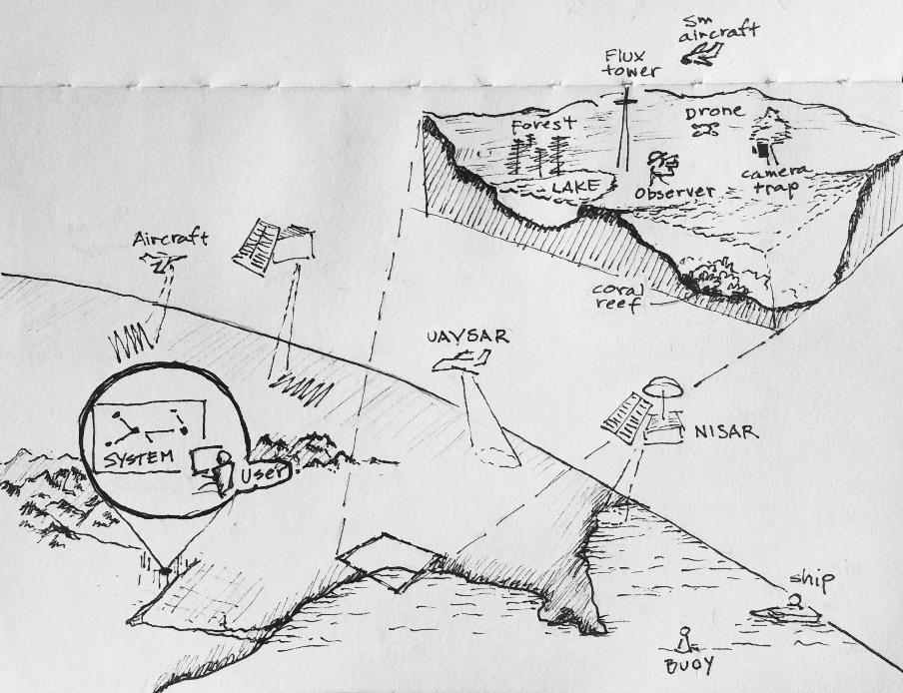
Global monitoring
Global Biodiversity Observing System (GBiOS)
Weather
Notes:
WMO Global Observing System:
Globally integrated system with many components
Many partners
Developed and grown over time
Acquires data, processes it, shares it with others in the network, delivers it to users

