Slide 1
LSI-VC-15 2024 CEOS Interoperability Handbook 2.0
Nitant Dube, WGISS
Agenda Item 3.1
LSI-VC-15 2024, Tokyo
3rd - 5th April 2024

Slide 2
CEOS Interoperability Handbook V2.0
Objective
CEOS Interoperability Handbook Version 2.0 should provide guidance to the organizations for development of Interoperable Data and Services and help them in Measuring their maturity level.
Maturity Matrix
Interoperability Handbook
Notes:
Looked at other frameworks
Didn’t try to re-invent wheel
This is the “CEOS” framework … vs. “adopting” someone else’s framework

Slide 3
Work Plan 2024-2026
Year | 2024 | 2025 | 2026
Interoperability Framework | Handbook V2.0 | Handbook V2.0 + Maturity Matrix | Interoperability Demonstration : Development of Earth Observation Plug and Play (EOPnP) modules
Year-2024 | Q1 | Q2 | Q3 | Q4 (Milestone#1)
Handbook V2.0 | E-mails sent, with request for identification of Champions | Discussions with Champions/ leads and Draft Sketch of HB 2.0 | Detailed discussions on each Factors | Presentation of Draft HB2.0 during WGISS-58
Year-2025 | Q1 | Q2 | Q3 | Q4 (Milestone#2)
Handbook V2.0 + Maturity Matrix | Presentation of Final version of HB2.0 during WGISS-59 Maturity Matrix Discussions during WGISS-59 | Release of HB 2.0 for comments Development of Maturity Matrix | Incorporation of Comments Development of Maturity Matrix | Endorsement during CEOS Plenary Presentation of Maturity Matrix during WGISS-60

Slide 4
Interoperability Factors
Interoperability
Vocabulary (Semantics)
Policy
Architecture
Interface (Accessibility)
Quality
Naming and Meaning of Data Elements
Policy to ensure Interoperable data and services
Open Data, Open Science, Open Source Science
Data formats, Analysis, Stewardship and Preservation
Analysis
Data Discovery and exchange protocols and API
Calibration, Validation, Quality Tags
Notes:
Looked at other frameworks
Didn’t try to re-invent wheel
This is the “CEOS” framework … vs. “adopting” someone else’s framework

Slide 5
CEOS Initiatives linked to Factors
Factor | Vocabulary (Semantics) | Architecture | Interface (Accessibility) | Quality | Policy
CEOS Initiatives | CEOS Common Online Dictionary Long term Preservation of Earth Observation Space Data : Glossary of Acronyms and Terms | CEOS-ARD (Guidelines) CEOS Persistent Identifiers Best Practices WGISS Data Management and Stewardship Maturity Matrix | WCDA, FedEO, CWIC, IDN CEOS Open Search Best Practices CEOS Service Discovery Best Practices | CEOS CALVAL & QA4EO LSI-VC consistent calibration and pre-processing | Data Purge Alert

Slide 6
Contributors
Factor | Vocabulary (Semantics) | Architecture | Interface (Accessibility) | Quality | Policy
WGISS | Katrin Molch |  |  | Nitant Dube | Tom Shore
WGCV
LSI-VC | Peter Strobl (EU commission) | # |  | #
WGCapD
CEOS-COAST |  |  |  | Prasanjit Dash
SEO/CEO

Slide 7
Thanks
nitant@sac.isro.gov.in
tshore@usgs.gov
Interoperability meeting is scheduled on Every Second Wednesday of the month

Slide 8
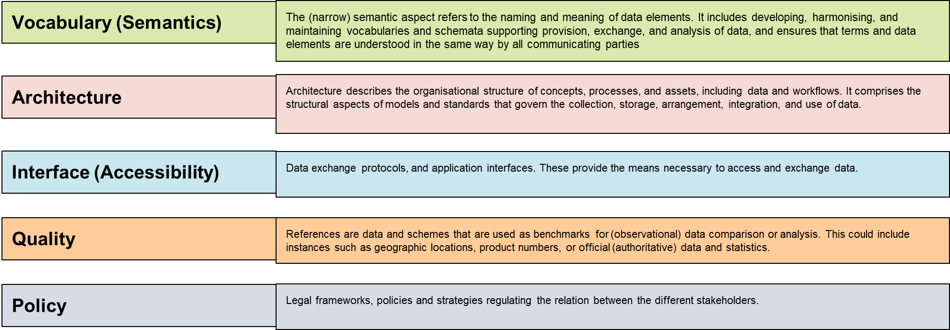
Interoperability Framework : Factors
Notes:
Looked at other frameworks
Didn’t try to re-invent wheel
This is the “CEOS” framework … vs. “adopting” someone else’s framework

