Slide 1
Surface Reflectance Quality, Equivalency and Consistency in Support of CEOS-ARD Interoperability
Medhavy Thankappan
Geoscience Australia
CEOS LSI-VC 15
3 - 5 April 2024

Slide 2
Context
Bespoke production workflows that re-generate surface reflectance (SR) products due to issues with interoperability of CEOS-ARD SR products (e.g. NASA Harmonised Landsat Sentinel and ESA Sen2Like products)
The CEOS-ARD initiative has been effective in promoting the need to standardise surface reflectance products but does not prescribe SR measurement equivalence as a requirement for interoperability
Ambiguity in definition of the Surface Reflectance measurand [Schaepman-Strub et. al., 2006].
Many approaches to "surface reflectance" production, including inputs, model selection and model parameters.

Slide 3
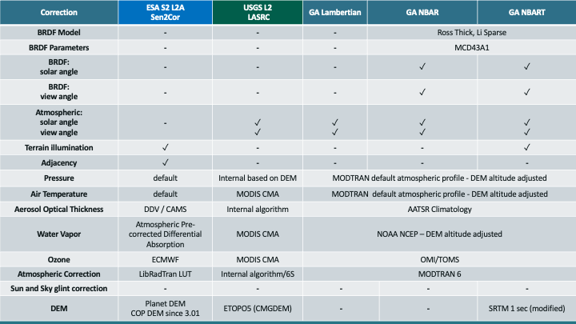
SR production approaches

Slide 4
Proposal
Proposal to build on CEOS-ARD achievements and take next steps to deliver on CEOS-ARD multi-sensor interoperability objectives
Seek to establish a set of inputs, corrections, associated parameters and tolerances for achieving SR equivalence in support of interoperability between CEOS-ARD SR products
Need for an agreed and unambiguous definition of SR in the context of CEOS-ARD cross-sensor interoperability, with potential for WGCV to provide guidance
Concept presented at ARD23 Workshop, WGCV (Jun 2023), LSI-VC (Oct 2023), briefing paper for discussion at WGCV (Mar 2024) - see Word document

Slide 5
Steps
Publish through appropriate channels as a key reference for practitioners
  CEOS-ARD Framework
  Standalone guidance document
  Surface Reflectance metadata specifications
  Journal paper
Determine tolerance of required inputs and methods
Confirm the range of required inputs and methods
Define the target measurand
  Explicit definition of surface reflectance in this context
Engage the expert community

Slide 6
Benefits
  Reduced duplication of effort​, cost savings​
  Increased global applicability of algorithms, instead of tuning for specific versions of surface reflectance​
  Consistent time-series across sensors and providers​
  Progress towards sensor-agnostic interoperability​
​

Slide 7
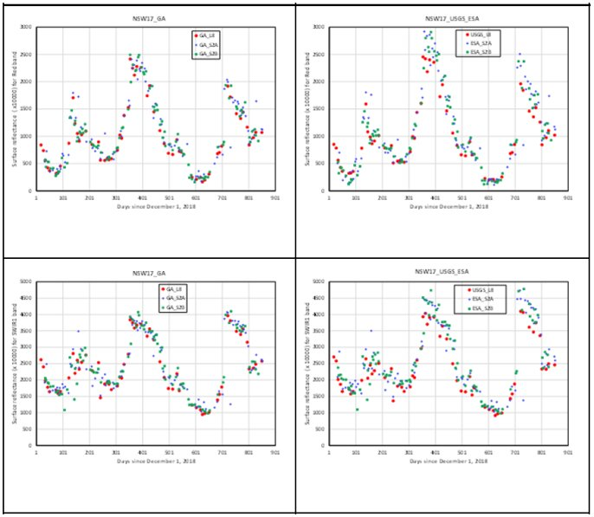
Example
Consistent approaches lead to equivalent surface reflectance measurands and yield better results from multi-sensor analyses​
Time-series consistency with common methods and inputs
Common methods
Agency-specific approaches

Slide 8
Outcomes from WGCV-53
Defining Surface Reflectance and its purpose, address uncertainties associated with SR products for specific applications, clarifying what users can expect from the product
Reporting what is done in the process for SR products is important, metadata should include information indicating what is being produced to avoid confusion and ensure consistency
Clarify the meaning of ‘interoperability’, could mean consistency in datasets to enable their use together.
WGCV and WGISS joint meeting (Oct 2024) will be a key opportunity to discuss interoperability of SR datasets

Slide 9
Thank you

