Slide 1
LSI-VC-15
2024
JAXA Mission Updates
Takeo Tadono, JAXA
Ake Rosenqvist, soloEO/JAXA
Agenda Item #2.6-3
LSI-VC-15 2024, Tokyo
3rd - 5th April 2024

Slide 2


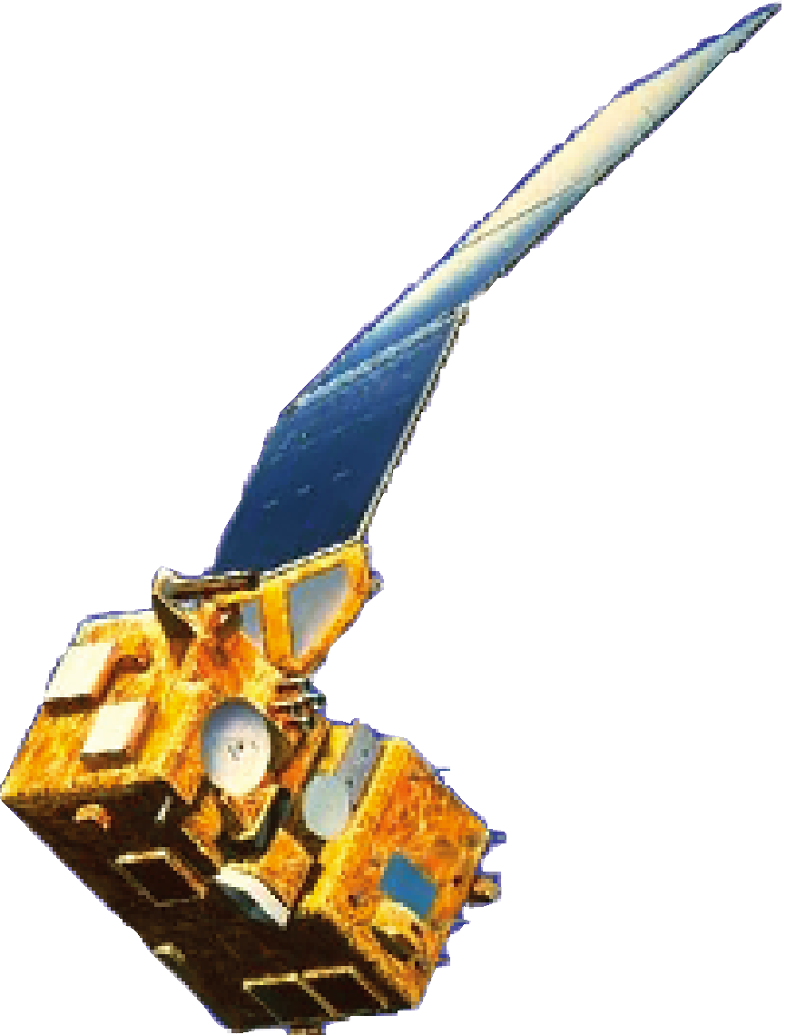
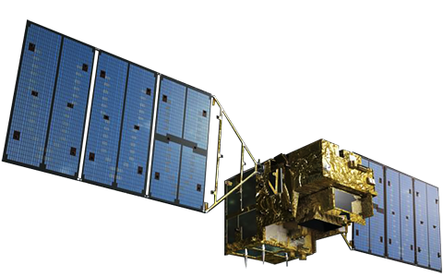
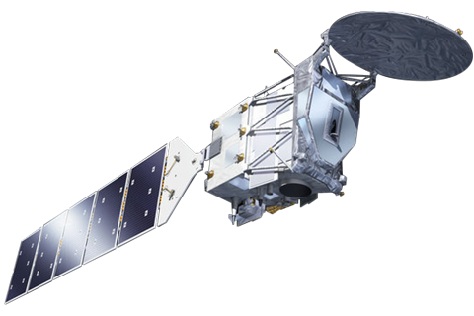
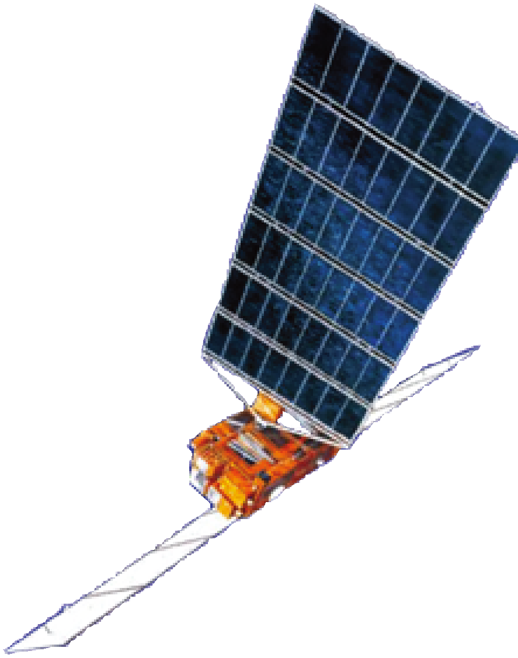
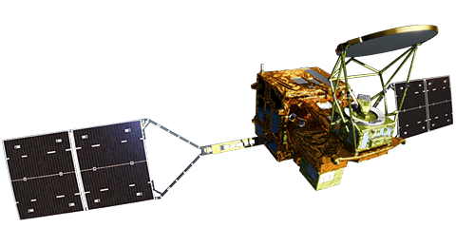

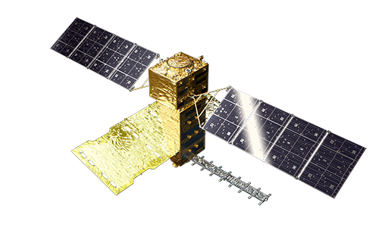
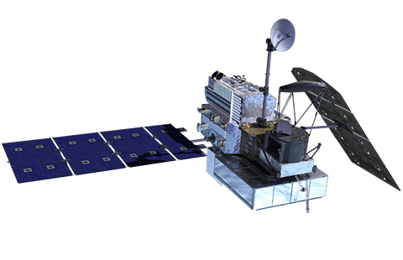
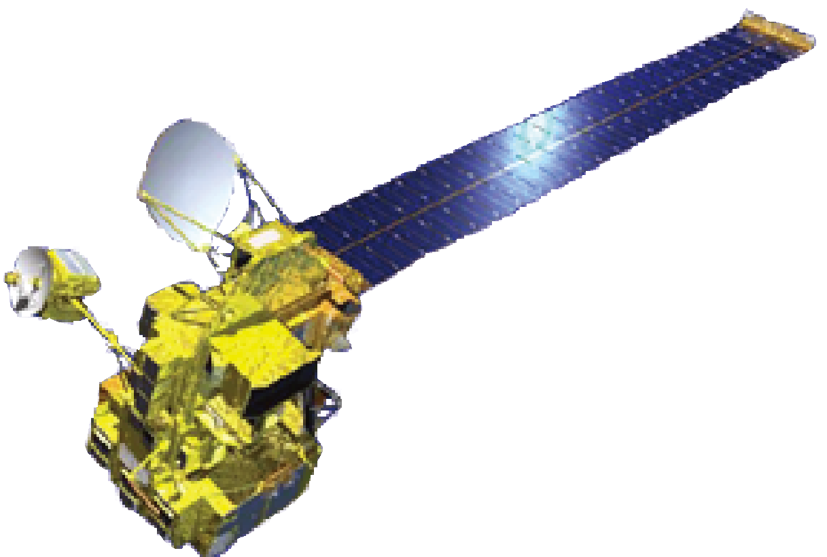

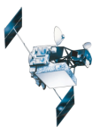
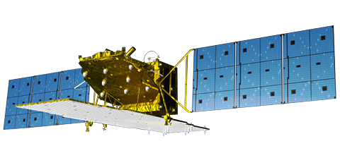
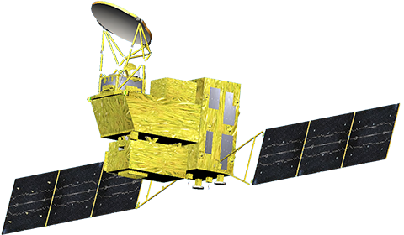
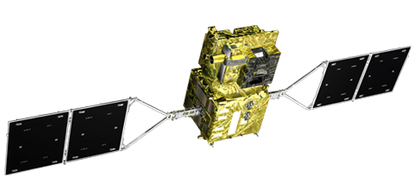

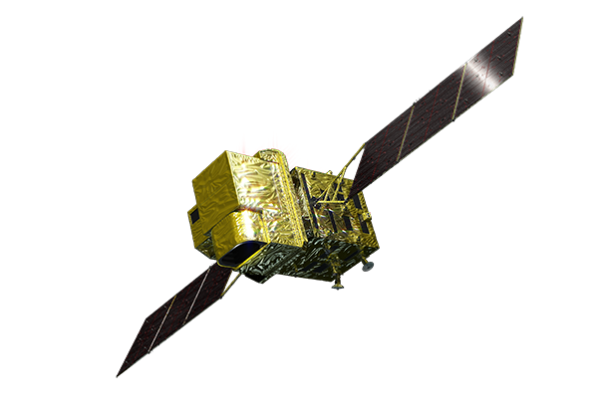
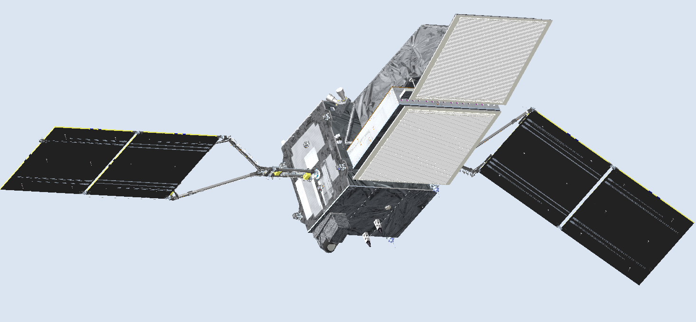
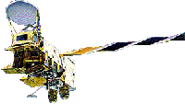
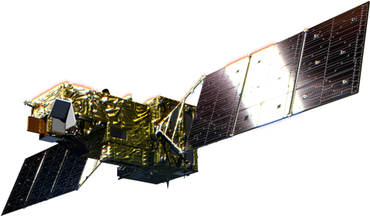
Completed
In Operation
To be Launched
MOS-1/MOS-1b
1987-1990/1995-1996
GOSAT
JFY2024
MOE/JAXA/NIES
EarthCARE
JERS-1
2009-
1992-1998
GCOM-W
2012-
ADEOS 1996-1997
GPM/DPR
ALOS-4
JFY2024
ADEOS-II 2002-2003
2014-
TRMM/PR
1997-2015
ALOS-2
GOSAT-GW
2014-
MOE/JAXA/NIES
JFY2024
ALOS
2006-2011
GCOM-C
2017-
PMM
JFY2028
Aqua/AMSR-E
GOSAT-2
ALOS-3 (Optical)
* Lost due to launch failure on March 7, 2023
2002-2015
MOE/JAXA/NIES
2018-
‹#›

Slide 3
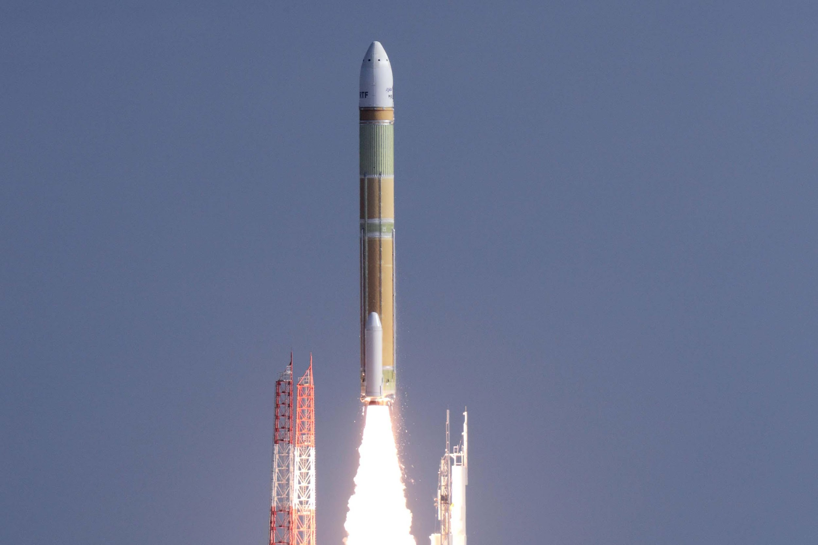
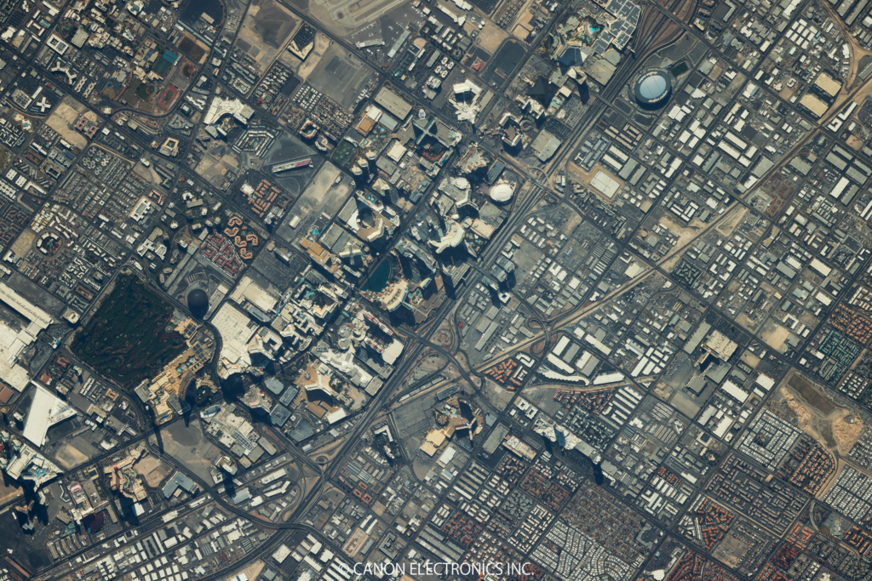
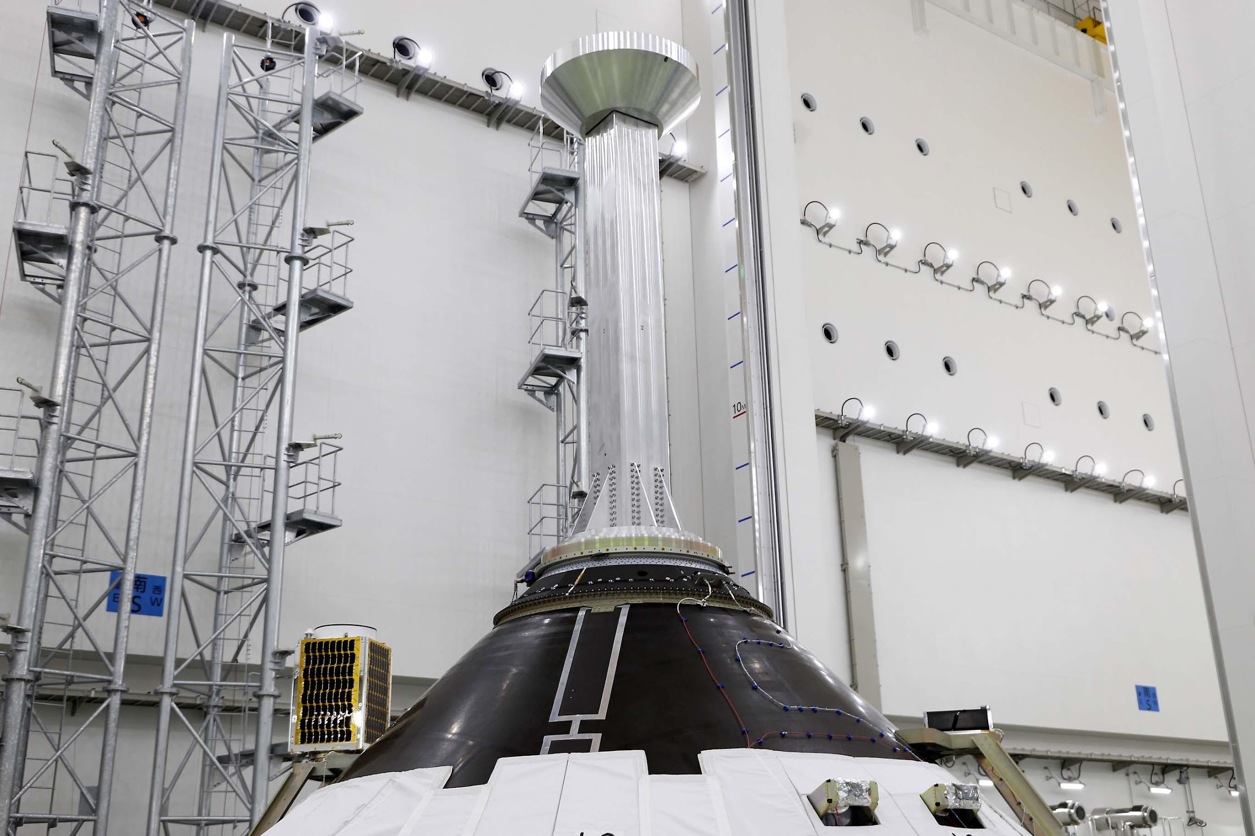
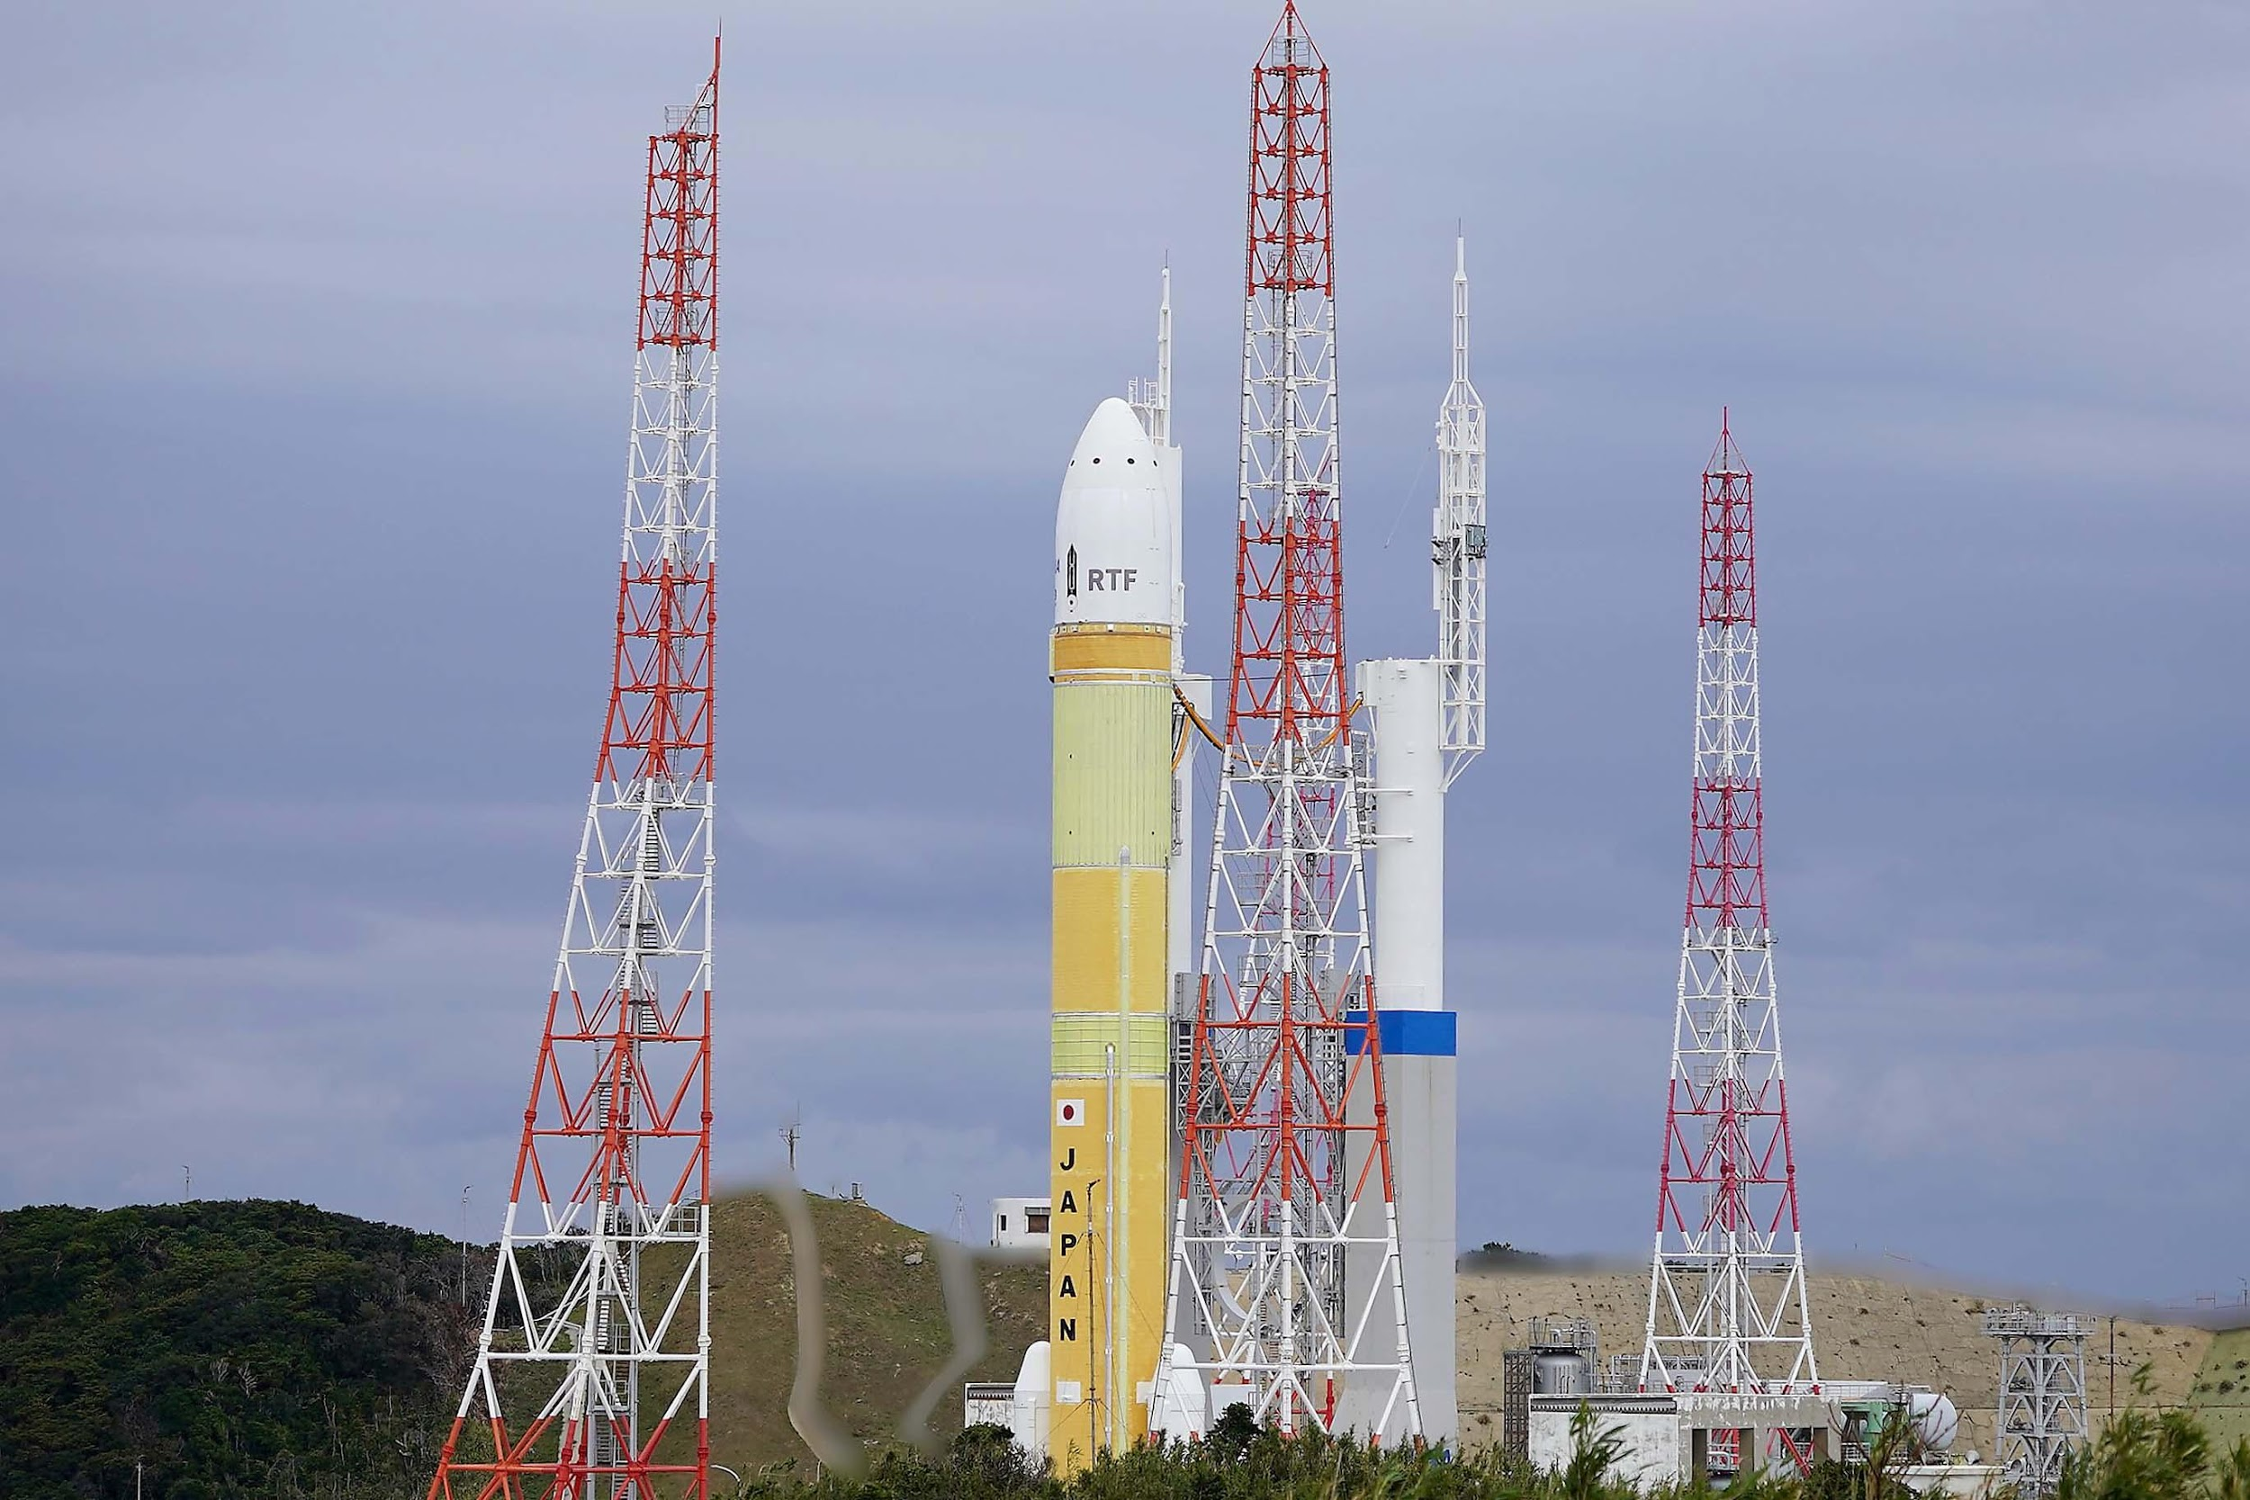
H3 Test Flight 2 on Feb. 17, 2024
H3 launch vehicle Test Flight 2 (TF2) was successfully launched on February 17, 2024.
H3-TF2 carried on the test payload “VEP-4” and two small satellites “CE-SAT-1E” developed by Canon Electronics Inc. and “TIRSAT” by the Japan Space Systems etc.
H3 now ready to move forward to the next mission launch.
VEP-4
CE-SAT-1E
TIRSAT
First light taken by EOS R5 onboard
CE-SAT-1E (March 10, 2024).
Configuration of H3TF2.

Slide 4
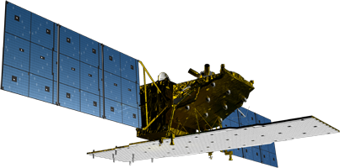
ALOS-2 & PALSAR-2
On-board internal calibration is performed every 3 months.
Product quality of major observation modes are being evaluated regularly using SAR data over calibration sites.
The standard product processing software was updated several times, including in June 2018 (radiometric calibration), Nov. 2018 (correction of range offset), and April 2021 (updates for Spotlight and ScanSAR).
> PALSAR-2 remains in good condition and performance.
PALSAR-2 calibration summary (using PALSAR-2 acquired 07/2014 – 09/2022)
Items | Results
Geometry (RMSE) | [Stripmap and Spotlight] 5.39 m (L1.1) / 6.73 m (L2.1) [ScanSAR] 60.77 m (L1.1) / 29.33 m (L2.1)
Radiometry | RCS accuracy (1σ) | 0.522 dB (corner reflectors) 0.41 dB (Amazonian forests)
Polarimetry | VV-HH amplitude ratio | 1.003 (σ=0.012)
 | VV-HH phase difference | -0.362 deg (σ=1.404)
 | Cross talk | [HV/HH] -42.970 dB (σ=6.609) [VH/VV] -42.889 dB (σ=5.590)
* https://www.eorc.jaxa.jp/ALOS/en/alos-2/a2_calval_e.htm

Slide 5
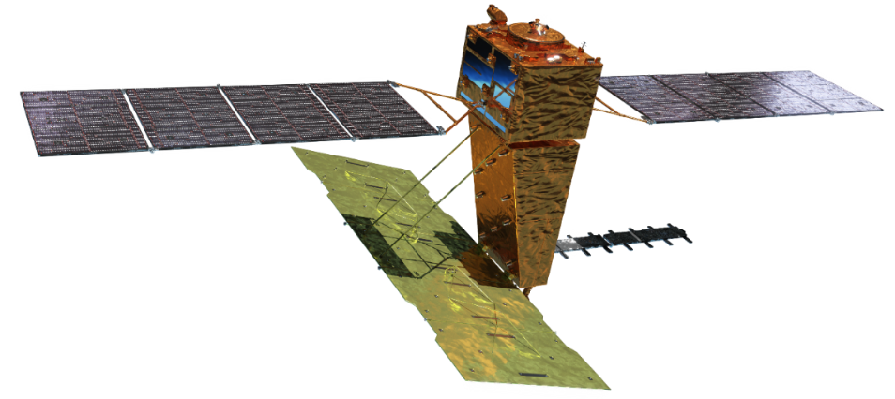

ALOS-4 “DAICHI-4” & PALSAR-3
Mission objectives:
  Ground deformation monitoring
  Disaster monitoring
  Continuation and enhancement of the ALOS-2 applications
  Maritime monitoring with SAR and AIS
Launch | H3 launch vehicle F3 in JFY2024
Orbit | Same orbit as ALOS-2 Sun-synchronous sub-recurrent orbit Altitude: 628 km Inclination angle: 97.9 degree Local sun time: 12 a.m. and 12 p.m. Revisit time: 14 day (15-3/14 rev/day)
Lifetime | 7 years
Size | X 10.0 m x Y 20.0 m x Z 6.4 m
Satellite Mass | 2,990 kg
Downlink | ~3.6 Gbps (Ka-band direct transmission) ~1.8 Gbps (Optical data relay satellite)
Mission Instruments | PALSAR-3 (Phased Array type L-band Synthetic Aperture Radar-3) SPAISE3 (SPace based AIS Experiment 3)
Prime contractor | Mitsubishi Electric Corporation
SPAISE3
PALSAR-3

Slide 6
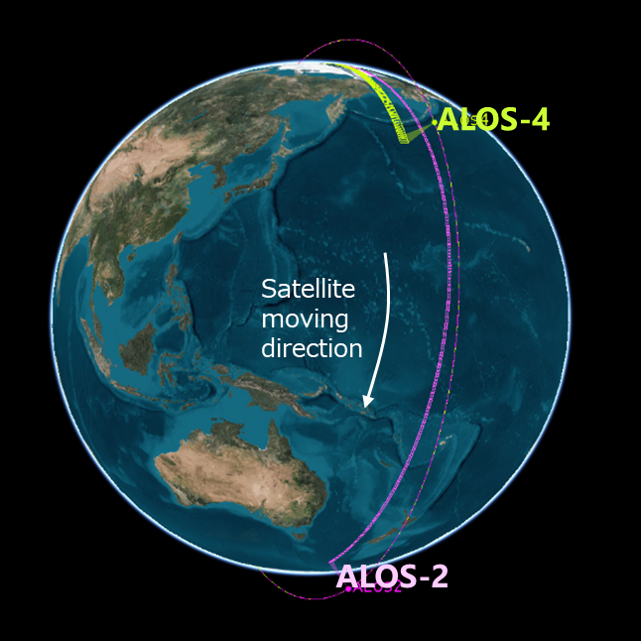

ALOS-4 “DAICHI-4” & PALSAR-3
Satellite
flight direction
200km
@30-56deg
700km
100km
Stripmap
1160 km
8 deg
35km x 35km
ScanSAR
1160 km
Spotlight
70 deg
mode | PALSAR-2 | PALSAR-3
Stripmap (res. 3 m/6 m/10 m) | 30-70 km | 100 or 200 km
ScanSAR (res. 25 m) | 350 or 490 km | 700 km
Spotlight (res. 3 m x 1 m) | 25 km x 25 km | 35 km x 35 km
The phase difference between ALOS-2/4 is about 103°, resulting short latency (<30 min) for emergency observations

Slide 7
ALOS-4 “DAICHI-4” & PALSAR-3
Observation modes
SAR mode | Spotlight | Stripmap |  |  |  |  |  |  | ScanSAR
Code name | SB | UW |  | UB | HW | HB | FW | FB | XB
Resolution [m] | 3 x 1 (Rg x Az) | 3 |  |  | 6 |  | 10 |  | 25 (1 look)
Swath width [km] | 35 x 35 | 200 | 100 |  | 200 | 100 | 200 | 100 | 700 (4 scan)
Center freq. [MHz] | 1257.5 | 1257.5 |  |  | 1236.5 (or 1257.5/1278.5)
Bandwidth [MHz] | 84 | 84 |  |  | 42 |  | 28 |  | 28
Polarization* | S, D | S, D | S, D, Q |  | S, D | S, D, Q | S, D | S, D, Q | S, D
Available Incidence angle range | 8-70 | 30-56 | 8-70 |  | 30-56 | 8-70 | 29-56 | 8-70 | 8-70
NESZ | < -20 dB | < -20 dB |  |  | < -24 dB |  | < -28 dB |  | < -20 dB
Rg. S/A | > 15 dB | > 15 dB |  |  | > 15 dB |  | > 20 dB |  | > 15 dB
Az. S/A | > 15 dB | > 15 dB |  |  | > 15 dB |  | > 20 dB |  | > 15 dB
Pol. X-talk | < -30 dB
Split-band option | N/A | N/A | N/A |  | N/A | N/A | 28+10 MHz | N/A | N/A
*Polarization: S = HH or HV or VV or VH, D = HH+HV or VV+VH, Q = HH+HV+VH+VV

Slide 8
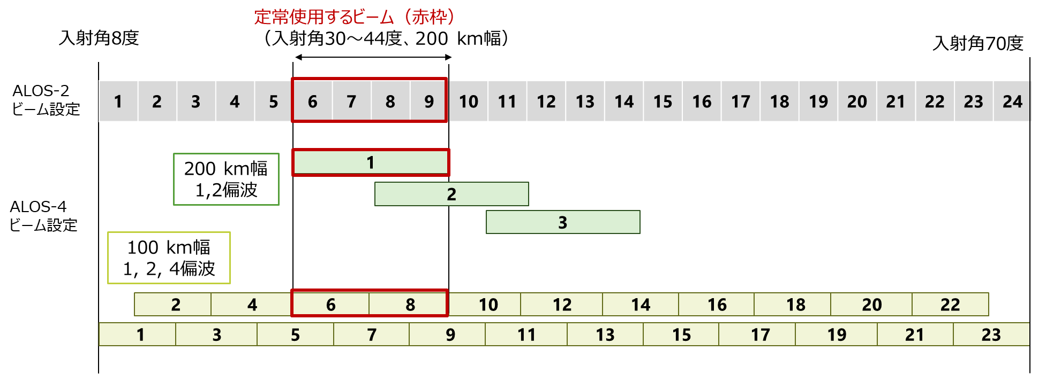
ALOS-4 “DAICHI-4” & PALSAR-3
Main observation beam: Right-looking observation with 30-44 deg. incidence angle
Left observation and other incident angle beams are used for emergency observations and pre-disaster basemap.
For each beam, near-range scene boundary is aligned with ALOS-2 scene boundary.
Incidence angle 8 deg.
Beam # for regular use
(30-44 deg., 200 km swath)
Incidence angle 70 deg.
ALOS-2
Beam ＃
200 km
1, 2 pol.
ALOS-4
Beam ＃
100 km
1, 2, 4 pol.

Slide 9
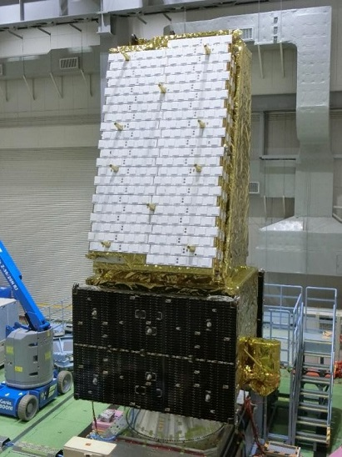
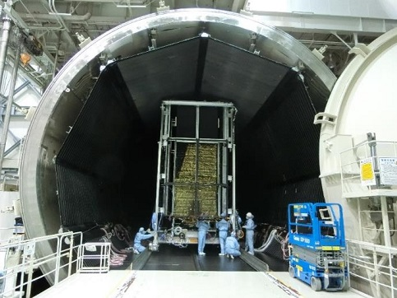
ALOS-4 “DAICHI-4” & PALSAR-3
System PFT had been completed and confirmed clearance for flight.
ALOS-4 was transferred to Tanegashima Space Center, JAXA, and is now conducting final assembly to prepare the launch.
Integration
Acoustic
Initial
Electrical
EMC
Thermal Vacuum
Final
Electrical
Vibration
& shock
System thermal vacuum test
System vibration test

Slide 10






ALOS-4 Ground Segments
Laser （TLM）
Laser （Mission data)
Laser (CMD)
ALOS-4
S-band
(CMD)
Ka band
(CMD)
Ka-band (TLM)
Ka-band (Mission Data)
S-band
(CMD)
Ka-band
(Mission Data)
S-band (TLM)
Ka-band (Mission Data)
S-band (TLM)
Ground Stations (Ka-band)
Ground Stations
(High latitude)
Ground Network Stations
(Tsukuba & Hatoyama)
CMD
CMD
TLM
CMD
Mission Data
Mission Data
Spacecraft Control Mission Operation system
(SCMO)
Mission Data
EICS integrates ALOS-2 data as single UI
Observation Plan
Mission Data
Observation Requests
Parallel data process with GPUs
Direct data distribution for emergency observation
Earth Intelligence Collection and Sharing system (EICS)
AUIG4
Standard Products
Data Search/Order
Observation Requests
Users

Slide 11
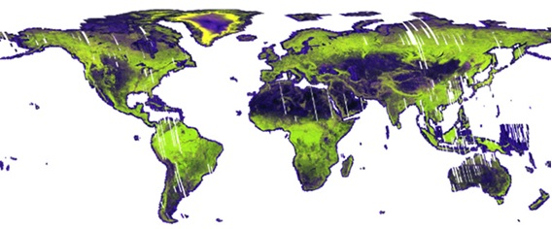
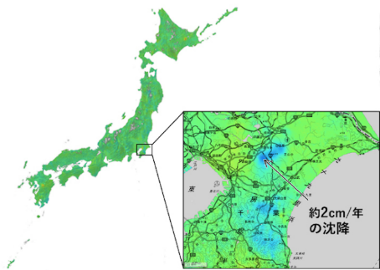
ALOS-4 Products
Standard Products
    Compatible definition with ALOS-2
    Product documentation and sample products are in preparation
    Data policy is under discussion
* Compliant with CEOS Analysis Ready Data (ARD) format specification
Higher-level Products
Global mosaic (NRB*)
Global forest/non-forest map (FNF)
Disaster response map and information
Time-series InSAR over entire Japan by GSI, etc.
https://ceos.org/ard/
Processing level | Content | Format
L1.1 | Single look complex image | CEOS
L1.2 | Signal data processed to a single-beam observation equivalent and uniform PRF | CEOS
L1.5 | Ground-range multi-look amplitude image | CEOS, GeoTIFF
L2.1 | Ground-range multi-look amplitude image with ortho correction to L1.5 | CEOS, GeoTIFF
© GSI

Slide 12
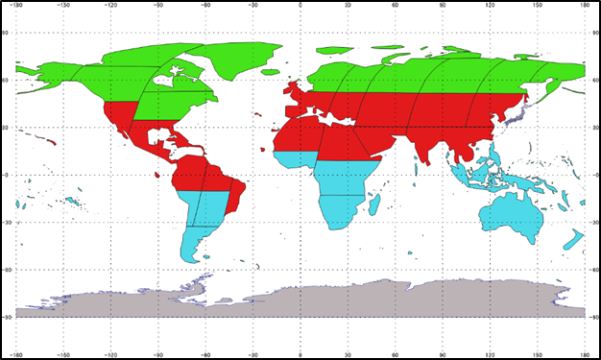
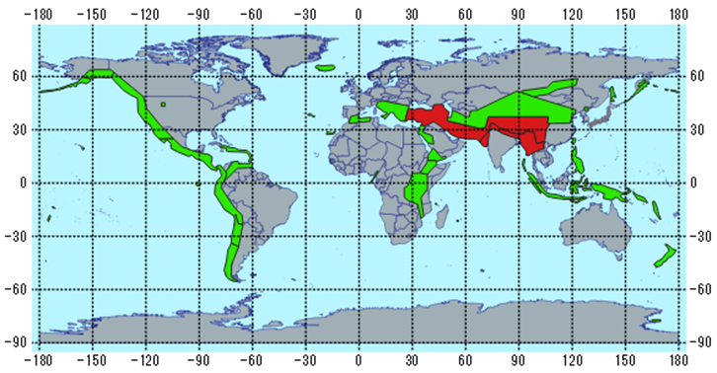
ALOS-4 Basic Observation Scenario (BOS)
Global Observations
Draft version (under discussion)
1 year = 26 cycles
Cycle | 1 | 2 | 3 | 4 | 5 | 6 | 7 | 8 | 9 | 10 | 11 | 12 | 13 | 14 | 15 | 16 | 17 | 18 | 19 | 20 | 21 | 22 | 23 | 24 | 25 | 26
day | 1 | 15 | 29 | 43 | 57 | 71 | 85 | 99 | 113 | 127 | 141 | 155 | 169 | 183 | 197 | 211 | 225 | 239 | 253 | 267 | 281 | 295 | 309 | 323 | 337 | 351
Des. | Global basemap |  |  |  |  |  |  |  | Disaster |  | Thematic observations
 | HB6R | HB8R | HB6R | HB8R | HB6R | HB8R |  |  | XB2R
Asc. | Global basemap |  |  |  | Disaster |  | Thematic observations
 | FW1R |  |  |  | XB2R
(background: FW1R, HB6/8R, etc.)
(background: FW1R, HB6/8R, etc.)
Global basemap
Stripmap 10 m DP 200 km swath covered by 3 cycles
Stripmap 6 m FP 100 km swath covered by 6 cycles
Disaster basemap
ScanSAR DP 700 km covered by 2 cycles

Slide 13
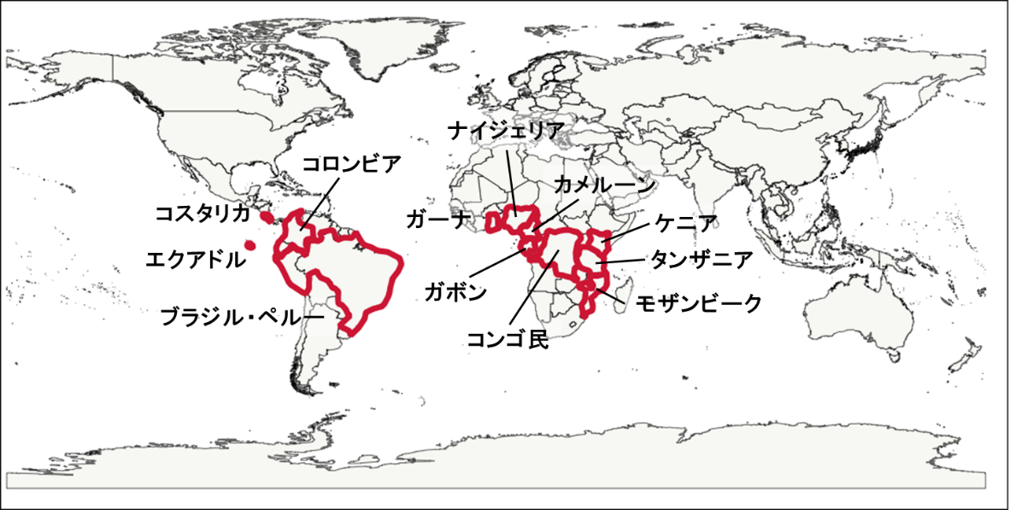
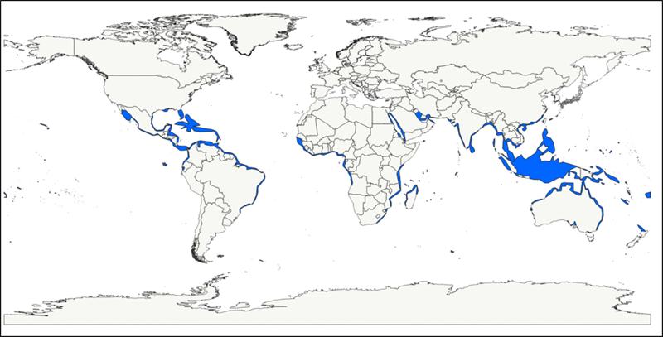
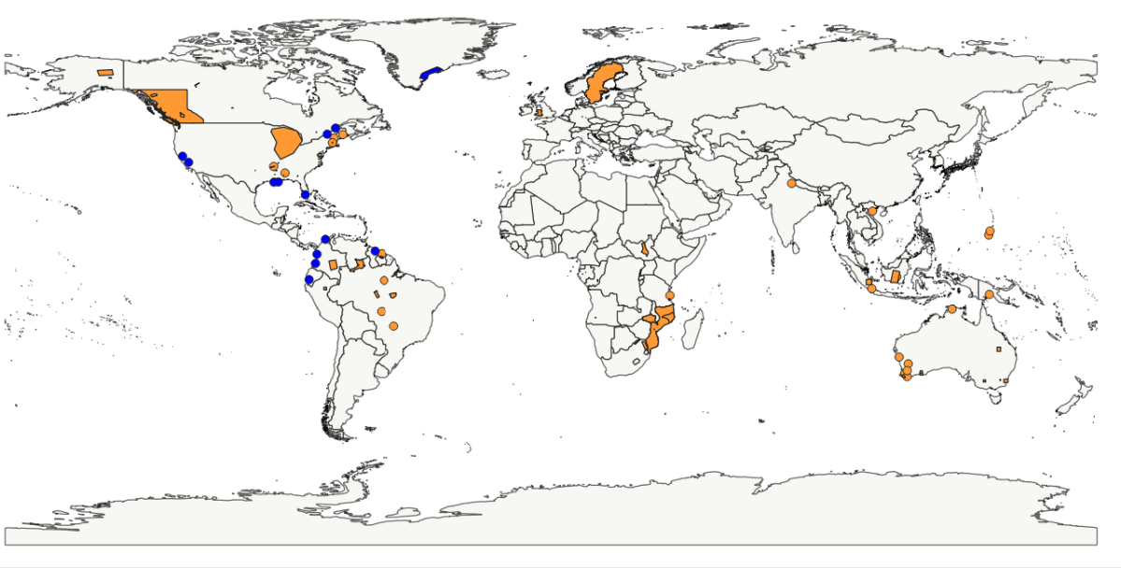
ALOS-4 Basic Observation Scenario (BOS)
Thematic observations
Draft version (under discussion)
Deforestation monitoring
Global Mangrove Watch
Kyoto & Carbon Initiative forests/wetlands/glaciers

Slide 14
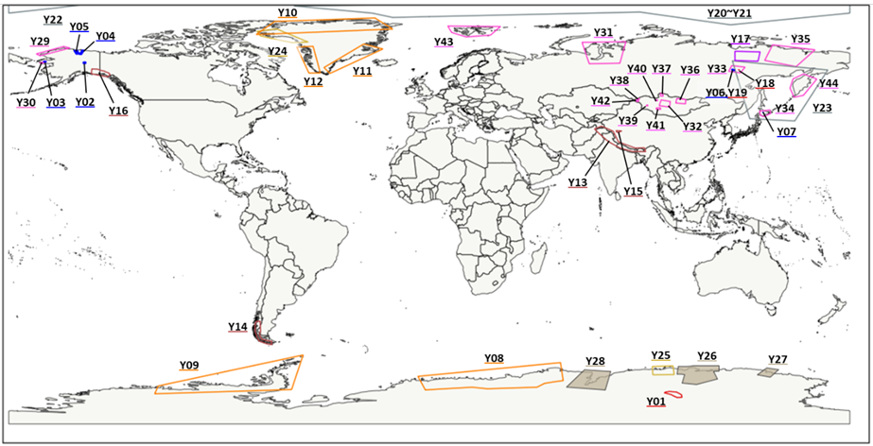
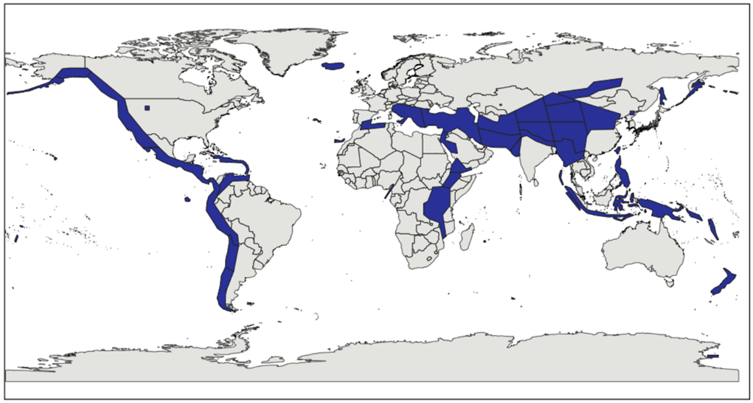
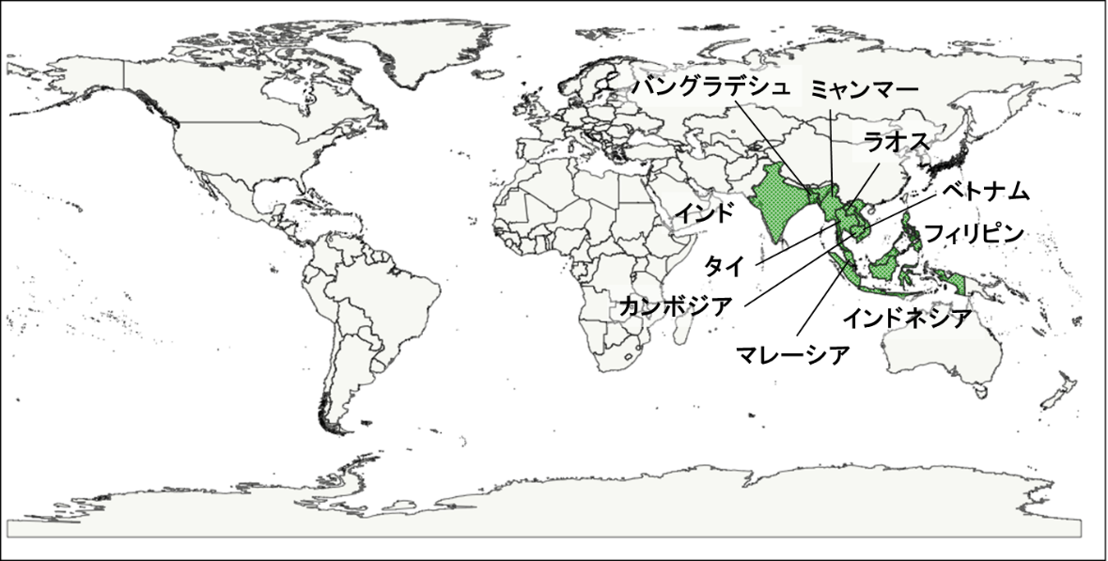
ALOS-4 Basic Observation Scenario (BOS)
Thematic observations
Draft version (under discussion)
Snow and ice
Ground deformation
Agriculture

Slide 15
ALOS-4 Initial Operation Plan
Month | L-1 | L+1 | L+2 | L+3 | L+4 | L+5 | L+6 | L+7 | L+8~
Event
▲launch
LEOP / Initial check-out
Initial cal/val
Regular observation
JAXA’s cal/val
Product evaluation by cal/val team (CVST)
Standard product release
Basic observation scenario start

Slide 16
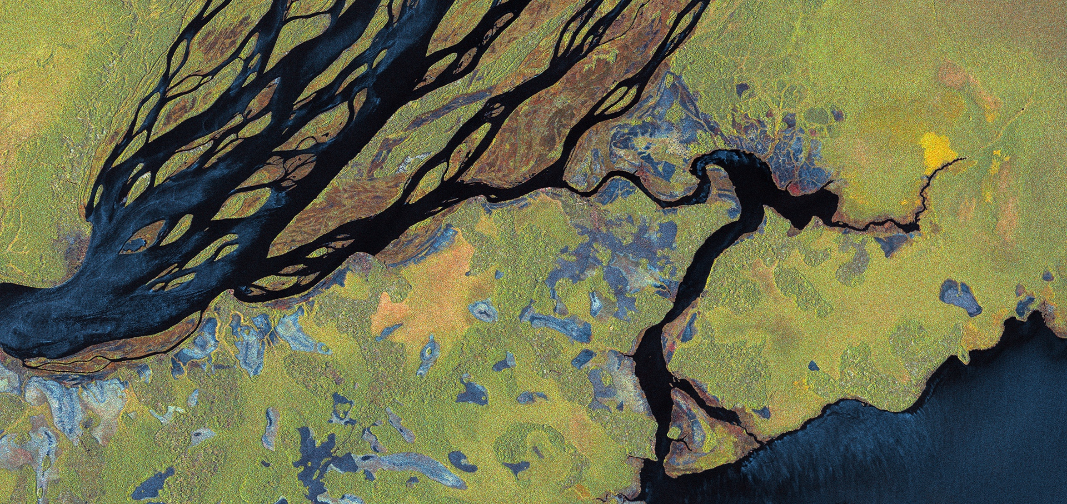
Thanks for the attention.
Any questions or comments?
Polarimetric backscatter
ALOS-2 © JAXA
‹#›

