Slide 1
LSI-VC-15
2024
Agency Updates: USGS
Steve Labahn, USGS
Agenda Item 2.6
LSI-VC-15 2024, Tokyo
3rd - 5th April 2024

Slide 2
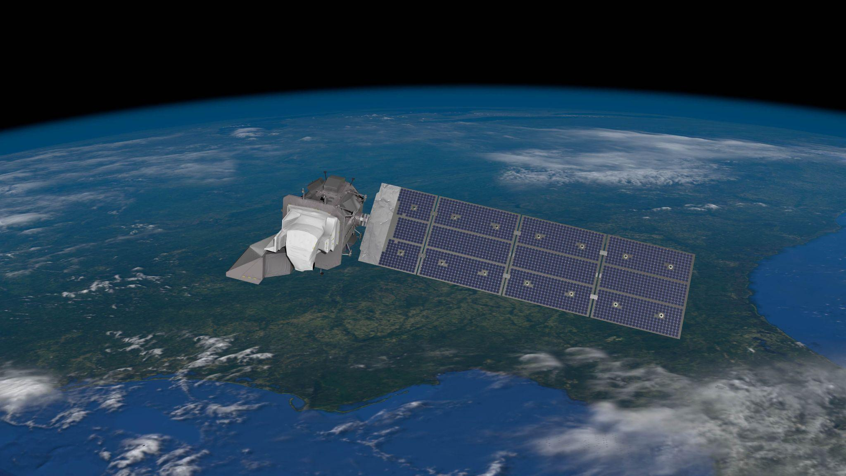
Landsat Satellite Series
16-day global coverage
NIST-traceable cross-calibration of sensor data
Irreplaceable record of historical change of the
Earth’s land surfaces covering over a half century
Free and open data policy
Landscape-scale resolution (15/30/100m)
Multi-spectral coverage in visible, near-, shortwave- and thermal infrared
Supports governmental (civil and military), commercial,
non-profit, and educational users across the U.S. and worldwide in a broad set of diverse applications
The world's longest continuously operated land remote sensing satellite series and most widely used land remote sensing data set, helping us understand and manage natural and human-induced landscape change via a multitude of land, water, and natural resource management applications.

Slide 3
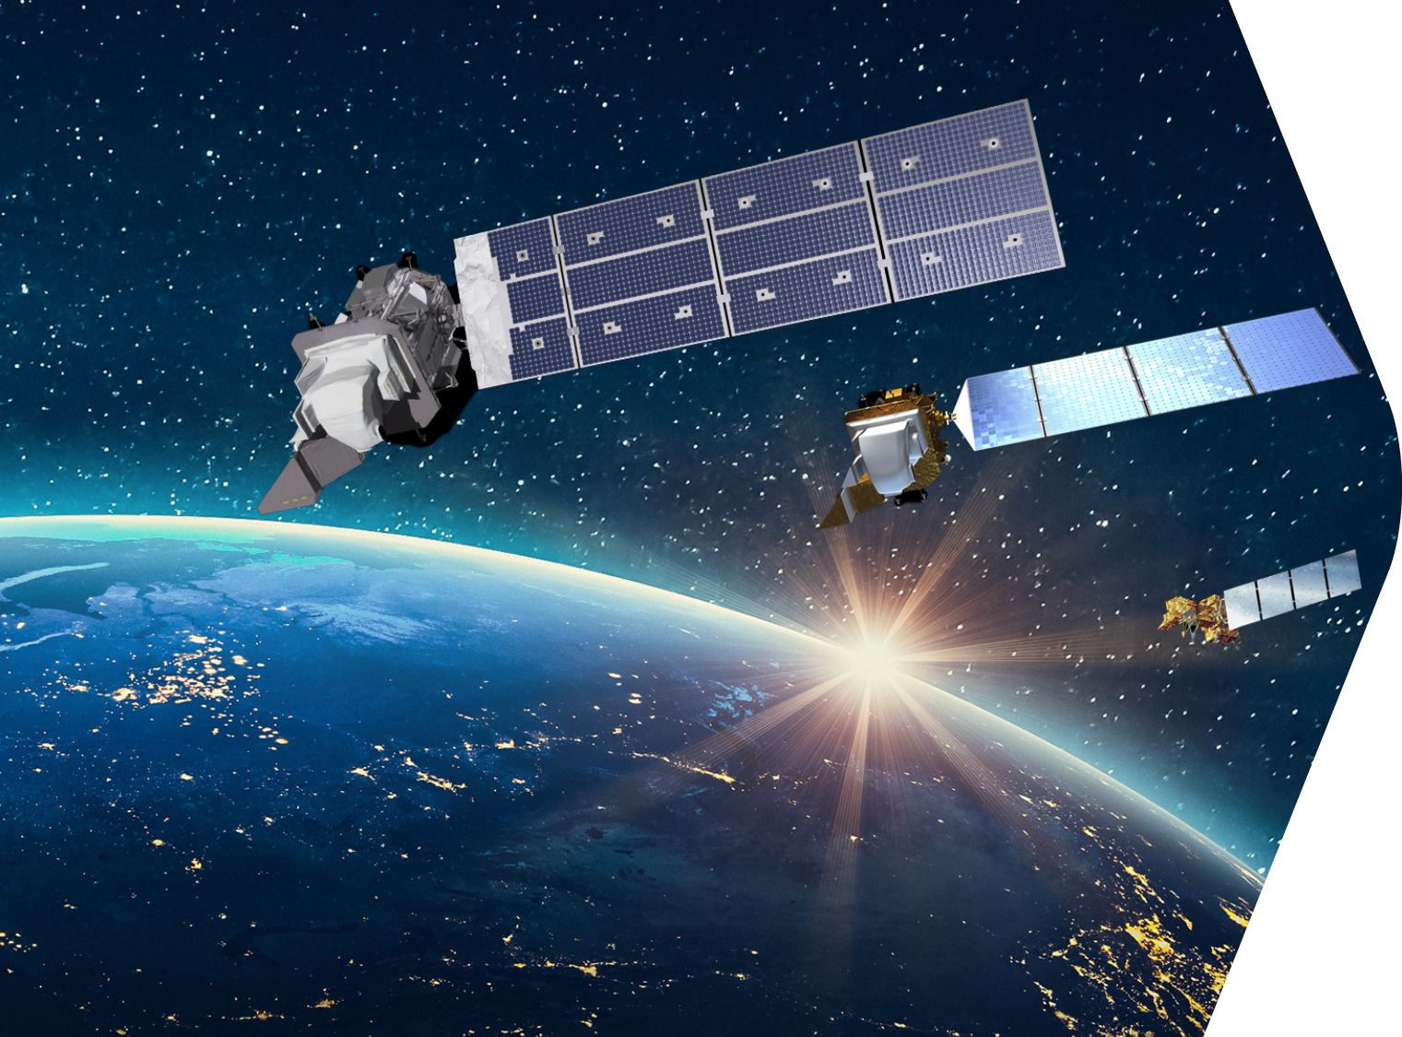
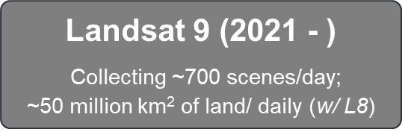
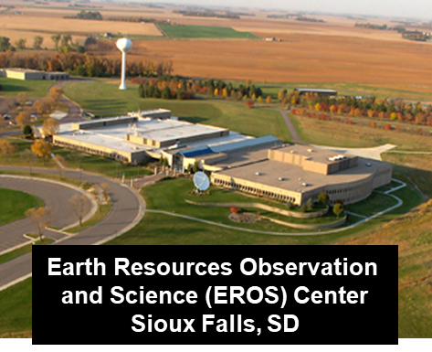
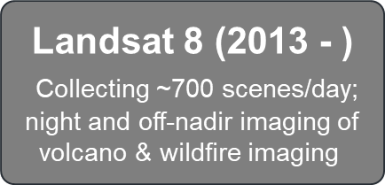
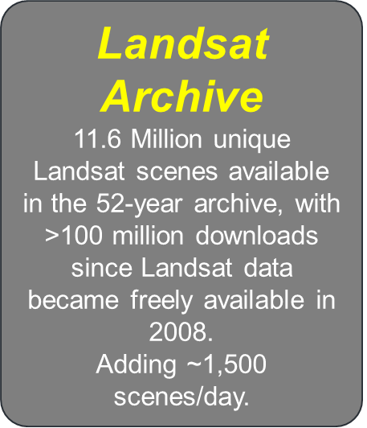
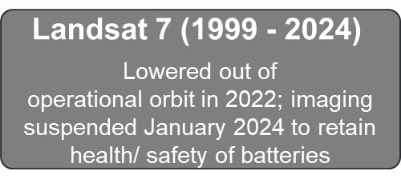
Landsat Operations

Slide 4
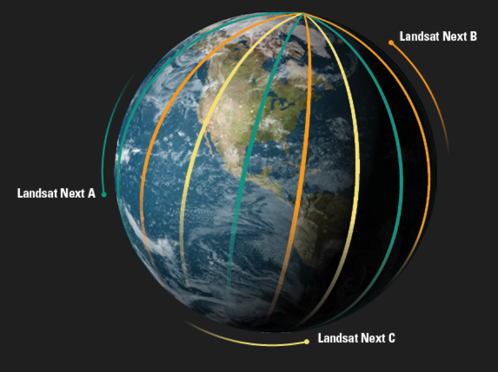
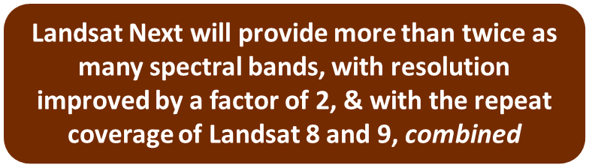
New Missions – Landsat Next
Designed to provide more frequent & finer-resolution science-quality data of the changing surface of the Earth, in concert with commercial and international datasets.
Technological Advances:
3 smaller satellites, combined 6-day revisit time supporting more frequent coverage of crop growth, coastal change & hazards.
“Super-spectral” with 15 new bands supporting water use/quality, soil conservation, & mineral mapping.
Improved spatial resolution (from 30 to 10 meters) for finer targets of farm fields, inland lakes, & streams.
Target Launch Readiness: 2030!

Slide 5

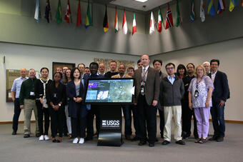
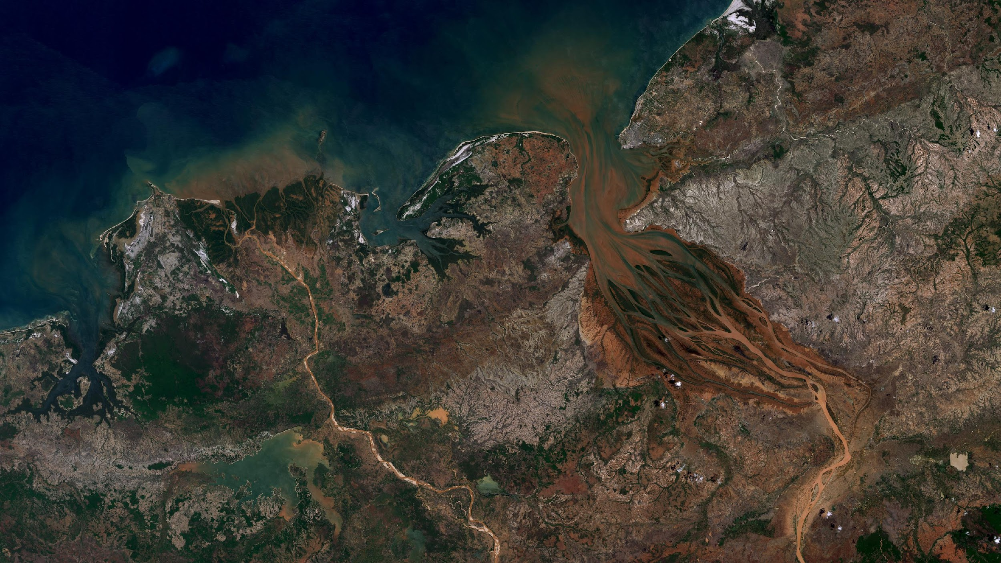
Landsat 2030
International Partnership Initiative
At the December 2023 U.S. National Space Council Meeting, the U.S. Department of the Interior announced the Initiative, which is opened to interested governments willing to commit to:
  global, open use of Landsat observations
  supporting the use of Landsat data for public decision support, commercial value-added services, and scientific and global change research
Substantial and positive response from USGS’s international partners
(Top) VP Kamala Harris, NSpC Chair, providing her remarks
(Bottom) Int’l Landsat Partners at the USGS EROS Center
Landsat 9 image of the Betsiboka River Basin, Madagascar
7 December 2021

Slide 6
USGS Landsat Collection 3: Objectives
Produce Collection 3 in 2028/2029 timeframe
Define and implement collection governance
Include Landsat Next data stream
Accommodate intermediate Collection releases
Standardize processing levels and product naming convention terminology
Provide radiometric and geometric continuity across the historical Landsat archive
Improve Landsat Next, L8/L9, and historical archive compatibility
Optimize to meet user needs while minimizing costs
Support optical sensor-agnostic exploitation (i.e., meet CEOS-ARD Goal/Threshold-Level requirements)
Utilize a robust geometric and radiometric validation process
Enable/enhance in-cloud exploitation and reduce data egress (i.e., enable AI/ML)
Coordinated/common auxiliary data and algorithms across major moderate-resolution data providers (i.e., maximize interoperability)
Provide open-source algorithms/software

Slide 7
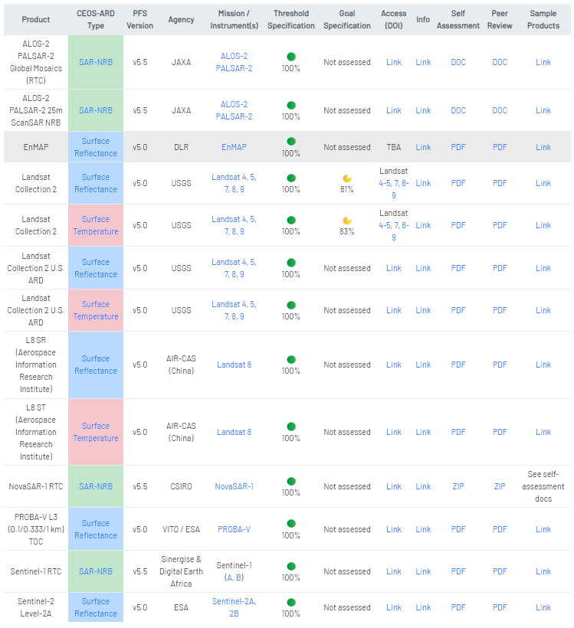

CEOS Analysis Ready Datasets https://ceos.org/ard/index.html#datasets

Slide 8
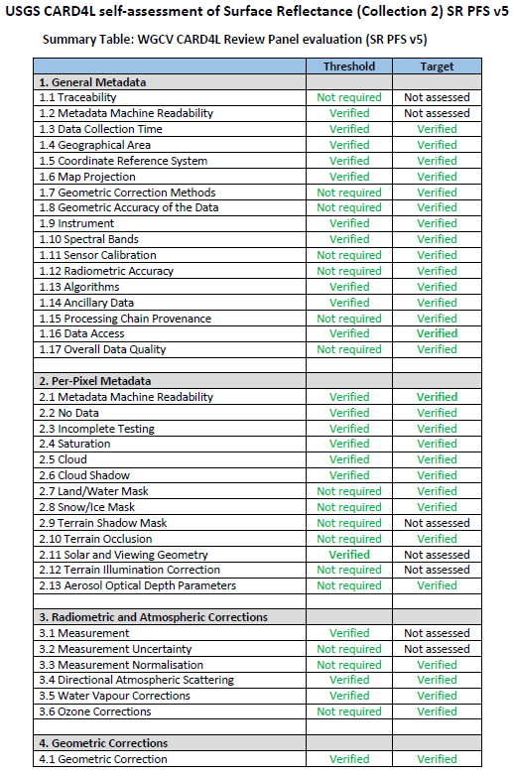
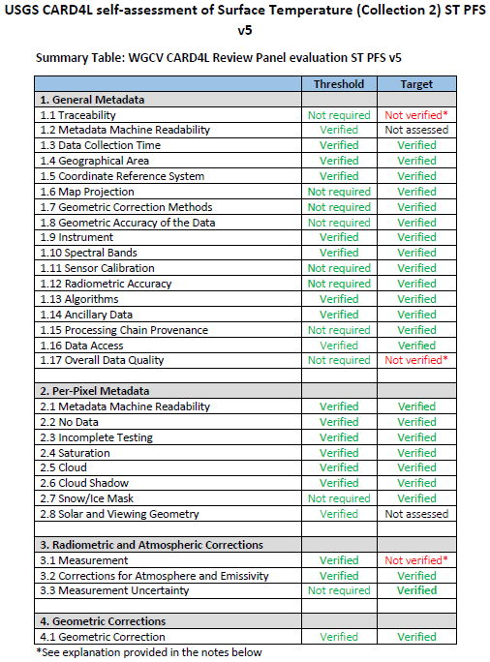
USGS Landsat Collection 3
Meeting Goal/Target-Level Requirements

Slide 9
Thank You!
Steve Labahn
labahn@usgs.gov

Slide 10
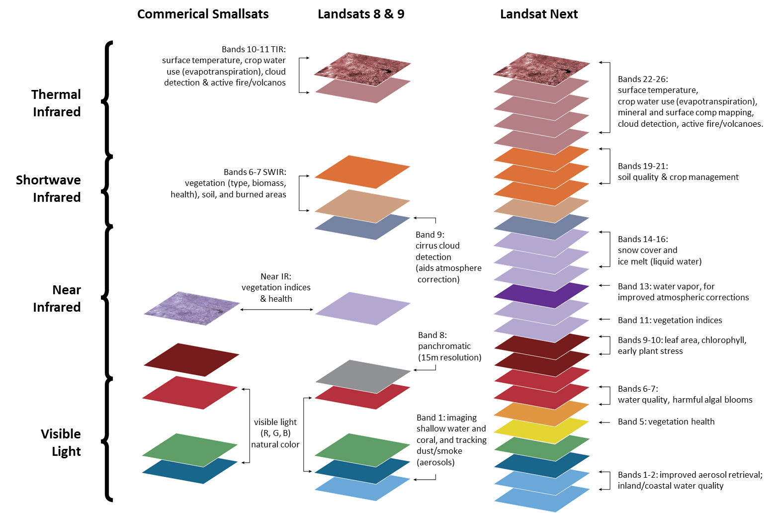
Landsat Next Comparison with Commercial, Landsat 8/9
Landsat Next Science/Applications Benefit | Enhancement
Supports emerging applications: Water quality & resources, including climate related stress and drought Snow hydrology Crop residue mapping & soil characterization and carbon sequestration Mineral mapping New climate change science while providing continuity with past Landsat missions, and compatibility with the European Sentinel-2 mission | Acquires ≈25 spectral bands, more than twice the number acquired by Landsat 8/9
Supports field-scale crop type mapping, crop yield estimates, and crop water usage; improved urban thermal mapping and heat islands; early detection of forest disturbance and degradation from climate change. | Improves spatial resolution to 10, 20, or 60 meters for all bands
Enables improved monitoring of within-season land and water dynamics Highest priority of current Landsat users Supports monitoring highly dynamic phenomena (water quality, fire, wetland inundation, land phenology) Greater resilience to cloud contamination | Acquisitions increased to provide near-weekly observations with LNext bands

